Slide 1

SANJAY TECHNOLOGIES PVT. LTD.
EMS / CMS / OEM SOLUTIONS

Slide 2

SANJAY TECHNOLOGIES : MISSION, VISION & VALUE SYSTEMS
MISSION
At ST Group, our mission is not only to grow the brand but also to prosper together with our customers and stakeholders by providing reliable and dependable services.
We at ST Group aspire to take on the leap for a better tomorrow by retaining their core values and going beyond them with modern-edge tech-oriented thinking to deliver sustainable solutions for a sustainable future.
VISION
Going beyond to be the best solution provider in CMS, EMS & OEM Services across all sectors.
VALUE SYSTEM
We respect the expertise and value contribution by individuals irrespective of position and profile of work.
We aim to go beyond promises and deliver results that have long-term benefits to our customers, vendors, investors and employees.

Slide 3
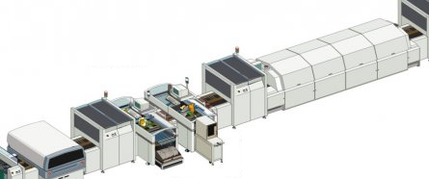
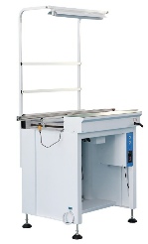
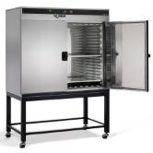
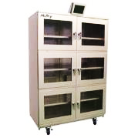
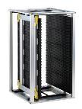
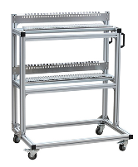
MANUFACTURING FACILITY
AUTOMATIC SMT LINES(80,000 CPH) & THT ASSEMBLY LINES
EQUIPPED TO HANDLE SMD & PTH BOARDS, BGA, QFP,QFN, 0402 / 0201 / 01005 CHIPS.
Total 13,000 Sq. Ft. Manufacturing Facility.
ESD Floors with fully air conditioned 2 Lines.
Dedicated NPD team for quick turn-around.
Complete EMS build capability & repair facility.
Space Built-up for additional SMT & THT lines.
Strong delivery network across the country.
In-Line SMT Machines for PCBA.
Fully Automatic AOI Machine (In-Line)
SMT ASSEMBLYLINE EQUIPMENTS & MACHINES
HOT WAVE
OVEN
HUMIDITY
CHAMBER
JOINT CONVEYOR INSPECTION
ESD SAFE PCB
MAGAZINE RACK
SMD FEEDER
TROLLEY

Slide 4
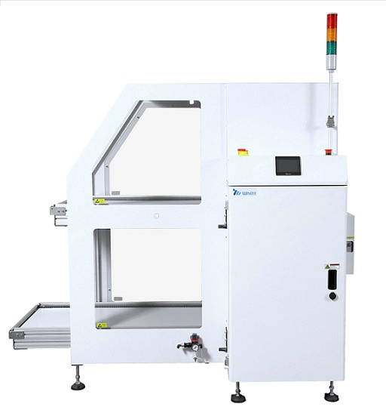
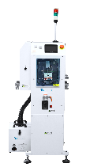
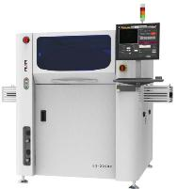
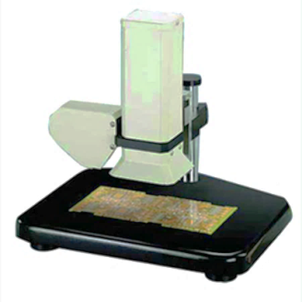
MANUFACTURING FACILITY
AUTOMATIC PCB LOADER MACHINE
AUTOMATIC PCB CLEANER MACHINE
HANWHA
SAMSUNG
FL-300 SLLE LOADER
WHITT – PCB ROLL CLEANING
Integrated Vacuum Pick-up & Magazine Systems.
Automatic Conveyor Feeding of PCB’s.
Conveyor Pitch & Pusher Adjustable.
Precise 5D Inspection 18MP Angled cameras.
Digital12 Projection moiré 3D inspection technology.
Reflective, OCR & Crack Defects-8Phase coaxial color light.
AUTOMATIC PCB SCREEN PRINTER
SOLDER PASTE INSPECTION (SPI)
ESE US-2000XQ PRINTER
GAM70 - LASER
VISION MEASUREMENT
Z-CHECK
Automatic Calibration & Programming (ESE Software).
SPI Closed Loop, 2D Inspection, Machine Statics.
10µ Accuracy & Wet Printing Repeatability 20µ @ 6sigma.
Automatic / Momentum of paste thickness.
Automatic calculation (Cp, Cpk, Cpm).
Non-Contact Measurement System.

Slide 5
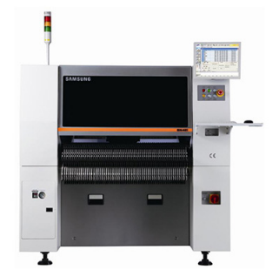
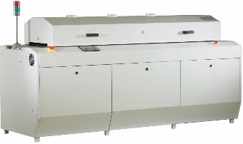
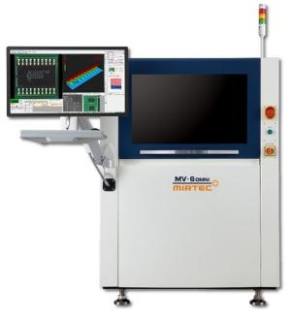
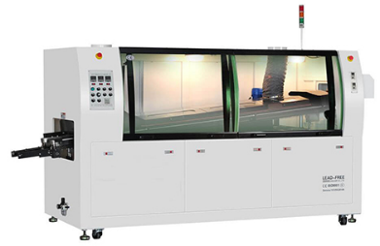
MANUFACTURING FACILITY
SAMSUNG PICK & PLACE MACHINE
EPS PCBA REFLOW OVEN
SM-481 +
Capacity: 80,000CPH
(2 Machines).
SM 481Plus 144Feeders (40,000CPH).
PCBA Size(L x W):450x300mm.
Placement Accuracy : 40µ/Chip & 25µ/QFP
JT - 8 Zone Reflow Oven with N2 Ready.
EPS RF500 – 5 Zone Reflow Oven.
Measurement Report & Statistical Analysis.
MIRTEC AUTOMATIC OPTICAL INSPECTION
EPS WAVE SOLDERING MACHINE
PCB 300x400mm
Temp.: 300C
Automatic Teach Tool (ATT)
S/W- Automatic
Programming
Digital12 Projection moiré 3D inspection technology.(18MP)
Reflective, OCR & Crack Defects-8Phase coaxial color light
Fine Pitch- 0.5 mm QFPs, BGAs, Connectors, LGAs, QFNs
.
ROHS Wave Soldering Machine.
NON-ROHS Wave Soldering Machine.
SMT & THT Wave Soldering.

Slide 6
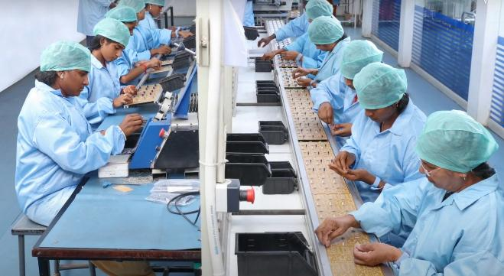
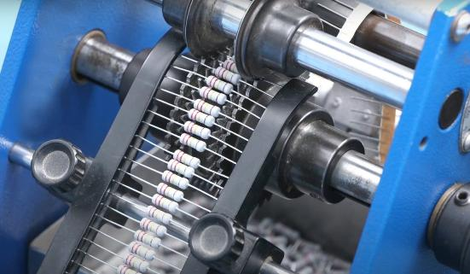

MANUFACTURING FACILITY
THT PCBA PRODUCTION LIINE
AUTOMATIC PRE-FORMING & LEAD CUTTING
THT STUFFING LINE
Dedicated THT Components Stuffing Line
THT PCBA Assembly line with Lead (Pb) Free.
Hand Soldering-Lead (Pb) Free
HAND SOLDERING LINE

Slide 7
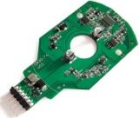

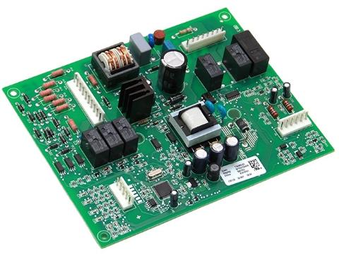
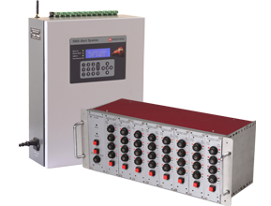
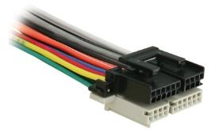
PRODUCT MANUFACTURING CAPABILITIES
PCB-A PROTOTYPIING SOLUTIONS
Turnkey service from Design & Development, PCB Fabrication, Component Sourcing, Assembly and Test Validation & etc.
EMS / CMS SOLUTIONS
SMT, THT & Mixed Assembly Services,
ROHS Reflow & Wave Soldering Services,
Automated AOI Inspection Tests,
Turnkey Box Assembly Building
CABLE & WIRE HARNESS
Cable & Wire Harness with PCB-Assemblies for Industrial, Automotive, Engineering Industry OEM Clients.

Slide 8
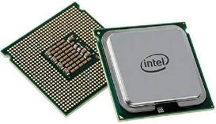
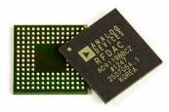
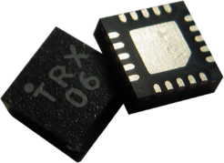
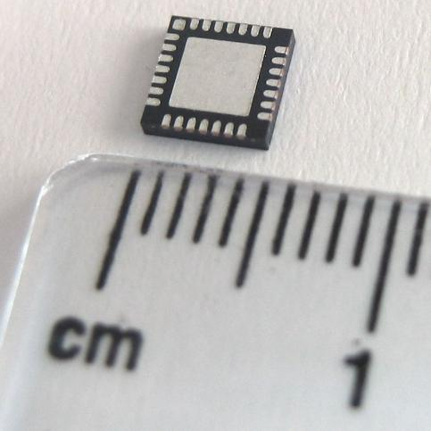

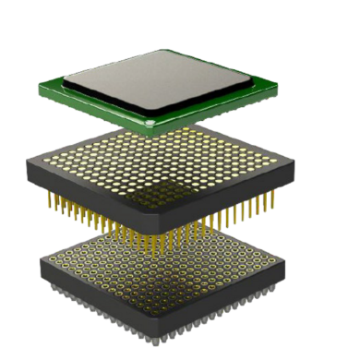

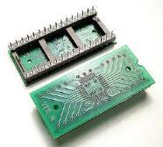
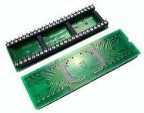
PRODUCT MANUFACTURING CAPABILITIES
SMT SOLDERING CAPABILITIES
LAND GRID ARRAY
(LGA SMD)
BALL GRID ARRAY
(BGA SMD)
QUAD FLAT NO - LEAD
(QFN SMD)
CPU SMT
(LGA SMD)
Quad Flat Pack
(QFP SMD)
HANDLING FINE PITCH - 0.3 mm
QFN / DIP SMT & THROUGH-HOLE ADAPTER
QFP / DIP SMT &
THROUGH-HOLE ADAPTERS

Slide 9
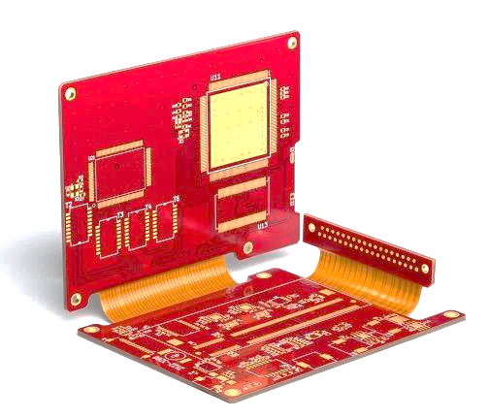
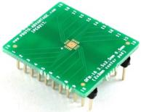
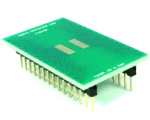
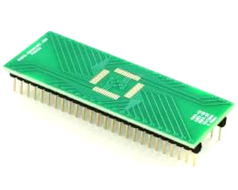
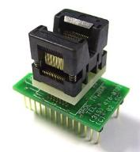
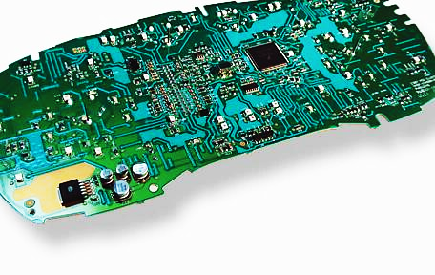
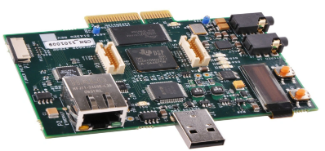
PRODUCT MANUFACTURING CAPABILITIES
SMT SOLDERING CAPABILITIES
DUAL IN-LINE QFN
0.2MM PITCH
FLEX – RIGID PCBA
QSOP ADAPTER
300 MIL DIP PLUG
QSOP ADAPTER
600 MIL DIP PLUG
HIGH QUALITY
24 LAYER PCBA
AUTOMOTIVE DISPLAY
CLUSTER PCBA

Slide 10
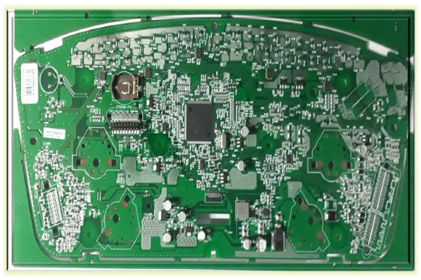
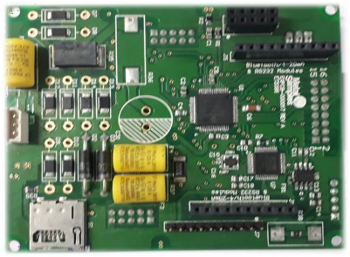
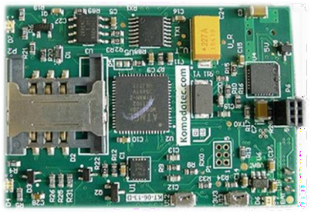
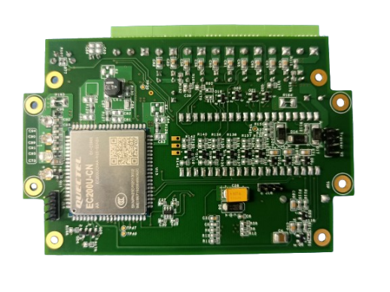
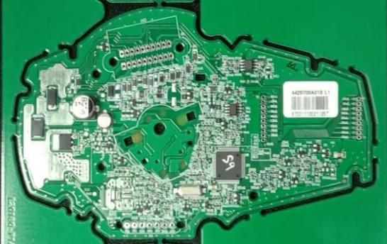
CLASS 3 IPC PCB - ASSEMBLY
EMS / CMS PRODUCT SOLUTIONS
SMT, THT & MIXED PCB-ASSEMBLIES

Slide 11
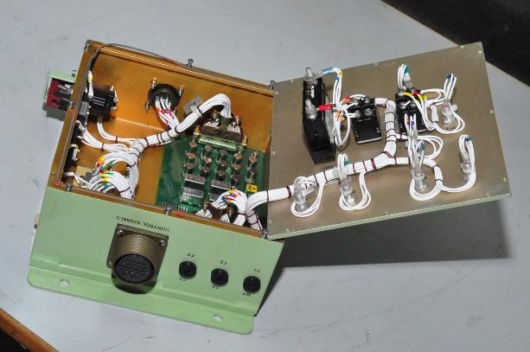
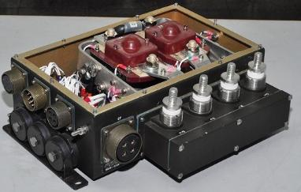
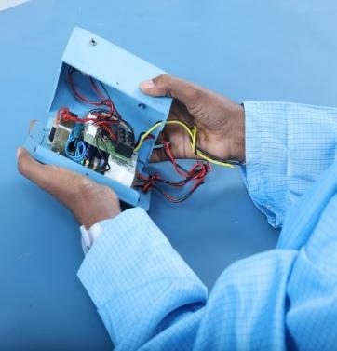
MANUFACTURING FACILITY
DEDICATED LINES FOR BOX BUILD ASSEMBLY PRODUCTIONS

Slide 12
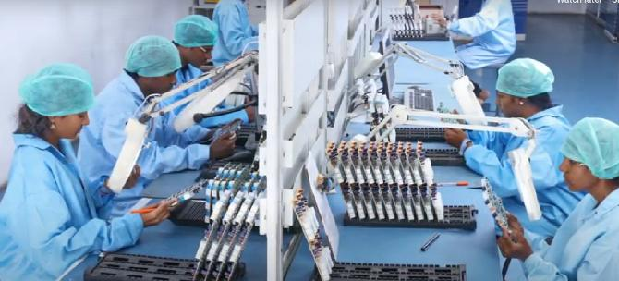
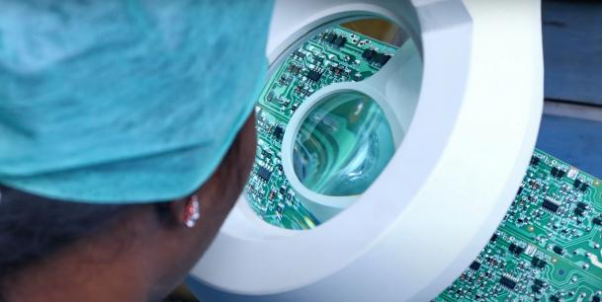
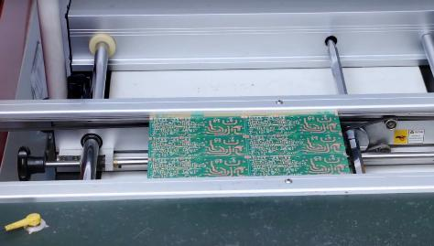
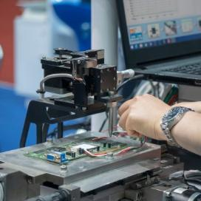
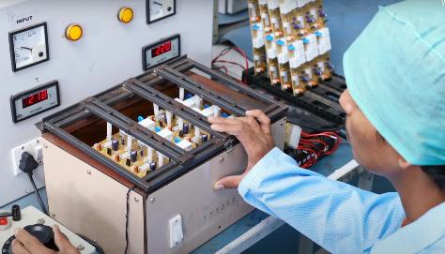
IN-HOUSE TEST FACILITY
IN-HOUSE QUALITY TESTING
QUALITY INSPECTION LINES
VISUAL INSPECTION (20X MAGNIFIER)
INSPECTION CONVEYOR
PASTE HEIGHT CHECK
FUNCTIONAL TESTING FIXTURE

Slide 13







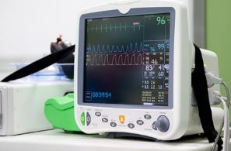
CLIENT INDUSTRY SEGMENTS
WE HAVE PRESITIGIOUS CLIENTS SERVING…
Automotive
Aviation
Industrial
Lighting
Renewable Energy
Oil & Gas
Railways
Medical

Slide 14

Please feel free to contact us, in case of any queries :
SANJAY TECHNOLOGIES PRIVATE LIMITED
7/4C Mettupalayam Road, Narashimanaiken Palayam, Coimbatore-641031, Tamil Nadu, INDIA
Mail us @ bdm@sanjaytechnologies.co.in BDM Mobile : +91 99400 05536
website : https://stgroup.biz/

