Slide 1
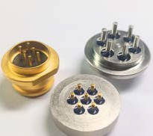
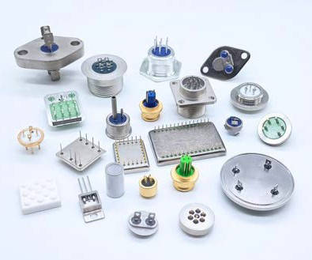
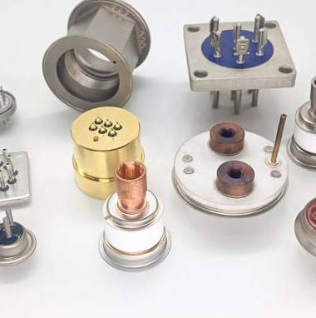
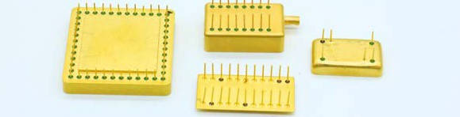
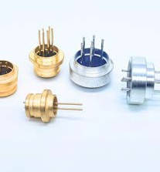
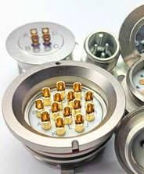

JJ Glastronics Pvt Ltd
India’s LARGEST
Integrated Manufacturer of Hermetic components
STRENGTHENING CONNECTIONS
SINCE 40 YEARS
Make in India
CONNECTIVITY SOLUTIONS FOR INDUSTRY AEROSPACE & DEFENSE
www.jjglastronics.com

Slide 2
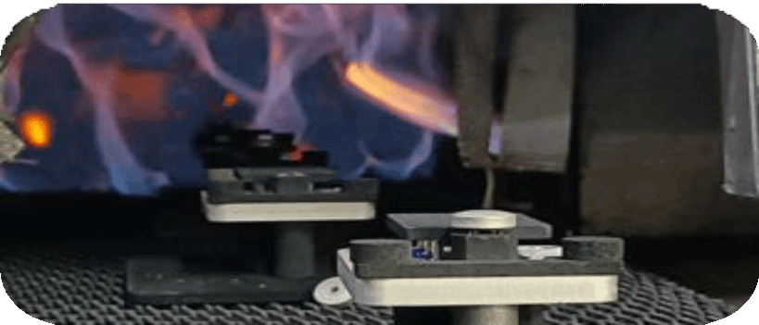
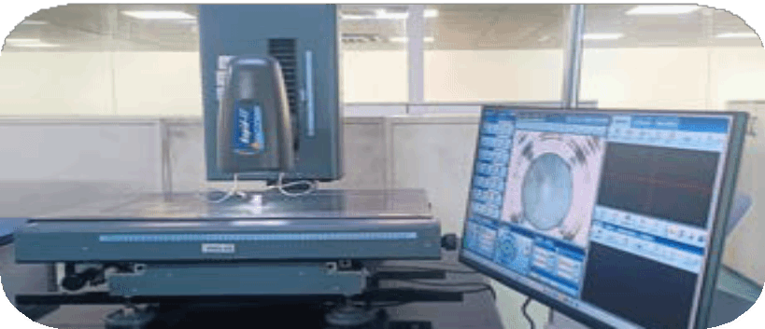

WHAT WE DO
We make hermetic components for Aerospace , Defense & Industrial
applications
We have an integrated manufacturing facility in Bangalore, India since 1985, occupying 100,000 sq. ft, with a strength of more than 300 people
We seamlessly execute annual deliveries from 1 piece - 20 million pieces per
product
We perpetually innovate and ceaselessly make groundbreaking products to remain in lockstep with the dynamic technological advancements in the industry
We adhere to MIL standard benchmarks to create products tailored for
demanding and robust applications
www.jjglastronics.com

Slide 3




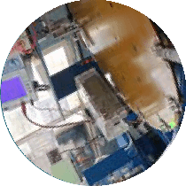
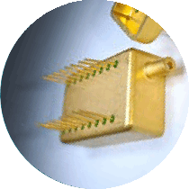

OUR HISTORY
2017
manufacturing for automotive, marine & aerospace industries
2003
2004
acq. the Hermetic terminal business of Samsung & LG
2014
in-house R&D team for new product development
2024
Completed 4 decades of manufacturing excellence
hardwork
& quick decision making
multiforms
2020
Started manufacturing semi-hermetic compressor component & sight glass
2011
NADCAP
certification for chemical coating (group company)
2023
manufacturing HMC packages
2002
acq. Bead glass division LG-Philips (LWB) Holland
2004
#1 multiform manufacturer worldwide
2021
Manufacturing high-voltage products for EV
2022
manufacturing ceramic components
2005
set up electro-plating line
2008
acq. Vitrus Inc subs of Tecumseh USA
1998
1986
MOU with BEL
2021
1985
est Amitronics
in Bangalore
inspection automation
2022
Started the collaboration with Athena Italy for semi-hermetic compressor component
2022
Precious metal plating
2008
acq. Overload protector business of Sensata USA
2006
expansion
www.jjglastronics.com

Slide 4
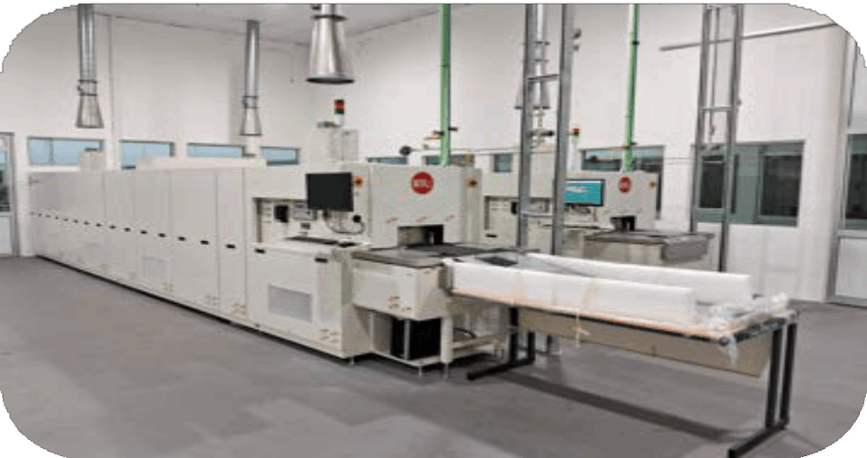
OUR CORE COMPETENCE
We are a leading integrated manufacturer of hermetic components, delivering precision, quality, and innovation in every aspect of our production. With over four decades of expertise, we are committed to excellence and continuous improvement, ensuring superior solutions for our customers through our in-house capabilities and dedicated team of experts
Our State-of-the-Art Sealing Furnace
Stamping
Sintering
Brazing
Sealing
Machining
Coating
Metalisation
www.jjglastronics.com

Slide 5
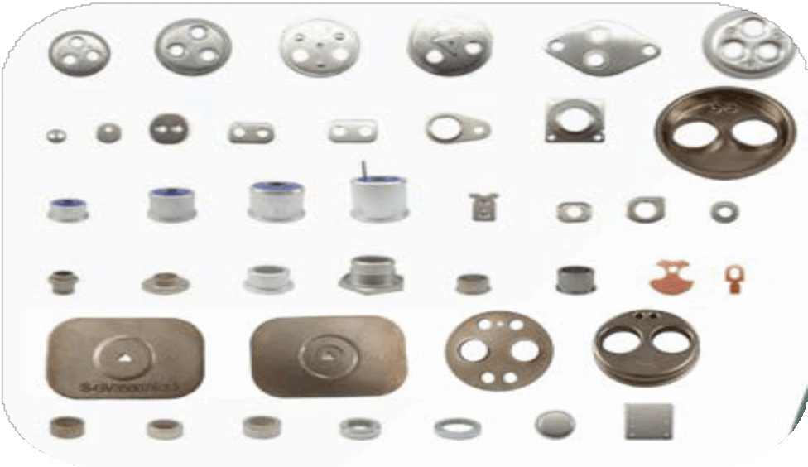
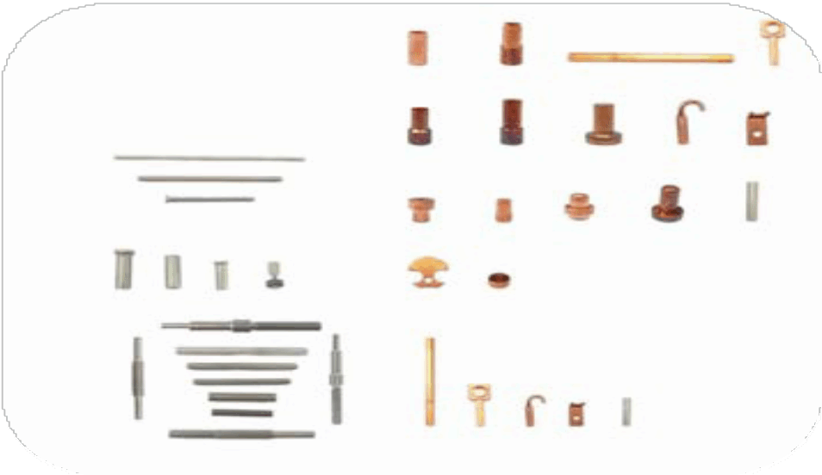
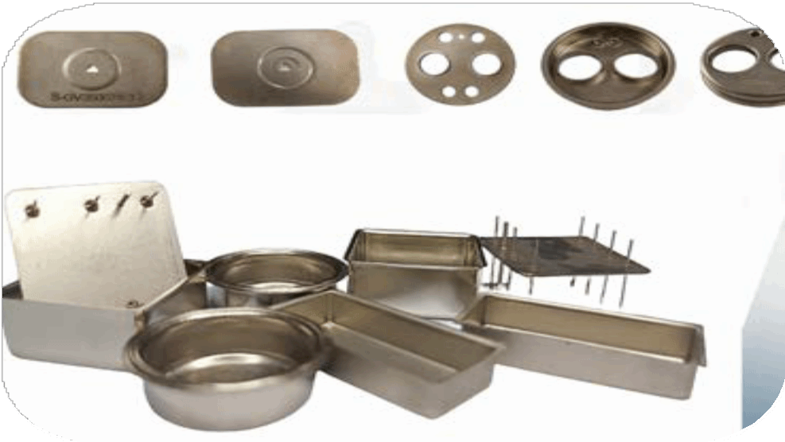
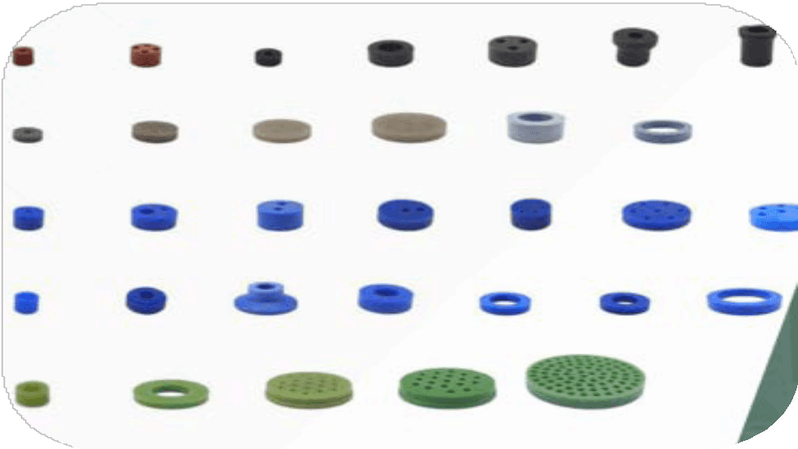
INTEGRATED MANUFACTURER
Stamping
Connectors
Housing
Preform
www.jjglastronics.com

Slide 6



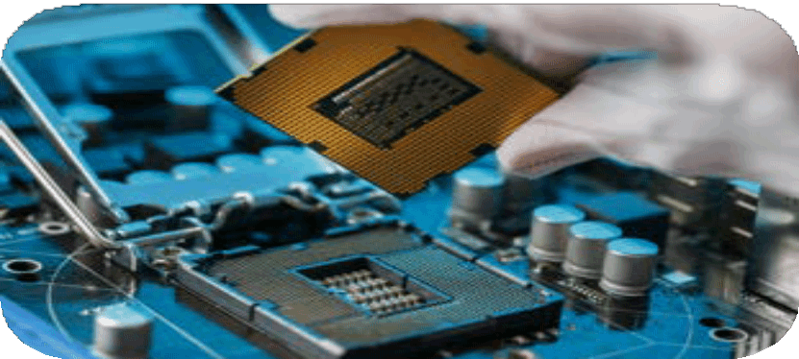
ENGINEERING EXCELLENCE ACROSS SECTORS
AEROSPACE
NAVAL
Precision-engineered hermetic components tailored for the aerospace industry, deliver exceptional precision, reliability, and quality for surveillance, power supply,
communication, and monitoring systems.
Rugged hermetic components
engineered for naval applications,
providing durability and resilience to
applications in harsh maritime conditions.
DEFENSE
INDUSTRIAL
MIL-types hermetic components
designed for defense applications,
guaranteeing robustness and security in demanding environments for mission-
critical operations.
Hermetic components like seals and connectors are vital in industrial
applications, ensuring reliability and
durability in demanding environments in the automotive and electronics industries for precision and safety.
www.jjglastronics.com

Slide 7
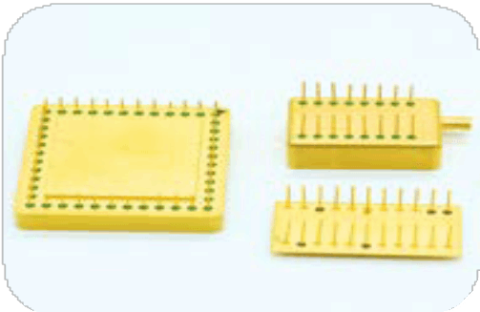
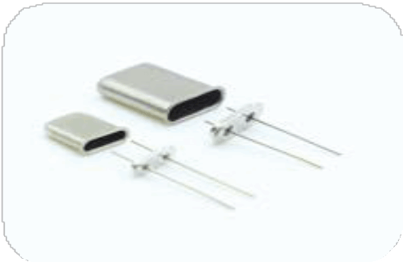
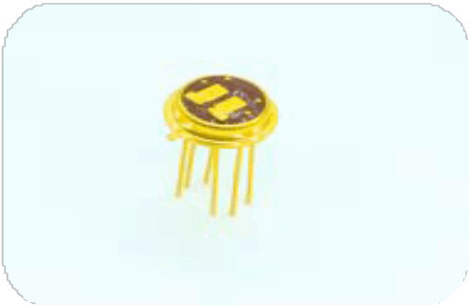
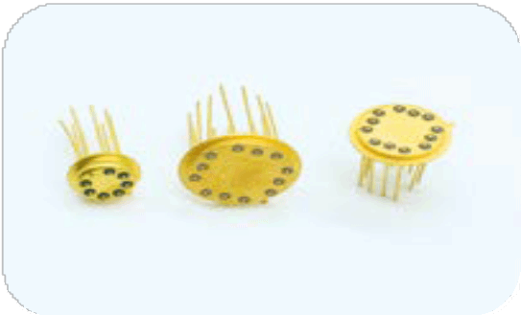
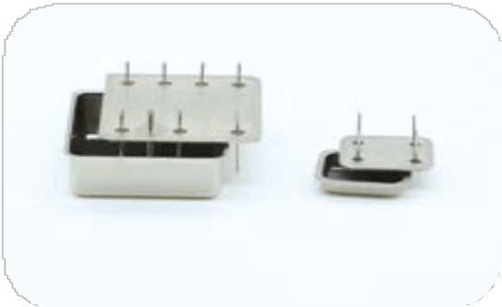
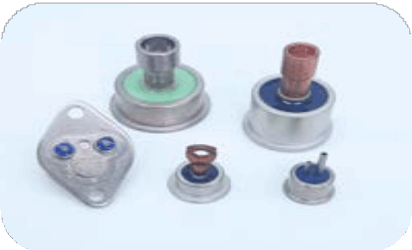
HERMETIC PACKAGES
HYBRID PACKAGES
CRYSTAL PACKAGES
Hybrid packages are sealed enclosures that combine multiple electronic components, protecting them from moisture and
contaminants. They ensure high reliability like frequent temperature cycles, shock and vibration, high humidity and humidity changes,
agressive media such as fuel, saltwater and acids.
Crystal packages are sealed enclosures that safeguard crystal oscillators, ensuring stable and accurate frequency
performance. They are crucial in telecommunications, aerospace, and electronics, where precision and reliability are
essential.
SENSOR PACKAGES
T.O. PACKAGES
Sensor packages are sealed units that safeguard sensors from harsh conditions, ensuring precise and reliable performance. They are essential in applications like automotive, industrial, and medical fields, where accuracy is critical.
TO packages are metal enclosures for semiconductor devices like transistors, diodes, and sensors. Used in automotive,
industrial, consumer electronics and Mil-Aero applications, they offer protection, heat dissipation, and hermetic sealing for reliability.
OCXO PACKAGES
TRANSISTOR HEADERS & POWER DIODES
OCXO packages are precision devices that provide superior frequency stability by keeping the crystal at a constant
temperature. Hermetic terminals ensure airtight sealing,
protecting against moisture, contaminants, and environmental factors.
Transistor headers provide stable mounting and heat dissipation for transistors, while power diodes handle high current and voltage, ensuring reliable rectification in power circuits for industrial
applications.
www.jjglastronics.com

Slide 8
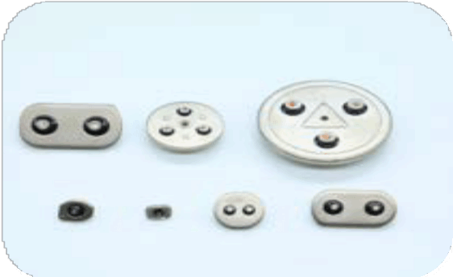
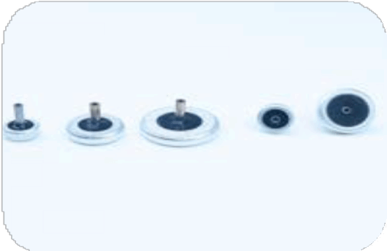
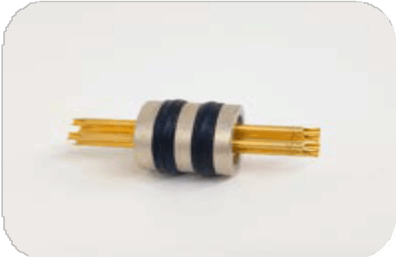
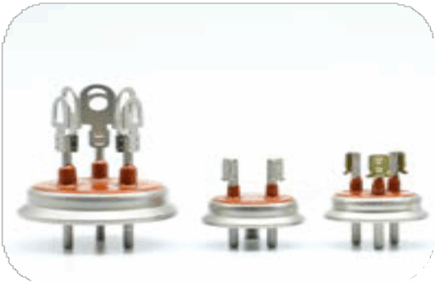
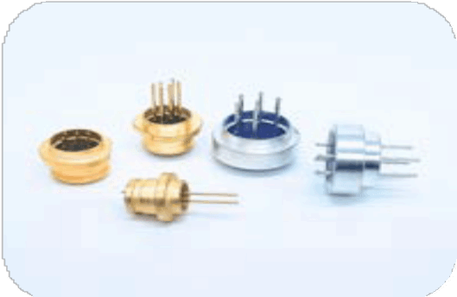
GLASS TO METAL SEALS
OVERLOAD PROTECTORS
TANTALUM CAPACITOR
Overload protectors are safety devices that prevent overheating or excessive current by disconnecting power. They are used in automotive, manufacturing, consumer electronics, power distribution, construction, and HVAC systems.
Tantalum capacitors are Wet Electrolytic Tantalum capacitors allowing operation temp from -55C to +230C.They provide excellent stability, reliability, and low leakage, making them ideal for use high
reliability defense & space applications
SINGLE & MULTIPIN FEED THROUGH
Single and multipin feedthroughs provide hermetic passage of electrical signals or power through barriers like vacuum chambers, ensuring reliable connectivity and environmental isolation in aerospace, electronics, and
medical industries.
REFRIGERATION COMPONENTS
GAS METER
Refrigeration components—compressors, condensers, evaporators, expansion valves, and refrigerant lines—work together to transfer heat, maintaining temperatures in systems used in food storage, pharmaceuticals, HVAC, and industrial cooling.
Gas meter hermetic connectors offer airtight connections for signals and power between gas meters and external systems, protecting against moisture, dust, and leaks, enhancing safety and accuracy in various applications.
www.jjglastronics.com

Slide 9
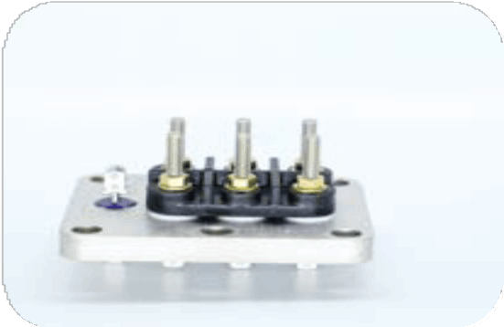
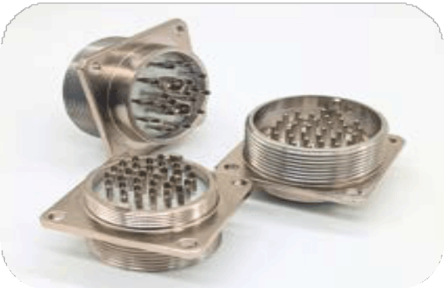
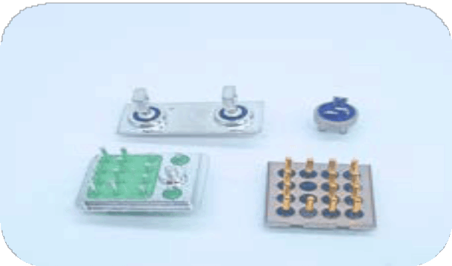
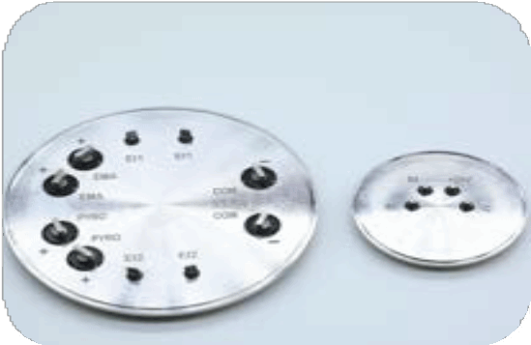
GLASS TO METAL SEALS
JJ Glastronics Pvt Ltd
SEMI HERMETIC COMPRESSOR PLATES
CONNECTORS
Semi-hermetic packages are protective enclosures for electronic components, such as compressors and semiconductors, that offer partial sealing against environmental factors like dust and moisture.
They balance protection and accessibility, commonly used in industrial
and HVAC applications.
Hermetic connector maintains a sealed environment, preventing contaminants like moisture, gases, or
particles from entering. Crucial in aerospace, military, medical, and industrial systems.
RELAY & SWITCHES
BATTERY LIDS
Hermetic relays and switches are sealed components designed to prevent the ingress of moisture, dust, and
gases, ensuring reliable operation in harsh environments.
They are widely used in aerospace, defense, and industrial applications.
Battery lids are protective covers that seal battery cells, preventing leakage of electrolytes and exposure to external contaminants. They enhance battery safety, performance, and longevity, commonly used in automotive, industrial, and portable
electronics applications.
www.jjglastronics.com

Slide 10
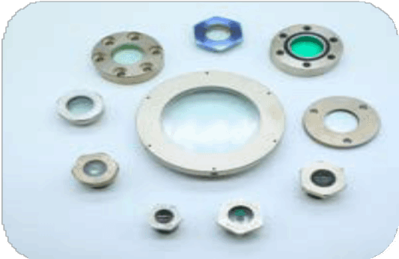
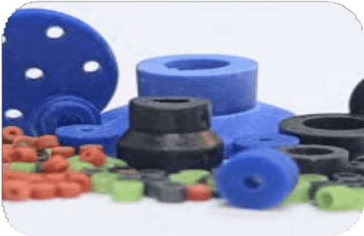
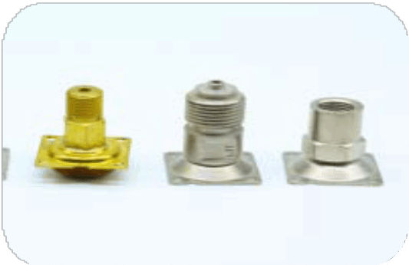

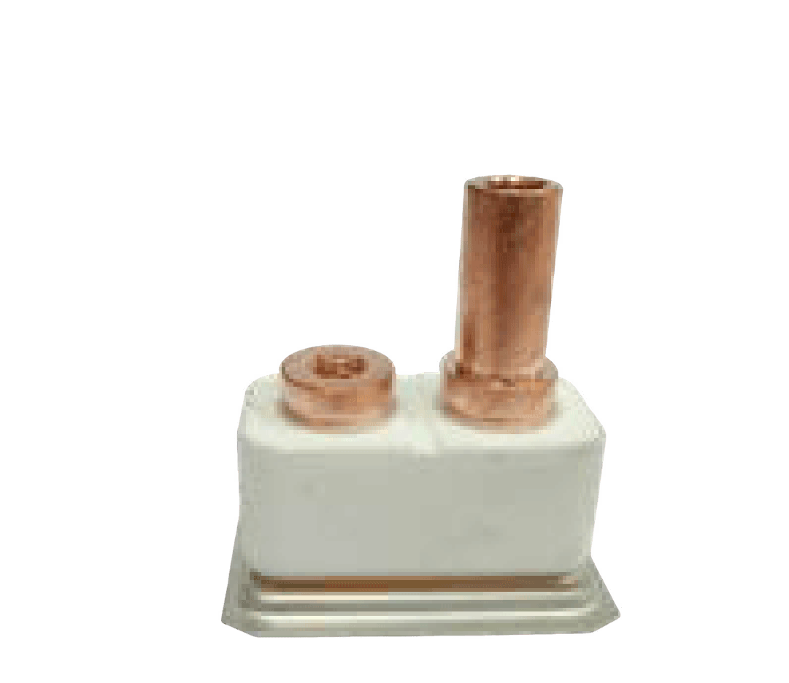
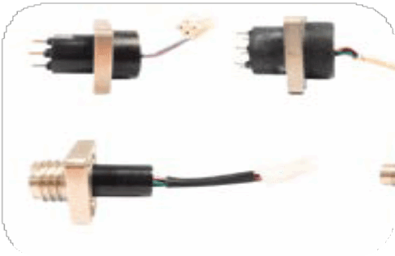
OTHER PRODUCTS
SIGHT GLASS
GRANULATES & PREFORMS
A sight glass is a transparent tube or window installed in
pipelines or tanks, allowing visual inspection of liquid levels, flow, or clarity. It’s commonly used in industries like oil and
gas, HVAC, and manufacturing for monitoring processes and ensuring system functionality.
These are used as sealing materials that are molded or stamped into specific shapes to create airtight seals. These materials ensure robust, leak-proof connections between terminals and enclosures, maintaining the integrity of electronic components in harsh environments like
aerospace, automotive, and industrial applications.
BRAZED ASSEMBLIES
ART GLASS
Brazed parts are components joined together using a filler metal with a melting point above 450°C but below the melting point of the base metals. This process creates strong, leak-proof joints, commonly used in automotive, aerospace, HVAC, and industrial
machinery for durability and reliability in high-stress applications.
Art glass refers to decorative glass pieces crafted with artistic techniques, featuring vibrant colors and unique designs. It includes vases, sculptures, and stained glass, valued for its beauty and craftsmanship.
CERAMIC TO METAL SEALS
GTMS WITH HARNESS
Ceramic to metal seals are components that join ceramic and metal parts, providing a hermetic, high-strength bond. They
offer excellent thermal and electrical insulation, and resistance to high temperatures and pressure, making them ideal for use in aerospace, electronics, medical devices, and vacuum technology.
Harness parts provides robust, hermetically sealed connections for critical applications. Ideal for aerospace, automotive, and
industrial environments, these harnesses offer protection against moisture, corrosion, and extreme temperatures. Engineered for durability and reliability, they ensure secure and long-lasting electrical connections in demanding conditions.
www.jjglastronics.com

Slide 11
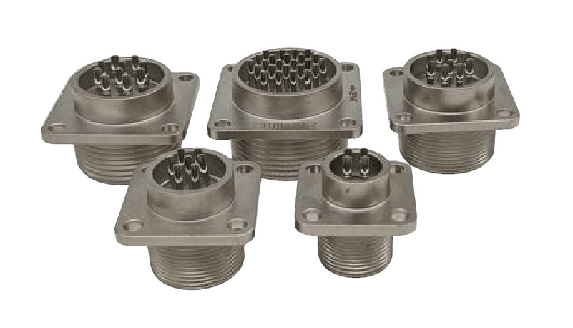
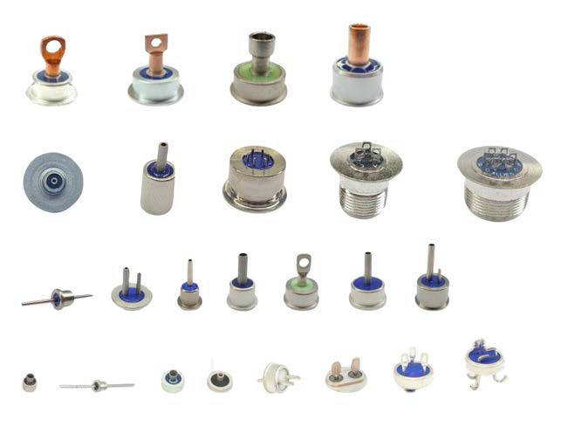
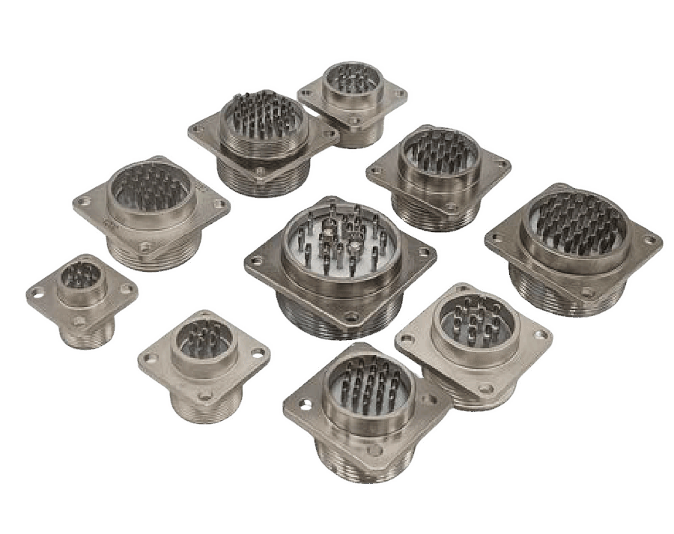
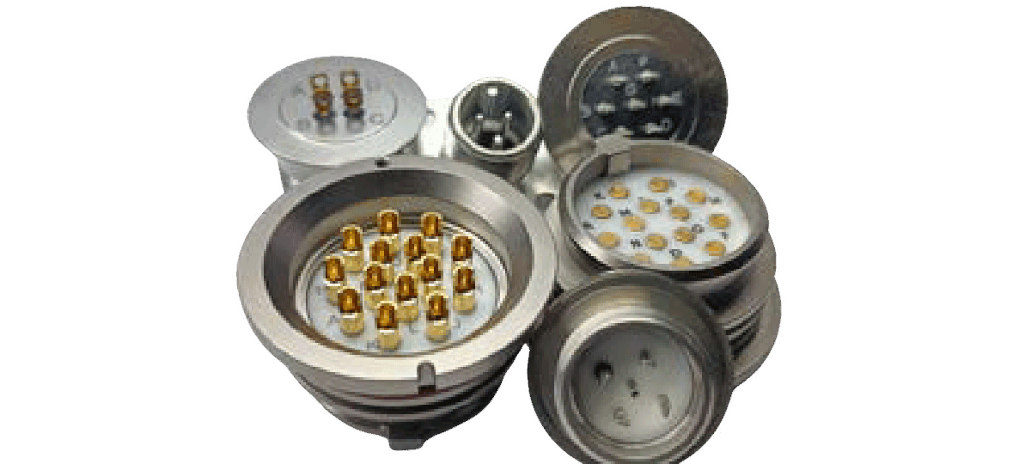
CONNECTORS
www.jjglastronics.com

Slide 12
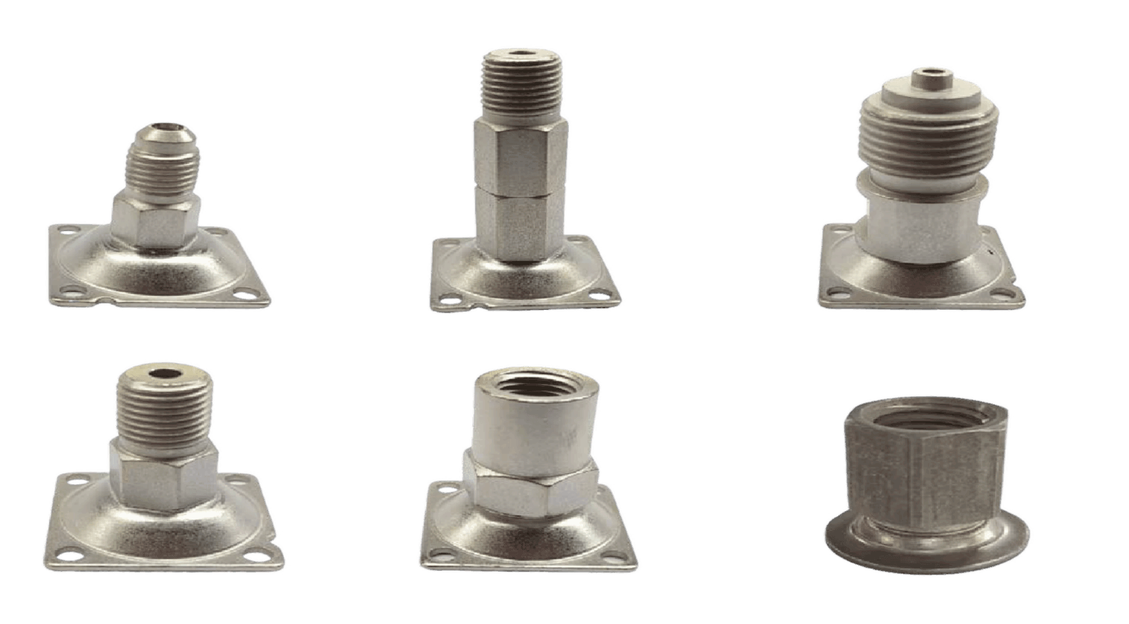
BRAZED ASSEMBLIES
www.jjglastronics.com

Slide 13
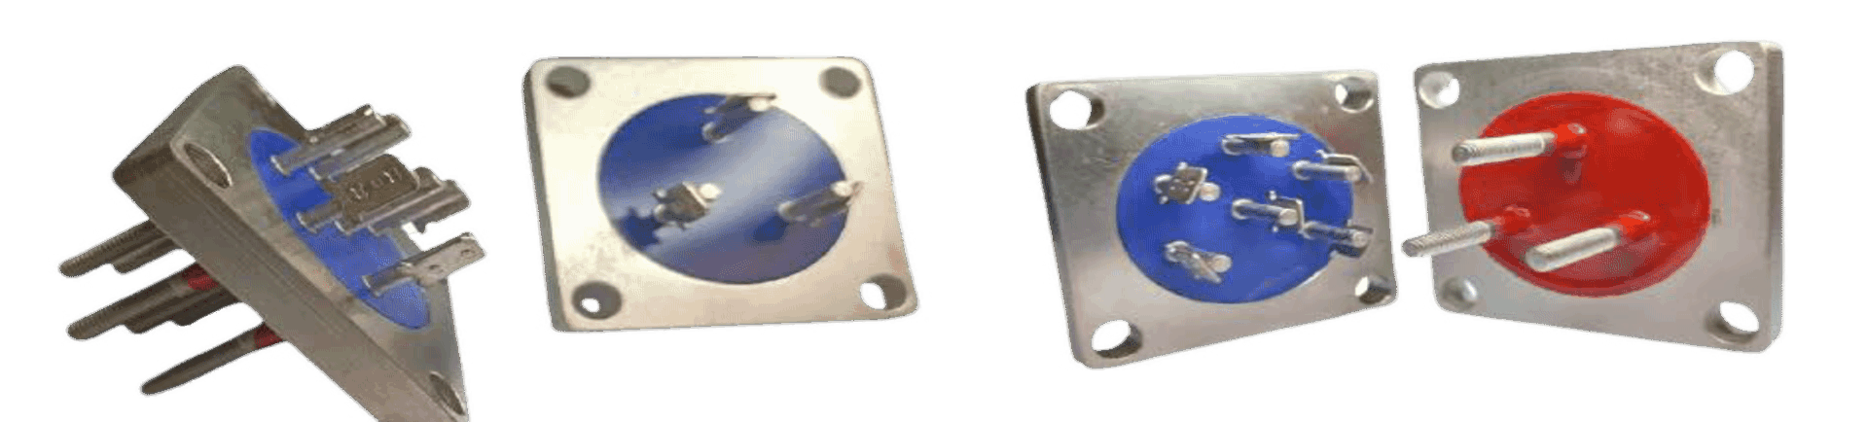
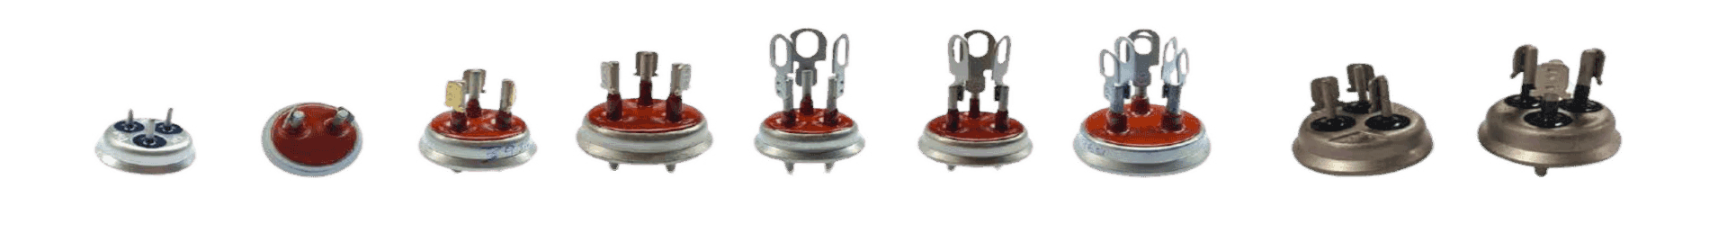
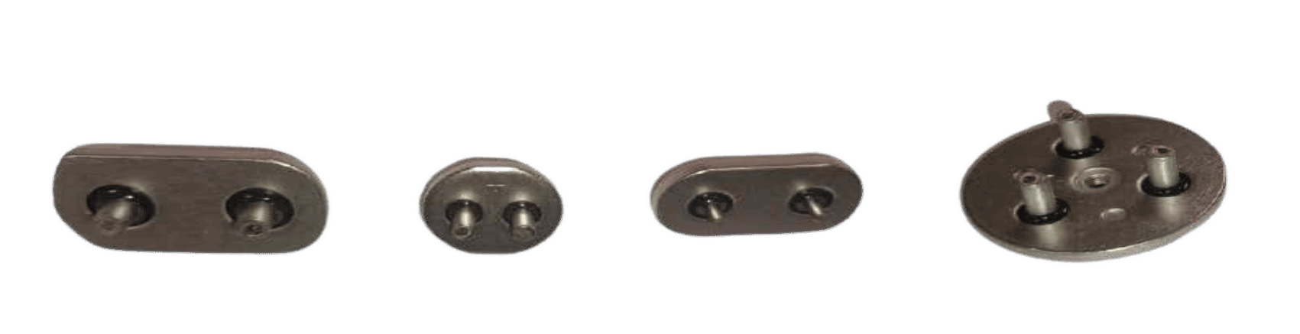
HERMETIC TERMINALS & OVERLOAD PROTECTOR
www.jjglastronics.com

Slide 14
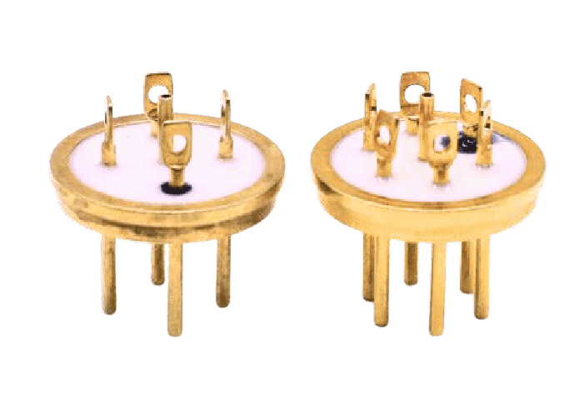
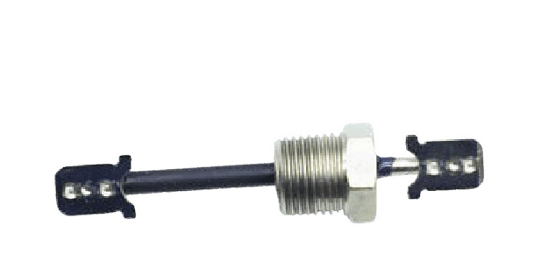
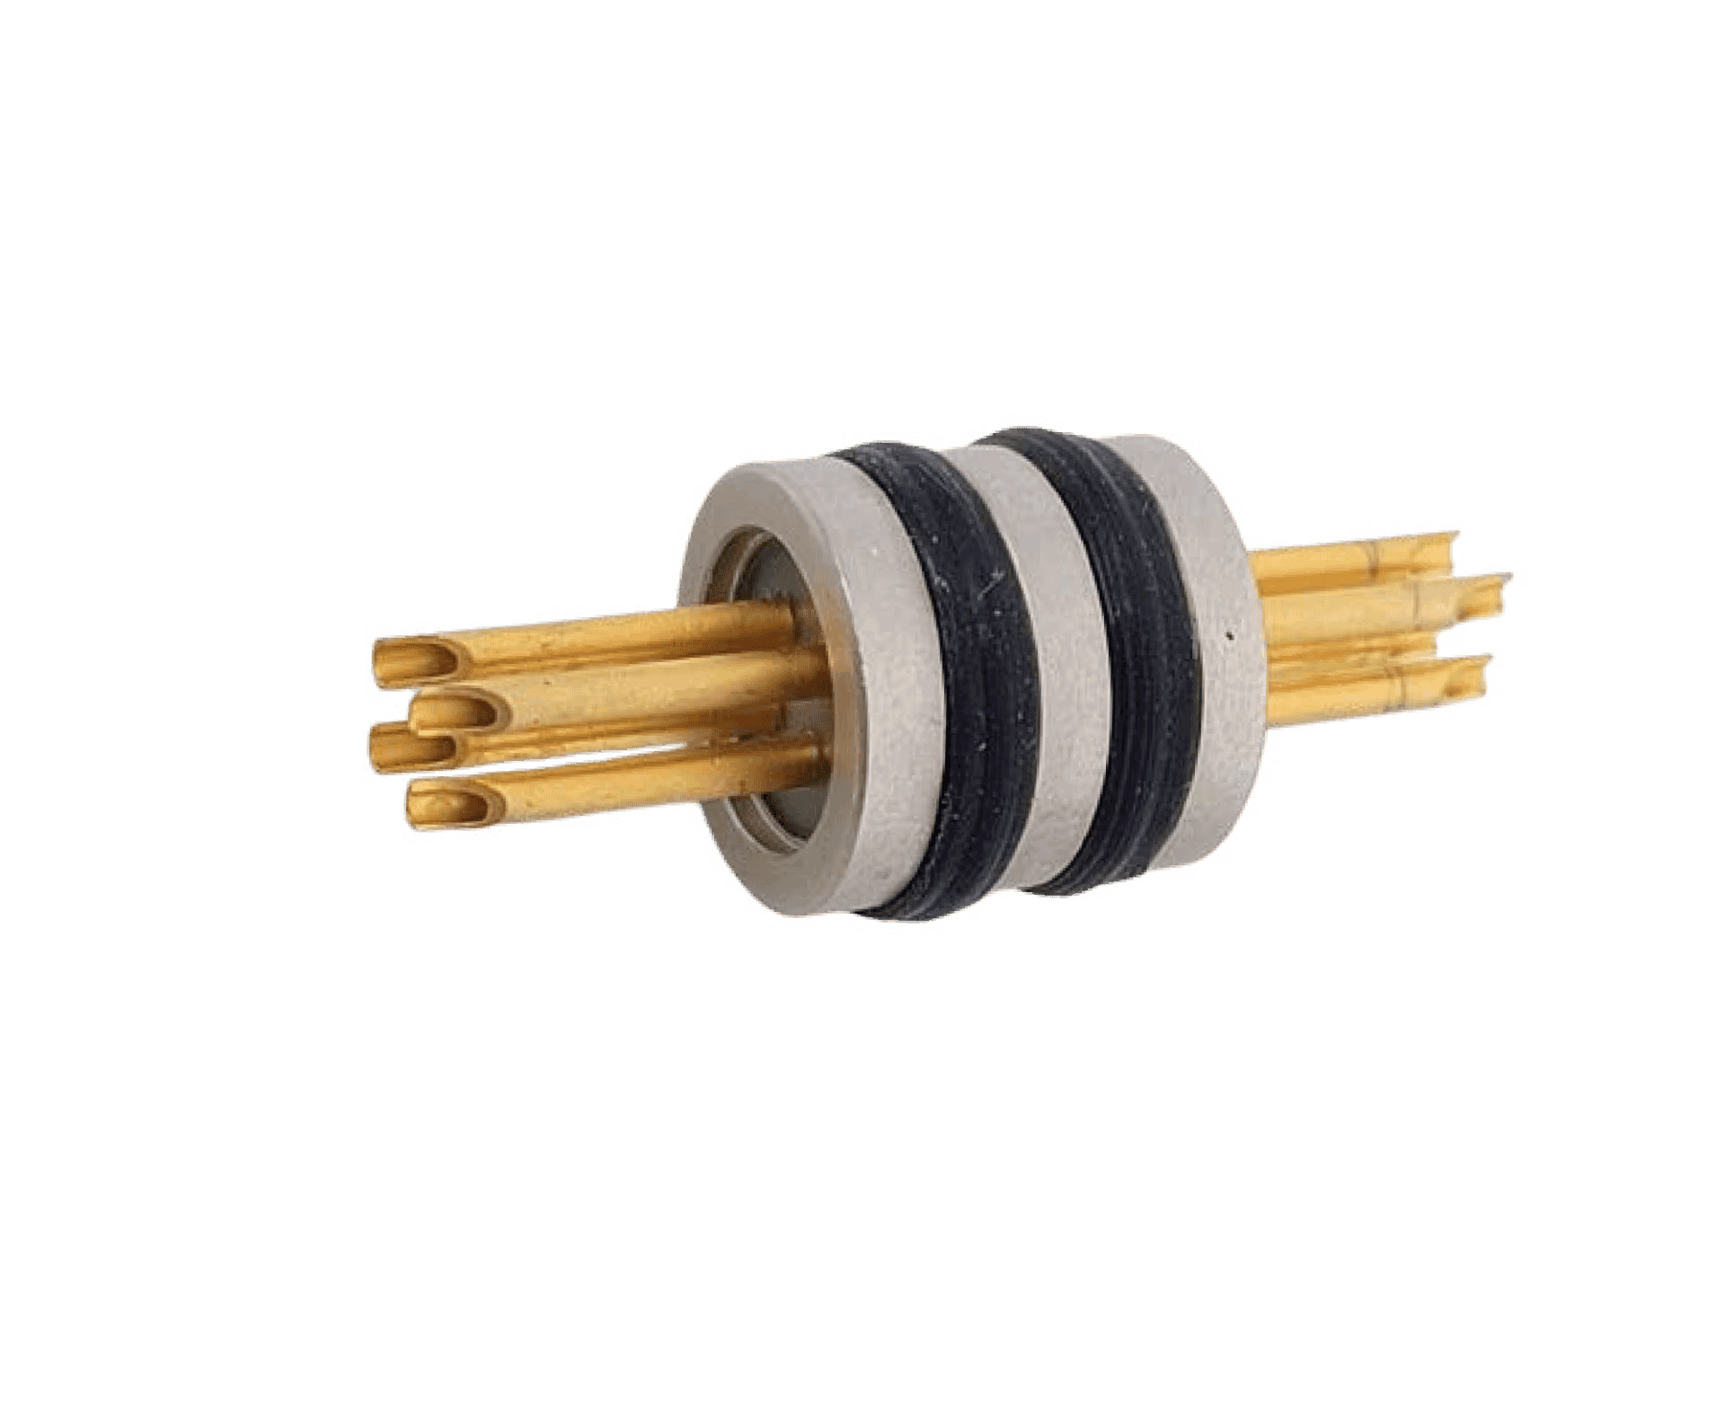
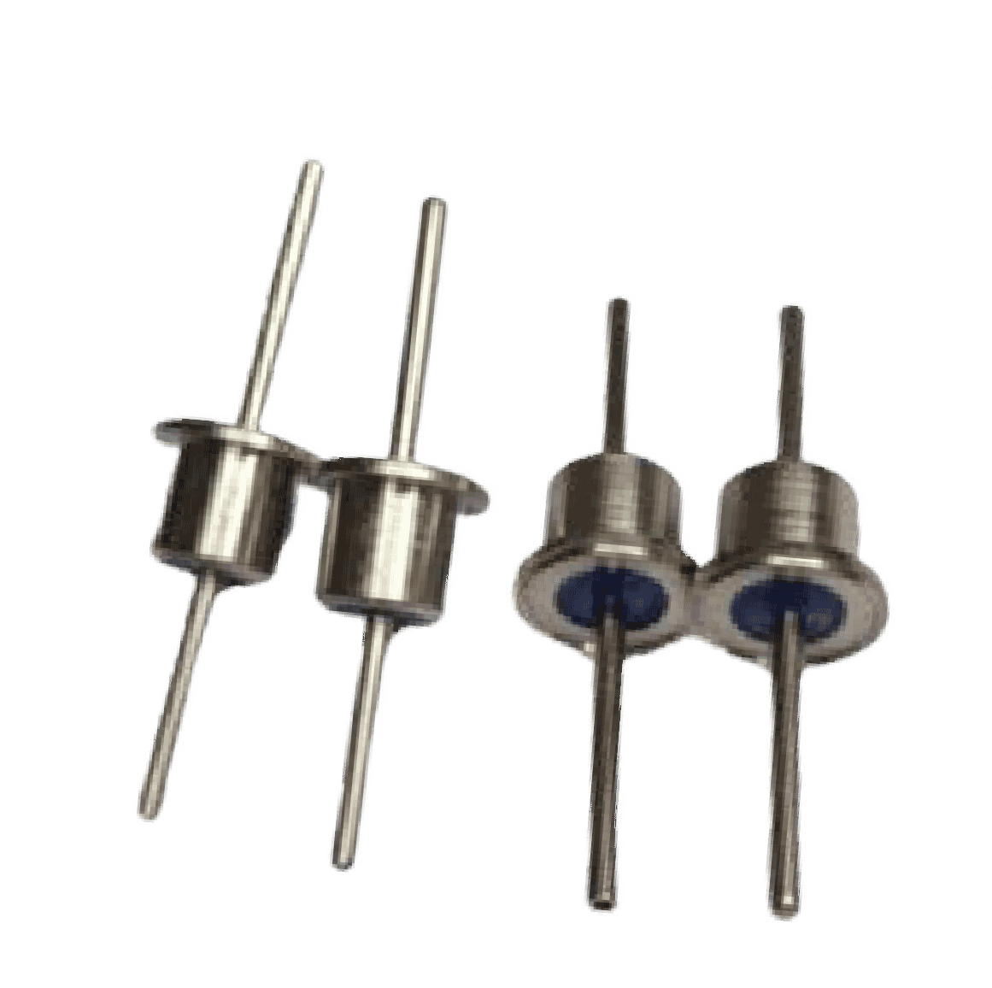
FEED THROUGHS
www.jjglastronics.com

Slide 15
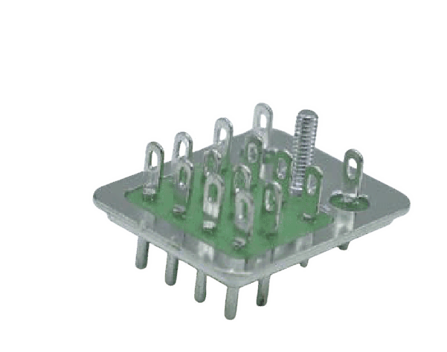
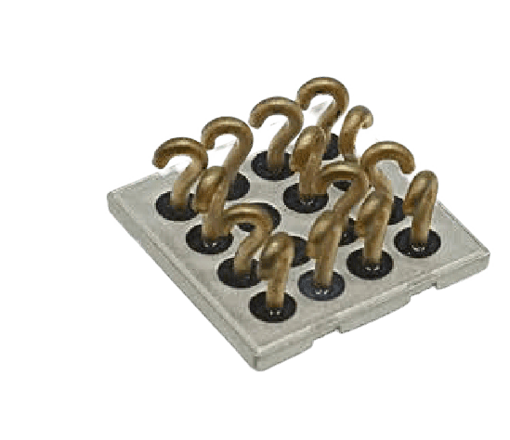


RELAYS
www.jjglastronics.com

Slide 16

HIGH VOLTAGE CONNECTORS
www.jjglastronics.com

Slide 17




HYBRID PACKAGES
www.jjglastronics.com

Slide 18

SIGHT GLASS
www.jjglastronics.com

Slide 19

SEMI HERMETIC COMPRESSOR PLATES
www.jjglastronics.com

Slide 20

CERAMICS
www.jjglastronics.com

Slide 21

HARNESS PARTS
www.jjglastronics.com

Slide 22


IN-HOUSE PLATING FACILITY
Electroless nickel plating
Nickel sulphamate plating Copper plating
Tin plating
Tin lead plating
Gold plating (Immersion)
Gold plating (Electrolytic) Zinc (Alkaline) plating Zinc Nickel plating
Zinc phosphating Manganese phosphating Electro polishing
Silver
Plating auto line
XRF Tester
www.jjglastronics.com

Slide 23


CONTACT US
JJ GLASTRONICS
marketing@jjglastronics.com, amit@jjglastronics.com
www.jjglastronics.com
25 A, Electronic City, Hosur Road, Bangalore, 560100, Karnataka, India
www.jjglastronics.com

