Slide 1
Welcome to
Laser Micromed Noida

Slide 2
Our Vision:
To provide our customers with a
Pleasant experience
meeting their
Price,
Quality
and
Delivery expectations

Slide 3
Our Vision:
Our Growth
is directly proportional to
Client’s Satisfaction level

Slide 4
Our Business Idea:
We want to be your
One stop shop
for all your
Plastic Moulded components

Slide 5
Our Business Idea:
To also provide Post moulding operations like –
Pad printing,
Screen printing,
Laser marking,
Heat staking,
Ultra Sonic welding,
IP 65 Water Proof components,
Pouch and Blister packing.
All under one roof !

Slide 6
Our Company Policy:
#1. Client first
#2. Act with Loyalty and Integrity
#3. Treat all with respect

Slide 7
Our Company Policy:
#4. Build teamwork and relationships
#5. Constant Innovation and Improvement
#6. Strive towards our Sustainability goals.

Slide 8
LASER Strengths :
We are an
Innovations
and
Development-based
manufacturing company.

Slide 9
LASER Strengths :
We readily incorporate
New Technology
and
New Machinery / SPM
to complement the production plans

Slide 10
Present Clients and Products:
JIO Reliance, India- Electronics
Arcadyan Taiwan - Electronics
Sercomm, Taiwan- Electronics
Comtrend Taiwan- Electronics
IKEA, Sweden- Electrical and Home
EGLO, Austria- Lighting

Slide 11
Past Clients and Products:
Bausch & Lomb, India -
Contact Lens Packagings
Sony India -
Car Stereo fitment Bezels.
Black & Decker Bajaj India-
Juicer Mixer Grinder parts

Slide 12
Past Clients and Products:
NEWELL Rubbermaid, USA –
Writing Instruments
RUSTA, Sweden-
Christmas Lighting
O.V.T, China-
Electronics Set Top Box

Slide 13
Machine Safety features :
All machines have Triple safety features
Regular Electro Mechanical , Hydraulic safety checking in all machines operations.
All machines have auto shut off features if any access door opens.
Zero Accident rate in our factory.
Oil spillage cleaned up on priority.
Training and awareness of safety in factory by Signage.
Electrical safety by regular monthly checking of Earthing.
Fire safety approval by Fire Safety Department
No Smoking zone in all factory
Auto Water Sprinklers in Raw Material Store area.
Fire Extinguishers in all areas of concern.

Slide 14
Worker Safety features :
All workers wear Foot safety equipment like Shoes
All workers wear Hand safety equipment like Gloves.
Over Head Crane usage only with Helmet protection.
Target- Zero Accident rate in our factory.
Oil spillage cleaned up on priority.
Training and awareness of safety in factory by Signage.
Fire safety approval by Fire Safety Department
Strictly No Smoking zone in all factory
Regular Fire Extinguishers usage training
Regular First Aid kit usage and Emergency Assistance training

Slide 15
Sustainability ambitions :
Encourage the use of electronic communications.
Discourage printing
If necessary, use printing on both sides of the paper.
DFE- “Design For Environment” by using recyclable packaging.
Where feasible use recyclable Raw material.

Slide 16
Sustainability ambitions :
Machine parameters that use minimum energy settings.
Purchase equipment with the latest microprocessors for
energy efficiency.
94% recycling achieved and target to achieve 99% in 2 years.
Use of ROHS-compliant materials.

Slide 17
Quality and Environmental Management System Certification
ISO 9001:2015
ISO 14001:2015
ISO 45001:2018

Slide 18
Quality Flow Chart:
IQC passed Raw Material
Injection Moulding Machine
Approved Process Parameter sheet
OK
OK
100%
Inspection of Moulded parts
Manual Rework
Scrap
NG
NG
OK
OK
Dispatch
Pre-Dispatch Inspection

Slide 19
Promoter’s Profile
Ms. Namita Pathak, CFO
B.E. ( Civil)
Delhi College of Engineering
LL.B. Delhi University
Experience- 36 years
CFO Responsibilities- Finance, Admin

Slide 20
Promoter’s Profile
Ms. Rajnesh Pathak, CTO
B.E. ( Electronics)
Bangalore University
M.B.A from AIMA
Experience- 38 years
Responsibilities- Technical, Client interaction

Slide 21
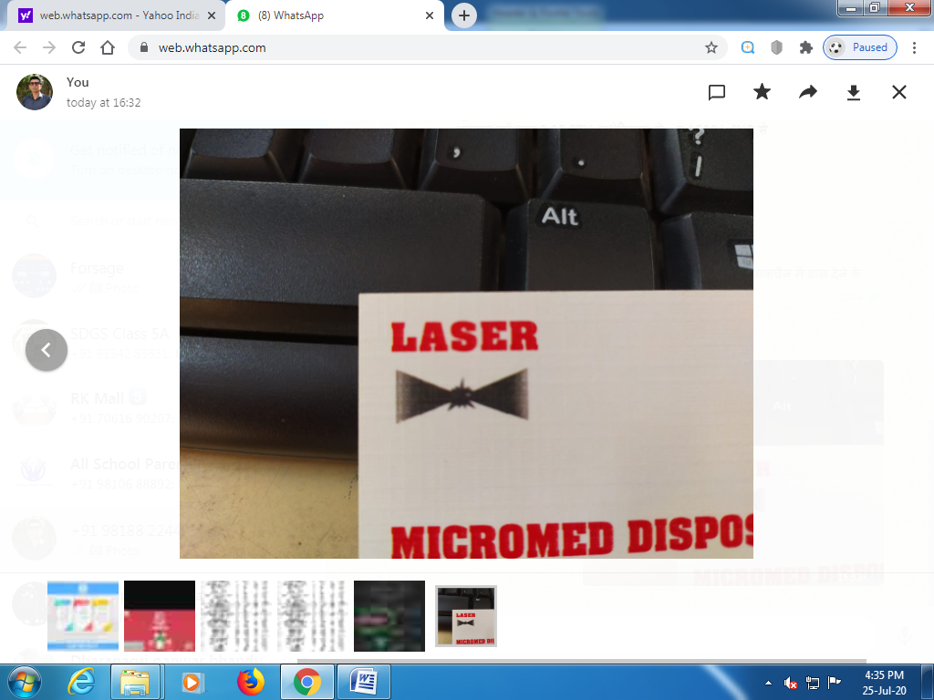
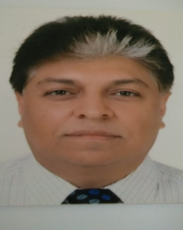
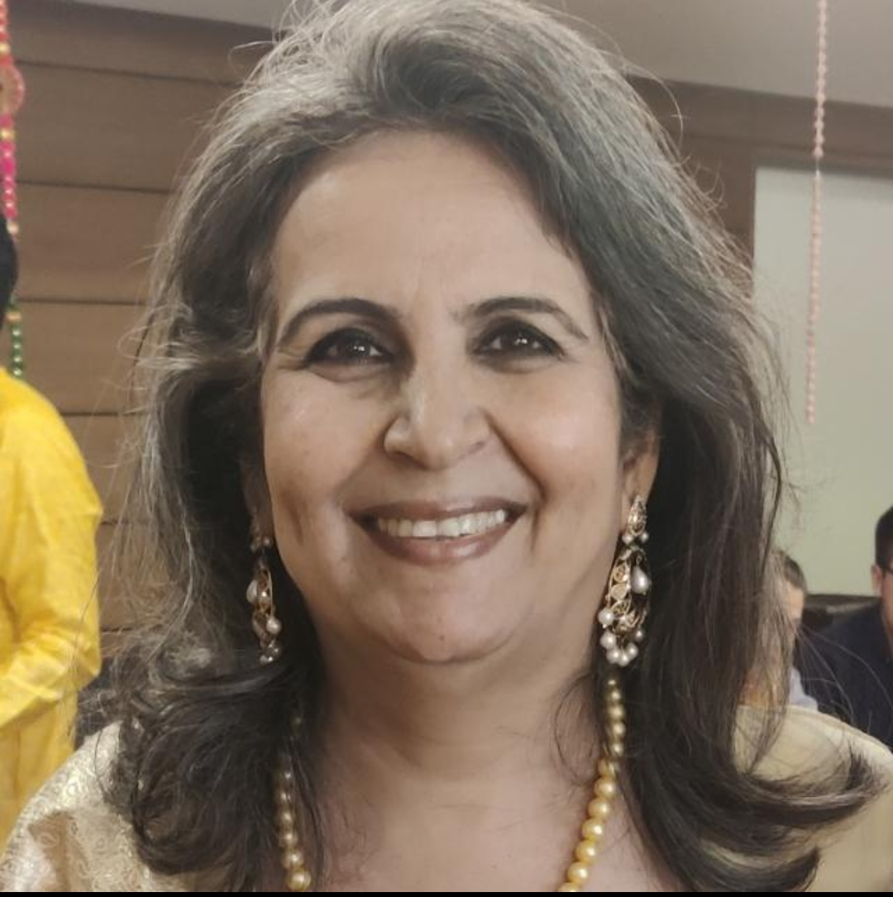
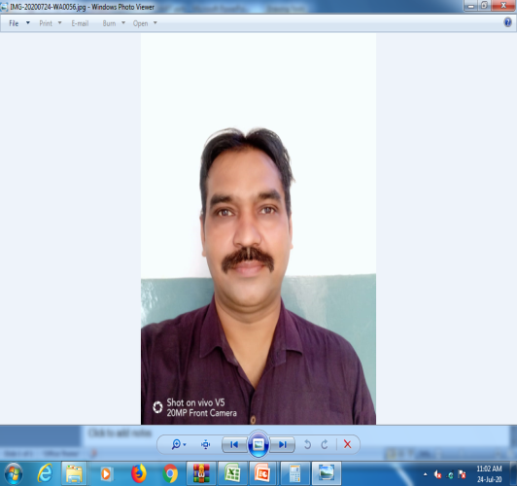
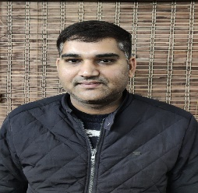
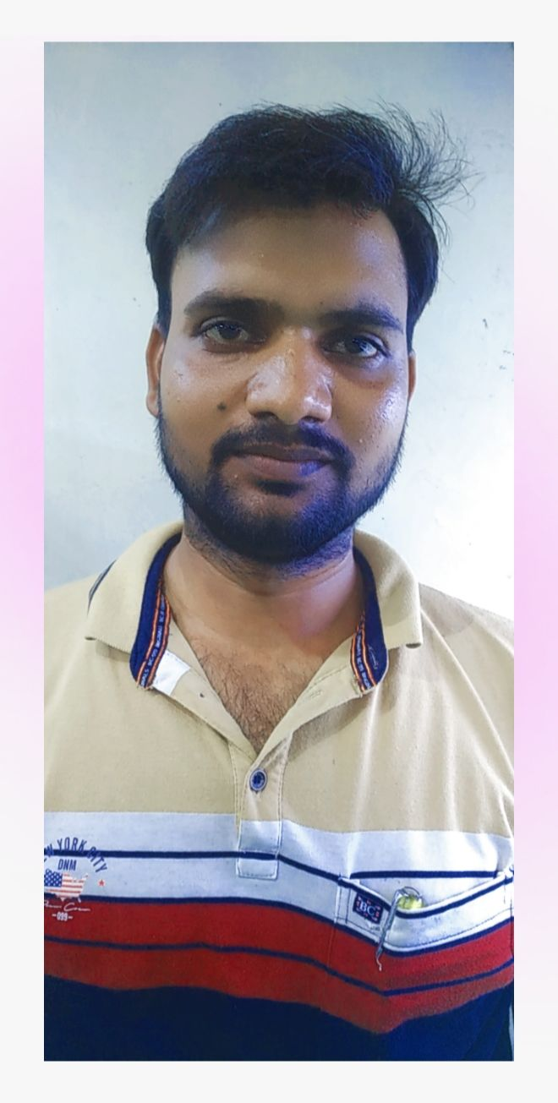
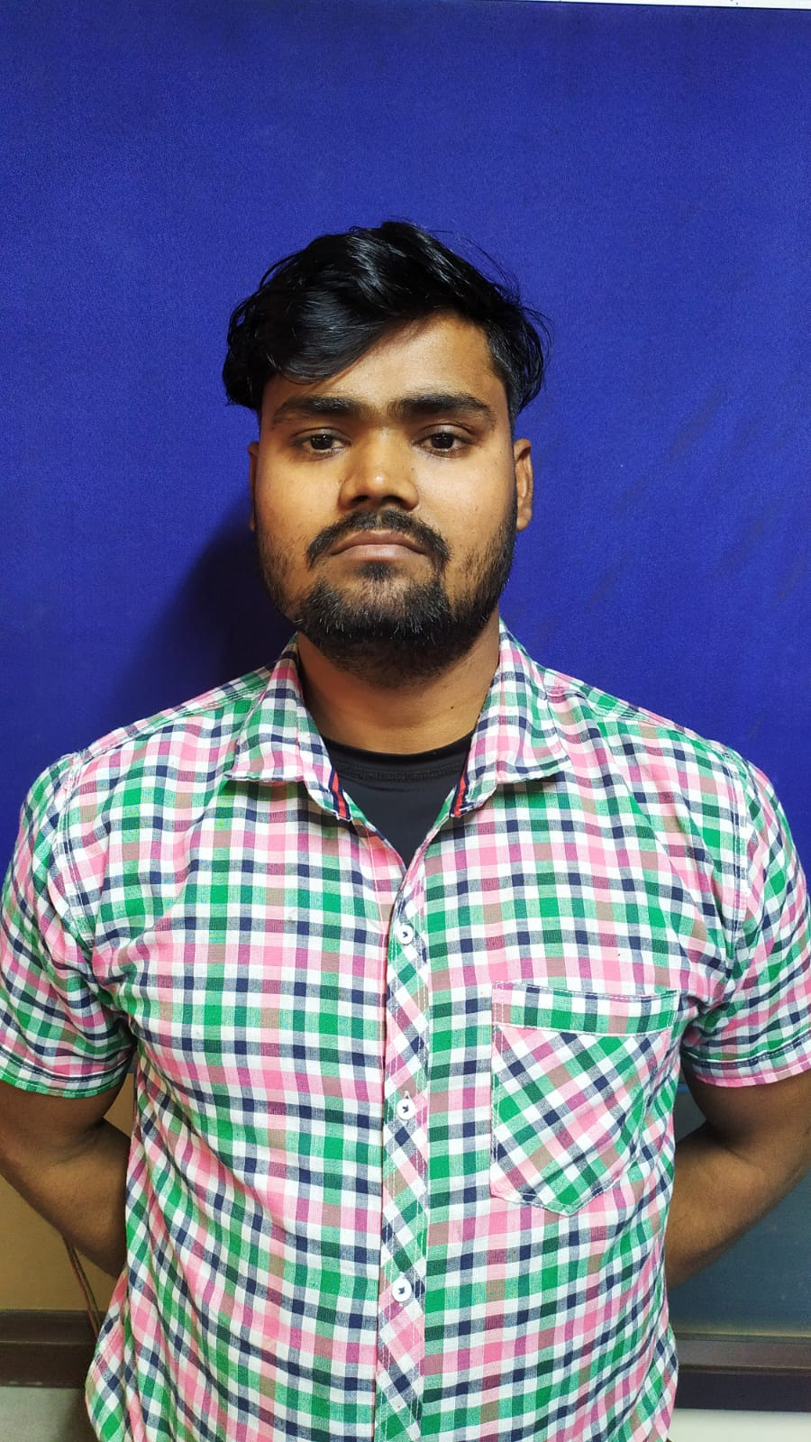
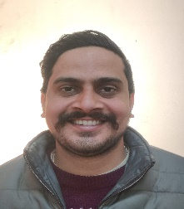
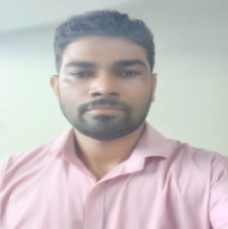
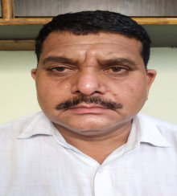
Organization Chart
Laser Micromed Disposables
Format No. : LASER/ORG/01
Rev. No. : 09
Rev. Date:
Eff. Date : 24.07.2025
CTO
RAJNISH PATHAK
CFO
NAMITA PATHAK
PLANT HEAD
UPENDRA
ACCOUNTS/ HR HEAD
DALEEP
MAINTENANCE INCHARGE
ABHISHEK
PRODUCTION. INCHARGE PHOOL SINGH
QUALITY HEAD
VINOD
STORE INCHARGE
RAHUL
PURCHASE INCHARGE
BINESH TYAGI

Slide 22
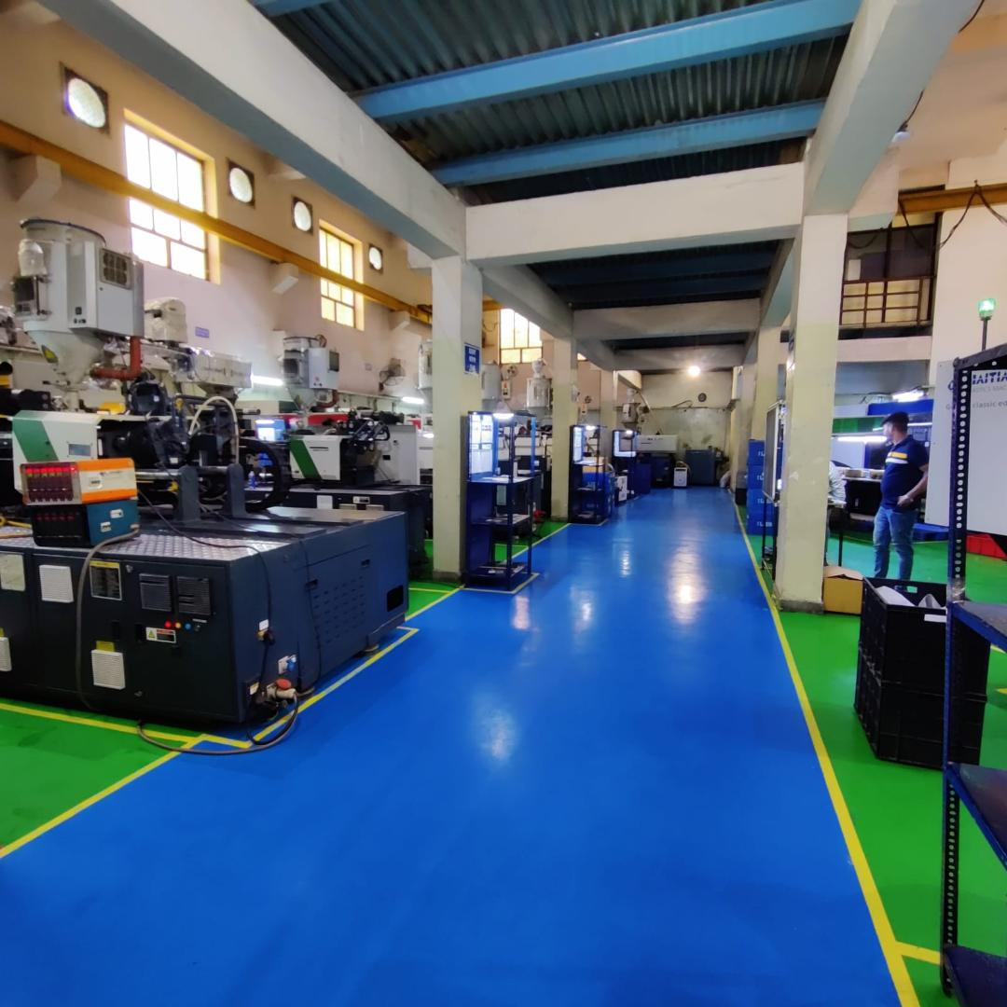
27,000 Sq Feet Factory Area

Slide 23
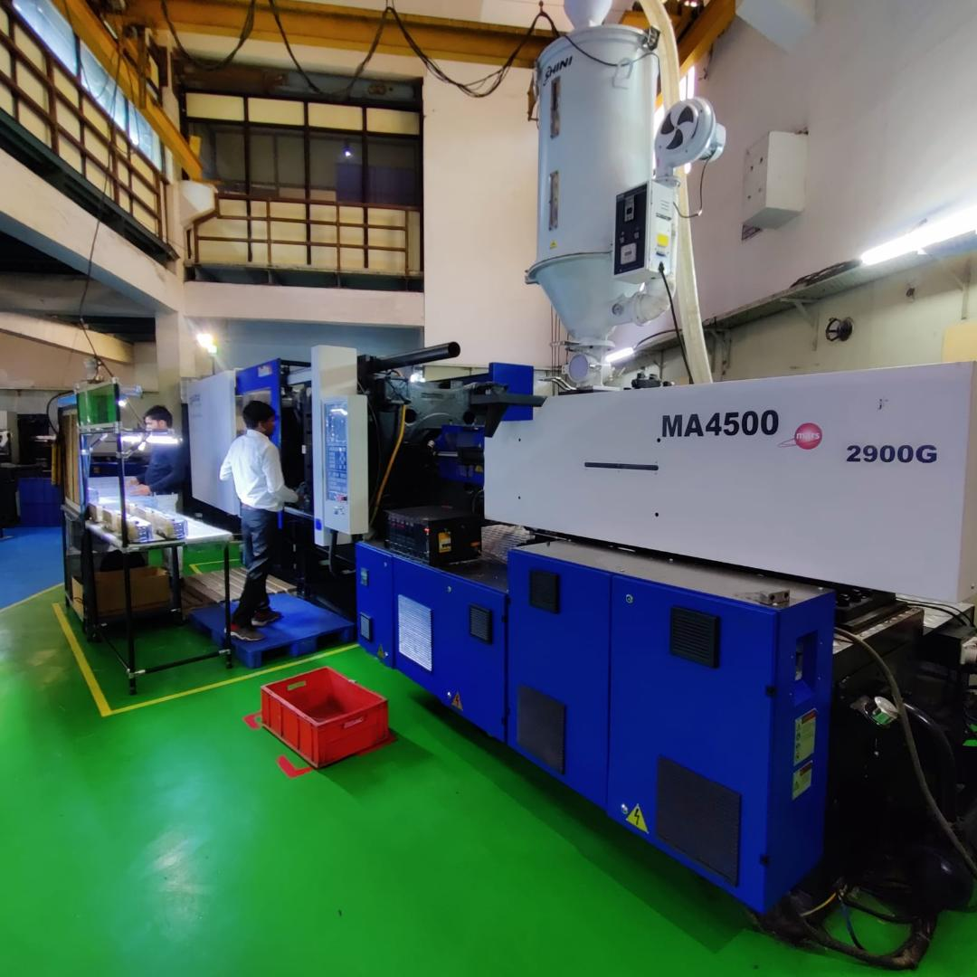
17 nos. Plastic Injection Moulding Machines
Sizes- 86Tons to 450 Tons

Slide 24
LASER MICROMED DISPOSABLES
D-90,H.C.,PHASE-II EXTN, NOIDA-201305,U.P. INDIA
DETAILED LIST OF MACHINERY MARCH 2024
S.NO. | PARTICULARS | YEAR | MAKE | SPECIFICATIONS | UNITS | NOS.
 | PLASTIC MOULDING MACHINERY:
1 | INJECTION MOULDING MACHINERY- MICROPROCESSOR CONTROLLED | 2024 | HAITIAN, INDIA | 470 | TONS | 1
2 | INJECTION MOULDING MACHINERY- MICROPROCESSOR CONTROLLED | 2023 | HAITIAN, INDIA | 450 | TONS | 3
3 | INJECTION MOULDING MACHINERY- MICROPROCESSOR CONTROLLED | 2010 | HAITIAN ZHAFIR | 360 | TONS | 1
4 | INJECTION MOULDING MACHINERY- MICROPROCESSOR CONTROLLED | 2019 | TOSHIBA, INDIA | 250 | TONS | 1
5 | INJECTION MOULDING MACHINERY- MICROPROCESSOR CONTROLLED | 2011 | DEMAND,TAIWAN | 250 | TONS | 3
6 | INJECTION MOULDING MACHINERY- MICROPROCESSOR CONTROLLED | 2020 | MILACRON, INDIA | 200 | TONS | 4
7 | INJECTION MOULDING MACHINERY- MICROPROCESSOR CONTROLLED | 2011 | DEMAND,TAIWAN | 160 | TONS | 2
8 | INJECTION MOULDING MACHINERY- MICROPROCESSOR CONTROLLED | 2019 | TOSHIBA, INDIA | 150 | TONS | 1
9 | INJECTION MOULDING MACHINERY- MICROPROCESSOR CONTROLLED | 2026 | HAITIAN, INDIA | 86 | TONS | 1
 |  |  |  |  | TOTAL | 17
 | AUXILIARY EQUIPMENT :
9 | HIGH SPEED GRINDERS |  | INDIA | 15 | HP | 2
10 | HOPPER DRIER - LARGE |  | INDIA | 100 | KGS | 15
11 | AUTO LOADERS |  | CHINA | 3 KG / MIN | KGS | 10
12 | TRAY OVEN- 12 TRAYS |  | INDIA |  |  | 1
13 | ROBOTIC ARM |  | CHINA | 3 AXIS+2 AXIS |  | 2
14 | WATER CHILLERS FOR MOULDS |  | INDIA | 5+2 | TR | 2
15 | MOULD TEMPERATURE CONTROLLER - MTC |  | CHINA |  |  | 15

Slide 25
LASER MICROMED DISPOSABLES
D-90,H.C.,PHASE-II EXTN, NOIDA-201305,U.P. INDIA
DETAILED LIST OF MACHINERY JULY2023
S.NO. | PARTICULARS | YEAR | MAKE | SPECIFICATIONS | UNITS | NOS.
 | UTILITIES:
16 | AIR COMPRESSOR DRIER & FILTERATION PLANT |  | INGERSSOL RAND INDIA | 60 | CFM | 2
17 | WATER SOFTENING PLANT WITH FILTERATION SYSTEMS |  | INDIA | 1000 | LITRES/HOUR | 1
18 | D.G. SET WITH SOUND PROOF CANOPY |  | KIRLOSKAR CUMMINS INDIA | 250 | KVA | 1
19 | SERVO STABILIZER- MICROPROCESSOR CONTROLLED |  | APEX, NOIDA | 300 | KVA | 1
20 | COOLING TOWER |  | INDIA | 200 | TR | 1
21 | DIGITAL WEIGHING SCALES |  | INDIA | 5-100 | KGS | 3
22 | ELECTRICAL OVER HEAD CRANE EOT |  | INDIA | 2 | TONS | 3
23 | FREIGHT ELEVATOR |  | INDIA | 2 | TONS | 1
24 | FIRE FIGHTING SPRINKLER SYSTEM |  | INDIA | 30 | SPRINKLERS | 1
25 | HYDRAULIC OIL FILTERATION MACHINE |  | KLEANZOIL |  |  | 1
26 | TESTING LABORATORY INSTRUMENTS | ASSORTED | CHINA / INDIA |  |  | 25
 | POST MOULDING OPERATIONS MACHINERY :
27 | PAD PRINTING MACHINE |  | INDIA |  |  | 1
28 | SCREEN PRINTING |  | INDIA |  |  | 5
29 | LASER MARKING MACHINE |  | INDIA |  |  | 1
30 | HEAT STAKING PNEUMATIC MACHINES |  | INDIA |  |  | 3
31 | PLASTIC COMPONENT DRILLING MACHINE |  | INDIA | 10 | MM | 1
32 | PLASTIC COMPONENT TAPPING MACHINE |  | INDIA | 10 | MM | 1
33 | PLASTIC COMPONENT LAMINATION MACHINE |  | CHINA | 50 | MM | 2

Slide 26
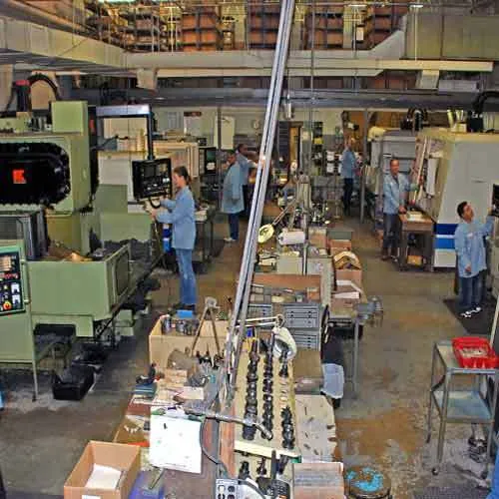
Tool Room
We have Conventional machines and Precision Machining centres

Slide 27
LASER COLLABORATIVE TOOL ROOM MACHINES AND SPECIFICATIONS MARCH 2025
S.NO. | MACHINERY | NOS. | BRAND | SPECIFICATIONS
1 | VERTICAL MILLING MACHINE(VMC) | 1 | COSMOS | 1400*700*700 mm
2 | VERTICAL MILLING MACHINE(VMC) | 1 | COSMOS | 1160*650*650 mm
3 | VERTICAL MILLING MACHINE(VMC) | 2 | COSMOS | 1050*600*600 mm
4 | VERTICAL MILLING MACHINE(VMC) | 1 | COSMOS | 800*500*450 mm
5 | VERTICAL MILLING MACHINE (VMC) | 1 | COSMOS | 600*450*450 mm
6 | CNC EDM MACHINE | 3 | JOEMARS | 2000*1000/01000*600/700*500 mm
7 | MILLING MACHINE | 2 | PRECICUT | 1270*254 mm
8 | LATHE | 2 | JYOTI | CD 1000mm
9 | SURFACE GRINDER | 2 | RAMANA | 640*240*200 mm
10 | ARC WELDING MACHINE | 1 | SHAKTI | Welding Machine 400A (3- P)
11 | POLISHING MACHINE | 1 |  | RTW1600 Mini Ultrasonic
12 | 2 FULL SET OF TESTING, METROLOGY AND MEASURING EQUIPMENT | 1 | ASSORTED

Slide 28
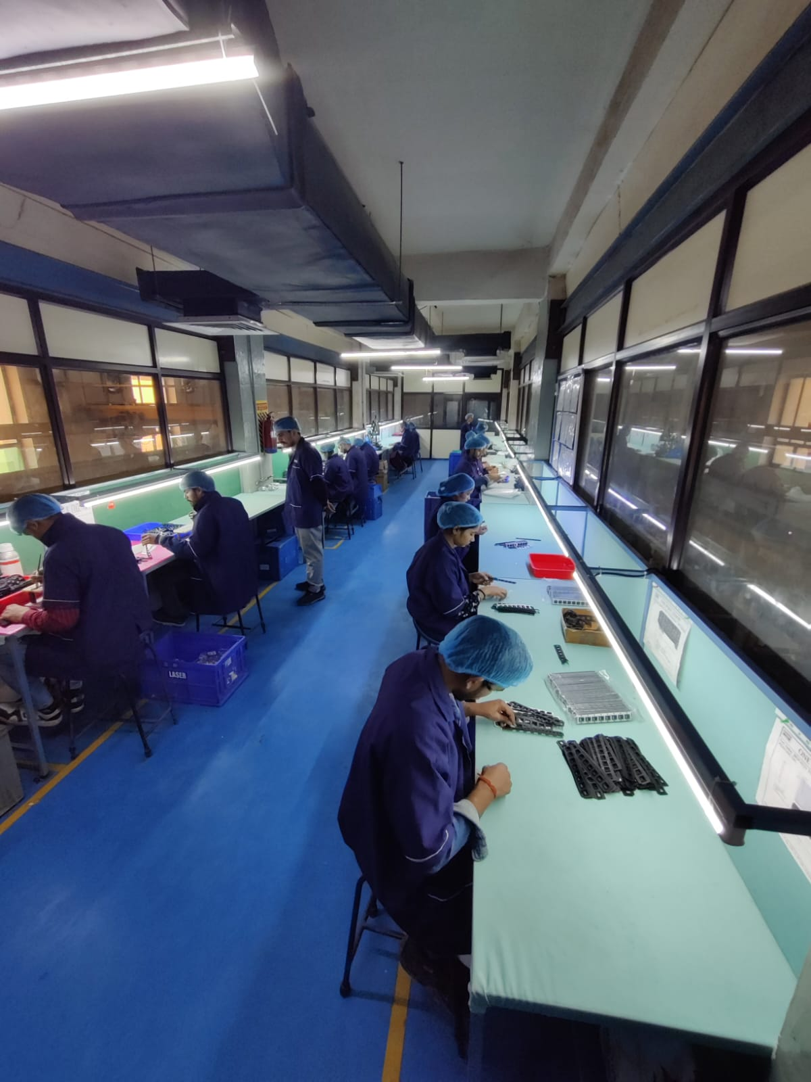
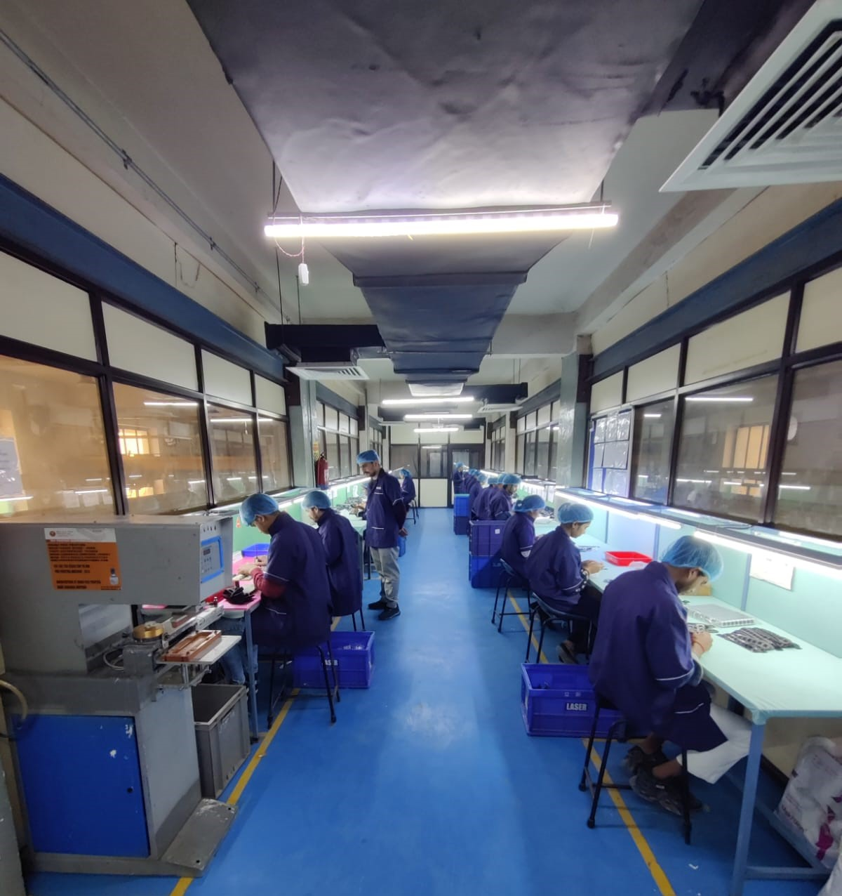
LASER
ASSEMBLY

Slide 29
Thank you for your Interest !
Look forward to associating with you on a long term mutually beneficial partnership.
WWW.LASERMICROMED.COM
RAJNESHPATHAK@LASERMICROMED.CO.IN

