Slide 1

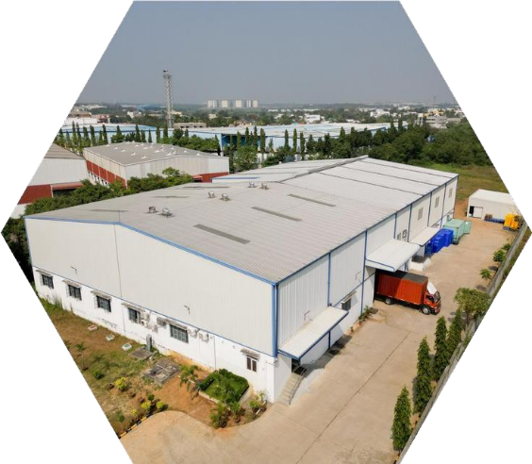



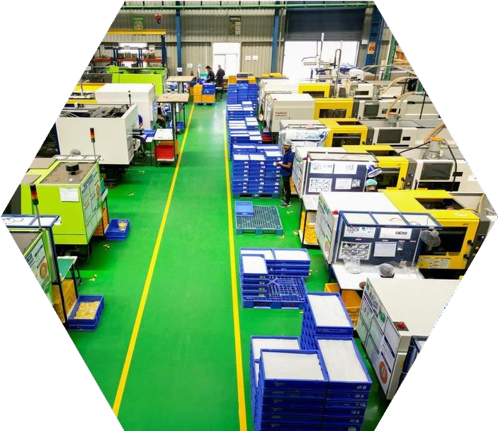
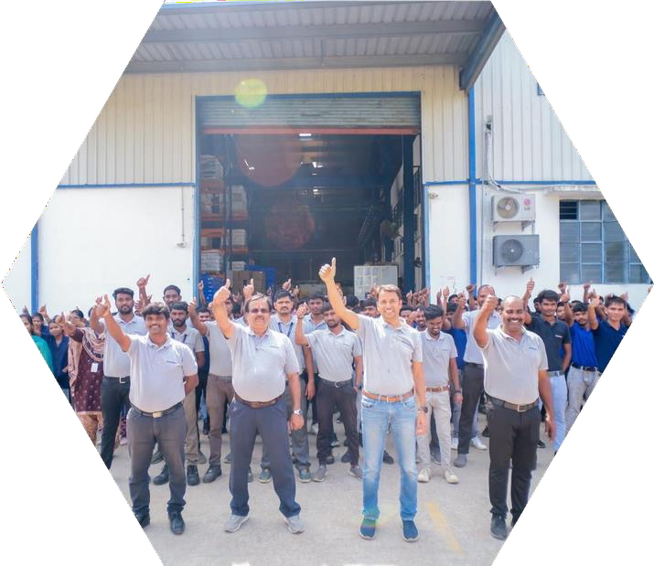
COMPANY PROFILE

Slide 2

SANCRAFT INDUSTRIES–CORE CAPABILITIES
Certifications & Compliance:
Certified to international standards: ISO 9001:2015, ISO 14001:2015, ISO 45001:2018, and IATF 16949 (TÜV SÜD) Strong focus on quality, environmental responsibility, and occupational health & safety systems
Manufacturing Expertise:
End-to-end manufacturer of precision plastic components, metal components, sheet metal enclosures, cables& sub-assemblies. Specialized in high-volume injection molding, including insert molding and integrated assemblies
Capability to support engineering-driven, tight-tolerance components across industries
Material Handling & Processing Strength: PLASTICS & METALS
Expertise in processing engineering-grade materials suchas: PC,Clear PC, Nylon, PC+ABS, POM, TPU & other special polymers. Advanced auto-conveying material feeding systems with integrated dehumidification for consistent quality
Expertise in processing sheet metals such as: CRS, HRS, GA Steel, AL, Cu and SS 303/304.
Operational Excellence:
Strong implementation of Lean Manufacturing practices to enhance productivity and reduce waste
Adoption of low-cost automation solutions to improve efficiency and scalability Robust project management approach ensuring:
-On-time delivery
-Cost optimization
-Consistent product quality
Quality & Delivery Commitment:
Strict adherence to customer quality standards and delivery schedules
Well-defined processes ensuring repeatability, traceability, and continuous improvement

Slide 3
















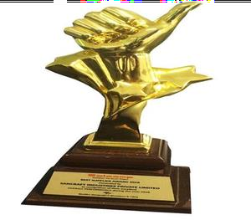
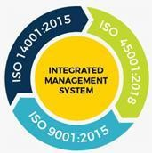


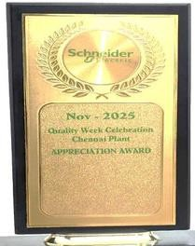






SANCRAFT INDUSTRIES MILESTONES
ISO 9001:2015
Electrical Industries Boardup
IATF 16949:2016
JV with RCC
New Technology Expansion: New Inj-M/C, Stamping Mc, Laser Cutting, VMC, EDM
New Factory Building, 100K SQft G+1
RJ45,HDMI, RC
Jack Cables Manufacturing
2017-2018
2019
2021
2022
2023
2024
2025
2026
New Verticals & Technology:
New Tool Design & Manufacturing,
Tool Spares,
Sheet Metal,
Metal Enclosures,
Sub- Assemblies
Incorporated
Best Supplier Award (SALCOMP)
ISO 14K & 45K
Certified with TUV SUD
New Customer addition
2025
Best SupplierAward (SCHNEIDER ELECTRIC)

Slide 4


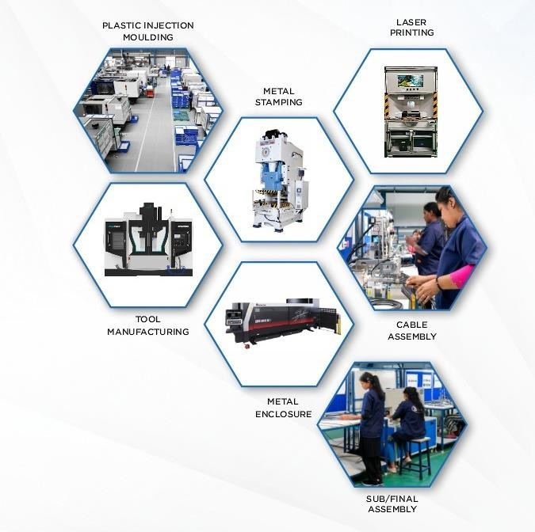
TECHNOLOGY ROAD-MAP
2017-2019
Plastic Injection Molding Insert Molding
Tool Spares Manufacturing
2019-2021
Laser & Screen Printing Tool Manufacturing Plastic Sub-Assembly
2022 - 2024
Cable Assemblies
Full Tool Manufacturing
2024-26
Sheet Metal Parts
Metal Stamping
Laser Cutting
CNC Bending
Sheet Metal Enclosures

Slide 5

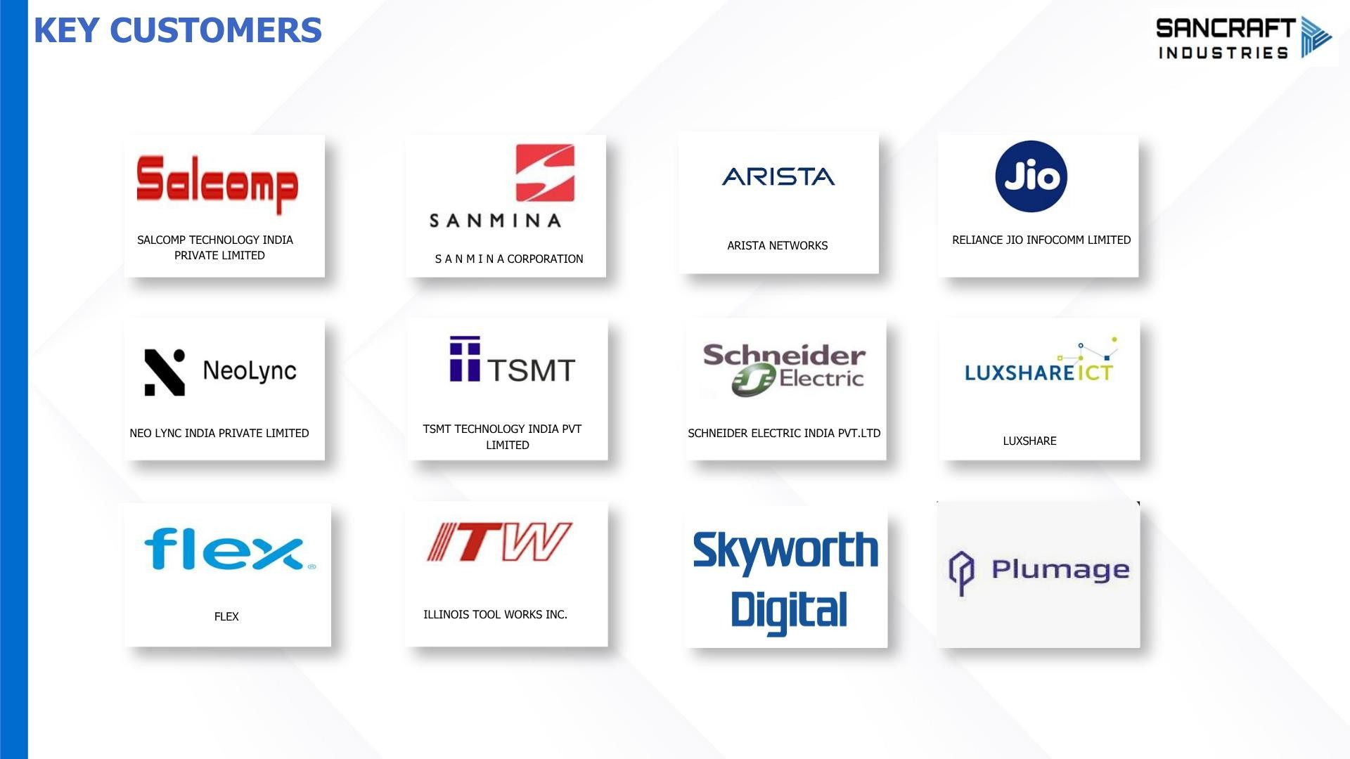



















KEY CUSTOMERS
SALCOMP TECHNOLOGY INDIA
PRIVATE LIMITED
ARISTA NETWORKS
RELIANCE JIO INFOCOMM LIMITED
S A N M I N A CORPORATION
NEOLYNC INDIA PRIVATE LIMITED
TSMT TECHNOLOGY INDIA PVT
LIMITED
SCHNEIDER ELECTRIC INDIA PVT.LTD
LUXSHARE
FLEX
ILLINOIS TOOL WORKS INC.

Slide 6

MACHINE CAPABILITIES
INJECTION MOULDING MACHINES
Brand Name | Capacity Level | Tonnage | No. of M/c | Type
ENGEL, FANUC | Low | 50T - 180T | 20 | All Electric, Servo
FANUC, HAITIAN, TOSHIBA, MILACRON | Medium | 180T - 400T | 6
ENGEL, FANUC, HAITIAN, MILACRON, TOSHIBA | High | 400T - 650T | 2
Total |  |  | 28
SHEET PROCESS MACHINES – METAL ENCLOSURES
Brand Name | Purpose | Capacity | No. of M/c | Type
AMADA LASER | Cutting | 2KW | 1 | Fiber
AMADA TURRET | Punch Press | 200 kN | 1 | CNC
TRIUMPH | Bending | 1.5T | 1 | CNC
PEM FIXING | Stud Fixing | - | 1 | PEM
SPOT WELDING | Spot Welding | 20KA | 1 | Welding
LINISHING | Belt Grinding | - | 1 | Linishing
RIVETING | Riveting | - | 1 | Riveting
Total |  |  | 7
PRESS STAMPING MACHINES – METAL PARTS
Brand Name | Capacity Level | Tonnage | No. of M/c | Type
IGSEC | Low | 110T | 1 | Hydraulic
IGSEC | Medium | 160T | 1 | Hydraulic
IGSEC | Medium | 200T | 1 | Hydraulic
IGSEC | High | 250T | 1 | Hydraulic
Total |  |  | 4
CABLES MANUFACTURING MACHINES
Brand Name | Purpose | Capacity | No. of M/c | Type
MACHINE-1 | Pre Process | - | 1 | Cable
MYLAR | Stripping | - | 1 | Cable
RADIO FREQUENCY | Welding | - | 1 | Cable
RIVETED PRESSED | Tin Plate | - | 1 | Cable
SOLDER | Resolder | - | 1 | Cable
JACKET | Stripping | - | 1 | Cable
MANUAL/AUTOMATIC | Crimping | 2T | 3 | Assembly
FINALE | Testing | - | 3 | Assembly
WIRE | Cutting/Stripping | - | 2 | Assembly
VERTICAL | Moulding | 70T | 2 | Assembly
Total |  |  | 17

Slide 7
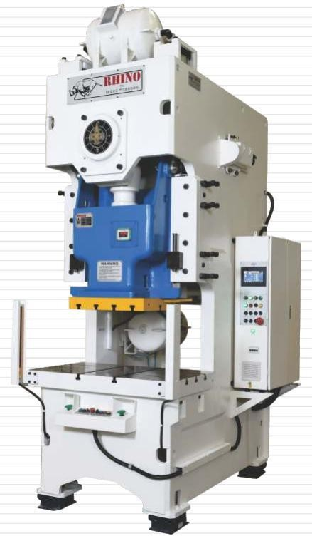
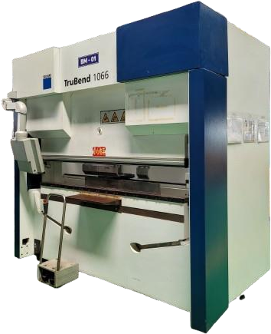
METAL STAMPING & ENCLOSURE TECHNOLOGY MACHINES
METAL STAMPING
CNC BENDING
ISGEC STAMPING MACHINE
TRUMPF CNC BENDING MACHINE

Slide 8
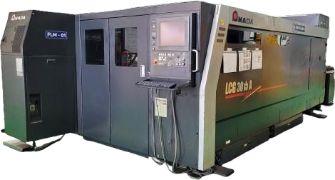
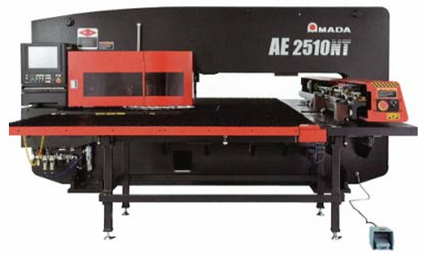
METAL STAMPING & ENCLOSURE TECHNOLOGY MACHINES
CNC BENDING
FIBER LASER CUTTING
TURRET PUNCH PRESS
AMADA LASER CUTTING MACHINE
AMADA CNC TURRET PUNCH PRESS

Slide 9



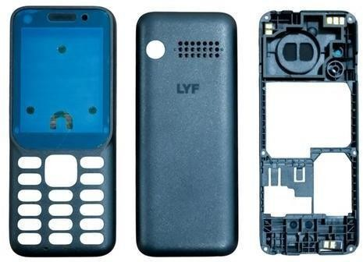

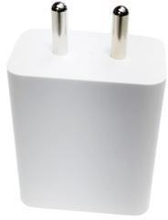
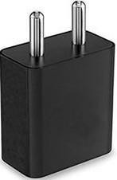
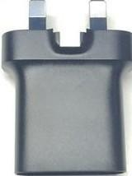
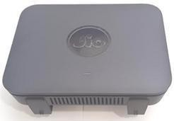
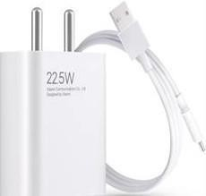
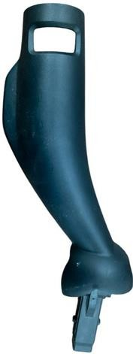
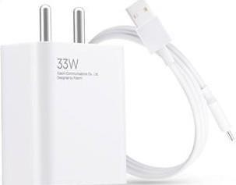
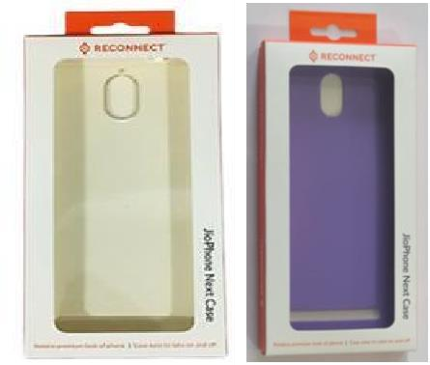



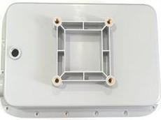
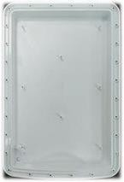
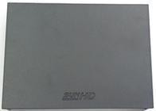
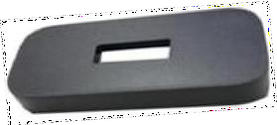

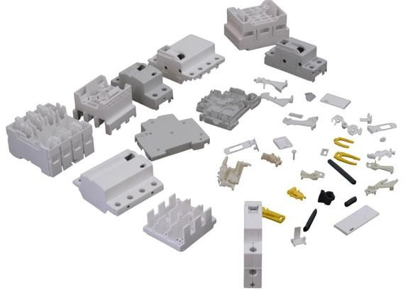
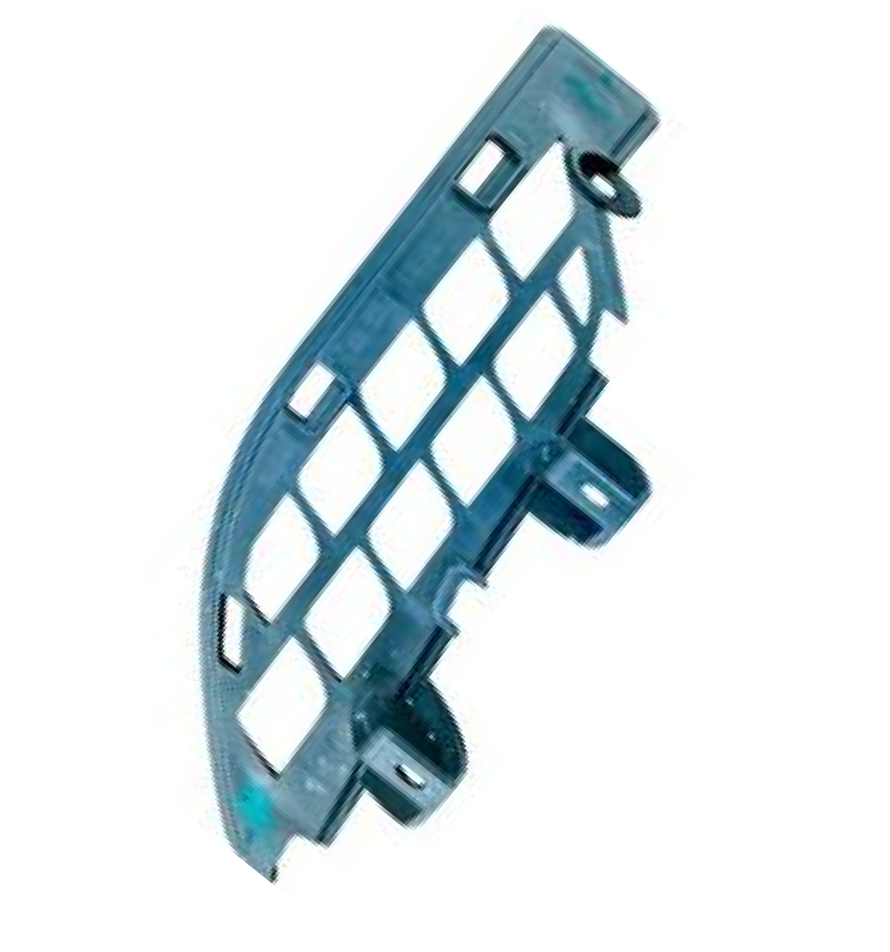

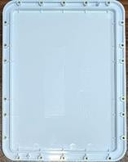

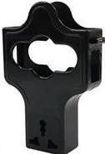
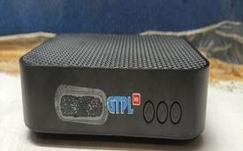
PLASTIC PRODUCTS
TELECOM & NETWORKING
MOBILE CHARGER PRODUCTS
MOBILE SUB-ASSY/COVERS & ELECTRICAL
JIO SET TOP BOX
JIO ROUTER
AIRTEL SET TOP BOX
JIO STB OTT
SUN HD SET TOP BOX
RADOME A6
ODCPE
IDU
LILLY SET TOP BOX
RADOME C6

Slide 10

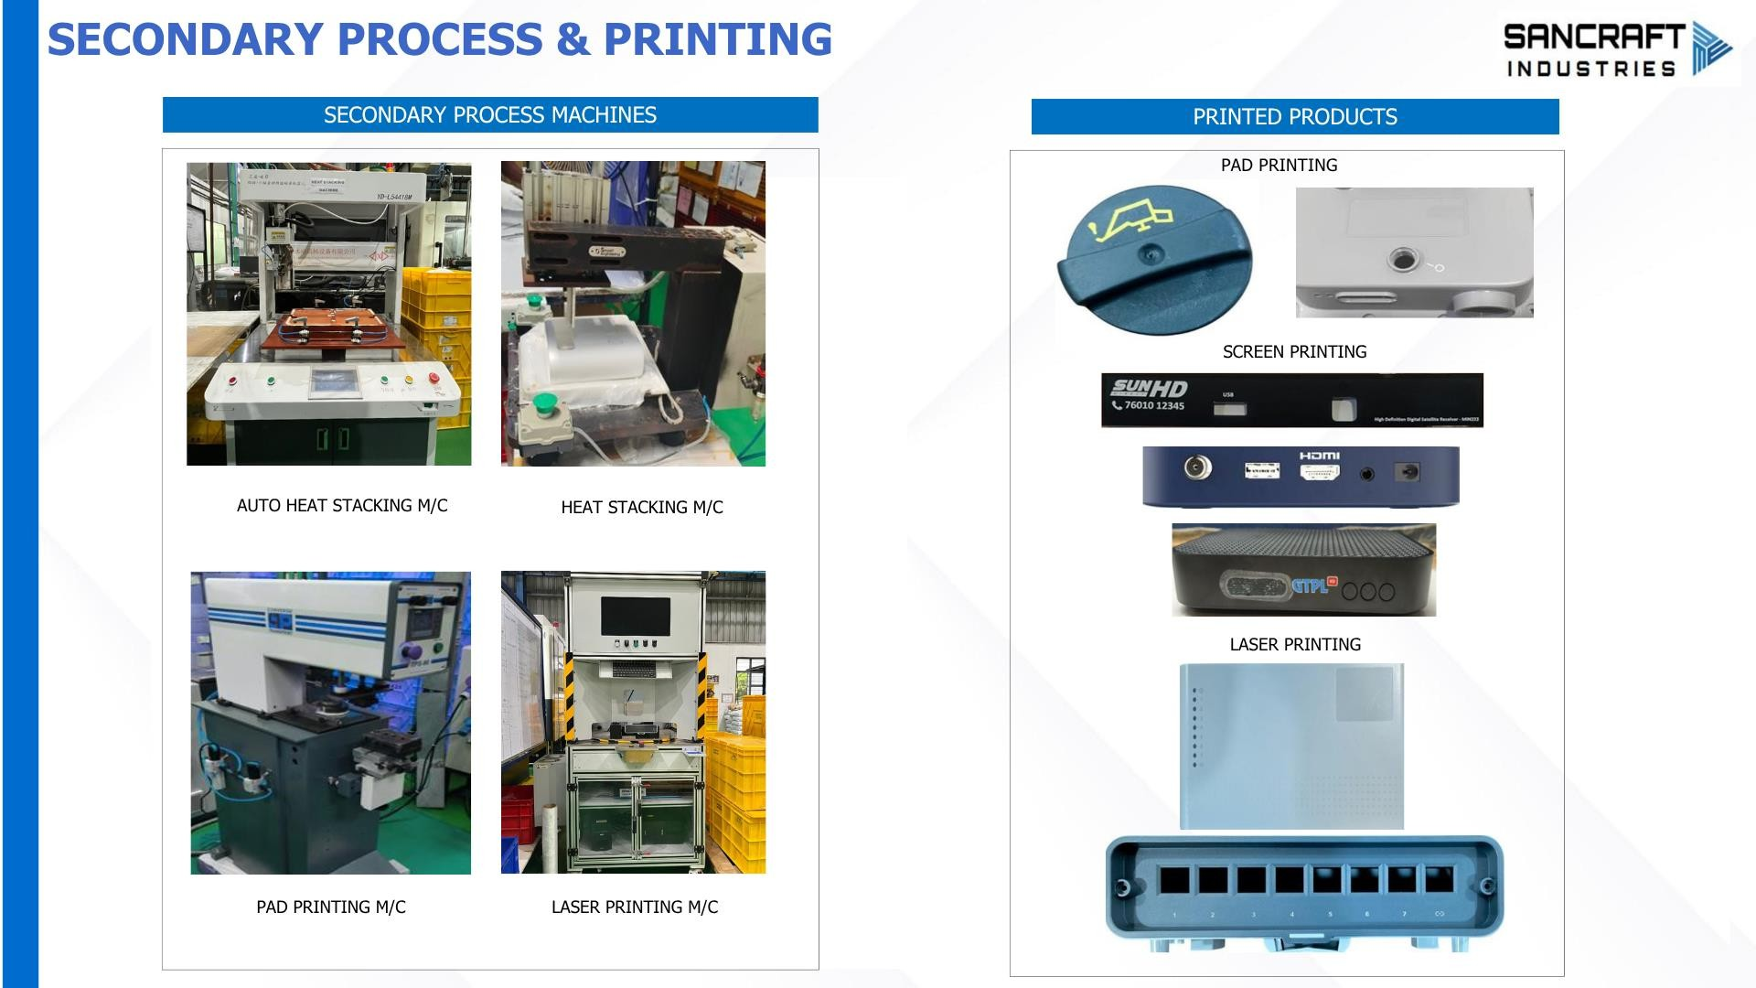


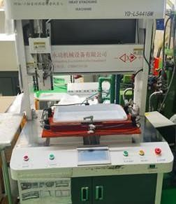
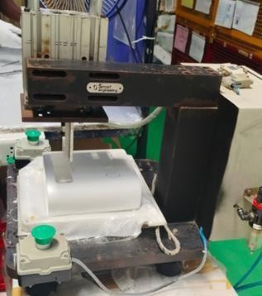

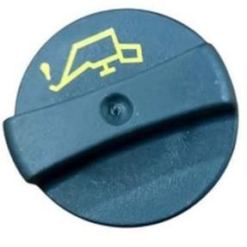
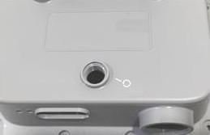


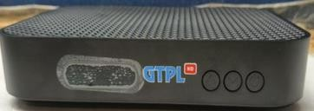
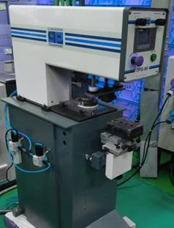
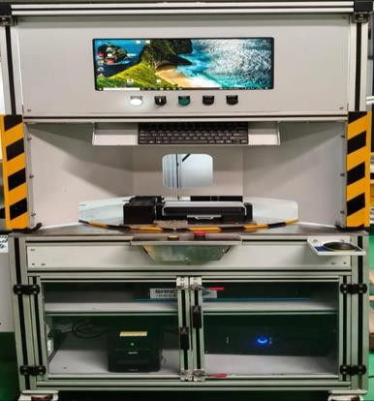

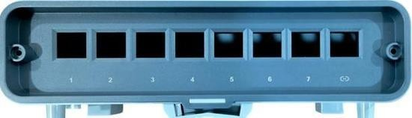
SECONDARY PROCESS & PRINTING
SECONDARY PROCESS MACHINES
PRINTED PRODUCTS
PAD PRINTING
SCREEN PRINTING
AUTO HEAT STACKING M/C
HEAT STACKING M/C
LASER PRINTING
PAD PRINTING M/C
LASER PRINTING M/C

Slide 11

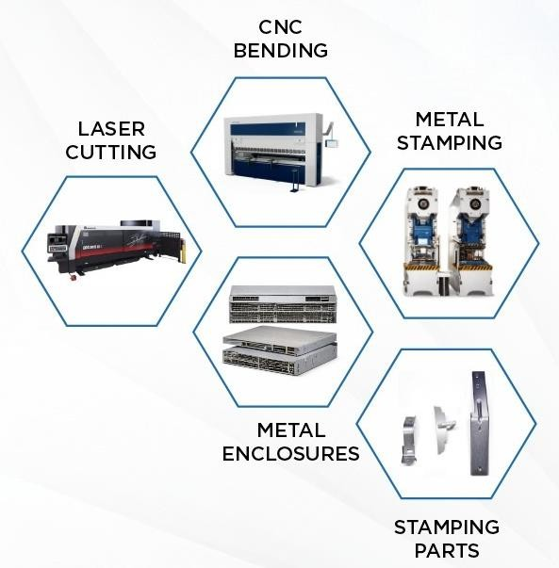
METAL STAMPING & ENCLOSURE TECHNOLOGY MACHINES
LASER CUTTING AMADA Make – 1 No.
Plan – Add min 2 more M/c 2026-27
CNC BENDING TRUMPF Make – 1 No.
Plan – Add min 2 more M/c 2026-27
METAL STAMPING
ISGEC Make – 4 Nos.
Plan – Add min 4 more M/c 2026-27
TURRET PUNCH
To be added in Aug 2026

Slide 12

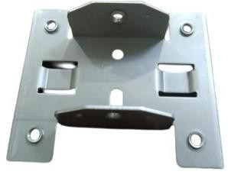
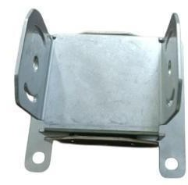
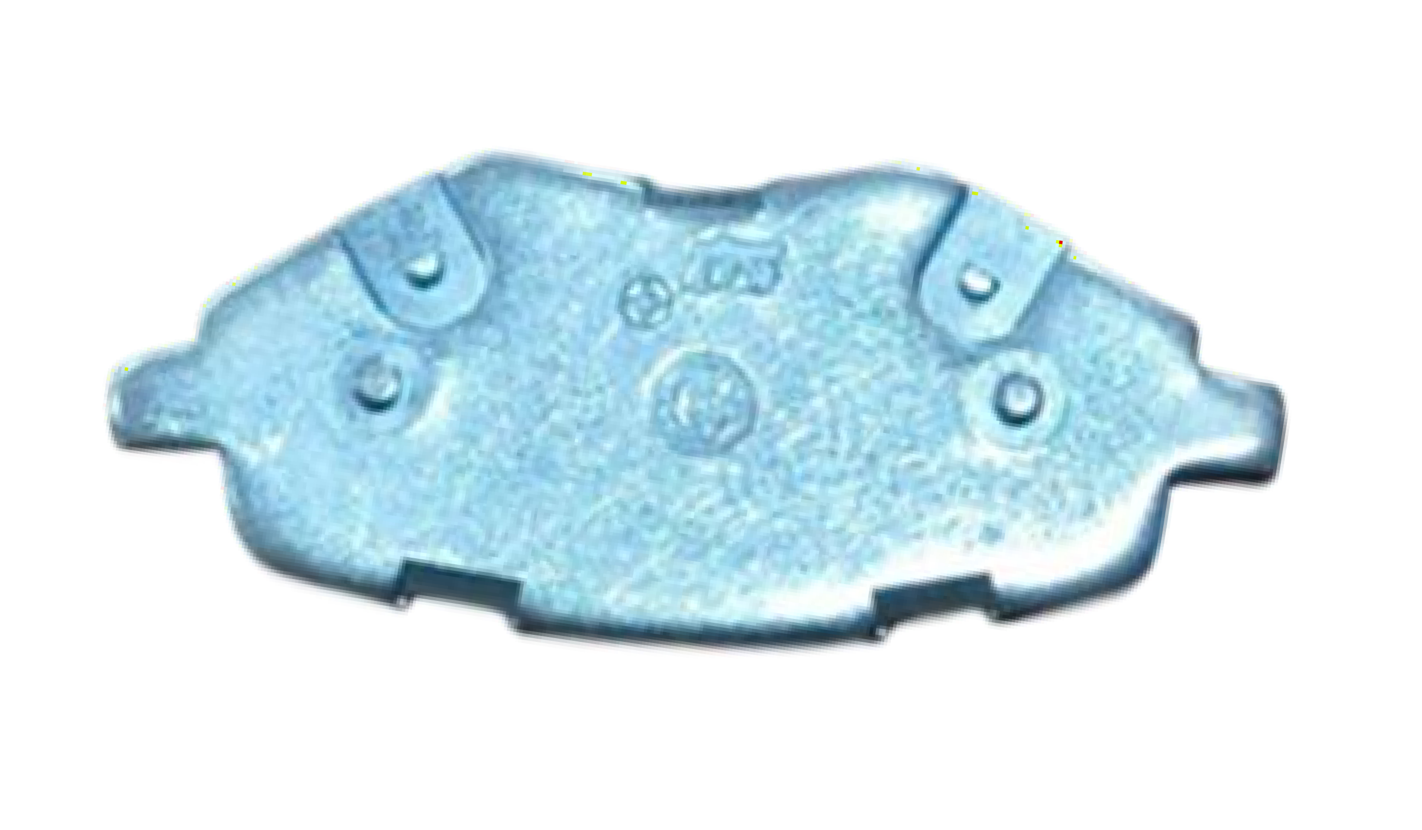
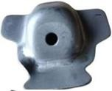
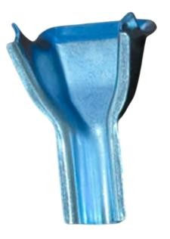
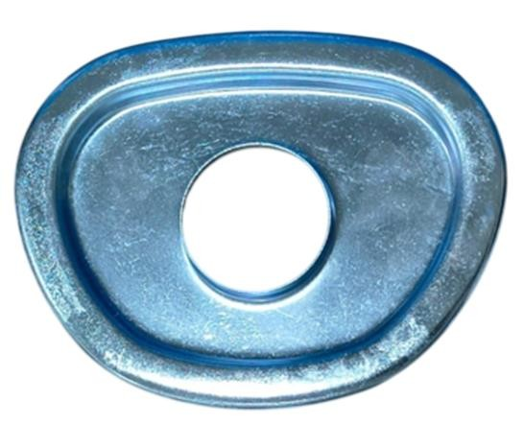
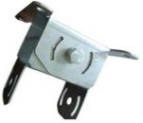
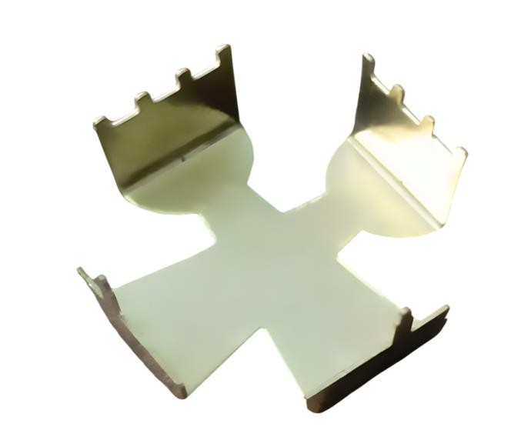
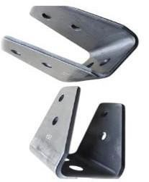
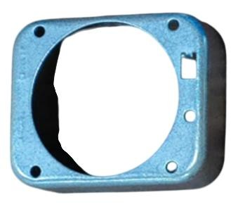


METAL STAMPING

Slide 13















METAL STAMPING & ENCLOSURE

Slide 14









TOOL ROOM MACHINES
VMC MILLING
ELECTRICAL DISCHARGE MACHINE
MEASURING EQUIPMENT
PUNCH FORMER COLLETS
V BLOCK
VMC -COSMOS
EDM –MIRRORDICK
SINE TABLE
DIAL STAND

Slide 15













SANCRAFT IN HOUSE MOLDS
MOLD FOR JIO SET TOP BOX
MOLD FOR JIO PHONE NEXT CASE
MOLDS FOR NEW PRODUCTS
TOOL MANUFACTURED BY SANCRAFT-INHOUSE
PHONE CASE TRANSPARENT
PHONE CASE BLUE
TOOL MANUFACTURED BY SANCRAFT
SET TOP BOX PARTS TOP & BOTTOM FAMILY MOLD

Slide 16

















TOOLS & MACHINES
TOOL DESIGN & MANUFACTURING
TOOLS SPARES MANUFACTURING
CONVENTIONAL MACHINES
SOLIDWORKS SOFTWARE
MILLING
LATHE
SURFACE GRINDING
ULTRASONIC CLEANING
VISUAL MEASURING MACHINE

Slide 17



























QUALITY LAB & MEASURING INSTRUMENTS
QUALITY EQUIPMENTS
MEASURING INSTRUMENTS
LAB & MEASURING INSTRUMENTS
MELT SLIP GAGE SET
( 0.5 ~ 100 M M )INDEX
PINGAGE SET (0.50~ 5.00MM)
SURFACE TABLE+HEIGHT GAUGE(0~600MM
MOISTURE ANALYZER
BALL DROP TESTER
VMM
MELT FLOW INDEX
DIGITAL VERNIER CALIPER – REAL TIME DATA CAPTURE
MICROMETER–REAL TIMEDATA CAPTURE
ELECTRONIC WEIGHING MACHINE
DIGITAL VERNIER CALIPER
BALL PRESSURE TEST
APPARATUS
FLAMMABILITY
COLOR SPECTRO METER
GLOSS METER
ROUGHNESS TESTER
COMPARATOR
FEELER GAUGE
MICROMETER
FORCE MEASUREMENT IMADA

Slide 18













CERTIFICATIONS & AWARDS
ISO9001:2015 IS0 14001: 2015
ISO 45001:2018
IATF 16949
SALCOMP BEST SUPPLIER AWARD 2018
SCHNEIDER BEST KAIZEN / APPRECIATION AWARD 2024-2025
BEST KAIZEN WINNER – YEAR 2024
BEST KAIZEN WINNER – YEAR 2025

Slide 19



EXPANSION–NEW FACTORY BUILDING
Existing Factory Building
New Factory Building G+1 Floor
New Admin Building
G+3 Floors

