Slide 1


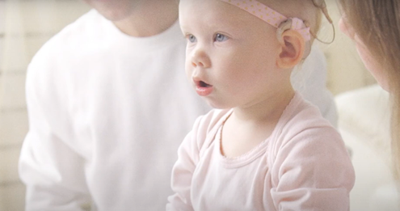
We believe in the transformative power of creating connections. We use innovation, engineering excellence, commitment to quality and reliability and superior customer experience to improve communication, elevate experiences, and engage and inspire people everywhere.
ENRICHING EVERYDAY LIFE
CREATING A SAFER FUTURE
HELPING MAKE EVERY DAY A MIRACLE
Smart wearables enabled by Molex micro connectors keep a constant pulse on critical health stats—so people stay well and active.
What’s around the corner? No need to worry about a cyclist ahead because the car already knows—Molex-enabled V2X technology makes it possible.
She’s hearing her mother’s voice for the very first time—thanks to a special implant made with Molex components.

