Slide 1


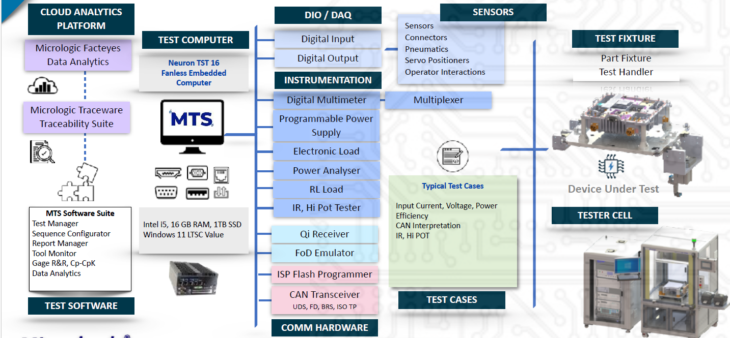
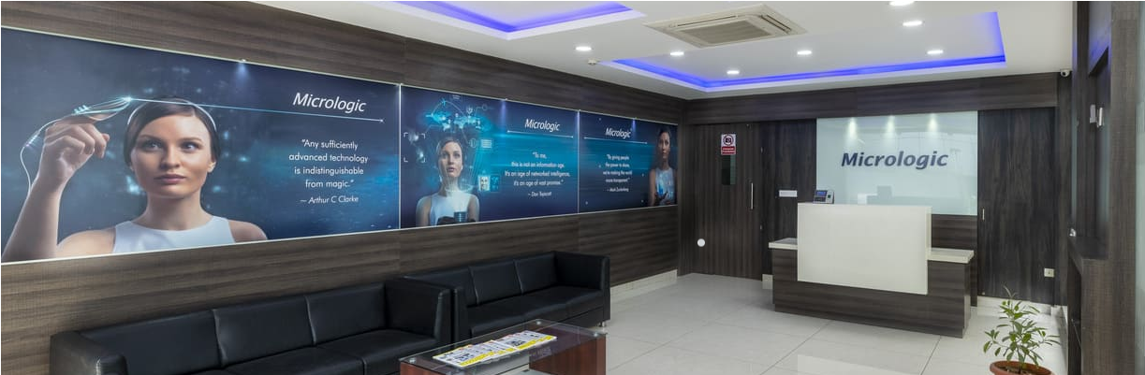
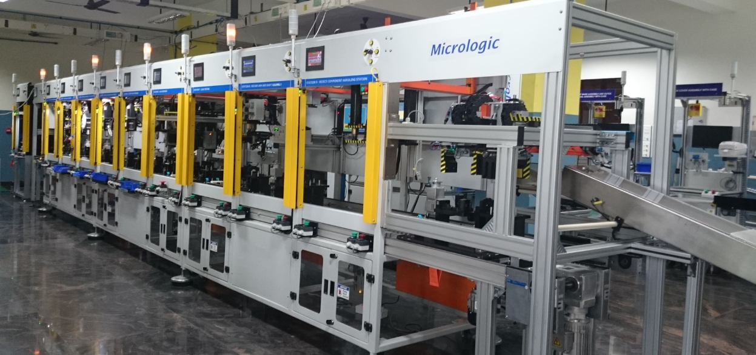
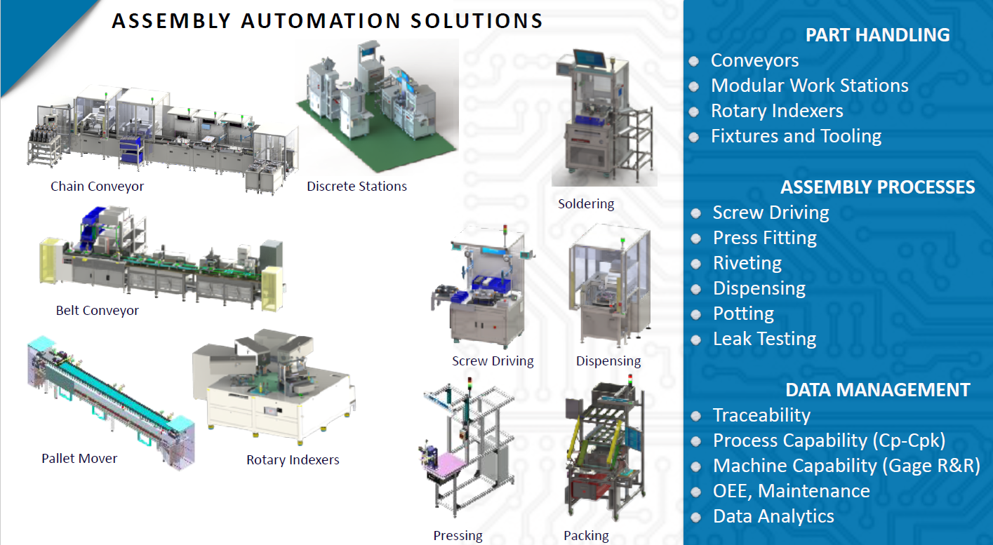
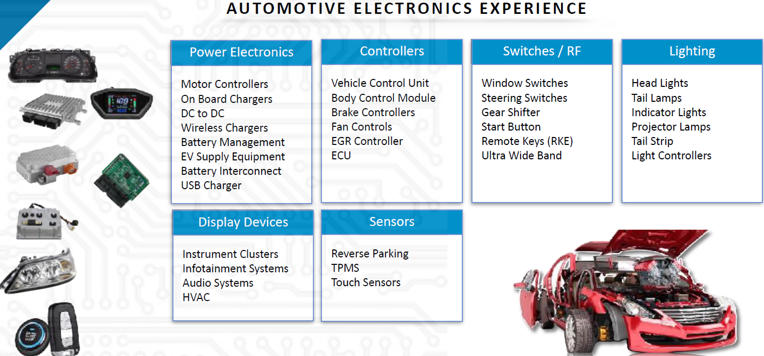
Smart Manufacturing, Industrial Automation
& Digital Transformation
About:
Micrologic Integrated Systems (P) Ltd
Founded in 2006
Locations – India , USA
2000+ Installations,
ISO 9001:2015 Certified
Solutions:
Assembly Automation
Automated Testing
Digital Transformation
Traceability
Products:
Test Cells
Assembly Cells
Robotic Cells
Control Systems
RF Shield Chambers
BON Pictures
MTS
Traceware
FACTEYES
Industry Verticals
Automotive
Electric Vehicle
Electrical & Electronics
Medical Devices
Contact:
#22-D1, "Micrologic Drive", KIADB Industrial Area 1st Phase, Kumbalagodu, Off Bengaluru - Mysuru Highway (NH275),
Bengaluru 560074, India
+91 9556321132
info@micrologicglobal.com
Visit us
FUNCTIONAL BLOCK OF A MTS TESTER
Business Value :
Increased efficiency and Productivity
Execution excellence and enhanced quality,
Increased throughput and reduced downtime
Optimize Cost of investment with automated production

