Slide 1
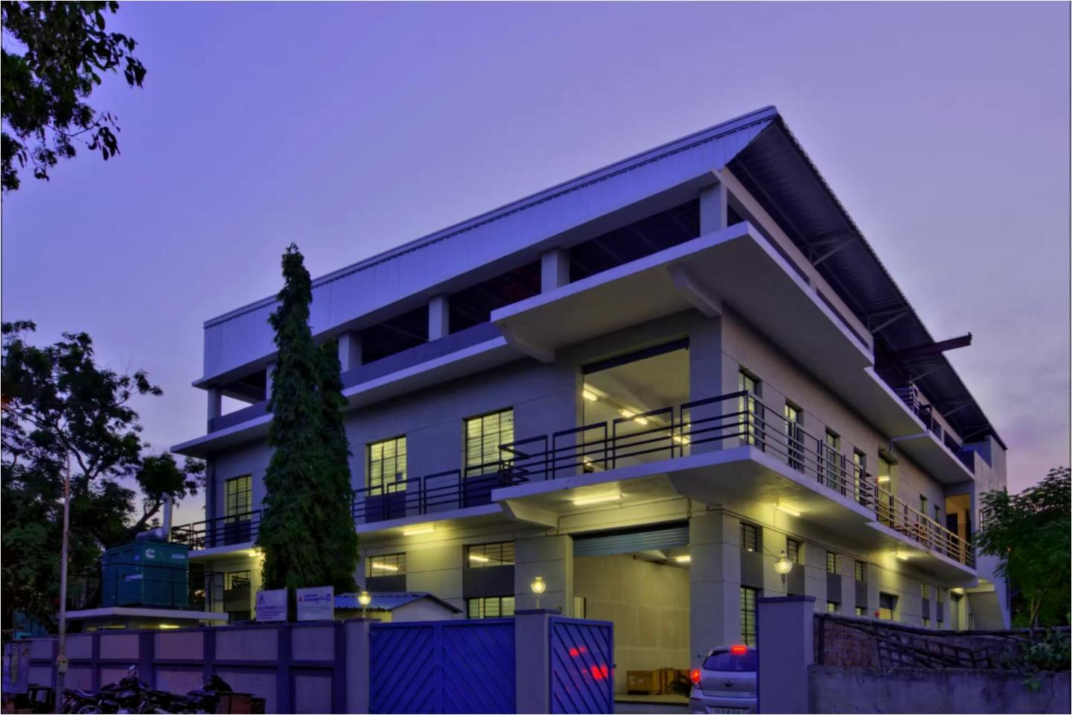


Ability Engineering private limited
Manufacturing of:
EMS Industries Fixtures
Near net Shape cold forge dies
Warm Forging Dies
Cold Forming bevel gear dies
Carbide die for bevel gear warm forge
www.abilityengg.in

Slide 2

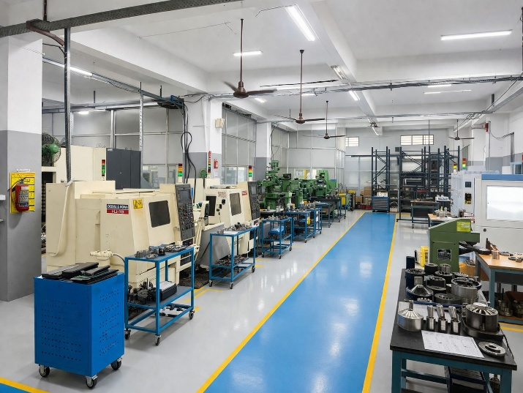
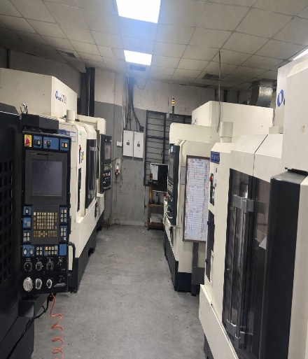
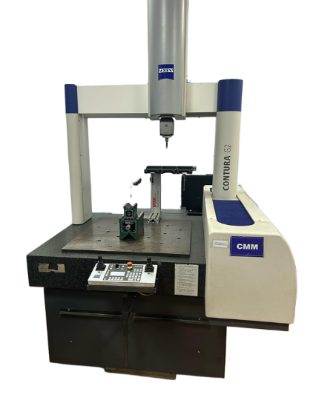
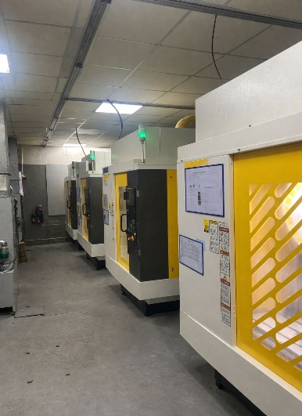
Legacy
For over 18 years, Ability Engineering Pvt Ltd has been a trusted leader in the manufacturing of Forging dies and EMS Fixtures We have built a strong reputation for excellence through our unwavering commitment to quality, precision, and customer satisfaction.
Our team takes pride in delivering a seamless experience at every stage—right from initial consultation and manufacturing to production and final delivery. By combining advanced manufacturing capabilities with dedicated customer support, we ensure that every product meets the highest standards and exceeds client expectations.
www.abilityengg.in

Slide 3

Vision & Mission
Vision
To become a leading manufacturing company, recognized for innovative and sustainable solutions that meet the evolving needs of our customers, while promoting growth and prosperity for all stakeholders.
Mission
Our mission is to consistently deliver high-quality, cost-effective products and services that exceed our customers' expectations. We strive to foster a culture of innovation, collaboration, and continuous improvement, empowering our employees to grow and succeed in a dynamic and challenging industry.
www.abilityengg.in

Slide 4
Our Competitive Edge
End-to-End Service
from Design to Delivery
Fully Integrated SAP
On-Time Delivery
Proactive Client Engagement
Efficient cost-saving
www.abilityengg.in

Slide 5
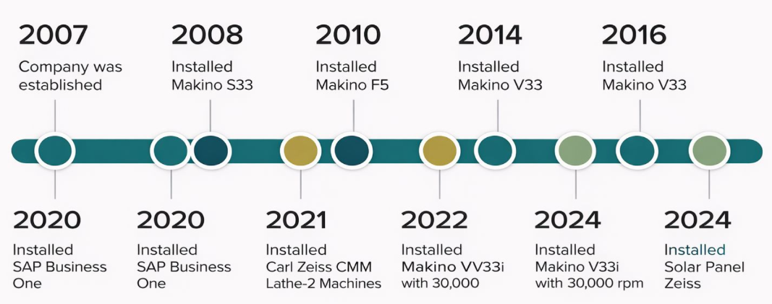
Milestone
www.abilityengg.in

Slide 6
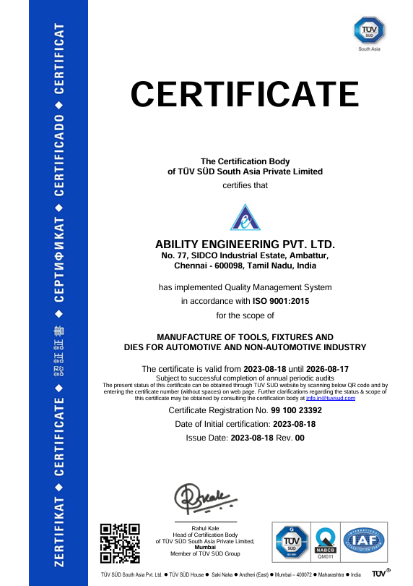
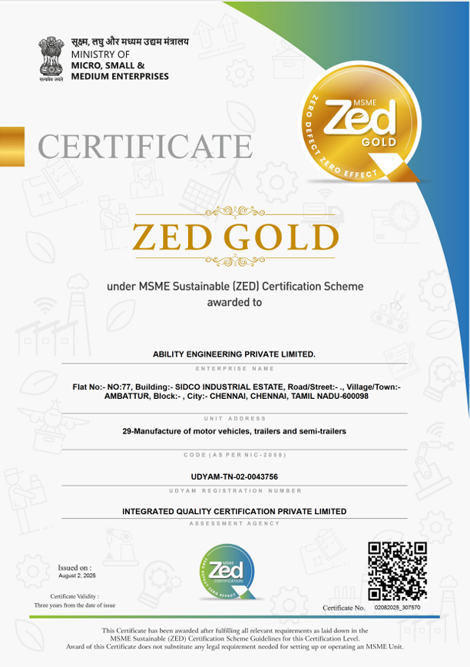
Certifications
Our products are certified to ISO 9001:2015 and ZED Gold standards, ensuring world-class quality for the automotive industry.
Furthermore, our advanced inspection facilities—including CMM machines, contour measuring machines, surface testers, and profile projectors—ensure precision, accuracy, and consistency in every product we deliver.
www.abilityengg.in

Slide 7
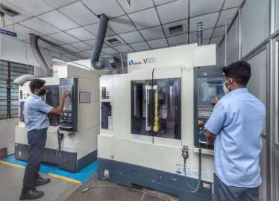
Manufacturing Facilities
Our VMC Facility includes 10000RPM TO 30000RPM
We are equipped with CNC lathes, VMCs,
Surface Grinding, cylindrical grinding, wire cut and M1TR ensure exceptional precision and excellence in every project.
www.abilityengg.in

Slide 8
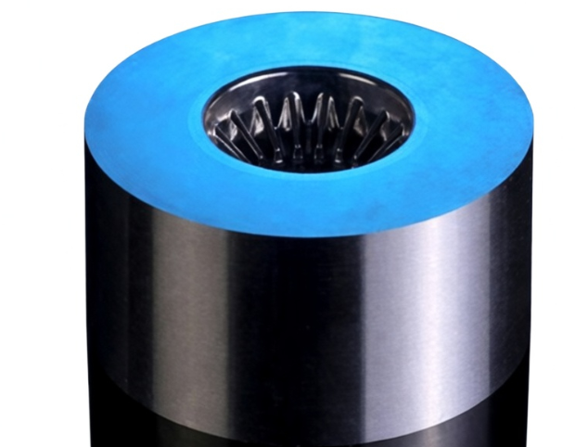
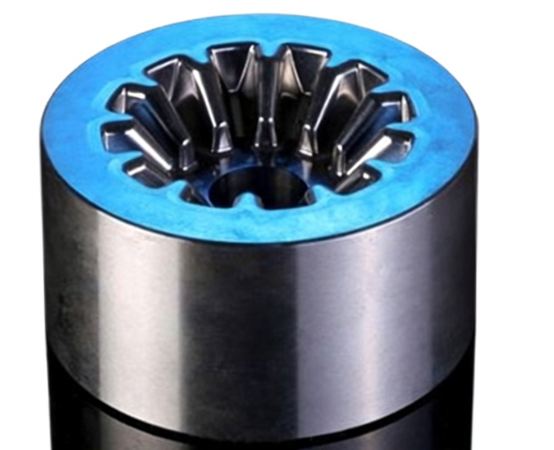
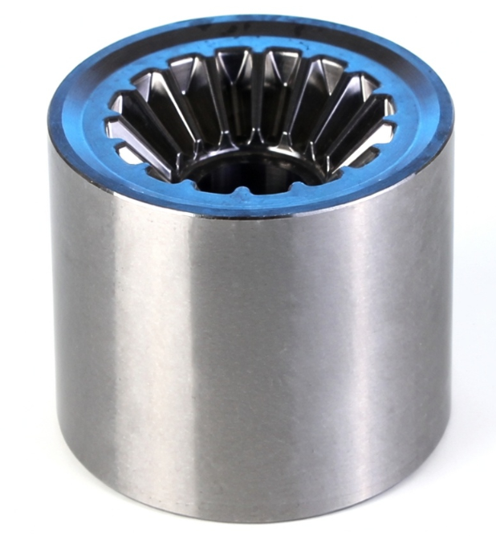
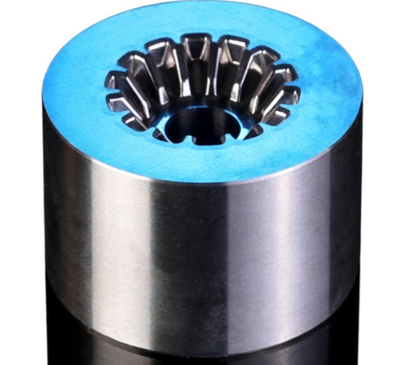
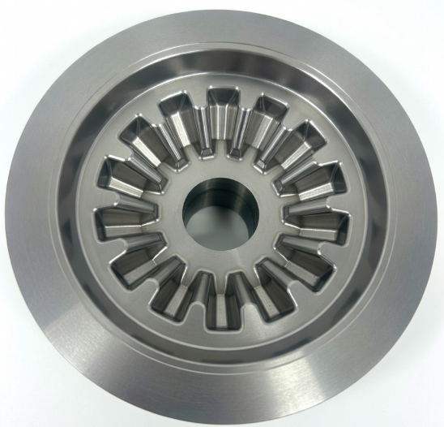
Cold forging die
www.abilityengg.in

Slide 9
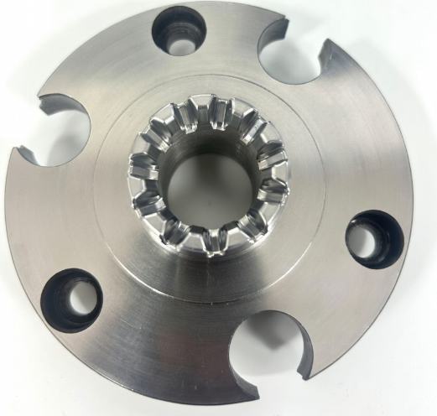
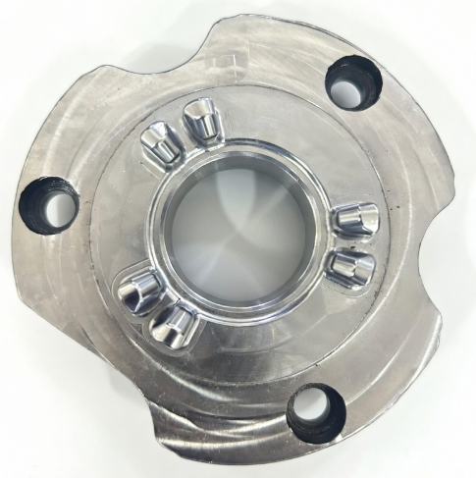
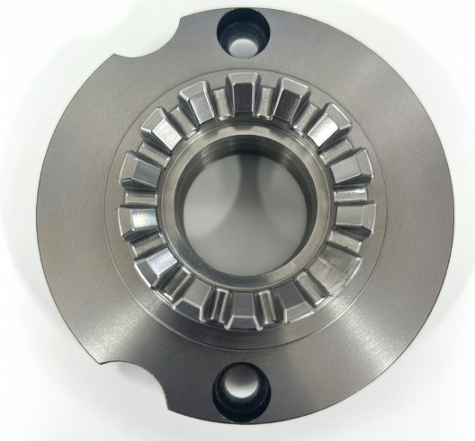
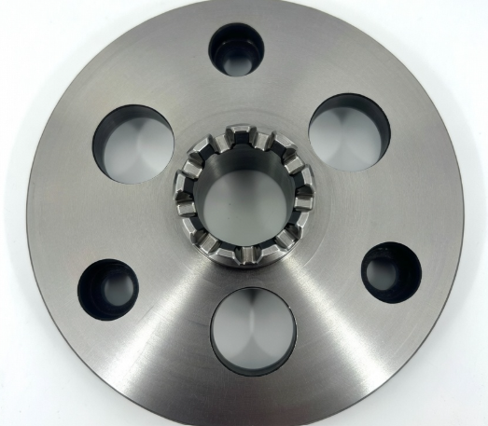
Bevel Gear fixture
www.abilityengg.in

Slide 10
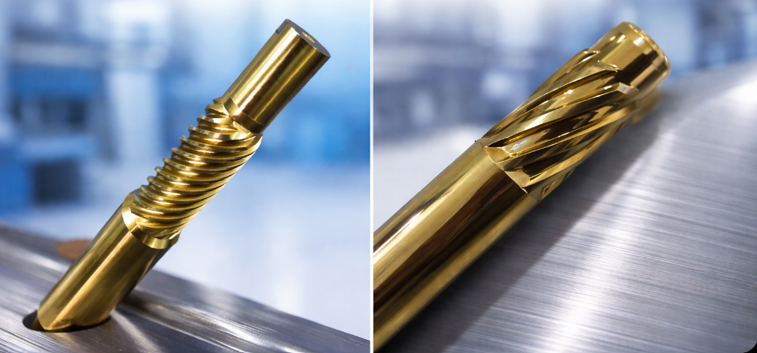
Cold forging Helical punch
www.abilityengg.in

Slide 11
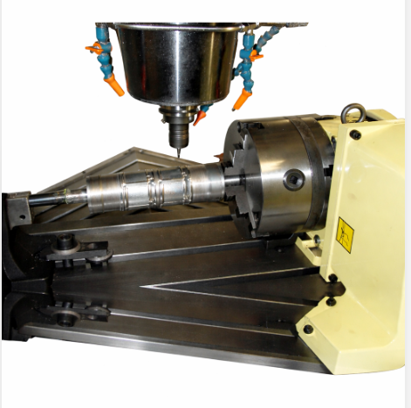
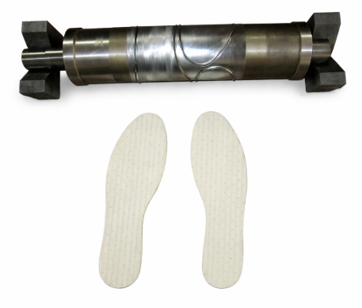
Rotary die machining
www.abilityengg.in

Slide 12
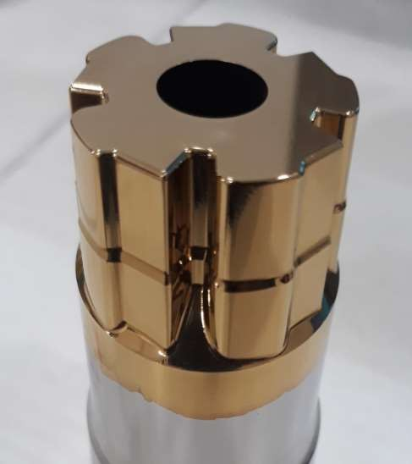
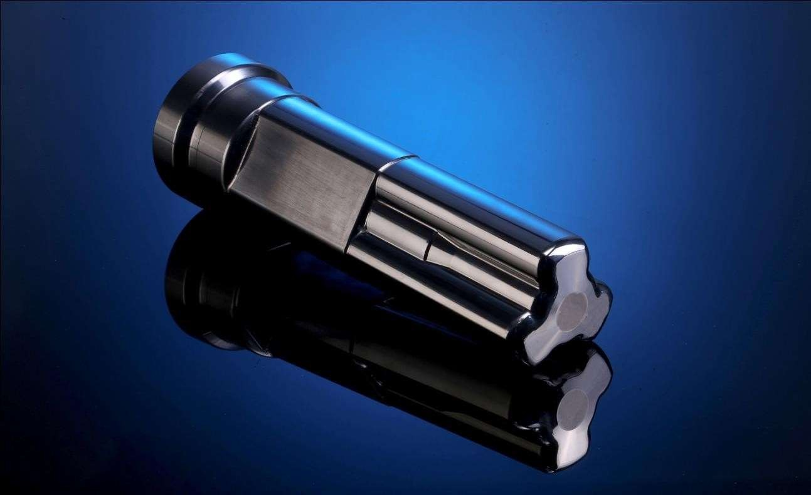
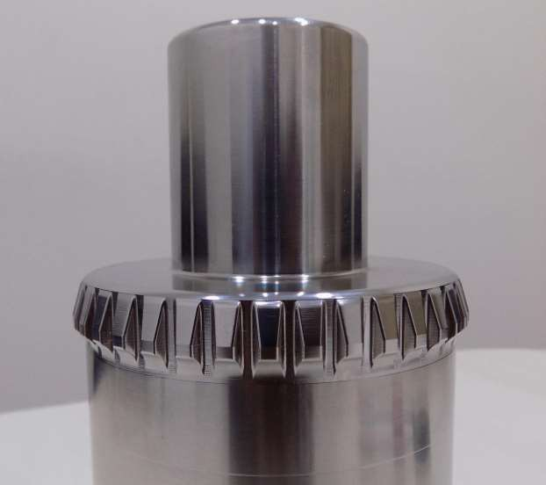
Cold forging punch
www.abilityengg.in

Slide 13
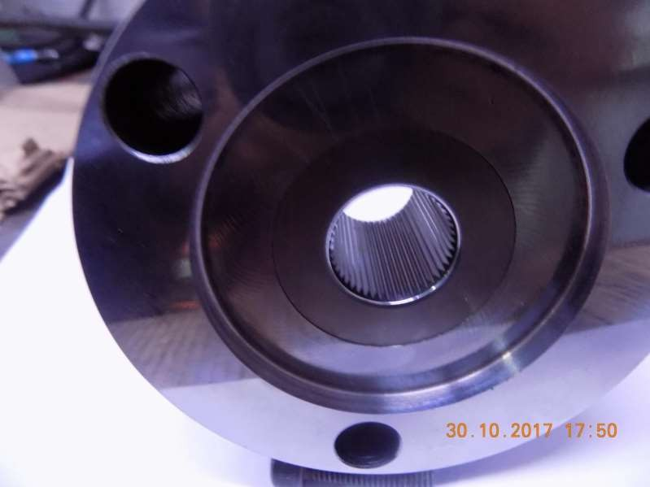
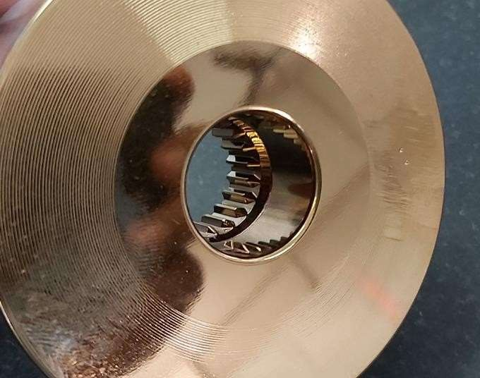
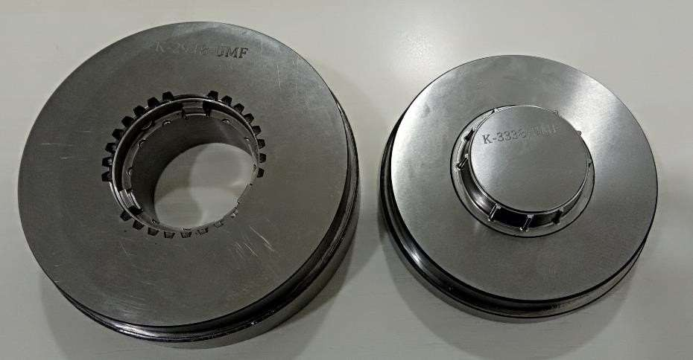
Internal spline dies & Synchronizer Ring dies
www.abilityengg.in

Slide 14
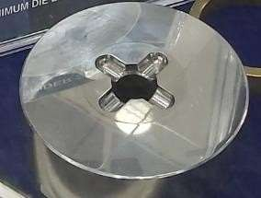
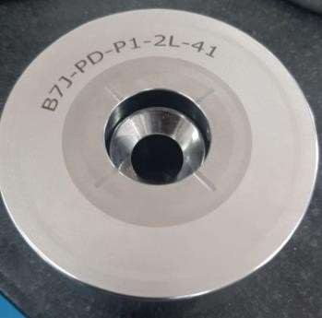
Carbide die for Spinder & Carbide extrusion die
www.abilityengg.in

Slide 15
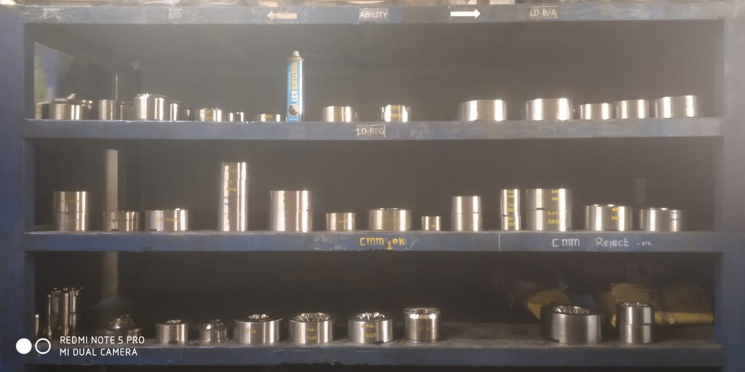
We are maintaining a two-bin system at the customer’s end

Slide 16









CUSTOMER
www.abilityengg.in

Slide 17
Ability engineering private limited,
No77,Sidco Industrial Estate, Ambattur,
Chennai-600098
Contact
+ 91 9841752281
Mail info@abilityengg.com

