Slide 1


Group Automation

Slide 2
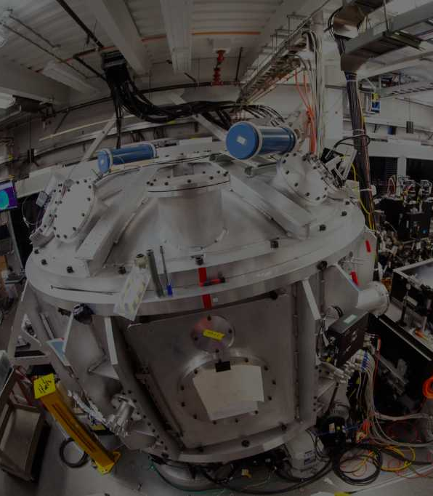





Group at a glance
1986
1991
$10M
20
Revenue
Technology partners
2006
100+
1500+
2013
Team members
Customers served
2016

Slide 3


Group at a glance
Providing an extensive range of test and measurement solutions to support customer in their design, development, maintenance & validation process
In-house built to print and development facility for space-grade electronics, RF-subsystems, satellite communication solutions and hydro-met products.
Customized calibration management solutions and automated DC to RF devices characterization solutions, supporting multi-vendor products.
A quality focused organisation in precision calibration instruments, service and software for temperature, humidity and pressure.
Joint Venture (marketing) with Kyoritsu Japan for providing low and medium voltage test products and solutions to the Indian market.

Slide 4
Business at a glance
Solutions
Manufacturing
Services
Industrial
Institutional
Aerospace
& Defense

Slide 5
Solutions at a glance
Solutions 1. Electrical and Electronic test and measurement solutions for design to validation
2. RF products and solutions
Manufacturing
Services
Control and Acquisition systems
RF subsystems for satellites
Wireless telemetry system
Hydrometeorology products
RF(Mic) Assembly
RF Optimization & testing
PCB Assembly, Optimization & testing
Package Integration Optimization & testing
DC/RF Cable, harness, assembly, routing
Package stacking, subsystem integration
Integrated subsystem testing
Test & Evaluation of packages & subsystems
Mechanical compatibility/fitting
Sub-assembly fabrication

Slide 6

Group Fundamentals
Operational excellence
Our Mission
Our Strength
VISION
Our Values
Strong position in target markets
Leader in technology & innovation
Facilities
Team
Customer process
AMBITION

Slide 7
Our Vision
“Our vision is to be the benchmark and partner of choice in Aerospace and Defense — advancing mission frontiers with next-generation Test & Measurement, Space Vision Systems, and high-reliability electronics, delivering customer-driven innovation that defines precision, safety, and performance.”
Notes:
The functioning of our increasing high tech world relies on constant & accurate testing and measurement.
Ensuring reliability under extreme conditions while reducing size, costs and weight is the future of aerospace & defence.

Slide 8
Our Mission
Be a trusted technology partner delivering mission-critical Test & Measurement, Automation, and High-Reliability Electronics.
Create customer success through system expertise, vendor-neutral solutions, and lifecycle support.
Advance innovation with indigenous R&D, space imaging, and next-generation aerospace & defence technologies.
Empower people and processes to achieve excellence, compliance, and sustainable growth.

Slide 9
Our Strengths
Domain experts team dedicated to provide technical inputs
We sell only when the product/ solution adds massive value to the customer
Regional presence in all parts of India
Pan India
Operations
Customer relationship
Solution based approach
Customer
in-depth understanding
Value added selling
Vendor
Registrations
Focus on long term relationship development across all positions (management -> end user)
Understanding customer needs, desires, problems culture and processes.
Registered with all major government accounts;
Strong GeM operations

Slide 10




Our Values
WIN – WIN – WIN
We work with WIN – WIN – WIN (Customer – Team – Partner) philosophy.
ACCOUNTABLE
We take ownership and deliver what we promise.
PASSIONATE
We strive beyond what is expected out of us.
COMPLIANT
We collaborate with honesty and transparency.

Slide 11





Facilities
Infrastructure
3 R&D Labs, 2 Hi-Rel Production Facilities
ESD Safe working area
High Reliability component storage
Certifications: ISRO-PAS-200; ISRO-PAS-202; ISRO-PAS-207; ISRO-PAX-300; ISRO-PAX-304; ISRO-PAS-400
Labs
ISRO Qualified Class 1,00,000; 10,000; Clean room labs
Quality Control & Assurance lab
Software tools
PCB design & simulation tools
Mechanical Design & simulation tools
FPGA-CPLD & Microcontroller development tools
Testing facilities
Burnt-in chamber
Temperature cycling chamber
Thermal vacuum chamber
Electro-dynamic vibration test system
Life test system
Equipment's
Signal Analyzer, Spectrum and Network Analyzer.
Noise Figure Measurement
Power sensor
6-1/2 Digital Multimeters
Variable Power Supply
DC Load meter, Current meters
Bonder- Ribbon Bonding
Bonder (Hughes) For 20mil Ribbon Bonding
Wedge Bonder (Hybond) For 1mil Wire

Slide 12



Komoline Aerospace at a Glance
Established in 1991, Komoline Aerospace Limited has been at the forefront of innovation in the fields of Aerospace, Defense and Hydro-Metrology
1000+ Subsystems
50+ Payloads
1000+ Automatic Weather Stations
50+ Clients
Over three decades of building mission-critical Aerospace & Defense Systems
Notes:
Facility – constantly upgraded as per customers requirements & as for partner collaborations
We are open to upgradation as required

Slide 13




Core Capabilities & Expertise
Space Payloads & Sensors
Electro-optical sensors, Remote Sensing
RF & Microwave Systems
EPC, TWT Amplifiers, Telecom & Navigation payloads
Ground Systems
Checkout instrumentation, System Integration
Weather & Environmental Systems
Automatic Weather Stations, Hydro-Met solutions
Expertise powered by ex-ISRO talent & 30+ years of Aerospace Heritage
Notes:
Facility – constantly upgraded as per customers requirements & as for partner collaborations
We are open to upgradation as required

Slide 14
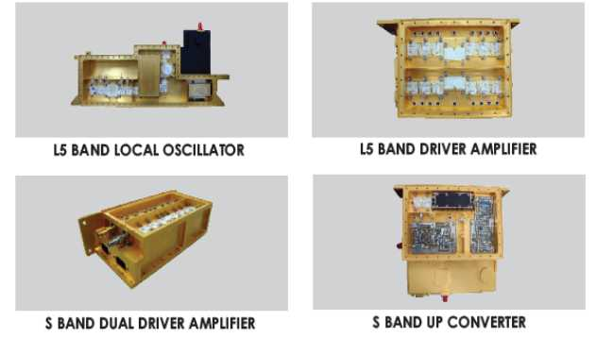
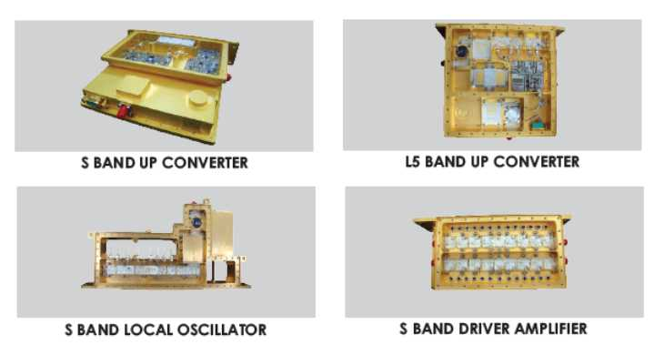
Facility’s Space Heritage
Key Flight Hardware Heritage
• Subsystems delivered to ISRO for communication & navigation payloads, Amplifiers, Oscillators, Up/Down Converters in 1000+ flight-qualified subsystems delivered.
Satellite Programs
• INSAT Series (4A, 4B, 4C, 3D)
• GSAT Series (3, 4, 5, 6, 7, 8, 10, 15)
• CARTOSAT
• RESOURCESAT
• OCEANSAT
• RISAT-1
• NAVIC
Exploration Missions
• Chandrayaan, • Mars Orbiter Mission (MOM) • IRNSS I & II

Slide 15
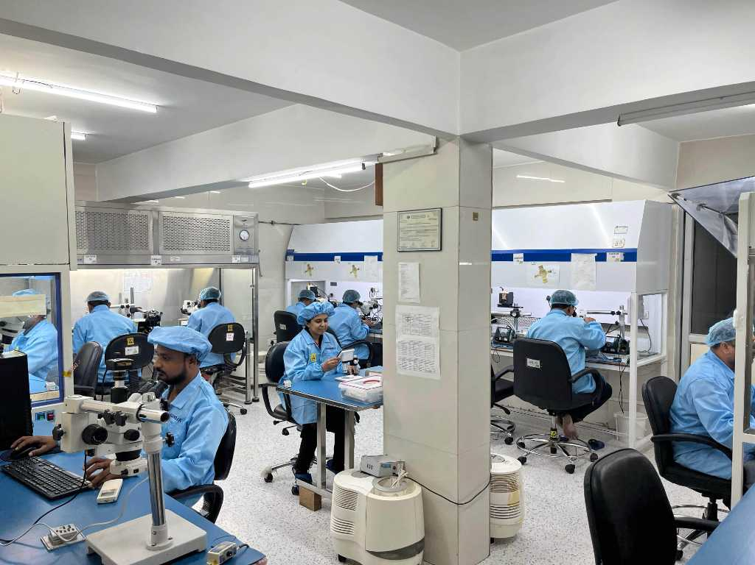
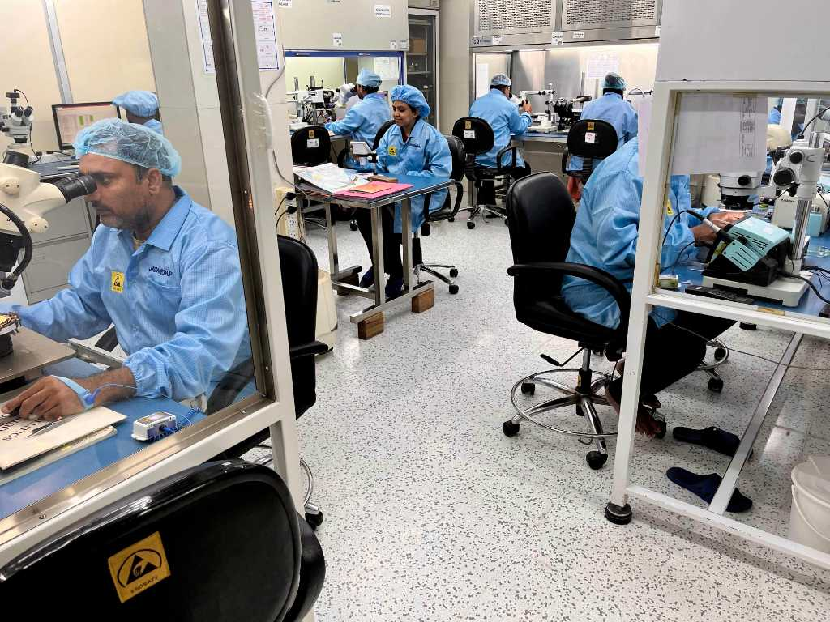
ISRO-Qualified Cleanrooms for MIC/HMIC/MMIC Packaging
“Assembly under ISO/ISRO standards”
Skilled technicians ensuring flight readiness”
“Delivering 1000+ flight-qualified subsystems to Indian space missions”
Notes:
Facility – constantly upgraded as per customers requirements & as for partner collaborations
We are open to upgradation as required

Slide 16
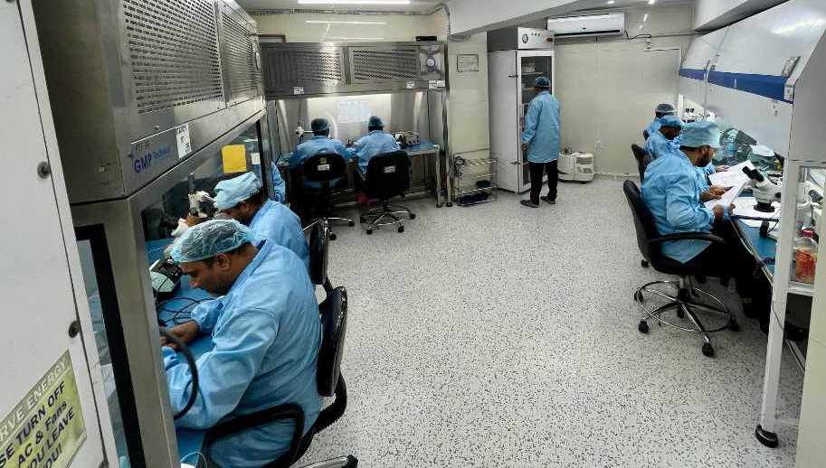
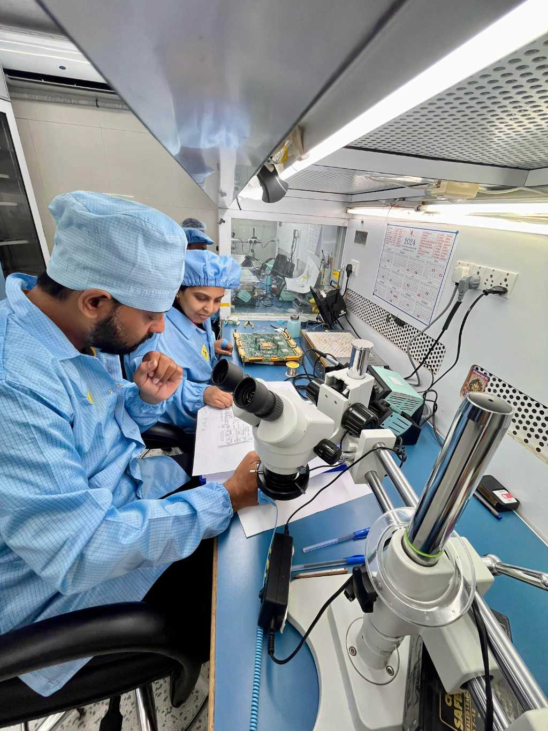
ISRO Qualified Cleanroom 100k for Payload Electronics Wiring & Assembly
“Delivering space-grade payload electronics trusted in ISRO’s flagship missions.”
Notes:
Facility – constantly upgraded as per customers requirements & as for partner collaborations
We are open to upgradation as required

Slide 17
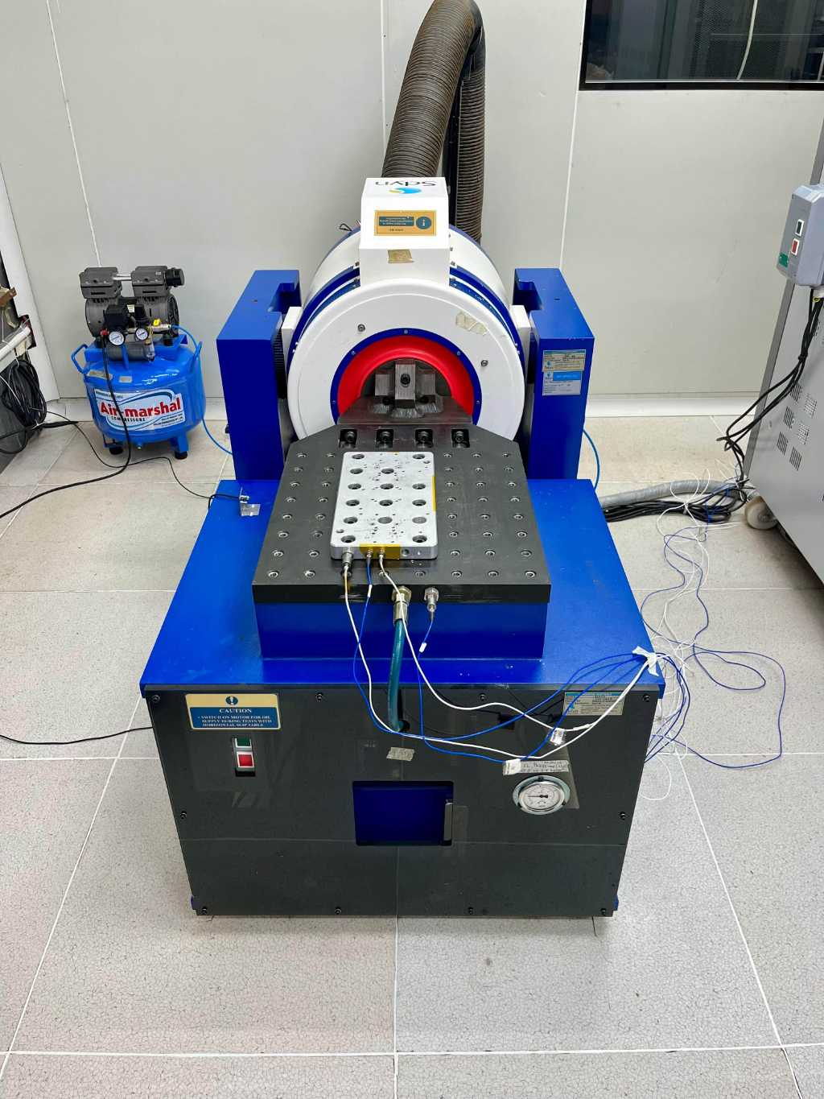
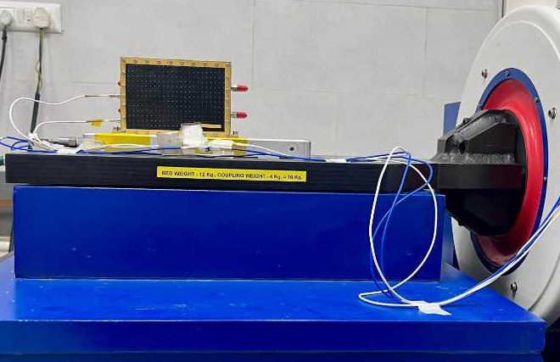
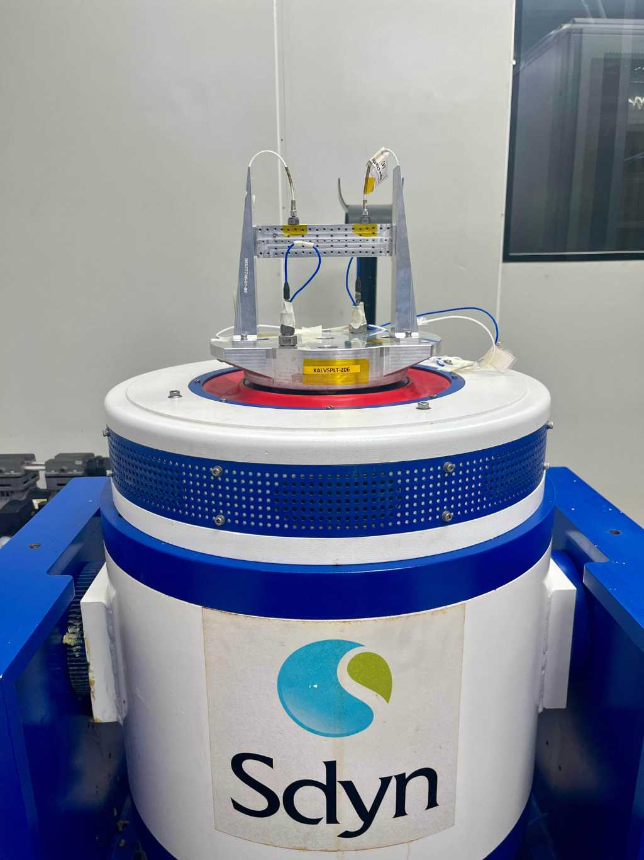
“ISRO-Qualified Vibration Testing Facility (Class 100k Cleanroom)”
“Simulates launch & flight vibration profiles to qualify aerospace subsystems for space missions.”
Notes:
Facility – constantly upgraded as per customers requirements & as for partner collaborations
We are open to upgradation as required

Slide 18
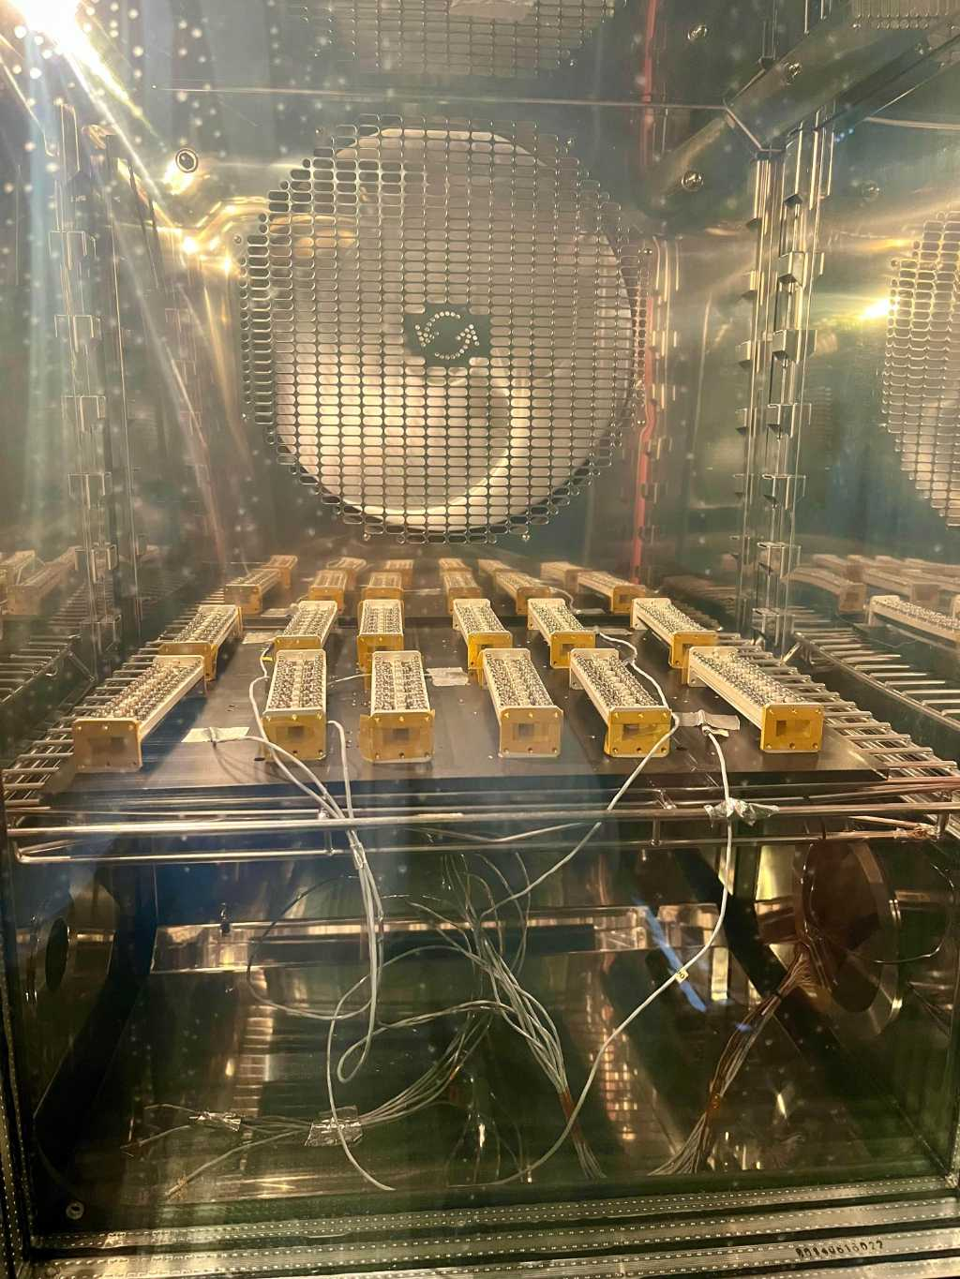
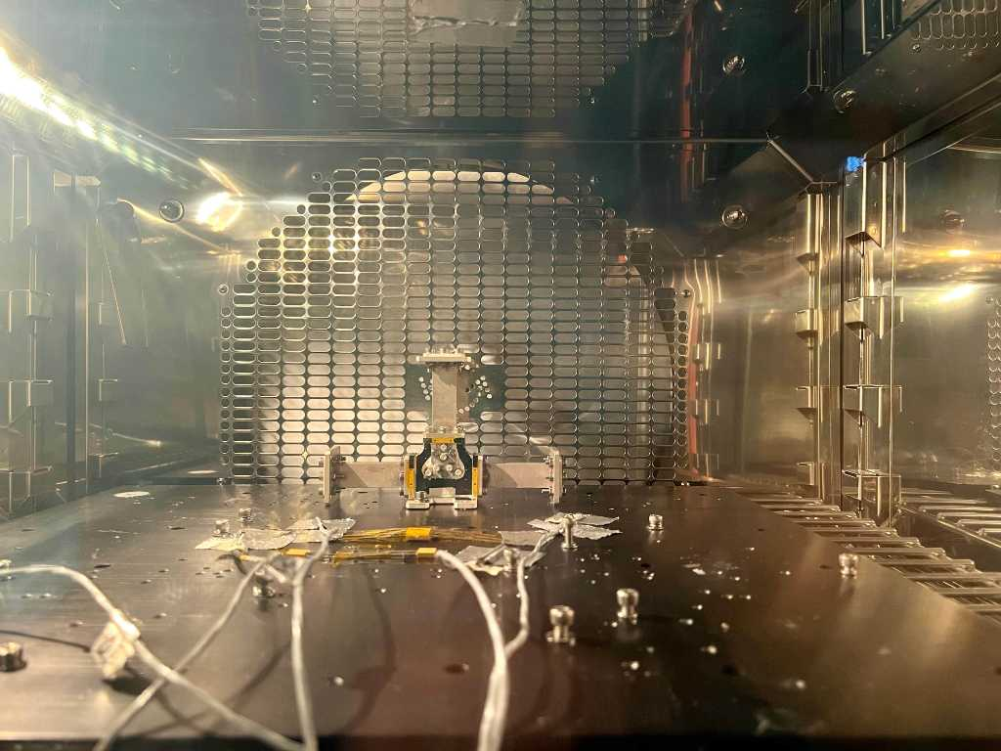
ISRO Qualified Cleanroom 100k facility for Thermal and Climatic Testing
(Climatic Chamber)
Notes:
Facility – constantly upgraded as per customers requirements & as for partner collaborations
We are open to upgradation as required

Slide 19
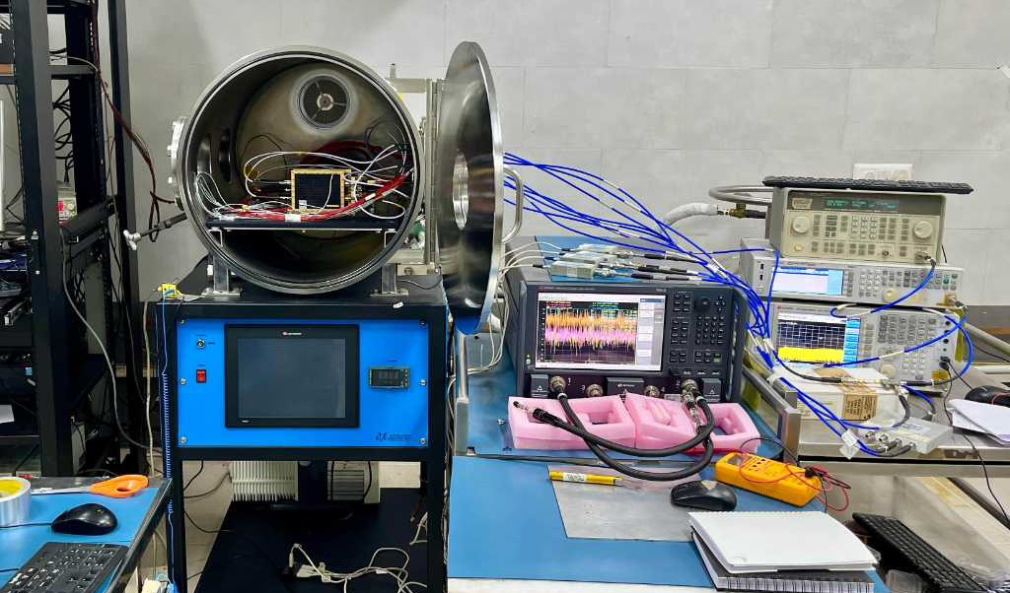
ISRO Qualified Cleanroom 100k for ThermalVacuum Testing
With Active Functional Testing Setup and Data logging
Notes:
Facility – constantly upgraded as per customers requirements & as for partner collaborations
We are open to upgradation as required

Slide 20
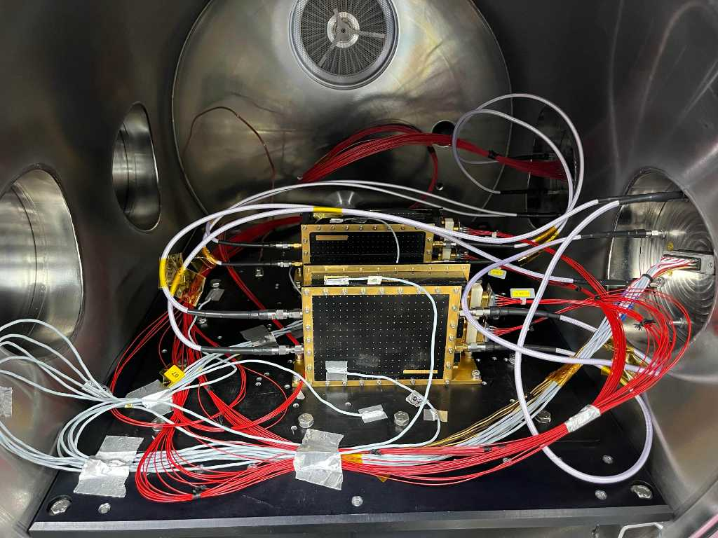
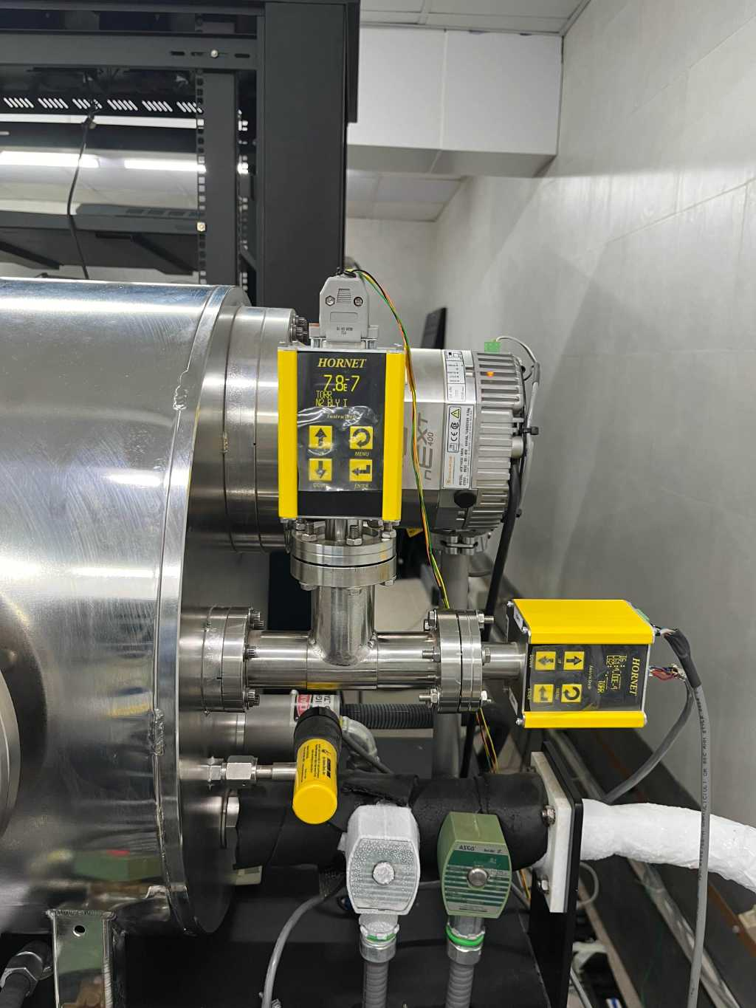
ISRO Qualified Cleanroom 100k for ThermalVacuum Testing
(Thermovacuum Chamber)
Notes:
Facility – constantly upgraded as per customers requirements & as for partner collaborations
We are open to upgradation as required

Slide 21
Team
Technical Team
Research and development team
Commercial Team
Marketing team
Application engineer team
Assembly team
Quality control team
Test and Evaluation team
Direct Sales Handling team
Channel Sales Handling team
Operations and supply chain team
Procurement team
Finance team
Technical experts (ex-ISRO) on board:
Electro optical space sensors
EPC and TWT Amplifier division
Microwave Remote Sensing Area
Ground checkout instrumentation for electro-optical payloads
Telecom & Navigation payload DC & RF equipment

Slide 22
Team – Organization Structure
Field Sales
Sales
Inside Sales
Lead Generation
Marketing
Marketing Executive
Application Engineers
Technical
Group Automation
System Integration
HR Executive
HR
Admin
Supply Chain
Finance
Storekeeping
Finance Executive
Operations
Account

Slide 23

Customer Engagement Process - Sales
Customer application mapping to technical understanding
Proof of Concept
White paper specification, comparison documentation support
Engaging during project planning development phase
Virtual trainings, Virtual Demo’s Events, Roadshows
Project foundation
Budgeting cycle
Training of the product
Retraining of the product
Service support
Calibration support
Testing support
Site preparation
System Integration
Operation Training
Setting up test process
Post - Sales
Installation

Slide 24
Customer Engagement Process – Marketing
Measure campaign success (ROI based) & put feedback into system on what works and what does not
What, When and How marketing activities are to be planned & executed
Gap Analysis, Planning
Segmentation
Prioritization, Target
Strategize
Implementation
Measure
Creatives for the campaign (emailers, WhatsApp broadcast)
Digital marketing (social media platforms)
Focused lead generation calling
Based on gaps, identify segments in focus, customer in focus & build groups with similar attributes
NPI
Promotion
Stock liquidation
Gap focused
Event focused
Based on segments and group prioritize where we want to focus on and set targets for same
Marketing mix – price/product/promotion

Slide 25










Customer – Aerospace & Defense

Slide 26















Customer - Institutional

Slide 27














Customer - Industrial

Slide 28
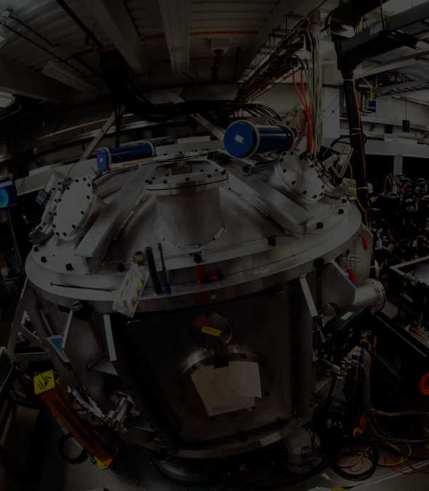
Contact Us
Headquarter
Ahmedabad, India
Email
priyanka@groupautomation.co
COMPANY NAME
con
Los Angeles California
HEADQUATER
Ahmedabad,
India
Phone
+91 99241 30840
Website
www.groupautomation.co
Regional presence across India

