Slide 1
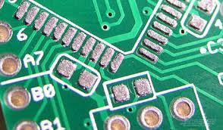
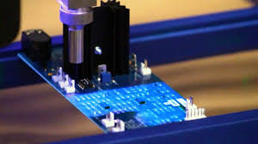
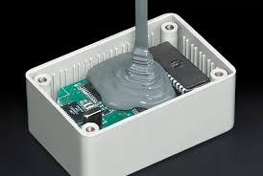
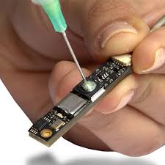
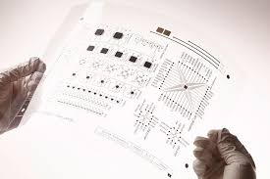
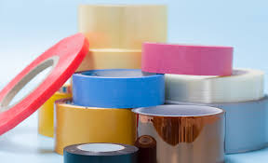
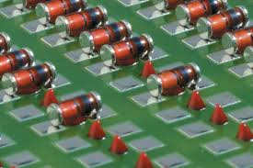

Product Range - Adhesives :
Solder
Conf Coat
Potting
Bonding
Inks
Tapes
Solder paste
Solder wire
Solder bar
Preforms
Liquid Flux
PCB cleaning
Stencil cleaning
Acrylic coating –
MIL grade
UL approved
Stripper / Remover
Masking tapes
Wet thickness gauge
Equipment –
Table top
In line fully automatic
Chemistries –
Epoxy
Silicone
PU
Type –
Single Part
Two Part
Attribute wise –
Thermally cond
UL compliant
High Temp
Cryogenic
Chemistries –
Silicone
Epoxy
Acrylic
Cyanoacrylate
UV curing
Anaerobic
Application wise –
Thermally cond
Electrically cond
Vibration dampening
Sealing
Structural bonding
Threadlocking
Silver Cond Ink
Copper Cond Ink
Carbon Cond Ink -
Water based
Solvent based
Transparent Cond
Piezoresistive
Piezoelectric
Dielectric Ink
Thermally Cond
Electrically Cond
Polymide Kapton
Polyester Cloth
Fleece Cloth
Glass Cloth
Cotton Cloth
Polyester
Acrylic Foam
Copper Foil
Aluminum Foil
Aluminum Fibre Glass
Masking Paper
Butyl
Cross Filament
Holding
Duct Tape
Anti Skid
Floor Marking
SMT Glue
Threebond printing glue – TB2217H

Slide 2
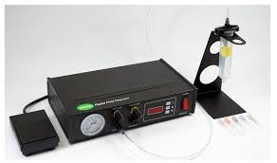
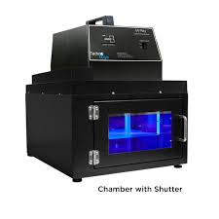
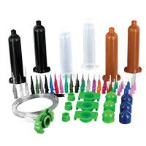
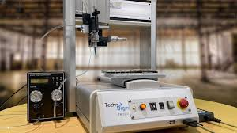
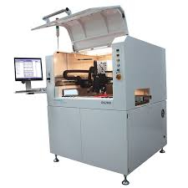
Product Range - Equipment :
Semi Auto Dispenser
Full Automatic Dispenser
Robot
UV curing
Accessories
Semi auto - adhesive
Semi auto – cyano
Manual gun – single part
Manual gun – two part
Valves –
Auger
Diaphragm
Suck-Back
Needle off
Application wise –
Single part adhesive
Two part adhesive
Cyanoacrylate
Inline dispensing
Software / Pprogram based
Fiducial / Pattern Recog
Height checking option
SMEMA connection
Application Wise –
High Speed dotting
Conformal Caoting
Microshot solder paste
Conductive Adhesives
Sealing / Gasketting
Dam & Fill
Underfill
LED base UV curing
UV spot curing system
UV flood curing system
UV measurement
Syringe with piston –
30 cc
55 cc
80 cc
200 cc
300 cc
Dispensing Needles –
PVC taper tip
semi SS
full SS
Adaptors
Static mixers
3 - Axis
4 – Axis
5 – Axis
Dual Table
Gantry Type

