Slide 1


Classification: Gizli\Secret
Özdisan Electronics
Electronic Component Solution Partner

Slide 2

Part of DMY Electronic Investments.
Consisting of 370 employees
Classification: Gizli\Secret
Özdisan Electronics
Özdisan Turnover
Founded in 1980 in Istanbul, Galata
12 Group Companies and Their Subsidiaries
Main Focus: Electronics
1.324 Employees
2025 Group Turnover: 350 M USD
135 M USD
120 M USD
111 M USD
110 M USD
113 M USD

Slide 3
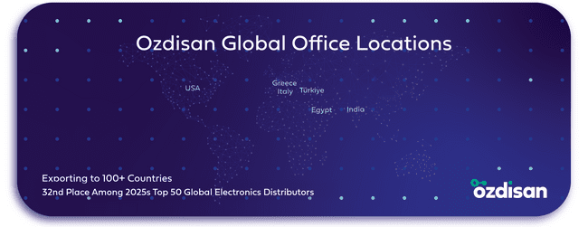

Classification: Gizli\Secret
Global Presence
Headquarter: Istanbul
Warehouses: Istanbul
Domestic Offices: Istanbul, Ankara, Izmir, Bursa
Overseas Locations: USA, Greece
Italy, India, Egypt
Customers: More than 100 countries
135 M USD
111 M USD
110 M USD
Özdisan Elektronik ranked 10th in Supply Chain Connect’s Top Asia Pacific Distributors list in 2025
77,6 M USD
63 M USD

Slide 4
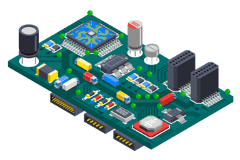
Classification: Gizli\Secret
Electronic Component Distribution
More Than 1.000.000 Items
Distributor of More Than 120 Brands
Product Supply of 2.000 Brands
Delivery From Stocks
Same Day Shipping
Online Shopping

Slide 5


Classification: Gizli\Secret
Electronic Component Distribution
53 M USD
In-Stock Inventory
24 M USD
Open Order

Slide 6

Classification: Gizli\Secret
Field Application Engineering (FAE) and R&D Support
Project Support
Equivalent Component Suggestion
Product Trainings
Design + Prototype + Production

Slide 7
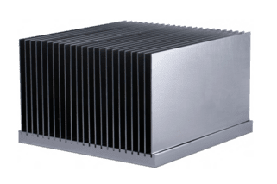
Classification: Gizli\Secret
Heat Sink Production
400 Tons of Annual Production Capacity
Skiving Machine Process
Surface Roughness Value Between
0.08 – 0.10 Microns
4-axis CNC Production
Super Finish Surface
Custom Design Production Like Drilling,
Tapping, Rough & Finish Operations, and Surface Miling

Slide 8

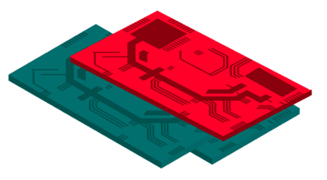
Classification: Gizli\Secret
PCB Supply & Production Support
According to the application, we have two different business models:
Production
Distribution

Slide 9

Classification: Gizli\Secret
LED Lighting Design & Production Support
Distribution
Exclusive Distribution for
Philips, Cree, Ledlink, and Evooptic
Design Support
Variety of LED Module Family and Customized Module Design Support
Production
Assembling on Our EMS Group Companies (Assan, EMS)

Slide 10
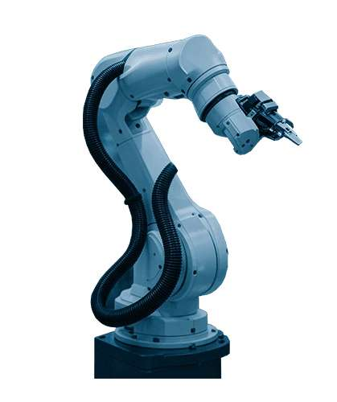
Automation Solutions
Distribution
Exclusive Distribution for Panasonic, Weintek, Invt, Eura Driver, and ABB
Technical Support & Service
Training & Technical Documentation
Custom Application & Software Solutions

Slide 11

Classification: Gizli\Secret
ozdisan.com
Launched in 2015
50.000+ Registered Users
Customers From More Than 100 Countries
1.000.000+ Items
Same Day Shipping

