Slide 1

Taipei Computer Association Delegation Visit to ELCINA House
11th July 2024

Slide 2
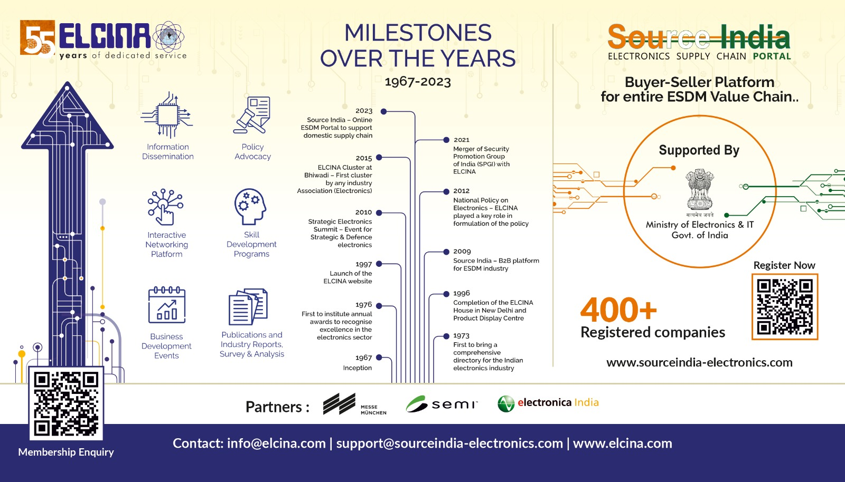

Slide 3


$5 Trillion Opportunity by 2026
$300 B
$200 B
$25 B
$100 B
$350 B
Auto
Auto Comp
Aviation
Biotech
IT/BPM
$65 B
$304 B
$640 B
$130 B
$30 B
Pharma
Chemicals
Construction
Defence
Leather
$180 B
$285 B
$300 B
$535 B
$123 B
Renewables
Roads
Electronics
Food Processing
Ports
$223 B
$125 B
$424 B
$100 B
$9 B
Textiles
Thermal Power
Tourism
Media
Wellness
$150 B
$110 B
$112 B
$192 B
Mining
Oil & Gas
Capital Goods
Railways
Notes:
https://uidai.gov.in/16-english-uk/aapka-aadhaar/994-state-wise-aadhaar-enrolment-ranking.html
https://www.pmjdy.gov.in/default.aspx?aspxerrorpath=/BankwiseLatest
https://www.trai.gov.in/release-publication/reports/telecom-subscriptions-reports
https://www.trai.gov.in/sites/default/files/PR_No.29of2020.pdf

Slide 4
ELCINA Delegations visits to Taiwan

Slide 5
Highlights of ELCINA Delegations visit to Taiwan last 10 years
14 Delegation visits
135+ Indian companies participated in ELCINA Delegations to Taiwan during this period
6 India-Taiwan Electronics Meet organized by ELCINA
25+ Taiwanese Companies/organization were visited by ELCINA delegations in Taiwan
100+ Unique Taiwanese organizations participated in two India Taiwan Electronics Meets organised by ELCINA
4 Taiwanese delegations hosted by ELCINA for business interaction, factory visits and cluster sited visits (Bhiwadi, Greater Noida, Gwalior, Hyderabad)
7 Comprehensive study on Indian Electronics Supply Chain conducted by ELCINA for Institute for Information Industry (III) Taiwan.

Slide 6
ELCINA MOU Partners in Taiwan
Taiwan Electrical & Electronics Manufacturers Association (TEEMA) –1999
Taiwan Printed Circuit Association (TPCA)- 2015
Institute for Information Industry (III) (2015)- Government of Taiwan
Taipei Computer Association(TCA)- 2016
2nd Updated MoU Signed with TEEMA
MoU with Taiwan Display Union Association (TDUA)
Energy Industry Business Model Innovation Centre (Taiwan Institute of Economic Research)
Centre for India Studies, National Tsing Hua University, Hsinchu
Hsinchu Science Park (2023)

Slide 7
ELCINA Facilitated Tie up
Infomax and Sahasra Group of Companies
Phison Electronics Corporation and Sahasra Group of Companies
Phison Electronics Corporation and Moser Baer India Ltd.
Top Tech International Co. Ltd and HLBS Tech (P) Limited
Infopower & MiTAC corporation

Slide 8
ELCINA Studies for Taiwan & India
Research Topic | Year
Electronics Supply Chain | 2022
EV Supply Chain | 2022
Satellite Supply Chain | 2022
Market Study focusing potential products for collaboration - Opportunity for Taiwanese companies in India | 2021
India EMS Industry Study Report after COVID-19 | 2020
Supply Chain Study | 2019
Market Study to Understand Distribution Channel for Select Electronics (Components & End Products) in India | 2017
Electronics Manufacturing Supply Chain for Key Products in India | 2016

Slide 9
List of Companies Approved under PLI for IT Hardware by Govt of India
S No. | Applicant
1 | Dell International Services India Pvt. Ltd.
2 | ICT Service Management Solutions (India) Pvt. Ltd.
3 | Rising Stars Hi-Tech Pvt. Ltd.
4 | Flextronics Technologies (India) Pvt. Ltd.
5 | Lava International Ltd.
6 | Dixon Technologies (India) Ltd.
7 | Infopower Technologies Pvt. Ltd.
8 | Bhagwati Products Ltd.
9 | Neolync Tele Communications Pvt. Ltd.
10 | Optiemus Electronics Ltd.
11 | Netweb Technologies India Pvt. Ltd
12 | Smile Electronics Ltd.
13 | VVDN Technologies Pvt. Ltd.
14 | Panache Digilife Ltd.

Slide 10


Key ACTIVITIES & Initiatives

Slide 11
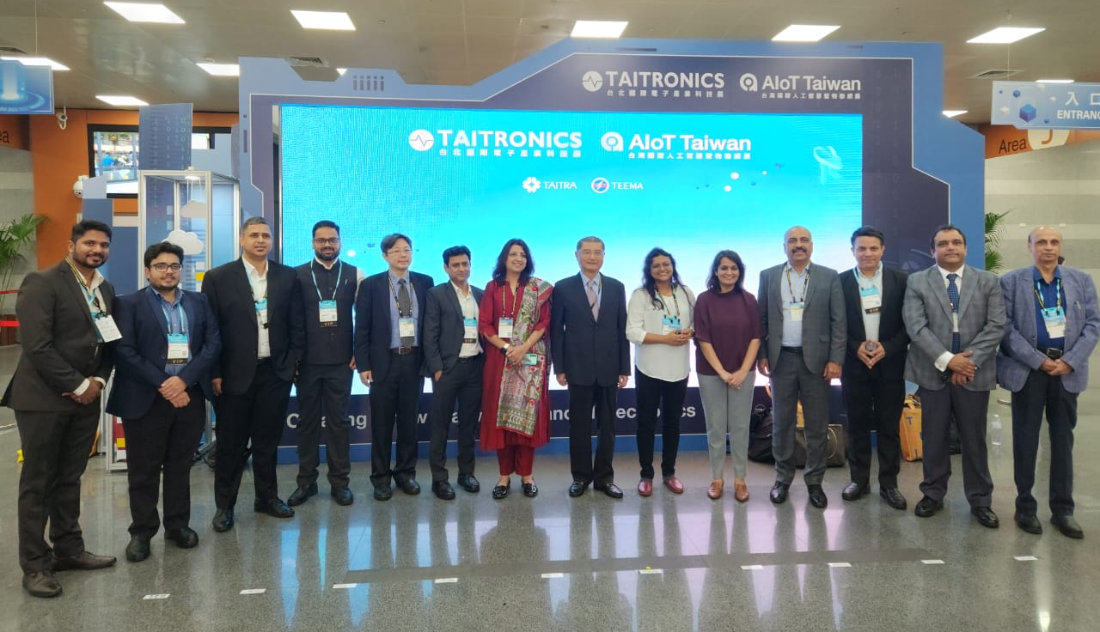
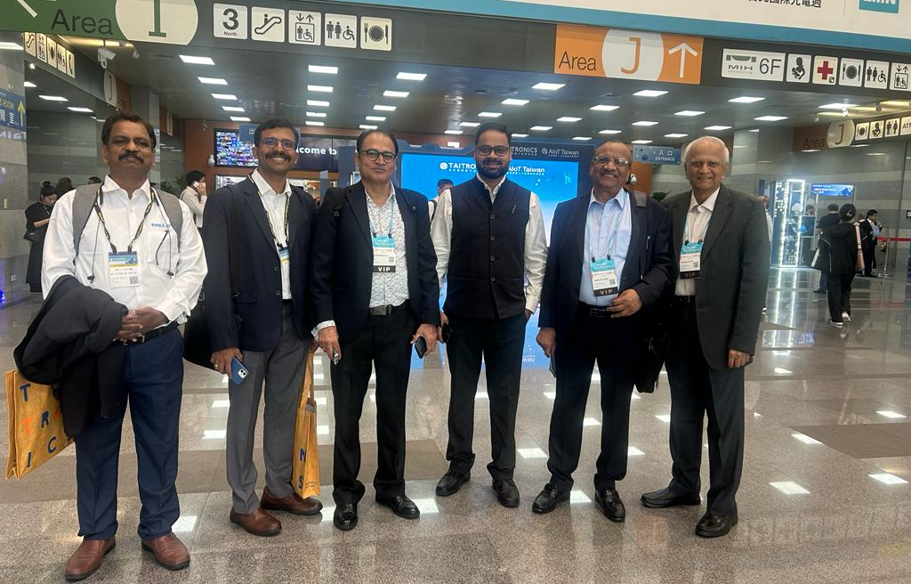

ELCINA Delegation to Taiwan, 22nd to 27th October 2023
ELCINA organized delegation to Taiwan to participate in the 7th India – Taiwan Electronics Meet (ITEM), organized by ELCINA at Taipei and also to participate in the Taipei International Electronics Show (Taitronics 2023), organized by TAITRA

Slide 12
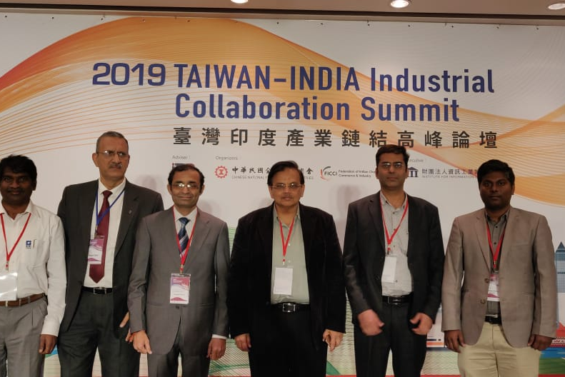
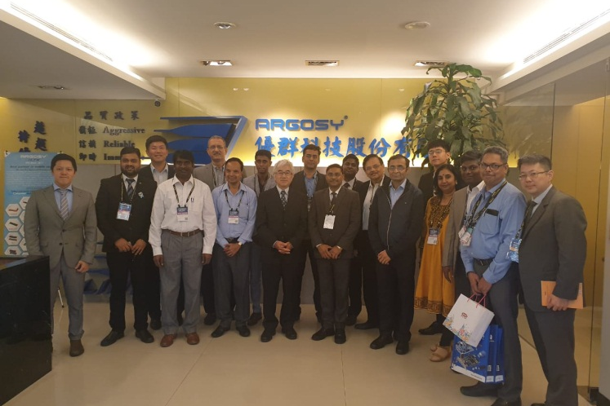
ELCINA Delegation to Taiwan, 15th to 19th October 2019
ELCINA organized delegation to Taiwan to participate in the 5th India – Taiwan Electronics Meet (ITEM), organised by ELCINA at Taipei and also to participate in the 45th Taipei International Electronics Show (Taitronics 2019), organized by TAITRA

Slide 13
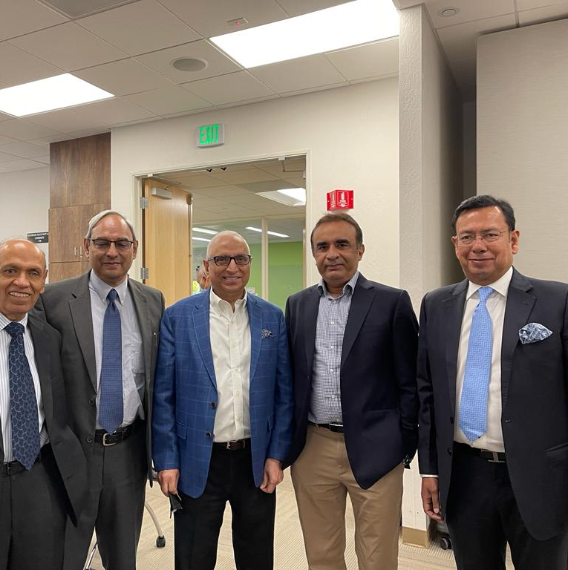

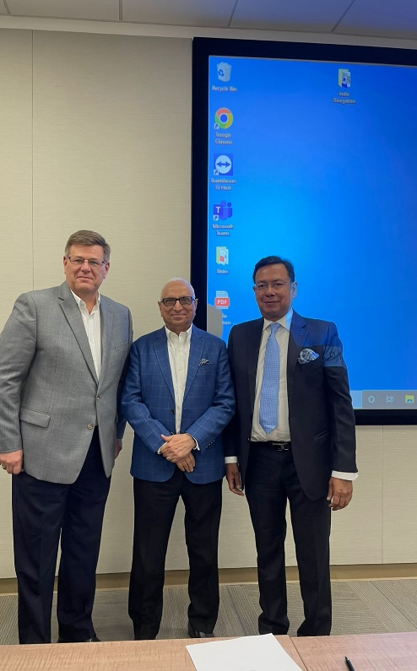
ELCINA signed MOU with SEMI USA in July 2022 for cooperation and promoting/executing SEMI courses in India

Slide 14
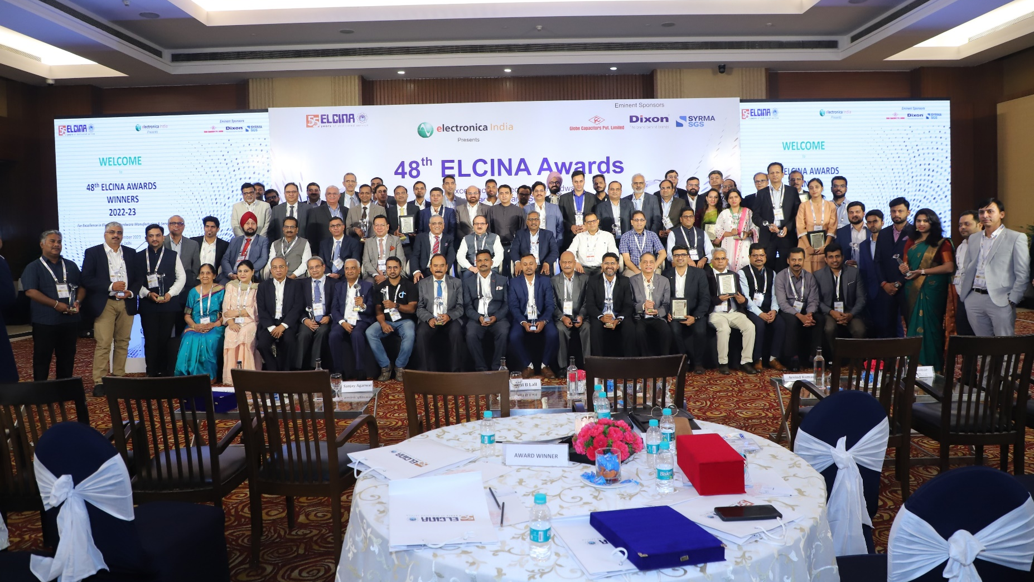
Presentation ceremony of Annual ELCINA Awards, 2023
The 48th Annual Presentation Ceremony for ELCINA Awards for Excellence in Electronics Hardware Manufacturing & Services was celebrated on 29th September 2023 The Lalit Hotel, Grand Ballroom, New Delhi

Slide 15






Thank You !
ELECTRONIC INDUSTRIES ASSOCIATION OF INDIA
ELCINA House, 422 Okhla Industrial Estate, Phase III
New Delhi 110020, INDIA
Tel: +91-11-26924597, 26928053, 41615985
Email: info@elcina.com
www.elcina.com | www.sourceindia-electronics.com | www.ses-india.in | www.elcinaclusters.in

