Slide 1

Glorious Circuit Technologies
Stepping Forward
Welcome to Glorious Circuit Technologies !!!
Glorious Circuit technologies, was incorporated in the year 2016 by eminent Industry Professionals at the heart of Bangalore, Karnataka, India. We offer our services in the fields of PCB Design, Fabrication, Assembly . GCT is an emerging leader in the field of PCB Services who focus at providing end to end PCB service solutions to technology companies around the globe.
Since our Inauguration from 2016, we have grown from strength to strength. GCT believes in producing quality and reliable products and services, competitive pricing, and on-time delivery to our customers. We intends to be a high-end PCB Services company to the market. We pride ourselves on working closely with our customers and providing quick turnaround time and a commitment to meet the needs within your specifications/requirement.
www.gloriouscircuits.com

Slide 2
Glorious Circuit Technologies
Stepping Forward
Profile:
Glorious Circuits Technologies is an PCB layout design services. Meeting our clients’ specific needs is our first priority. With quality and on time delivery, We believe that the reason we are in business is to serve you , not the other way around. As such, we pride ourselves on open dialogue, transparency and mutual creativity. Together with our dedicated team of experts, no challenge is beyond us. I also invite you to contact me on below number, mention in signature, at any time.
Glorious Circuits Technologies support customers globally, to provide sustaining engineering support throughout the product cycle time. The team also provides engineering support for cost reduction, Re-engineering, High Speed PCB Design, SI Analysis (Time Domain and Frequency Domain analysis), EMI/EMC and Reliability Analysis.
Highly skilled PCB layout engineers working with world-wide customers deliver “ Zero error in design”.
The experience acquired from handling highly complex PCB designs for cutting-edge technologies spread across major Industry Verticals like Military, Aerospace, Telecom, Medical, Automotive, Industrial and consumer electronics requirements in areas related to Embedded product development , IC packaging, High-speed PCB design, System-in-Package(SIP), Signal Integrity/Power Integrity Analysis. We tied up with the fabrication-house and assembly-house to produce quality PCB and packages meeting the design specification and delivering them within the schedule

Slide 3

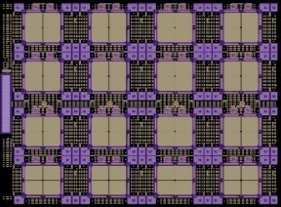



DFA
(DFM&DMT)
Fab & Assembly
Library
SI,PI, Thermal Analysis
Support
Complex Layout
Data Security
Skilled Designers
Multi Tool Expertise
Glorious
Supports
>99% First Time Right Designs
Onsite Support
Expedite Delivery Options

Slide 4







Tools for CAD and Design Analysis`
Library Preparations
PCB library expert from PCB Libraries(IPC 7351)
Schematic design
Design Entry HDL- OrCAD from Cadence
Altium Designer from Altium
PCB Layout design
Allegro From Cadence
Xpedition and Pads from Mentor Graphics
Altium Designer – Altium, Cad star - Zuken
DFx Analysis
Valor from Mentor Graphics
SI Analysis
Sigrity from Cadence
ADS -Keysight
ANSYS
Thermal Analysis
Thermal ANSYS
Mechanical
Solid Works and AutoCAD

Slide 5
layout Design Capabilities
Feasibility Analysis for Product Miniaturization
Database Library Development & Maintenance
Highspeed Stack Up Building Support
Constraints Driven Schematic Drafting
Controlled Impedance Design
Highspeed/High density/Highly Constrained Designs
HDI, VIP, Back Drill, Blind and Buried vias
Design for DFM/DFA/DFT
Concurrent/Express Design Support
On-site or Offshore Design Support
Process Oriented Design Execution
High-speed Interfaces & Memory Technologies:
Ethernet Over Backplane
Fiber Channel (SFP+, QSF) , DDRx
1/10G Line Card, USB, Bluetooth, WiFi
SERDES, XAUI, SRIO, GPS, RF & Microwave
USB, SATA, HDMI, SAS3, NVMe, HDD/SSD, SAS expanders
PCIe Switches / Controllers, PCIe add-on
PXIe, LXI, VXI, VME, High Vg / Ct, RTD
Switch / Matrix Cards, Digital I/O Cards, Backplanes, Break Out Box
QPI/UPI, PCIE, DMI, QSGMII, SGMII
DDR4/3/2, RLDRAM, QDR, LPDDR
PCI Express, PCI Express 2.0, PCI Express 3.0
Handled Up to 100 GBps

Slide 6
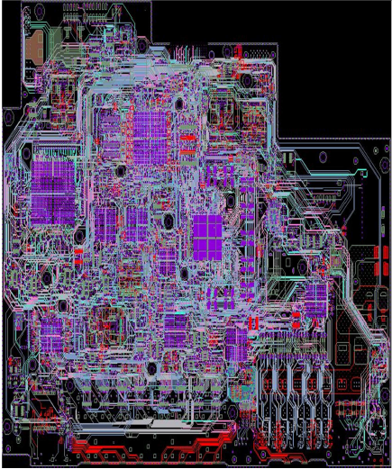
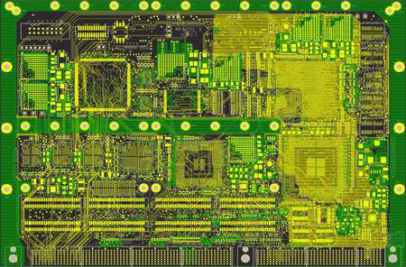
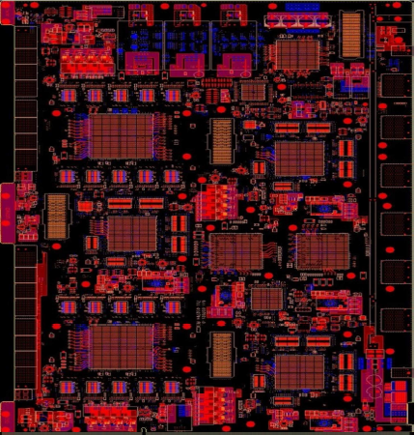
Glorious Designed Layouts
Express routing design Model:
High Speed: 10Gbps
No of Layers: 18
No of Components: 3558
No of Nets: 2286
No of Connections: 11257
No of Diff Pairs: 286
No of Pins: 14543
No of FPGAs: 10
DDR3 Memory Module: 11
Routing Duration: 10 days
Carrier Card-18 Layers,
1902 Components,
1512 PIN BGA,
8415 connections,
9.19"x6.3"
High Speed: 12Gbps
No of Layers: 22
No of Components: 9836
No of Nets: 7948
No of Connections: 39216
No of Diff Pairs: 1620
No of Pins: 49117
No of FPGAs: 10
DDR2 Memory Module: 58

Slide 7
Simulation Capabilities

Slide 8

Table of contents
Importance of Simulation
Signal Integrity
Power Integrity
Thermal Analysis

Slide 9

Importance of Digital Circuit Simulation
Digital circuits are at the heart of modern technology.
Designing and building these circuits is no easy task. Designers must ensure that the circuit will function correctly and efficiently before it is built.
Testing a physical circuit can be time-consuming and costly.
Simulation allows designers to test a digital circuit on a computer, quickly and easily identifying any potential problems.
Simulation allows designers to make changes to the circuit and test them in real-time, without the need for expensive and time-consuming physical testing.
Simulation is an essential tool in the design and development of digital circuits, helping to ensure that the final product is reliable, efficient, and cost-effective.

Slide 10
Simulation Process Flow
Initiation & Project Definition
Architecture
Circuit Design
Layout Design
Product Release
Deliverables
Complete Simulation Strategy.
Project forecast Simulation Engineer & Tools.
Project Tracker/Schedule
Deliverables
Simulation input to design architecture.
Stackup Design.
Simulation Model collection
Deliverables
Design constraints.
Placement and routing guidelines.
Pre-Layout simulation results.
Simulation reports.
Deliverables
Layout recommendations.
Post-Layout simulation.
Whole board review.
Simulation reports
Deliverables
Feedback to fabrication.
Validation preparation.
Final reports.
Project simulation sign-off.

Slide 11
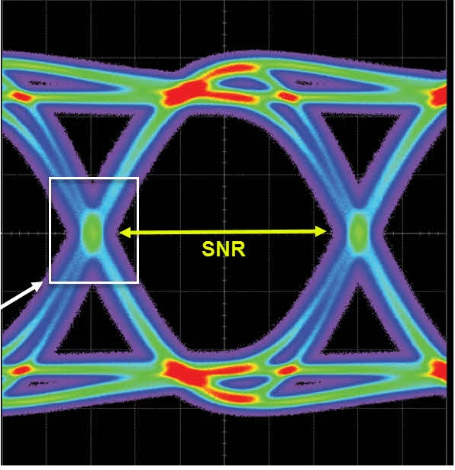
Signal Integrity
Understanding the Factors that Affect Signal Quality and How to Ensure Good Signal Integrity
Measurement of the quality of an electrical signal as it travels through Interconnects and can be affected by a variety of factors, including distortion, crosstalk, and noise etc.
Problems caused by poor signal integrity: errors, data loss, and system failures.
Transmission line effects such as attenuation, skew, and crosstalk can occur as the signal travels through the interconnects.
Simulation and analysis tools to predict and measure the effects of noise, crosstalk, and distortion on a signal.

Slide 12
Experience with type of interfaces handled in SI Analysis
Parallel buses
RGMII
NAND FLASH, NOR FLASH
SPI, UART, I2C
SRAM, DRAM, DDR2, DDR3, DDR4, GDDR4, GDDR5, LPDDR3/4
Serial buses
SGMII, XAUI
PCIe Gen:1,2,3,4 & 5
CSI 2 & 3
USB GEN: 3,4 & 5
Our Simulation tools: ANSYS : SI Wave , HFSS and Electronics desktop

Slide 13
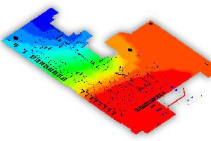
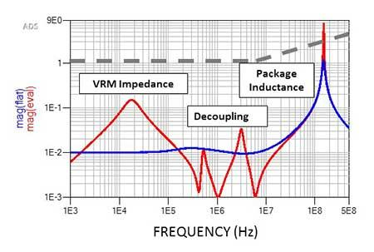
Power Integrity
Understanding the Factors that Affect Power Quality and How to Ensure Good Power Deliver
Power integrity is a measure of how well a system's power supply is able to deliver clean and stable power to the various components that make up the system.
Ensure that the system is able to operate reliably and at its full potential.
Poor power integrity can lead to a number of problems, including voltage drops, voltage sags, voltage overshoots, and power supply noise.
There are several techniques that can be used to improve power integrity, including adding capacitors, inductors, and ferrite beads to the power supply and using power management ICs to regulate the power supply.

Slide 14
Experience of type of power design handled in PI Analysis
Type of PI Analysis
DC Drop Analysis
AC(Decoupling) Analysis
Plane noise Analysis
Power Design
VDD_Core 0.9V, 2A & Ripple 1%
VDD 1.1V, 2A & Ripple 1%
VDDQ 1.3V, 1A & Ripple 1%
VDDQ 1.5V, 2.2A & Ripple 1%
Our Simulation tools: ANSYS : SI Wave

Slide 15
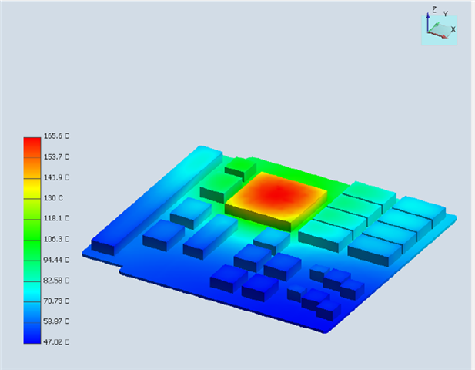
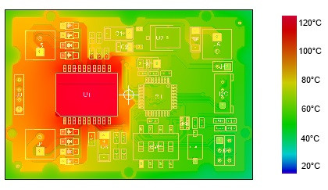
Thermal Analysis
Understanding the Factors that Affect Thermal Quality and How to Ensure Good Thermal Delivery
Measurement and prediction of heat generation and dissipation in electronic systems.
Ensure that the system is able to operate reliably and at its full potential.
Problems caused by poor thermal management: system failures and reduced performance.
There are several techniques that can be used to improve Thermal delivery including component placement, environmental conditions and materials etc.

Slide 16
Experience of type of Thermal design handled
Complex Designs
3000 electronics components
Thermal complex designs handled on computers, smartphones, and servers, as well as automotive and aerospace designs.
Thermal management techniques used in complex designs, such as: Heat sinks, Fans. Liquid cooling, Phase change materials & Thermoelectric cooling
Our Simulation tools: ANSYS : ICE PACK

Slide 17
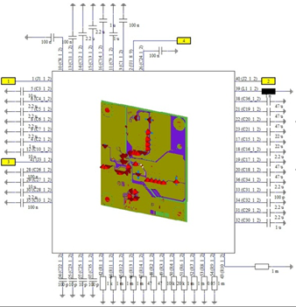
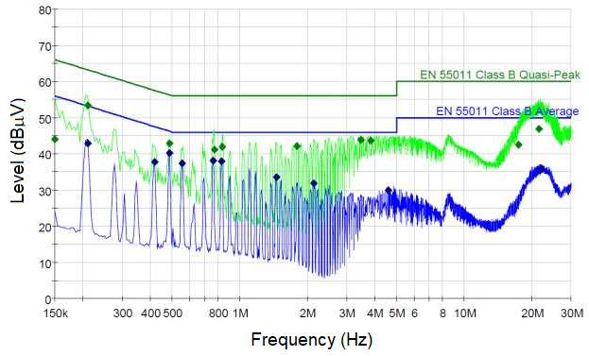
EMC - Radiated emissions(RE)
EMC stands for Electromagnetic Compatibility.
Electronic devices to operate correctly when subjected to electromagnetic interference (EMI) without causing interference to other devices.
Radiated emissions are the electromagnetic radiation emitted by electronic devices that can cause interference with other devices or systems.
It can be caused by various sources, such as signal traces, connectors, power supplies, and other electronic components.

Slide 18
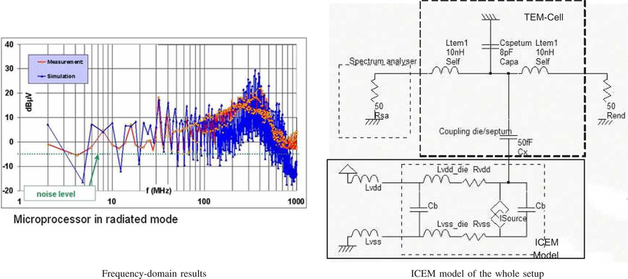
EMC - Conducted Emissions(CE)
Conducted emission refers to the electromagnetic interference (EMI) that is conducted along power lines or signal lines in electronic circuits
Switching frequency: switching frequency can result in higher conducted emission levels
Layout and routing: Proper layout and routing can help reduce conducted emissions.
Component selection: Components with lower parasitic capacitance and inductance reduce conducted emissions.
Grounding: Proper grounding techniques reducing conducted emissions.

Slide 19
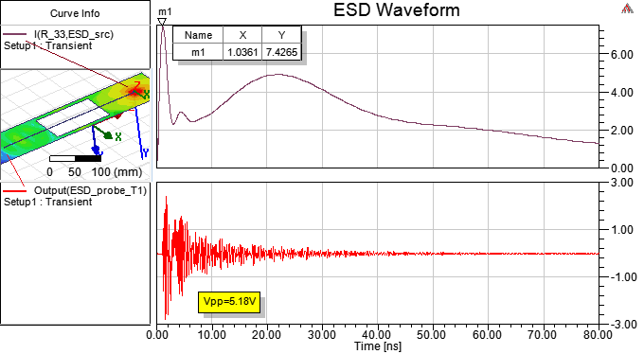
EMC - Electrostatic Discharge(ESD)
Conducted electrostatic discharge (ESD) is the transfer of static electricity between two objects that are at different electrical potentials, often resulting in damage to electronic devices.
Humidity: Low humidity can increase the buildup of static electricity
Device sensitivity: Some electronic devices are more sensitive to ESD than others.
Grounding: Proper grounding techniques can help reduce the likelihood of ESD events.
Shielding: Shielding can help protect against ESD events

Slide 20
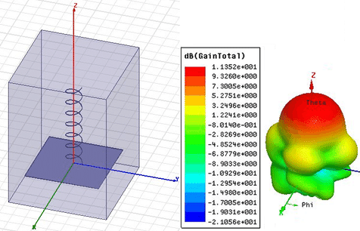
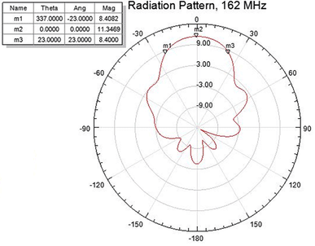
Radio frequency (RF) simulation
Simulation on RF systems, including antennas, filters, amplifiers, mixers, and oscillators.
Simulating the behavior of these systems before they are built.
Engineers and designers can obtain accurate and reliable results from RF simulations
Designers can optimize their performance and reduce the need for expensive prototyping and testing.

Slide 21
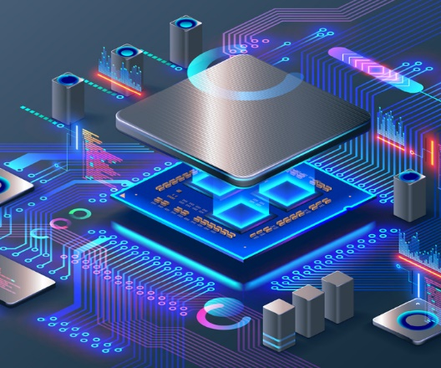

IT infrastructure capabilities
We have Robust IT infrastructure capabilities which ensure optimal performance, speed and reliability for our simulation work high-powered workstation
High Powered Workstation Specifications:
Processing Power: 64 cores, 88 threads for parallel processing.
Memory Capacity: 128GB RAM (Expandable to 1.5TB) for large datasets.
Storage Efficiency: SSD + HDD for fast access and ample storage.
Graphics Capability: Nvidia Quadro K4200 (16GB) for graphics-intensive tasks.

Slide 22
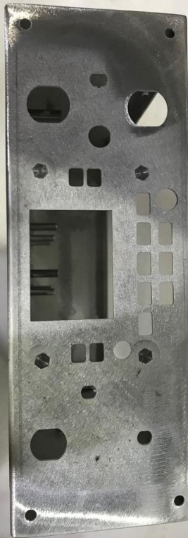
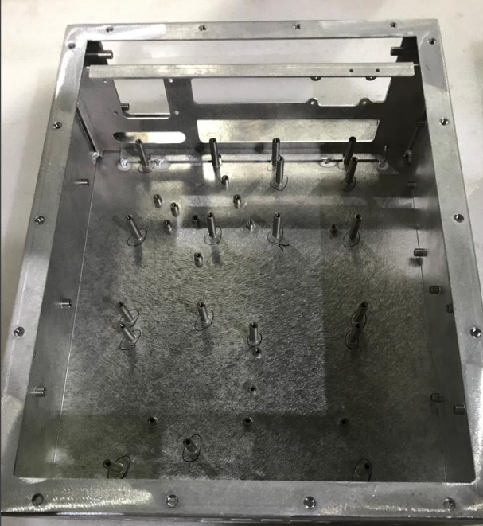
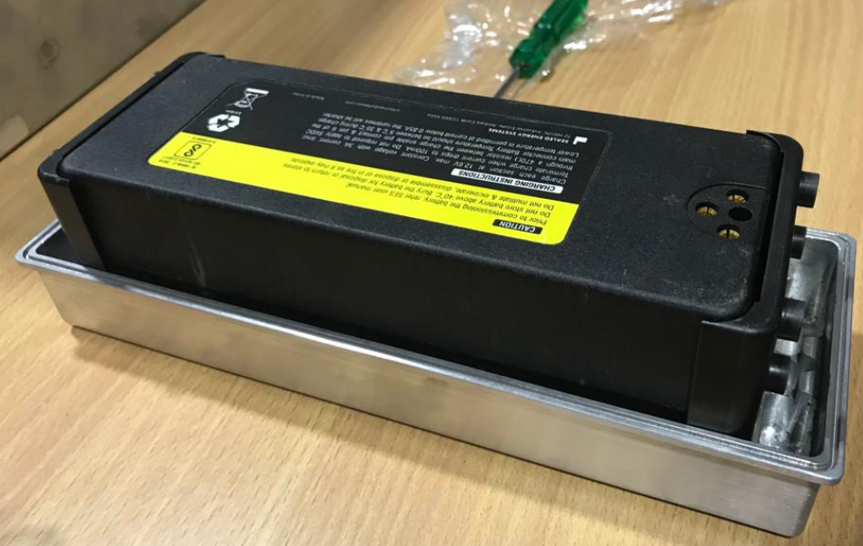
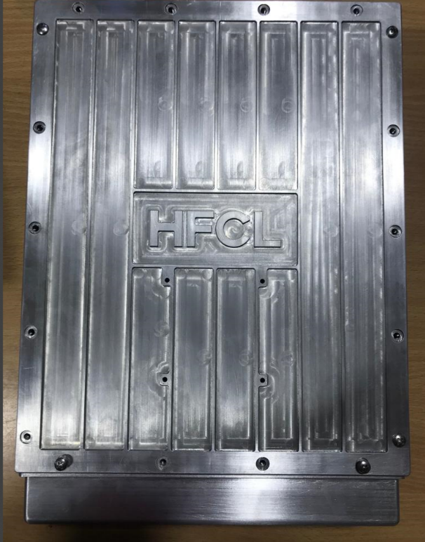
Enclosure Design for Telecom Products (Class 3 requirement)

Slide 23
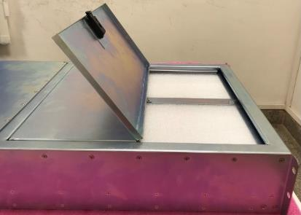
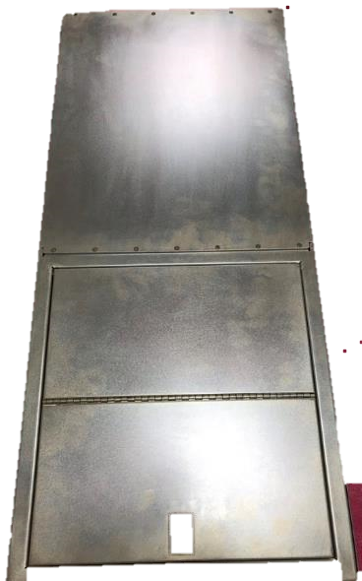
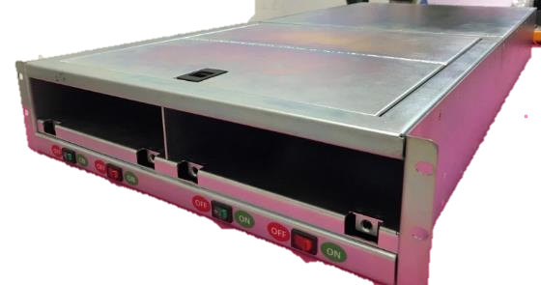
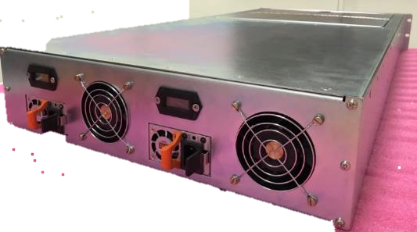
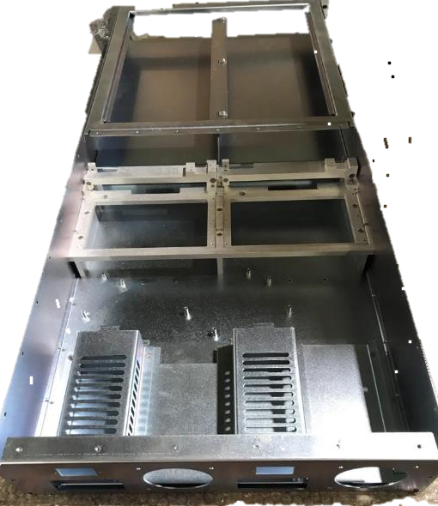
Enclosure Design for Telecom Products (Class 3 requirement)
Front view
Side view
Midplane holder
Top view
Rear view
Power Supply Module bracket
Fan

Slide 24
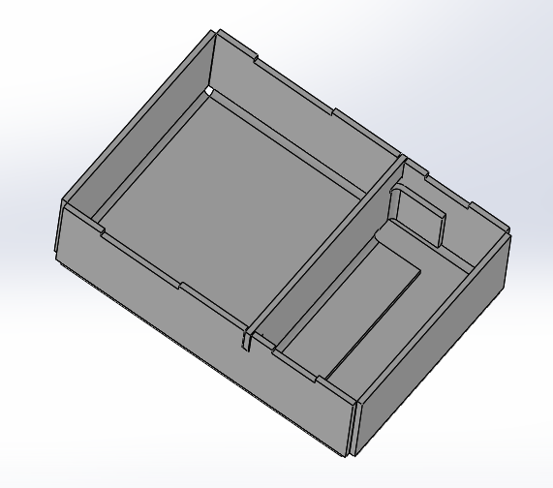
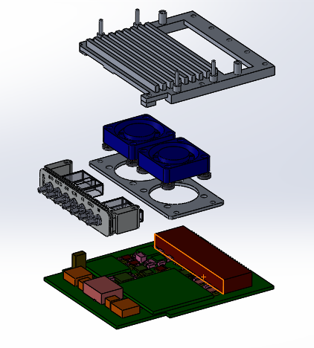
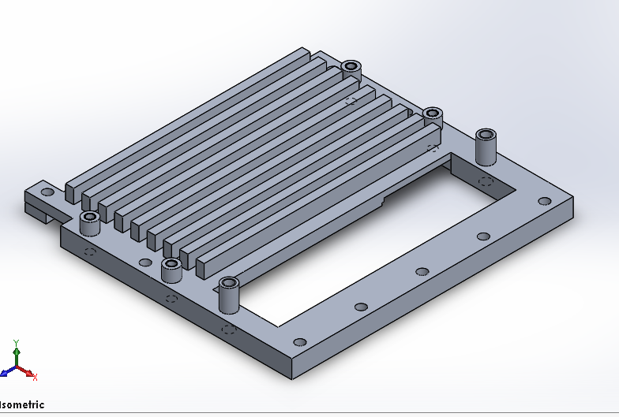
Enclosure Design for Telecom Products- Heat Sink design

Slide 25
Our Team
Team | Head Count
PCB Library Development Engineers | 2
PCB Design Engineers | 24
Analysis (SI/PI/Thermal/DFM/DFA) Engineers | 4
Mechanical Design Engineers | 2
Quality Check Engineers | 2
Business Operation | 2

Slide 26

Glorious Circuit Technologies
Stepping Forward
Thanks !
Any questions?
Corporate Office
Glorious Circuit Technologies
No.35/1, 6th Floor, 10th main, NGR Building, Roopena Agrahara,
Bommanahalli, Bangalore – 560068, India
Ph.: +91 8778742110
Sales Enquires: sales@gloriouscircuits.com
Web Site : www.gloriouscircuits.com

