Slide 1

Chiprime
Semiconductor Pvt. Ltd.
(Accord Group Company)
Corporate Overview

Slide 2



Our Story
  Accord Group was incorporated in 1972
  Group net-worth $4bn & revenue $1bn
  Chiprime became a separate entity in 2022
  Focusing on Embedded Product Engineering
  A&D, Space, Nuclear, Semicon, Industrial
  A team of 60+ FTEs
  Development centers in Bangalore & Chennai
  AS9100 and ISO9001 certified

Slide 3




ENGINEERING
UP COMING PROJECTS

Slide 4





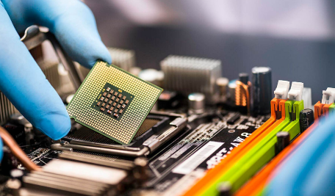

Design & Manufacturing
System Integration
Value Engineering
Consulting Services
Defense & Aerospace
Semiconductor
Space Industry

Slide 5
Business Verticals
Turn Key solution
Complete Package
Customization
Value Engineering
Design Simplification
Supply Chain Efficiency
Consulting
Training and Development
Measurable Results
Cost Efficiency
Time Savings
Risk Mitigation
Customer Testimonials and Case Studies
Implementation Support
Strategic Insights
Defense & Aerospace/Space/Semiconductor/Automotive/Industrial

Slide 6
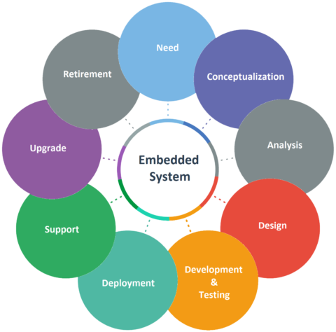
Our offerings-Design & Manufacturing
  LRU Design – End to End
  Systems/Subsystems/Board design
  ATE/Simulators/Test Jigs design
  Firmware, Device drivers, BSP, GUI
  eCAD, mCAD, IP core design
  Electronics Manufacturing

Slide 7
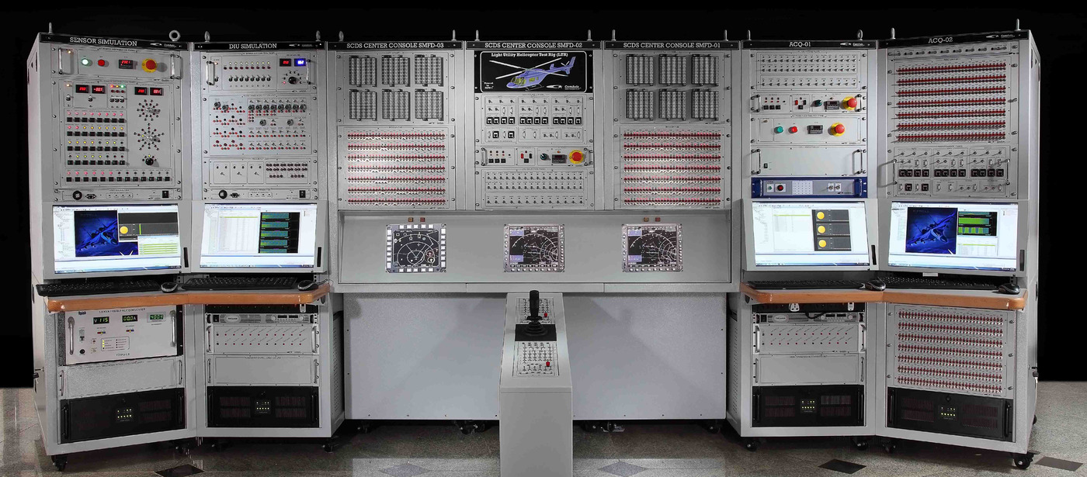
Our offerings - System Integration
  ATE design
  Manual & Semi-automatic Test Jigs
  Box building & Wire harnessing
  COTS - Custom Tools Integration

Slide 8

Our offerings – Value Engineering
  Supply of COTS Tools & systems
  R&D Lab setup and Maintenance
  Reverse engineering
  Distribution and Sourcing

Slide 9

  Technology consulting
Resource augmentation
Skilled & Experienced resources
Flexible business model
ODC, onsite, Augmentation, Fixed Price
Semiconductor, FPGA, IOT, Circuit design, Board design, Embedded Software, DO254,DO178

Slide 10











Customers
Business Partners

Slide 11
Thank You
Chiprime Semiconductor Pvt.Ltd. (Accord Group Company)
GINSERV,CA Site No.1, 80 Feet Rd, Leela Palace Road, Kodihalli, Bengaluru, 560008.INDIA. Ph : +91 9886981797 Email: info@chiprimesemiconductor.com. www.chiprimesemiconductor.com.

