Slide 1

Minchu Products and Services
Portfolio

Slide 2

Minchu Products and Services
We Design, Develop, Market and Sell Innovative Products to the Indian Market. Our Motto is to take . the "Make in India" initiative to the next level by indigenously developing Useful and Innovative products in various industries, thereby providing jobs to local vendors.
Our aim is to focus more on producing greener products locally and exporting to different countries.
We specialize in Product design and are capable of taking product design from concept to reality.

Slide 3
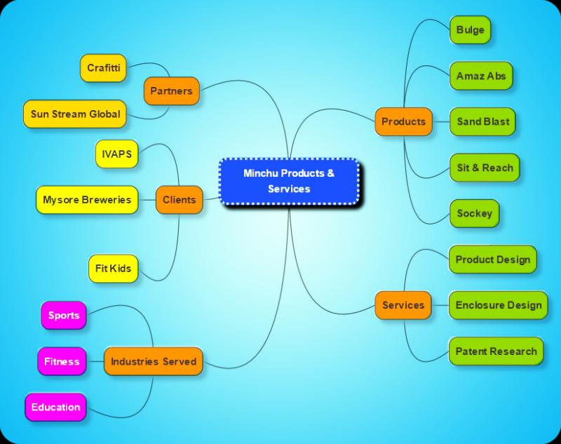
Minchu Products and Services
Services provided for our clients are :
Design, Development and Production of Sports & Fitness Equipments.
Enclosure Design and Development for Modem.
Prototyping of Various Enclosures for military Applications, Heat Sinks, etc.
Prototyping of Various parts for Water Purifier
Brackets , PCBs
Prototyping of Enclosure Racks for Fitment and Initial Testing.
Patent Portfolio Management.
Patent Analysis and Ideas Generation Using Systematic Innovation (TRIZ)

Slide 4
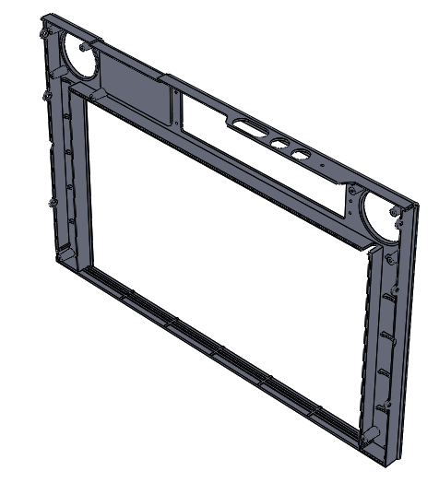
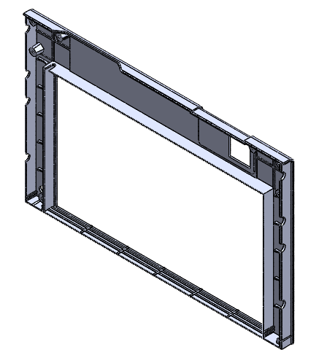
Project Sample: Bezel Design - Plastics
  Summary: To re-design the bezel based on customer’s New Industrial Design sketches and old reference product 3d models.
  Input: Existing Product models, Industrial Design sketches
  Scope:
    Converting Industrial Design Sketches into 3d models
    Products should be designed for
  Solution: The existing design was modified to eliminate over-engineered components, without compromising the aesthetic and functionality delivering 45% reduction in enclosure cost.

Slide 5
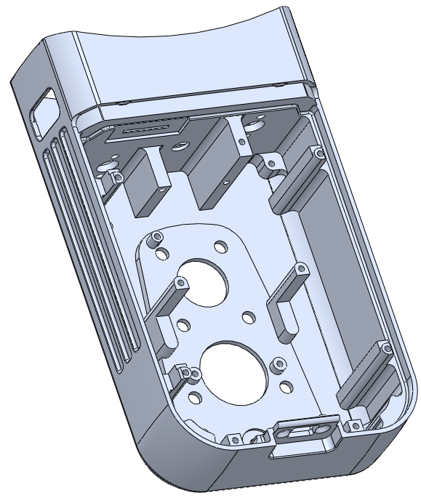
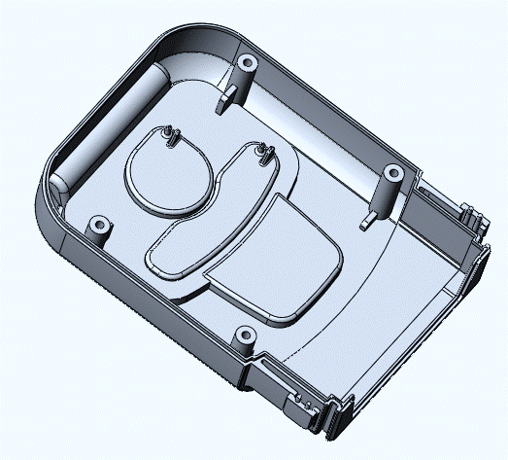
Project Sample: Enclosure Design - Plastics
  Summary: To design the hand held plastic enclosure that is ergonomic and easy to use. The emphasis was on ergonomics and aesthetics.
  Input: Reference Product and Design Files
  Scope:
    Enclosure Design
    Ergonomics
    Prototyping
    Tool Design - Support
    Testing and approvals
  Solution: New Product Design – earlier design was larger and bulky not suitable for hand held operation.

Slide 6
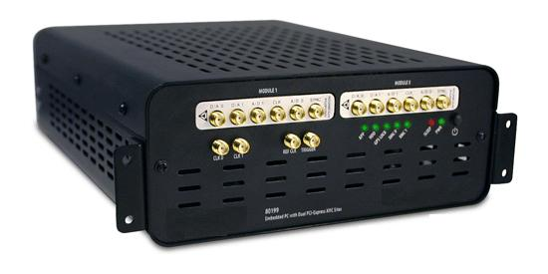
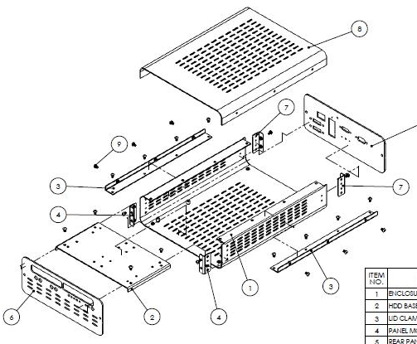
Project Sample: Enclosure Design
  Summary: A robust rack mountable metal enclosure for an industrial PC was required to be developed. This being a flagship product from the customer, the focus were on both product performance and aesthetic design
  Input:
    PCB Design
    Design Constraints
  Scope:
    Develop a metal enclosure for industrial PC
    Enclosure prototyping
    Bulk supply from India.
  Solution: A compact rack mountable enclosure was developed considering EMI / EMC, thermal flow, and further expansion possibilities.

Slide 7
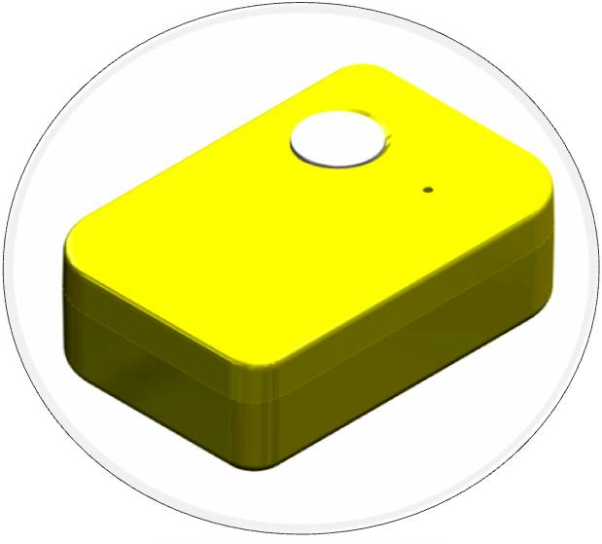
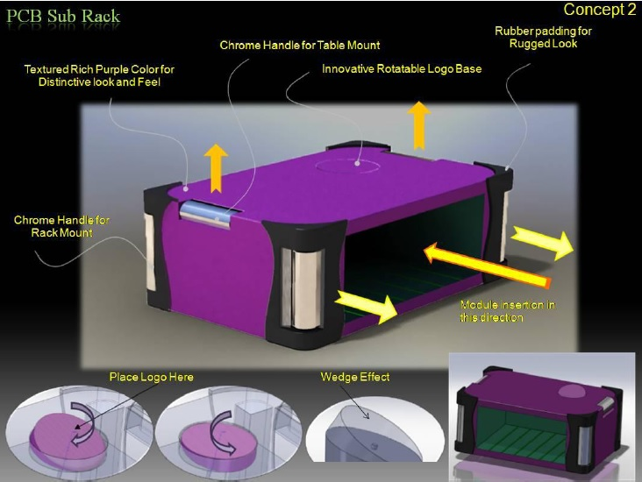
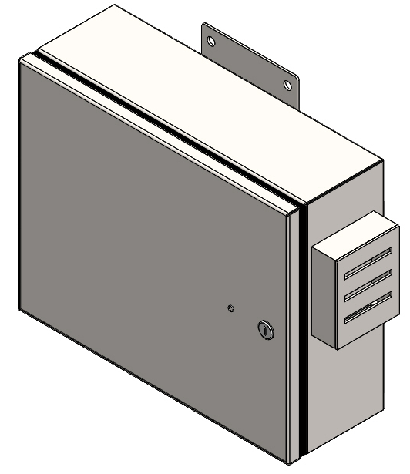
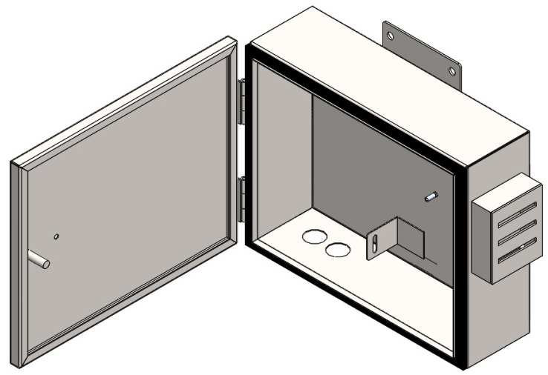
Project Sample: Sheet metal and Plastic enclosures

Slide 8
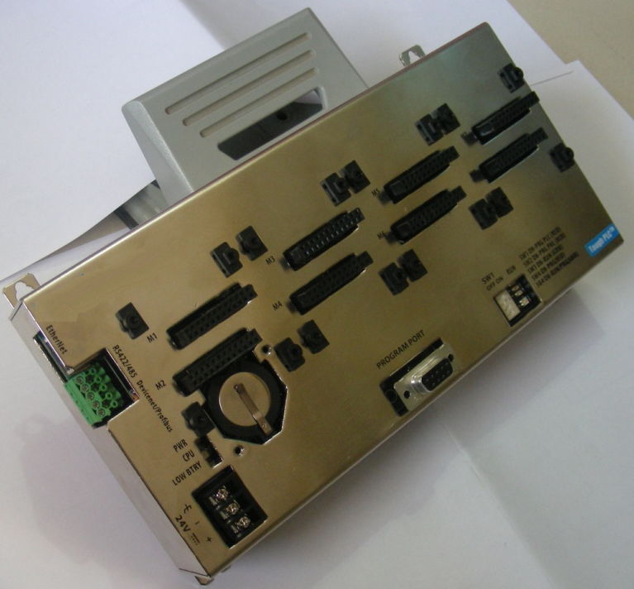
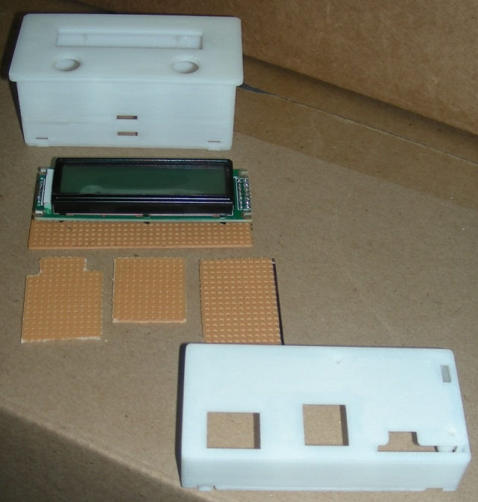
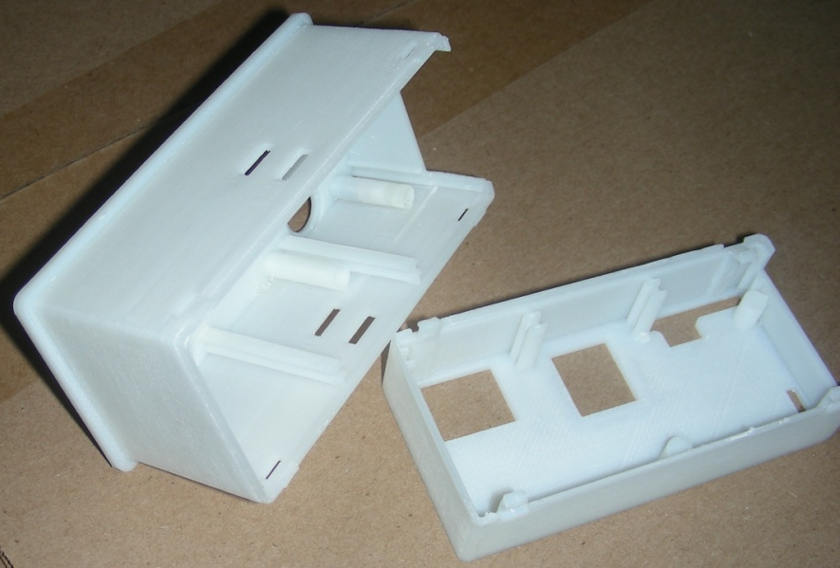
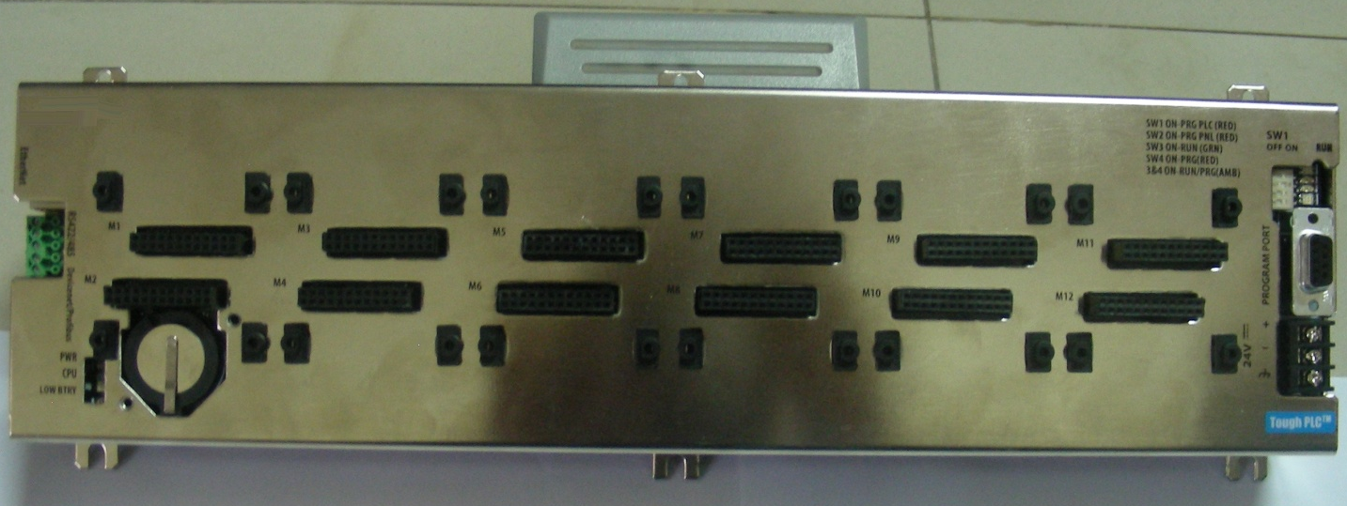
Project Sample: Sheet metal and Plastic enclosures

Slide 9

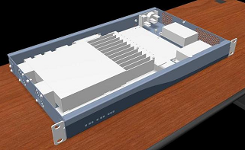
Project Sample: Enclosure re-design to reduce
production cost
  Summary: To re-design the enclosure without affecting the brand identity, functionality and EMC parameters, resulting in substantial cost reduction.
  Input: Existing Product and Design Files
  Scope:
    Teardown Analysis
    Re-design
    EMC testing and approvals
    Prototyping
  Solution: The existing design was modified to eliminate over-engineered components, without compromising the aesthetic and functionality delivering 45% reduction in enclosure cost.

Slide 10
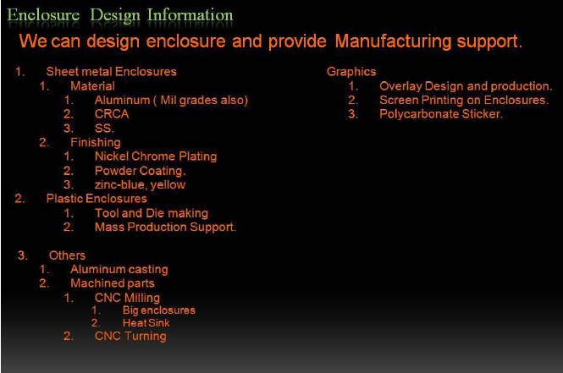
Sheet metal and Plastic enclosures

Slide 11
Thank You

