Slide 1


Mango Semiconductors India Private Limited
An ISO 9001, ISO 14001 Company
A-328, 3rd Floor, Plot No-37/I Pacific Business Park, Sahibabad Industrial Area, Ghaziabad
0120- 4238670
1

Slide 2
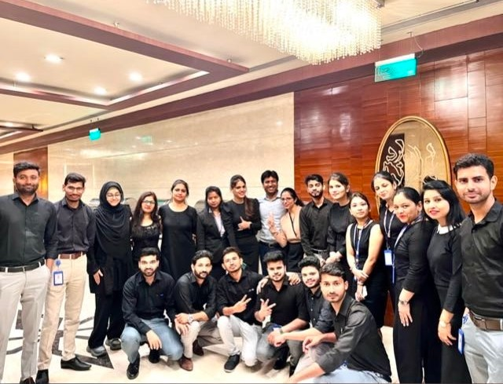
Who We Are?
Incepted – 2014
Mission - Our mission is to support our customers with Quality electronic components with shortest LT& at competitive prices
Our Team - Mango Semiconductors is having a team of 25+ People
Financial Status: Financially very sound company with zero debt
Our own Office :We are having office 1200 sq. ft. and running warehouse of 300 sq. ft. in Pacific business park, Ghaziabad , Delhi-NCR
Mango Semiconductors (I) Pvt Limited has mission to supply only 100% genuine electronics components by means of our excellent work ethics, responsiveness and commitment to our clients.

Slide 3








Our USP (Unique Selling Proposition)
Launched Ecommerce store in April’2023- www.mangofy.in | Process driven company, Account S/w, Inventory S/w, Sales CRM HR S/w |  | Strong Technical and Marketing front (Both Directors are Engineers with rich industry experience)
Strong Financials, Own Office + Warehouse + Zero debt Company |  |  | Team of 28+ 15+ in Sales 3 in Purchase Dedicated Accounts, Dispatch, QC, HR, Admin team
1000+ Niche | Known for Honesty, |  | Authorized Brands
 |  |  | Amphenol (Mil and Industrial) Phoenix Contact NKK Switches Omega Eng. AiT SEMI Fuji Terminal
Customer + Export to >10 Country (Catering almost all industry | Commitment & responsiveness & Ethical standard never Miss-commit : We only promise what we can deliver

Slide 4

Quality Assurance
1 Year warranty for all parts against any manufacturing Defect
Procurement of 100% material either from Manufacturers or Authorized distributors only with 100% traceability.
Mango /Manufacturer CoC with every supply
Own QC team, which monitors and control the quality during the whole process including receiving, storage and delivery. Before shipping, all parts get checked and verified by our QC team
Certification: ISO9001, ISO14001, DUNS, MSME

Slide 5







Our Authorized Brands

Slide 6
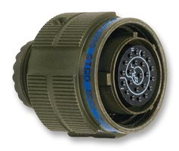
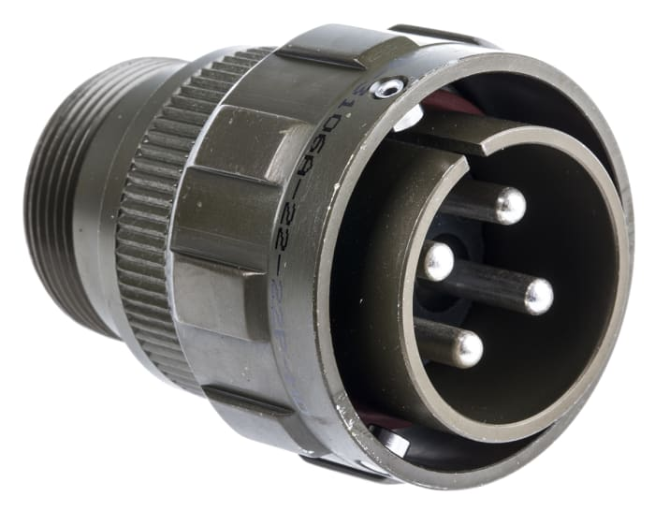
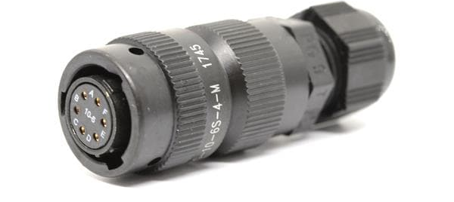
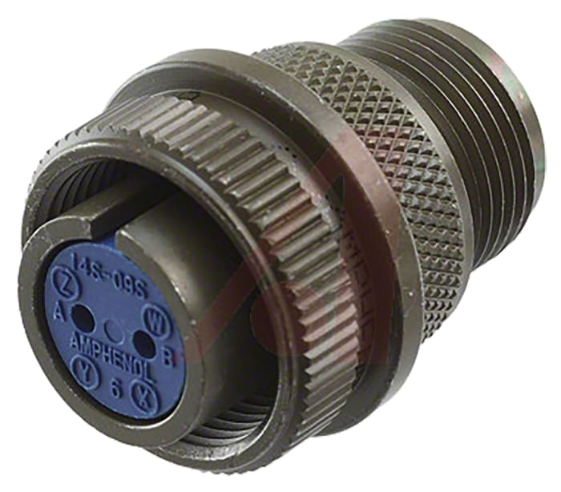
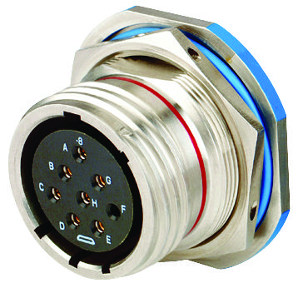
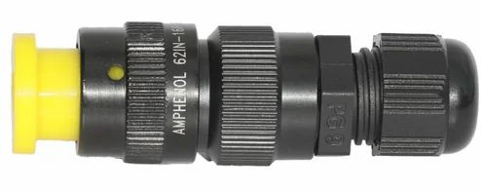
Authorized Partner
Mil – grade Connectors
62IN SERIES
D38999 SERIES
MS97 SERIES
MS97B SERIES

Slide 7
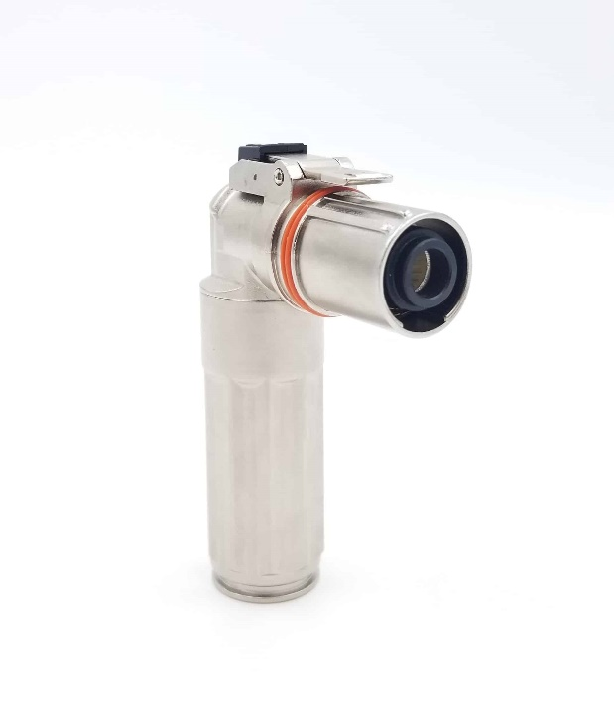
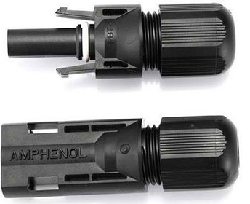
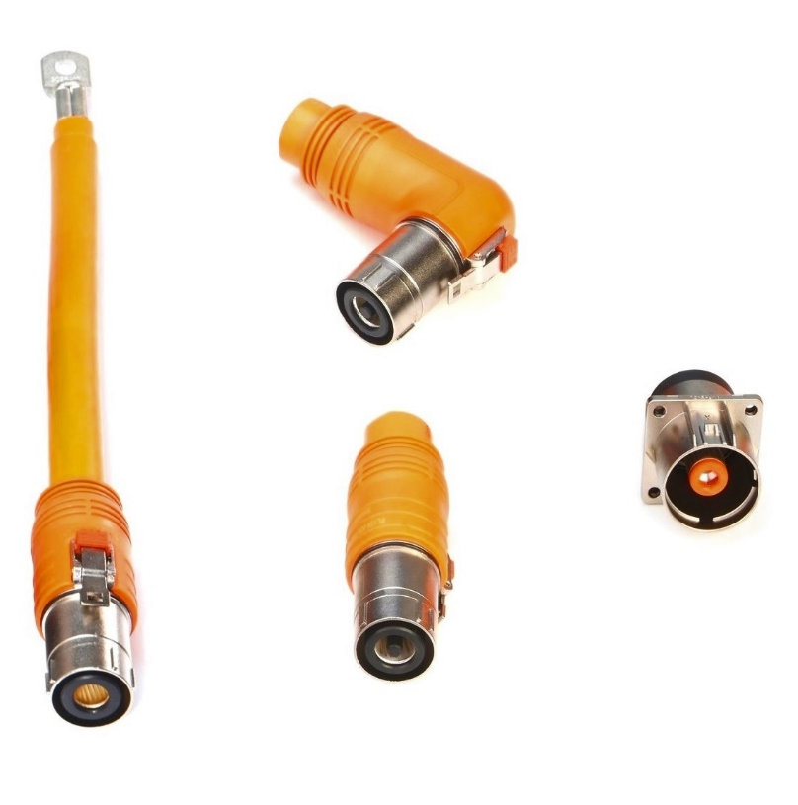
Authorized Partner
EV, HEV and Solar Connectors
Powerlock Connectors
H4 PV Connectors

Slide 8
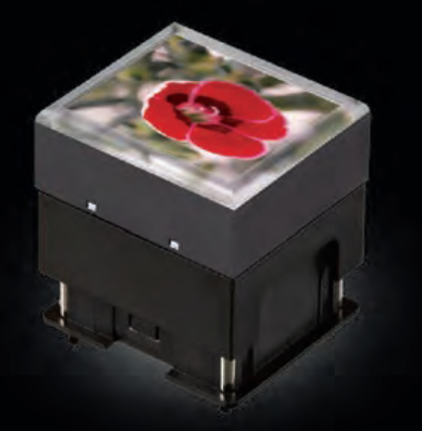

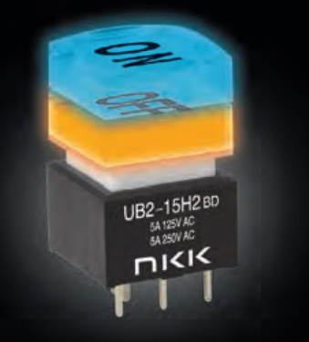
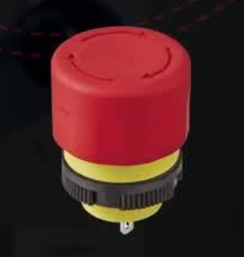

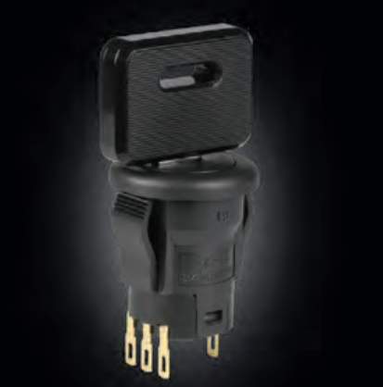
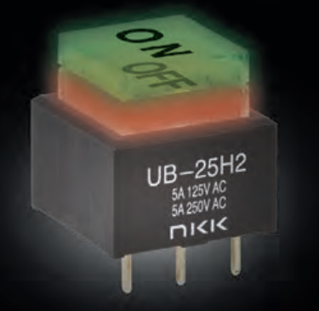

Authorized Partner

Slide 9

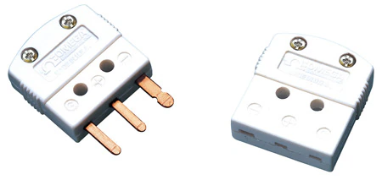
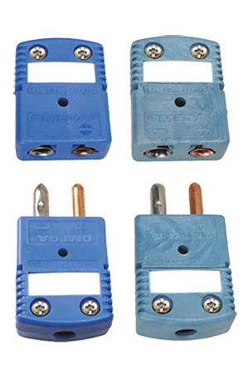
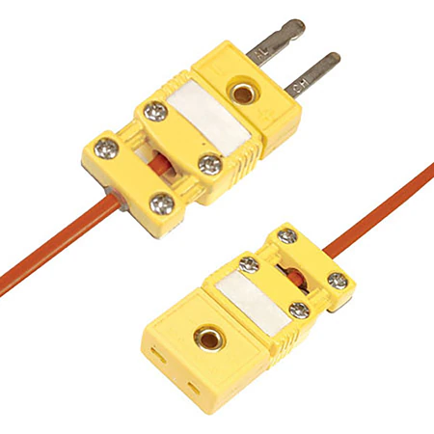

Authorized Partner

Slide 10
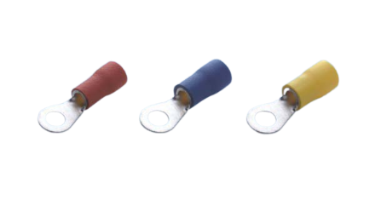






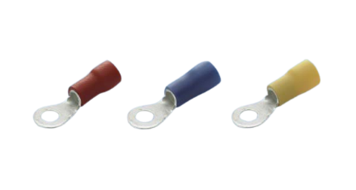

Authorized Partner

Slide 11
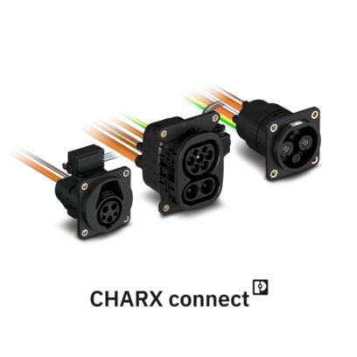

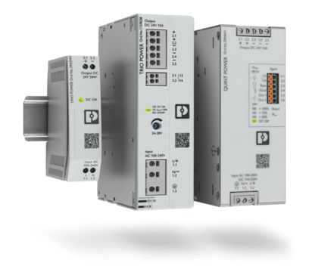

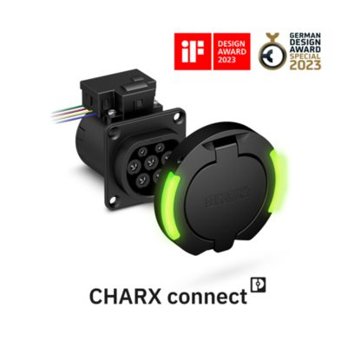
Authorized Partner
Power supplies and CHARX – Charging technology for e-mobility

Slide 12
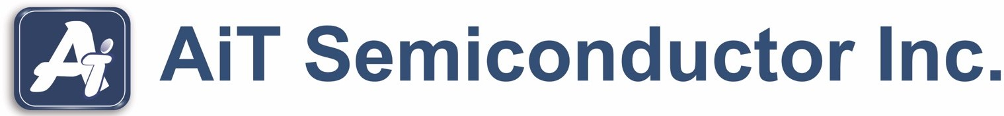

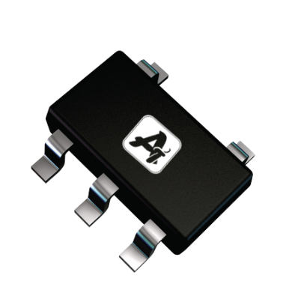
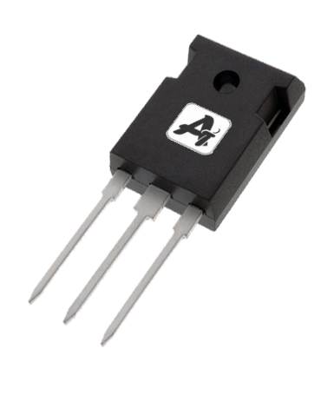
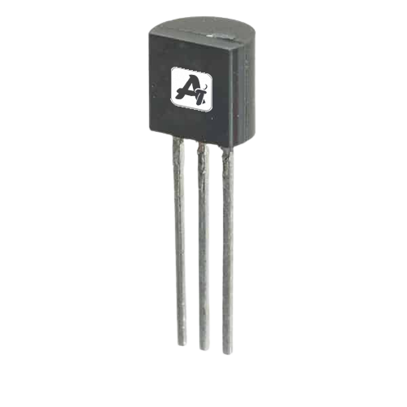
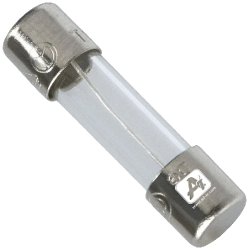
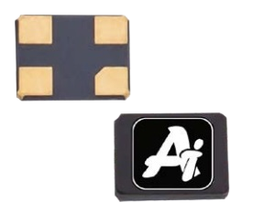
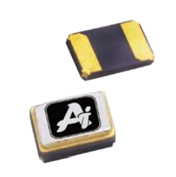


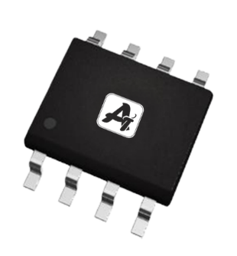
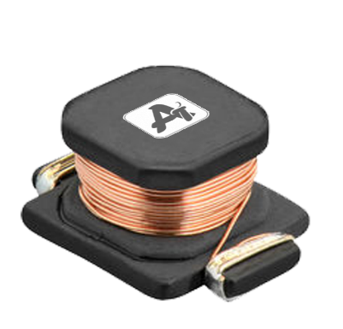

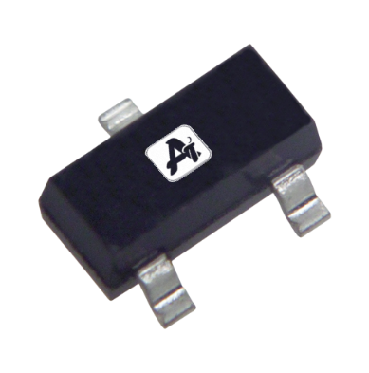
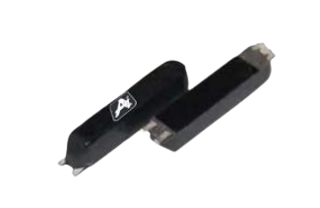
Authorized Partner
Power Management IC
Discrete
Memory
Inductor
Crystal
Fuse

Slide 13




























Supporting Brands
Connectors

Slide 14
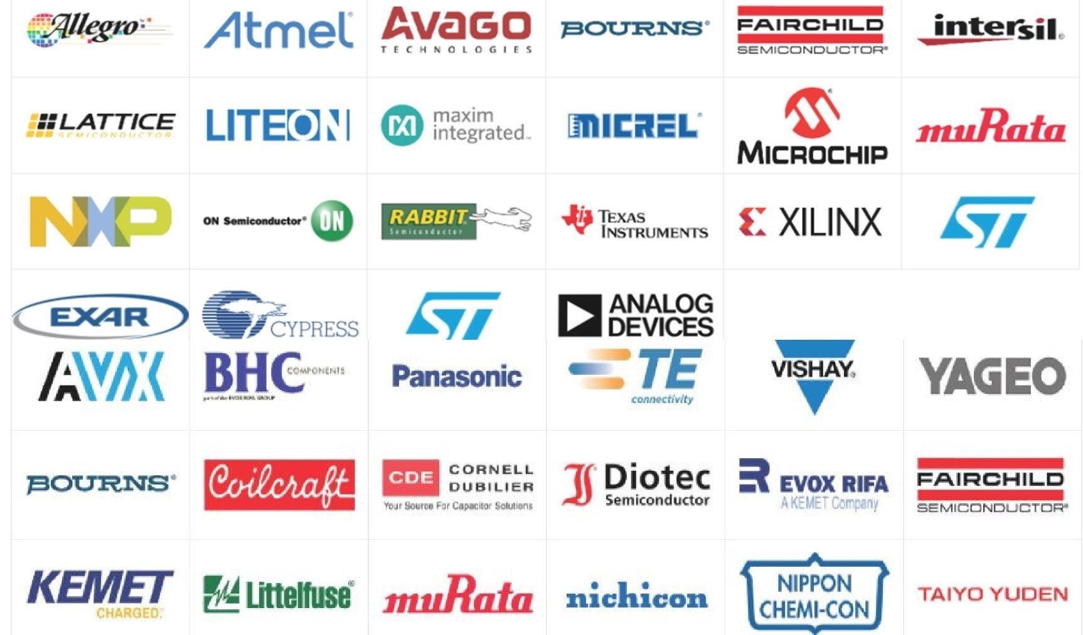
Supporting Brands
Active/ Passives

Slide 15
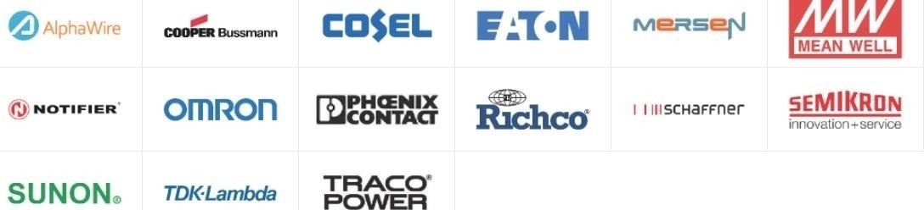

Supporting Brands
Automation Products
Relay & Switches

Slide 16

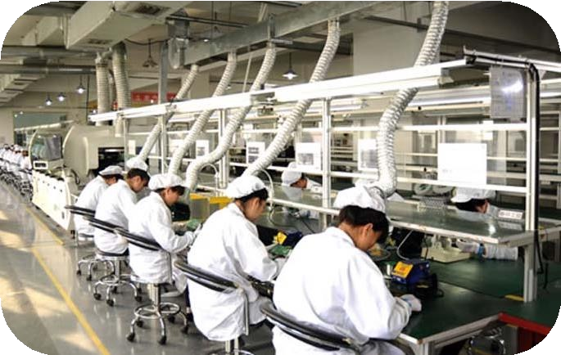
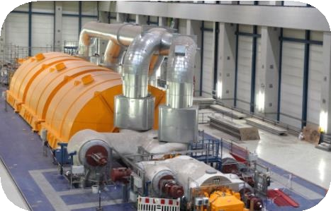

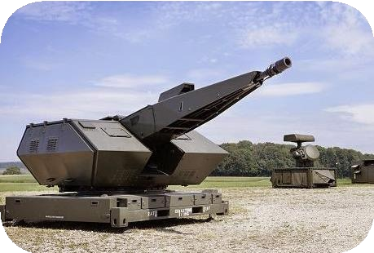

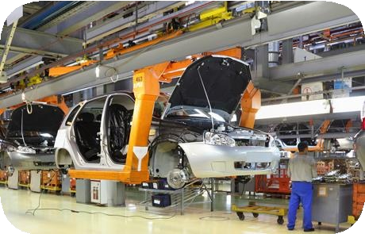
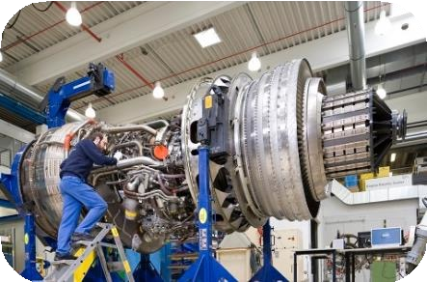

Industry Being Catered
Mango Semiconductors is supplying material to almost all the industry who may possibly use electronics components & never compromise with the quality
Automotive
Defense system
Aviation Industry
Wire Harness
PCBAssembly
Robotics
Medical Equipment
Sports Equipment
Automation solution
Industrial Equipment
Textile/Spinning Mills
Petrochemical
Educational Institutes
Consumer durable
Marine Offshore
Weighing System
Load cells
Control panel access
LED Displays

Slide 17



























Our Clientele
Current Customer base : 1000+ Niche customer base
>15 Government Customers including HAL, Indian Railways, DRDO, ECIL
Supplying Material to all segment customer like Aviation,Aerospace, Defense, Automotive, healthcare, wire harness.
Export to 10+ Countries- HK, Taiwan, France, Poland, US, China, Germany

Slide 18

Our Clientele

Slide 19
Thanks a lot for your Time & Patience
For more details please visit : www.mangofy.in

