Slide 1
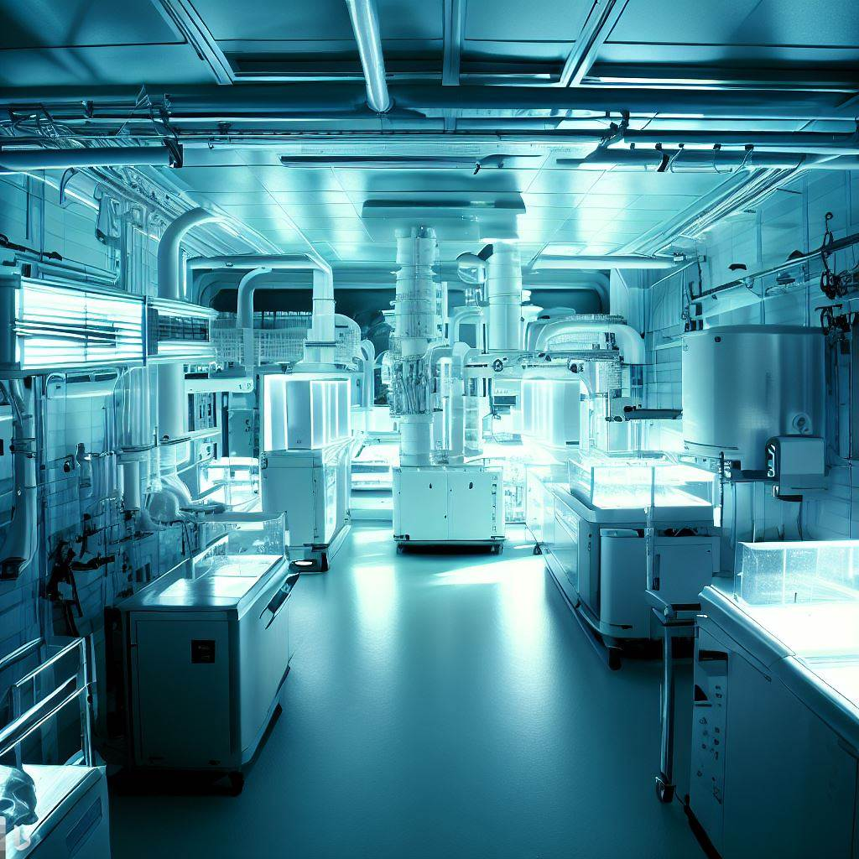
THE
GLOBAL LEADER
IN
TOTAL INFRASTRUCTURE SOLUTIONS
www.kewaunee.in
Rajesh R Solanki
Nov-2023

Slide 2


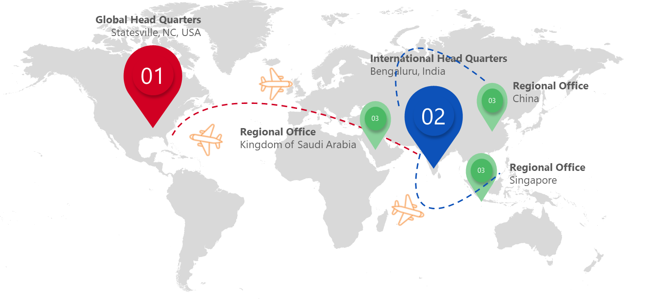
ABOUT US
$200+ M
Revenue
5,000+
Customers
WHO WE ARE
Over our 117+ years of existence, Kewaunee has grown to be a world leader in the design, manufacture, and installation of laboratory solutions and services.
Our corporate headquarters is in Statesville, North Carolina USA. The international headquarters is in Bengaluru, India.
State of the art manufacturing facilities are in Statesville serving the domestic and international markets, and another facility in Bengaluru, India serving the local and Asian markets.
NASDAQ
Established 1906
25m+ Lab Space Built
1,000+
Associates
1,050+ Turnkey Lab Projects
300,000+ Fume Hoods Installed
Global Manufacturing Plants In USA & India
Holistic Manufacturing, Infrastructure & Industry 4.0 Solutions
Offices – USA, India, Singapore, Kingdom Of Saudi Arabia
WORLDWIDE NETWORK…

Slide 3

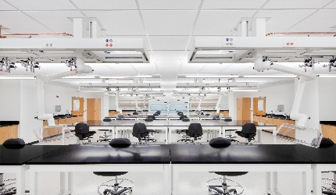
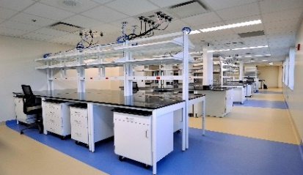
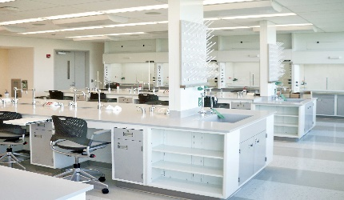
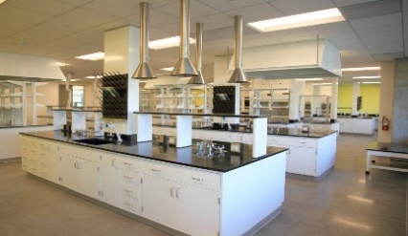

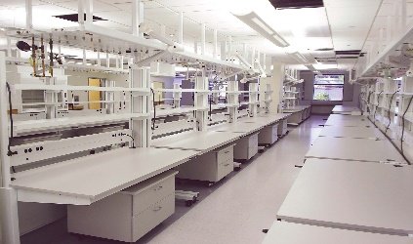
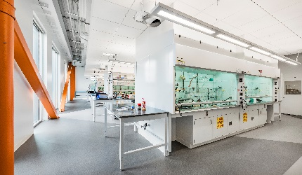
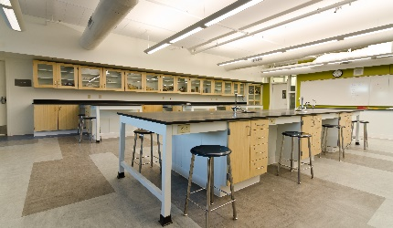
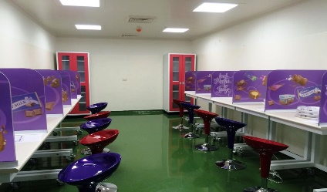
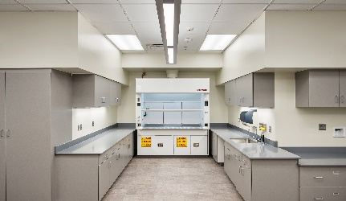
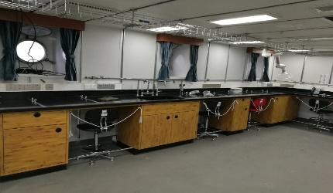
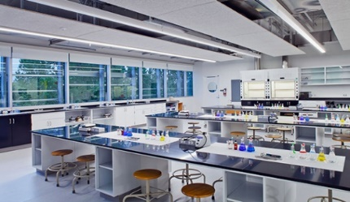
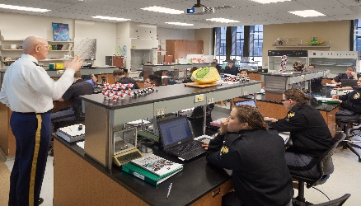
ABOUT US
INDUSTRIES WE SERVE
PHARMACEUTICALS
BIOTECHNOLOGY
CHEMICAL
PETROLEUM
ELECTRONICS & SEMICONDUCTOR
HEALTHCARE
EDUCATION
FOOD & BEVERAGE
Kewaunee’s expertise lies in designing and building facilities suited for specific industries. Having developed specialized infr. projects practically across all industry segments, we believe each industry and sector needs a tailored solution, not a template.
FRAGRANCE
MARINE RESEARCH
DEFENCE
FORENSICS

Slide 4
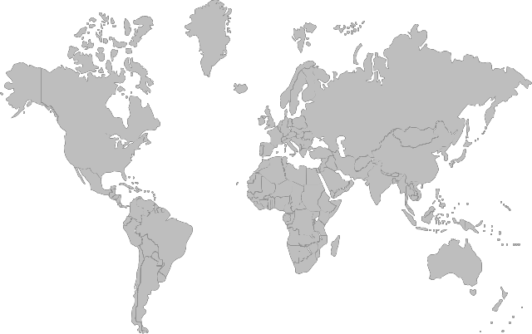
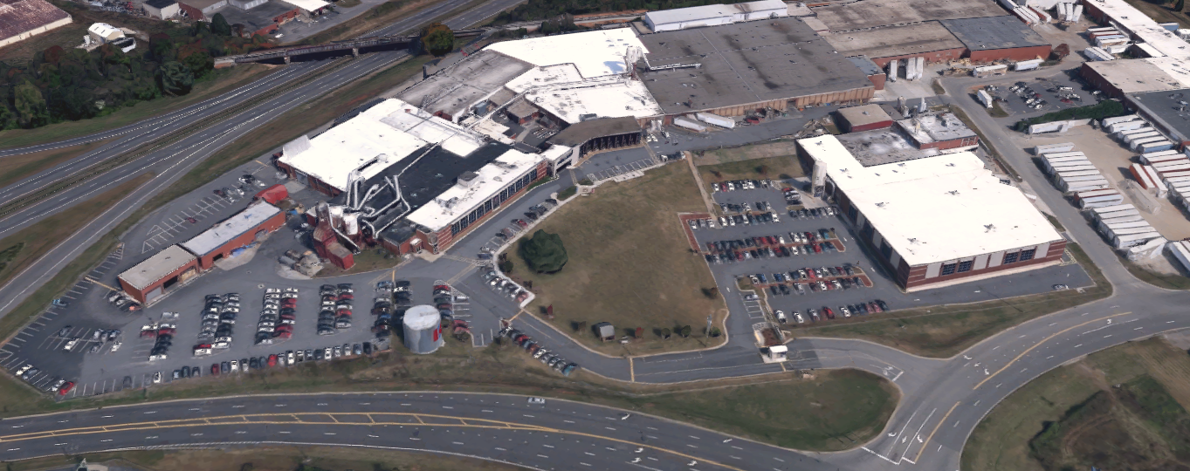
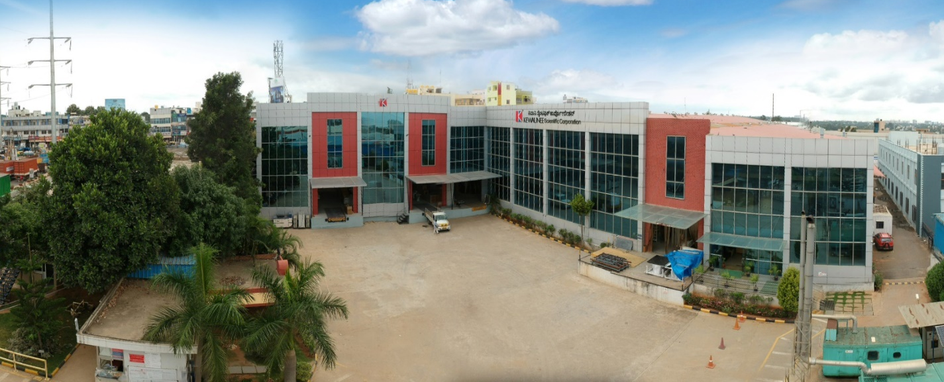
OUR GLOBAL MANUFACUTRING FACILITIES
Kewaunee Scientific Corporation
Statesville, North Carolina 28677
Kewaunee Labway India Pvt Ltd
Bangalore, India

Slide 5

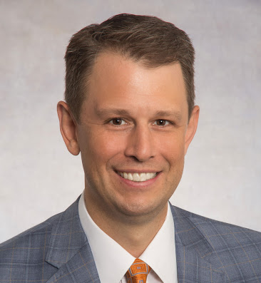
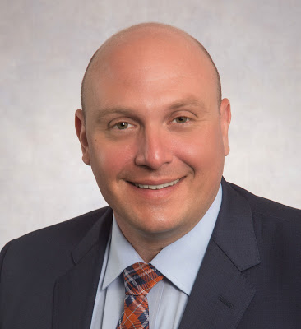
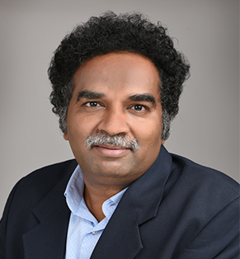

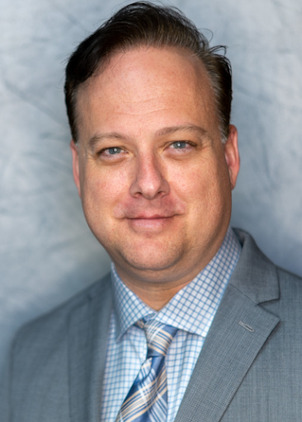
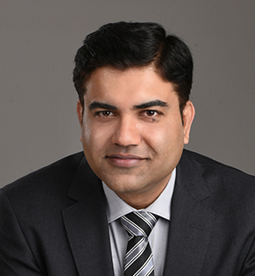
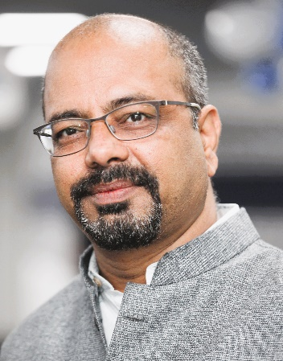
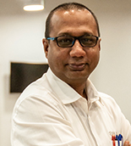
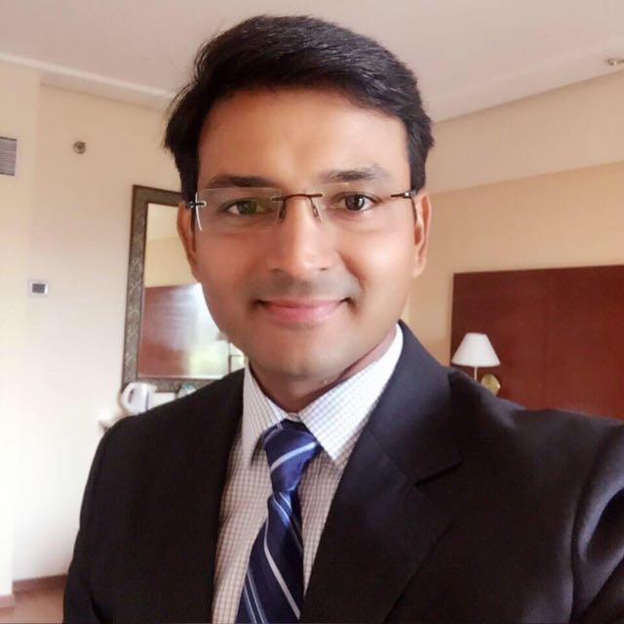
OUR TEAM
A
Thomas D. Hull III
President, Chief Executive Officer
B
Donald T Gardner III
Vice President - CFO
C
B. Sathyamurthy
VP Intl Ops (KSC), & MD Intl Ops
A
B
C
D
E
D
Kurt P Rindoks
VP – Global PD & Strategic Alliances
E
Douglas J Batdorff
VP – Manufacturing Operations
F
Srinivas P N
VP - South Asia, Middle East & Africa
G
Rajesh Solanki
Director- Semiconductor-electronics business
H
Subrato Dey
Head – Turnkey Infrastructure Solutions - India
F
G
H
I
I
Manish Dimri
Dty. General Manager – Sales & Marketing
AND A 1,000 MORE …

Slide 6

OUR CAPABILITIES
Engineering, Procurement and Construction
Industry 4.0
Products
>150 , inhouse planning, design and project engineers
>1050 green and brownfield projects delivered for varied industries
Use of latest design and project management software
Strong Financials
Laboratory and Manufacturing Domains
VR/AR based design walkthrough
IoT based infrastructure automation for safety,
CFD airflow design
K-Smart, cloud-based project management
Technical Lab Furniture
Fume hoods and LEVs
Safety Cabinets
Design & Engineering
Supply & Installation
Commissioning & Validation
After Sales Service

Slide 7
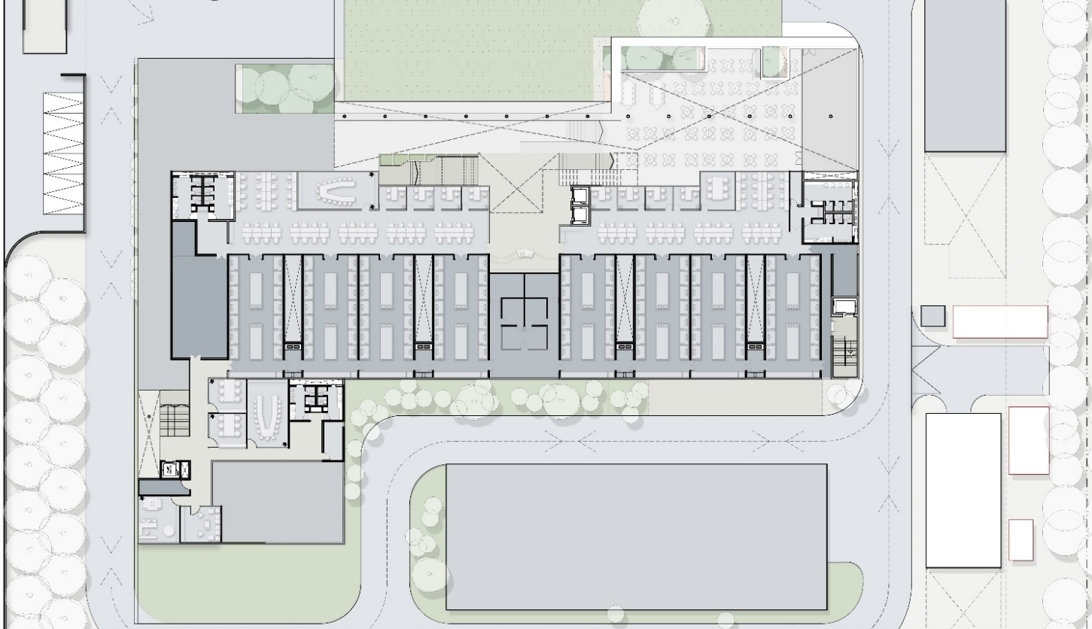
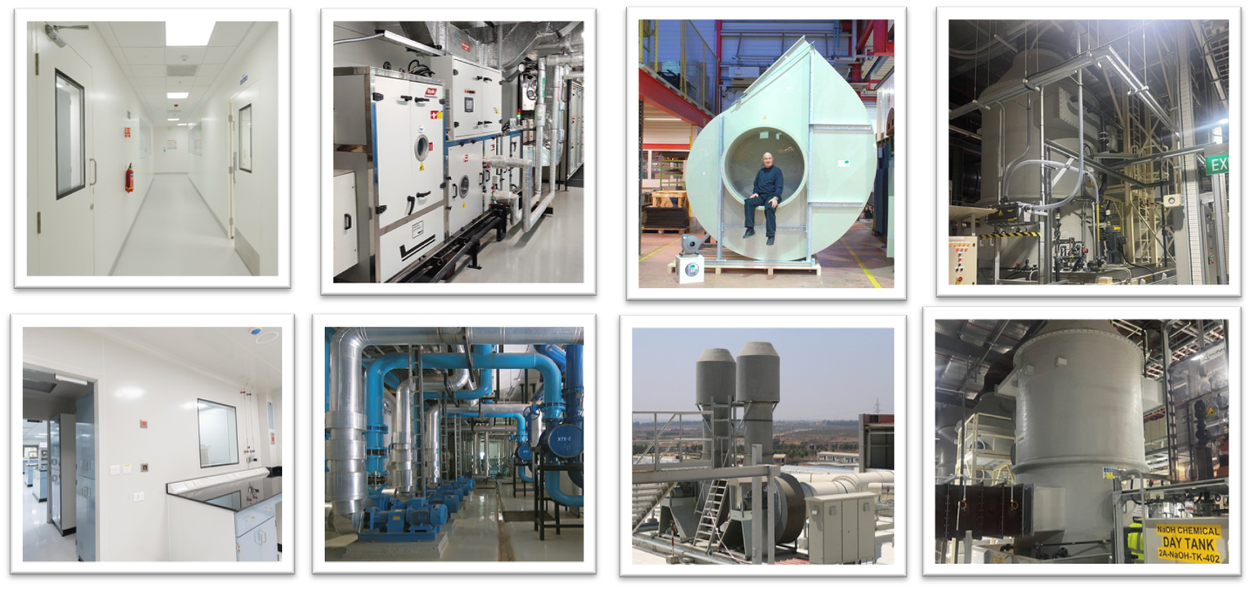
WHAT WE DO
DESIGN/ENGINEERING
FITOUT/CONSTRUCTION/INSTALLATION/COMMISSIONING/VALIDATION
CLEANROOMS
HVAC
EXHAUST
SCRUBBERS
Site feasibility
Master Plan
Concept layouts
Detailed Engineering
MoC Selection
Design & Engineering
Supply & Installation
Commissioning & Validation
After Sales Service

Slide 8
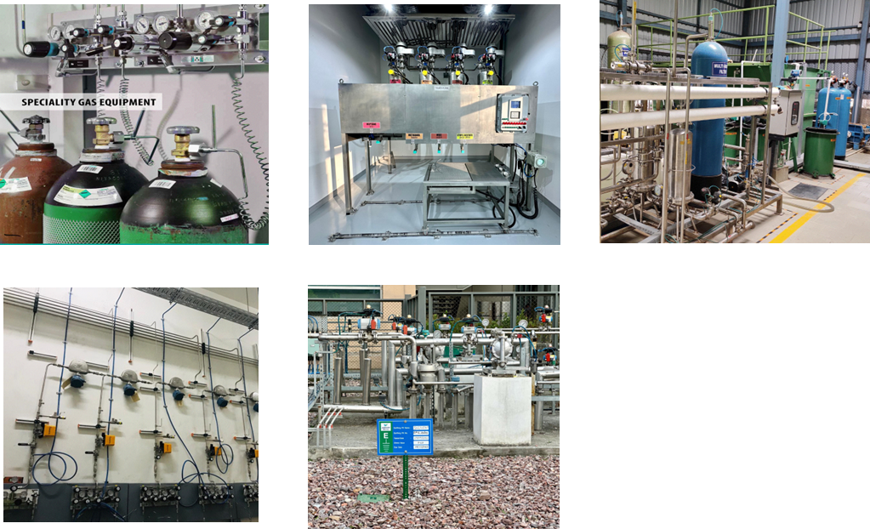
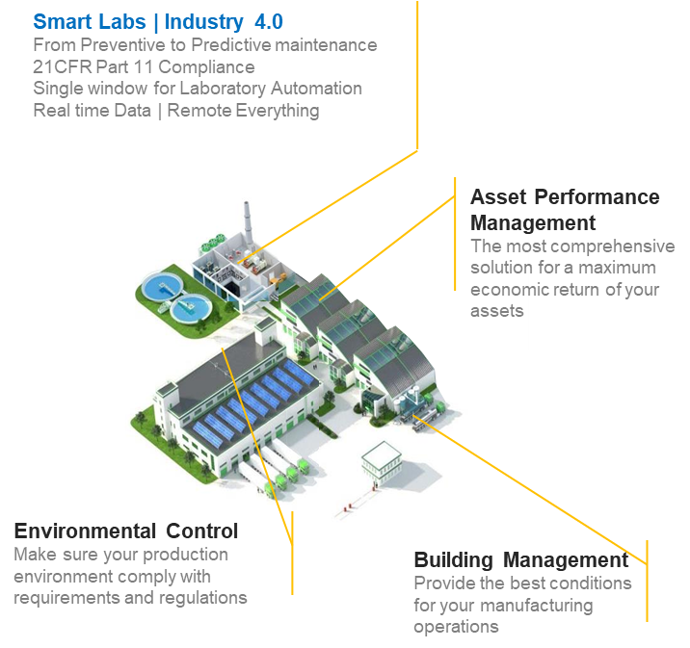
WHAT WE DO
DESIGN/ENGINEERING
FITOUT/CONSTRUCTION/INSTALLATION/COMMISSIONING/VALIDATION
GAS DELIVERY
CHEM DELIVERY
STP/ETP
AUTOMATION
Site feasibility
Master Plan
Concept layouts
Detailed Engineering
MoC Selection
Design & Engineering
Supply & Installation
Commissioning & Validation
After Sales Service

Slide 9
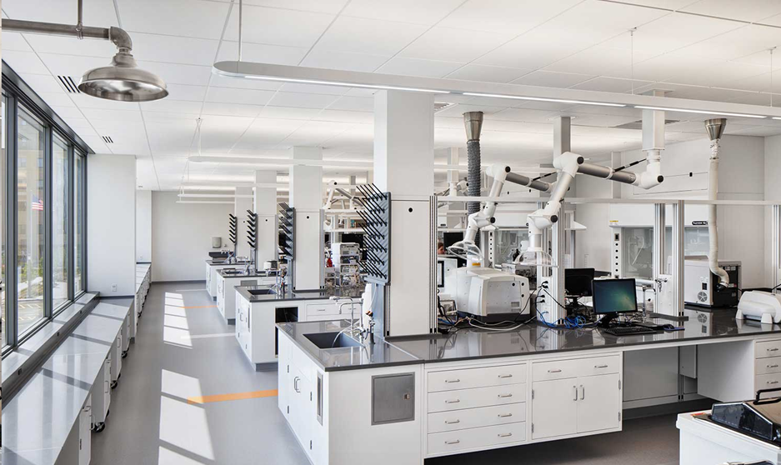
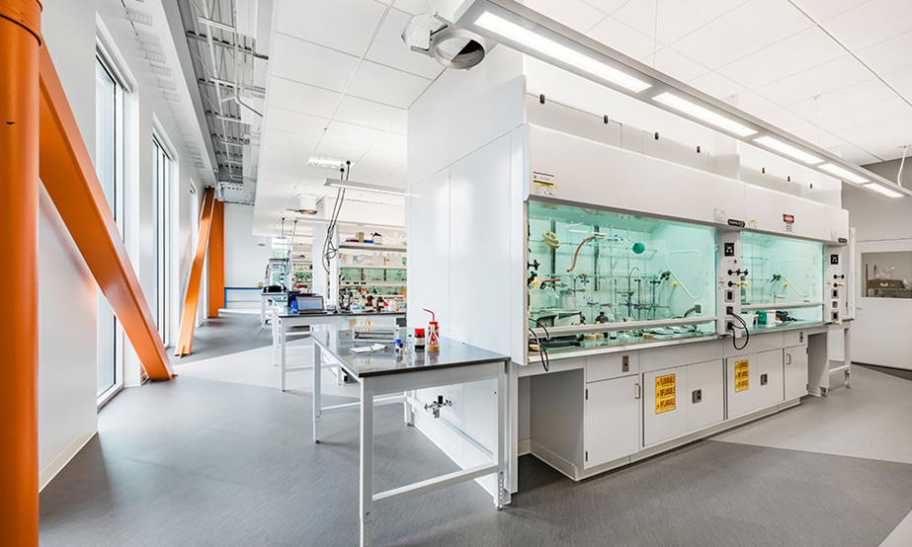
Our PRODUCTS
LAB FURNITURE
Adaptable and Caseworks based modular furniture system designed with reusability, reconfiguration and relocation
FUME HOODS
Various configuration for chemicals, radio isotopes and distillation
Benchtop and Floor mounted

Slide 10


OUR PROJECT APPROACH
USER REQUIREMENT
SPECIFICATION
2
4
TENDERING &
PROCUREMENT
COMMISSIONING &
VALIDATIONS
1
PLANNING &
DESIGN
3
EXECUTION &
CONSTRUCTION
5
BRAND
AMBASSADORS
6
PEOPLE
PROCESS
PRODUCT
WARRANTY
& AMC
MANAGED SERVICES
HANDOVER TO
OPERATIONS

Slide 11
OUR OFFERINGs…
S/N | Topics | Packages | Products |  | Internal Fitout Projects |  | Brown field Projects |  | Green field Projects
1 | Planning & Engineering Services | Package-1 | Interior furniture planning & engineering. |  | Space planning along with bench/ floor mounted equipment & basic with MEP engineering upto battery limits defined. |  | Entire building planning & full fledge Architecture & MEP engineering for entire project |  | Master plan & Architecture Engineering-with the technological aspects and multi-disciplinary approach to planning, design, construction, and operation,
2 | Civil Constructions Works | Package-2 | X |  | X |  | Minor Civil works including water proofing, building Façade |  | Major Civil works including all buildings as shown in master plan, water proofing, building Façade
3 | Internal & External Development Works | Package-3 | X |  | X |  | External Developments –Roads, Compound Walls, Signages, Pavers etc |  | External Developments –Roads, Compound Walls, Signages, Pavers etc
 |  | Package-4 | X |  | Interiors -Modular partition systems, flooring, painting, ceiling any other basic woodworks |  | Interiors -Modular partition systems, flooring, painting, ceiling any other basic Woodwork |  | Interiors -Modular partition systems, flooring, painting, ceiling any other basic Woodwork
 |  | Package-5 | X |  | X |  | Landscape -both soft & hard Scape as per master plan |  | Landscape -both soft & hard Scape as per master plan
 |  | Package-6 | X |  | X |  | Passenger & Service Lifts System |  | Passenger & Service Lifts System
4 | Laboratory Fume hoods & Lab Caseworks | Package-7 | Ventilation System & Accessories |  | Ventilation System & Accessories |  | Ventilation System & Accessories |  | Ventilation System & Accessories
 |  | Package-8 | Furniture System & Accessories |  | Interior Furniture System & Accessories |  | Inteirior Furniture System & Accessories |  | Interior Furniture System & Accessories
 |  | Package-9 | Exhaust System & Accessories including Scrubber & Blower |  | Exhaust System & Accessories including Scrubber & Blower |  | Ventilation Exhaust System & Accessories including Scrubber & Blower |  | Ventilation Exhaust System & Accessories including Scrubber, PP Blower
 |  | Package-10 | VAV System & Accessories |  | VAV System & Accessories |  | Fume hood VAV System & Accessories |  | Fume hood VAV System & Accessories

Slide 12
Our offerings
S/N | Topics | Packages | Products |  | Internal Fitout Projects |  | Brown-Field Projects |  | Green Field Projects
5 | MEP Services | Package-11 | X |  | Gas Distribution System |  | Gas Distribution System |  | Gas Distribution System
 |  | Package-12 | X |  | PHE distribution upto battery limit defined |  | PHE distribution, Hydro-Pneumatic System |  | PHE distribution, Hydro-Pneumatic System
 |  | Package-13 | X |  | HVAC System (low side System) along with AHU's |  | HVAC System (High & low side System) along with VRF/ Air/Water cooled Chiller |  | HVAC System (High & low side System) along VRF/ Air/Water cooled Chiller
 |  | Package-14 | X |  | Electrical System (low side System) upto inside floor levels |  | Electrical System (both HT & LT) |  | Electrical System (both HT & LT)
 |  | Package-15 | X |  | X |  | Networking System -DATA and Voice System (Only Passive) |  | Networking System -DATA and Voice System (Only Passive)
 |  | Package-16 | X |  | X |  | IBMS-Integrated Building Management Systems |  | IBMS-Integrated Building Management Systems
6 | Safety Systems | Package-17 | X |  | Safety System Consisting of: FAS, PA, CCTV, Access Control upto inside floor levels |  | Safety System Consisting of: FAS, PA, CCTV, Access Control |  | Safety System Consisting of: FAS, PA, CCTV, Access Control
 |  | Package-18 | X |  | Gas Leak detection System |  | Gas Leak detection System |  | Gas Leak detection System
 |  | Package-19 | X |  | X |  | Fire Hydrant System |  | Fire Hydrant System
 |  | Package-20 | X |  | Gas Suppression System in Solvent Rooms. |  | Gas Suppression System in Solvent Rooms. |  | Gas Suppression System in Solvent Rooms.
 |  | Package-21 | X |  | X |  | Safety Signage -Internal & External |  | Safety Signage -Internal & External
7 | Modular Furniture System | Package-22 | X |  | X |  | Modular Furniture's for office & canteen, including Chairs & Sofas for reception & Admin |  | Modular Furniture's for office & canteen, including Chairs & Sofas for reception & Admin
8 | Plant & Utilities for Laboratory usage | Package-23 | X |  | X |  | Common Effluent Treatment Plant |  | Common Effluent Treatment Plant
 |  | Package-24 | X |  | X |  | Nitrogen Plant |  | Nitrogen Plant
 |  | Package-25 | X |  | X |  | Water Treatment Plant (RO) Plant System & Accessories |  | Water Treatment Plant (RO) Plant System & Accessories
 |  | Package-26 | X |  | X |  | Diesel Generator Sets with HSD yard |  | Diesel Generator Sets with HSD yard
 |  | Package-27 | X |  | X |  | Air Compressor & Vacuum Pump |  | Air Compressor & Vacuum Pump
 |  | Package-28 | X |  | X |  | Process Chiller Lab application |  | Process Chiller Lab application
 |  | Package-29 | X |  | X |  | Steam Boiler |  | Steam Boiler
9 | Sustainable energy & Leed Certification | Package-30 | X |  | X |  | Solar Panels |  | Solar Panels
 |  | Package-31 | X |  | X |  | IGBC - Green Interiors for Gold/ Platinum for the building |  | IGBC - Green Interiors for Gold/ Platinum for the campus
10 | Digital Solutions ( IOT) | Package-32 | X |  | X |  | Kewaunee Green Guardian - IOT Based Laboratory Health Monitoring System |  | Kewaunee Green Guardian - IOT Based Laboratory Health Monitoring System

Slide 13

PRODUCTS and engineering standards

Slide 14

OUR CLIENTS
Partnering Top Fortune 500 Companies in Semiconductor & Electronics industry

Slide 15

OUR CLIENTS
Partnering Top Fortune 500 Companies in Solar Energy

Slide 16

OUR CLIENTS
Partnering Top Global Companies in Cell & Battery innovation & technology

Slide 17
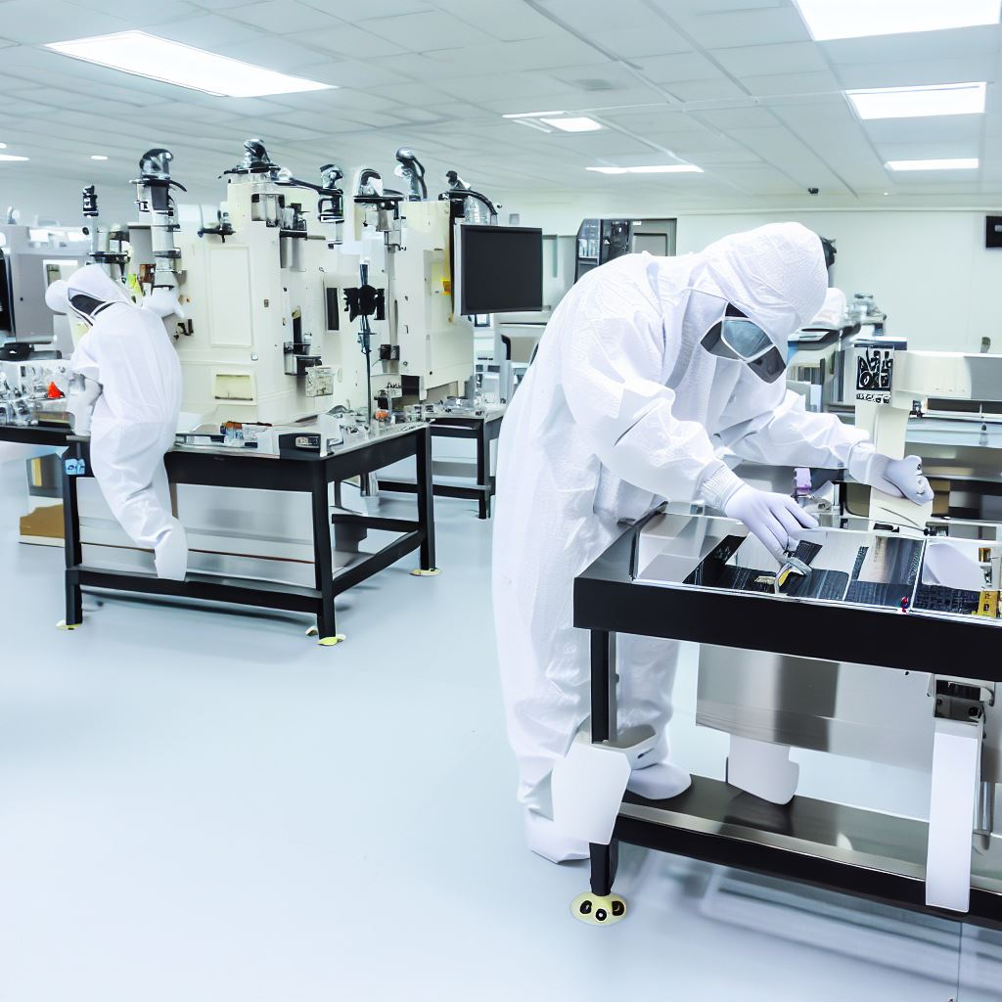
Thank you!
Rajesh.Solanki@kewaunee.in
httpS://www.KEWAUNEE.IN

