Slide 1

Welcome to Presentation
By
TUV – Product Testing Lab , India.

Slide 2
About Product Testing
Two state of the art laboratories, one in Pune and the other one in Bengaluru.
Support Global market requirements of testing and certifications.
TUV India support testing for European directives like LVD, EMC, Machinery etc.
Complete product compliance / pre-compliance testing is possible at both Laboratories.
On-site testing support at manufacture location over PAN India

Slide 3
Unique FEATURES PTL:
Accreditation for Medical Electrical Devices Testing under NABL. Such a facility is offered by very few in INDIA. Devices such as ECG Monitor, ECG Machine, Infusion Pump, Syringe Pump, Radiant Wamer, BP appratus etc. can be tested as per the applicable Standards.
State of art facility for Vibration Testing which can support testing upto 6000Kgf. A unique facility compared to compititors.
Walk-In Climatic Chamber (3 Cubic Meter Volume) to support testing of Industrial Control Panels, Defence Equipments and Large Machineries
EV being the future of transporation, TUV India PTL is ready to cater to Cell & Battery Pack manufacturers with state of the art testing facility, helping them to meeting their quality and compliance requirements.

Slide 4
Overview of capabilities
Services Offered:
    EMI-EMC Testing (Compliance/Pre Compliance Testing) (In-house & Onsite)
    Battery Testing
    Consumer Electronics & Household Appliances Testing
    EMC Testing for Railway Applications
    Telecom Product Testing as per TEC Regulations (MTCTE)
    Control Panel Testing
    Machinery Testing
    Testing & Measuring Equipment Testing
    Light Fixture & Component Testing
    Power Supplies, Stabilizers & Power Converter Testing
    Mechanical, Environmental & General Testing Services (Vibration & Shock Table, Climatic & Thermal Shock Chamber, Ingress Protection (IP) Testing, Salt Spray testing )

Slide 5











Who are our customers
Any company that is into manufacturing of electrical & electronics products like machines, Home appliances, Information technology, Audio Video & Railway application products is our potential clients.
Moreover , if they are exporting to EU they need certification in which we can support with testing along with certification.
Any product that operates on a power supply ranging from 5V to 1500V would require the testing offered by us.

Slide 6
Our Unique Selling Proposition
Our value added services
MNC test lab services with competitive test charges with other labs
One stop testing and certification solution
Flexibility to fulfil customer requirement.

Slide 7



MAJOR ACCREDITATION OF OUR LAB
National Accreditation Board for Testing and Calibration Laboratories (NABL) / ISO 17025
Bureau of Indian Standards (BIS)
Telecommunication Engineering Centre (TEC)
International Laboratory Accreditation Cooperation (ILAC)

Slide 8
SERVICES WE CAN OFFER THROUGH OUR PRODUCT TESTING LAB
Service | On Site | In House
Safety Testing as per LVD & MD | Yes | Yes
EMC Pre-Compliance Testing | Yes | Yes
EMC Compliance Testing | Yes | Yes
Environmental Testing (Chamber) | No | Yes
Battery Testing | No | Yes
Medical Device Testing | No | Yes
IP, Vibration, Shock & Salt Mist test | No | Yes
Type Testing as per Standard | Yes | Yes
BIS Mandatory Testing | No | Yes

Slide 9
Test Facility Capability - Product Wise
In House | On Site
Audio/Video Products | Commercial and light Industrial Machinery
Information Technology Products | Bulky UPS
Uninterrupted Power Supply | Machineries
Medical Devices | Large Control Panel
Laboratory use Equipments
VFD
Motor
Telecom Equipments
IVD Products
Battery testing

Slide 10
EMI/EMC Testing
EMC: Electromagnetic Compatibility
  Emissions: Unwanted radiated and conducted electrical energy
  Immunity: Undesirable response to external electrical energy
EMI: Electromagnetic Interference

Slide 11
EMI / EMC TEST AS PER CISPR/IEC/EN
Conducted Emission Test - 150KHz to 30MHz.
Radiated Emission (OATS) Test - 30MHz to 6GHz.
Magnetic Field Measurement (OATS - Loop Antenna) - 150KHz to 30MHz
Discontinuous Emission (Click) Test - 150KHz to 30MHz.
Disturbance Power Test - 30MHz to 300MHz.
Harmonic Emission Test - 1ф, 16A (230VAC, 50Hz)
Voltage Fluctuation and Flicker Emission Test - 1ф, 16A (230VAC, 50Hz)
ESD Immunity Test - ±30 KV Air Discharge, ±15 KV Contact Discharge.
Conducted RF Immunity Test - 150KHz to 230MHz (up to 30Vrms)
EFT / Burst Immunity Test – Up to ±5.3 KV.
Surge Immunity Test – Up to ±6.6 KV
Telecom Surge - 10/700μs.
Power Frequency Magnetic Field Test (Up to 30 A/m)

Slide 12
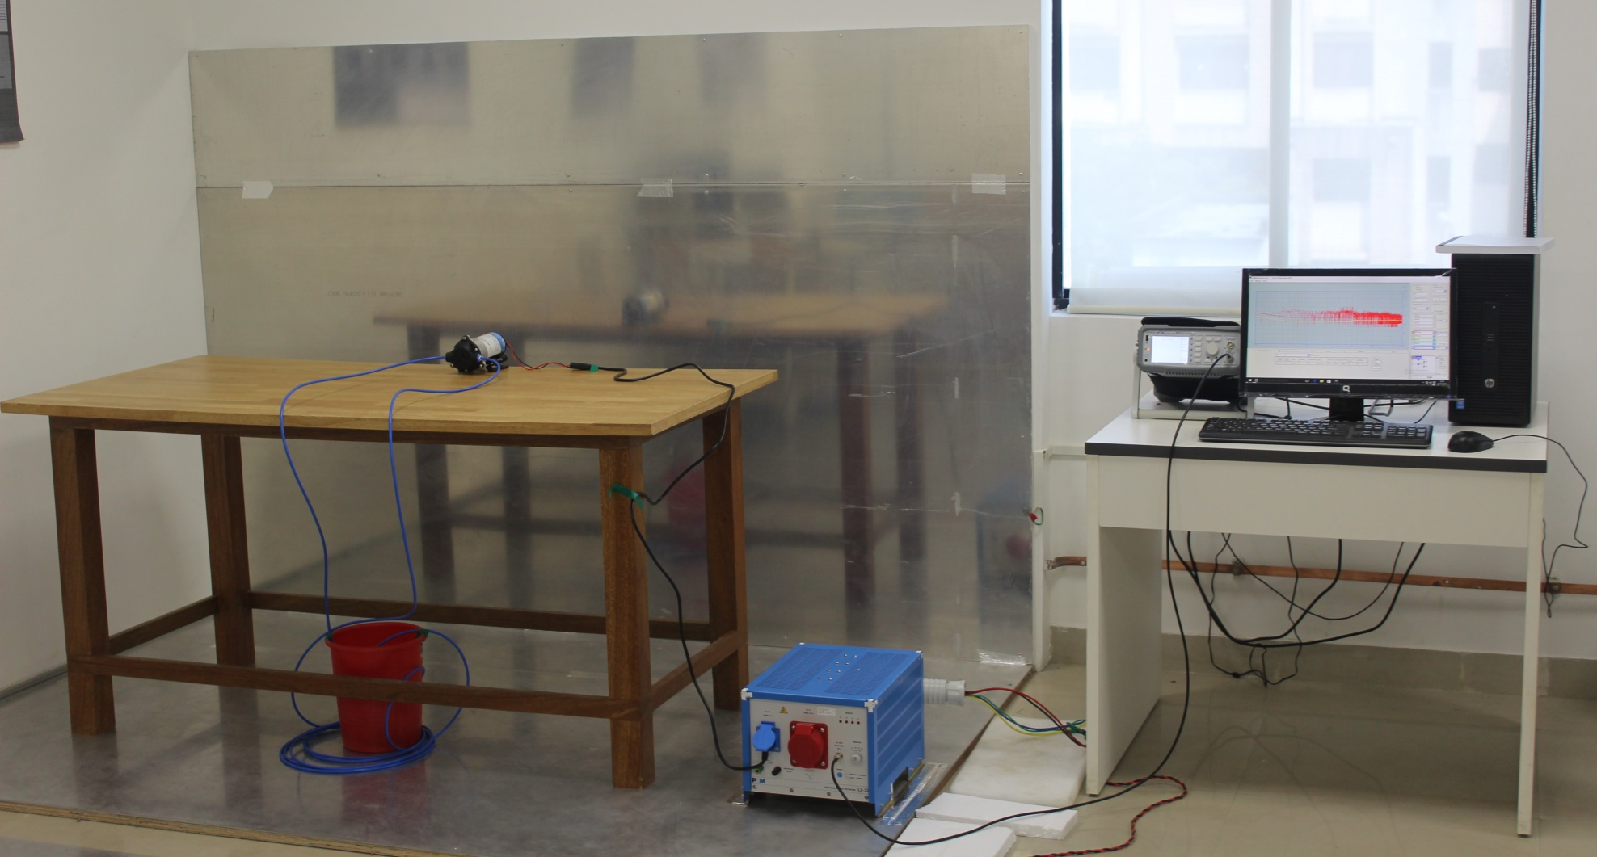
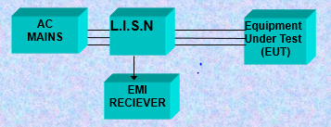
Conducted Emission Test SETUP
The test set-up consists of:
A Line Impedance Stabilization Network (LISN), which separates noise from mains
This noise is measured by a EMI Receiver/Spectrum Analyzer.
The RECIEVER has three type of detectors Peak, Quasi peak and Average

Slide 13
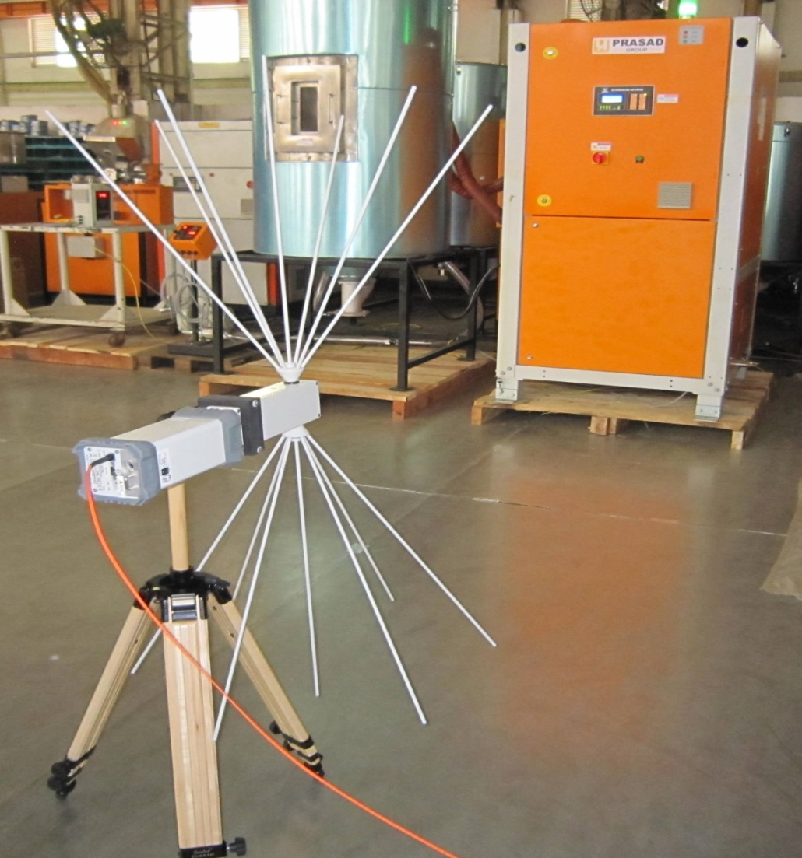
Radiated Emission Test (On Site TESTING)

Slide 14
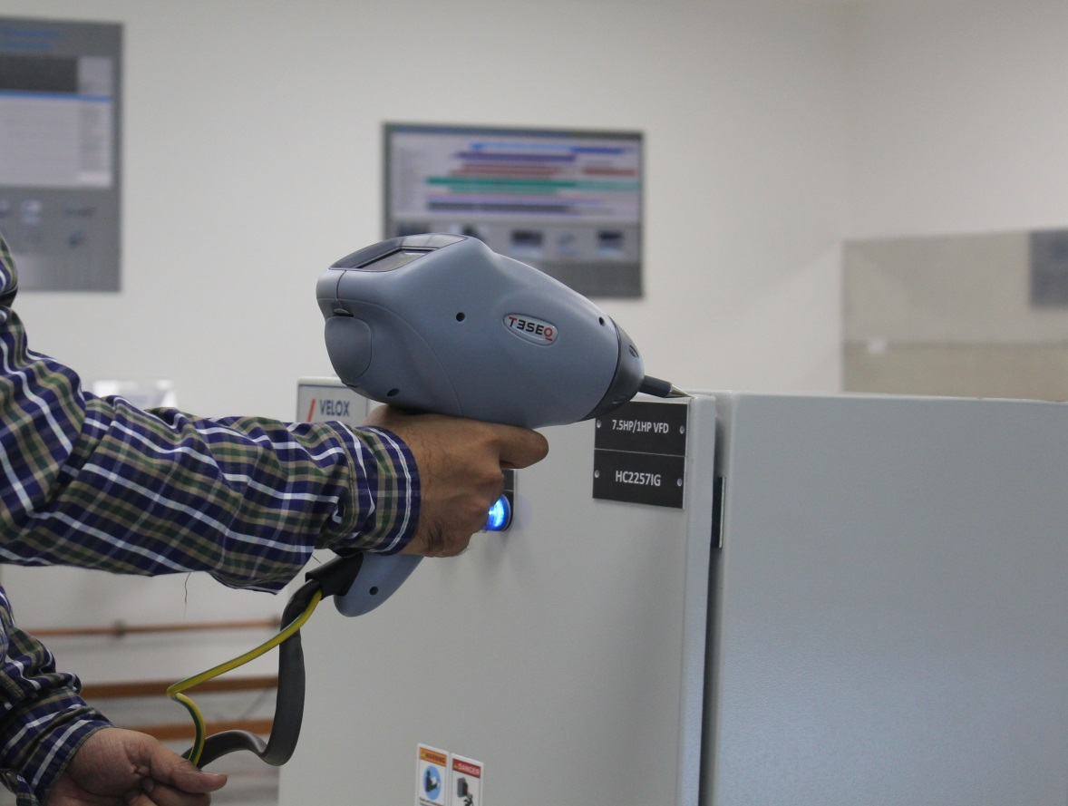
Electro Static Discharge Test
OBJECTIVE Used to test the effect of Discharge of Static Electricity when a charged operator touches an equipment

Slide 15
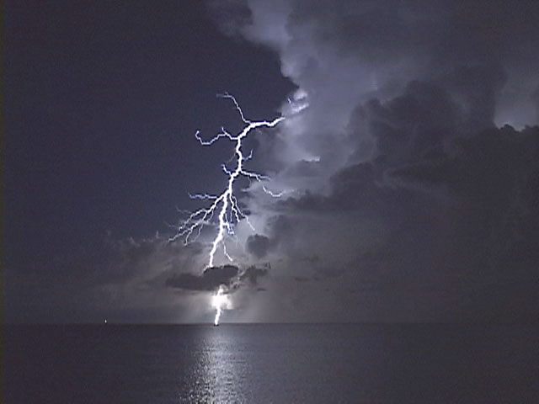
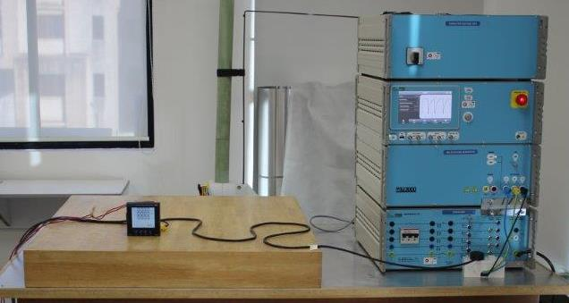
Surge Immunity
Mostly a problem of lightning being injected into the power mains or other cables

Slide 16
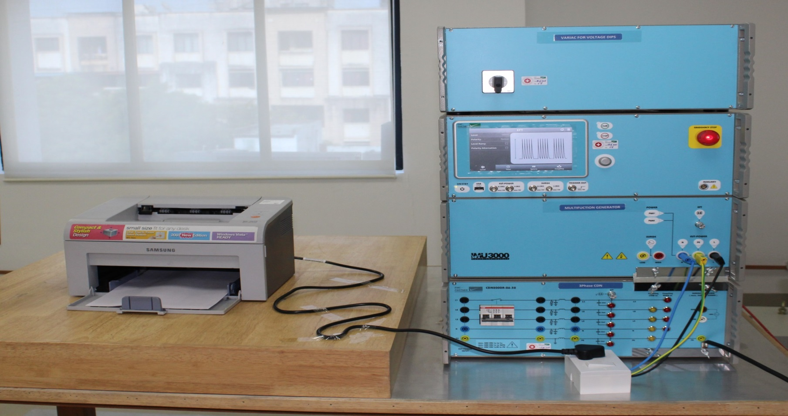
ELECTRIC FAST TRANSIENT/BURST TEST

Slide 17
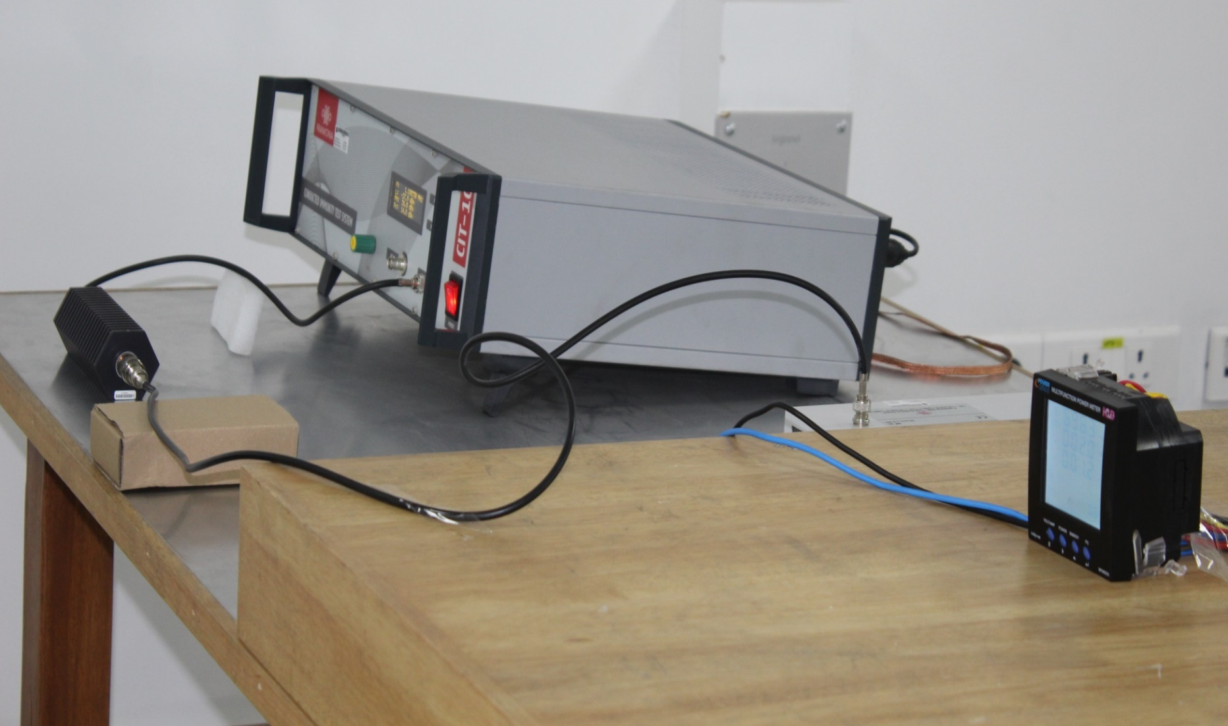
CONDUCTED RF IMMUNITY TEST

Slide 18
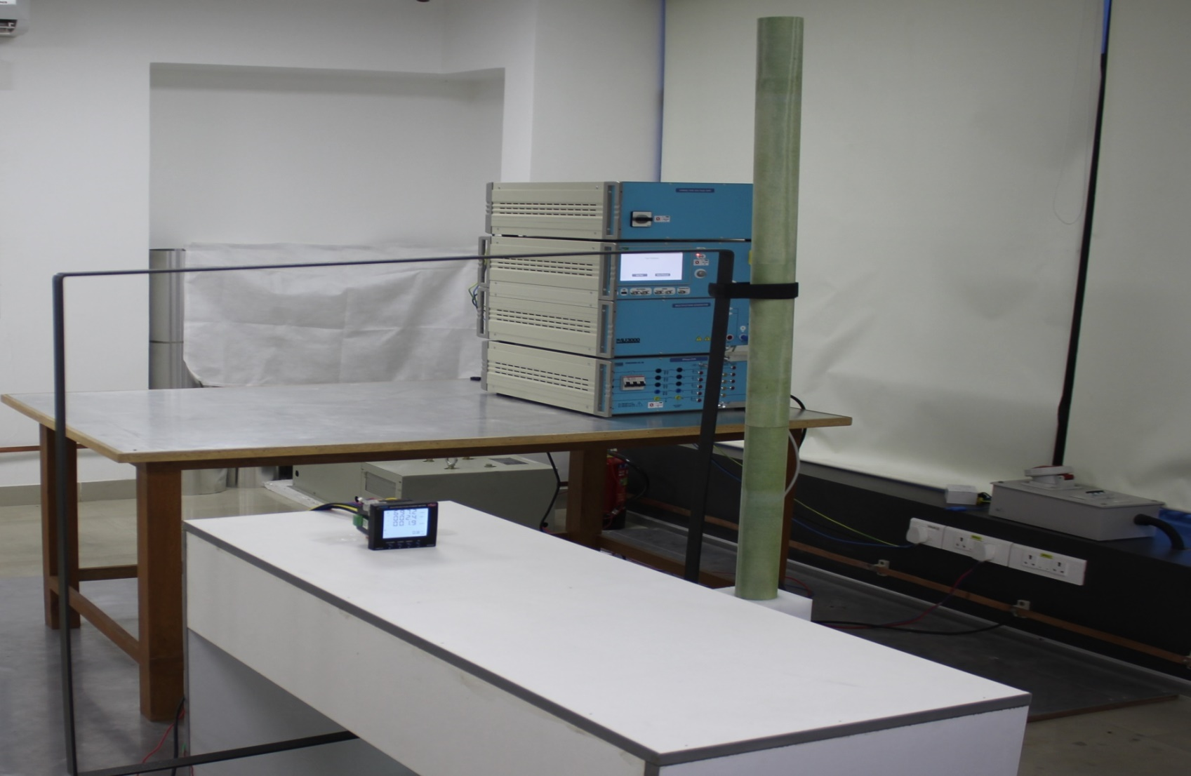
POWER FREQUENCY MAGNETIC FIELD TEST

Slide 19
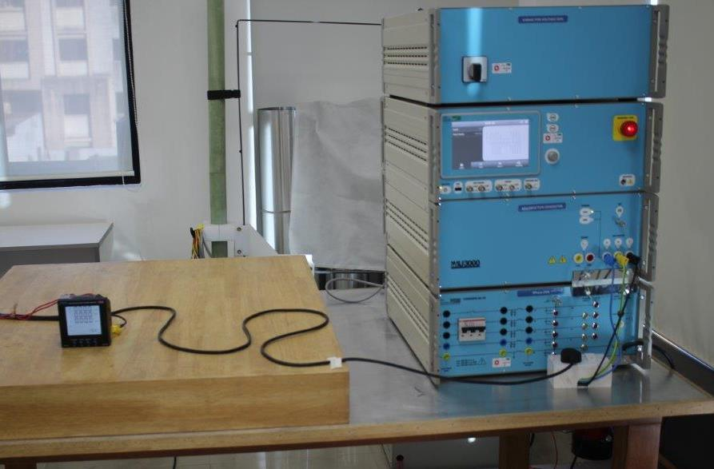
VOLTAGE DIPS & INTERRUPTION TEST

Slide 20
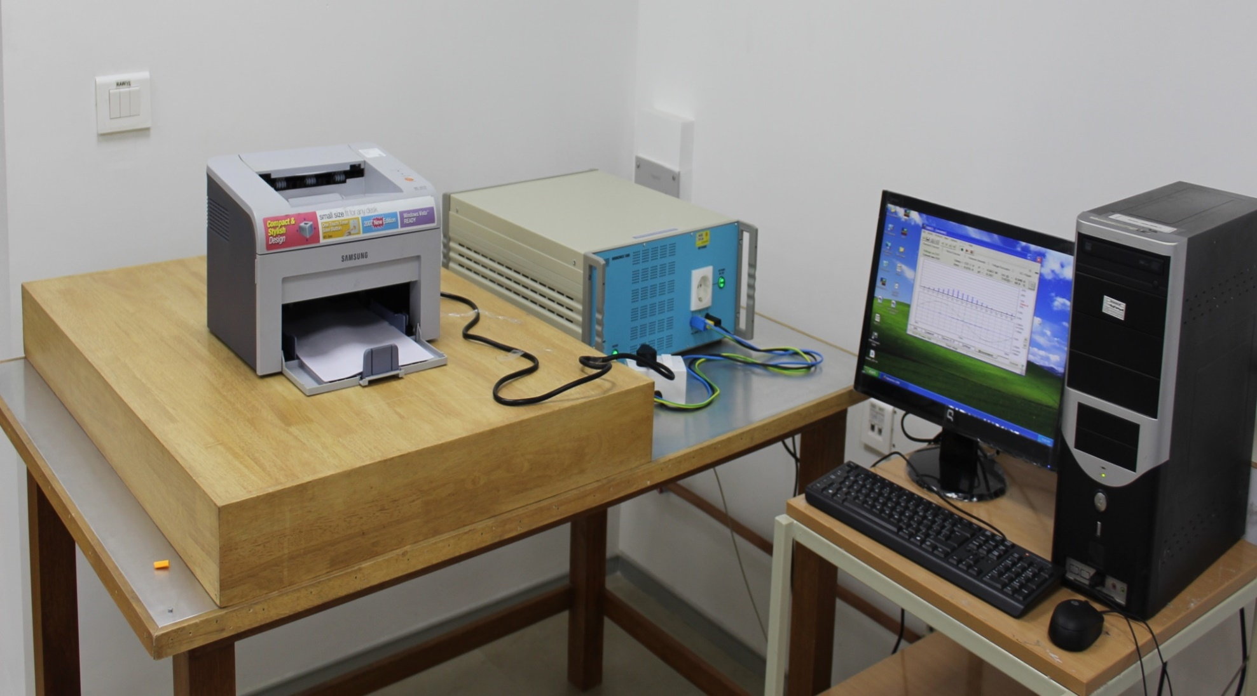
HARMONICS & Flicker EMISSION TEST

Slide 21
Key Tests Performed : Electrical Safety
Insulation resistance test
Temperature rise test
Leakage Current
Impulse test
Resistance to Dust & Moisture
Resistance to Corrosion
Electric Strength
Impact test
Stability test
Creepage & clearance distance measurement
Power Measurement

Slide 22
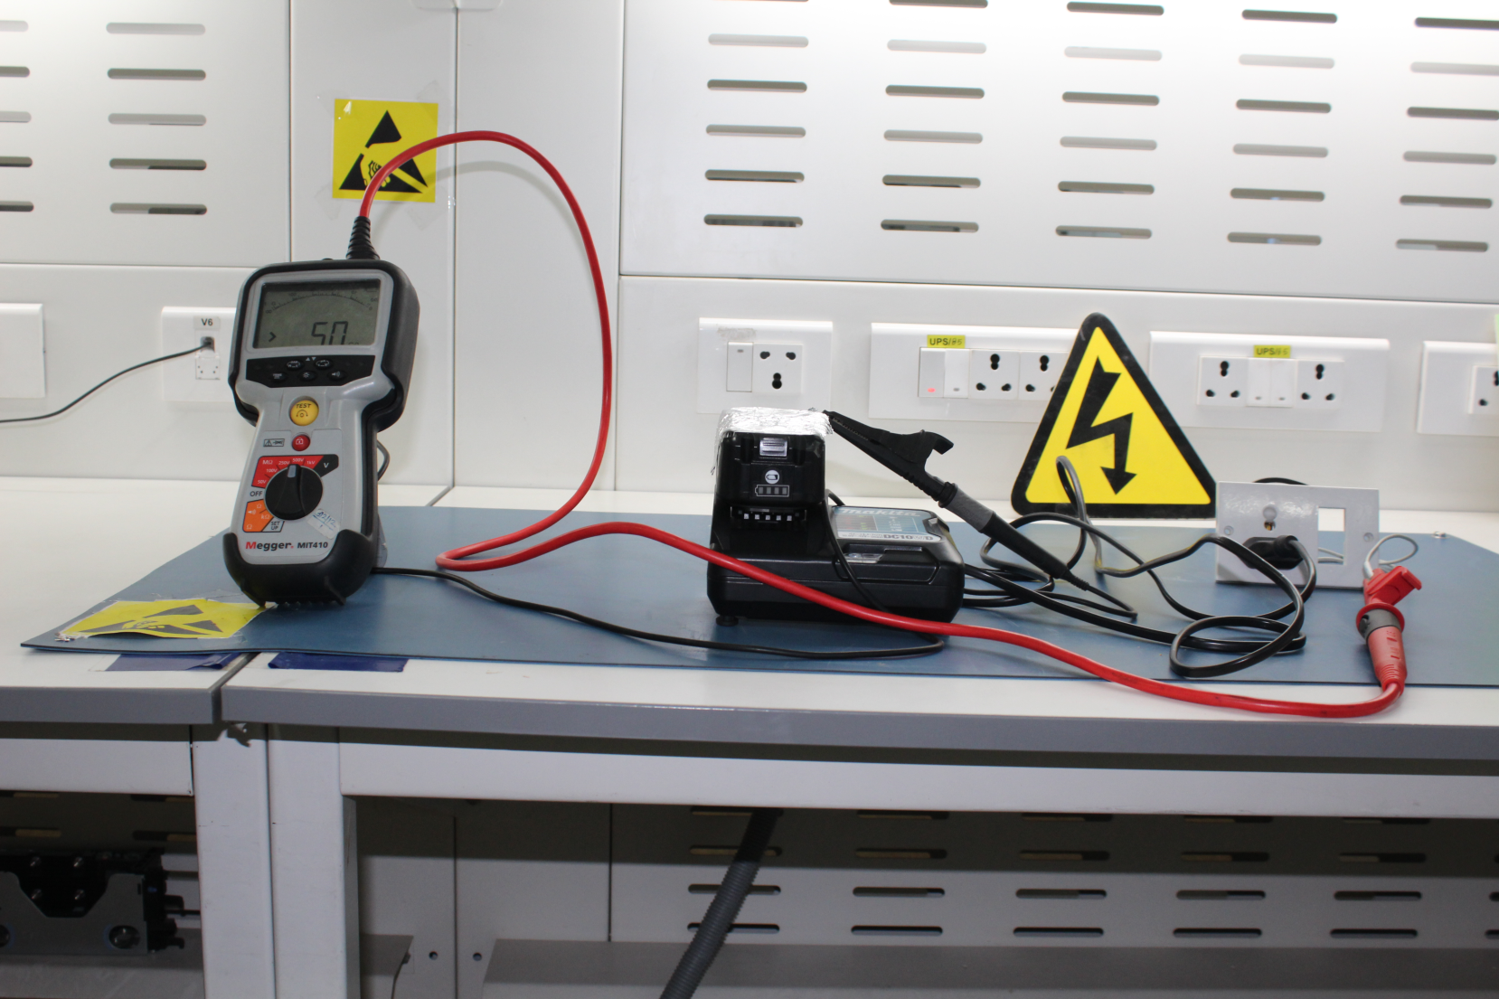
INSULATION RESISTANCE TEST

Slide 23
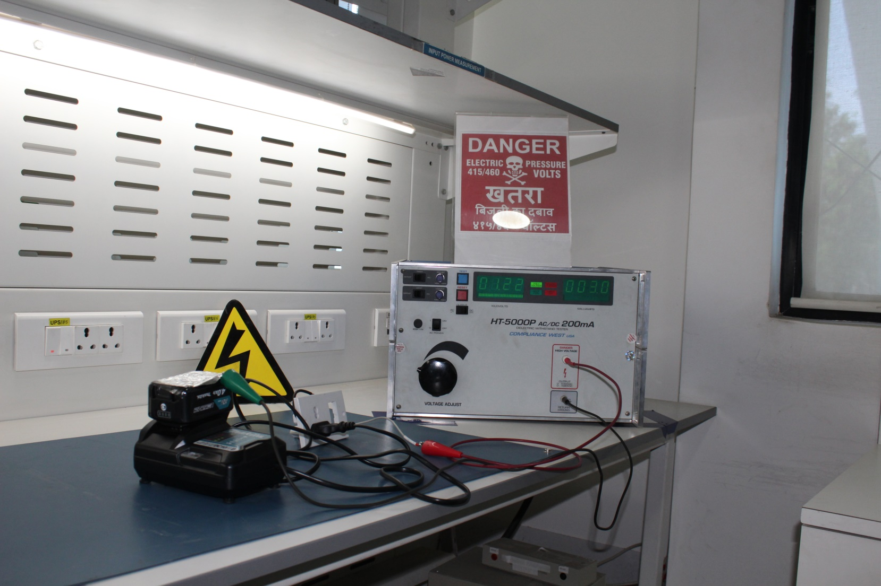
High Voltage Test

Slide 24
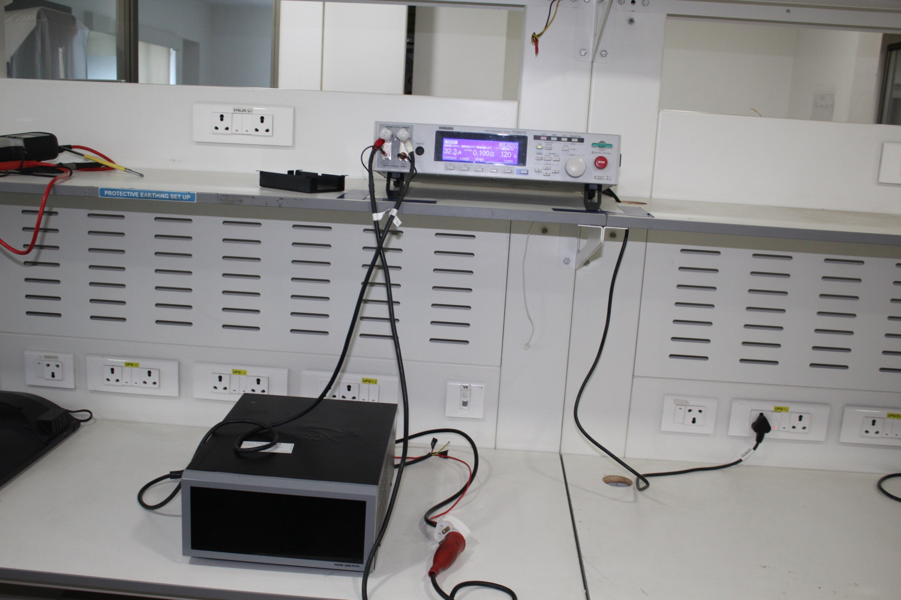
Ground bond test

Slide 25
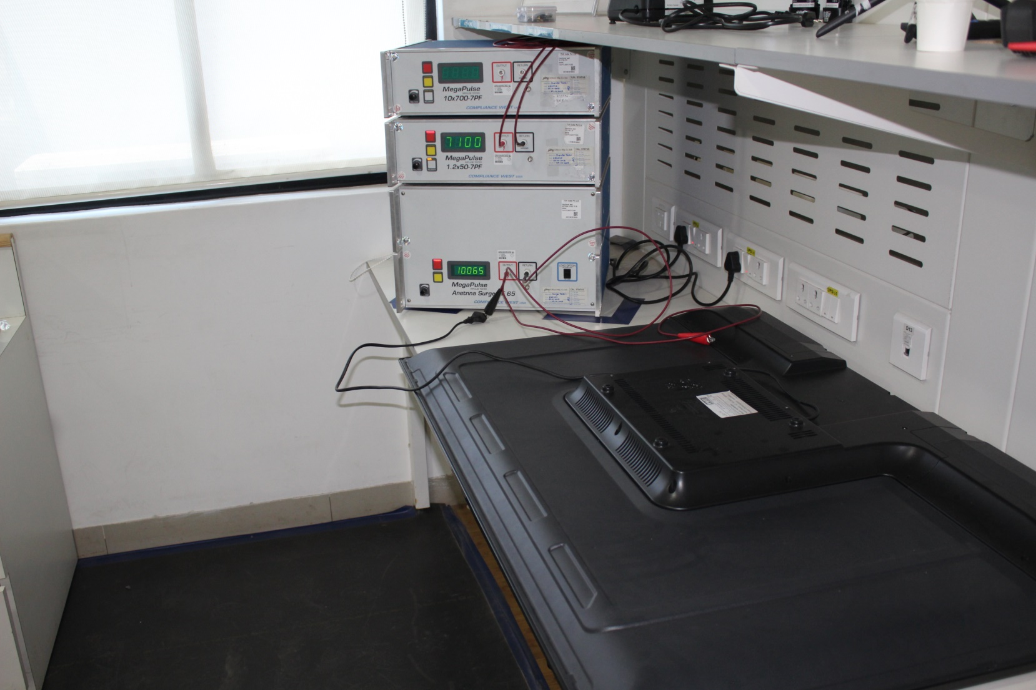
IMPULSE, Antenna surge test

Slide 26
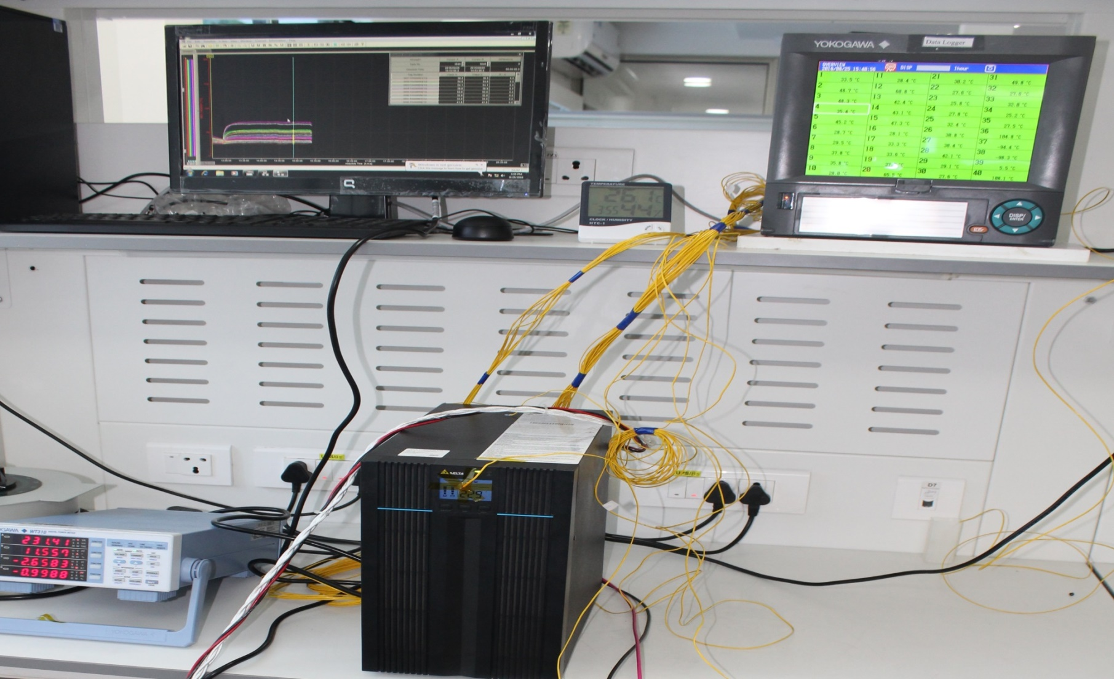
Temperature Rise Test setup

Slide 27
Flammability testing
Glow Wire Test
Needle Flame Test
Ball-Pressure Test

Slide 28
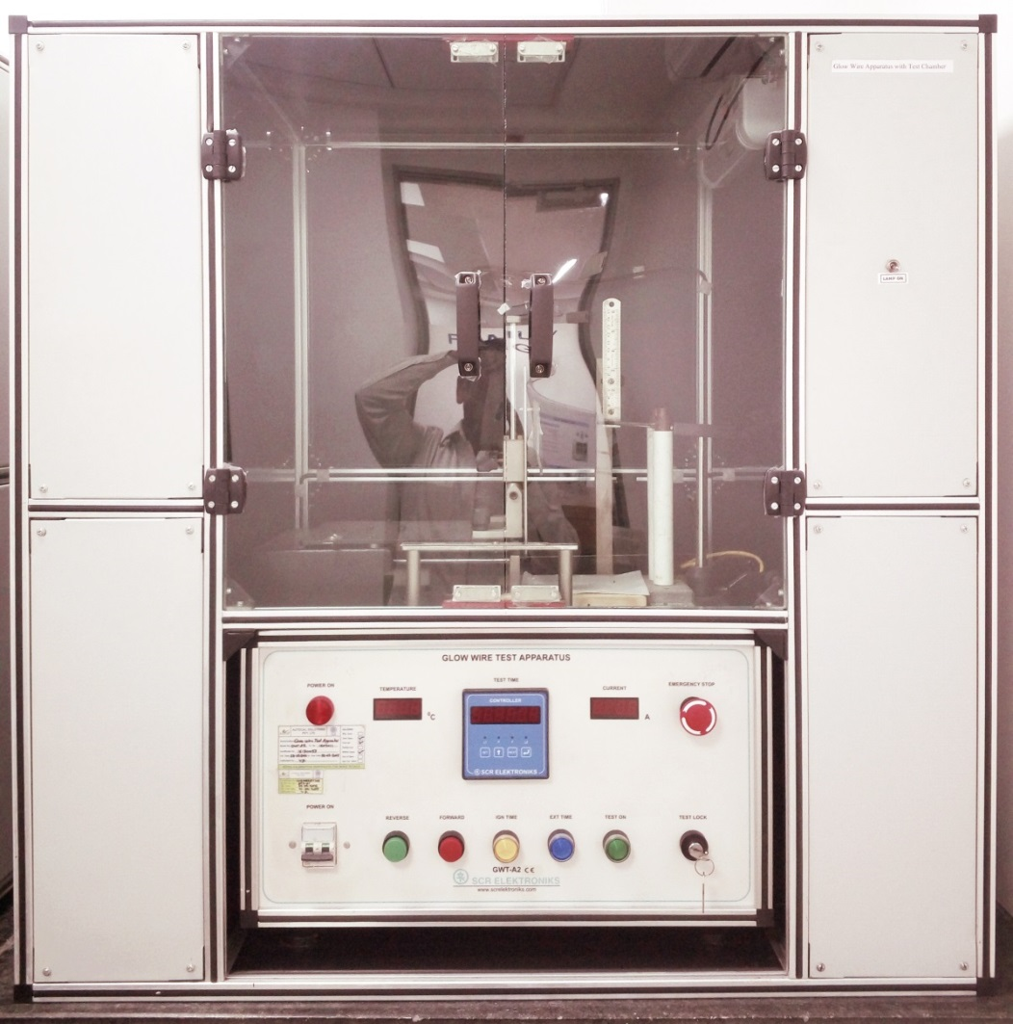
Glow Wire Tester Apparatus

Slide 29
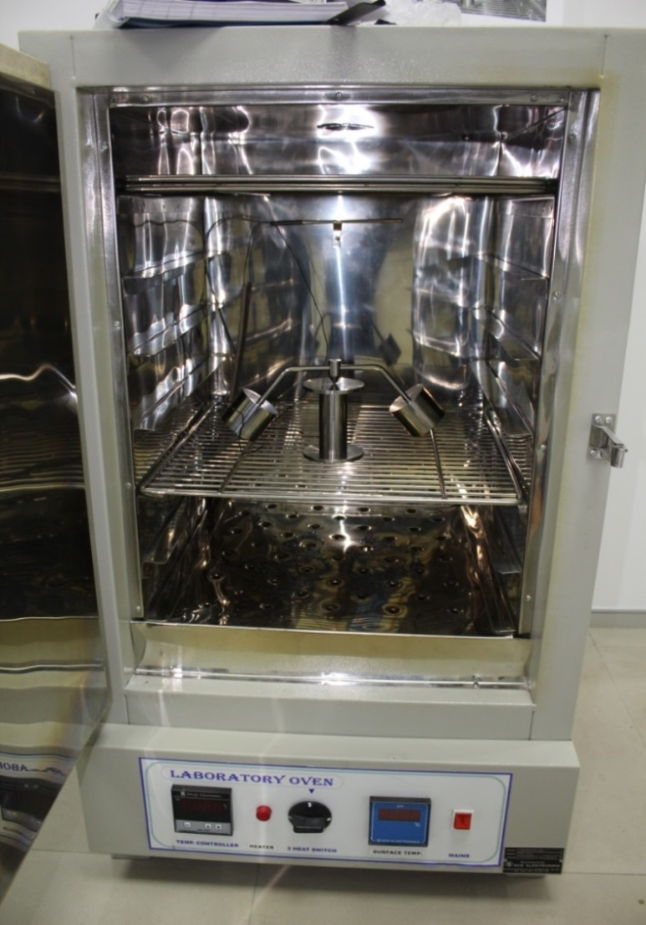
Ball Pressure Test apparatus

Slide 30
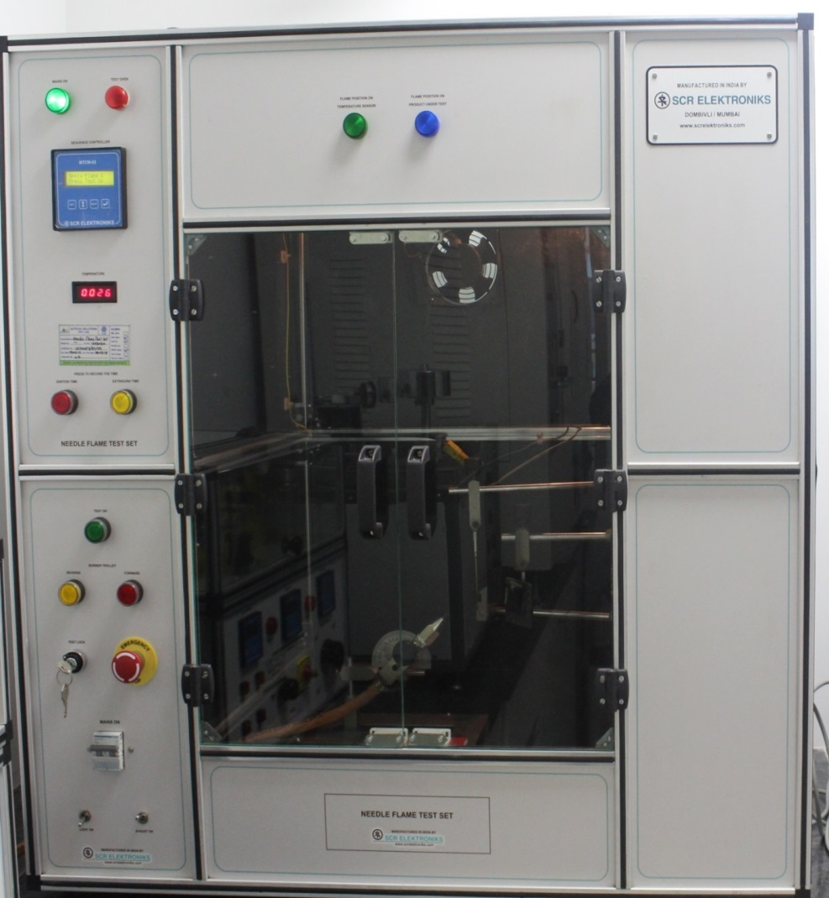
Needle flame

Slide 31
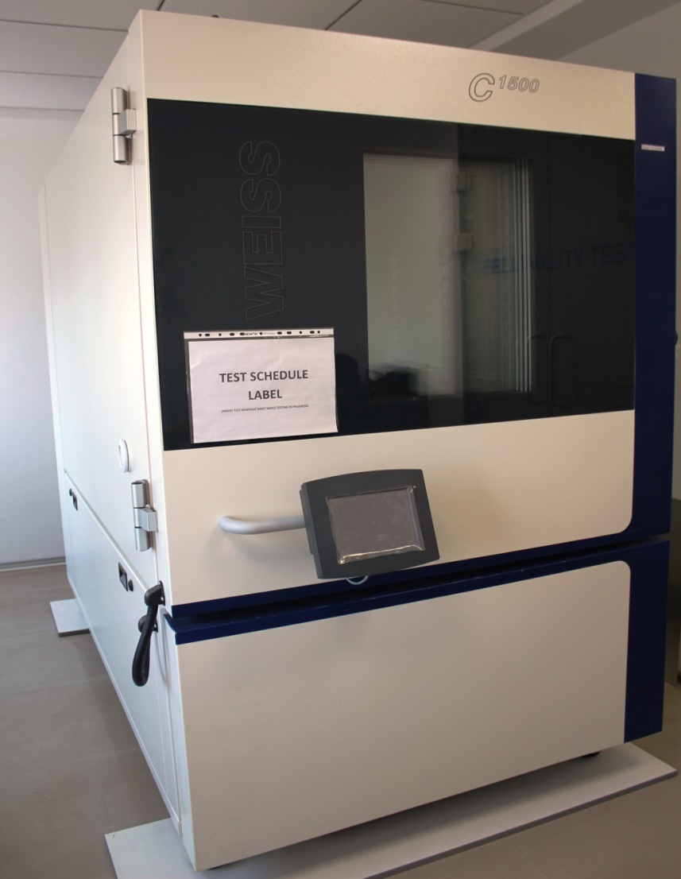
Environmental testing

Slide 32
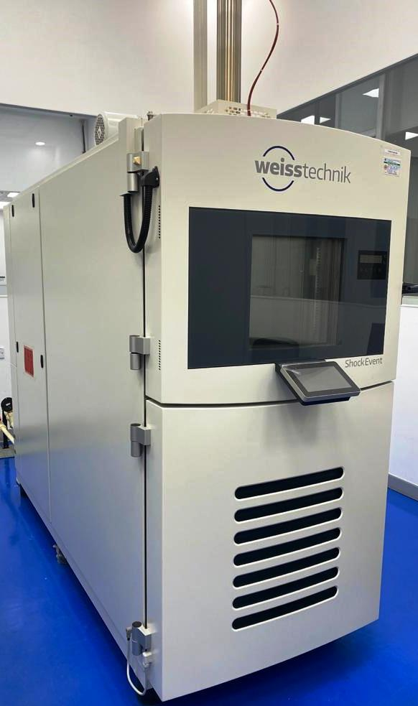
Thermal shock Chamber
Thermal shock chamber | Temperature range of hot chamber: (+50 to + 220)⁰C Temperature range of cold chamber: (-80 to +70)⁰C Transportation time: < 10 sec

Slide 33
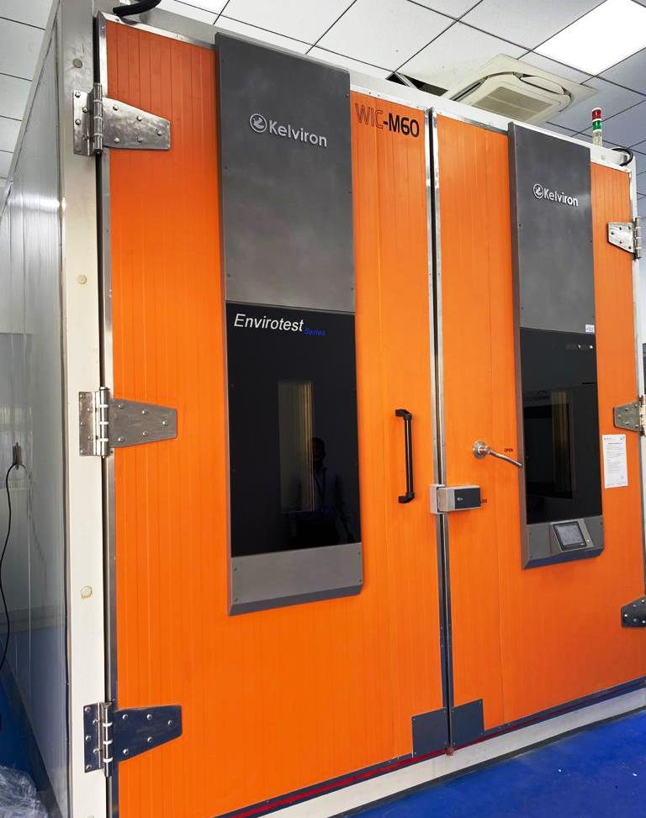
Environmental walk in Chamber
Environmental walk in Chamber | Specification
Chamber Inner dimension | 3000 mm (W) x 3000 mm (D) x 3000 mm (H)
Temperature Range | - 40ºC to 100ºC
Humidity Range | 20% RH – 95%RH
Rate of Rise | 5ºC/min
Rate of fall | 3ºC/min

Slide 34
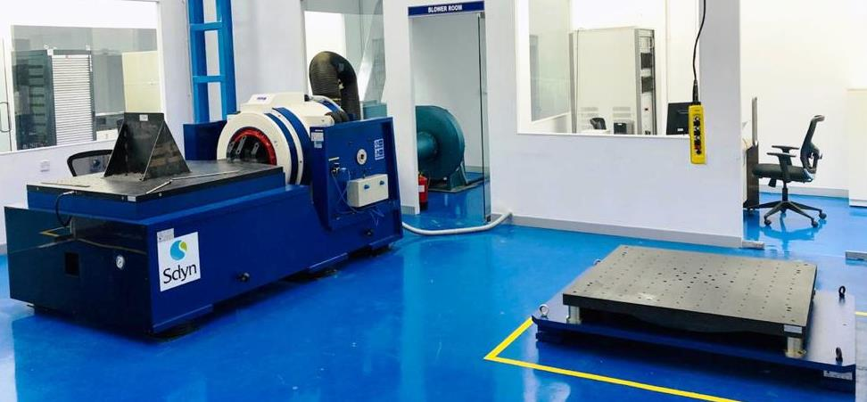
Vibration testing

Slide 35


TUV INDIA PVT. LTD.

