Slide 1
Silkee Electronics PVT. Ltd
A Presentation

Slide 2
The Background
Global Mobile handset makers, Auto Ancillaries and EMS companies have started Manufacturing Products in India and “Make In India” initiative of Govt. has given impetus to it.
To complete the entire electronics manufacturing ecosystem, there is a need for component suppliers.
SILKEE has added a state of the art facility to its 18 year old keypads facility in association with a leading company in Korea

Slide 3
Highlights
A leader in Rubber KeyPads for 30 years
Enjoys 90 percent market share for conventional keypads in India
Single source supplier for leading manufacturers
IATF 16949 Certified Company
3 Factories all in NH7 National Highway
Number of Employees: 350
Sales turnover: Rs.160 million

Slide 4
Milestones
1990–Rubber Keypads manufacturing started in association with YOU EAL KOREA
1993 – Established second unit at HOSUR
1994 – Exported to ALCATEL, Mexico
1995 – ISO 9002 CERTIFIED
1996 – Laser Etched Keypads - Developed
1998 – Developed Pager keypads for Motorola,
2007–A New Plant for Mobile phone Keypads with KOREA
2010 – Developed Back lighted Dash board Knobs & buttons with Inj.Moulding, Painting & Laser marking for Auto Ancillaries like VISTEON, KOSTAL & BHTC

Slide 5
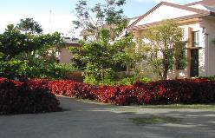
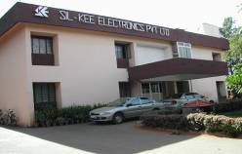
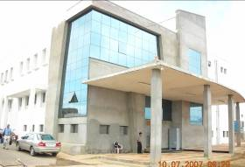
Production Facilities
Rubber KeyPad production
69B, Electronics city, Bangalore –15,000 sq,ft
&
75AII, SIPCOT, Hosur – 10,000 sq. ft
Mobile KeyPad , Painted & Laser Marked Push buttons & Consoles
235&236 KIADB Industrial Area—20,000 sq. ft
Jigani Link Road, Bangalore -99

Slide 6
People
Managing Team
Master’s in production engineering and a graduate in electronics with experience in space research, Polymers, tooling and product innovation.
R & D Team
Innovators in tooling& Polymer science with wide experience in electronics manufacturing.
Quality Assurance
Motivated to excel with periodic training. Silkee products are ROHS certified.
Production Team
Young productive team with high enthusiasm.

Slide 7
Design Capabilities
Rubber Keypads
Silkee will offer suitable design for applications like telephones, Remotes, Medical equipments, Hand held instruments and gadgets and even to critical applications like Defence and Aero Space
Keypads for mobile phones
In association with its Korean partner M Solver, it can offer from 1st. to 8th. generation Keypads for mobile phones, from full rubber pads to slim type with EL and other light guiding features to meet the cost and functional needs of the customer.

Slide 8
Process Capabilities
Silicon rubber compounding & Precision moulding
Design & mfr. Of Precision tools for Rubber & Plastic
Injection moulding, Precision Plastic parts
Robot Spray coating on key-tops in clean atmosphere.
Laser etching on keypads for back lighted keypads, Push buttons & consoles for Automotive & Health care Sector
Screen Printing, Pad printing epoxy clear PU coating
Assembly of Mobile phone Keypads with XY robots with press cure or UV curing adhesive with special bonding strength.
Quality management system in all the above processes for continuous and sustained improvement in cost control and quality.

Slide 9

All keypad Process in one Factory
Design
R&D
Assembly
Mold
PK-Printing
Injection
Rubber
Process
Spray
(Color, UV)
Film Process
(Printing/Forming)

Slide 10
Keypads For Remotes, Telephones and Electronic Gadgets

Slide 11





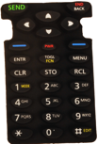
































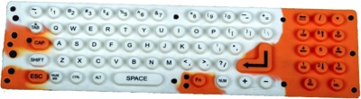











Slide 12
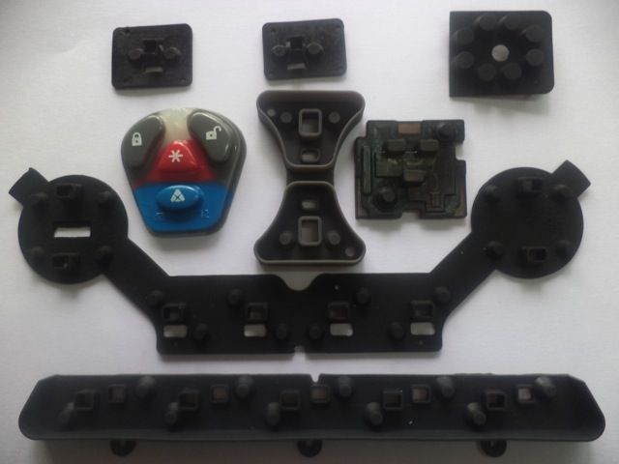
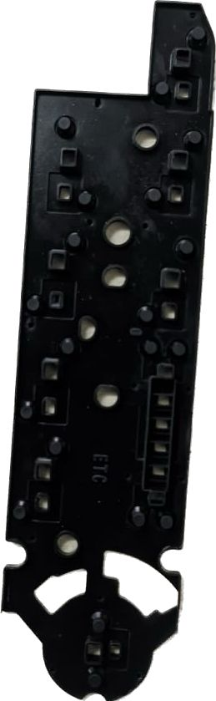
Products – Automotive Sector
Keypads for Automotive sector with Close Tolerance, High Reliability, Very Low contact Resistance ( Including GOLD contacts)

Slide 13
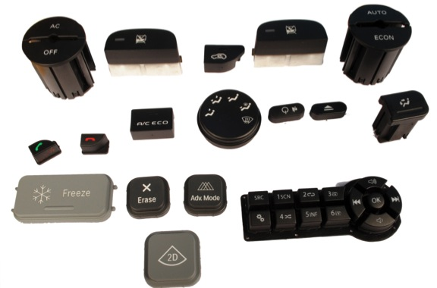
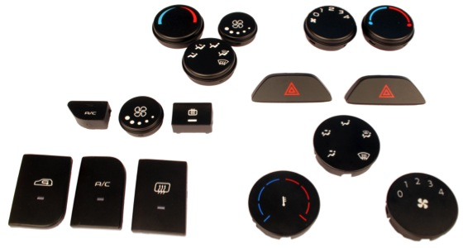
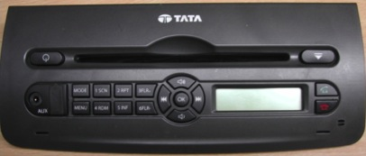
Products – Automotive Sector
Moulded, Printed, Painted and Laser marked Dash board Switches for AUTOMOBILES

Slide 14
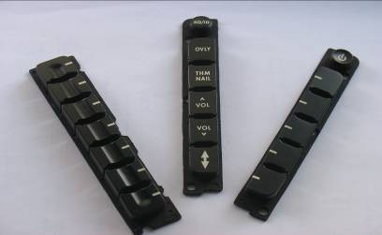
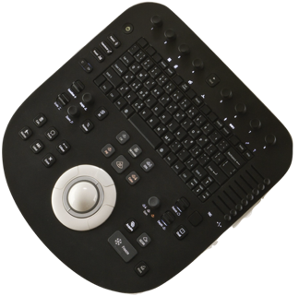
Products
Painted & laser Marked Consoles for Back lighted Control panels of Health care & Avionics Sector

Slide 15
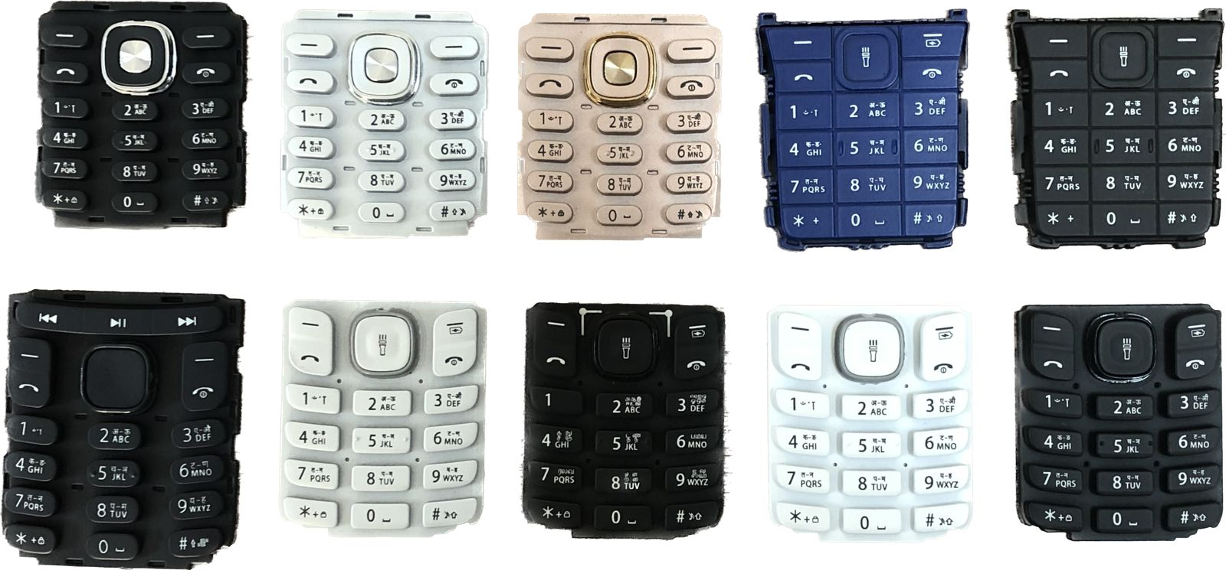
Products
Keypads for Mobile Phones

Slide 16
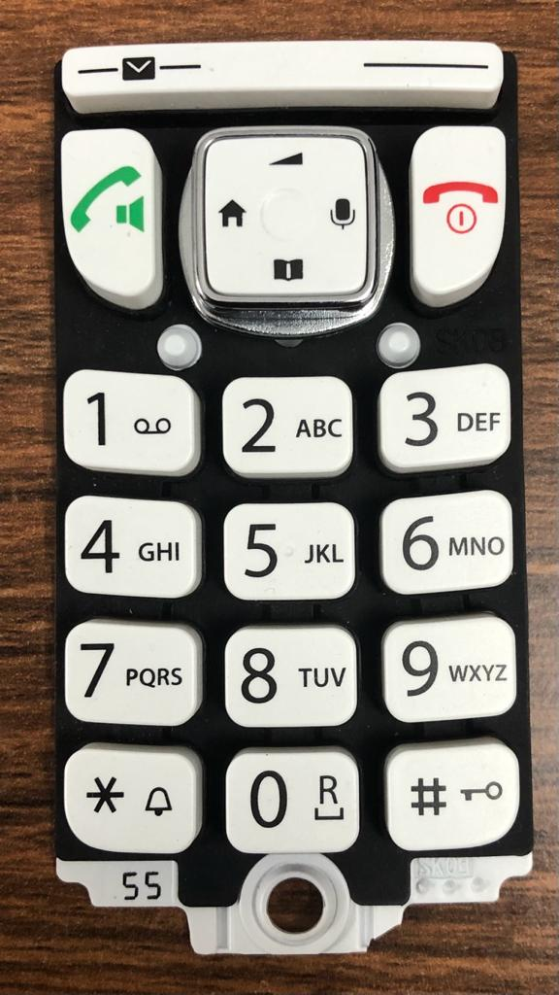
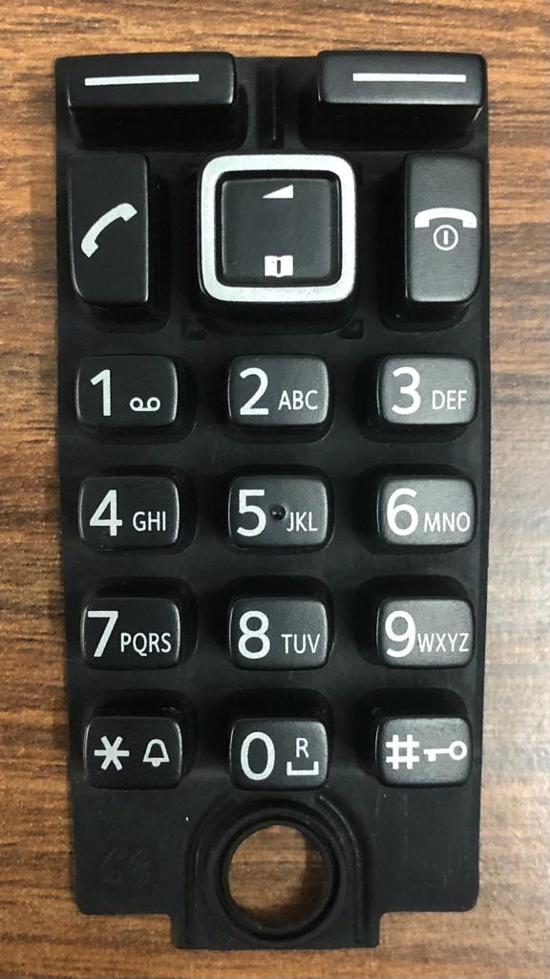
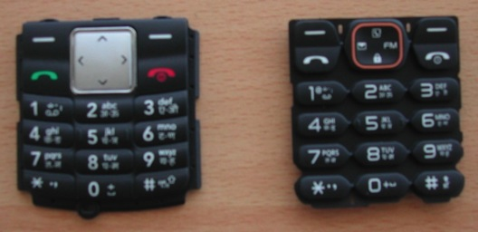
Products
EF type keypads
Laser Etched Rubber keypads for Cordless and mobile phones

Slide 17
PLANT & MACHINERY
SIL-KEE MANUFACTURING AND TESTING FACILITIES WITH CAPACITIES.

Slide 18
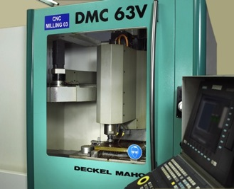
TOOL ROOM
CNC Tool Milling m/cs MAHO-DECKAL - 3 nos
CAD-CAM Software – ProE & Smart cam
CNC EDM – MOLD MASTER- 600X500mm
EDM – 550X500
Large precision surface grinder 600X500
Milling m/c with DRO
CAPACITY
6 Rubber molding Tools/month

Slide 19
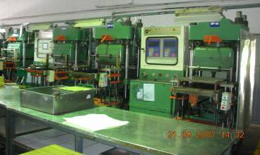
Rubber molding
Kneader 25Kg & 40Kg – 2 set
2 Roll Mill 12”dia - 3 nos
Pre Former 9” dia - 3 nos
200 Ton Automatic –PLC controlled Rubber molding Press HSIN-CHI, Taiwan – 10 Sets
200/250 Ton Press with Vacuum HSIN-CHI, Taiwan - 12 Sets
Capacity
2 Million/month

Slide 20
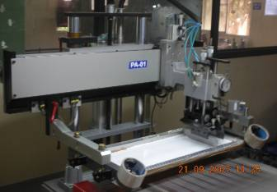
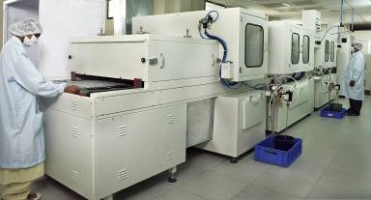
Rubber-Printing & Spraying
Auto Printing m/c Table Size 750X500 HANKY-TAIWAN – 15 nos
Manual Printing station -15 nos
Manual spray station - 2 nos
3 booth Paint Spray line Leesack, Korea - 1no.
2 Booth UV Clear coat line Leesack, Korea - 1no.
Capacity
1.5 million/month

Slide 21
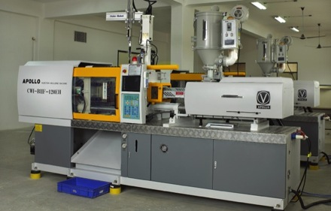
Plastic Molding
120 Ton Injection molding m/c’s – 3 Nos with Robot arm, PLC control, mold temp. control & Matl. Preheating chamber
Capacity/month
0.3 Million

Slide 22
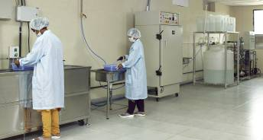
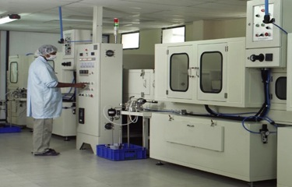
Plastic Paint Spray line
Ultra water purifier for DM/DI water -1no.
6 Bath Washing line with Ultrasonic cleaning - 1no.
Auto Spray coating with Robot – Leesack, Korea – 1 no.

Slide 23
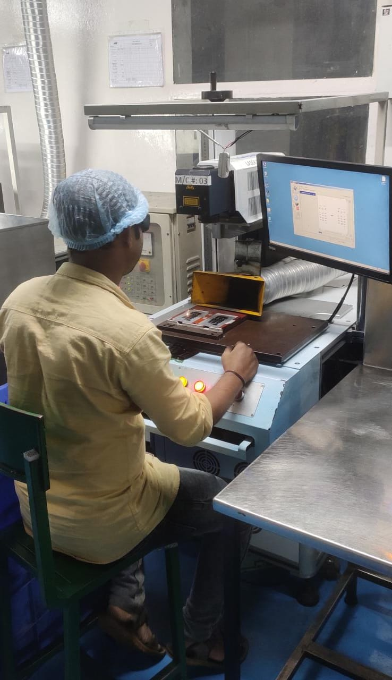
LASER MARKER
Laser marker SY3000 Twin Head Nd. YAG Laser from EO Technics, Korea
Installed – 11 m/c’s
Capacity /Month
1.0 million

Slide 24
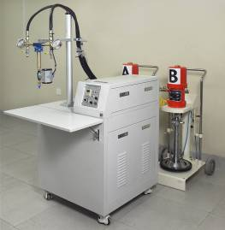
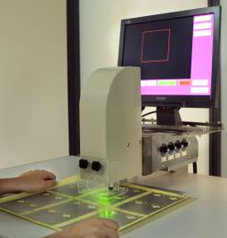
FILM LINE
Auto Screen Printer SP Tech , Korea Table size 900x900 - 2 nos
Screen Preparation set up with exposure, stretcher and High pr. Washing
Laminater
Anti static Film Cleaner/ wiper
Auto Punching with Camera Control
Hyd. Hot forming
Hyd. Cutting Press
LSR Dispenser
Compression molding Press
Capacity/month 0.2million

Slide 25
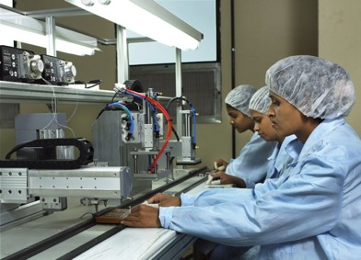
KeyPad Assembly
KeyPad assembly Line with X-Y Robot for Instant glue dispensing - STS Co., Korea
KeyPad assembly line for UV curing adhesives
Capacity/month
0.5 million

Slide 26
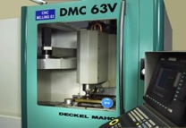
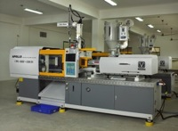
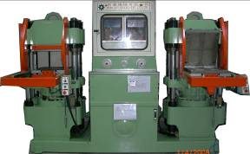
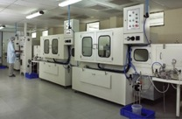
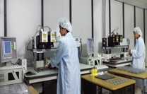
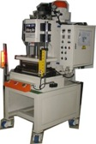
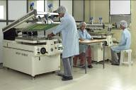

Facility at a Glance
CNC Tooling
Injection Moulding
Rubber Molding Press
Spray painting
Laser Etching
Hot Forming M/c
Printing
Assembly line

Slide 27
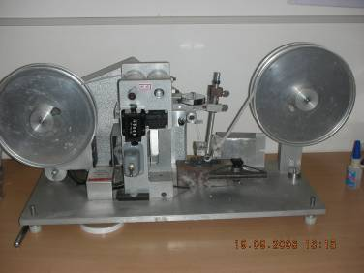
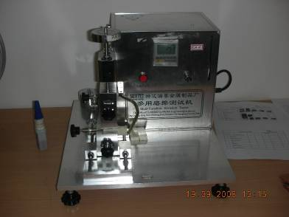
Testing Facility
Norman RCA Tester
Multi purpose Abrasion tester with facility to feed Liquid mediums like Alcohol, MEK etc.

Slide 28
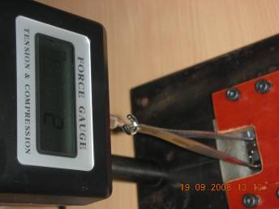
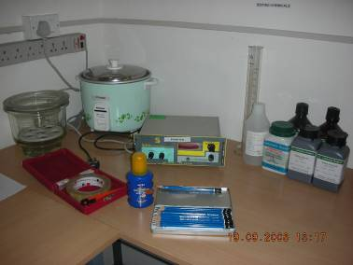
Testing Facility
Push Pull gauge to test the adhesion strength of Keys – range 0-5Kgs
Equipments for Boiling water test, Pencil hardness test, Scotch Tape peeling test and cosmetic test and acid test

Slide 29
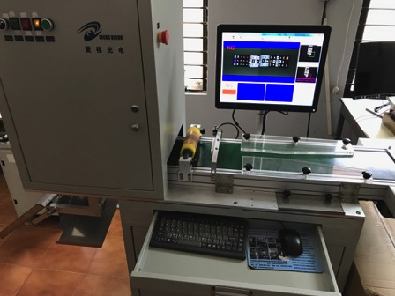
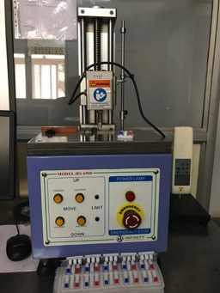
Testing Facility
COMPUTERISED VISUAL INSPECTION
SYSTEM
FORCE-TRAVEL GRAPH
TESTER

Slide 30
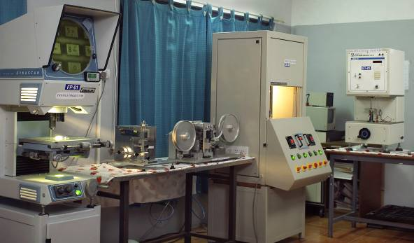
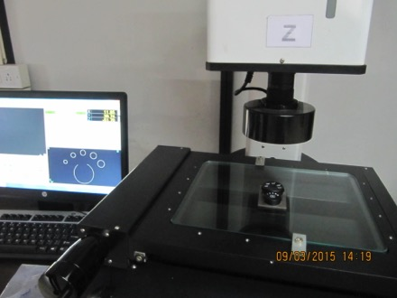
Testing Facility
Profile Projector, Rubber Curing Tester
& Life cycle Tester
VMS -
Visual Measuring System

Slide 31
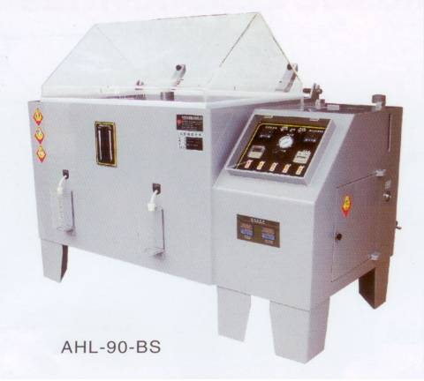
Testing Facility- Contd.
Salt Spray Tester
5% Nacl @ 35ºC, 48 Hrs

Slide 32
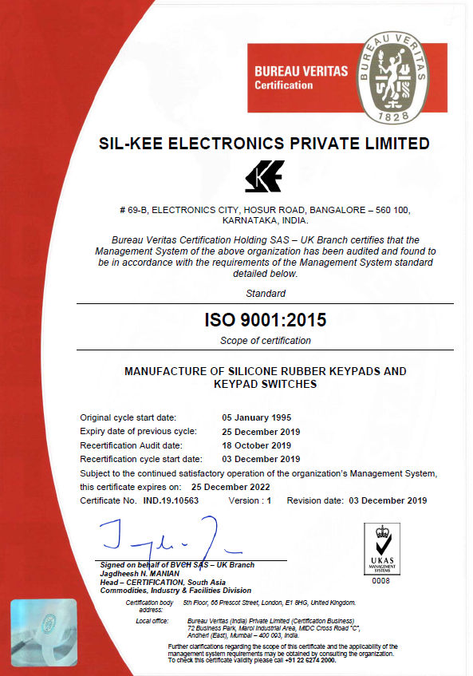
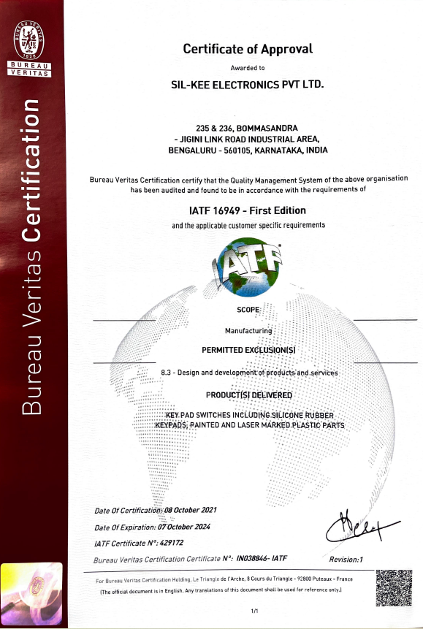
Test Certificate

Slide 33
Customers - Domestic
Sl.No. | Domestic Customers | Locality | Parts
1 | Beetel Teletech Ltd. | Ludhiana | Telephone keypads
2 | Videocon Industries Limited | Aurangabad | TV Remote Keypads
3 | American Power Conversion (I) P.Ltd | Philipines | General Keypads
4 | Bharat Electronics Limited | All over India | General Keypads
5 | Hitachi Home & Life Solutions (I) Limited | Noida | AC Remote Keypads
6 | Larsen & Toubro Limited | Mysore | General Keypads
7 | Minda Corporation Limited | All over India | Keypads for Automobile Parts
8 | Pramod Telecom Private Limited | Lucknow | Telephone keypads
9 | SFO Technologies Private Limited | Cochin | Keypads & Consoles for Medical equipments
10 | KOSTAL India Private Limited | Vellore | Keypads & Switches for Automobile
11 | Visteon Automotive Systems India Private Ltd. | Chennai | Keypads & Switches for Automobile
12 | Tata Consultancy Services | Goa | General Keypads
13 | Behr-Hella Thermocontrol India (P) Ltd., | Pune | Keypads & Switches for Automobile
14 | Samsung -Indai | Noida | Mobile Phone keypads ( Not now)
15 | FOXCONN- INDIA | Chennai | Mobile phone Keypads for NOKIA

Slide 34
Customers - Domestic
Sl.No. | Domestic Customers | Locality | Parts
16 | Marquardt India Pvt. Ltd. | Pune | Keypads & Switches for Automobile
17 | Lava International Ltd. | Noida | Mobile Phone Keypads
18 | Flextronics Tech (I) Pvt Ltd. | Chennai | Mobile Phone Keypads
19 | Napino Auto & Electronics Ltd | Rajastan | Keypads & Switches for Automobile

Slide 35
Customers - International
Sl.No. | International Customers | Locality | Parts
1 | American Power Conversion (I) P.Ltd | Philipines | General Keypads
2 | BARCO NV | Belgium | General Keypads
3 | Fisher & Paykel Healthcare Limited | New ZeaLand | General Keypads
4 | Xiamen Nord Trading Co. Ltd., | China | General Keypads
5 | Baird Investment Advisor Co., Ltd. | China | General Keypads
6 | BORNICO Electronic Manufacturer | Poland | General Keypads
7 | OAK Holland Trading | Netherlands | General Keypads
8 | SPICA NV | KORTRIJK | General Keypads
9 | GIGASET COMMUNICATIONS GmbH | Germany | Keypads for Cordless Phone

Slide 36
THANK YOU

