Slide 1





Address: UNIT1 16/F, TAK LEE IND CTR BLK B, TSING YEUNG CIRCUIT 8, TUEN MUN HONG KONG Tel：+91 72590 27127
Website：www.fbetter.com
Email： talluriarun@fbetter.com
Email: canna.xie@fbetter.com
  Company Profile
Established in 2006
Fbetter founded in 2006, is a dedicated Authorized Electronic Component Distributor and Solutions provider.
The company has set up sales offices in Shenzhen, Shanghai, Hong Kong, India and R&D center in Shenzhen, providing innovative technology and total-solutions for more than 800 companies.
We have over 1500 ㎡ warehouse which are located in Hong Kong and Shenzhen，it can store over 100KK+ components, in order to provide the best and effective service for our clients.
2022
Continuous customer maintenance and development of BMS market and overseas market.
2020
Developed the new area and supply electronic parts for Power Tools TTI.
2015
The main supplier and agent of audio customers in the market.
2012
Built Bluetooth design-house，do business with Notebook-Lenovo.
2010
Start business with Car Faurecia，Skypine, and other local cars.
2008
Design-win TV/blue-ray DVD customer: TCL, Skyworth, MTC, KTC.
2006
Fbetter founded in 2006, is a dedicated Authorized Electronic Component Distributor and a solutions provider.

Slide 2
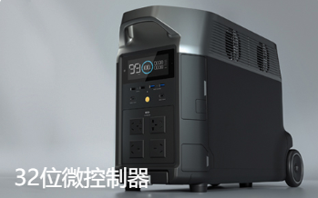
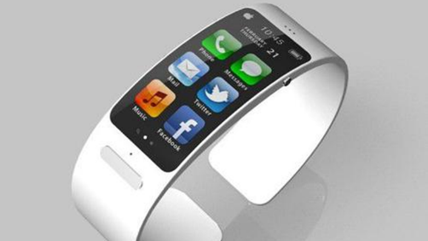
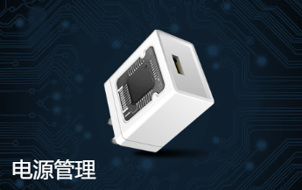
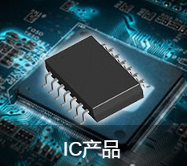
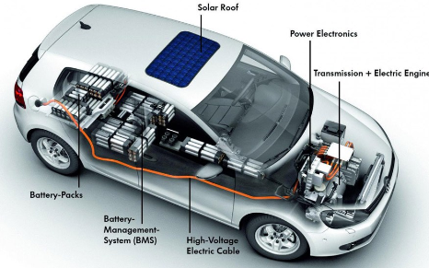
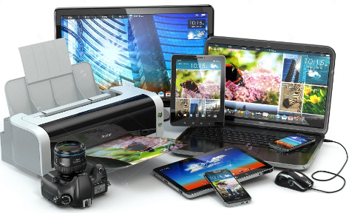
  We provide competitive one-stop software and hardware design
  and component sales services.
※ Set up sales offices in Shenzhen, Shanghai, Hong Kong, India
※ Providing innovative technology and product solutions for more than 800 companies.
※ 50+ engineers, include Software, hardware
※ Over 15 years experience in this field
※Over 1500 ㎡ warehouse and 100KK stock
Consumer Electronics
Intelligent household appliance
Battery Management System
03
04
02
Medical cosmetology
& Personal care
01
Industry
05
Electric power tool
产品名称 02
MCU
Overcurrent/Voltage Protector
Power IC
Analog IC
MOSFET
MEMS
The products we supply including:
Active Components: MCU, Power management chips (DC-DC,LDO, BMS IC etc.), Sensor, Gyroscope, OPA products, etc.
Passive Components: Protective components(overvoltage protection -TVS, ESD Suppressor; Overcurrent protection -Fuse, PPTC), Microphone, MOSFET, Diode, Magnetic inductance, etc.
Fbetter pursues the business philosophy of "customer as the center, striver as the foundation" to create a respected century-old enterprise. We focus on the development with our clients and workers in building a better future.

