Slide 1


BIBA Electronics Pvt Ltd
Manufacturer and Distributors of LCD Display and Touch Panels in India.

Slide 2

About Us
BIBA Electronics Pvt Ltd
BIBA was setup in 2014 to support, semiconductor service and components to global embedded market.
BIBA specializes in LCD Display, Touch Panels, Cover Lens and related electronics components.
BIBA qualifies to supply components to Automotive, Industrial and Consumer Grade market.

Slide 3






History
2023 – Factory setup completed and process for Make-in-India Started.
2023 - Started supplying Instrument Cluster to EV Companies.
2023 – Associated with Hannstar Display for Automotive TFTs.
2021 – Successfully assembled Character and TFT Touch Module in India
2022 – Associated with Yeebo Display Ltd for Passive LCDs
2019 – Associated with New Vision Display for Automotive Touch Panels.
2021 – Converted to Private Limited company from Proprietor Firm.
2015 - Distribution for LCD Displays.
Segmented LCDs, Character Displays and Graphic LCDs.
2016 – Associated with Truly Semiconductors for Automotive and Industrial TFTs.
Started 2014

Slide 4
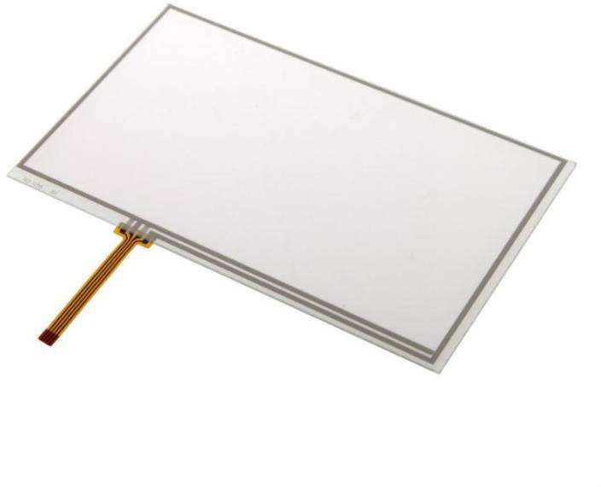
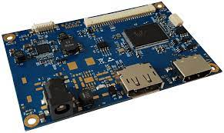
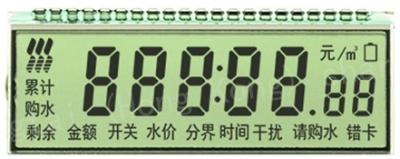
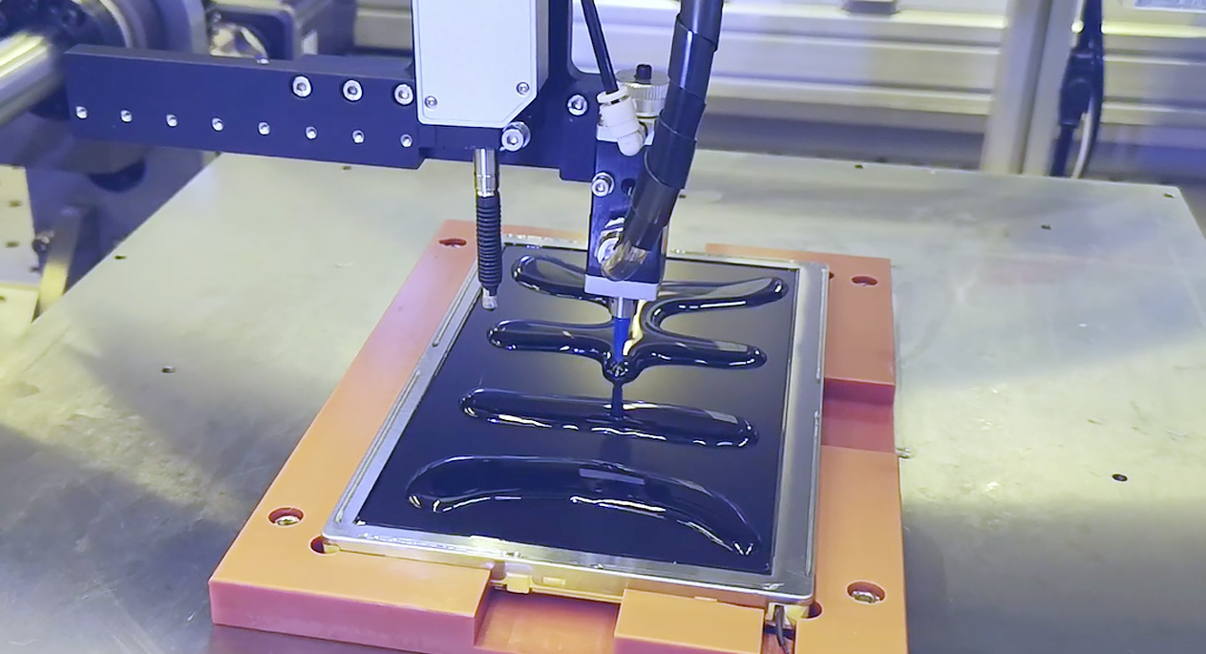
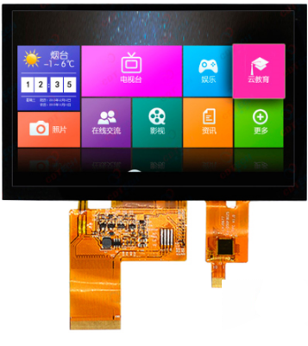
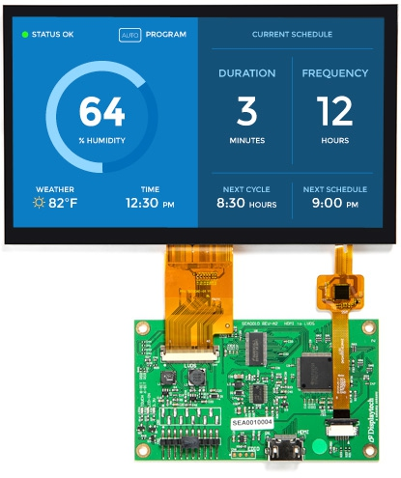
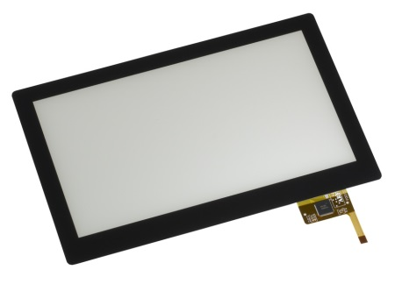
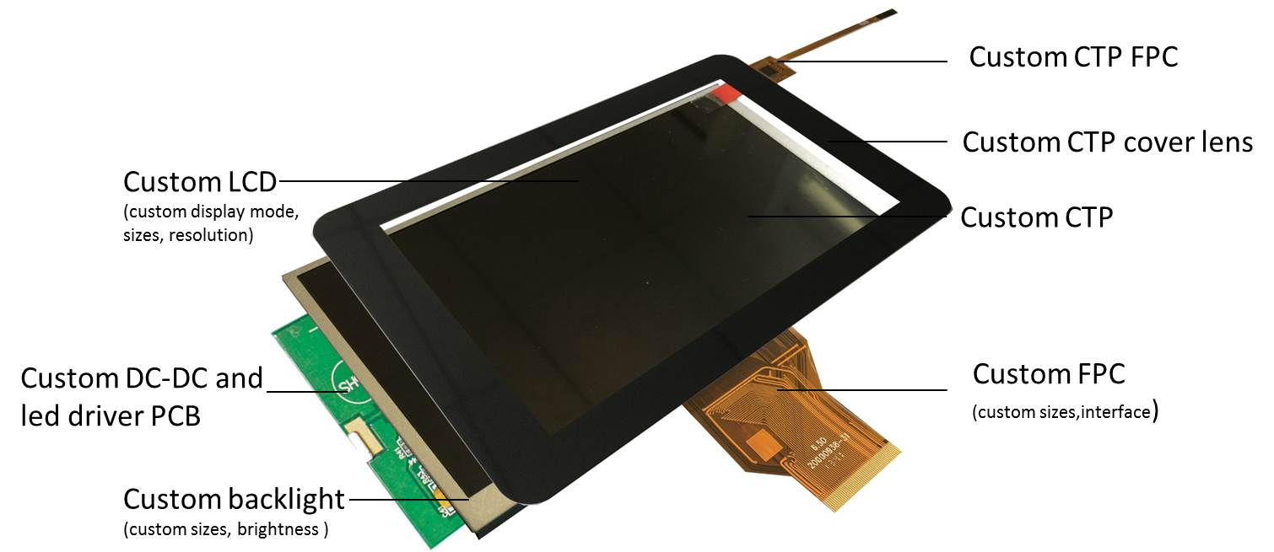
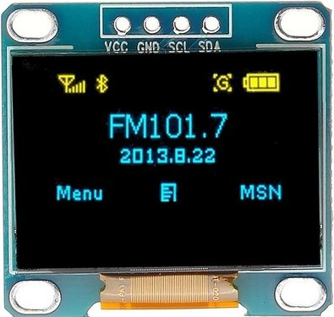
Product Portfolio
Display | Touch Panel | Cover Lens | HDMI / USB Boards
Passive & Active LCD Passive & Active OLED Paper-Like Displays | Resistive Touch Panel Capacitive Touch Panel | Custom Cover Lens Optical Bonding Printing | LVDS / RGB to HDMI TFT I2C to USB Boards

Slide 5
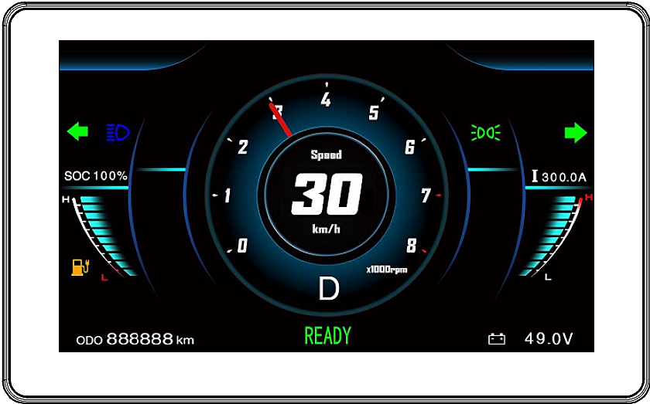
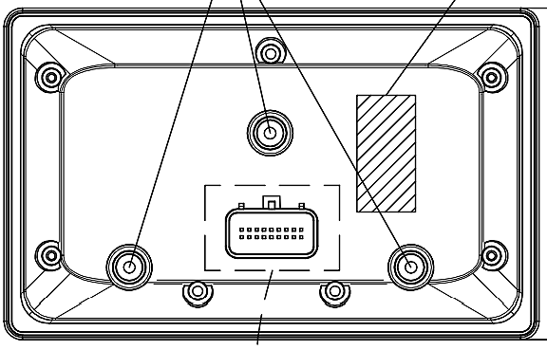
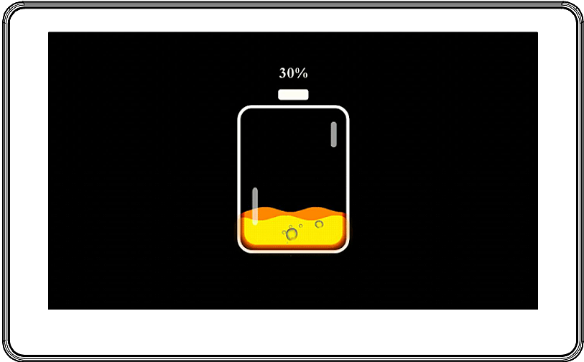
New Product
TFT Cluster for 2-Wheeler Electric Vehicle
7.0” Instrument Cluster Application: 2-Wheeler Instrument Cluster, Electric Vehicle. 1024x600, Sunlight readable, 18 pins CAN Interface. Customization Available – Frame, software, CAN Protocol and display.

Slide 6
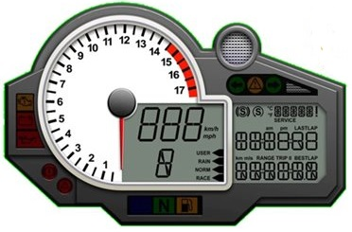
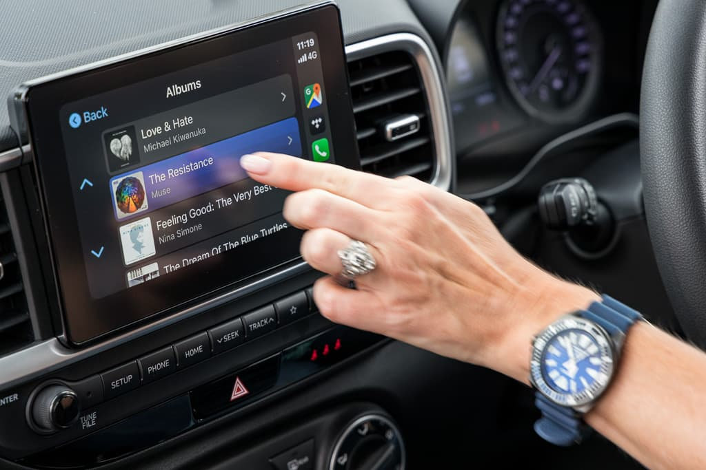
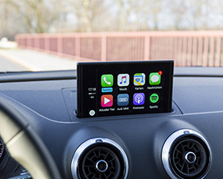
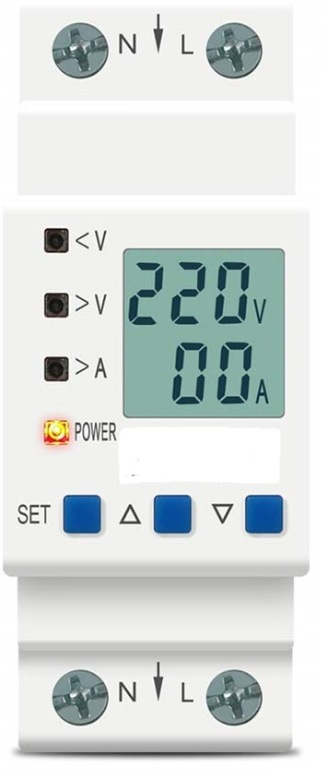
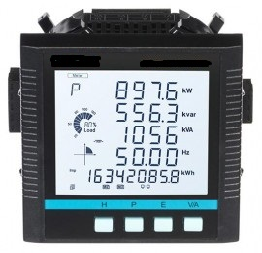
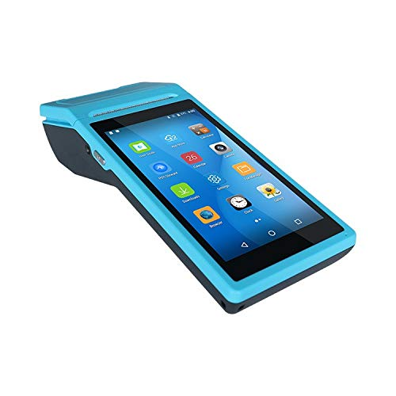
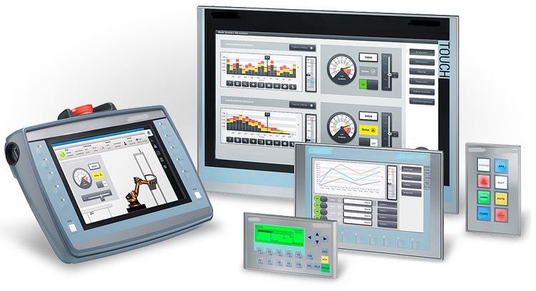
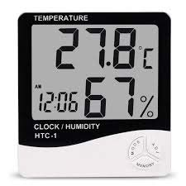
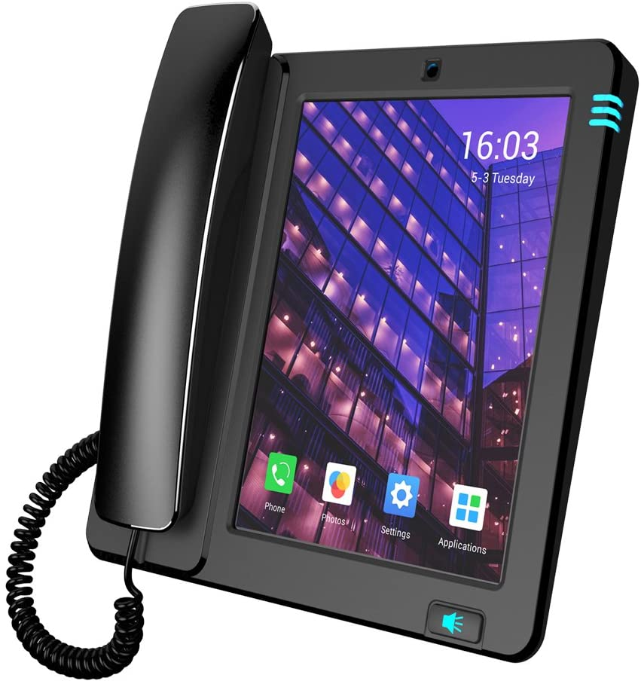
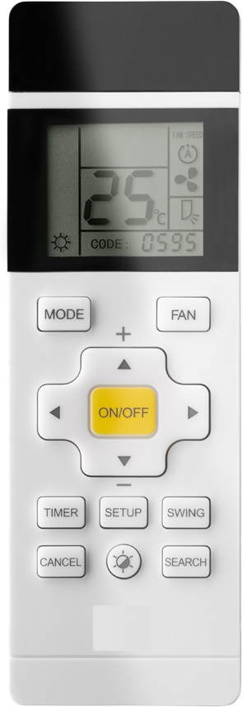
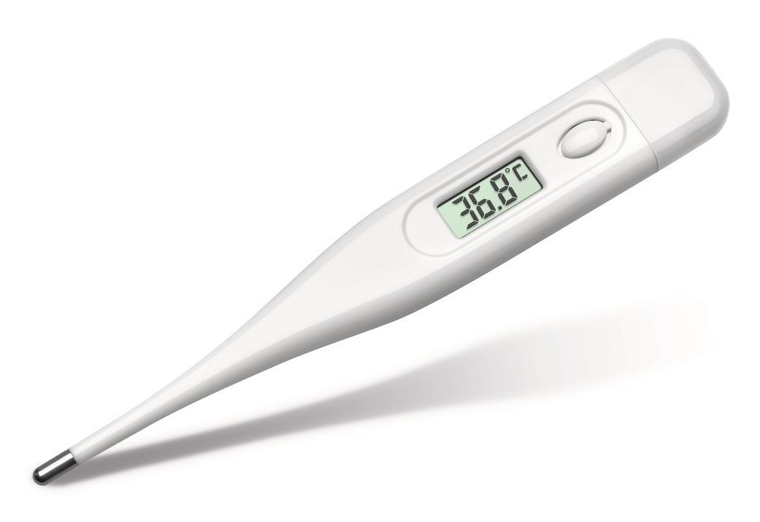
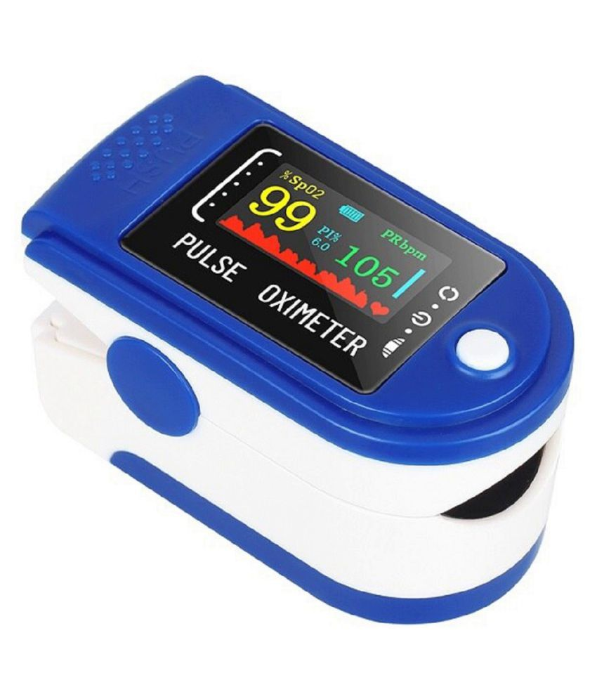
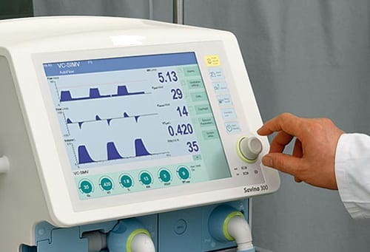
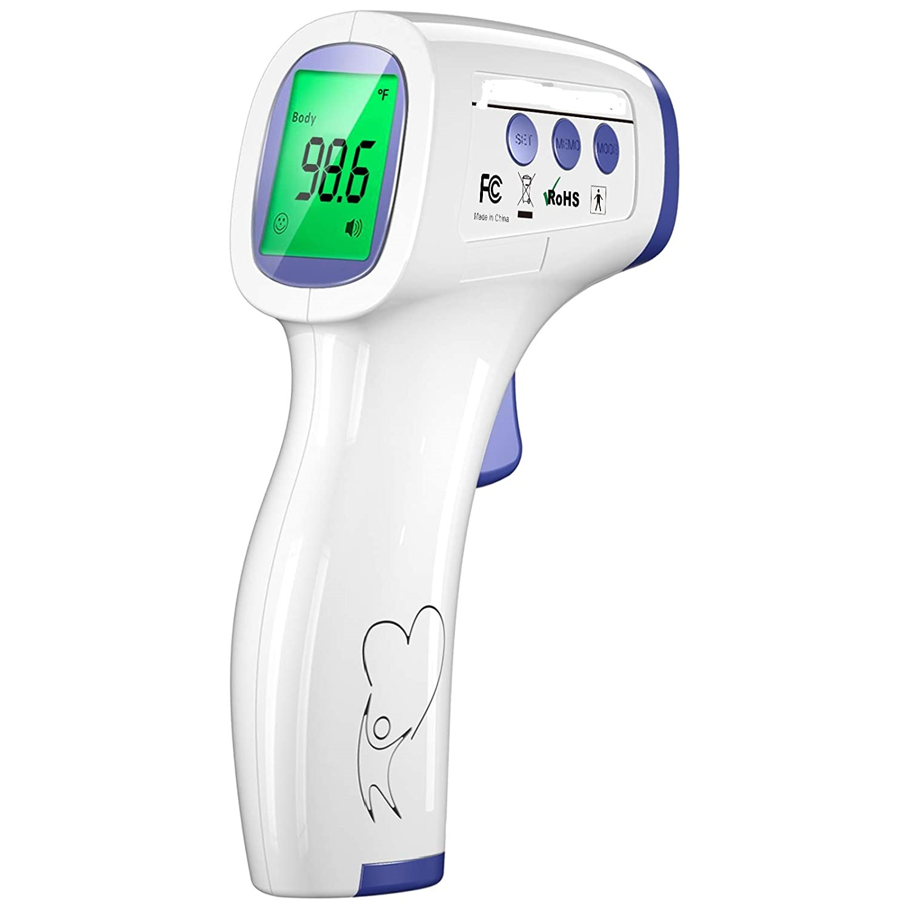
Applications we Support
Automotive
Industrial
Consumer
Medical

Slide 7
TFT and Touch Panel - sizes
1.77”
Resolution: 128x160, 240x320
2.4”
Resolution: 320x240 / 320x480
3.5”
Resolution – 320x240 / 320x480 / 480x272 / 800x480
Interface: MIPI, SPI, RGB, I2C
Viewing Area: 6, 12
Touch Panel: without / CTP / RTP
Interface – SPI / RGB / MIPI
Viewing Direction: 12, 6, Full
Touch Panel: without / CTP / RTP
Interface: CPU / SPI / RGB / MIPI
Viewing Direction: 12, 6, Full
Touch Panel: without / CTP / RTP

Slide 8
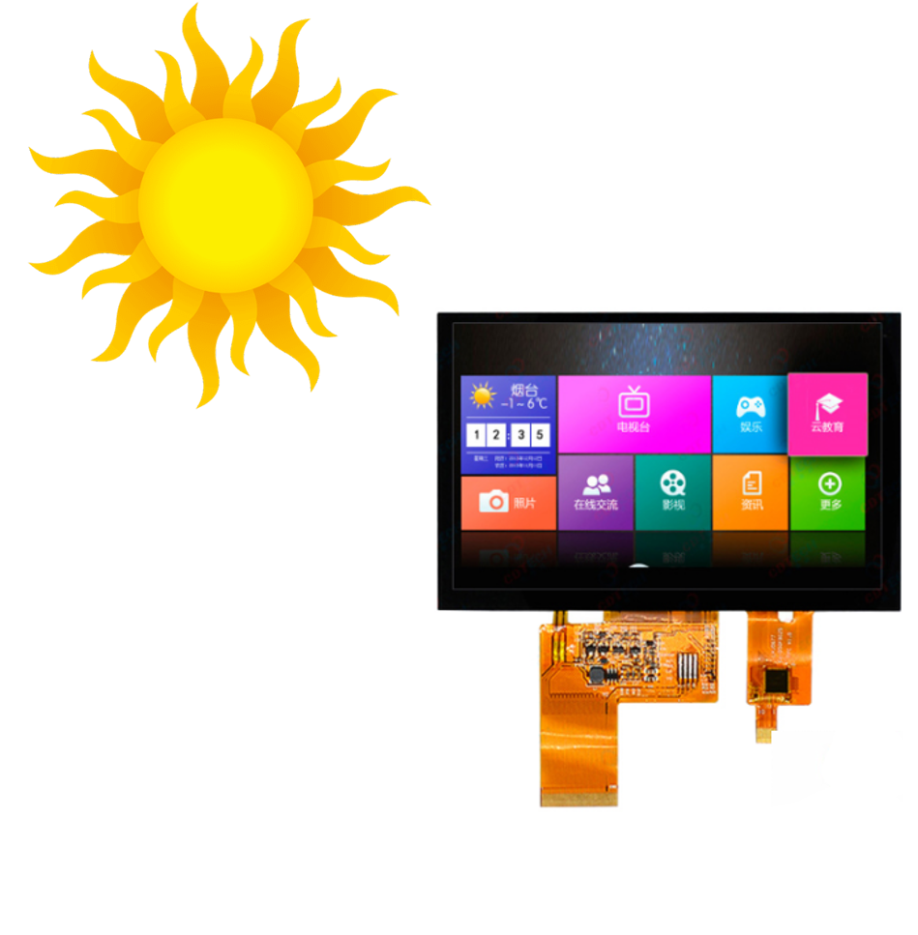
TFT and Touch Panel - sizes
4.3”
Resolution: 480x272, 800x480, 480x800, 720x1280
5.0”
Resolution – 480x272, 480x800, 1024x600, 1280x720
Interface: CPU / SPI / RGB / MIPI / LVDS
Viewing Direction: 12, 6, Full
Interface – SPI / RGB / MIPI / HDMI
Viewing Direction: 12, 6, Full
Touch Panel: without / CTP / RTP
Touch Panel: without, CTP, RTP, Water & Glove Support
Brightness: 400cd/m2, 900cd/m2, 1200cd/m2
Grade: Automotive, Semi-Automotive, Industrial
Operating Temp: -10℃ ~ 60℃, -20℃~70℃, -30℃~80℃

Slide 9
TFT and Touch Panel - sizes
5.7”
Resolution: 320x240, 640x480, 1280x720, 1920x1080
7.0”
Resolution – 480x800, 800x480, 800x600, 1024x600, 1280x720, 1024x768, 1280x800, 800x600, 1920x1200,
Interface: CPU / SPI / RGB / MIPI / LVDS, HDMI
Viewing Direction: 12, 6, Full
Interface – SPI / RGB / MIPI / HDMI / eDP,
Viewing Direction: 12, 6, Full
Touch Panel: without / CTP / RTP / Water & Glove support
Touch Panel: without, CTP, RTP, Water & Glove Support
Brightness in CD/m2: 400, 900, 1200
Grade: Automotive, Semi-Automotive, Industrial
Operating Temp: -10℃ ~ 60℃, -20℃~70℃, -30℃~80℃

Slide 10
TFT and Touch Panel - sizes
8.0”
Resolution: 800x480, 800x600, 1280x800, 1024x600, 1920x1080
10.1”
Resolution – 800x480, 1024x600, 1280x800, 1366x768, 1920x1080, 1920x1200
Interface: CPU, SPI, RGB, MIPI, LVDS, HDMI
Viewing Direction: 12, 6, Full
Interface – SPI, RGB, MIPI, HDMI, eDP,
Viewing Direction: 12, 6, Full
Touch Panel: without / CTP / RTP / Water & Glove support
Touch Panel: without, CTP, RTP, Water & Glove Support
Brightness in CD/m2: 400, 900, 1200
Grade: Automotive, Semi-Automotive, Industrial
Operating Temp: -10℃ ~ 60℃, -20℃~70℃, -30℃~80℃

Slide 11

TFT and Touch Panel - sizes
12.1”
Resolution – 800x600, 1024x600, 1280x800, 1366x768, 1920x1080, 1920x1200
13.3”
Resolution – 800x600, 1024x768, 1366x768, 1600x1200, 1920x1080
Interface – SPI, RGB, MIPI, HDMI, eDP,
Viewing Direction: 12, 6, Full
Touch Panel: without, CTP, RTP, Water & Glove Support
Brightness in CD/m2: 400, 900, 1200
Grade: Consumer, Industrial, Medical
Operating Temp: -10℃ ~ 60℃, -20℃~70℃, -30℃~80℃
Interface – SPI, RGB, MIPI, HDMI, eDP,
Viewing Direction: 12, 6, Full
Touch Panel: without, CTP, RTP, Water & Glove Support

Slide 12
TFT and Touch Panel - sizes
15.0”
Resolution – 800x600, 1024x768, 1280x720, 1366x768, 1920x1080, 1920x1200, 3240x2160
15.6”
Resolution – 1366x768, 1600x900, 1920x1080, 2560x1440, 3200x1800, 3480x2160
Interface – eDP, LVDS, HDMI, eDP,
Viewing Direction: 12, 6, Full
Touch Panel: without, CTP, RTP, Water & Glove Support
Grade: Consumer, Industrial, Medical
Operating Temp: -10℃ ~ 60℃, -20℃~70℃
Interface – eDP, SPI, RGB, MIPI, HDMI, eDP,
Viewing Direction: 12, 6, Full
Touch Panel: without, CTP, RTP, Water & Glove Support

Slide 13
TFT and Touch Panel - sizes
15.0”
Resolution – 800x600, 1024x768, 1280x720, 1366x768, 1920x1080, 1920x1200, 3240x2160
15.6”
Resolution – 1366x768, 1600x900, 1920x1080, 2560x1440, 3200x1800, 3480x2160
Interface – eDP, LVDS, HDMI, eDP,
Viewing Direction: 12, 6, Full
Touch Panel: without, CTP, RTP, Water & Glove Support
Grade: Consumer, Industrial, Medical
Operating Temp: -10℃ ~ 60℃, -20℃~70℃
Interface – eDP, SPI, RGB, MIPI, HDMI, eDP,
Viewing Direction: 12, 6, Full
Touch Panel: without, CTP, RTP, Water & Glove Support

Slide 14
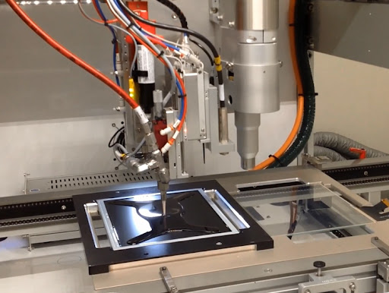
Touch Panels
RTP
Size: 1.77” ~ 21” diagonal size.
CTP
Size: 1.77”~26”
Interface: 4Wire
Application: Medical, Kiosk, POS, Monitors
Interface: I2C, USB
IC: Microchip, Goodix, Cypress, Focal Tech
Feature: Water Immunity, Salt-Water Immunity, Glove Support, Motion Sense,
Cover Lens: Glass, PMMA (plastic)
Cover Lens: Glass, PMMA, Corning Glass
Customization: Shape, size, FPC, feature
Bonding: Air Gap, Optical Bonding

Slide 15
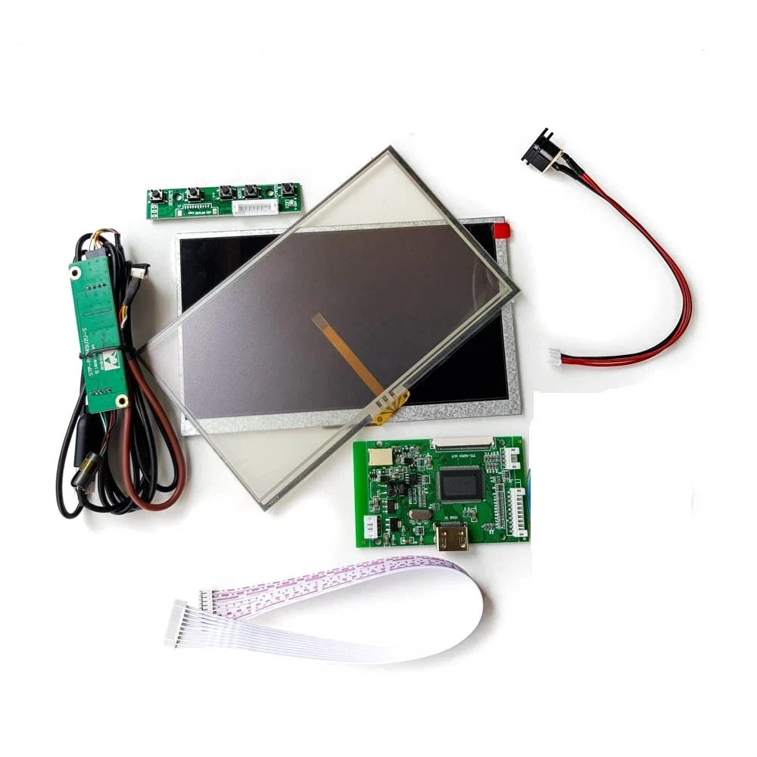
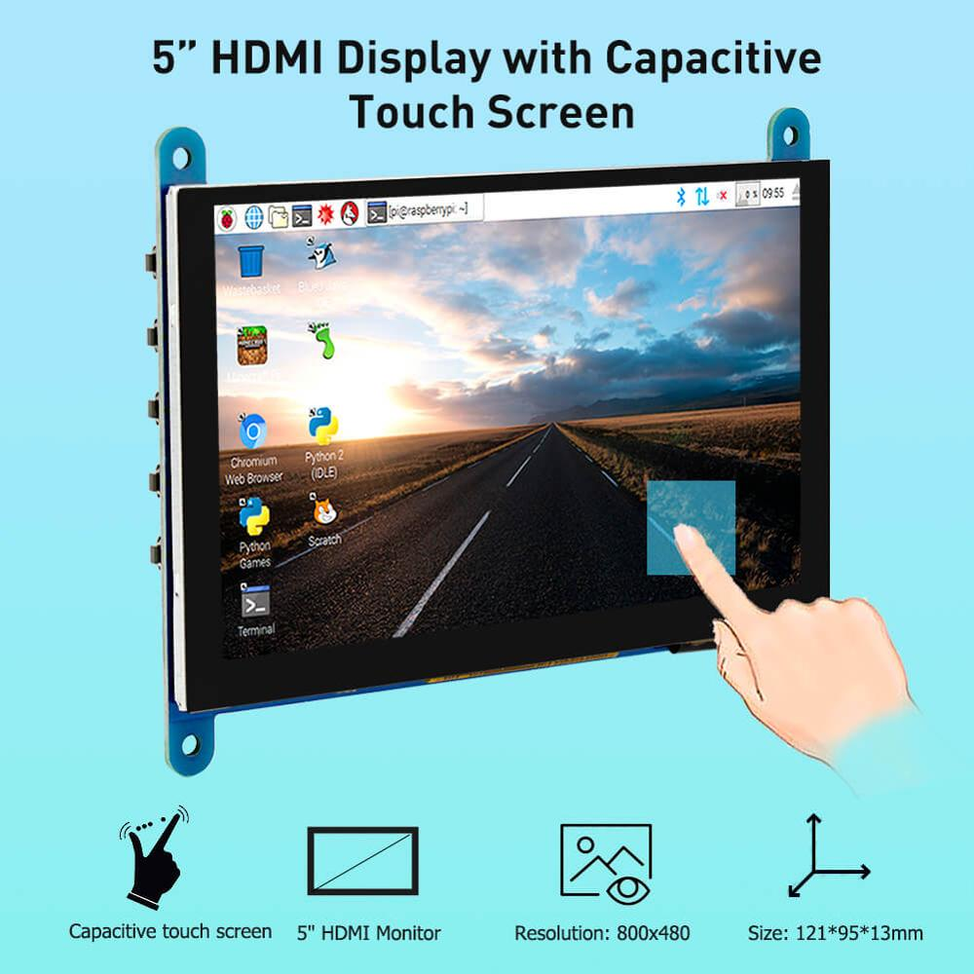
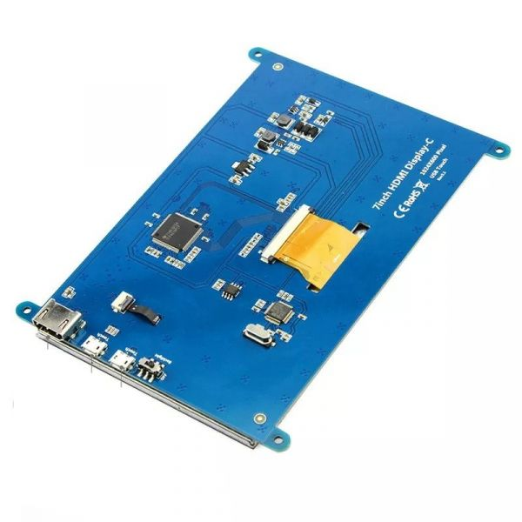
Displays with HDMI Boards
HDMI
Size: Above 5.0” TFT
USB
Touch
I2C to USB Converter board.
Interface: HDMI Board.
Feature: integrated board, individual board
Application: best for evaluation purpose and SBC
All size of CTP

Slide 16























Happy Customers…!!!

Slide 17
Thank You.
BIBA Electronics Pvt Ltd.
+91-7488297022
info@bibaelectronics.com
www.bibaelectronics.com
UG-006, Upper Ground Floor, MGF Metropolis, Gurugram, Haryana, 122002

