Slide 1

Epitome Components Pvt Ltd
Date: 01-04-2022

Slide 2
O V E R V I E W O F E P I T O M E
Established in 1996.
Privately held company owned by Dhoot Family.
Products: Single Side PCBs
Metal Clad PCBs
Double Side PCBs
Multilayer PCBs (up to 6 layers)
RF PCBs
Manufacturing Plants : 3 (1 located at Supa MIDC & 2 at Ahmednagar MIDC)
Sales Turnover of 30.24 Million USD for the year 2021-2022.(1 USD = Rs.76/-)
Total Investment of 14.74 Million USD
More than 1000 employees across all three plants.
Certification: ISO9001-2008, ISO14001-2004, UL 94 V 0 Approved (File No. E- 212855), RoHS Compliant
Products, LCSO Approval (Defence), IATF 16949 .
Certificate of qualification for processing of Large size RF Boards for Space Application.

Slide 3
V I S I O N & M I S S I O N
VISION
To create a World Class Organisation with brand equity as a preferred one stop supplier of PCBs in India.
To achieve leadership position in volume manufacturing of PCBs across sectors.
MISSION
To achieve excellence in process & Quality.
Adopt best manufacturing practices to achieve world class status.
Compliance of Health, Safety & Environmental requirements.
Be a flexible, competitive & reliable Supplier.

Slide 4
P R O D U C T S & C A P A C I T I E S
Sr. No. | Product | Capacity (Monthly) | Capacity ( Yearly)
1 | Single Side PCBs & Metal Clad PCBs → Present Capacities → Post Expansion Capacities | 1.00 Lacs Sq. m/month 1.30 Lacs Sq.m/month | 12.00 Lacs Sq. m/year 15.60 Lacs Sq. m/year
2 | Double Side PCBs (includes Multi-Layer PCBs) & RF PCBSs → Present Capacities → Post Expansion Capacities | 15,000 Sq. m/month 30,000 Sq. m/month | 1.80 Lacs Sq. m/year 3.60 Lacs Sq. m/year

Slide 5
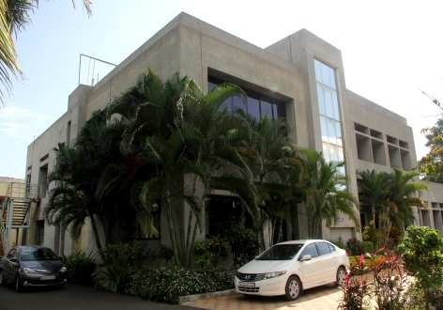
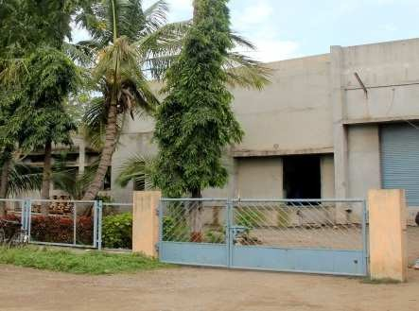
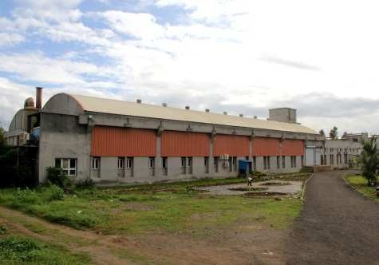
M A N U F A C T U R I N G P L A N T S
Plant No. | Plant 1 | Plant 2 | Plant 3
Location | G-17, Ahmednagar | C-40, Ahmednagar | A 20/1, Supa MIDC, Ahmednagar
Established | 1996 | 2006 | 2009
Working Area | 70,000 Sq. ft. | 40,000 Sq. ft. | 80,000 Sq. ft.
Operation | Single Side & Metal Clad PCBs | Single Side PCBs | Double Side , RF & Multi-Layer PCBs

Slide 6

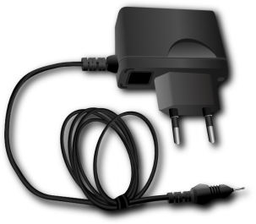
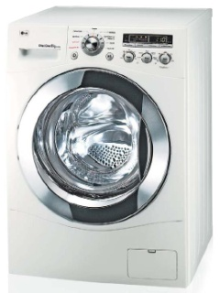
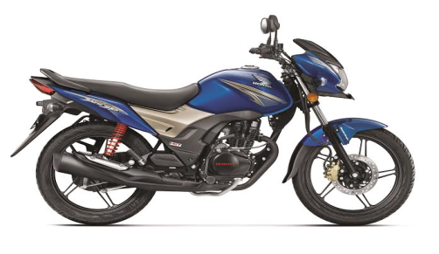
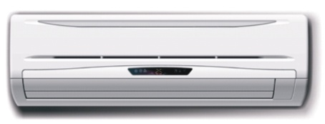
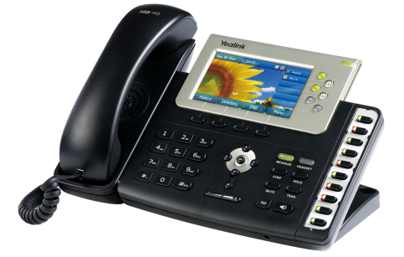
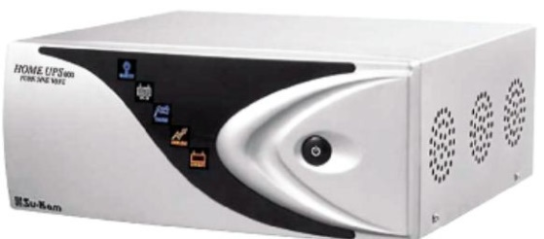
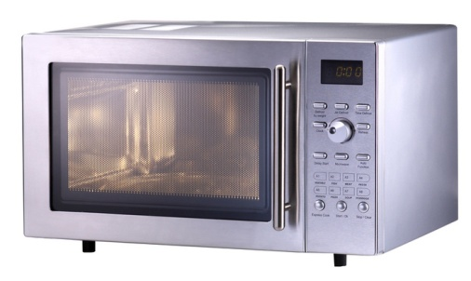
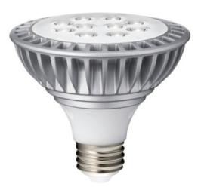
P R O D U C T R A N G E & S E G M E N T S
Single Side PCBs
Materials: FR 1, FR 2, CEM 1, CEM 3, FR 4, Metal Clad
Track width/spacing: 8mil / 8mil
Min hole size : 0.4mm (CNC), 0.6mm (Punching)
Thickness: 0.8mm- 1.6mm
Copper Thickness: 35/0, 70/0
Finish- Lacquer, OSP, HAL(Tin Lead), HAL (Lead Free), Carbon, Peel able Printing

Slide 7
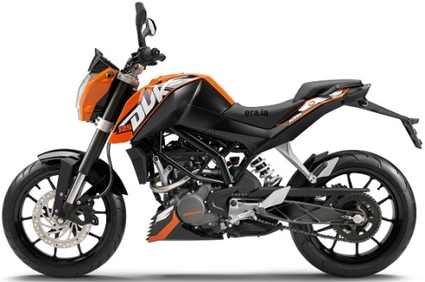
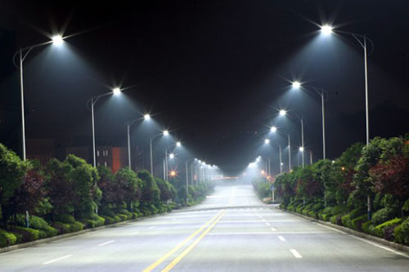
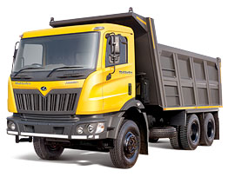
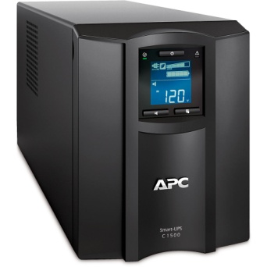
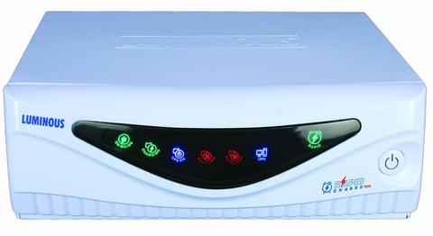
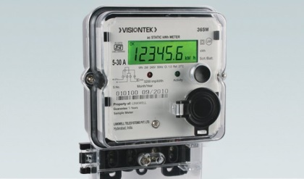
P R O D U C T R A N G E & S E G M E N T S
Double Side PCBs
Materials: CEM 3/ FR 4/ FR 4 High TG
Track width/spacing: 6 mil / 5mil
Min hole size : 0.25
Thickness: 0.4mm- 2.4 mm
Copper Thickness: 18/18, 35/35, 70/70
Finish- OSP, HAL(Tin Lead), HAL (Lead Free), Immersion Tin, Hard Gold (Out Sourced), ENiG, Carbon, Peelable Printing

Slide 8


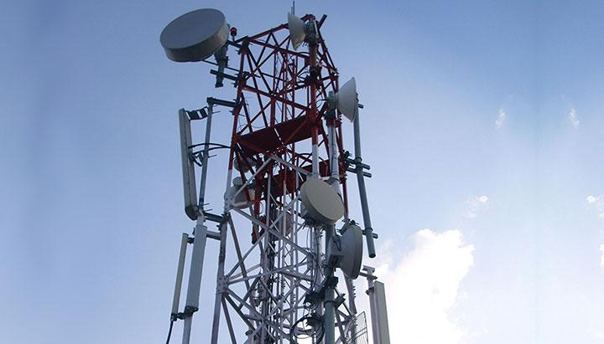
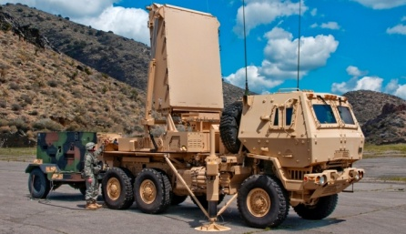
P R O D U C T R A N G E & S E G M E N T S
RF PCBs
Materials: FR 4, PTFE(Rogers, Arlon, Neltec, Taconic, Isola
Track width/spacing: 0.2mm-2.4mm
Copper Thickness: 17.5/17.5, 35/35, 70/70,105/105 (Non PTH)
Finish- OSP, Immersion Tin, Hard Gold (Out Sourced)

Slide 9

S A L E S S T A T I S T I C S
In Million
(Exclude Taxes)

Slide 10
























K E Y C U S T O M E R S

Slide 11









K E Y A P P L I A N C E C U S T O M E R S

Slide 12
M A N U F A C T U R I N G F A C I L I T I E S

Slide 13
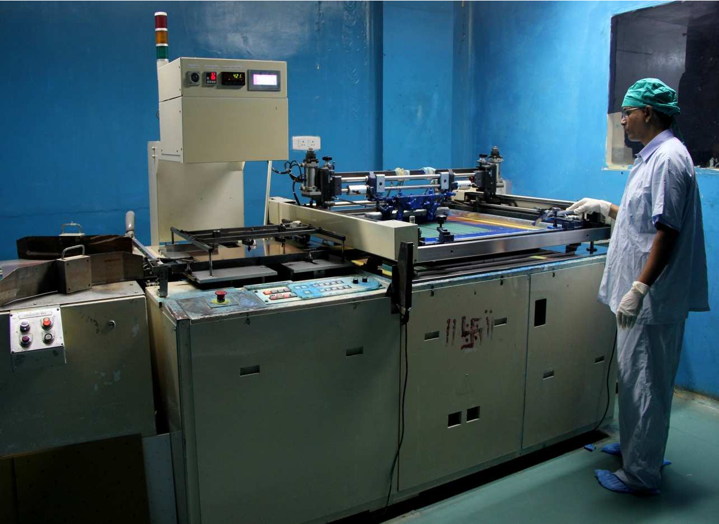
Single Side Facilities
ONO SOKKI Machine
Fully automated Printing Machine circuit printing machine in class 1,00,000 clean room

Slide 14
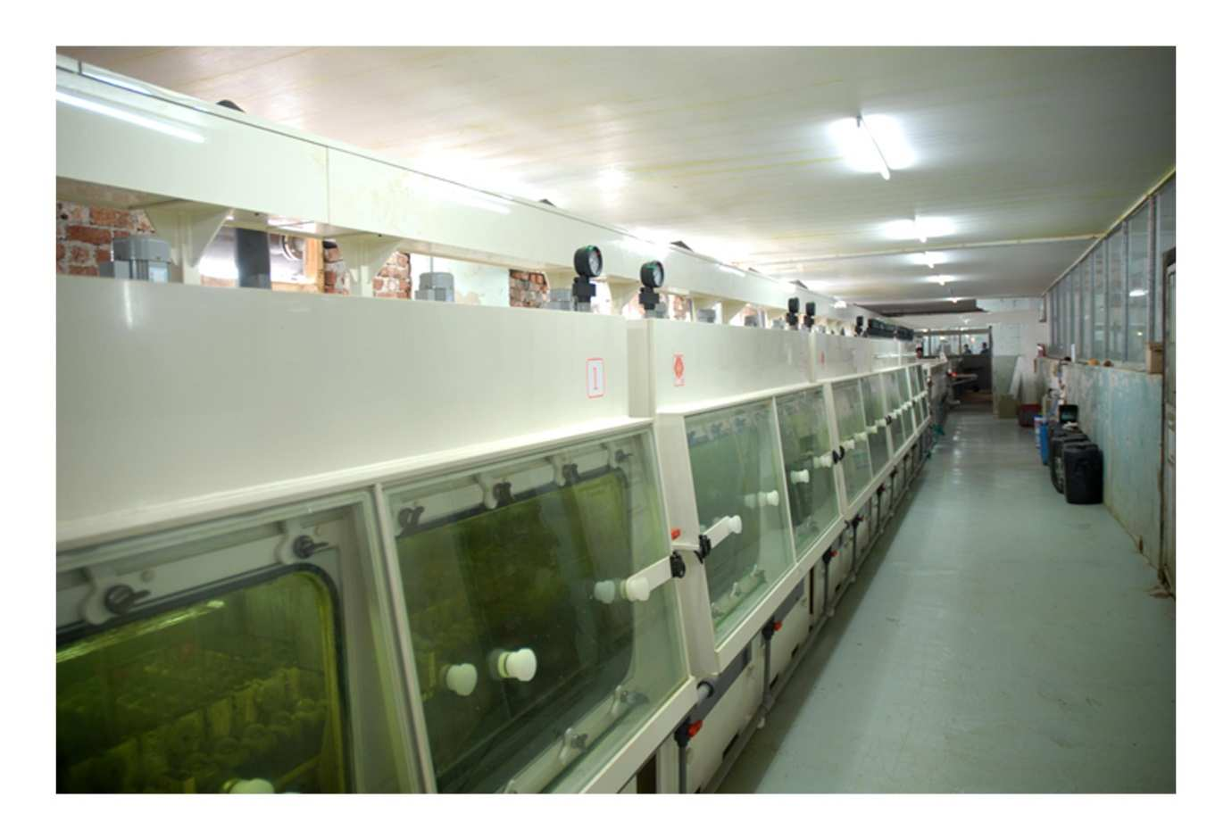
Single Side Facilities
Etching Line
Key Feature:
  Fine track Single Side & Double Side 5 Chamber Etching line.

Slide 15
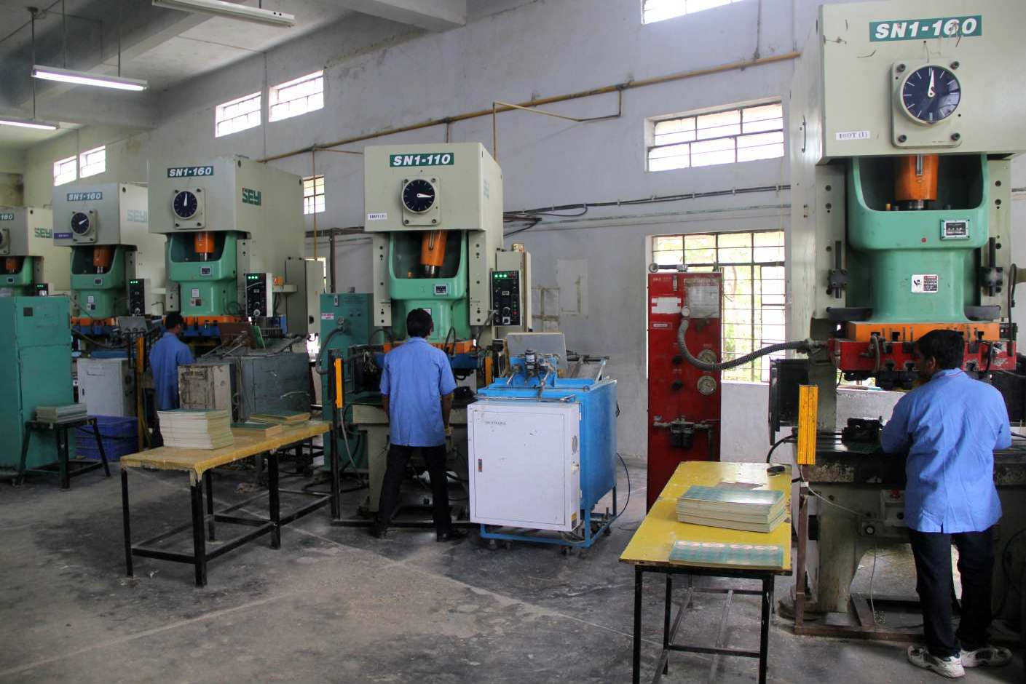
Single Side Facilities
Press Shop
Key Features:
Fine piercing with high tonnage capacity
Capacity of 1,00,000 strokes per day

Slide 16
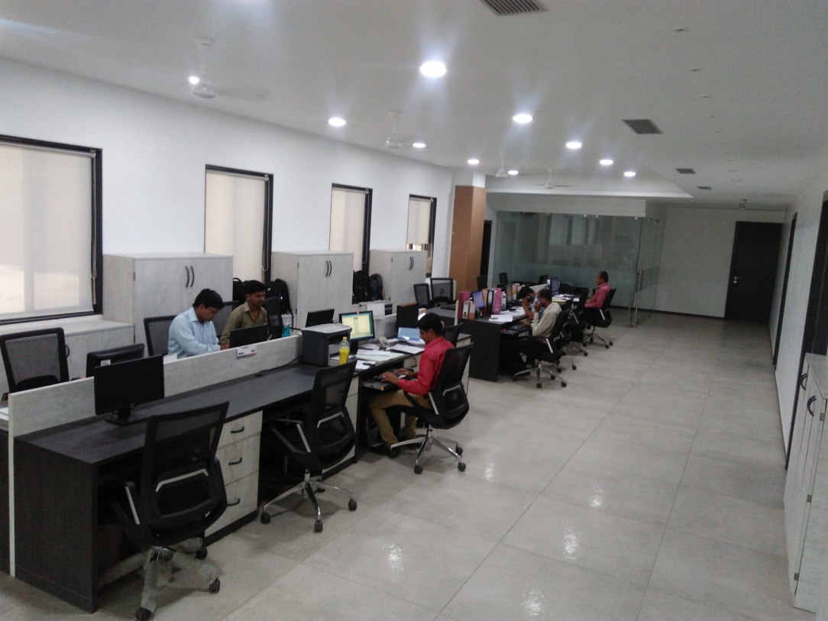
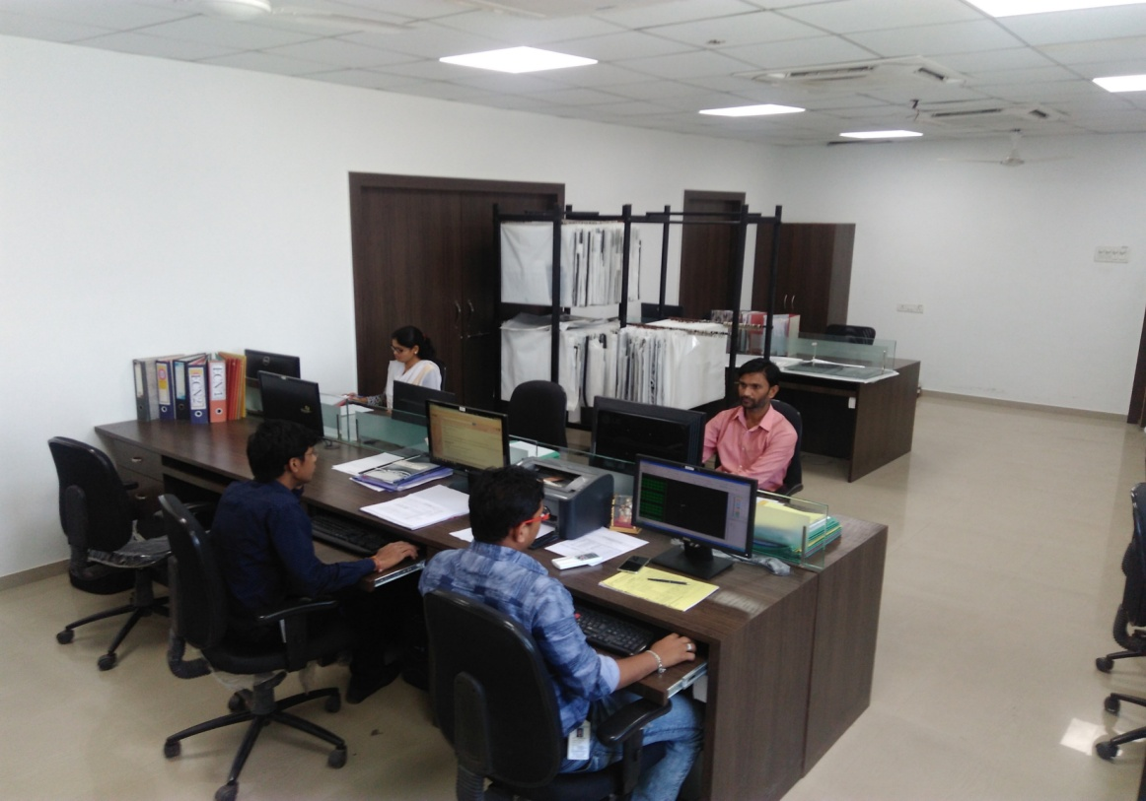
Double Side Facilities
Corporate Office
Engineering Department

Slide 17
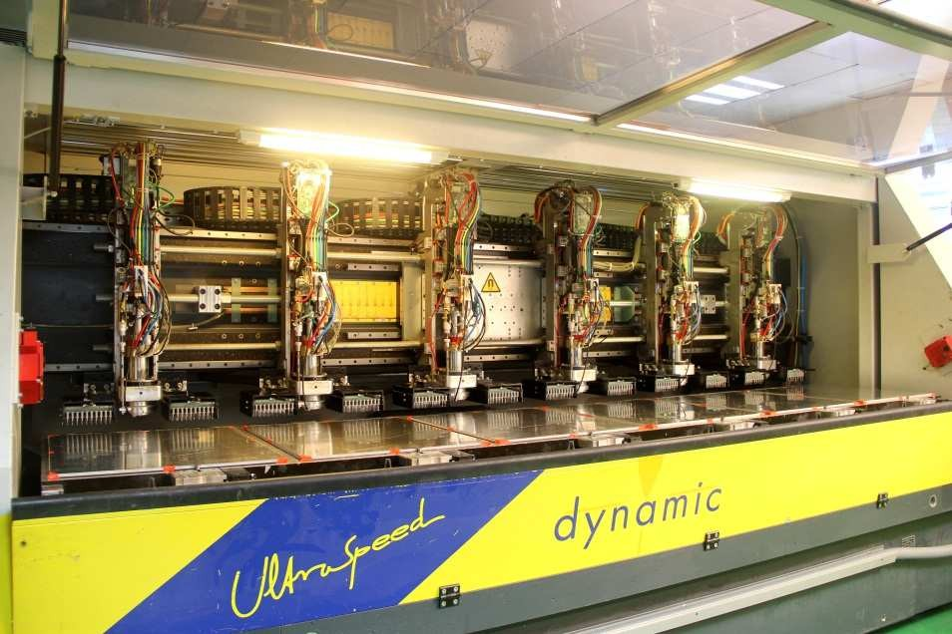
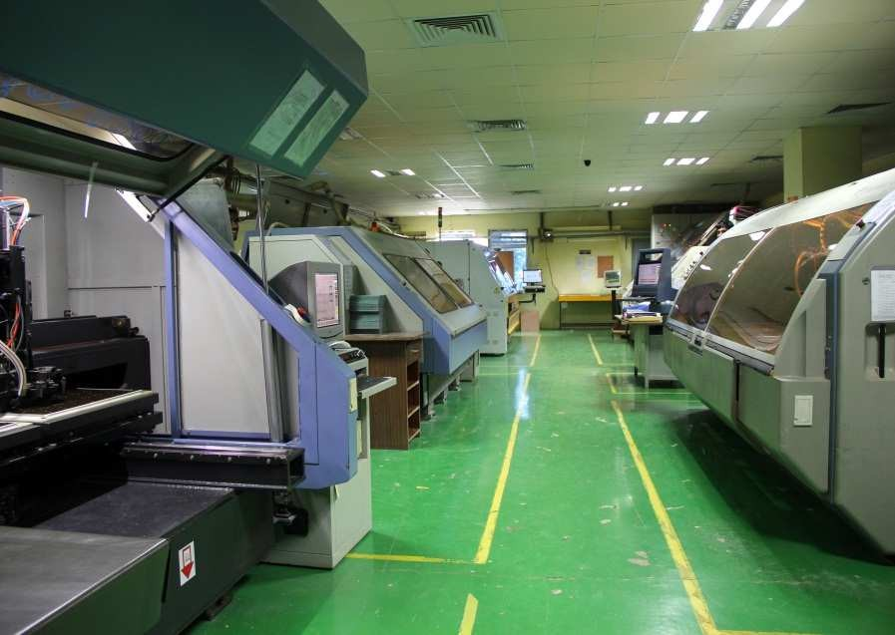
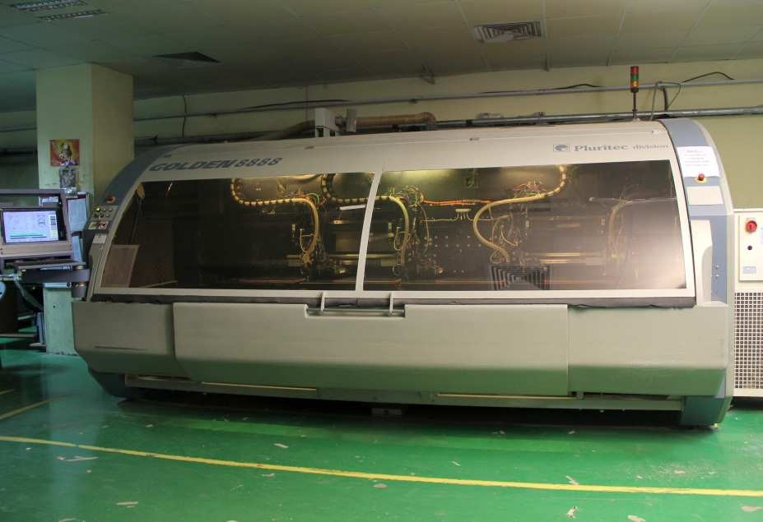
Double Side Facilities
CNC Drilling & Routing Machines

Slide 18
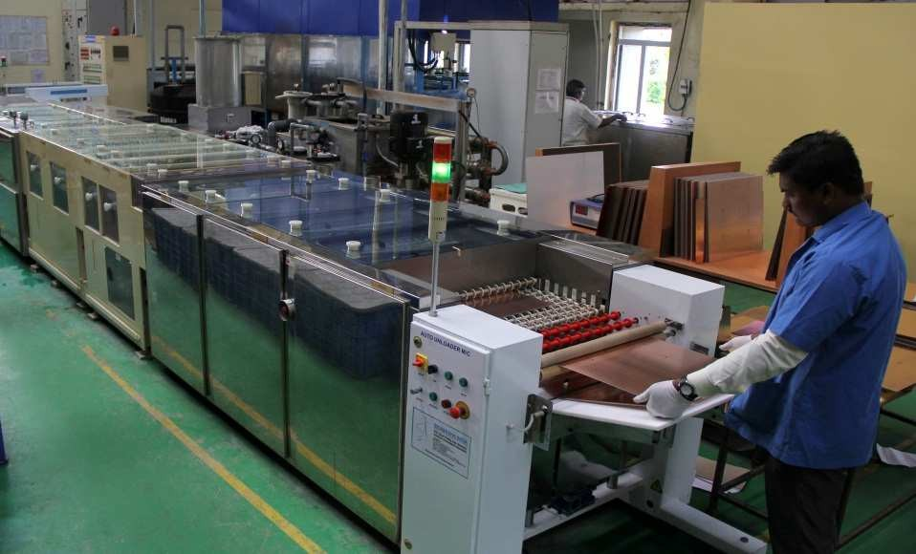
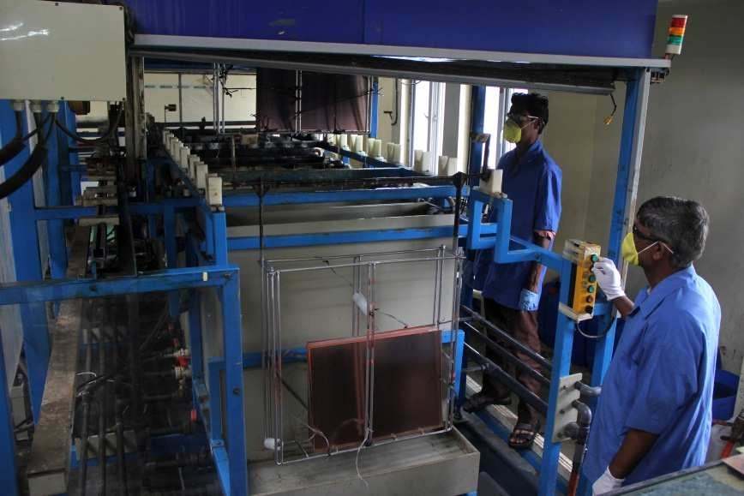
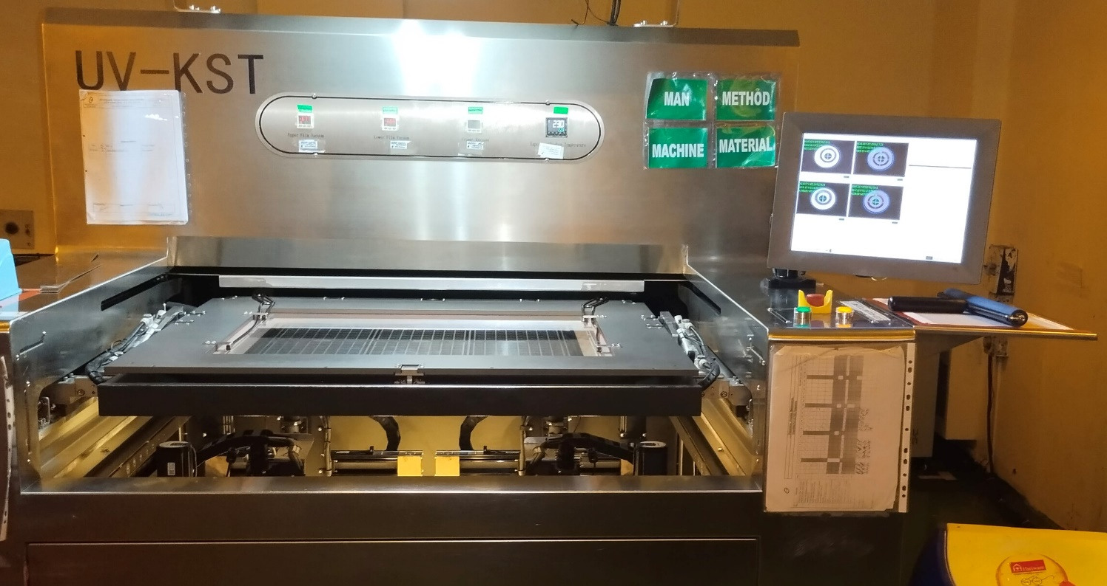
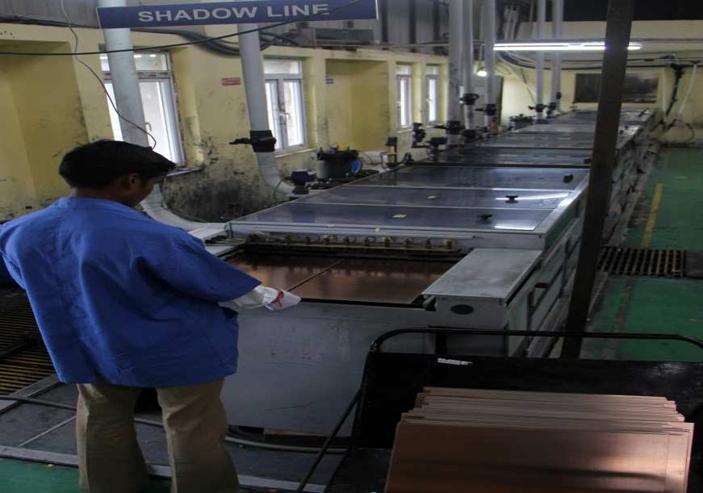
Double Side Facilities
De burring Line
De smear Line
Auto KST
Shadow Line

Slide 19
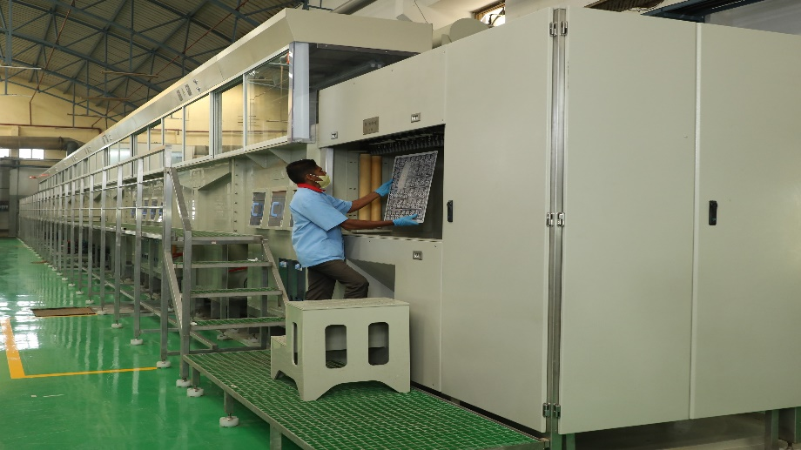
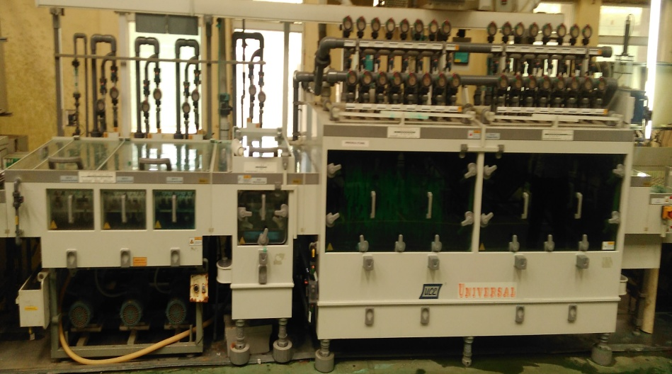
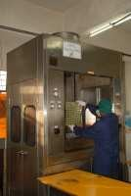
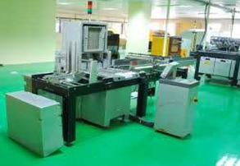
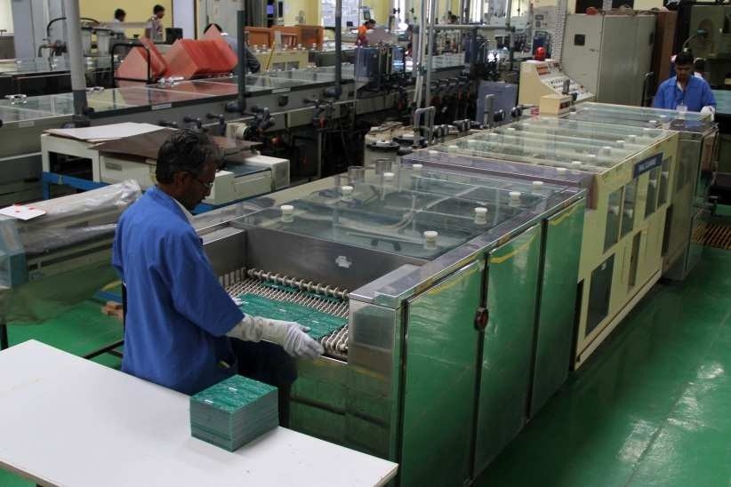
Double Side Facilities
V C P Line
Etching Line
HAL Machine
Electrical Testers
Final Cleaning Line

Slide 20
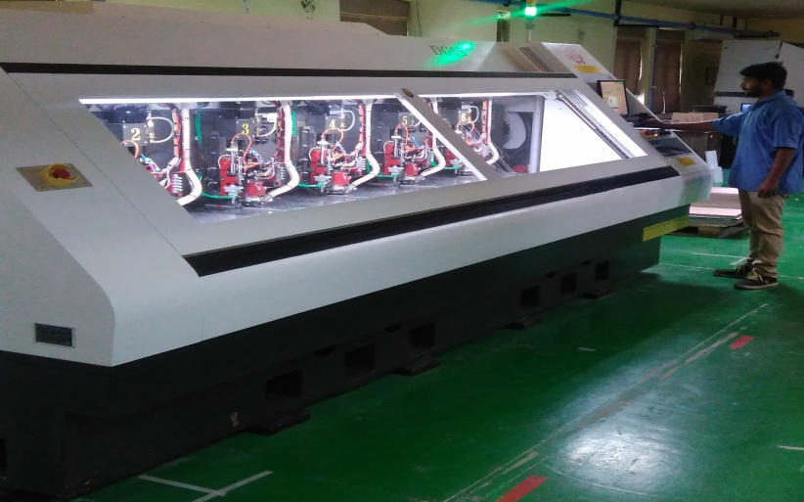
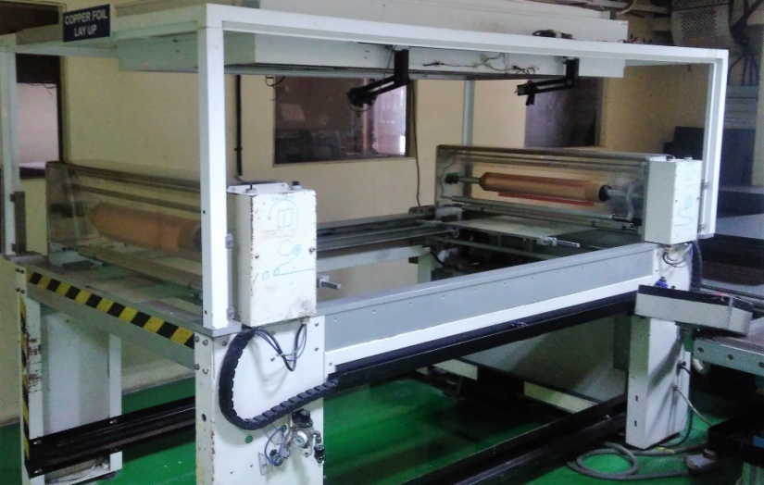
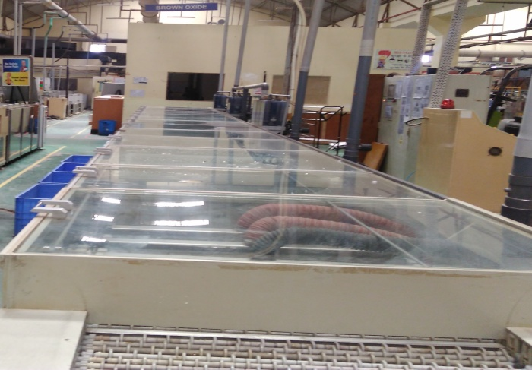
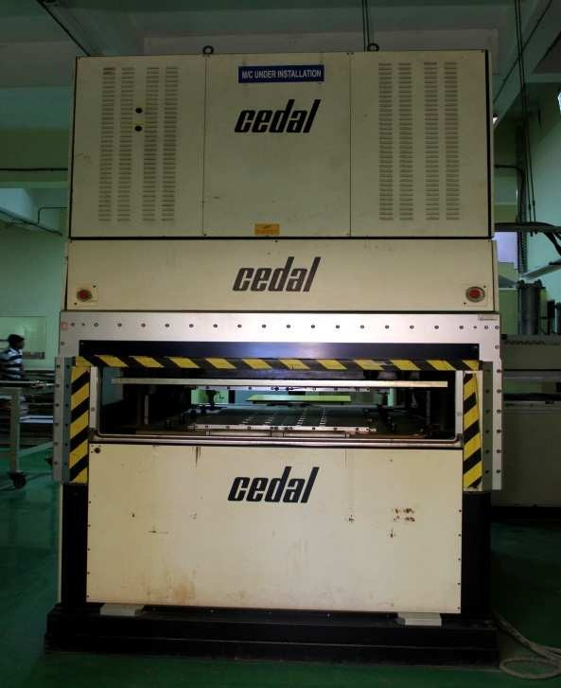
Multi Layer Facilities
Multi Layer Drilling
Lay up Station
Brown Oxide Line
MLB Press

Slide 21
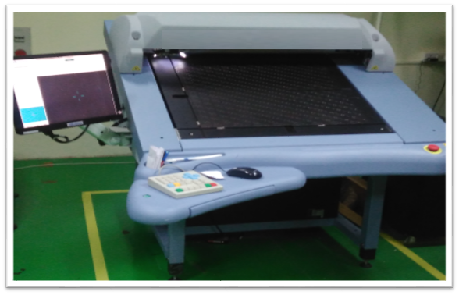
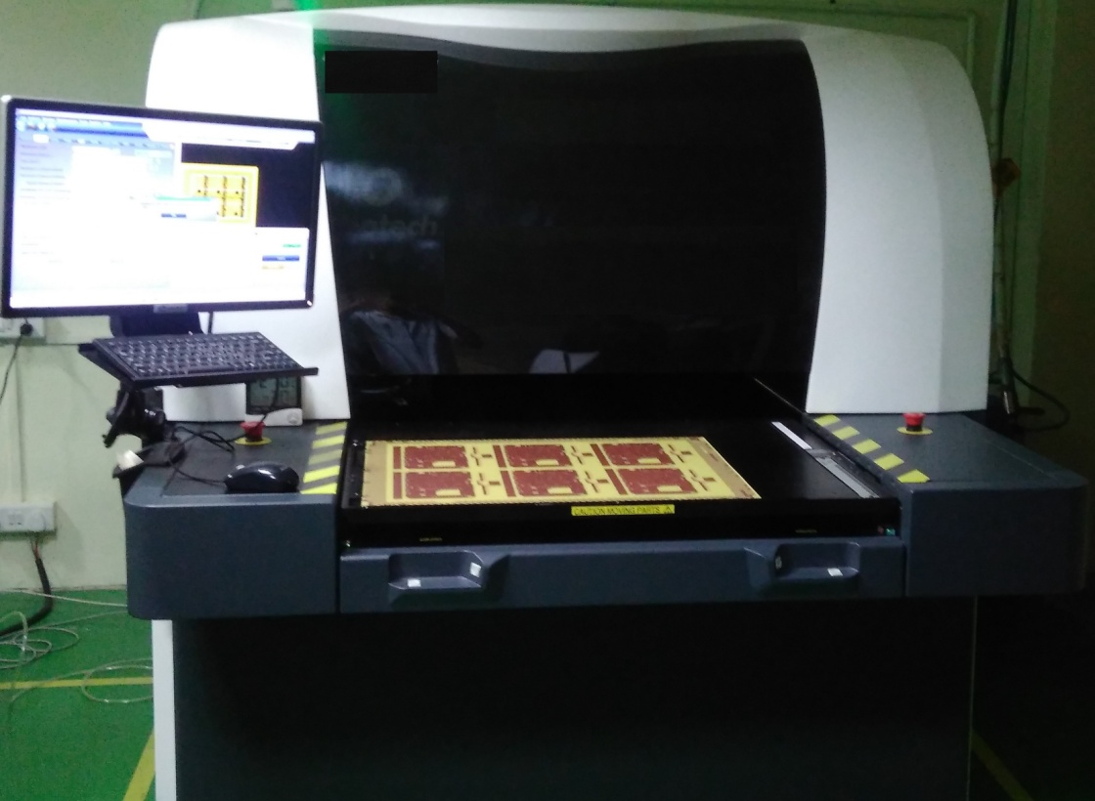
Multi Layer Facilities
AOI Machine with Verifier

Slide 22
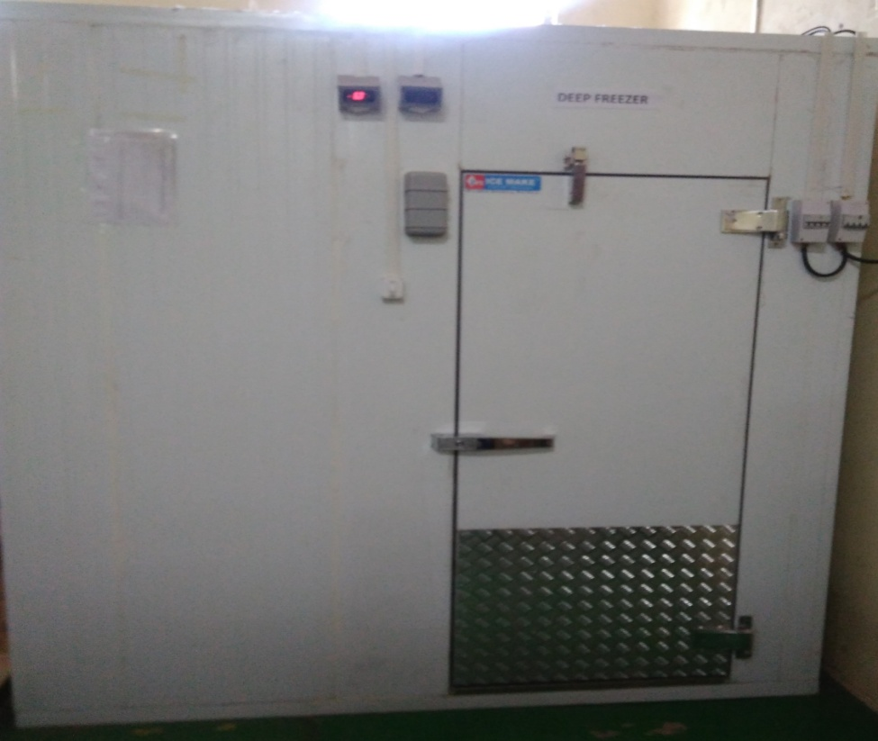
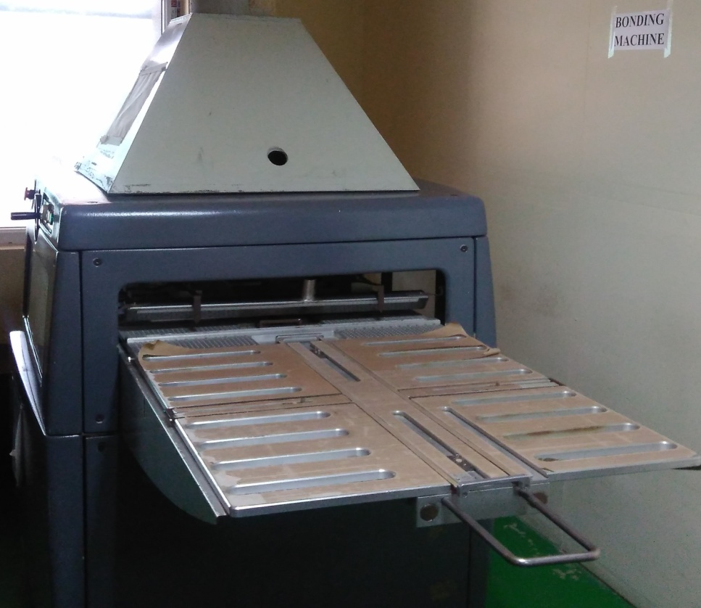
Multi Layer Facilities
Cold Storage for Prepreg
Bonding Welder

Slide 23
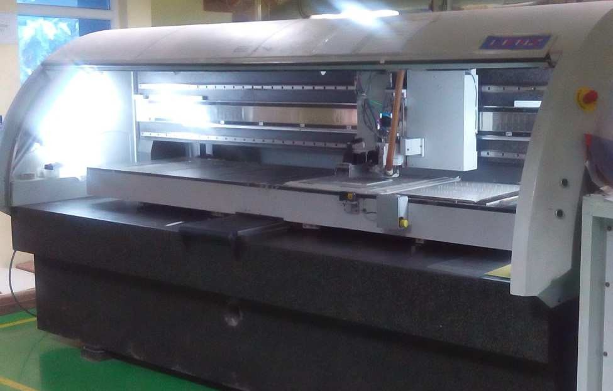
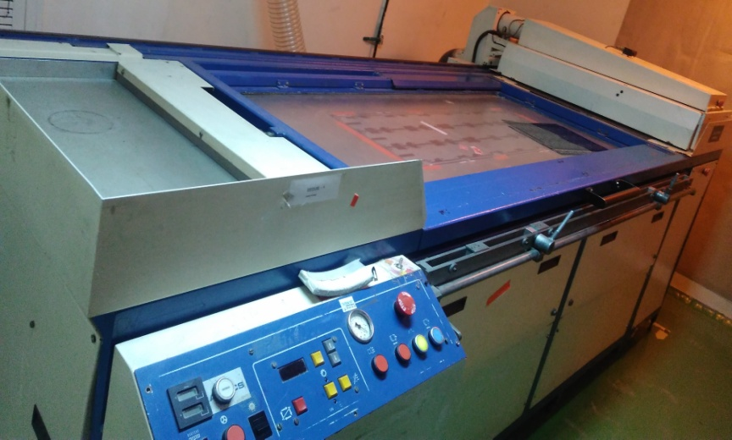
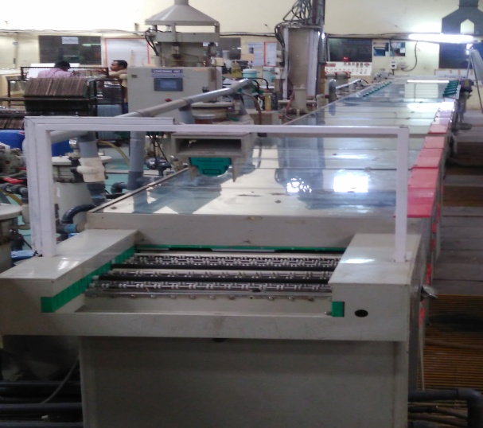
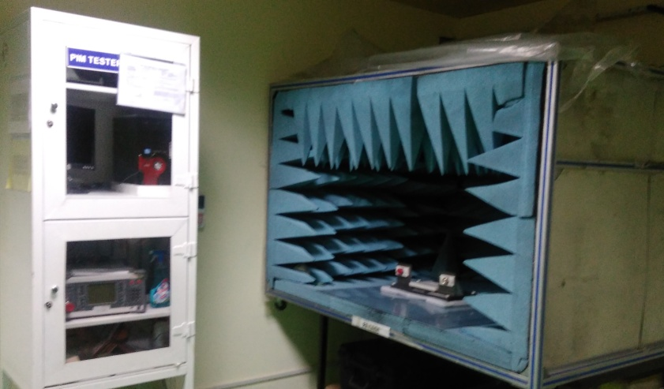
RF Manufacturing Facilities
Large Bed CNC
Large Bed Exposure
PIM Tester
Immersion TIN Line

Slide 24
Unique Capabilities of RF PCBs
We have unique capability for manufacturing of specialised PCBs in India for manufacture of long board up to 2 meter long. This is possible due to our investment in Large bed CNC (2.8m long bed) and large format exposure machine (2m long)
v Capability to provide PTH Boards in most PTFE laminates such as AD 255 etc. We use shadow process (direct metallisation) for through hole connection
v Recently we have developed Capability to process long board (up to 2 meters) in polyamide material with just 85 micron thickness for space applications.

Slide 25
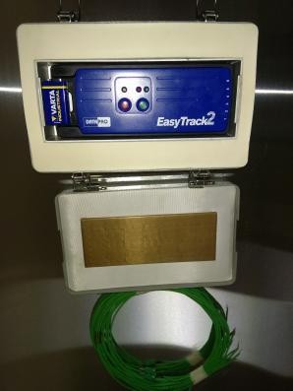
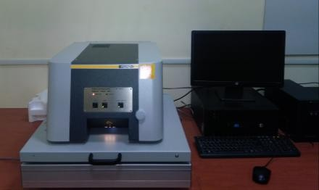
Laboratory and other test equipment's
2. XRF Meter
0
Range: -150 to 500 c
Least Count: 0.01 micron
Accuracy: 4%
1. Oven Profiler
Range: -150 to 500 c
0
Least Count: 0.1 c
Accuracy: ±0.5 °c

Slide 26


Laboratory and other test equipment's
3. Mask Thickness Measurement
Range: 0 to 200 micron
Least Count: 0.1 micron
4. Particle Counter
Sample Time: 1-10 min
Flow Rate: 0.1 CFM

Slide 27


Laboratory and other test equipment's
5. Profile Projector
Motorised joy stick operated X,
Y and Z measuring axes.
Resolution: 0.5 micron
6. Micro Scope & Micro Section
Sophisticated Microscope with
1000x magnification available for the process
controls and reliability testing.

Slide 28

ENVIRONMENT, HEALTH & SAFETY
v A clean and safe environment forms the basis for healthy growth of an organization.
v At Epitome, we take utmost care of environment – inside as well as outside of the plant.
v Installed ET plant to reuse water, conserving the most precious natural resource.

Slide 29



ENVIRONMENT, HEALTH & SAFETY
Installed RO plant, to bring down our demand for fresh water.
  Cultivated a green surrounding by feeding treated water.

Slide 30

Supplying to leading companies to diversified sector
Automobile
Lighting
Space & Defense
Consumer Electronic
Industrial
Home Appliance
Telecom

Slide 31
Epitome - Committed to Customer Satisfaction
World class manufacturing facilities
Only PCB company in India with 3 manufacturing facilities
Experienced Management team
Proven Track record of 25 years in PCB manufacturing
Young, dynamic and driven professionals
Fast development time and quick deliveries for urgent requirements of Strategic customers
Cost conscious and competitive
Continuing CAPEX in facilities
Focussed on Continuous improvements
Strong financials

Slide 32
Present and Future Capacity (Supa Plant)

Slide 33
Present and Future Capability (Supa Plant)

Slide 34
Present and Future Capability (Supa Plant)

Slide 35
Thanking You
Epitome Components Pvt Ltd

