Slide 1

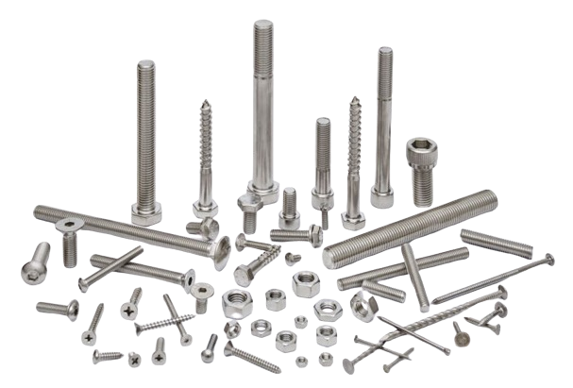


COMPANY
PROFILE
85306 30625, 96876 54343
info@screwfixinternational.com

Slide 2


TABLE OF CONTENT
All Types of Screw, Bolt & Nut Manufacturers And Exporters
  About Company
  Vision
  Mission
  Leadership
  Core Value
  Industries We Served
  Certificates
  Our Products
  Mfg. Process
  Corporate Video
  Product Gallery
  Production area photos
  Contact
85306 30625, 96876 54343
info@screwfixinternational.com

Slide 3

ABOUT COMPANY
Screwfix International Pvt. Ltd. is a dynamic and innovative company based in Surendranagar, Gujarat, India.
Established on February 18, 2022, we specialize in the manufacturing of high-quality fabricated metal products, excluding machinery and equipment. Our focus is on delivering superior products that meet the highest standards of excellence and precision.
.
85306 30625, 96876 54343
info@screwfixinternational.com

Slide 4



VISION
We envision a future where our products set the benchmark for
quality and reliability in the metal fabrication industry. Our goal
is to expand our reach and make a sign cant impact on the
global market by maintaining high standards of manufacturing
excellence and customer service.
85306 30625, 96876 54343
info@screwfixinternational.com

Slide 5

At Screwfix International Pvt. Ltd., our mission is to be a
leader in the metal fabrication industry by providing
unparalleled products and services. We aim to achieve this
through continuous innovation, adherence to quality, and
a commitment to customer satisfaction.
MISSION
85306 30625, 96876 54343
info@screwfixinternational.com

Slide 6

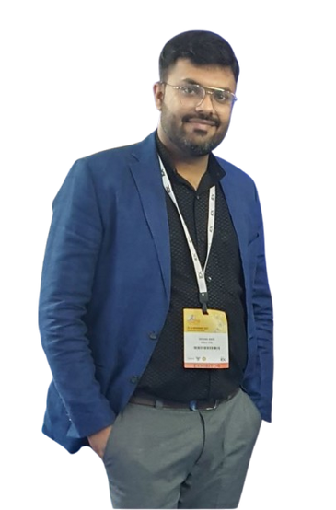
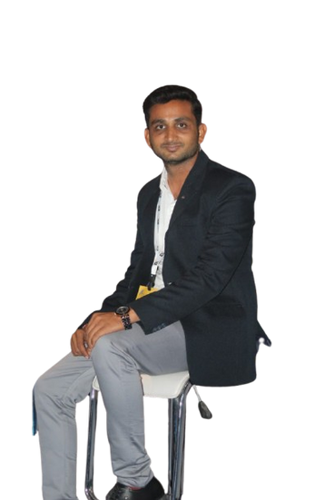

LEADERSHIP
Screwfix International Pvt. Ltd. is led by a team of experienced professionals who bring a wealth of knowledge and expertise to the company. Our directors, Devangkumar Jayendrakumar Dave and Niranj Nileshbhai Patel, are dedicated to steering the company towards achieving its strategic goals and objectives.
MR. DEVANG DAVE
MR. NIRANJ PATEL
DIRECTOR
DIRECTOR
85306 30625, 96876 54343
info@screwfixinternational.com

Slide 7
CORE VALUE
  Quality :
We prioritize quality in every aspect of our operations, ensuring that our products meet and exceed industry standards.
  Innovation :
We embrace innovation, continually investing in new technologies and processes to enhance our product offerings.
  Integrity :
We conduct our business with integrity, maintaining transparency and honesty in all our interactions.
  Customer Focus :
Our customers are at the heart of everything we do. We strive to understand their needs and deliver solutions
that provide value.
85306 30625, 96876 54343
info@screwfixinternational.com

Slide 8
  OEM
  HVAC
  Oil And Gas
  Agriculture
  Automotive
  Automobiles
  Construction
  PCB Asssembly
  Petro Chemical
  Food Processing
  Toys & Games
  Home Appliances
  Heavy Fabricators
  Interior & Exterior
  Health Care
  Electrical
  Electronics
  Furniture
  Sheet Metals
  Glazing
  Facade System.
  Power Energy
INDUSTRIES WE SERVED
85306 30625, 96876 54343
info@screwfixinternational.com

Slide 9
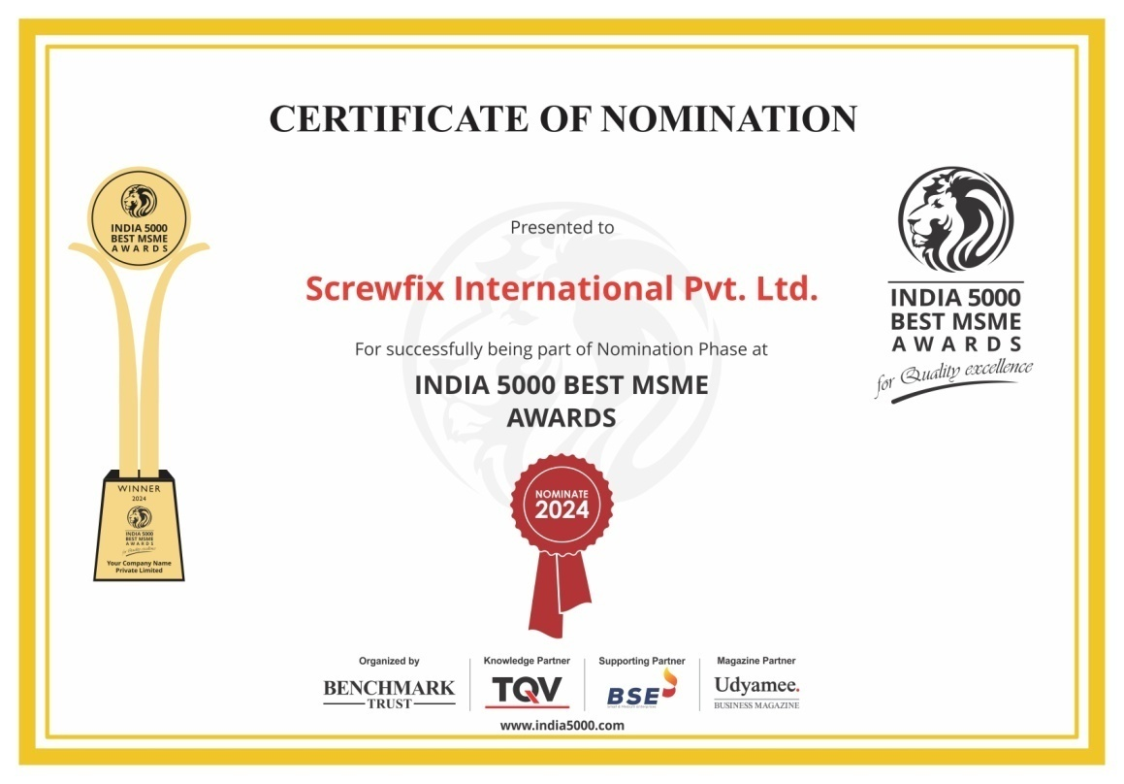
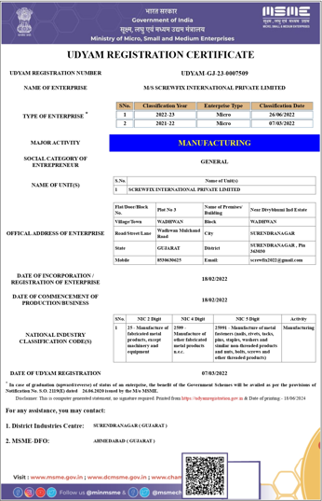
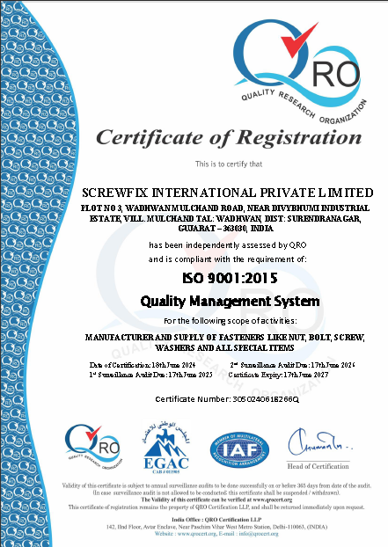
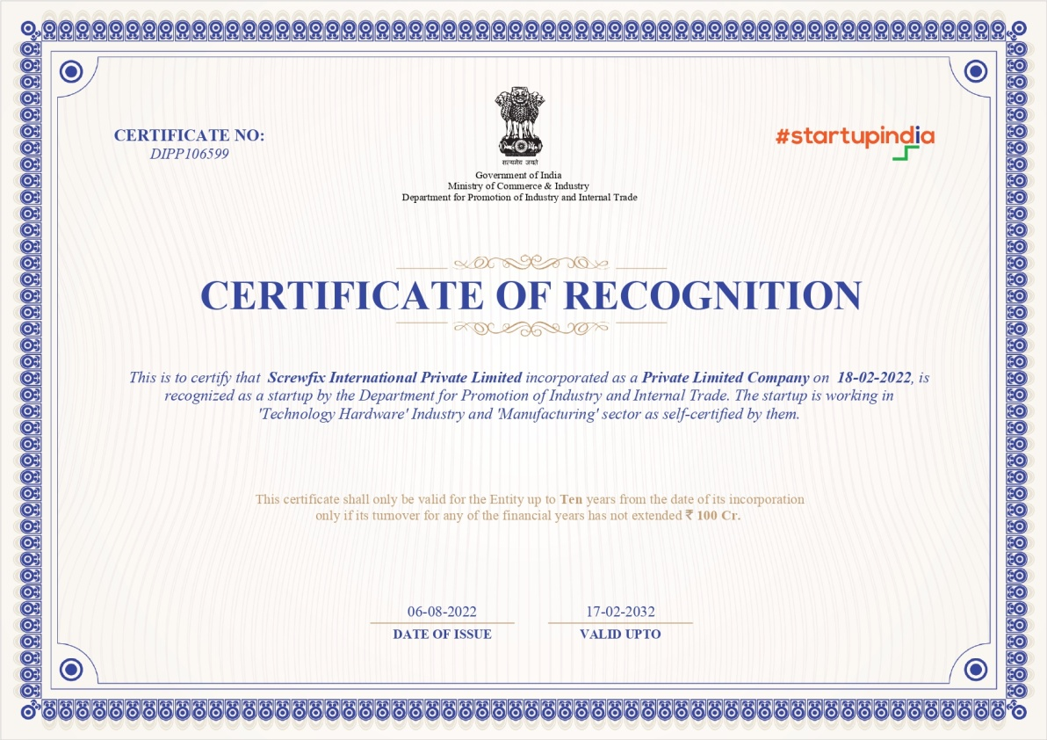
CERTFICATES
85306 30625, 96876 54343
info@screwfixinternational.com

Slide 10
OUR PRODUCTS
We are manufacturing high quality of fasteners item. We manufacturing the products in Stainless Steel,Mild Steel And HIgh Tensil Material
  All Types Screws
  Nut
  Bolt
  Washer
  Thred road
  Allen bolt
  Rivet
  J-bolt
  Anchor Fastener
  Etc
85306 30625, 96876 54343
info@screwfixinternational.com

Slide 11
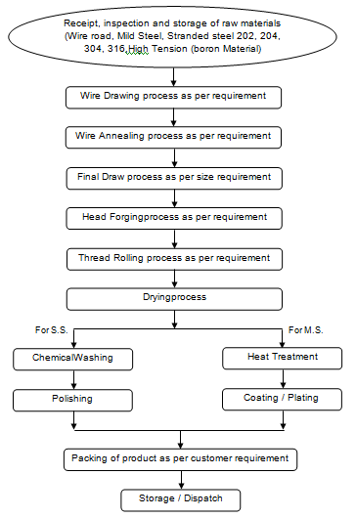
MFG.
PROCESS
85306 30625, 96876 54343
info@screwfixinternational.com

Slide 12
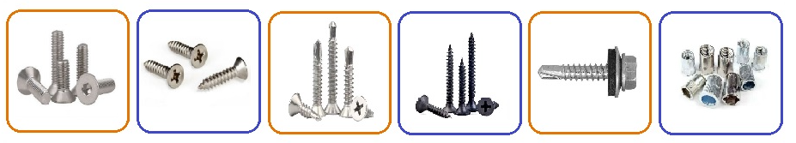
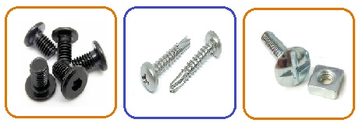

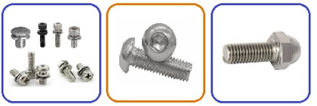
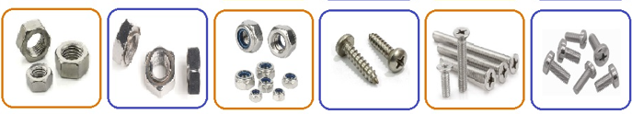
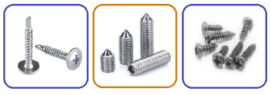
PRODUCT GALLERY
85306 30625, 96876 54343
info@screwfixinternational.com

Slide 13



85306 30625, 96876 54343
info@screwfixinternational.com
info@screwfixinternational.com

Slide 14
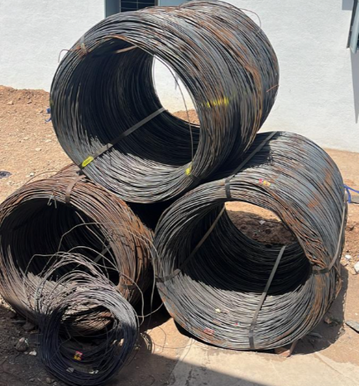
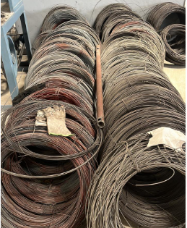
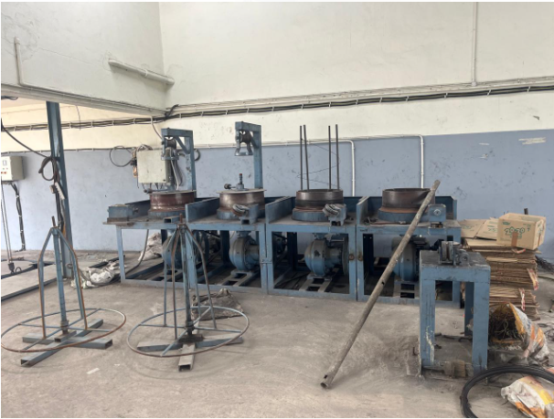
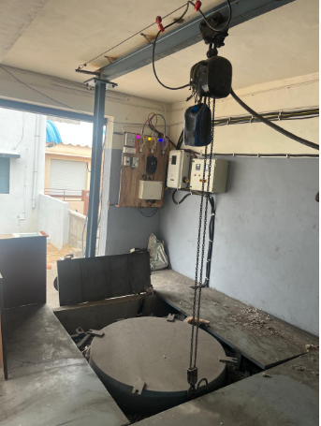
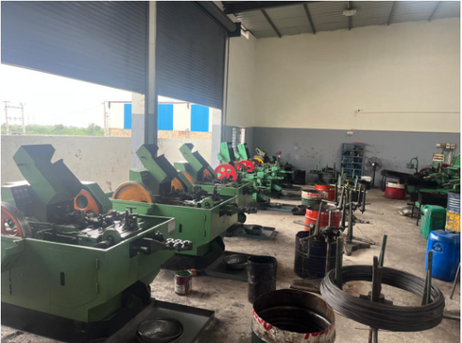
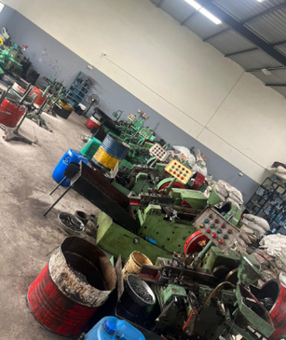
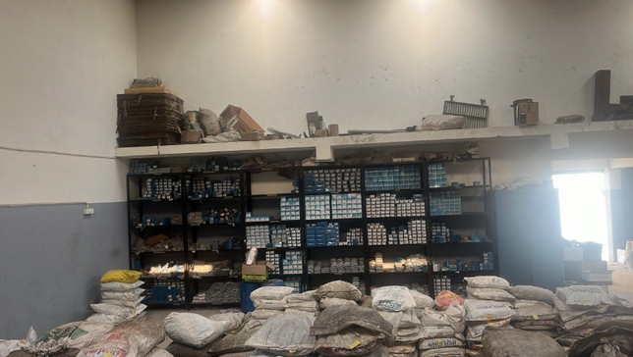
PRODUCTION AREA PHOTOS
85306 30625, 96876 54343
info@screwfixinternational.com

Slide 15
LET'S CONNECT WITH US!
SCREWFIX INTERNATIONAL PVT. LTD.
FACTORY
Shree Krushna Estate, Survey No. 41, Plot No. 2 & 3/1,
Nr. Divyabhoomi Industrial Estate,
Village - Mulchand Wadhawan,
Surendranagar - 363001
Tel : +91 85306 30625, +91 96876 54343
Email : Info@screwfixinternational.com

