Slide 1
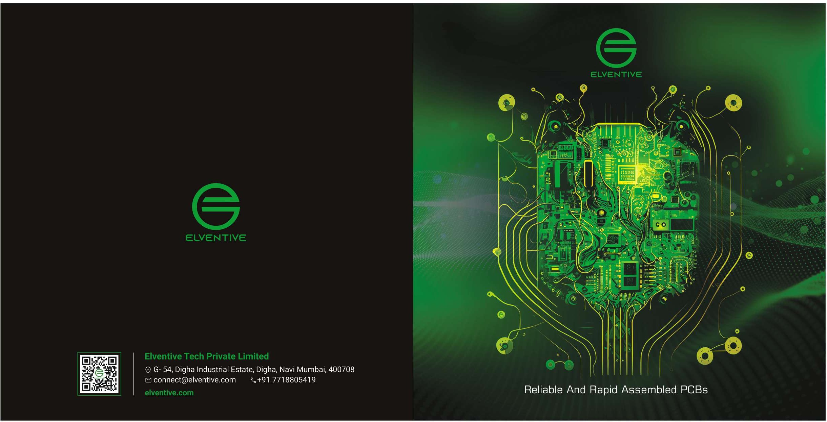

Slide 2
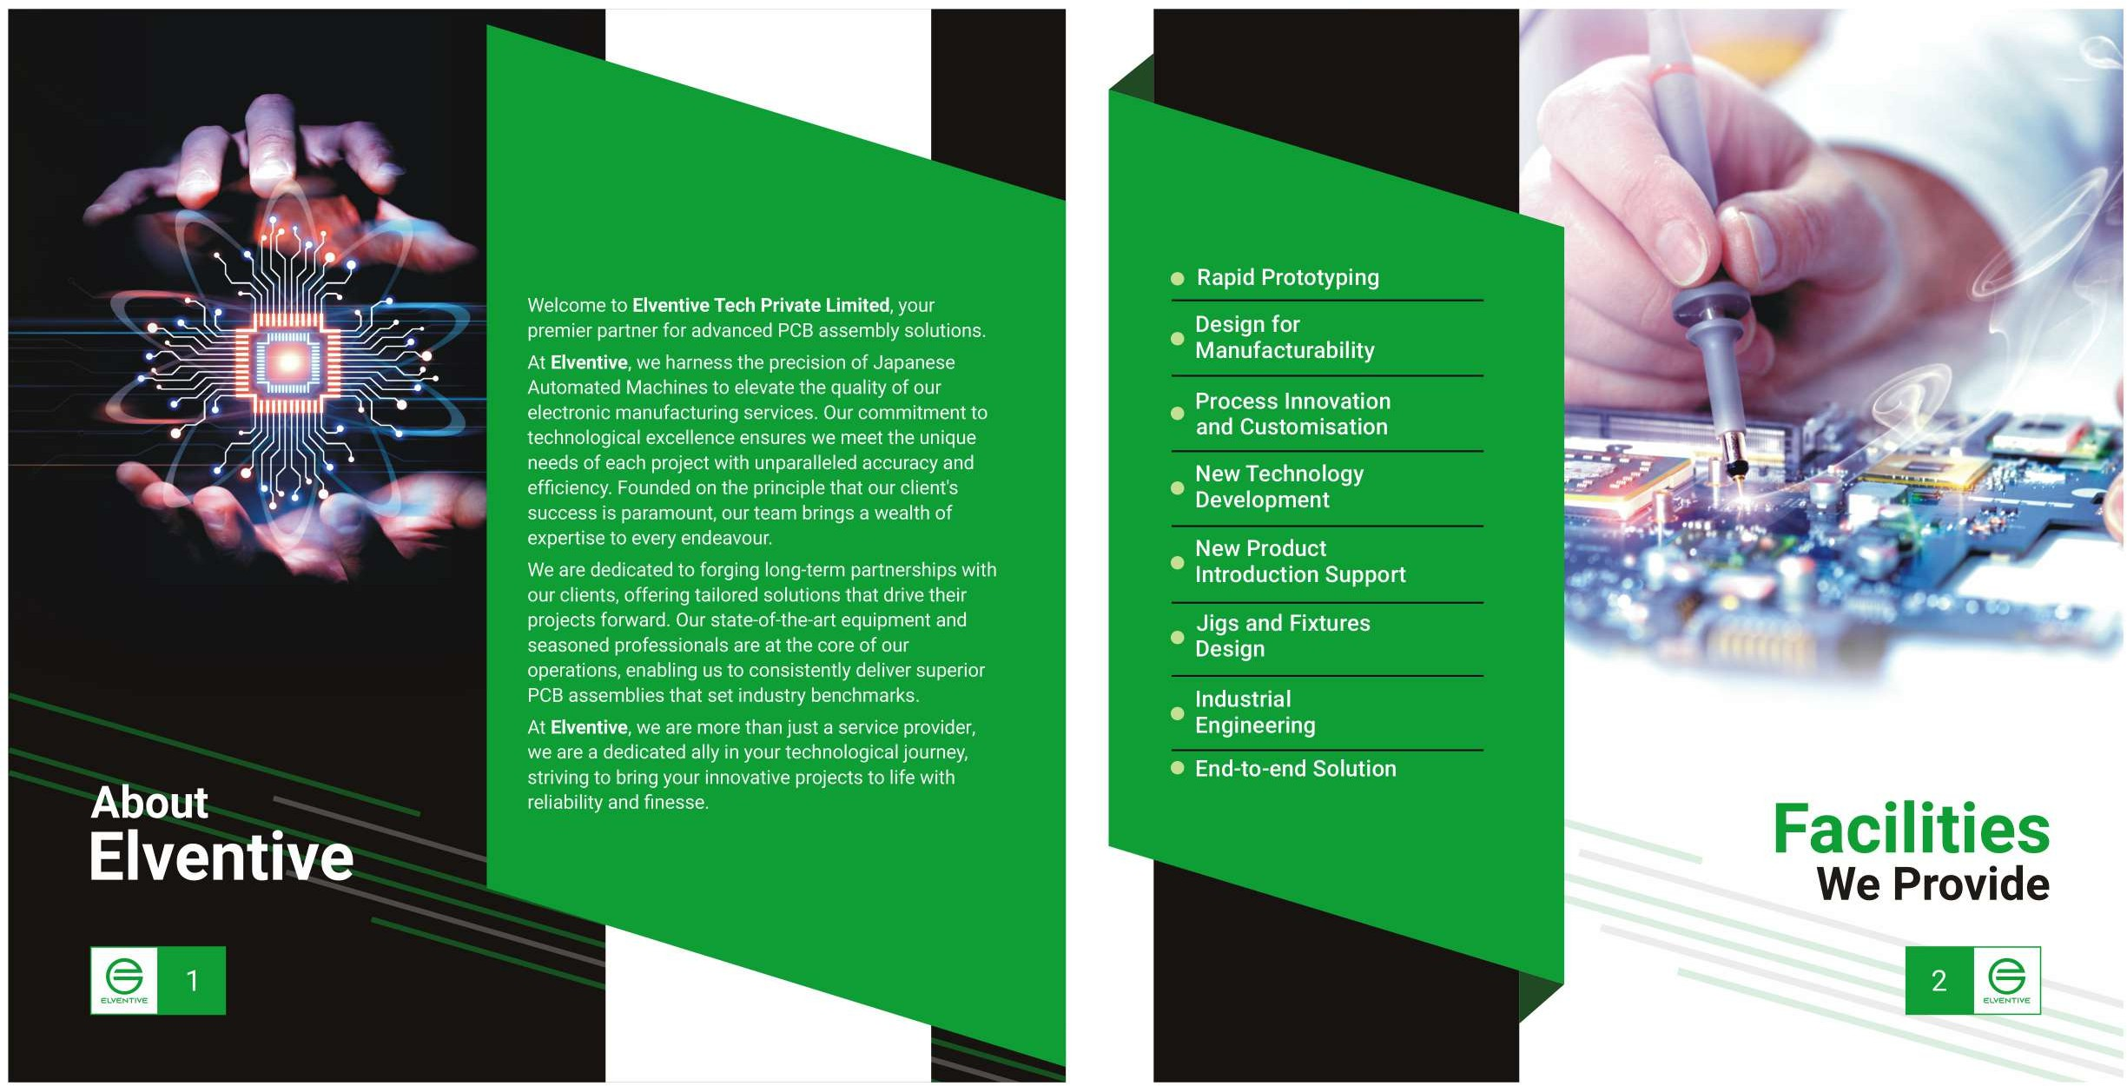

Slide 3
PCB
Assembly Services
Elventive is a vertically integrated PCB company serving premium customers across diverse industries and applications. Our automated highspeed SMT line, equipped with advanced optical testing facilities, offers reliable multilayer PCB design and assembly for both through-hole and SMT high-density solutions. We support rapid prototyping and turnkey projects to accelerate client's development activities.
Our PCB assemblies, backed by 100% quality assurance, are supplied to various sectors,
including Traction, Industrial, Marine, Defence
applications and more.

Slide 4
