Slide 1
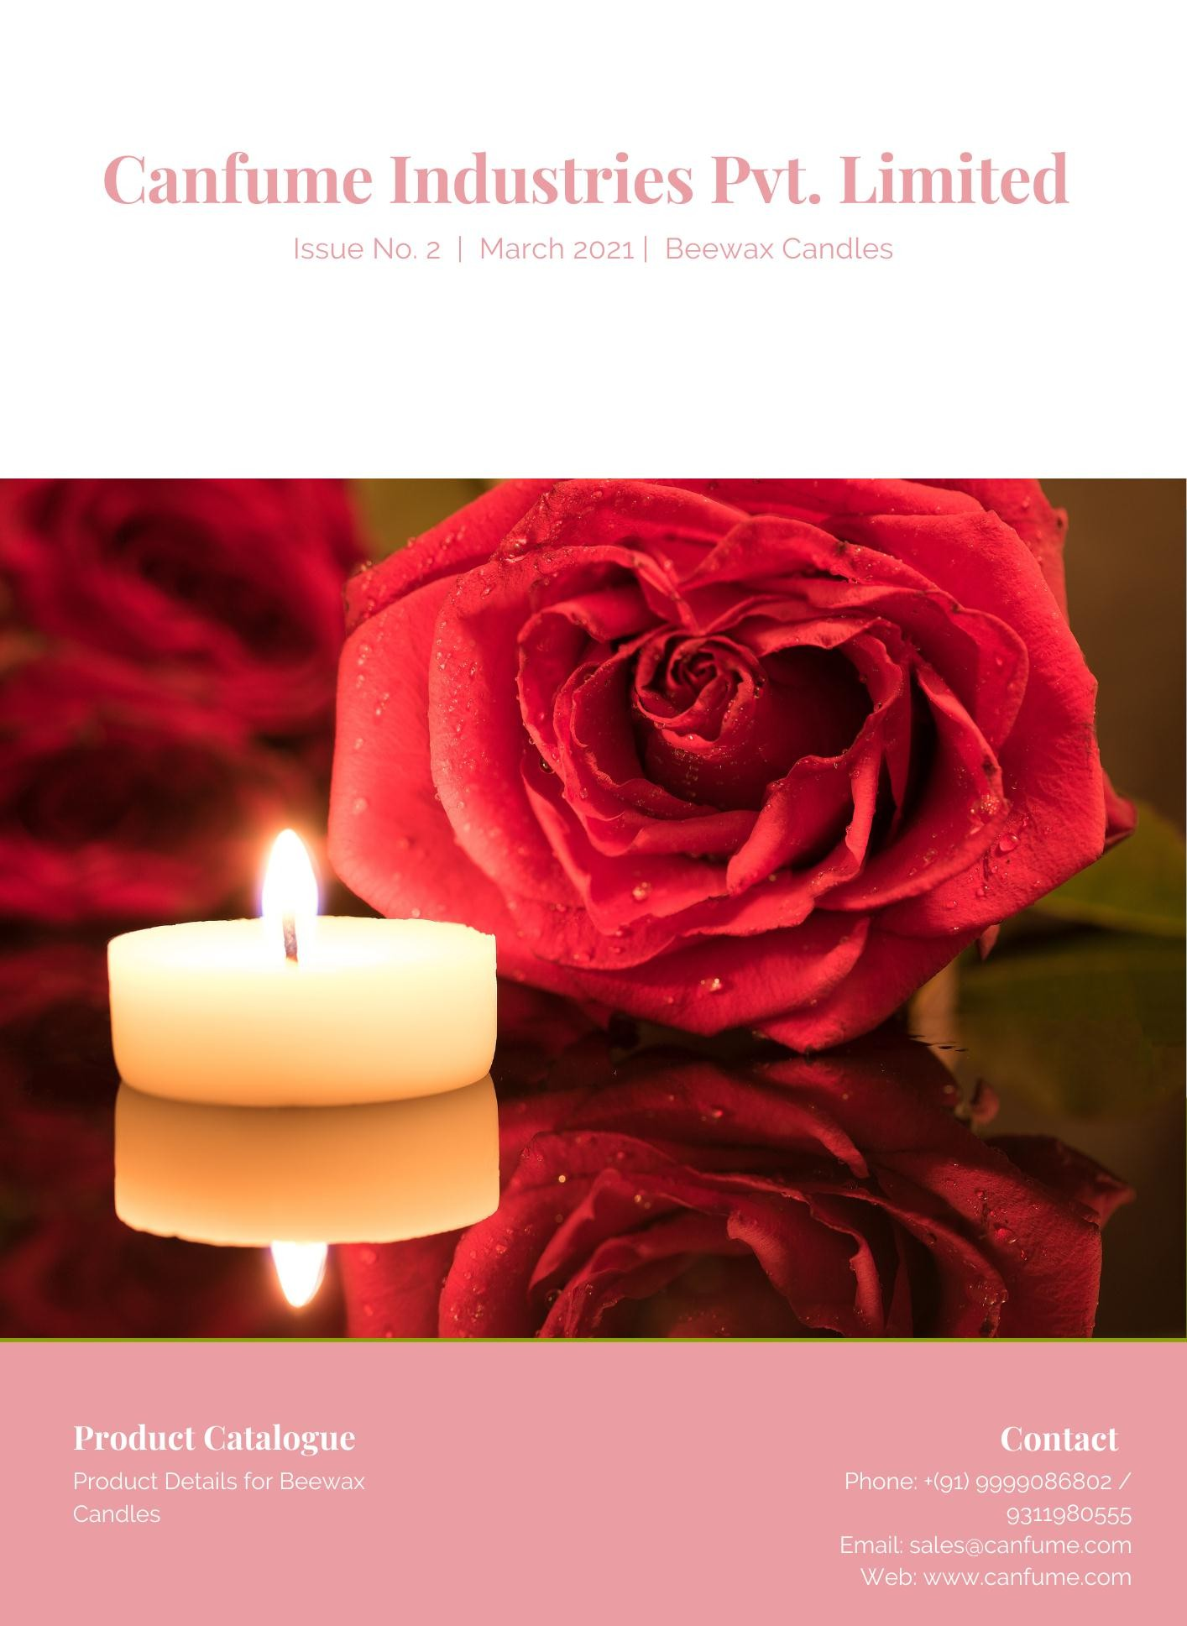



++ Canfume Industries Pvt.
Limited
(House of organic
candles)
Canfume Industries Pvt. Limited
(House of organic candles)
Web: www.canfume.com

Slide 2
++ Canfume Industries Pvt.
Limited
(House of organic
candles)
Canfume Industries Pvt. Limited
(House of organic candles)
Company Profile
CANFUME INDUSTRIES PRIVATE LIMITED (Est. Sept,2020)
manufactures, wholesale, export, retail to the local and global market.
Broad services include Manufacturing and Sales of the BEST IN CLASS candles.
Our specialization is in
COMPANY PROFILE
Organic Bee Wax Candles
Decorative Diya
Fancy Candles
Scented Candles
We aim to spread the light of happiness with our varied range of
products.
Web: www.canfume.com

