Slide 1








Corporate Overview
ITAR - DDTC
Copyright ©2025 Accelyzei

Slide 2



ABOUT US
Copyright ©2025 Accelyzei

Slide 3














Accelyzei Core Business Segments
ISO26262
ISO21434
Fusa
Safety Critical
DO-330
ARP4754A
ARP4761
DO-178B/C
DO-254
DO-160
Semiconductor
AI
SAP
ServiceNow
Software
Gen-AI
IoT
Analytics
MS Dynamics

Slide 4
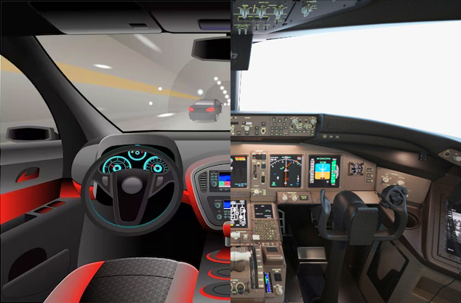





Accelyzei Company Overview
An organization committed to providing comprehensive product engineering services and solutions, encompassing the entire product development lifecycle.
System/Hardware/Software design, development, V&V, in safety-critical domains - Aerospace, Defense and Automotive.
"Spec-Silicon-Post Silicon" services in the Semiconductor sector.
Specialized expertise in FAA/EASA/Automotive standards.
Software services specializing in cutting-edge technology domains, including Artificial Intelligence, Advanced Analytics, Intelligent Automation, and Enterprise Solutions.

Slide 5

OUR JOURNEY
© Copyright 2025 Accelyzei

Slide 6







Company Timeline
Looking into Future
Strategic Partnerships – Driving end-to-end technology leadership across Safety-Critical, Semiconductor, and Software domains
IoT & AI Innovation – Advanced IoT hardware and AI model development & deployment for critical applications
AI Tools & Models – Delivering cutting-edge AI in Safety Critical and Semiconductor systems globally
Semiconductor Initiatives – Chip design, development, and establishment of Semiconductor Test Labs in India
Technology Domains Expansion
IoT Solutions – Gateways, custom sensor boards, and software frameworks across markets
Semiconductor Services – Spec-to-Silicon, ATE, Post-Silicon with OSAT partnerships
AI / Gen-AI Development – Expanding deeper into Software & Safety Critical domains
Niche Technologies &
Contracts
Bagged prestigious contracts in Aerospace and Software domains
Software Technology Partnerships
2025-26
2020
2022-23
2019
2021
2024-25
Company Inception
Established in 2019 in the US, supported by an India Delivery Center in collaboration with Indian partners.
Partnerships & Key Milestones
Trusted Technology Partner to OEMs in Healthcare and Aerospace
Key Safety of Flight & TIA Milestones in Aerospace programs
Safety Critical & Business Critical Software Programs Delivered
Beyond Boundaries
Global Expansion - Expanded into Europe, UK, and UAE in Safety Critical software, IoT, and enterprise solutions
Strategic Partnerships - Strengthened OSAT partnerships in the US
Trusted Tech Partner - Technology partner to a global OEM, delivering end-to-end IoT solutions with CO-IP ownership

Slide 7

OUR CAPABILITIES
Copyright ©2025 Accelyzei

Slide 8

Aerospace Expertise (DO 254 – DO 178 – FPGA)
FAA, EASA & Aircraft OEM Certification Planning & Issue Papers Compliance
Avionics System Development & Safety Assessment – ARP4754A & ARP4761 (FDALs)
Safety Critical Software Development, V & V – DO-178B/C/DO-330 (IDALs)
FAA/EASA SOI Audit Support and Certification
System Integration Testing & Certification Compliance Documentation
Safety Critical Complex Electronic Hardware Development, V & V – DO-254/DO-160 (IDALs)
Advanced Hardware and Software Verification Methodologies – FAA/EASA Compliances
IFE System/Hardware/Software Development, and Testing
System-Hardware-Software Expertise

Slide 9
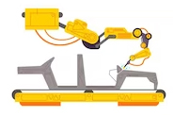

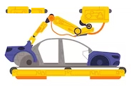
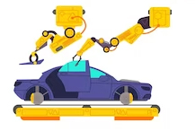
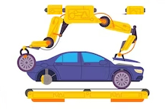
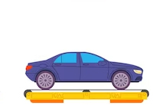



Automotive Expertise (ISO 26262 and 21434)
ISO26262 Compliance with Part 3, 4, 5, 6, and 8
Semiconductor and Chip Design (IP/SOC/FPGA), V & V (Part 5)
Supporting Processes (Part 8)
Functional Safety and Planning (Fusa Phased Approach)
Embedded design, development, V & V (Part 6)
ISO21434 Cyber Security Process Expertise
1
2
3
4
5
6
STL DEVELOPMENT & COVERAGE ANALYSIS
IN COMPLIANCE WITH A SPICE

Slide 10


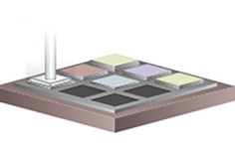
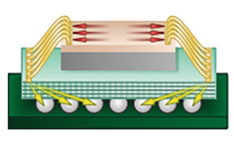
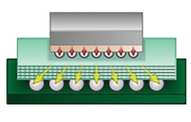
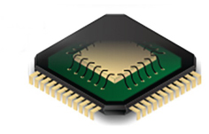

Semiconductor Expertise (ASIC - FPGA - SOC - ATE)
Advanced Test Engineering – Test Automation, System/Wafer Level/Bench/ATE/Packaged Device/PCB Design & Manufacturing
System Architecture, Design & Development
Pre-silicon Emulation and Validation Engineering – Palladium, Veloce, and ZeBU
ASIC/FPGA/SOC Design, Development, V & V
FPGA Selection, Prototyping and high-speed board design, development & testing
Processor Core/Advanced Verification – SV, UVM, Matlab/Simulink/Co-Simulation
Physical Design & DFT Expertise
1
2
3
4
5
6
7
Spec-to-Silicon-Post Silicon Services

Slide 11
















Software Engineering Services
AI, Gen-AI Strategy & Solutions
5
4
Delivery & Support
Internet of Things SW & HW Solutions
Advanced Software
Development
3
Data Analytics
Full Stack Application Software Development
2
Application Architecture
Intelligent Automation, RPA
1
Requirements Analysis, Design
Mobile Applications
IT Strategy & Consulting
Enterprise Software Development & Support

Slide 12


CUSTOMERS
12
Copyright ©2025 Accelyzei

Slide 13



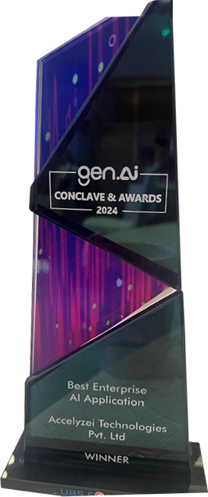

Awards & Recognition
Best Enterprise
AI Application
Best IT Company - AI
HMTV Business
Excellence
Gen AI Conclave
Awards 2024
Awards 2023
13
Copyright ©2025 Accelyzei

Slide 14

ENGAGEMENT MODELS
Copyright ©2025 Accelyzei

Slide 15






Our Value Proposition
Unique expertise across three verticals
Hybrid Model Execution – Onsite &
Offsite
Collaborative Models
1
2
3
4
5
6
SMEs & Technical Consultants
Robust Data Security Policies
Security Certifications

Slide 16






Engagement Models
Collaborative
Project based Engagement
We work closely with our customers to establish organizational strategy, identify problem statements, define scope, and develop the Statement of Work (SOW), ensuring transparent collaboration from problem identification to solution delivery.
Our project-based model offers end-to-end management for specific programs, handling all phases from planning to execution and delivery, ensuring a seamless experience with complete accountability.
Customer Engagement Models
Partnerships & JVs
Staffing Models
We collaborate with leading technology companies fostering strong synergies, leveraging our collective expertise and resources to drive innovation, tackle complex challenges, that meet the evolving needs of customers across industries
We customize our staffing approach to deliver on-demand resources, from comprehensive project teams to specialized consulting experts, strategically aligned to meet the unique requirements of your programs.

Slide 17


Copyright ©2025 Accelyzei

