Slide 1

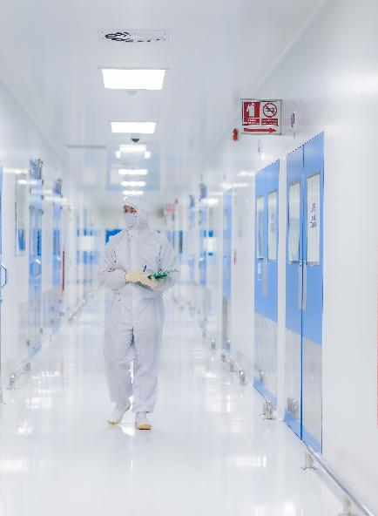


Engineering Excellence in Cleanroom Solutions

Slide 2
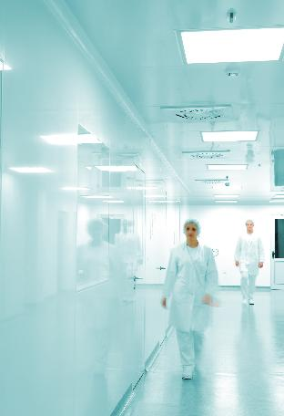
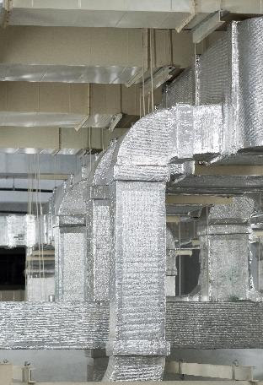
Panels, HVAC, MEP
About Us
Fabtech: 20+ years of expertise in end-to-end cleanroom solutions (Panels ,MEP).
Kelvin: 15+ years of expertise in HVAC Integration.
Industries Served: Pharma, Biotech, Semiconductor, Electronics, Renewable energy, and more.
Key Strengths: In-house manufacturing, turnkey execution, and global compliance.
Our Promise: Precision, reliability, and efficiency in every project.
Controlled Environments
Read more at fabtechcleanroom.com
kelvinmech.com

Slide 3




A Strong Group Backing Innovation
Cleanroom Panels & MEP Services
HVAC System
Integrator
OUR GROUP OF COMPANIES
Specializes in Air Handling Units (AHU)
Economical-grade modular panels

Slide 4


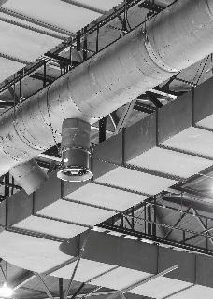
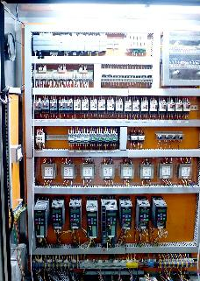



Our
Services
Fabtech Cleanroom & Kelvin provide end-to-end cleanroom solutions, integrating design, manufacturing, and execution across cleanroom panels, HVAC, and MEP systems for seamless, high-performance facilities.
Cleanroom Panels Ceiling & Flooring
Heating Ventilation & Air Conditioning
MEP Services (Electrical)
Modular panels, doors, and flooring designed for contamination control and regulatory compliance.
Precision-engineered air handling solutions ensuring clean, controlled environments.
Complete mechanical, electrical & plumbing integration for efficient & reliable facility operations.

Slide 5
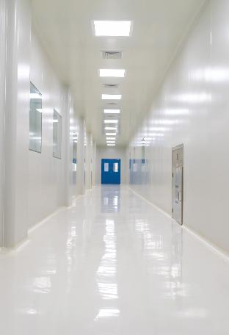
Cleanrooms
Modular Cleanroom Partition System
  Wall Panels
  Covings
  Doors
  View Panels
  Ceiling Panels
Epoxy Flooring
Custom-engineered to meet industry regulations (GMP, ISO, FM)
Seamless integration with HVAC and MEP for turnkey solutions

Slide 6
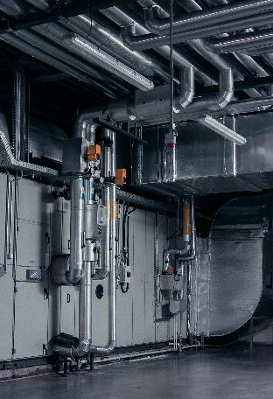
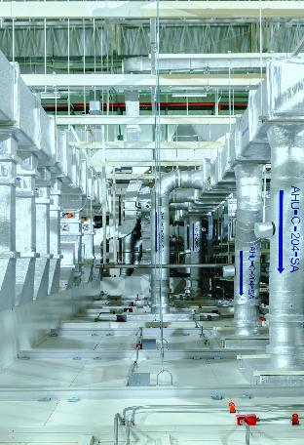
HVAC
Precision air handling for controlled environments
Energy-efficient designs ensuring optimal airflow and filtration
Designed for compliance with industry regulations
HVAC Systems, A Sub-discipline Of Mechanical Engineering, Use Principles Of Thermodynamics, Fluid Mechanics, And Heat Transfer Principles To Ensure Thermal Comfort And Healthy Indoor Air Quality.

Slide 7
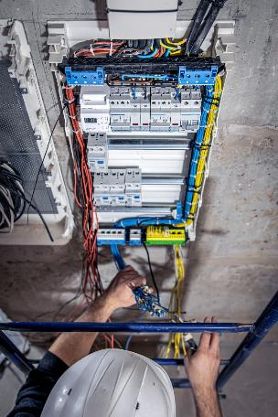
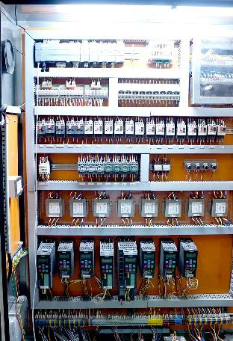
MEP
Wide Array of Services –
  Lighting & power distribution
  Control Panels design & integration
  Automation and control systems
  Electrical System design & installation
  Testing & Commissioning
Complete facility-wide integration for efficiency and safety
Electrical and mechanical systems ensuring reliability and compliance
Optimized for cleanrooms, pharma, and high-tech industries

Slide 8



Steps We Take
Design
Build
Execute
Custom-engineered solutions for precision-controlled environments.
In-house manufacturing ensures quality, scalability, and compliance.
Seamless installation and integration for optimal performance.

Slide 9
01
02
03
20+ years of experience in providing world class Cleanroom Solutions
Start-to-Finish Cleanroom Solutions (Cleanroom Panels+ HVAC+MEP)
Customized Solutions tailoring customer requirement
Six Reasons to choose us
04
05
06
Trust of more than 2000 customers
In house Manufacturing
ISO 9001-2015 Company

Slide 10

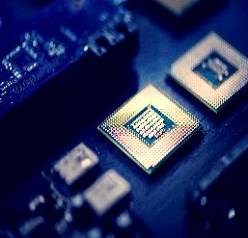
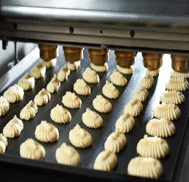
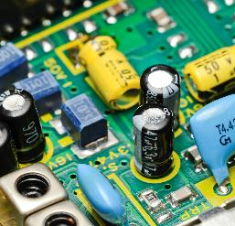



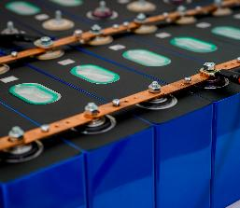

Pharma and Biotech
Semiconductor
Food and Beverages
Industries
we serve
Electronics
Healthcare
Data Centres
Diverse Industries, Tailored Solutions. Our expertise ensures precision-controlled environments tailored to industry-specific standards.
Read more at fabtechcleanroom.com
Green Energy
EV Batteries
Automotive

Slide 11
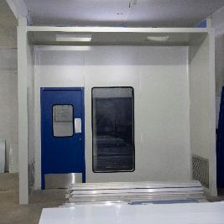
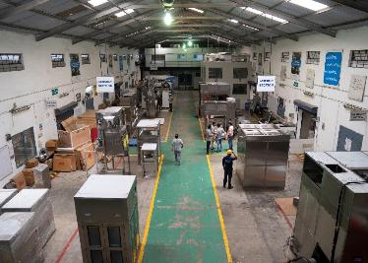
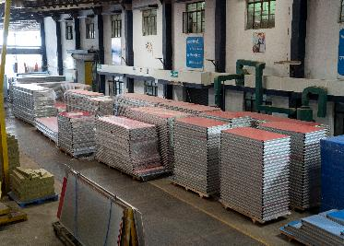
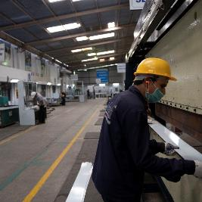
Manufacturing Capability
Umbergoan, Gujarat
Murbad, Thane
Cleanroom Panels & Equipment
Cleanroom Panels, Doors & Windows

Slide 12
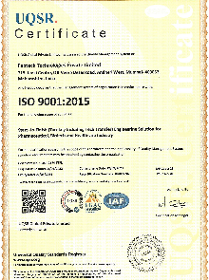
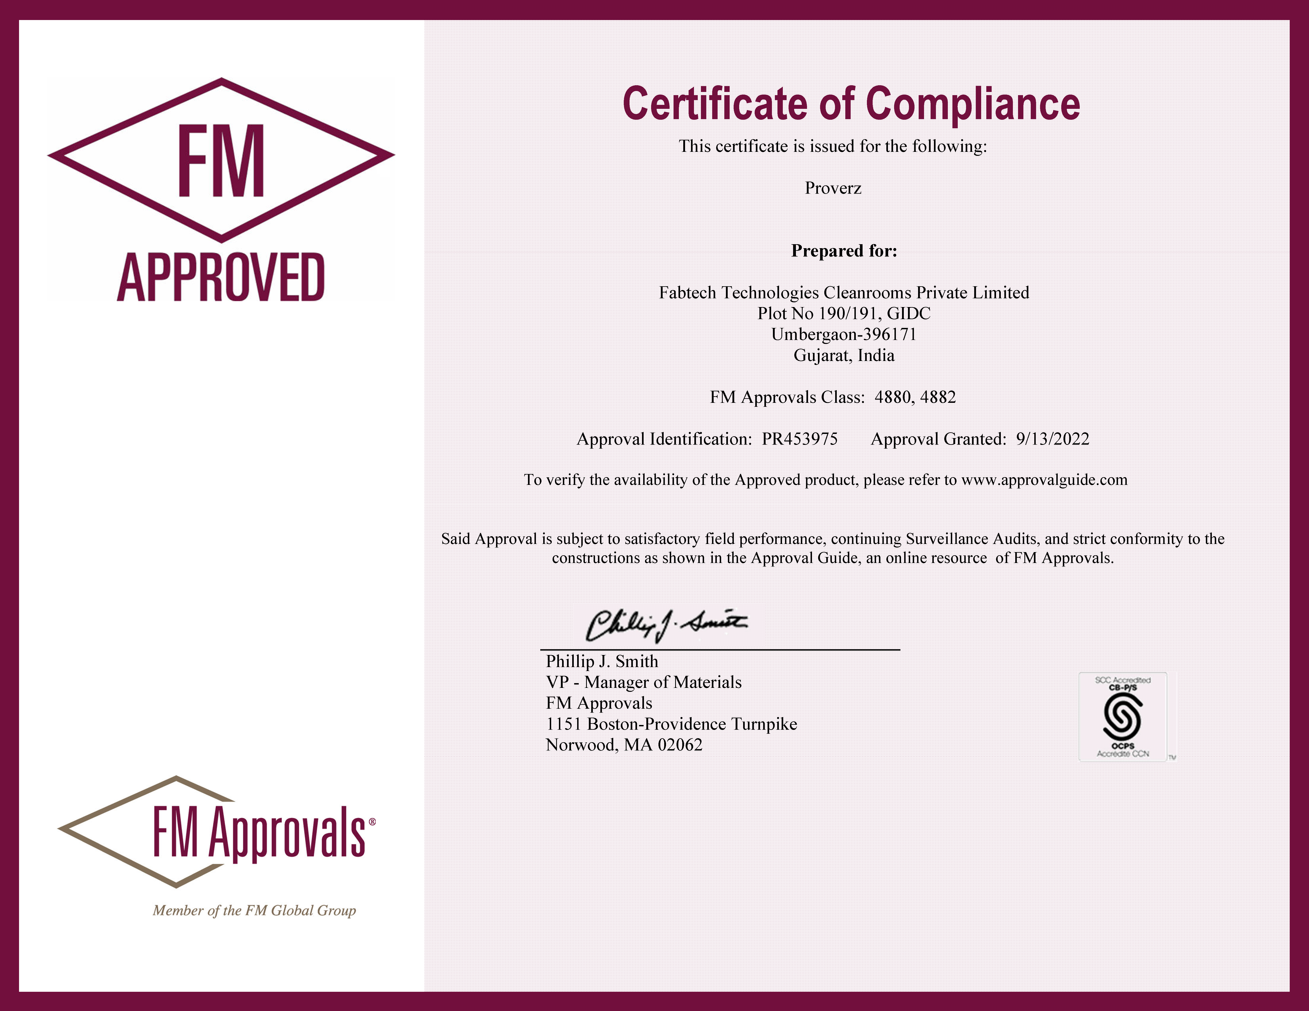
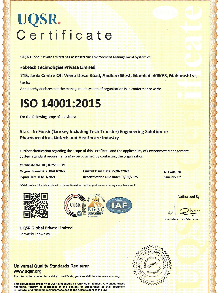
Certifications
ISO 9001:2015
ISO 14001:2015

Slide 13
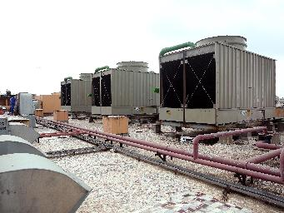
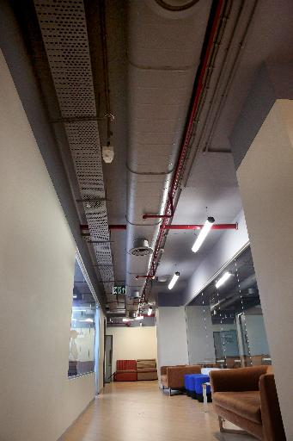
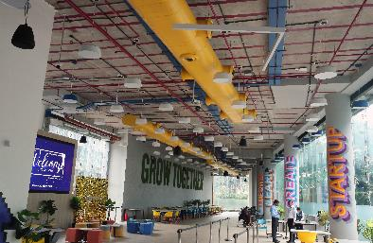

Key Projects
HVAC, HBT Cooper
Our portfolio includes a diverse range of projects, from hospitals to hospitality and from Semiconductor to Renewable Energy for renowned names such as Atlas, HBT-Cooper, Mercedes Benz.
HVAC Setup, O Live Hostel
HVAC, Atlas University

Slide 14
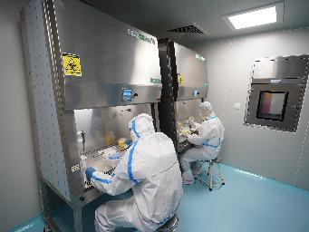
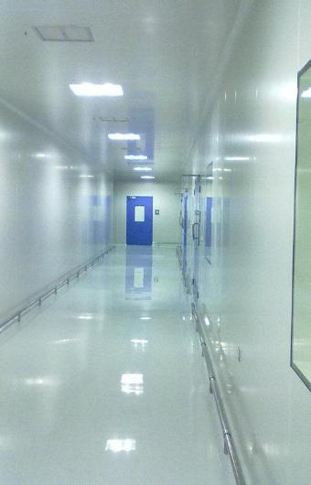
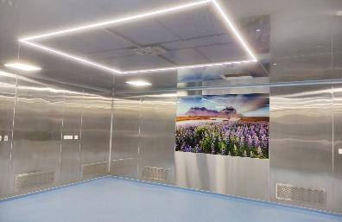
Key Projects
BSL-3 Lab, PGICH Noida
Our portfolio includes a diverse range of projects, from hospitals to BSL-3 labs, for renowned names such as Lupin, Bosch, BARC, & Oxford Laboratories.
Operation Theatre, BARC
Cleanroom, Lupin

Slide 15
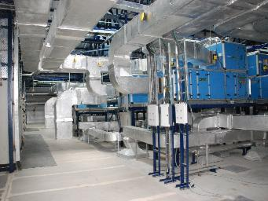
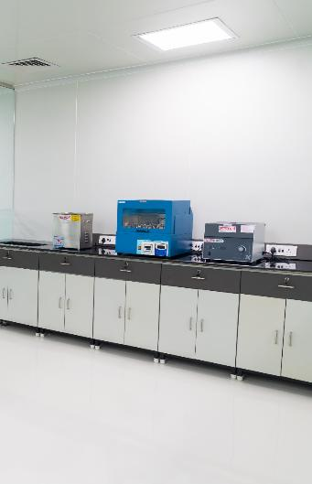
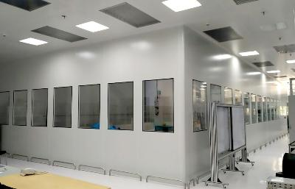
Key Projects
HVAC, Sharon Pharma
Our portfolio includes a diverse range of projects, from hospitals to BSL-3 labs, for renowned names such as Lupin, Bosch, BARC, & Oxford Laboratories.
Cleanroom Setup, Bosch
Oxford Lab, Turnkey Project

Slide 16
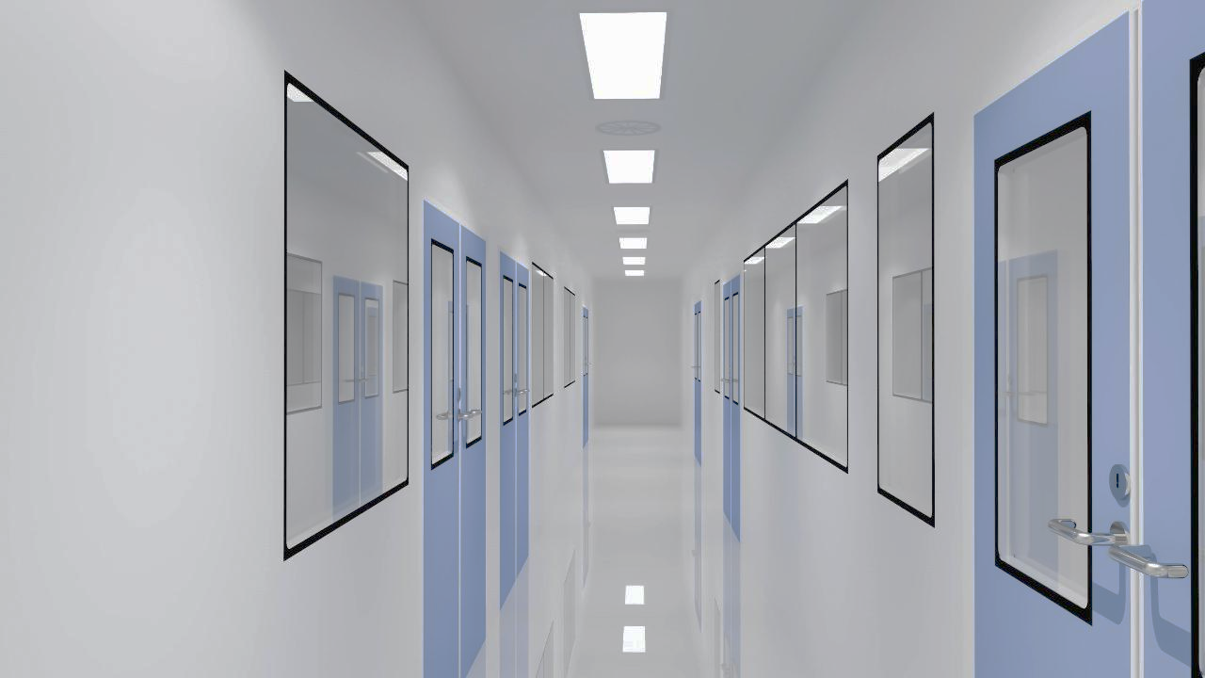










Our
Clients
Fabtech Cleanroom & Kelvin deliver high-performance cleanroom and HVAC solutions for semiconductors, electronics, automotive, data centers, and green energy. Our expertise in precision environments and compliance-driven design makes us the trusted partner for leading global brands.

Slide 17



















Our Pharma Clients
Fabtech Cleanroom & Kelvin are trusted partners for leading pharmaceutical and biotech companies, delivering GMP-compliant cleanroom and HVAC solutions. With end-to-end expertise in facility design, manufacturing, and execution, we ensure precision-controlled environments for drug manufacturing, R&D, and advanced therapies.

Slide 18






Our
Govt.
Projects
With a strong track record in regulated environments, Fabtech Cleanroom & Kelvin have successfully executed government and institutional projects requiring precision, reliability, and strict compliance. Our solutions support research labs, healthcare, defense, and high-tech manufacturing facilities.

Slide 19


Contact Information
Let’s Build Excellence Together. Contact us to discuss your cleanroom and HVAC needs.
Kelvin:
+91-8108055554
mail: sales@kelvinmech.com
Unit No. K-204, Ansa Industrial Estate, Saki Vihar Road, Sakinaka, Andheri East, Mumbai- 400072
Fabtech:
+91-2261592900
mail: quote@fabtechnologies.com
615, Janki Centre, Off Veera Desai Road, Andheri (W), Mumbai - 400053
www.fabtechcleanroom.com
linktr.ee/fabtechkelvin
https://www.kelvinmech.com/

Slide 20

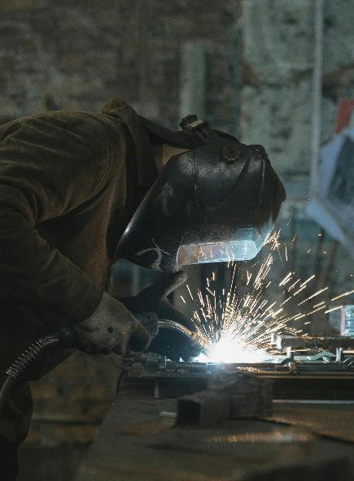

fabtechcleanroom.com
Thank You

