Slide 1


COMPANY
PROFILE
BAID POWER SERVICES Pvt. Ltd.
INTEGRATING INNOVATION
address
152, Block-b, lake town,
Kolkata–700089, West Bengal
phone 033 2521 0322 / 9836398664
email anupam@indiapowerhouse.Net
ANupam Baid
Director

Slide 2
About US
BAID POWER SERVICES P. Ltd.
Established in 2003.
NSIC registered, ISO certificated Systems.
Its office, Factory, and R & D center are in Kolkata.
We are a team of young and experienced engineers dedicated to design.
We have designed many innovative products in Healthcare Infra / IT, Data Acquisition, IoT, Smart City, Power Electronics, EV Charging systems
Experts in IoT and Embedded systems
30 Years of Multi-domain expertise
Notes:
“Baid Power Services Pvt. Ltd” (BPS) is a leading manufacturer of Electrical Control and distribution panels and battery chargers. Promoted by directors having 30 years of experience in Power Electronics industry and qualified technocrats it has goodwill among reputed customers like State Electricity Boards (WBSEDCL, JSEB, ASEB, etc.) Railways, Defense, PSUs and steel sector.

Slide 3
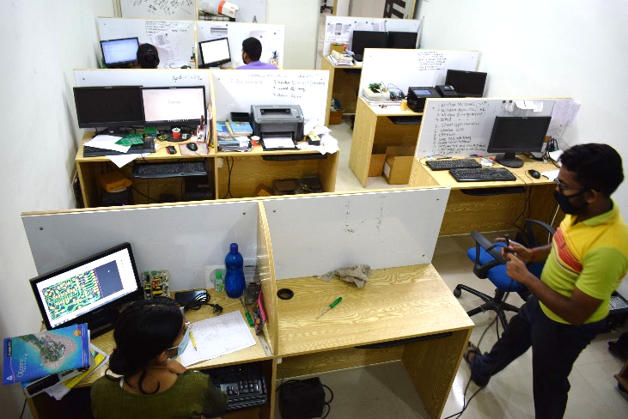
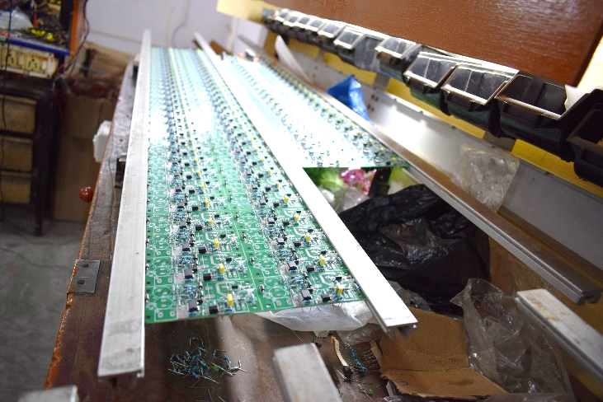
About Our Company
“Baid Power Services Pvt. Ltd” is a diversified manufacturing enterprise providing products and solutions in healthcare and power control and distribution segments. With over 35 years of experience, we have satisfied our customers by providing the right solution, at the right time and at the right cost. Striving to be ahead of the technology curve, we are integrating innovation and providing cutting-edge technology to our customers.
Truly believing in developing indigenous products and technology we strive to take “Make in India” forward. With more than 45 + products and counting we are constantly innovating for our customers, with some of our products competing with global leaders.

Slide 4
Overview
Our Vision
The vision of Baid Power Services Pvt. Ltd. (BPS) is to be one of the most trusted, respected, and preferred brands for electrical and electronic equipment that finds application in Power Distribution & Transmission, Control & Instrumentation, and Healthcare segments.
Our Mission
Provide customized solution: BPS provides innovative solutions to customers’ needs integrating leading latest technologies to achieve customer delight.
Cost-effective Products: BPS analyses each customer’s requirements, offers the right products or develops new solutions most suitable for them at the most effective cost.
Strive for Quality: BPS strives to create world-class products that meet global quality standards to ensure customer satisfaction.

Slide 5



Certifications
Celebration the big wins and memorable moments.
ISO 9001:2015
NSIC Registered
CIDC Registered
Member of :
FACSI, CETA, CEDA, ELMA, CMDA, FOSMI etc.

Slide 6


Directors’ Profile
Ramesh Baid
B. Com (H)
PE from Jadavpur University
Experience of 30 years across business sectors
Ex-President / Leadership of leading Associations CETA, CEDA, ELMA etc.
Anupam Baid
B. Tech (AEIE)
MBA (Marketing & Finance).
An active member of JCI, IEI, ISA, IEEE
Member BOS Heritage University

Slide 7


Industries We Serve
POWER UTILITY
EPC CONTRACTOR
HEALTH CARE SECTOR
GOVERNMENT SECTOR
DEFENCE & PWD
STEEL/ ALLOY
INDUSTRIES
RAILWAYS

Slide 8
Industrial Sector
Introduction
BPS has years of expertise in designing and Manufacturing products in the field of Power Distribution and transmission, for Steel Plants and other Industries, Health Care Institutions for Nurse Calls, Railways equipment, Defence, and other consumer segments.
BPS has a dedicated team of qualified engineers to design customized solutions to cater to the specific requirements of the industry/customers.
BPS is the leading name for DC Power Systems and many products for Health Care Institutions. Our quality management systems are ISO 9001:2015 certificated.

Slide 9
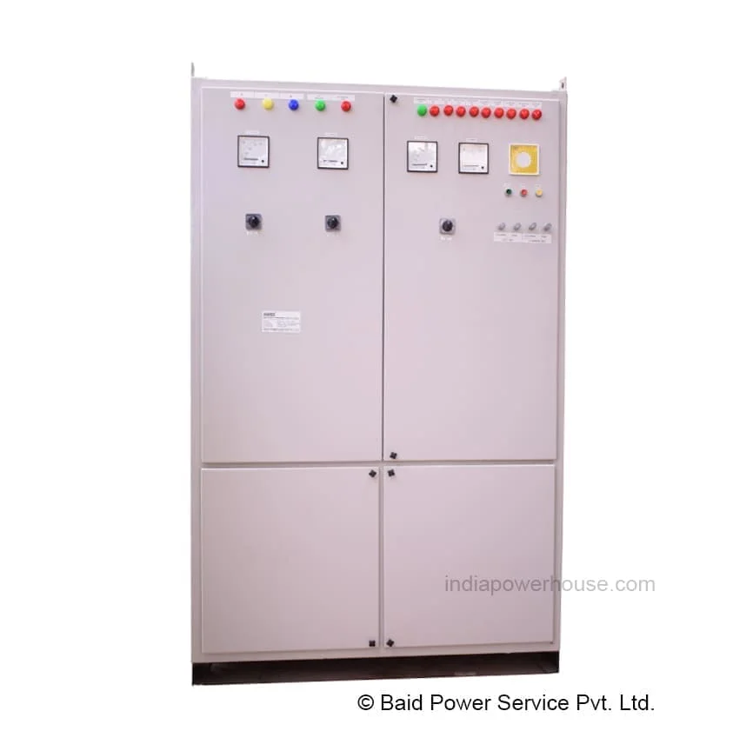
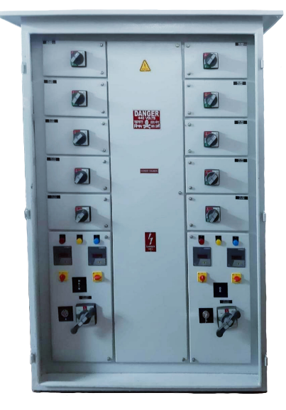
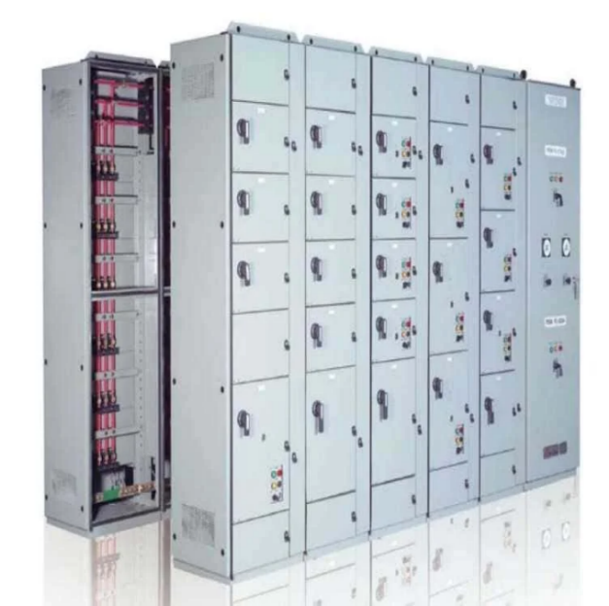
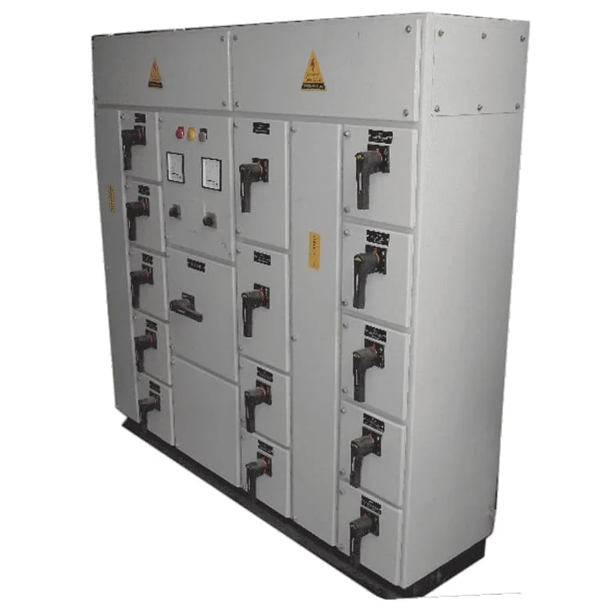
Float Boost Battery Charger
• Float Cum Boost Charger
• Float & Boost Charger
• Float & Float Cum boost Charger
• Dual Float Cum Boost Charger
AC DC Distribution Panel
• Power Control Center (PCC Panel)
• Motor Control Center ( MCC Panel)
• Automation Panel (SCADA PLC Panel)

Slide 10
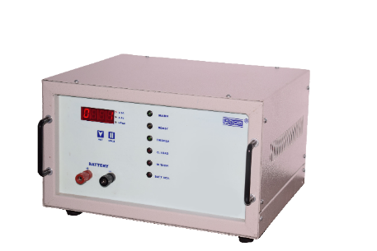
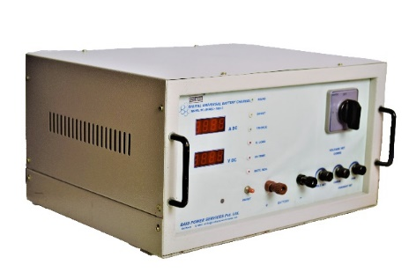
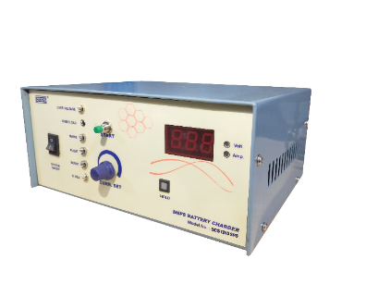
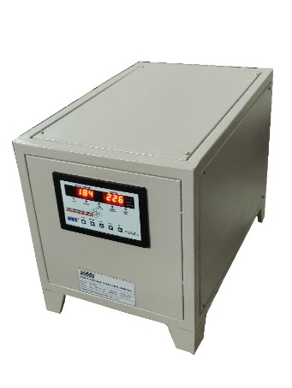
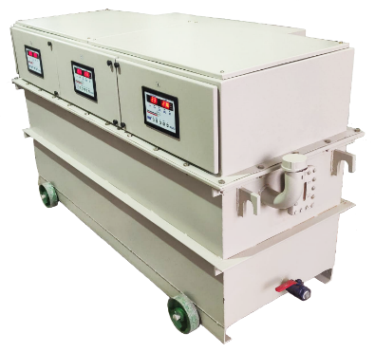
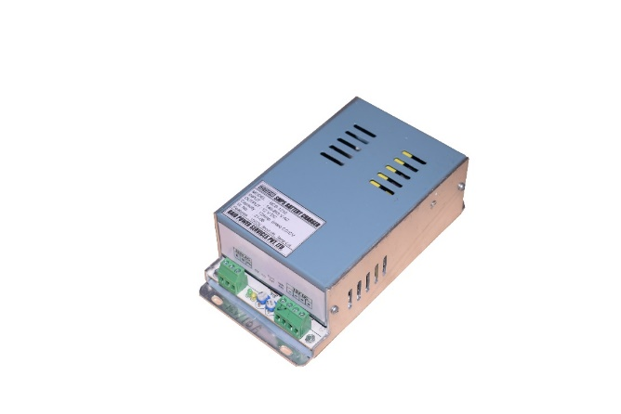
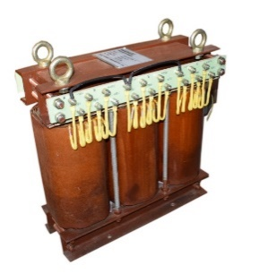
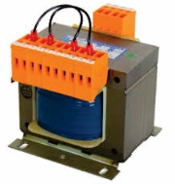
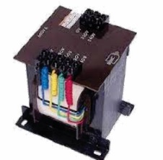
Battery Charger
• Digital SMPS Based
• Automatic Battery Charger
• Multipurpose Battery Charger
• Digital Universal Automatic
Servo Voltage Stabilizer
• Servo Controlled Stabilizer ( Series BSS)
• Servo Stabilizer Three Phase (PSTD)
Other Product
• Auto Load Changeover Relay
with Load Limiter
• Control Transformer
• SMPS

Slide 11

Credentials
Commitment to customers
Global reputed clients
Large corporations, hospital, nursing homes and semi-government departments
Notes:
ur commitment to customers has insured global reputed companies in our client profile. Elite clientele comprising of large corporations, hospital, nursing homes and semi-government departments are in our regular customer list

Slide 12
Healthcare Sector
About Nurse Call System
Nurse call systems, are communication systems being used in hospitals and nursing homes for patient monitoring purposes.
Recent nurse call system technologies that offer patient monitoring integration have proven beneficial for the nursing of critical care patients.
Nurse call systems are available in both wired and wireless.
Advanced NCM systems with internet protocol systems and wireless technologies including mobile device integration have significantly influenced the nurse call systems market growth.
MUST FOR
HOSPITALS
NURSING HOMES
CARE HOMES
OLD AGE HOMES
ISOLATION CENTERS

Slide 13
Why is Nurse Call System?
The increasing work pressure of nurses and the decreasing number of patient to nurse ratio is leading to the increasing demand for nurse call systems in the healthcare market.
There is a rising requirement of workforce optimization in hospitals and critical care centers which could be tackled by the incorporation of technologically advanced nurse communication systems.
Nurse call systems are accepted in workforce management
To enable patients to summon nursing staff to serve patients more attentively and efficiently.
They improve responsiveness, levels of care, operational efficiency, and patient satisfaction.

Slide 14
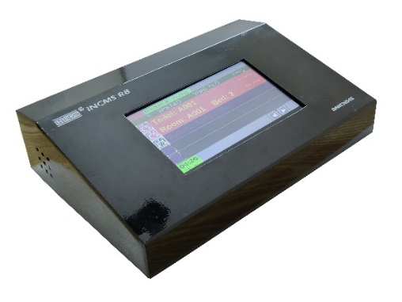
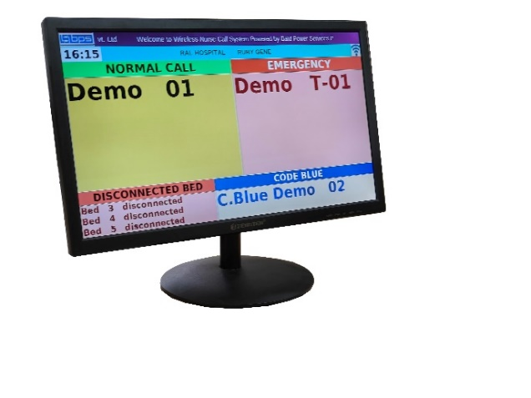
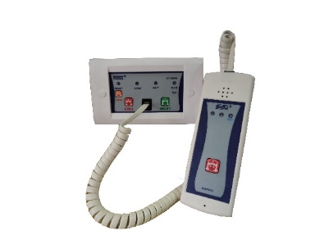
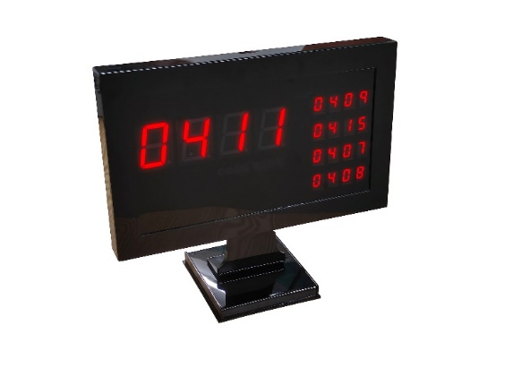

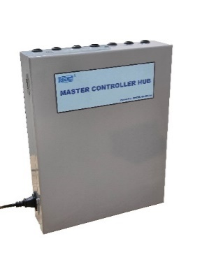
Nurse Call Monitoring System
1. IP Based System
R7 – IP Based
R7W – Wireless WIFI Based
R8 – 7” LCD Touchscreen Display
2. Micro Controller Based
644 Series – with Code Blue

Slide 15
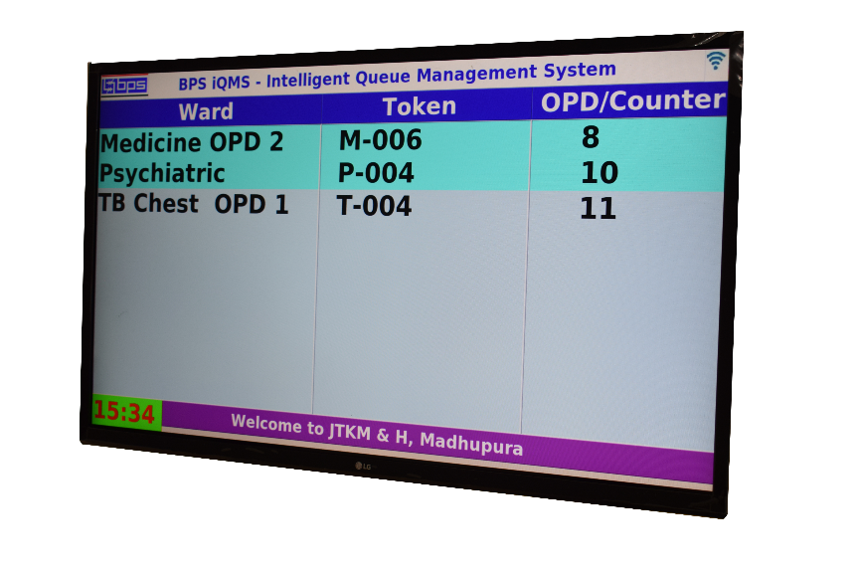
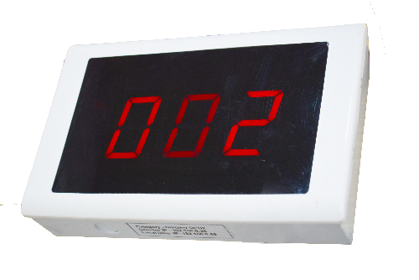
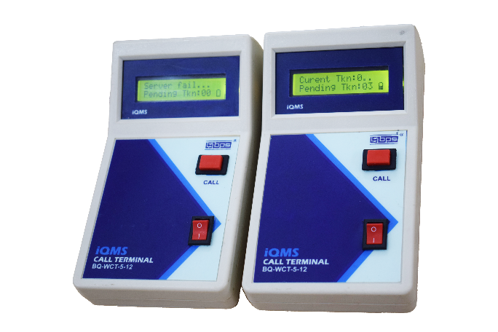
Queue Management System
Standard Models- Wired
Standard Models – Wireless
Customized Solutions

Slide 16
Nurse Call Systems Opportunity
Growth opportunities in Emerging countries such as India, China, Brazil, Russia, and several countries in Latin America and Southeast Asia
The growing focus on improving the quality of hospital care and healthcare infrastructure
Global pandemic and exponential demand for care centers
Medco - Legal cases and cases of neglect and accountability in the system

Slide 17
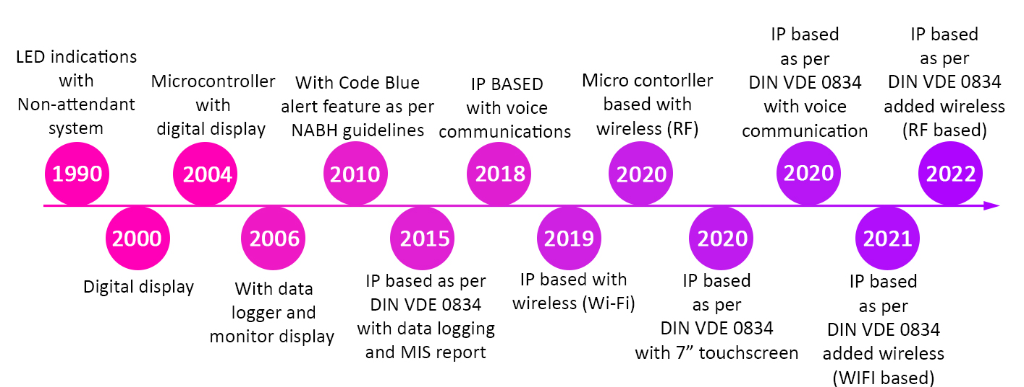
BPS - Nurse Call Systems EVOLUTION

Slide 18

BPS - Nurse Call Systems FUTURE
Multimedia terminal for in patient / Doctors
Vo-IP based Voice communication for patients
Digitalization at the patient’s bedside
Wireless patient care with advanced
Data and MIS reporting feature
Android / iOS-based app integration
Integration with HMS systems

Slide 19

BPS - Nurse Call Systems EXPERTISE
More than 20 years of experience in the field with strong customer base & Recent Works

Slide 20
Partnership Opportunities
We are expanding our manufacturing capacities and invite you to join us as:
Sale Representative
State Wire Dealers
Installation Services
Sale Representative
As a sales representative in the field of medical equipment, your role is crucial in connecting with clients, understanding their needs, and promoting your products and services. Here are some key responsibilities and skills that can make you effective in this role.
State wire dealers Dealing in medical equipment/ CCTV, communication networking,
Having a team of field application engineers
Certainly! Specializing in setting up, assembling, integrating, and providing maintenance or repair services for medical equipment is a valuable skill set. Here are some key points you might want to consider or include in your specialization.
The power of word-of-mouth referrals remains unmatched. At BPS, we deeply value the trust you place in us and the effort you take to recommend our services to others., we are excited to introduce our exclusive “Refer and Receive” program for your invaluable support and referrals.

Slide 21






Contact US
info@indiapowerhouse.net
www.baidpower.com
Baid Power Services Pvt. Ltd.
152, Block B, Lake Town,
Kolkata-700089
West Bengal, India.
+91 98363 98644
+91 (033) 4067 8112
+91 (033) 2521 0322

