Slide 1

ELICO LIMITED
ELICO Ltd is a leading Analytical Instruments Design & Manufacturing Company established in 1960 headquartered in Hyderabad, Telangana. It is the first Analytical Instrumentation Company in India.
Proprietary & Confidential
WWW.ELICO.CO

Slide 2
About ELICO
  Established in 1960, towards development of Indigenous analytical instruments
  R&D Approved by DSIR, Since 1973
  Working with DRDE, Since 2005 for Developed of Chem-Bio Detectors
  More than 100 IPR’s (Patent, Design, Trademarks)
  WIPO Global Award 2024 – Finalist
  Joint PhD Programs with NIT Warangal, Sri Krishnadevaraya University Ananthapur, Gulbarga University, Gulbarga
  Offers Design, OEM & ODM Services to MNC in Europe & USA
  More than 50,000 customers across India
  Leading Manufacturer of Analytical Instruments with a wide customer base.
  Elico Diversified into multiple business verticals .
  Agriculture, Research & Academia, Healthcare, Environmental, Pharmaceutical, Life Sciences, Chemical, Petrochemical, Steel, Cement and Defense etc.
WWW.ELICO.CO

Slide 3





Business Verticals
Analytical Instruments
Division
Electrochemistry Products
Spectroscopy Products
Chromatography Products
ODM/OEM Products
Technology Services
Design and Development
Of Analytical Instruments
Product Engineering
Software Services
Elico Health Services
EMR Implementation
HL7 Implementation
Custom Workflow Solutions
Revenue Cycle Management
ELICO Mechoptronix
Electro Mechanics
Opto mechanics
Electronics
Optics

Slide 4

ELICO MECHOPTRONIX PROFILE
Mechoptronix Division of ELICO is evolving into an independent entity with a vision of becoming Global player to lead in the field of mechoptronics aligning with global demands.
Focused to bring out High precision Opto-mechanical and Electro-mechanical and electro optical products to global standards.

Slide 5
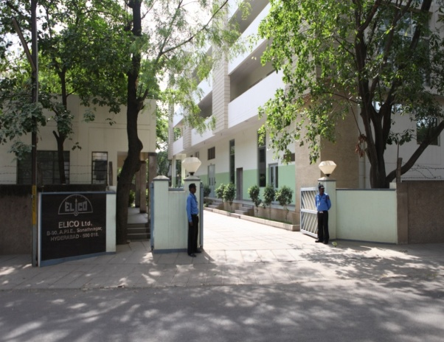
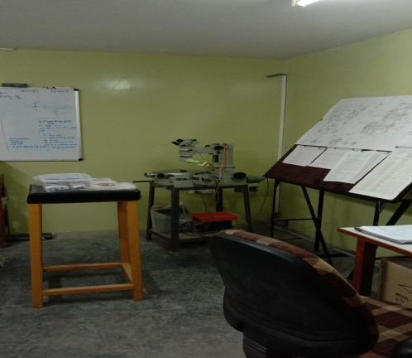
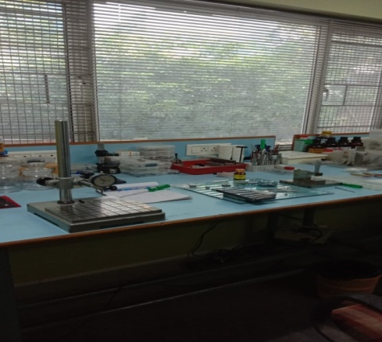
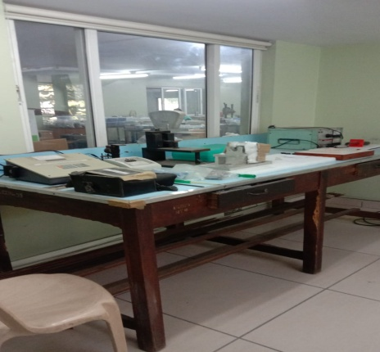
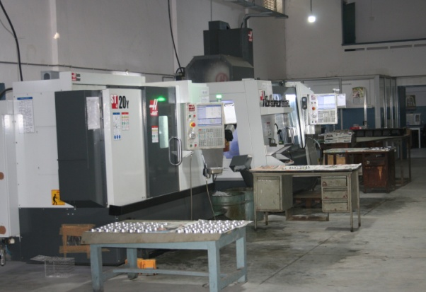
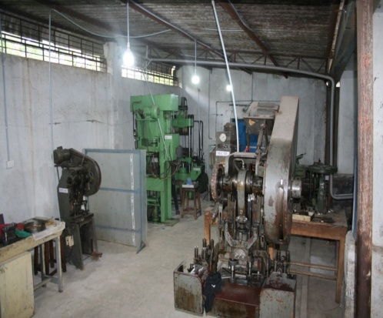
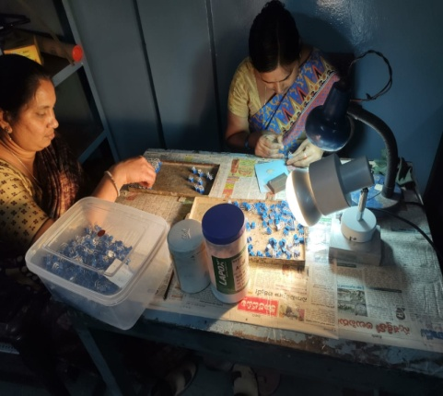
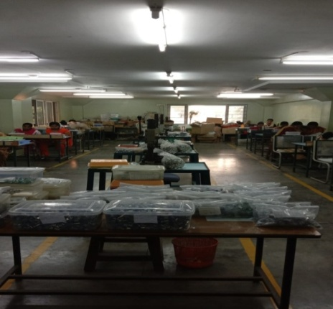
  FACILITY
  ( ASSEMBLY & MANUFACTURING)

Slide 6
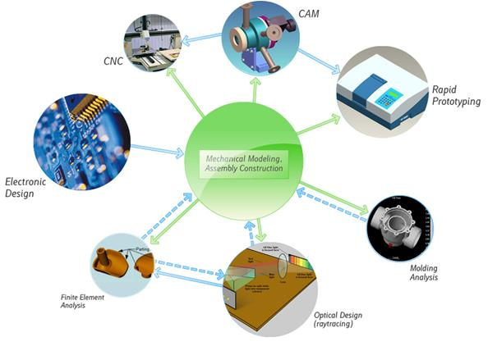
  Core Competency
Optical Design
Mechanical Design
( CAD/CAM/CAE)
Electronics
Design
Software Tools

Slide 7
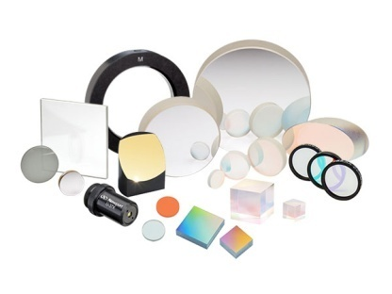
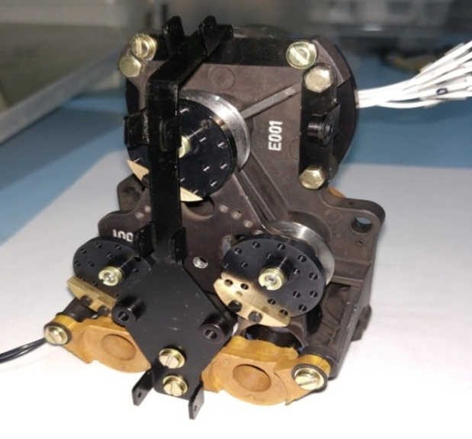
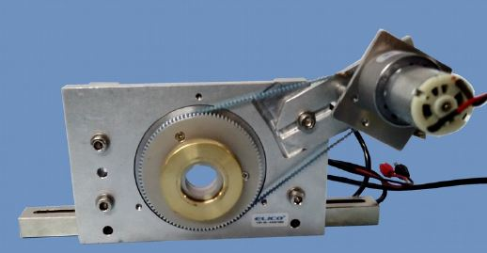
Product Portfolio
Opto-Mechanics
Electro-Optics
Electro-Mechanics
Custom Built / Precision Machined Products

Slide 8
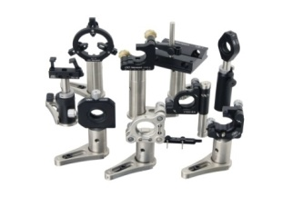
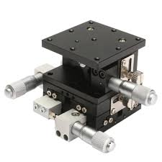
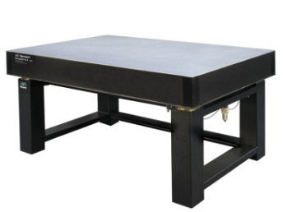
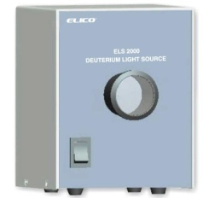
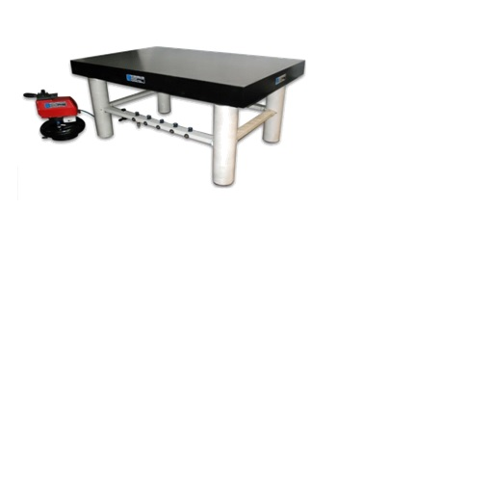

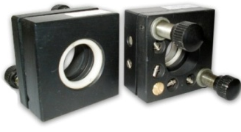
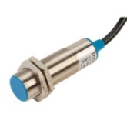
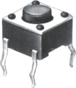
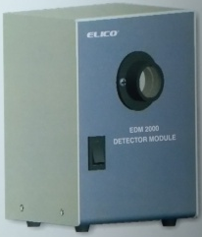
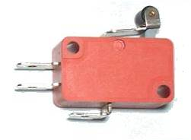
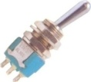


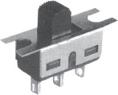
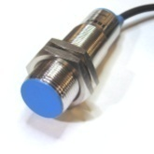
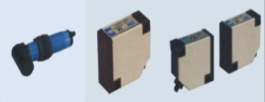
Mechoptronix Products
(Applications)
Electro Optical Assemblies
(Custom Built)
Monochromators, Spectrometers
Light Sources
Optical Tables
Experimental kits in Optics
Positioning Systems
Profile and Rail Systems
Fiber Optic Components
High precision machined parts.
Professional Grade
Switches like Toggle,
Push Button, Rocker, Slide
Tactile, Thermal,
Proximity etc.
Telecom, Defense, Automation,
Automobile, Machine Tools,
EMS, Instrumentation
Research Labs, Universities,
Defense, Machine Tools, Telecom
Automation, Space

Slide 9


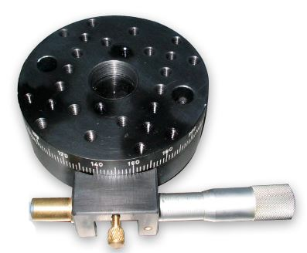
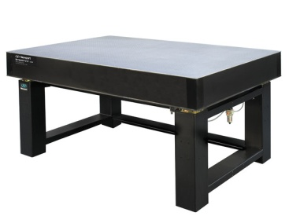
Opto-Mechanics
Optical Mounts
Precision Stages
Optical Tables

Slide 10

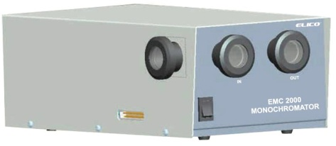
Electro-Optics
1. Tungsten Halogen: ELS 1010
λ= 400-1100 nm
Light Sources
Light Detectors
Monochromator
2. Deuterium: ELS 2000
λ= 160-400 nm
3. Xenon: ELS 3150
λ= 200-900 nm
1. EDM 1000
Spectral Response: 200-400 nm
2.EDM 2000
Spectral Response: 160-900 nm
EMC 2000
λ= 200-800 nm

Slide 11
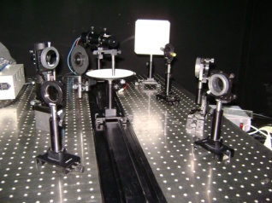
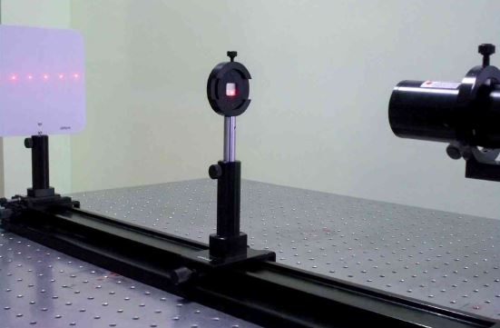
Electro-Optics
Educational Kits
Wide range of Experimental kits with an option of module development and customization to suit customer needs aligning with Global Players with International Standards
Interference
Diffraction
Polarization

Slide 12


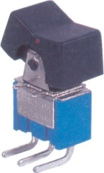
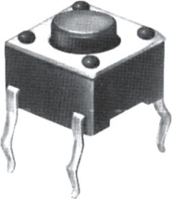

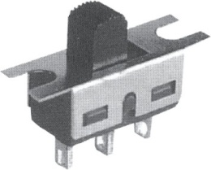

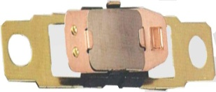
Electro-Mechanics
Professional Grade Switches
  Electro-Mechanical
  Toggle Push Button Rocker Tactile Micro
  Slide Thermal Inductive Capacitive Photoelectric

Slide 13

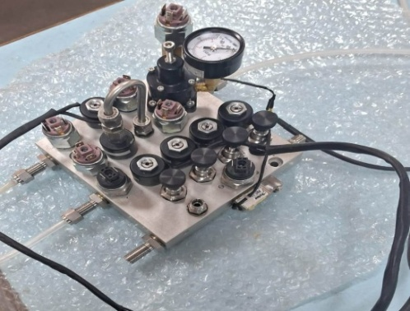
Custom-built Products
  Modulator Assembly
  (Developed for Opto Electronics Factory)
  IR Cell Holders
  (Educational Institutes)
  Piezo Electric Generators
  (Educational Institutes)
  GAS CONTROL UNIT
  (Defence Application)

Slide 14
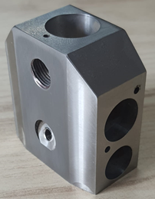
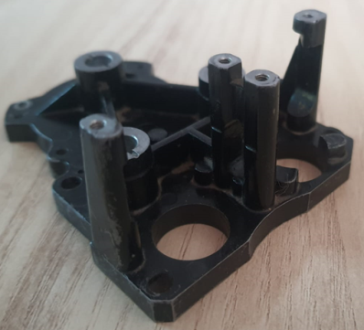
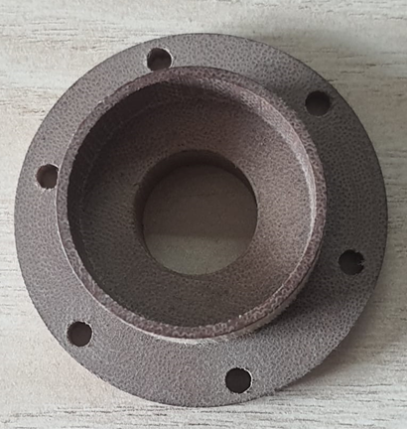
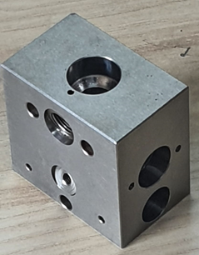
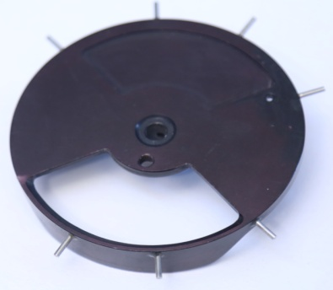
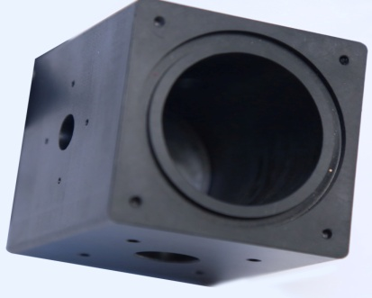
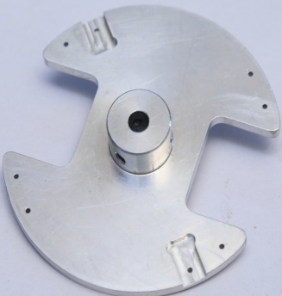
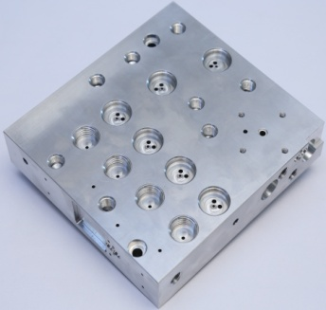
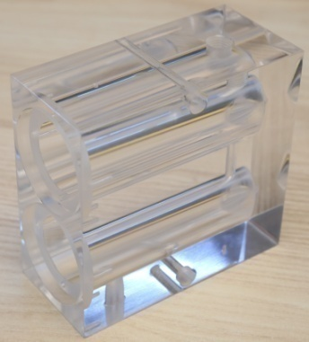
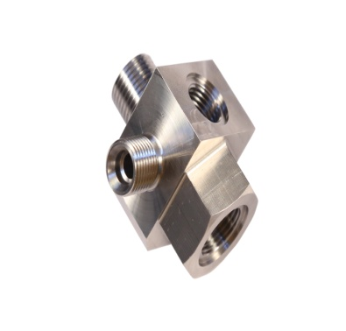
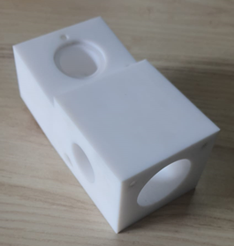
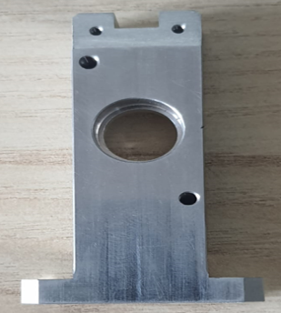
PRECISION MACHINED PARTS

Slide 15
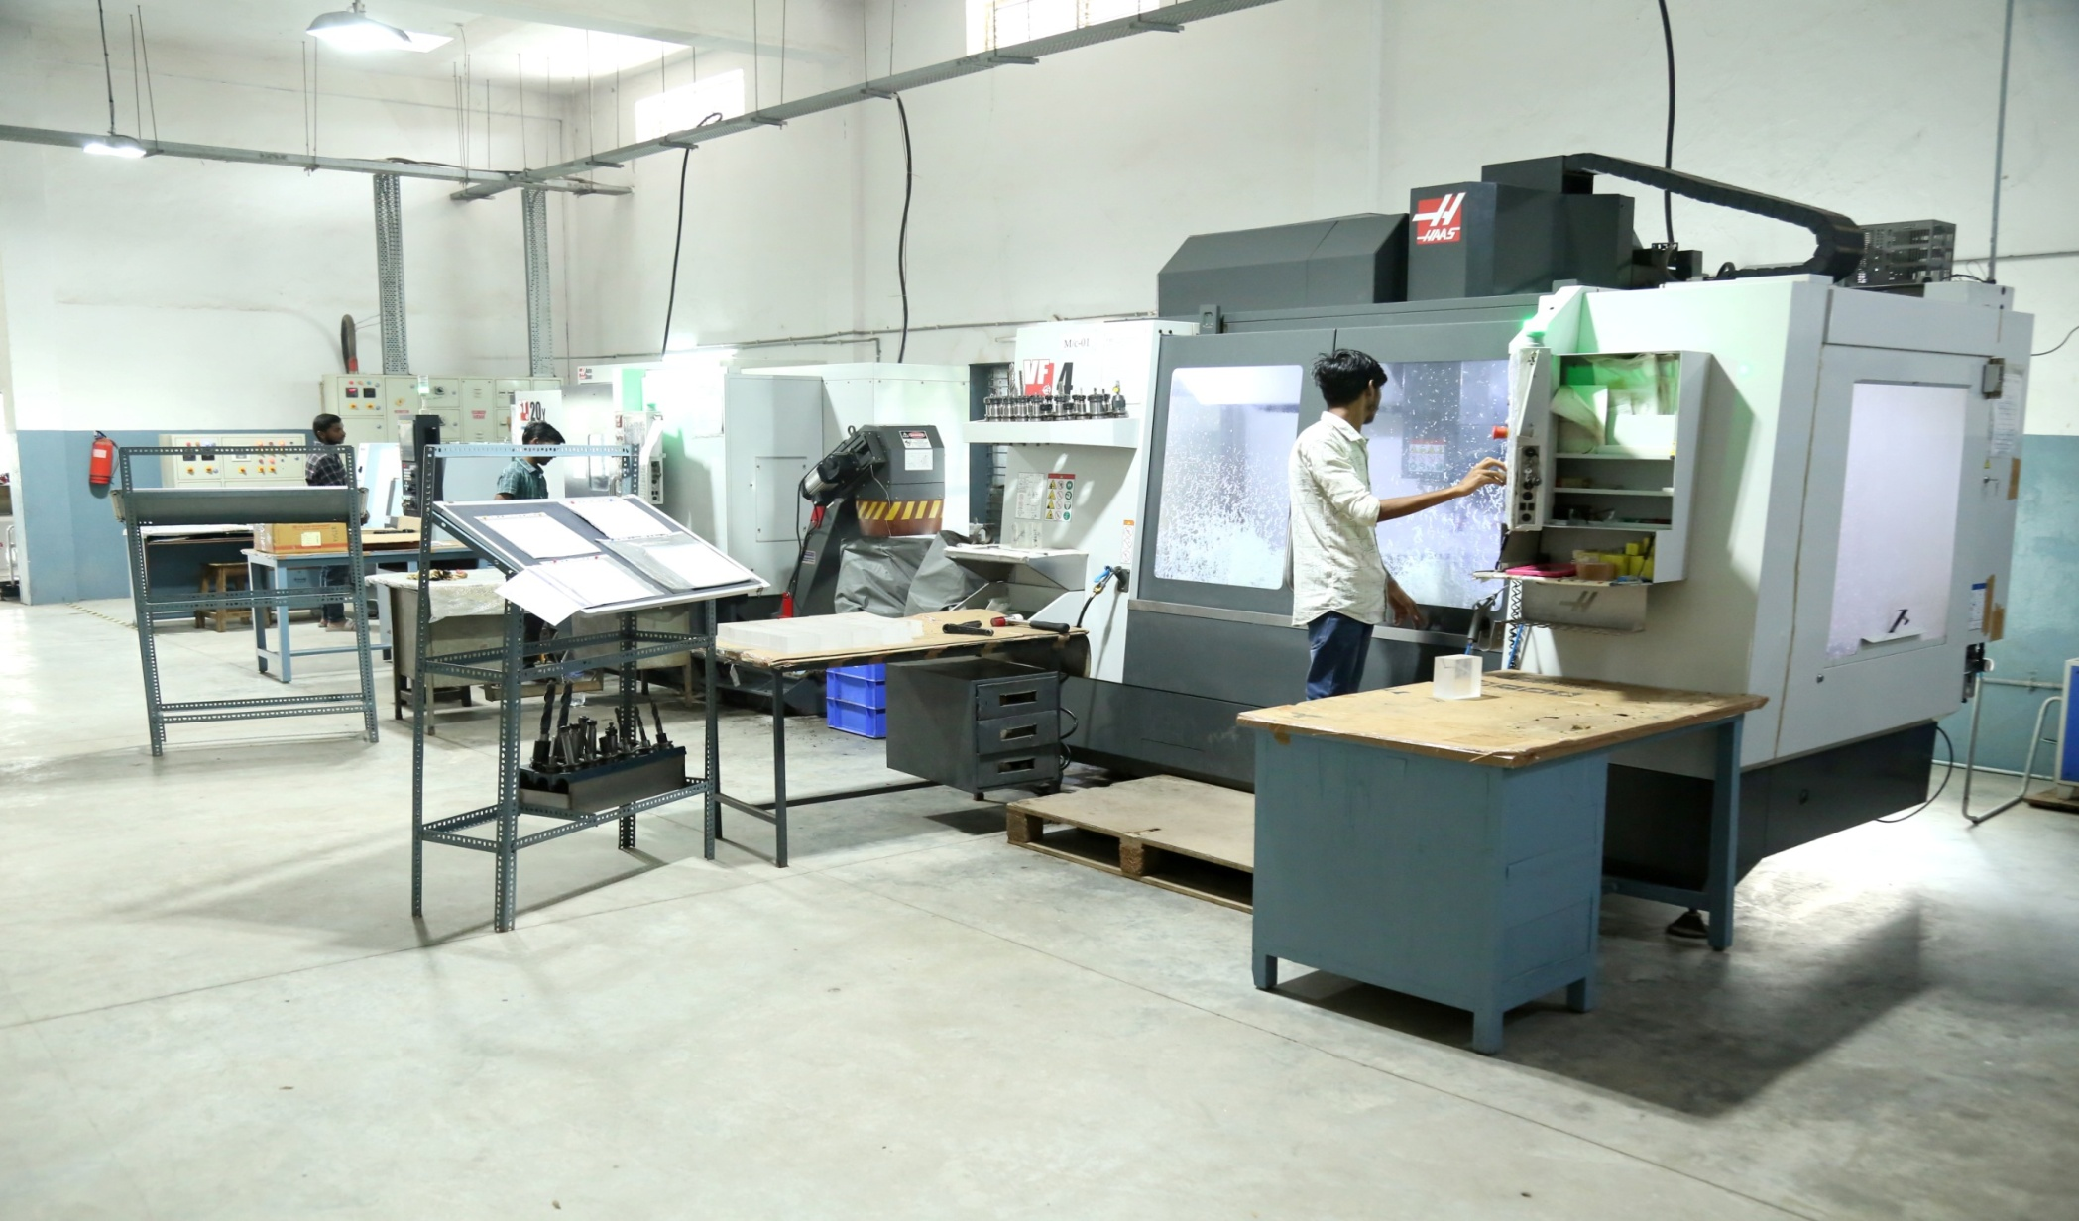
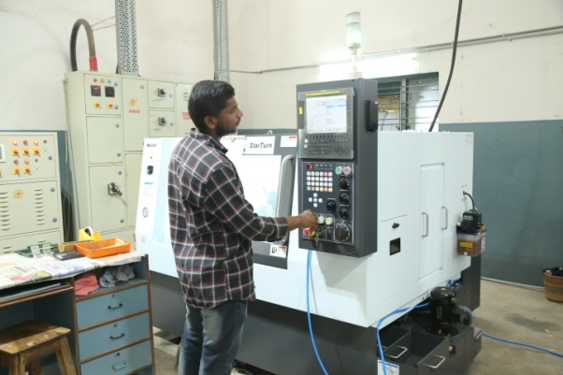


Infrastructure
Manufacturing Facility:
Adopted State of the art CNC Turn Mill, Vertical Milling Machine & CNC Turning for Precision Machining
CNC Turning
Turn Mill
Vertical Machining Center

Slide 16



Infrastructure
Manufacturing Facility:
Backed by conventional Machinery like Power Presses, Millers, Moulding Machines, Grinders and lathes, Paint Booth.
Mold & Press Shop
Tool Room Machines
Semi Automatic Paint Booth

Slide 17
SOLUTIONS BEYOND
Aerospace & Defence Applications:
High-precision components for mission-critical systems.
Machine Vision:
Custom optics for automated inspection.
Robotics:
Precision mounts and assemblies for advanced robotics.

Slide 18
Thank you!
----------------------------------------------------------------------------------------------
Address:
B-90, A.P.I.E., Sanathnagar,
Hyderabad – 500018, India
Cell: + 91 9866005441,+91- 9100674671,
Tel : 040- 44451286 |Fax: + 91 40 23771639
Email: info@mechoptronix.com & mechoptronix@elico.co
URL: dev.mechoptronix.com (Under Development)

