Slide 1
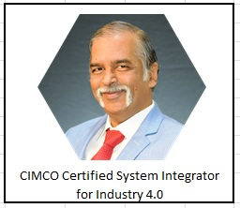
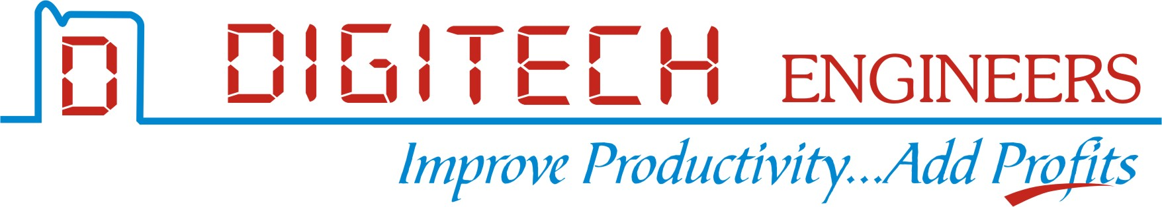
Agenda of Presentation
"Who We Are,"
"What We Do" and
"Case Studies."

Slide 2
Who we are
Deepak Bodhani-Founder & CEO
Email: ceo@digitechpune.com | Phone: +91 7972889960
Education
Post Graduation in Physics with Electronics Year : 1979 from Pune University
Diploma in Business Management (D.B.M.) Year:1987 from IMDR, Pune
Professional Experience
R&D Engineer (CNC Wire cut) | 7 Years at PRAV Electrospark
Conducted research and development in CNC wire cut technology.
Contributed to advancements in CNC technology, enhancing machine precision and reliability.
Manager Maintenance (CNC) | Force Motors Ltd. | 3 Years
Led the CNC maintenance team, ensuring optimal machine performance and minimal downtime.
Developed and implemented maintenance protocols, improving machine longevity and efficiency.
Founder & CEO | Digitech Engineers | 1989 - Present
Established Digitech Engineers, specializing in CNC data communication and Industry 4.0 solutions.
Gained over 35 years of expertise in CNC data communication, PLCs, and CIMCO (Denmark)
Machine Monitoring Systems, Back Plot Software, Paperless shop floor system
Secured agency agreements with leading companies such as System Base (South Korea) and SENA
TECHNOLOGIES (South Korea).
Executed numerous Wi-Fi and Bluetooth DNC projects across India and the Middle East,
contributing to the digitization of manufacturing processes.

Slide 3
Who we are
Our Skills
CNC Data Communication
Machine Monitoring Systems (CIMCO)
Online OEE Monitoring
Wi-Fi and Bluetooth DNC Solutions
Business Management and Strategic Planning
Professional Achievements
Successfully transitioned several manufacturing setups to paperless operations.
Led numerous projects in India plus the Middle East, including the UAE, Qatar, and Saudi Arabia, establishing a strong international presence.

Slide 4
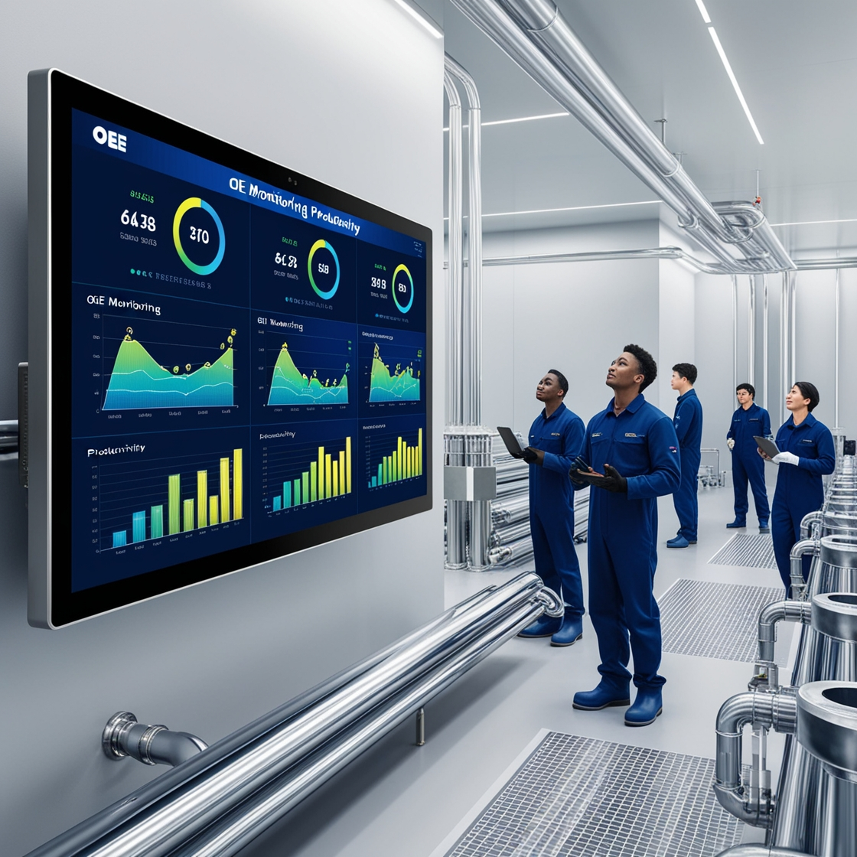
What we do
Establish connectivity between machines and computer
Design a dashboard for productivity monitoring
Display live OEE
Display down times
Generate alerts for productivity improvement
Generate reports

Slide 5
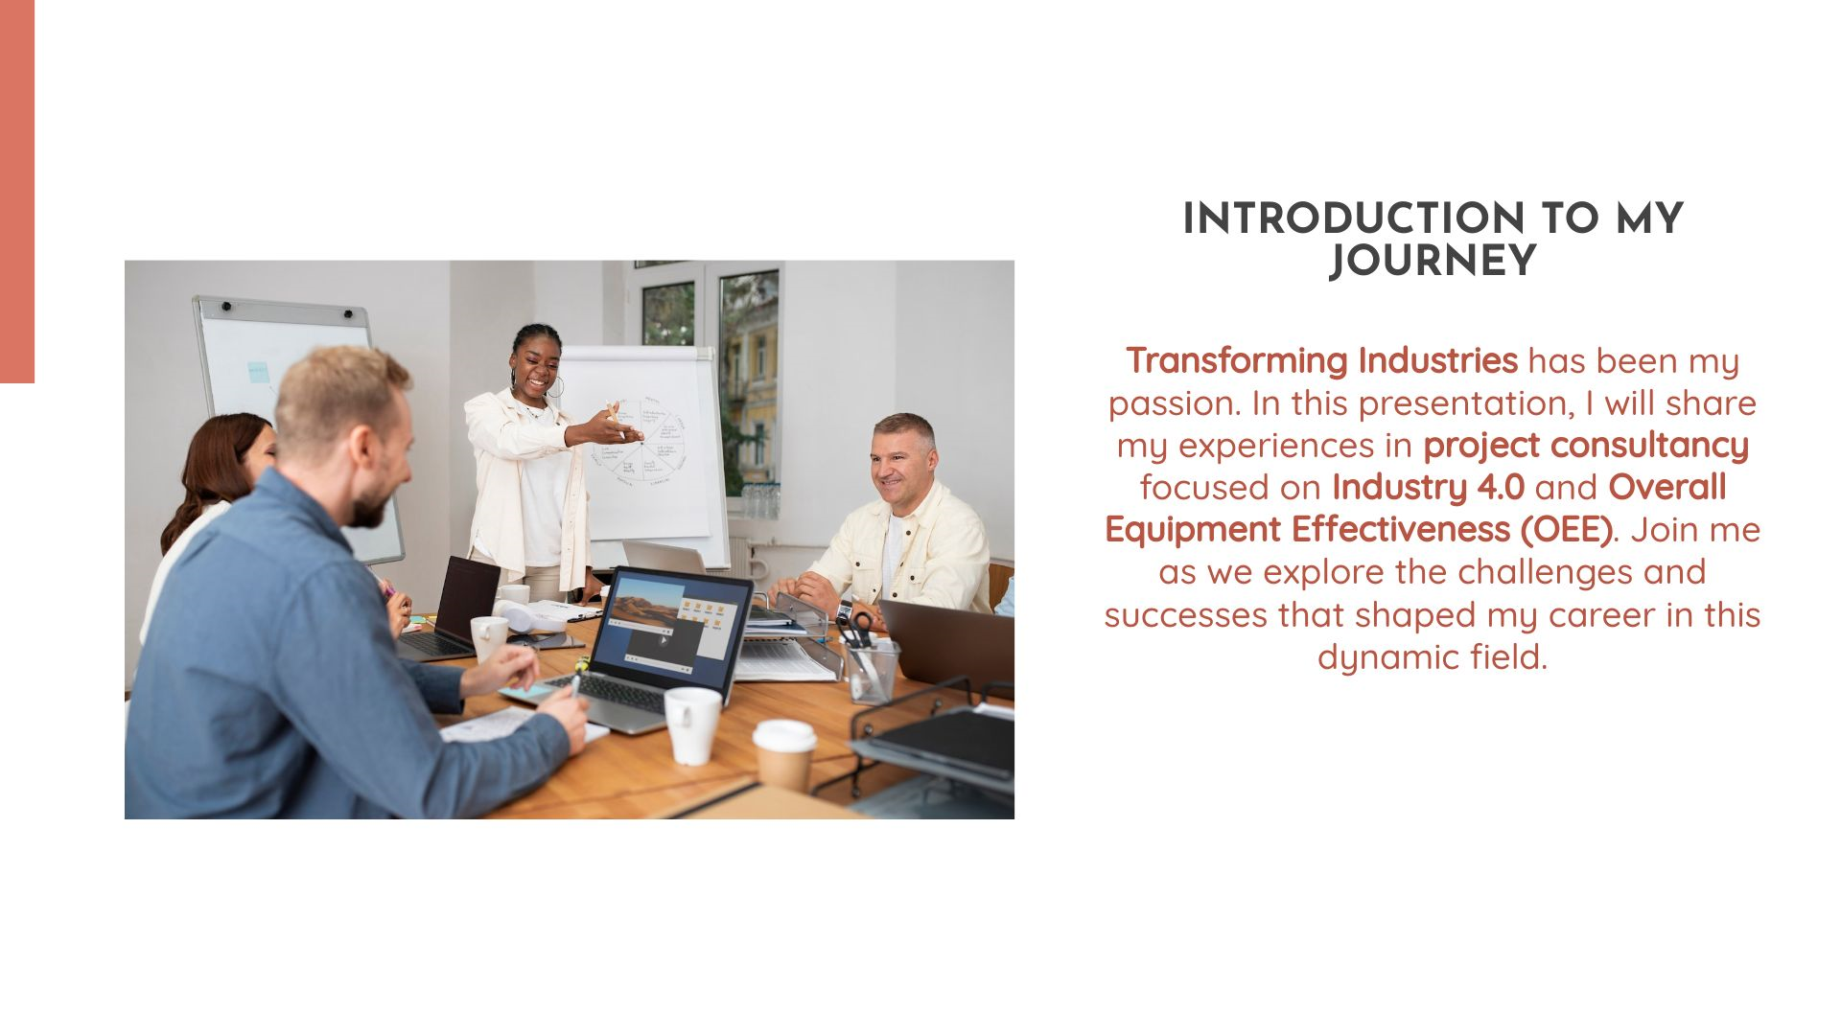

Slide 6
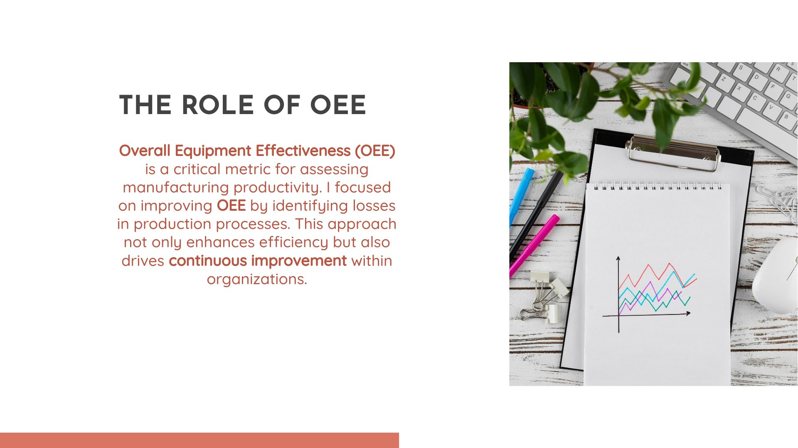

Slide 7
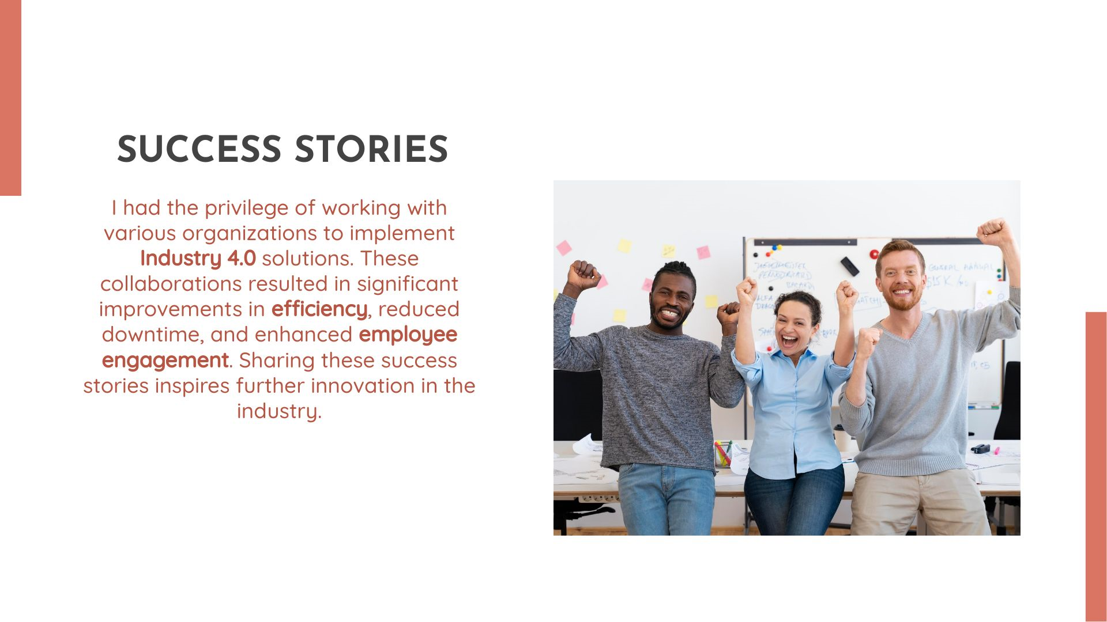

Slide 8
Success Stories
We are thankful to :
AES Seals
Ultra Engineers
Smith International
Andritz Hydro
Delta Corporation – Doha, Qatar
W.O.M. – Velu, Near Pune
Fibro India
Indo Schottle
Manweir – Doha, Qatar
Sanjay Ghodawat Uni – Kolhapur
Danfoss – Wagholi, Pune

Slide 9



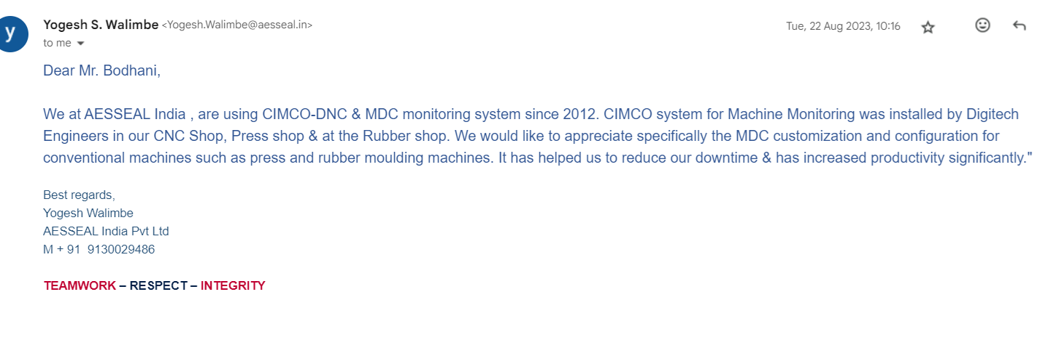
Success Story 1
AES Seal with head office at South Yorkshire-UK is a manufacturer of complete range of gas seals for compressors, API Pumps, Mechanical Seals.
Different Machine Controllers
Different batch quantity
Cycle time: Planned Vs actual was not matching
Delay in getting production report due to manual data entry
Less production
Installed CIMCO live OEE
Accurate down time logged
Online OEE displayed for each machine, which generated healthy competition
Instant reports
Increased production by 10 %, saving on electricity
First PO was for CNC Shop
Next PO for Press shop
Next PO for Rubber Shop

Slide 10
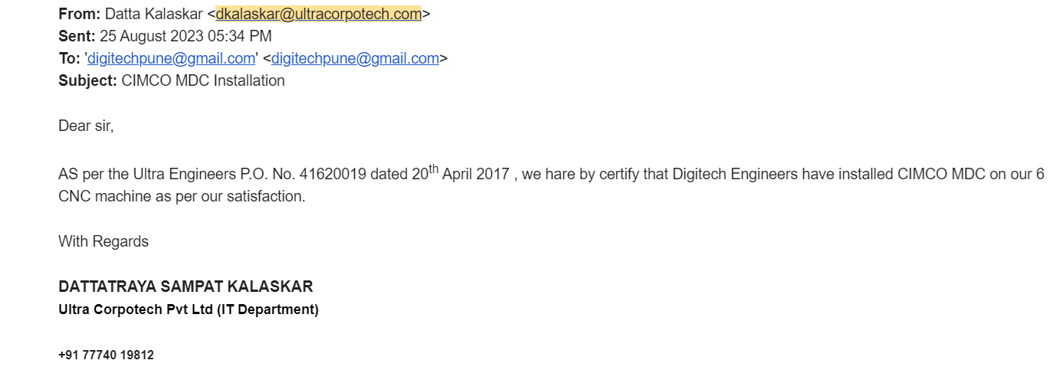
Success Story 2
Since year 1991, ULTRA are a well established organization actively engaged in manufacturing of precision & high quality Heavy Duty Metal Components used for specific application in Oil & Gas industries, Energy & Power, Automobile.
Different Machine Controllers at 4 locations
Some were very old
M00 time loss was difficult to catch
Delay in getting production report due to manual data entry
Installed CIMCO live OEE
Accurate down time logged including M00 & M01
Online OEE displayed for each machine, on a big TV screen
Instant reports to G. M.
First PO was for 4 CNC Shops
Next PO for combined machines

Slide 11
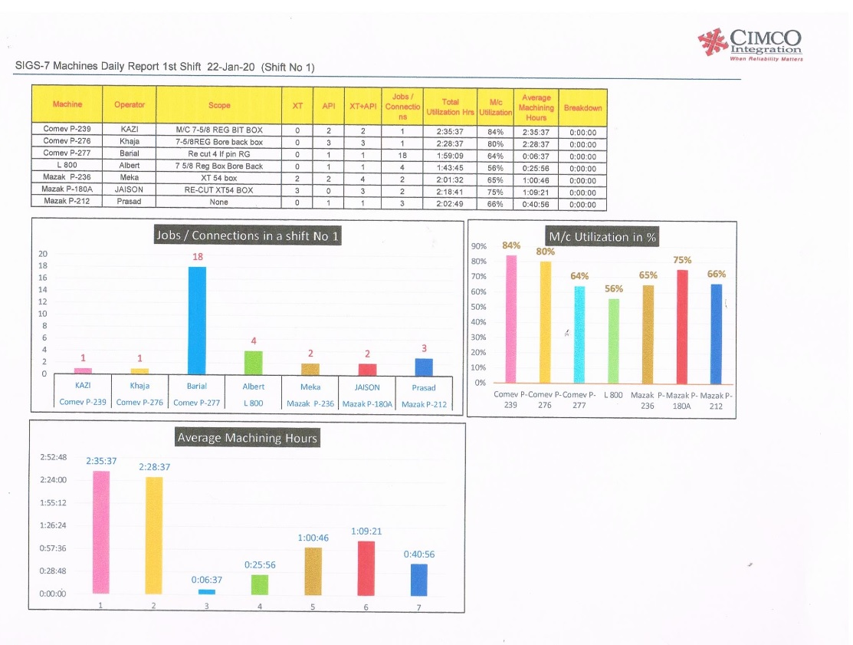
Success Story 3
Smith International Gulf Services, was established in Dubai, in 1974. With 46 years experience, SIGS, today is a leading provider for the oil & gas industry across the Middle East, Asia, Africa.
Difficult to change the mindset
Time given for installation was a big challenge
Operators were new for Android TAB interface. Training was necessary
Installed CIMCO live OEE
Android TAB installed
Online OEE displayed for each machine on TAB
Daily reports & weekly reports as they wanted n their format, were given.
Increased production by 10 % by reducing setup time
Awaiting for next PO for other plants

Slide 12
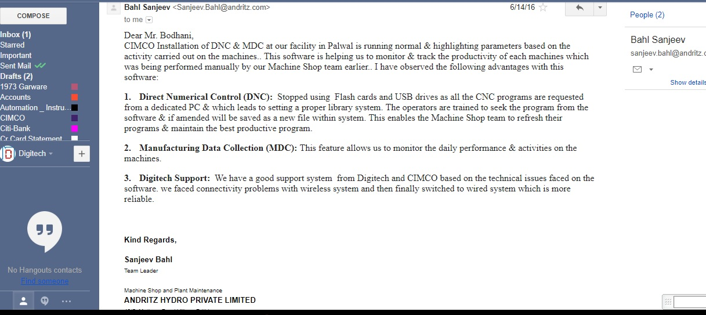
Success Story 4
ANDRITZ HYDRO Pvt. Ltd. is a fully owned subsidiary of ANDRITZ HYDRO GmbH in Austria. ANDRITZ Hydro is one of the leading global suppliers of electro-mechanical equipment & services for hydropower plants
All machines are old.
No intelligent ports on CNC
Setup time was too much due to large jobs
Management was not happy about productivity, as true picture was not given from CNC Shop
Part program loading was taking too much time
Installed CIMCO live OEE
Studied machine hardware & got the right signals.
Online OEE displayed for each machine.
DNC installed
Increased efficiency due to correct monitoring machine shop 24 X7
It is a good reference site in North India for us now

Slide 13
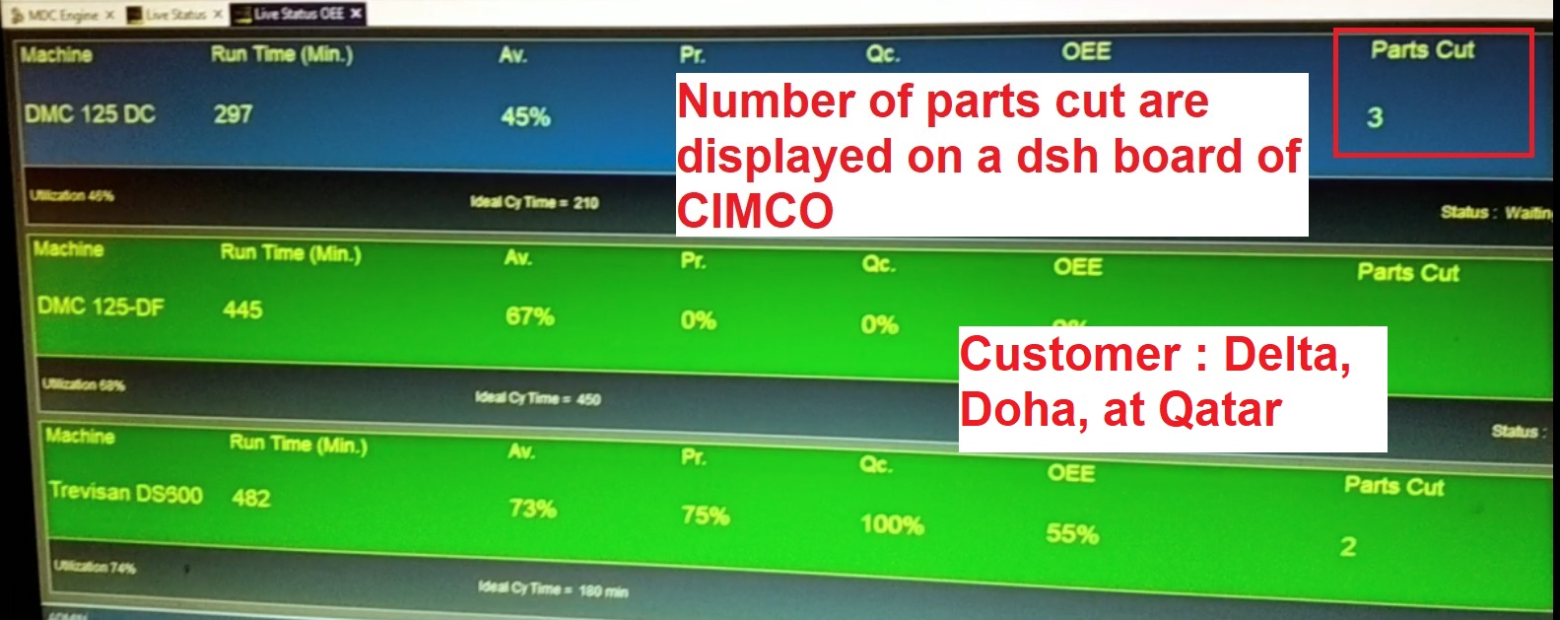
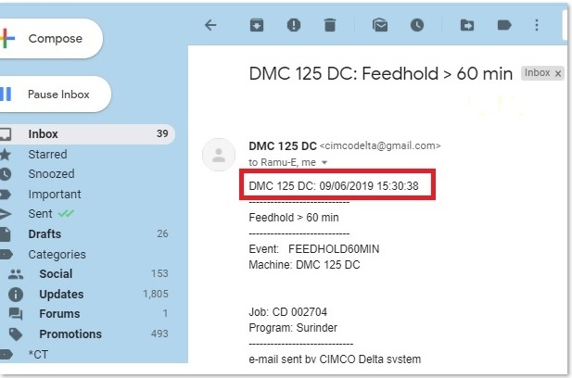
Success Story 5
Delta Corporation (Doha, Qatar) is a highly qualified global leader in the provision of equipment for the oil & gas. Delta manufactures wellhead equipment, valves, actuators & flow control products.
All machines were new. But OEE was not as per the expectations
Operators were using FEEDHOLD for unnecessary time. It was very difficult to keep a track why FEEDHOLD is for long time.
Installed CIMCO-MDC to display live data
FEEDHOLD is now monitored for each machine.
E-mail alerts are given
Expecting further orders

Slide 14
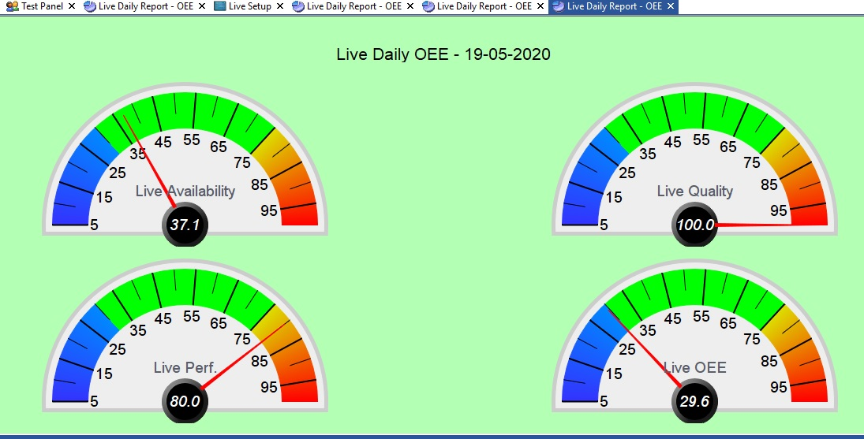
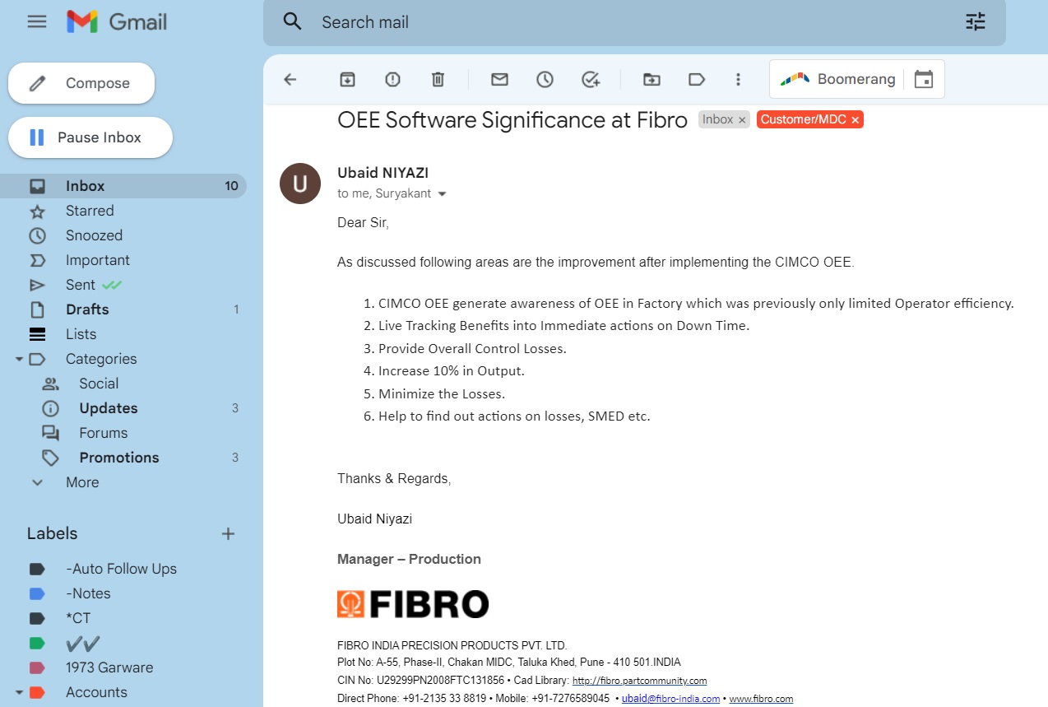
Success Story 6
Fischer-Brodbeck GmbH (FIBRO) was founded in 1958. Since 1974, it is a has been part of the Läpple Group. Today FIBRO employees are active worldwide in the fields of standard parts & rotary tables.
They were looking for one common dashboard for all machines. They got offers from other suppliers, but all machines were not covered by one solution.
MAZAK solution was too costly
Load-Unload time was not able to log accurately
OEE was not right.
Installed CIMCO live OEE
Accurate load-unload time is captured, which is different for different machines.
One TV per shop installed.
Increased production by 10 to 12 %,
Good control oer downtime
Received next order to put “VOICE Messages” to existing machines for alerts for pre-defined events. This work is in progress now.

Slide 15
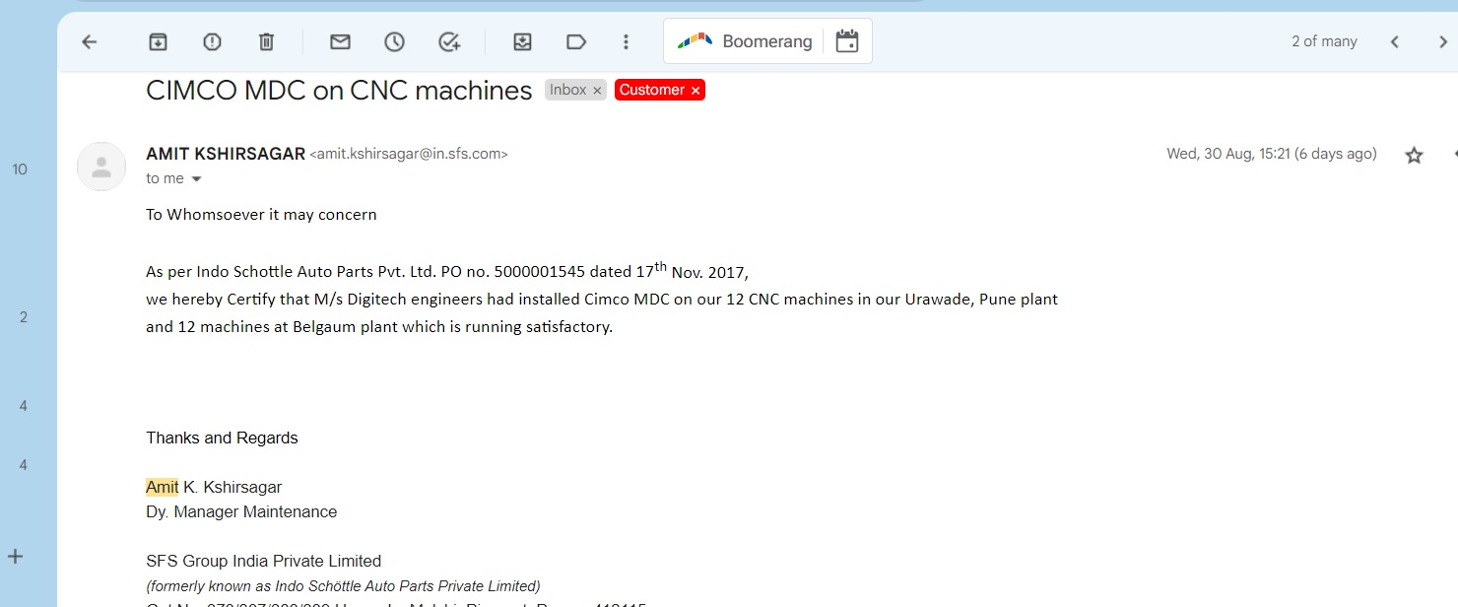
Success Story 7
SFS Group India P Ltd has 12 CNCs in Pune Plant & 12 in Belgaum plant.
They were looking for one common dashboard for all machines. They got offers from other suppliers, but all machines were not covered by one solution.
Part count data was not available directly
Some machines had 2 Pallets. Thus for one program, 2 parts were produced
OEE was not right.
Installed CIMCO live OEE
Accurate down times were captured.
One TV per shop installed.
Increased production by 10 to 12 %,
Good control over downtime
Customized solution for part count was given
Next order is expected

Slide 16
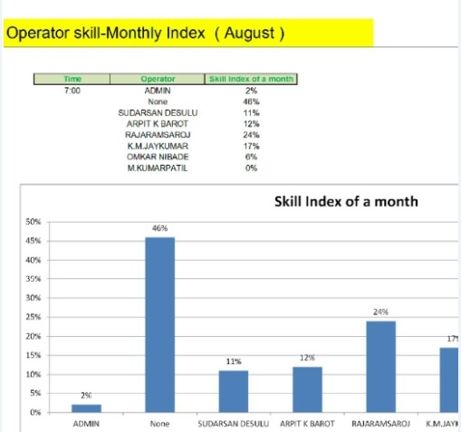
Success Story 8
Manweir at Doha is a big group in Oil & Gas in Qatar.
They were looking for reliable & proven system to monitor all machines
Wanted to reward the best operator of the month
Installed CIMCO live OEE
Accurate down times were captured.
Wi-Fi network was established
Skill index of operator was given on a graph
Good control over downtime
First order for 3 machines
Next order was received for all machines

Slide 17
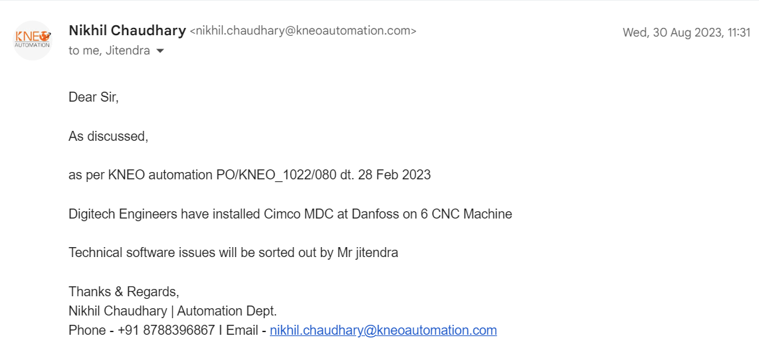
Success Story 9
Danfoss
They were looking for a different dash board.
They finalised one company “ Kneo Automation”
To give access to CIMCO Database was required
Installed CIMCO live OEE
The front end is by M/s Kneo
In the background, CIMCO is running to capture live data.
A good reference was established.

Slide 18







C ceo@digitechpune.com
https://www.linkedin.com/in/deepak-bodhani-a036a05/
+91 7972889960 www.digitechpune.com
https://www.youtube.com/@digitechpune

