Slide 1

CORPORATE PRESENTATION
Copyright © Samniya Techsys Pvt. Ltd.
TEMP:SAT/JAN-2018/01

Slide 2

INTRODUCTION
Company
Headquartered in Bangalore, India
Leadership
Strong Senior Technical Leadership Team
Proven Management Team
Domains
Aerospace
Automotive
Automation
IT Services and Hi-tech
ISO 9001:2015 certified
Target Clients
Tier 1, Tier II, OEMs, System Integrators
Focus on long term partnerships and repeat business
Engineering Team
Human capital with multiple decades of experience in the related industries
Quality Excellence
Growth Plans
Core teams on Machine learning, Artificial intelligence and IoT
Prior experience with product and service companies
Technology partnerships
Talent Management

Slide 3



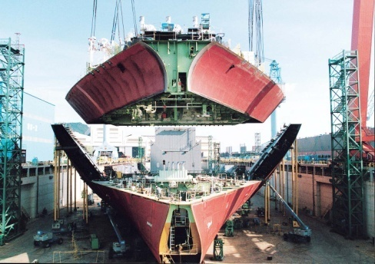


DOMAINS AND INDUSTRIES
Aerospace
Automotive
Automation
Ship Building
IT Services
Energy

Slide 4
OUR OFFERINGS ACROSS INDUSTRIES
Turn-Key System Development
Custom Embedded Systems
Software Engineering
Technical Publication/ Technical Illustrations
Wire Harness/Automated Test Equipments ( ATE)
Mechanical /Structural parts Design and 3D Modelling
Talent Management/
Staffing
Support and Maintenance Services

Slide 5
PRODUCT ENGINEERING SERVICES

Slide 6
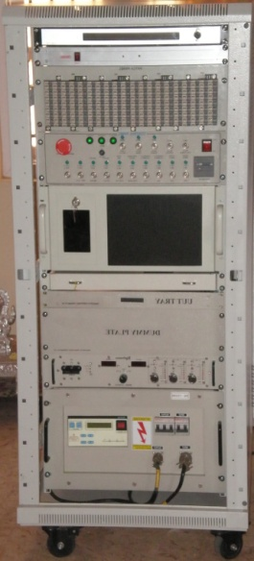
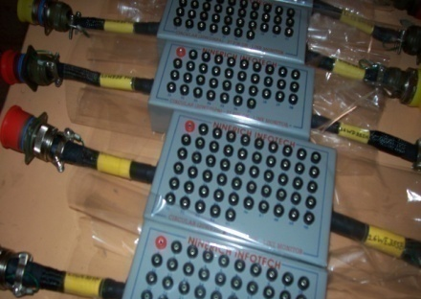
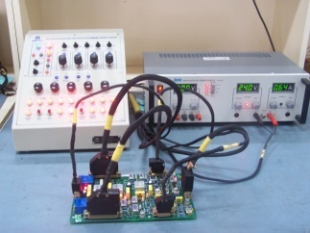
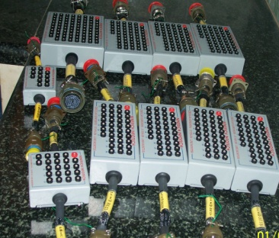
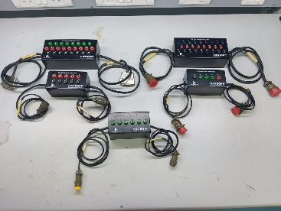
TEST SYSTEM ENGINEERING & MANUFACTURING
We provide customized / standard test solutions for all your applications/ products/ LRUs and systems, with the experienced team of System engineers we can understand the functionality of the systems better and can propose customized, reliable and effective test solutions in a cost effective approach.
Design and Develop Test Systems
Custom built Automated Test Equipment (ATE)
Test Equipments to the Build to Print Requirements
Test Equipments to the Build to Specification Requirements
Test Jigs & Rigs fabrication

Slide 7
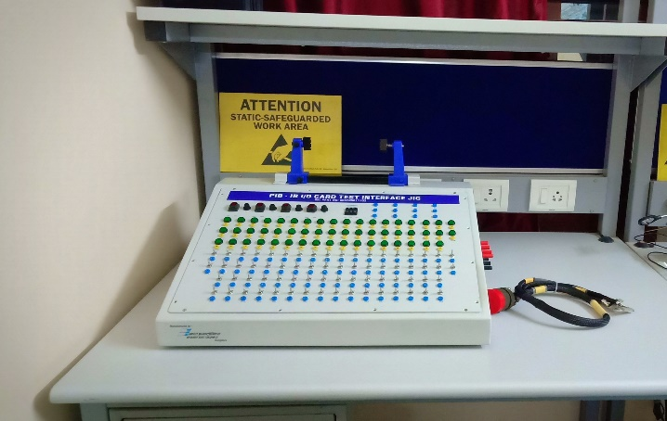
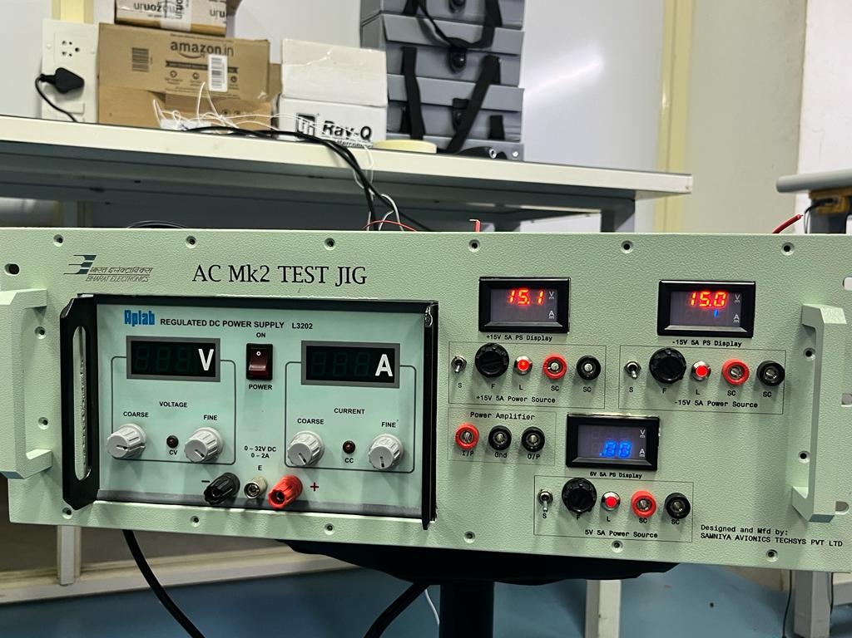
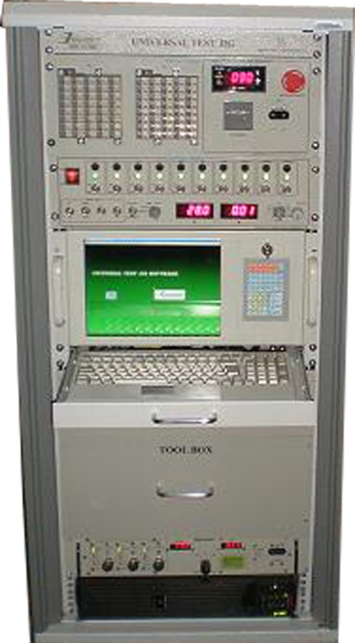
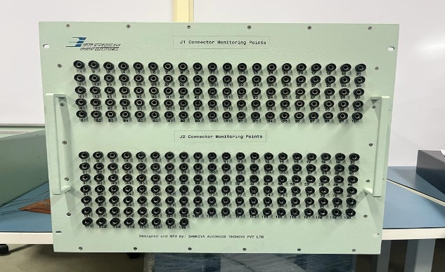
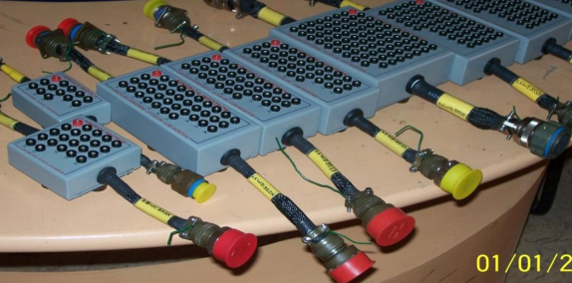
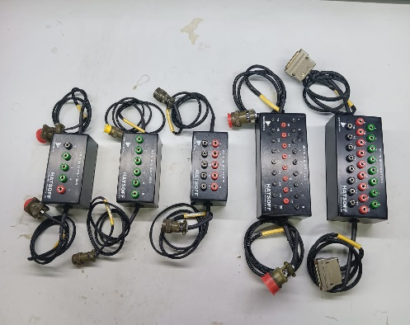
Test Jigs

Slide 8
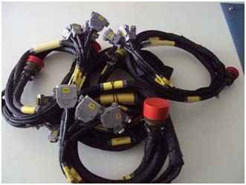
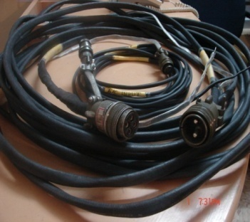
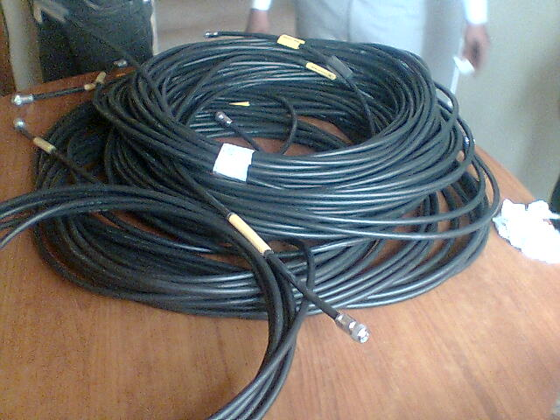
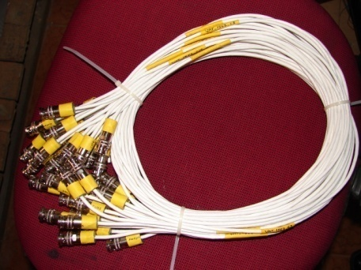
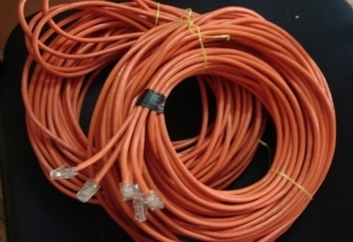
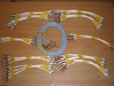
WIRE HARNESS ENGINEERING & MANUFACTURING
Samniya is the one stop solution for all your wire harness fabrication and cable fabrication requirements, we provide the complete End to End support in wire harness Engineering & Manufacturing, we practice a stringent quality stage gate inspection at every stage of the fabrication to meet the global slandered.
Wire Harness Activities Includes:
Design and Routing of wire harness & Components detailing .
Wiring Board design
Wiring chart, BOM preparation
Wire harness fabrication / cable assembly
Braiding, Shielding, Marking & Finishing
Wire Potting
Testing
Integration & Installation.

Slide 9
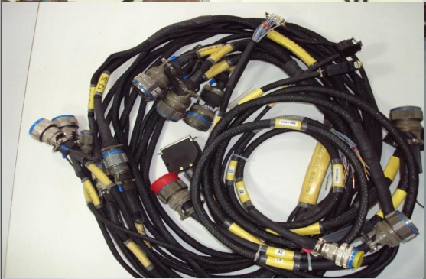
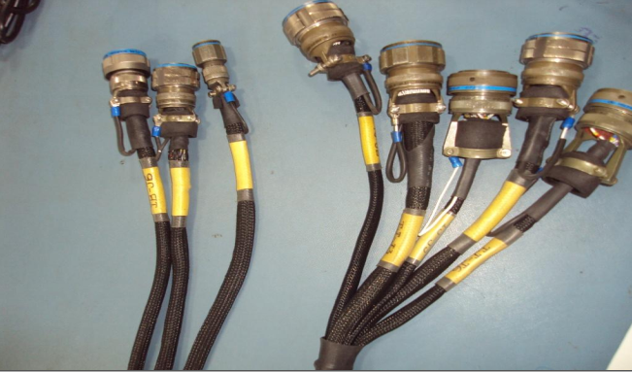
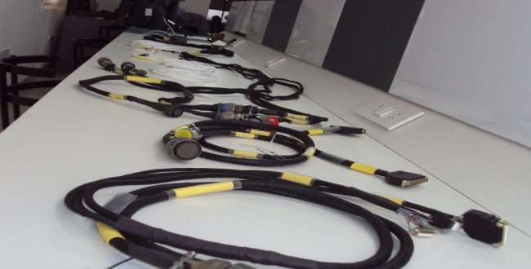
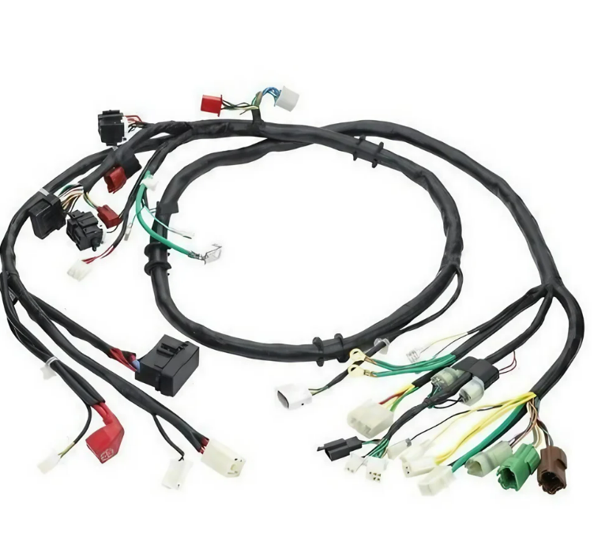
Wire Harness
Military Ground Equipment Wiring
D38999 Series Connectors Wiring
Aircraft Wiring
Automobile Wiring

Slide 10
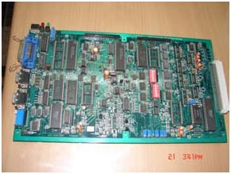
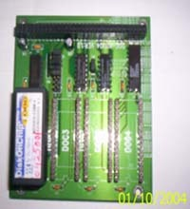
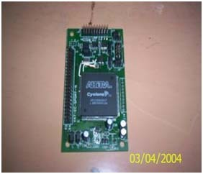

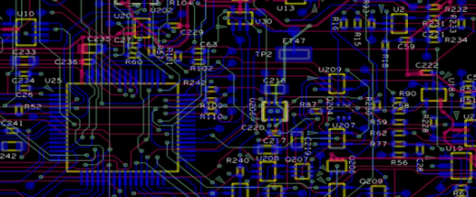
CUSTOM EMBEDDED ENGINEERING
At Samniya we support/ provide customised embedded system design, development and manufacturing meeting specific customer requirements.
Hardware Design
Customized Analog, Digital and Mixed signal boards design
Embedded board bring up
FPGA design and implementation
Synchro to Digital /Digital to Synchro conversion
PCI Cards (Analog, Digital, Discrete I/O)
Isolated Digital & Analog I/O cards.
RS232/RS422/RS485 Communication IO cards.
Wireless (BT, Wi-Fi, 802.15.4, ISM), RFID)
Embedded Software:
Firmware Development
Board Support Packages (BSP)
Device Drivers Development(Windows, Linux, RTOS)
PCB Design
Design of Multi layer & High Density Boards.
High-speed digital design & analysis
Schematic and layout translation
Advanced PCB including HDI rigid, flex and low loss board design.
Simulation & Verification Services
CAM verification / Gerber edits and checks
Digital simulation for integrity
Thermal simulation
Solutions:
Servo controllers for actuators,
Custom Power supply design.
Product Design Service
Custom Computing Solutions
Design verification and testing
Production Management
IoT Solutions

Slide 11
Hands on Experience in
Customized data acquisition / IO Card Design on Standard form factors
VME based data Acquisition
PCIe Based Data Acquisition
PMC Based Data Acquisition
PMC Based IO Design
cPCIBased Data Acquisition
cPCI Based IO Design
PCI Based Data Acquisition
PCI Based IO Design
HSMC Based IO Design
FMC Based IO Design
Analog Designs,
DAC - 1.2 GHz Rated DAC (LVDS Interface)
DAC - 500 MHz for arbitrary waveform generation (LVDS Interface)
ADC – 400 MHz with 73 dB SFDR
ADC – 210 MHz with 76 dB SFDR
DDS – 3 GHz for Arbitrary waveform generation
Processor Based Design,
Intel E3930 based design
ARM based design
iMX 7D based Design
Protocol,
1553B Interface
ARINC 429 and 717
RS422,485
Ethernet
USB
UART
C012
FPGA Based Design
Experience with SPARTAN 3A and SPARTAN 3AN, Virtex 4 SX, FX, LX, Virtex5 SX, FX, LX, Virtex6 FX, Virtex7, Kintex 7, Artix 7, Zynq 7, Altera Cyclone IV,V

Slide 12

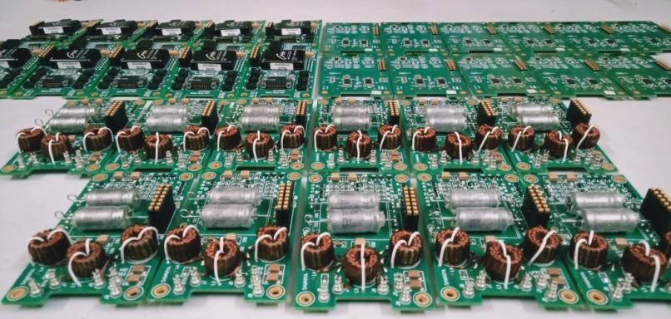
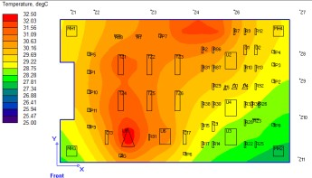
Case Study on Digital & Analog Servo Controller for an UAV Actuator Case study
Over View: Servo Controller Cards for Rotary Actuator are the Shop replaceable boards used in the Nose Wheel Steering Actuator and Control
Surface Actuator.
This is a build to specification requirement, Where customer provided only Baseline Schematics, Bill of material.
Samniya Responsibility:
Requirements capture
Schematic Analysis
PCB Layout Design
Board Analysis including Signal Integrity(SI) Analysis, Thermal Analysis,
Component Derating Analysis and MTBF of the boards
BOM Scrubbing and Procurement of components
PCB Layout design and Fabrication as per the required standards.
Population of PCB
Assembly and FTP
SRU level ESS tests
Kit of parts and Final Assembly complying with RDAQA
Testing and Qualification

Slide 13
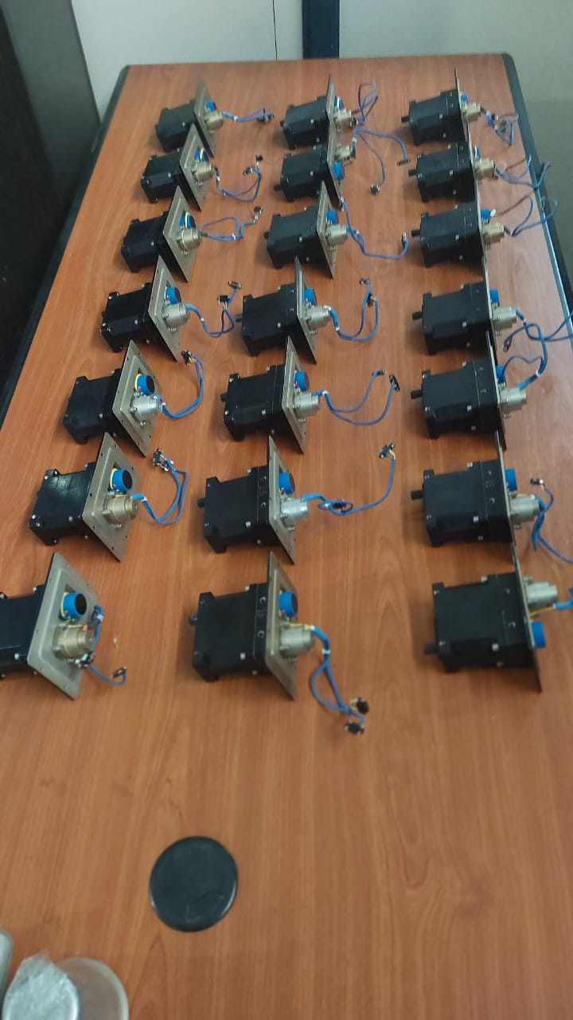
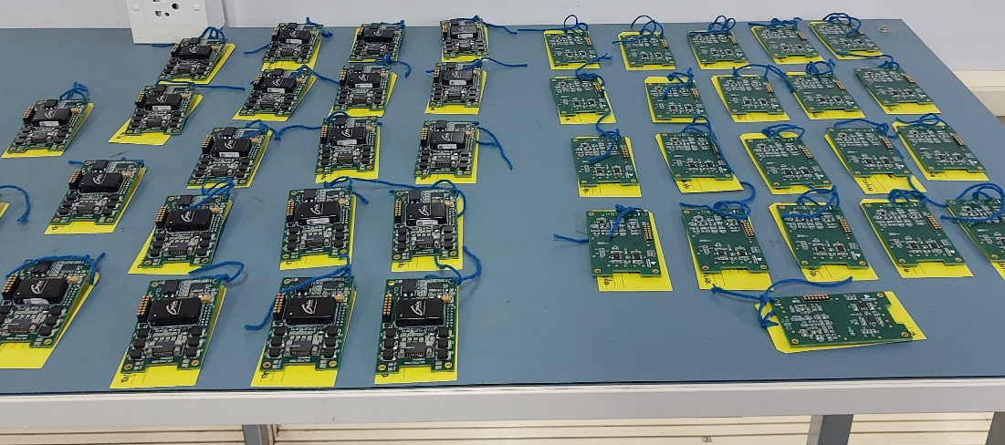
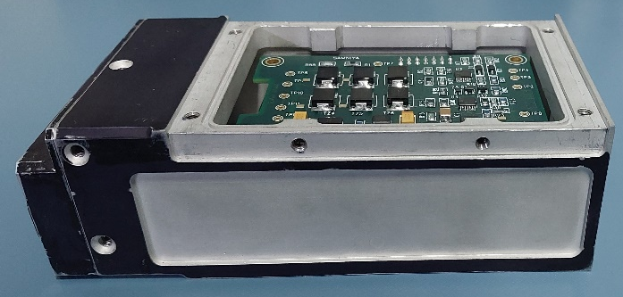
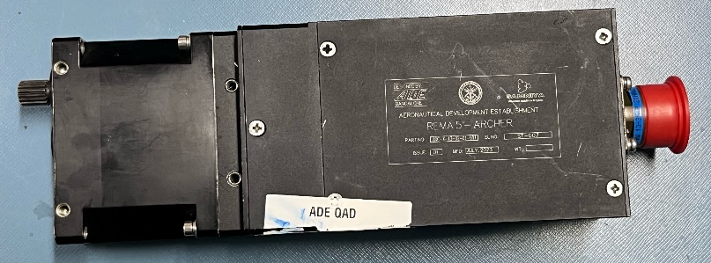
Fully Airworthy Qualified System.

Slide 14
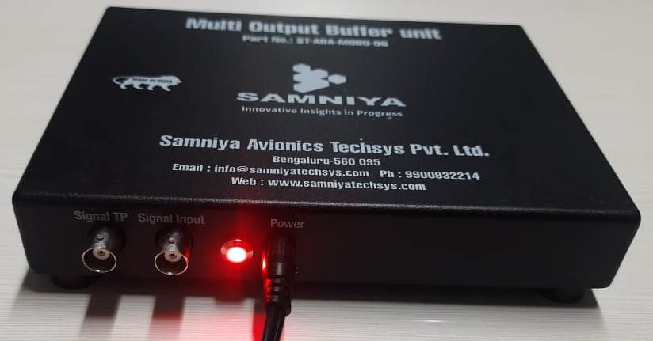
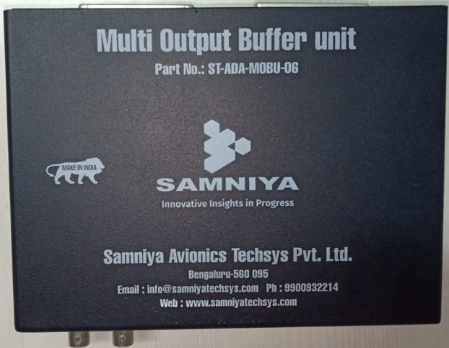
Multi Output Buffer Unit (MOBU) Case study
Multi Output Buffer Unit (MOBU) is used to drive the single signal Input to Multiple Outputs, This unit drives signal input to two different 16 Set of Outputs through two 50 Pin Standard D-Type Connector. This unit works with input 230V 50-60Hz and Output 15v Power supply adaptor.
Application:
Simulation of Sensor out put up to 5Mhz with 2+ to 10V VPP, to use at Test environments.
Specifications:
Size : 180mm x 150mm x 30mm (LxWxH- Portable & Table top)
Power Input : 15V.
Frequency Range : up to 5 MHz, +/- 10v
Driving Capabilities : Up to 5 Mtrs.
Signal Output : 32 Outputs through two 50 pin D- type connectors
Operating Temperature : 0° C - 50° C
Storage Temperature : -40°C - +80°C
Operating Voltage : 230 V AC using 15V 5A Output power adaptor.

Slide 15

Samniya Avionics Techsys Pvt. Ltd.
#12, 1st Floor, 3rd Cross, PNR Layout, 6th Block, Koramangala, Bengaluru,560095
+91 9900932214
info@samniyatechsys.com
www.samniyatechsys.com

