Slide 1



introduction
INFOTRANS
Superefficient molds
Amazing plastic products

Slide 2
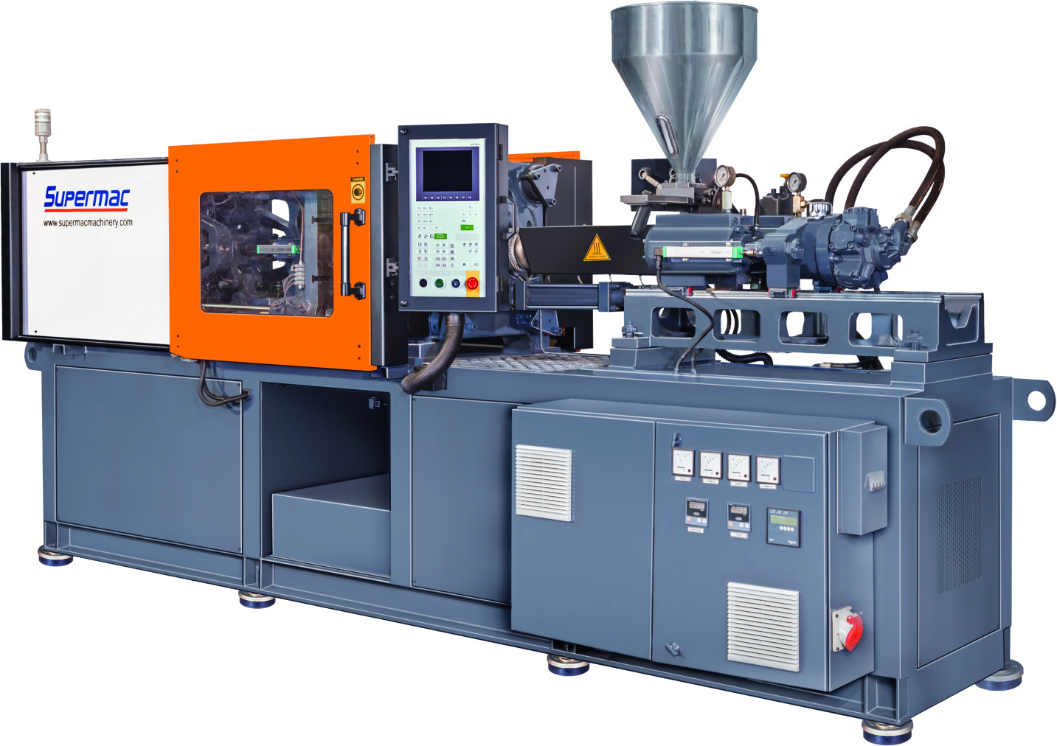

OUR
Company
  Over 20 years in Operation offering Plastic Molded parts
  Product Design to Delivery in a single window
  Substantial and Varied project experience with unflinching reliability
  Operations well suited for crucial industrial parts
  Till date served large conglomerates to SMEs
  All of the above distills into great quality products at competitive prices without fail.

Slide 3

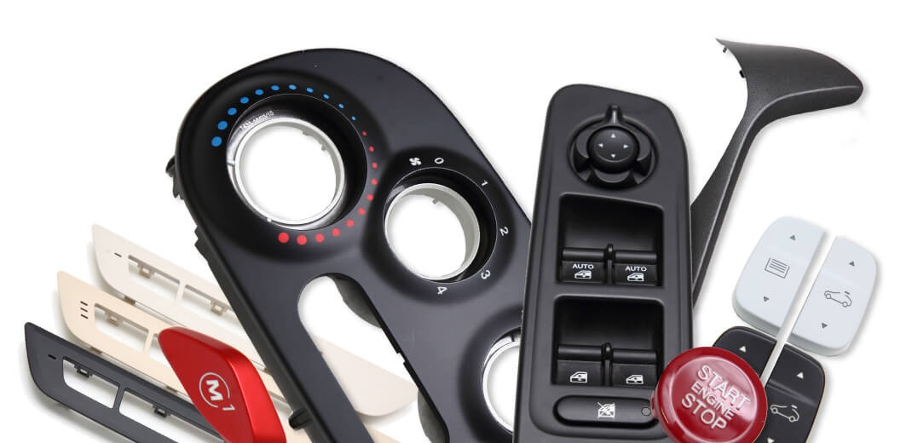

OUR
Broader Customer Categories
Renowned Manufacturers of various industrial equipment and Manufacturers of B2C products like medical , pharma , furniture and consumer goods
Manufacturers and Dealers with own brand of household appliances and products
Exports – Direct or Thro’ Merchant Exporters

Slide 4
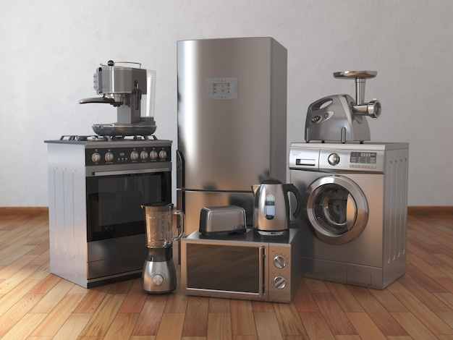

OUR
B2B Product Sectors
  Industrial Appliances and Consumer Electronics
  Industrial machines
  Pharmaceutical
  Modular and flat packed furniture
  Automotive parts
  Gifting
  Medical equipment and supplies
  Packaging
  Toys

Slide 5
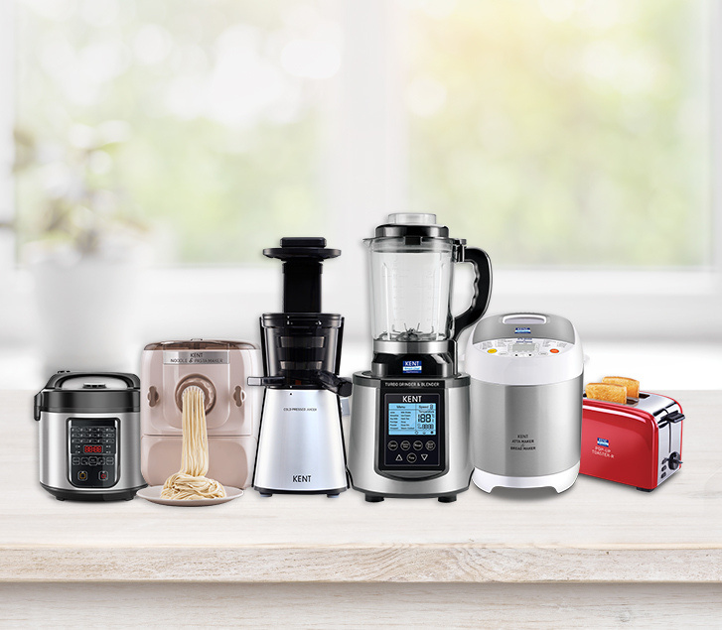
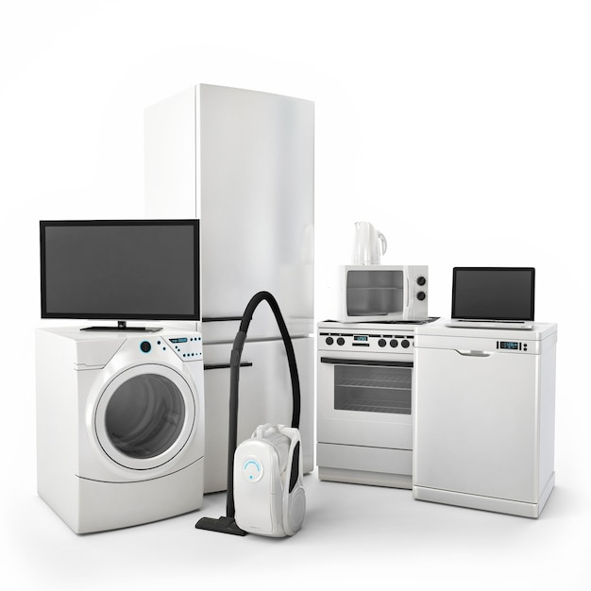
Sector
Household Appliances
  Washing Machines , Dishwashers
  Refrigerators
  Vacuum Cleaners
  Air Conditioners , Fans
  Water heaters
  Clothes Iron
  Mixer Grinders , juicers , Water Filters
  Speakers , Routers , LED Lights , Switches

Slide 6


Sector
Medical Equipment
And Supplies
  Analyzers , Nebulizers , Oxygen concentrators
  Hospital Beds , Infant warmers
  ECG machine , Cardiac monitor
  Tubes for blood test , Urine test container
  Syringes
Notes:
7

Slide 7
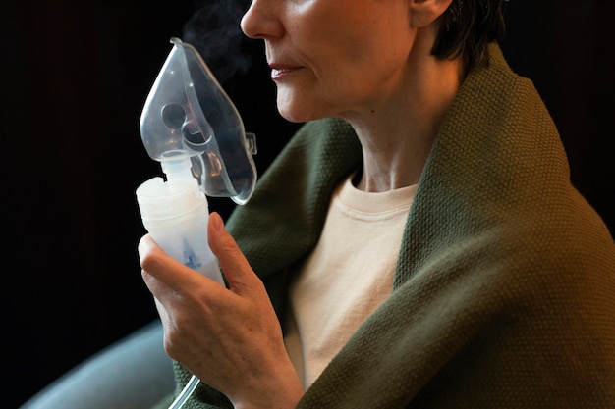
Sector
Pharmaceutical Supplies
  Child-resistant caps , pill bottles, boxes , pill organizers
  Measuring caps – cough syrup, Drip caps
  Pregnancy test kit
  Drug Inhalers, Eye drop dropper
  Eye drop bottles, caps , droppers
  Lung exerciser - Spirometer
Notes:
8

Slide 8
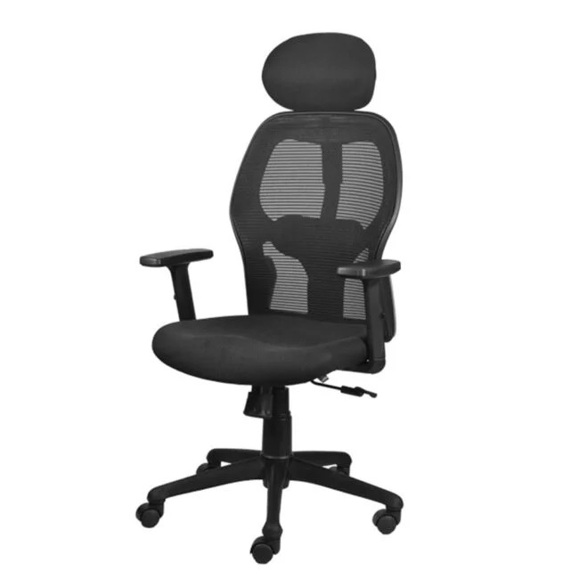
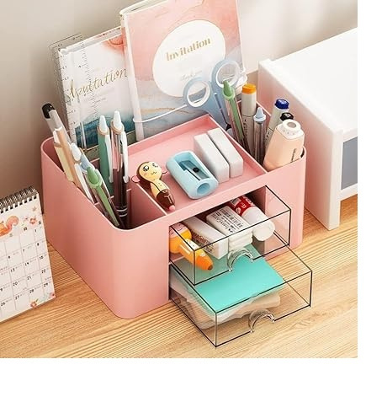
Sector
Modular Furniture
  Chairs , stools – Parts od chair / stools
  Storage cabinets
  Shelves and fixtures
  Desk organizers , laptop stands
  Computer trolleys
  Photo Frames , Vases

Slide 9

Sector
Automotive parts
  A , B , C Pillar covers
  Glove boxes
  Mudguard liners , Air spoilers
  Wheel Covers
  Door and other panels
  Radiator fans and fan covers
  2 wheeler parts headlight visor , front mudguard , Mirror parts , signal lamps
  3 wheeler mirror parts , signal lamps , engine covers

Slide 10
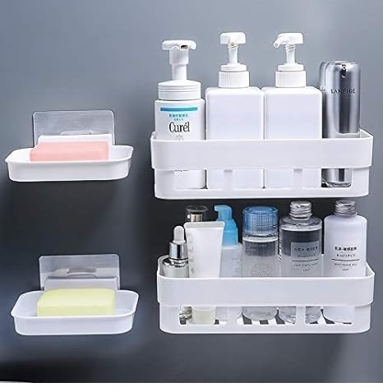
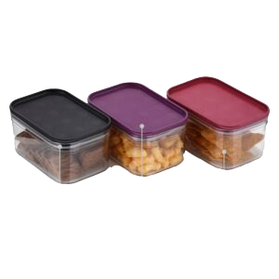
OUR
Household Products
  Kitchenware : Food containers , storage boxes , bowls and baskets
  Bathroom Accessories : various fixtures , mirror cabinets , toilet seats , flush tanks
  Cleaning supplies : buckets , brushes , mops , laundry baskets
  Furniture : chair , table , storage units

Slide 11

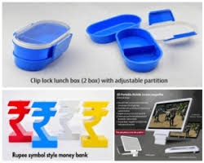
Sector
Gifting
  Corporate Gifting – Desk organizers . Pen stands , lamps
  Various I Cards / Tags
  Medical Demo kits
  Water bottles
  Gadgets
  USB business cards / brochure

Slide 12
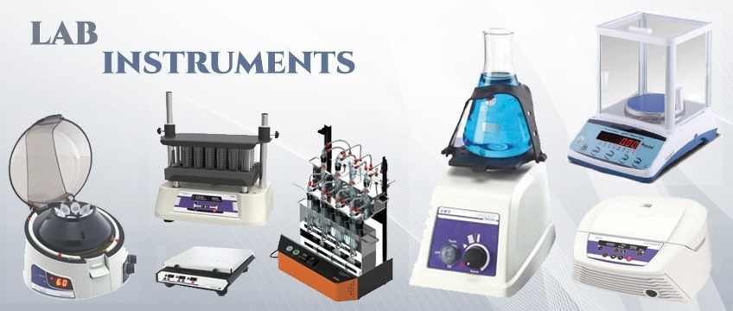
Sector
Industrial Machines
  Submersible Pumps – Impellers , Diffusers
  Office equipment – Printers , Zerox machines , Paper shredders , Water Filters
  Commercial floor cleaning equipment
  Lab equipment
  Electronic Panels – Enclosures
  Defense – Rifle butts , Telecomm equipment , Bomb shells
  Electrical , heavy electrical and solar field equipment , enclosures and control knobs for electronic equipment , Wire spools

Slide 13
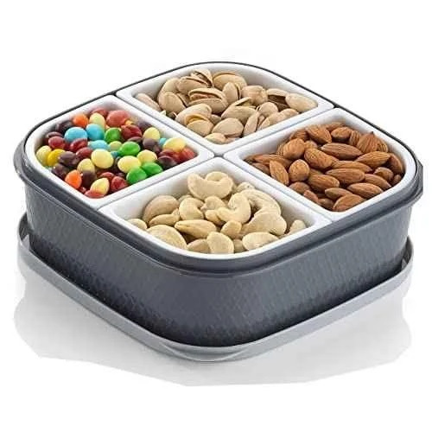
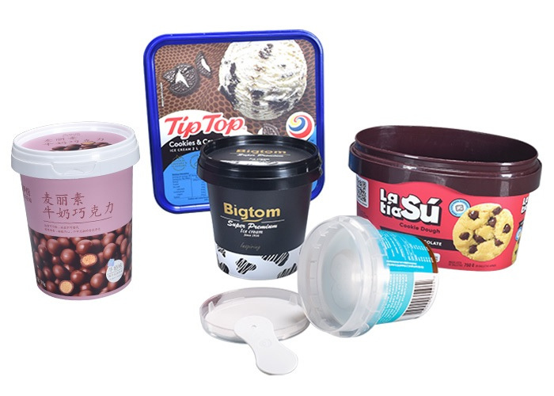
Sector
Packaging
  Airtight Containers for dry fruit , tea pacakging
  Transparent jars and caps
  Tamperproof packaging for Ice creams
  Thin wall packaging cups / containers
  Crates and Trays for vegetable and othe goods transport
  Custom designed packaging for industrial items

Slide 14


Sector
Toys
  STEM and other toys for various age group
  Sports equipment – bats , Safety helmets
  Gym equipment

Slide 15


WHY
Infotrans ?
Extensive Experience with Demonstrated skills and achievements
Adherence to agreed quality standards at a competitive price
Expansive and supportive Industry Network
Scientific approach
Complete commitment to Agreed deliverables
Demonstrated Dependability

Slide 16



WE PROVIDE
BEST SERVICES
Clients like Reliance Industries , Crompton Electricals , Baker Gauges , Tata International have found our services reliable and have provided us with numerous and important project opportunities time and again.
Our clients from SME segment have recognized our abilities to handle crucial projects with critical requirements and tighter deadlines.

Slide 17

OUR RECENT
Accomplishments
  Substitutes for complex Imported parts developed and delivered
  Completed fully auto mold for soft pvc part for Export to The USA
  Exported bulk quantity of spacer for furniture
  Delivered set of fully hardened molds with tight tolerances and crucial geometry to an exporter
  Successfully developed mold for mop-bucket for running on 550 tons machine with more than 95% quality points met at T0.

Slide 18

WE PROVIDE
WORLDWIDE
SERVICES

Slide 19


THANK YOU
https://www.infotrans-caddesign.com/

