Slide 1





HIFLO SOLDERS PVT LTD

Slide 2


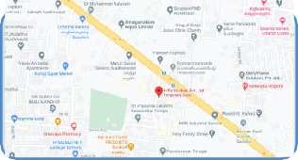
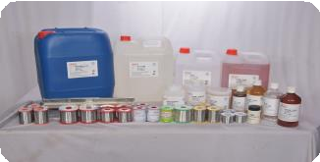
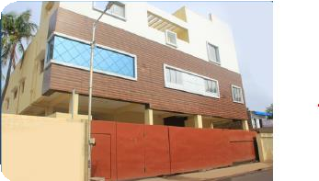
Profile
Incorporated in 1998
Catering Domestic & international markets
Plant Location
No.1,Big Street, Ponniammanmedu,
Madhavaram, Chennai-600110
Products
Non-Ferrous Metals - Tin and Lead base / Lead Free Solders (ROHS)
Electronic Assembly & Industrial Fluxes, Cleaners, Solder Paste
Plant Area
10250 Square Foot
Build up Area - 8500 Square Foot

Slide 3

About us
1000 + Customer Base & Listed in Top 10 Solder Manufacturer in India.
Global supplier
Registered with 15 Government & Public Sectors
Only IATF certified
solder manufacturer in India.
Only Dross reclaim facility with manufacturing set up in India
20% Market share in India's established industry sector

Slide 4

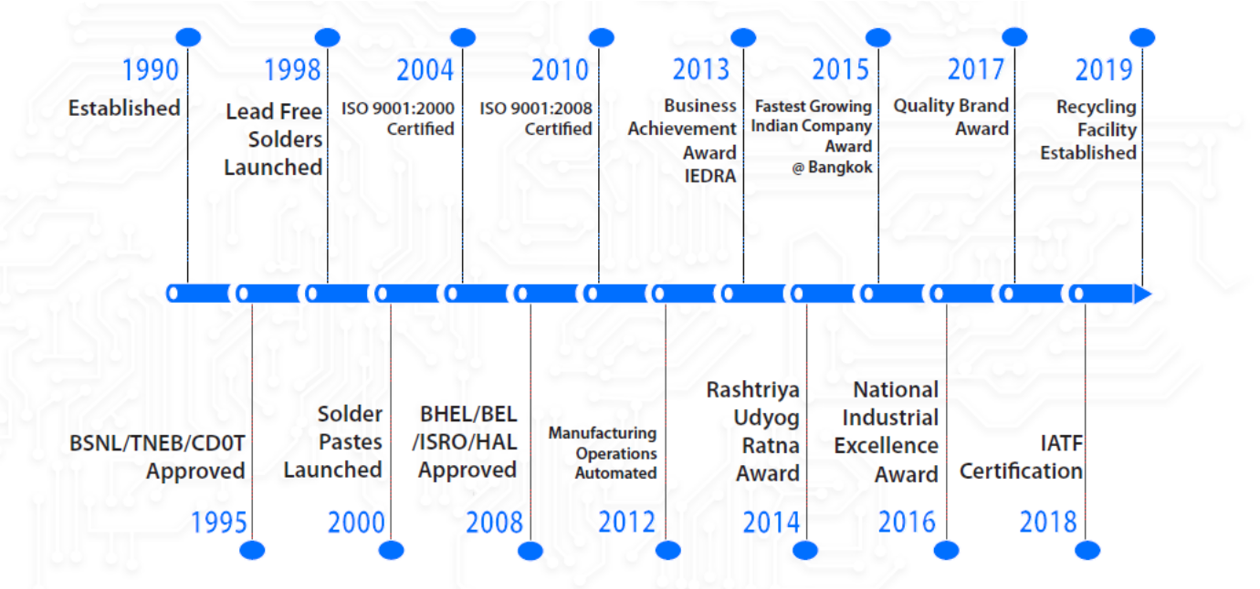
Our Journey….

Slide 5
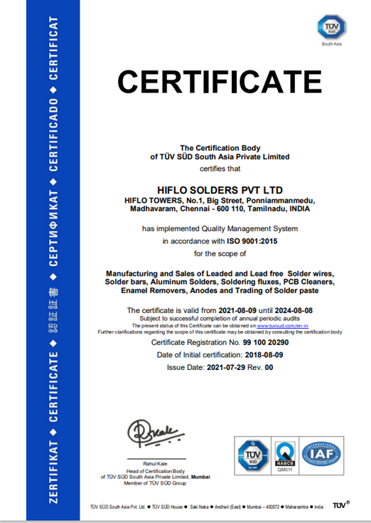
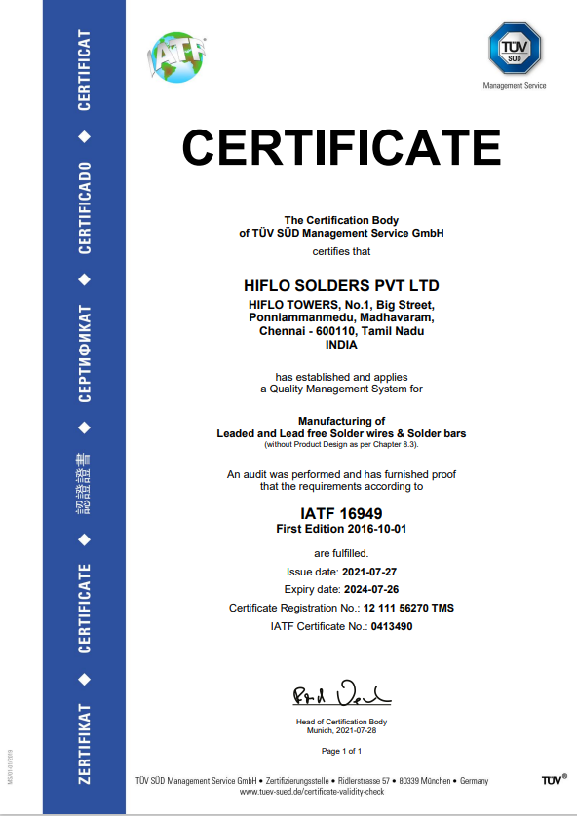
Quality Certifications

Slide 6
Manufacturing Flow Chart
Raw Material
Inspection
Wires are spooled
in bobbins
Packed and with Labels & Shrink wrapping
Base metal Melting
Wires are drawn to
Packed in Carton
Boxes for despatch
& alloying
required diameters
Base Metal Alloy
Base metal Rods
testing
extruded into thick
wires with flux core

Slide 7
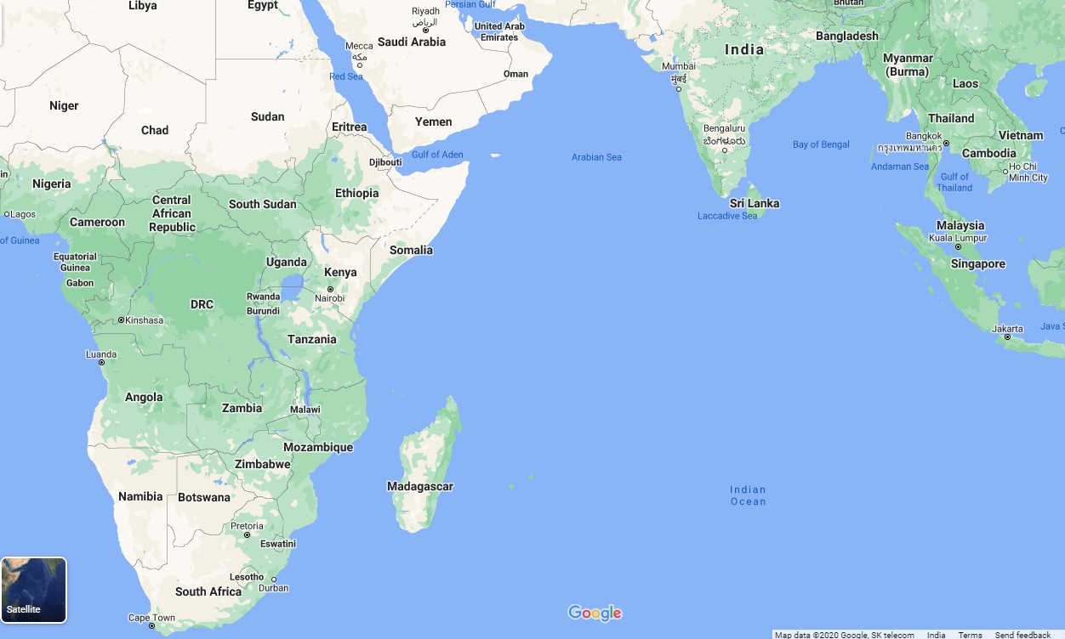
International customers

Slide 8
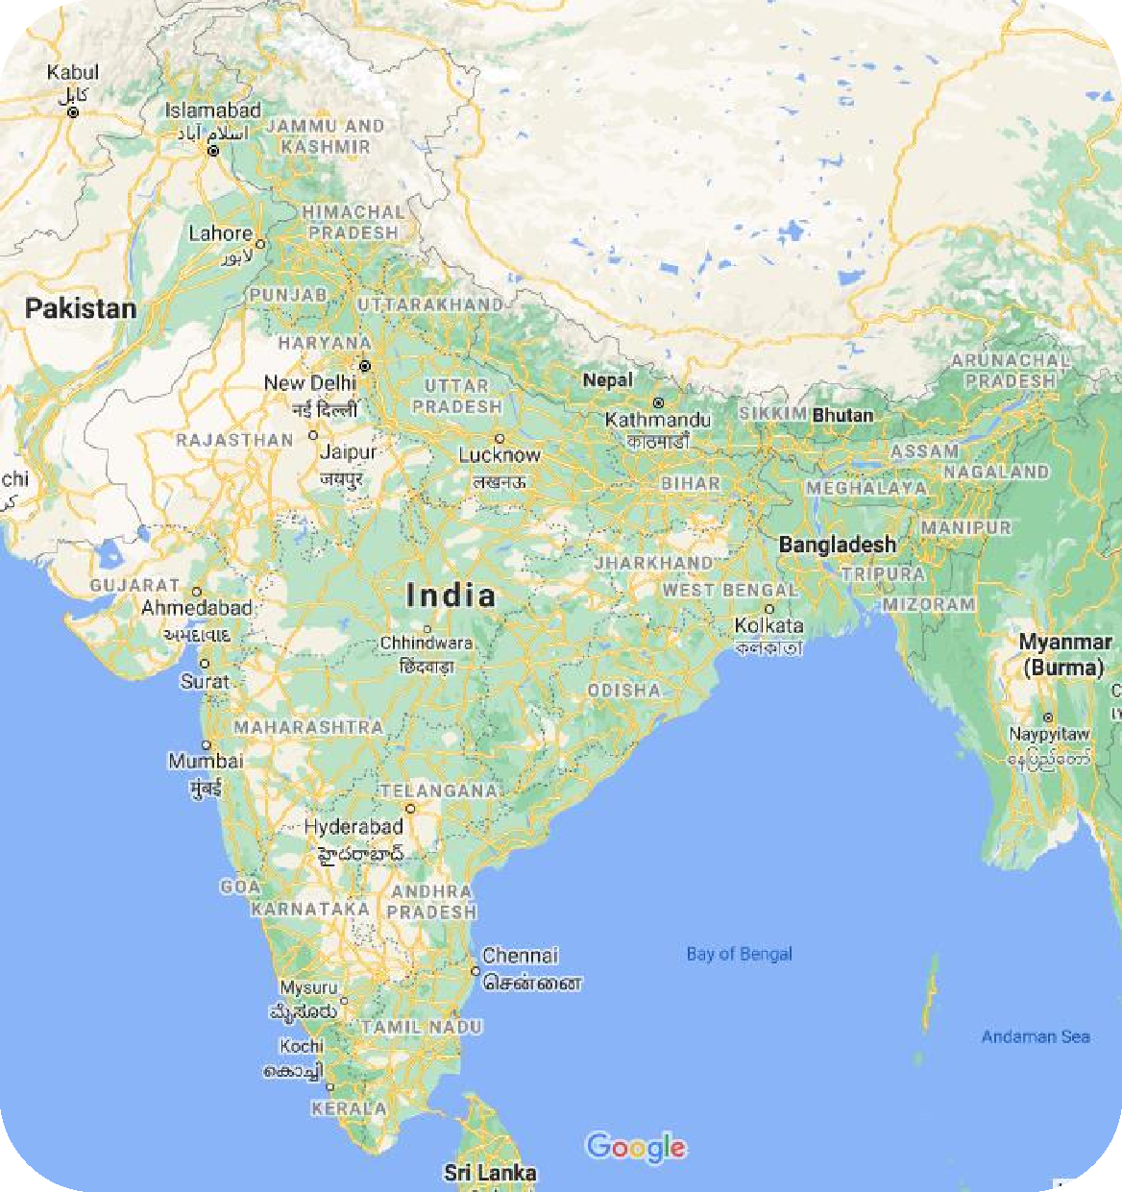
Major Customer Locations
Industrial : Genus Energy Meters. Automotive : Denso, Minda, Pricol, Magnetic Marelli, Delphi, Maruthi subcons
EMS : TITAN
Automotive : Varroc , Minda, Kinetic , Johnson controls, Hyundai Mobis
Major EMS & OEMs Computer : Dell Consumer : Samsung
EMS : Sanmina, Salcomp, Flex
Automotive : Visteon,

Slide 9
Sectors we serve
Aerospace
Automotive
Automotive Electronics
Battery/UPS/Stabilizer/Inverter
Communication Systems
Defence
Electronics
Electricals
Public Sector
Radiators
Solar Energy
Transformers
Wiring Harness

Slide 10
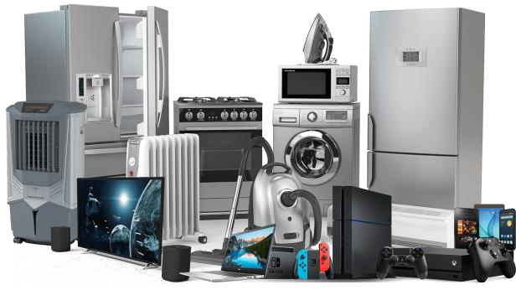

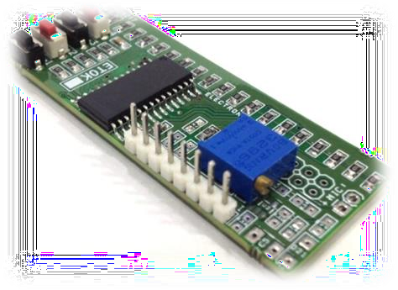
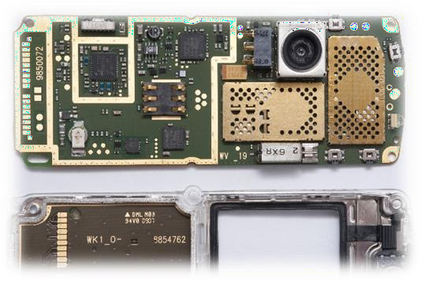

Major Segments
Consumer Electronics
Automotive Electronics
Telecom / Mobile Phone
Industrial
Lighting
Electronic Mfg. Services

Slide 11
Product Portfolio
Solder wires
Solder Paste
Solder Bar
Anodes
Flux
Cleaners
Solder Boosters
Leaded
Leaded
Leaded
Tin
P Flux
CS- MK
Solder Plus
Lead free
Lead free
Lead free
Nickel
BGA Flux
CS-AT
Dross Red Powder
Zinc
NC Flux
Bi-sol
Dross red Granules
Rosin
Al Flux SS Flux WS Flux
Tinning
Flux

Slide 12
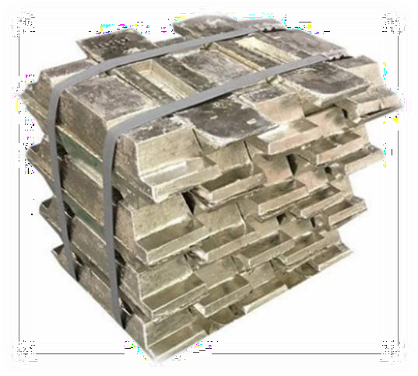
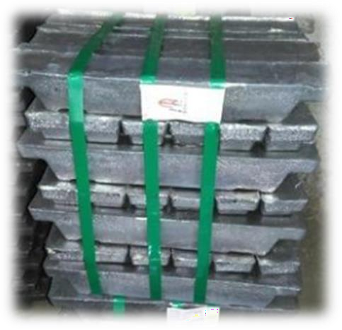
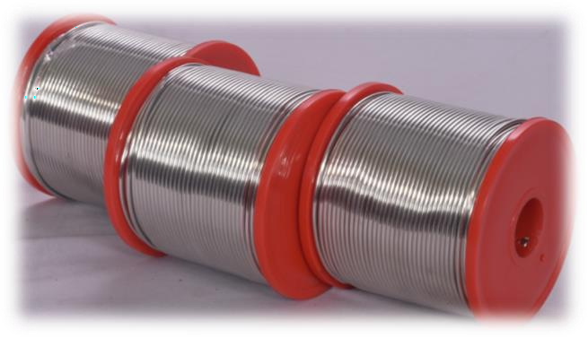
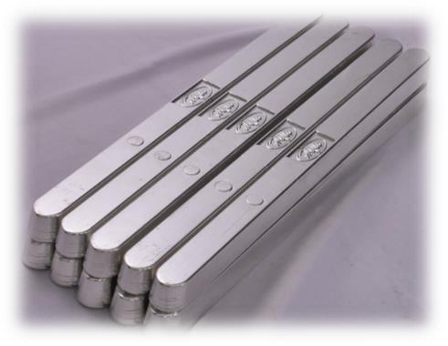
Products Made at Hiflo
Tin Ingots
Lead Ingots
Leaded Bar / Wire
Sn10Pb90 Sn20Pb80 Sn30Pb70 Sn40Pb60 Sn50Pb50 Sn60Pb40 Sn63Pb37 Sn70Pb30 Sn80Pb20 Sn90Pb10

Slide 13
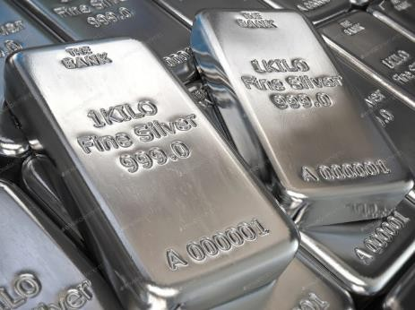
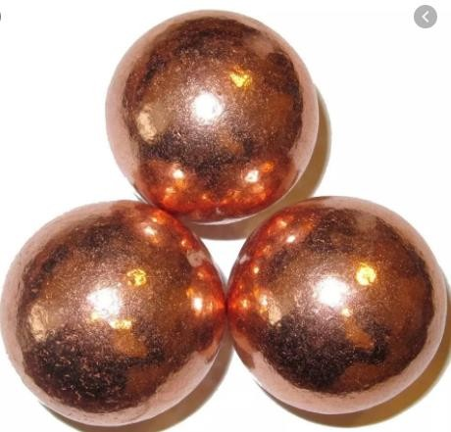
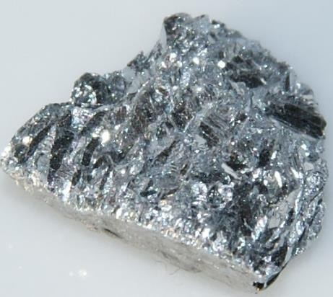


Products Made at Hiflo
Ag / Cu / Sb
Tin Ingots
Lead Free Bar / Wire
SAC0307 SAC305 SAC387 SAC405 Sn97Cu3 Sn96Ag4 Sn99.3Cu0.7 Sn96.5Ag3.5 Sn96.85Ag3.15 Sn95Sb5
Ag - Silver
Cu - Copper Sb - Antimony

Slide 14
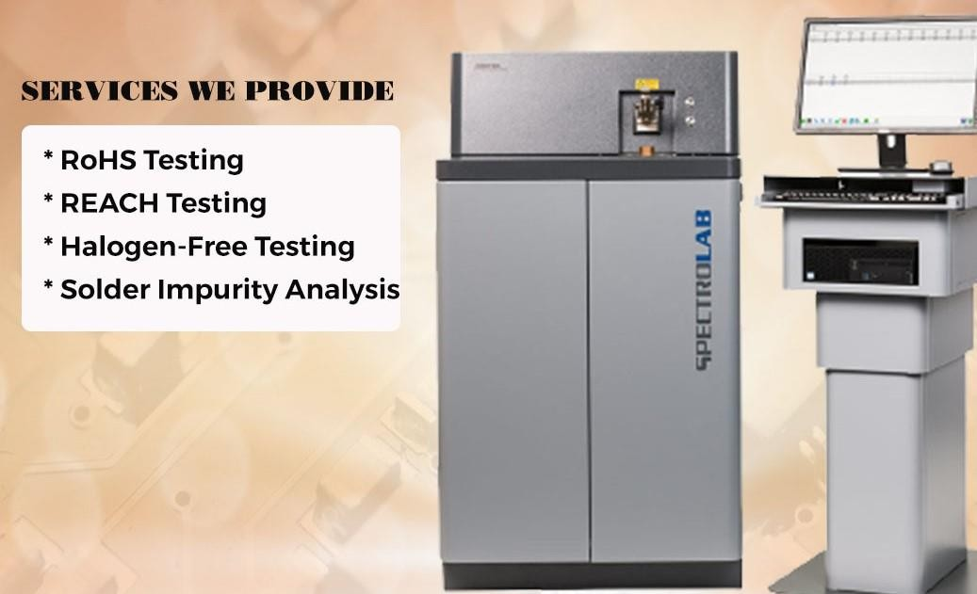
State of the art testing Equipment

Slide 15

Dross Reprocessing Services

Slide 16
Why Hiflo ?
Meets the highest industry standards
Help customers to meet process challenges
Provide the lowest cost of ownership
Superior value by providing differentiated products, services and support.
Green Initiatives – collection of Waste - Dross

Slide 17
www.hiflosolders.com

