Slide 1



Your Gateway to India's Electronic Components Market
Ortecs India
An Overview
WWW.ORTECS.COM

Slide 2

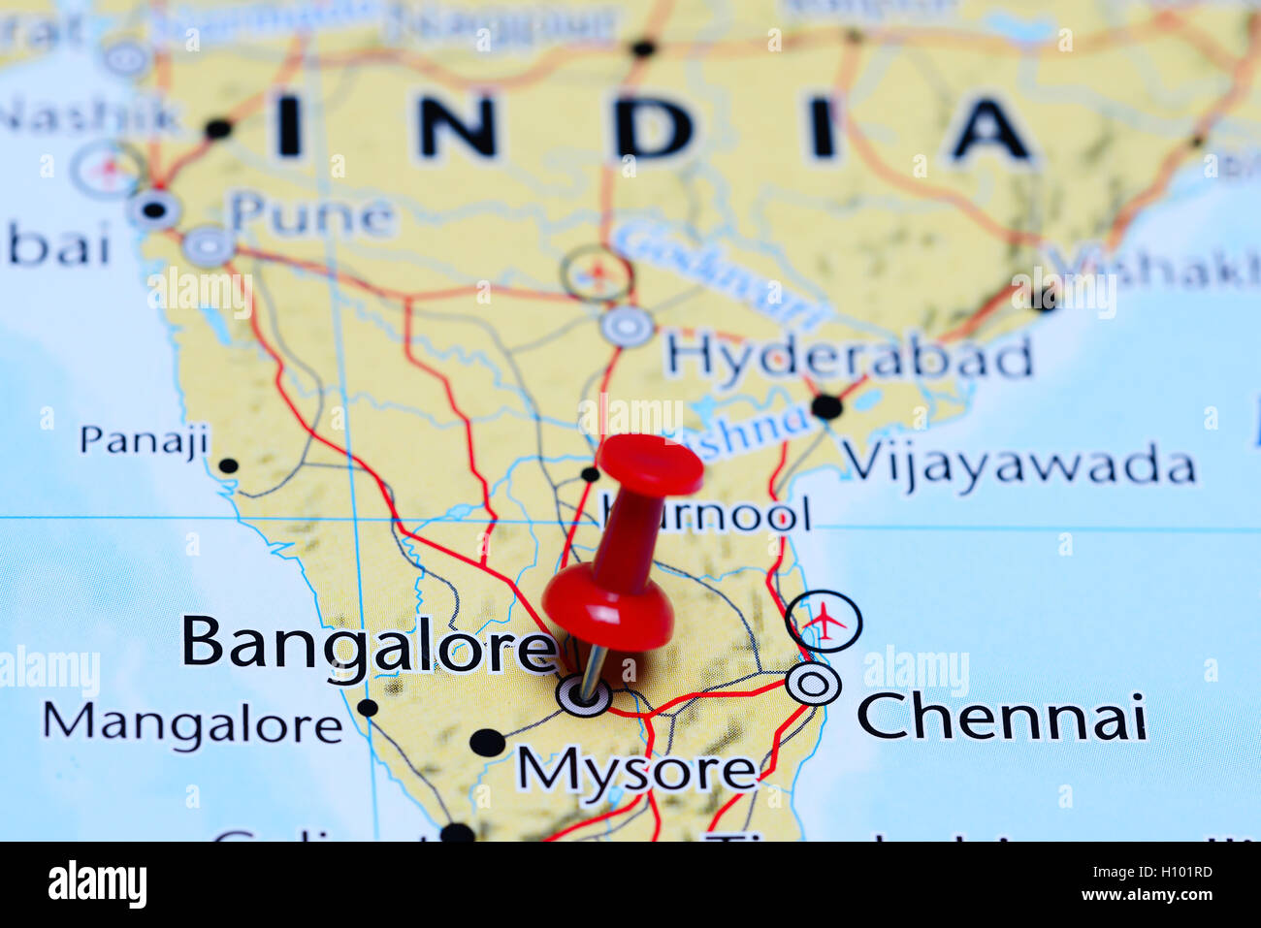
FORAY INTO THE INDIAN MARKET
  Ortecs entered into the Indian market in 2015 to originally support RAFAEL and their sub-contractors in the India region.
  Since then Ortecs India have developed a strong customer base covering different segments of the Indian market.
  The India headquarters is located in Bangalore which is the center of India’s high-tech industry.
  India being among the fastest growing economies of the world, Ortecs considers this market to be of strategic importance and has seen tremendous growth in business in the past several years.
  Ortecs India is an independent division with it’s dedicated Technical, Sales, Purchasing and logistics teams able to provide standalone support to our Indian customers.

Slide 3

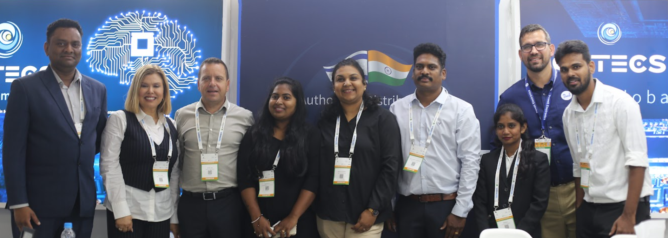
The Dynamic India Team
In-house capabilities of our India team includes sales, technical support, design-in, sourcing, purchasing, customer support and logistics.
Cross functional experienced team from well-known players in the distribution segment.
We have the right mix of experienced and upcoming young professionals which makes for a dynamic well rounded team to support our customers for the India region.
50+ Years of combined experience
Diverse cross functional team
Geographical coverage across India

Slide 4

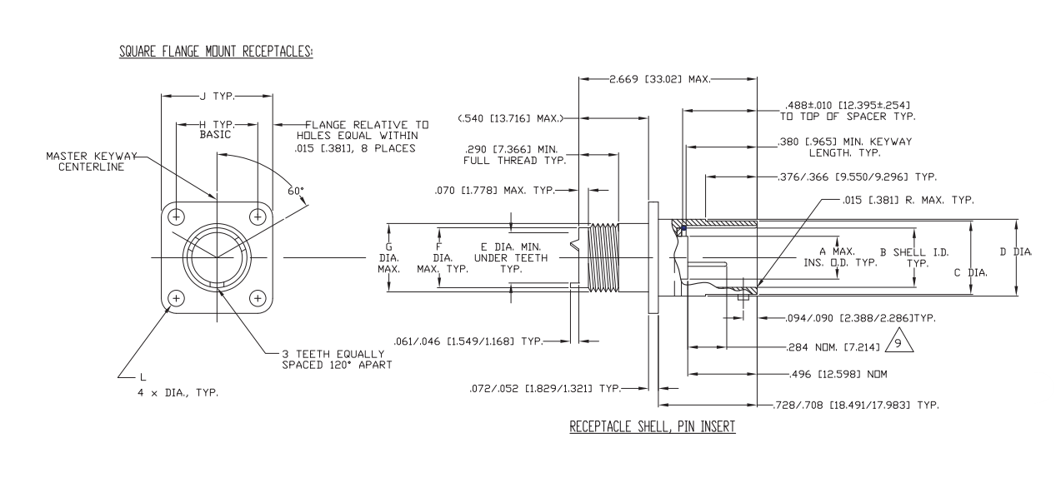
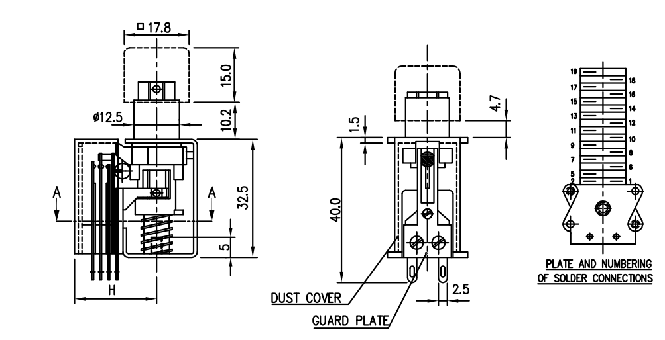
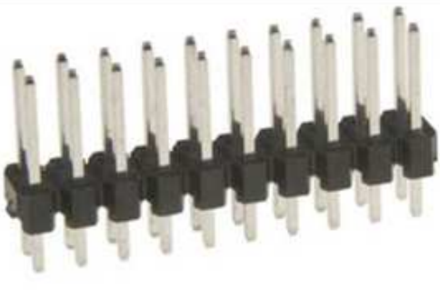
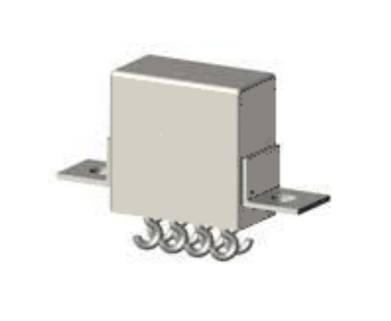
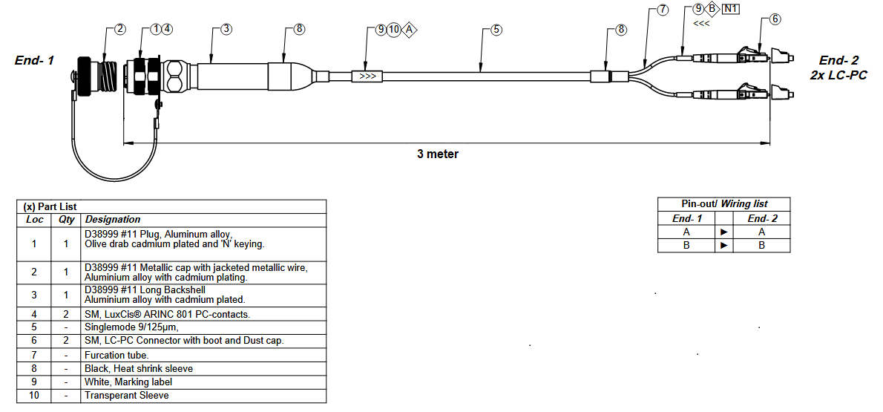
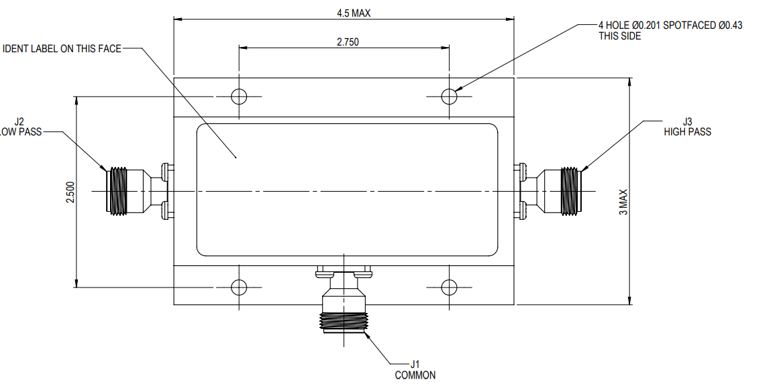
DESIGN-IN SUCCESS STORIES IN INDIA
Connector with High Speed contacts
PCB HEADER with customer testing requirements
REED Switch
Hermetically Sealed relays
Fiber Optic Cable Assembly
RF Diplexer
Team Israel
Team India
Team Philippines
Team USA
FAE, Sales & Logistics-16
Logistics
Sales & Marketing-2

Slide 5
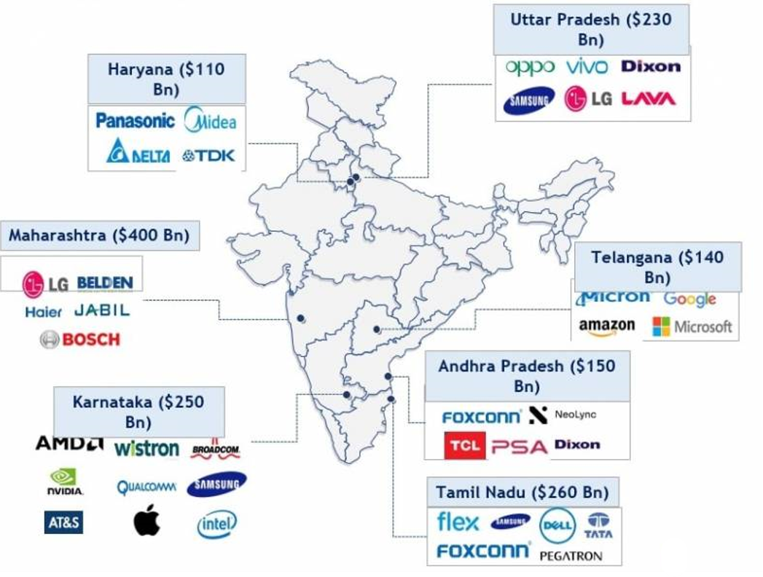
Why India?
Electronics Design and Manufacturing Growth Hub
$155 Billion Market for Electronics
  India continues to remain a growing market for electronics due to increased digitization through rollout of 5G, industrial use of IoT, rise in disposable income and the availability of affordable products has leading to increased penetration.
Growing EMS & Components Opportunity
  India houses 550+ EMS players engaging in OEM and ODM services. This will easily allow backward integration, robust supply chain creation and enhanced production efficiencies.
Improving Infrastructure
    The National Infrastructure Pipeline (NIP) is a first-of-its-kind exercise to build world-class infrastructure across roads, railways, airports, energy, etc. with a total investment plan USD 1.4 Trillion by 2025 to make India an economic powerhouse.

Slide 6
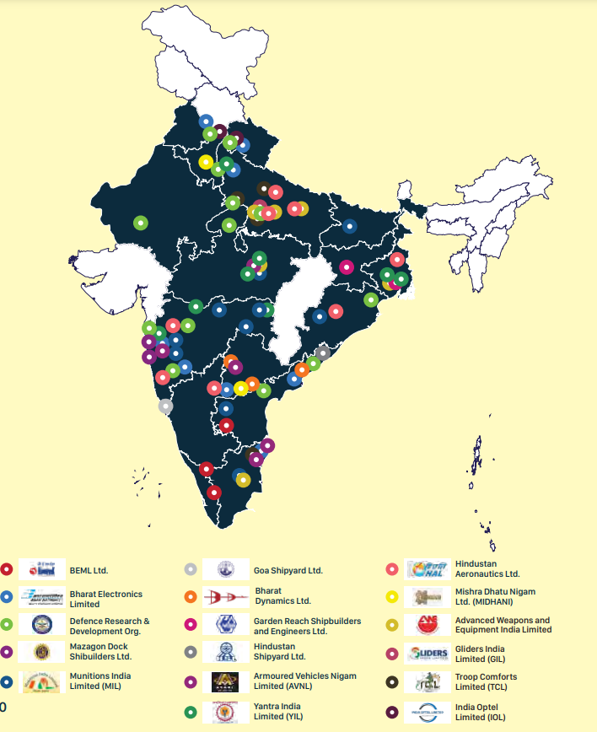
Why India?
4th Largest Defense Spender in the World
India contributes 3.7% to the total global military expenditure. $72.6 Billion allocated in 2023-24.
2nd largest armed force in the world (1.45 million active personnel)
$1.9 Billion worth of exports in 2023. 10x growth since 2016.
Export target of $5 Billion by 2025.

Slide 7
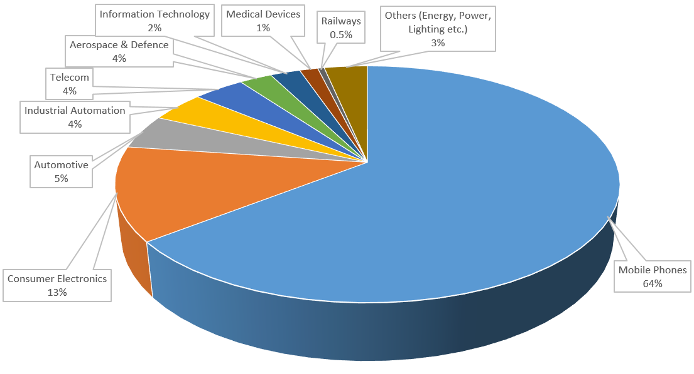
INDIAN COMPONENT MARKET – TAM $45 Billion
Source: Frost & Sullivan ESDM Market report 2022

Slide 8


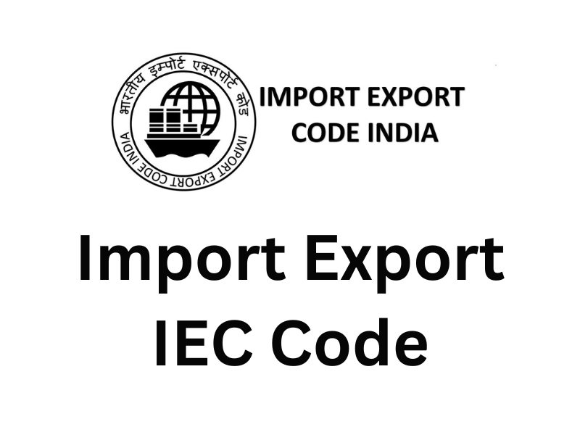
Ortecs Electronics India Private Ltd
Ortecs Electronics India Private Limited is registered in India and fully compliant with local tax laws to do business in India and support our customers with local INR and international currencies as per request.
Ortecs India ensures valid import-export license to ensure seamless import and export of goods for our customers. The logistics team is well versed in navigating the complex customs regulations.
Following are the compliance information for reference:
  GST : 29AACCO2376E1ZF
  CIN : U72200KA2015PTC084363
  PAN : AACCO2376E
  TAN : BLRO05084C
  IEC : 0716902109

Slide 9





Supplier Network in India
As a part of its extensive global supplier network, Ortecs partners with high quality manufacturers in India to provide the innovative solutions for our customers.
Ortecs ensure regular audits, training and close collaboration with our suppliers to ensure the highest quality products for our customers.
Manufacturers carry industry leading certifications: UL, IEC, ISO 9001: 2015, ISO 13485: 2016, AS9100 etc.

Slide 10






















OUR LEADING CUSTOMER IN INDIA

Slide 11

THANKS FOR LISTENING

