Slide 1


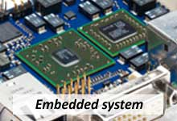
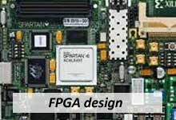
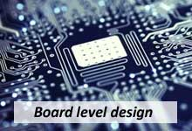
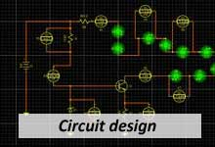
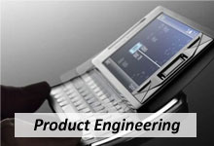

Bharat Avionics Pvt Ltd.
ISO 9001 -2008 Certified
- Presentation on company profile
info@bharatavionics.com
www.bharatavionics.com

Slide 2














About us
We the pioneers in the field of Avionics and Industrial solutions, We offer Avionics Design, Development, Software, Hardware and Embedded systems, sourcing solutions of Global Components for aerospace and military.
ISO 9001 -2008 Certified Company
info@bharatavionics.com

Slide 3
Embedded System services
We offer design services in embedded system on Android, Linux, QNX, Windows or RTOS, BSP, Drivers, Middleware and GUI.
» Android based product development – Mobile Phones, Tablets, Automotive, and Consumer Electronics
» Optimized Android development for tablets and portable devices
» Linux Bootloader, Kernel Optimizations
» Windows Device Drivers: Storage, Multimedia, Networking, Avionics
» WindRiver VxWorks drivers and application development
» uCLInux drivers and application development
» USB Host & Slave, SD/MMC, CD
» Sound, LCD, Keypad, Touch Screen (Resistive and Capacitive)
» Drivers and application for I2C, I2S, SPDIF, UART, Ethernet, SPI Interfaces
info@bharatavionics.com

Slide 4
FPGA Design services
The following FPGA design services are available individually or as parts of a turnkey FPGA design services
» Problem/requirements analysis, vendor selection
» Behavioral model design
» RTL (Verilog or VHDL) design
» RTL verification
» Logic synthesis
» Implementation
» Static timing analysis
» Bit stream generation
info@bharatavionics.com

Slide 5
Board Level Design services
We provide a complete and comprehensive turnkey design solution for board level designs. Specializing in high speed design and layout technologies.
» Design and Schematic Capture
» Signal Integrity
» System/Board Level Functional Simulation
» Impedance Controlled Layout
» Design for Test
» PCB Manufacture and Assembly
Circuit Design services
» Power supply design for ICs and Boards
» ADC, DAC, VCO, Op-amp, PLL based design
» Digital Circuit design
» Analog and Mixed signal design
info@bharatavionics.com

Slide 6
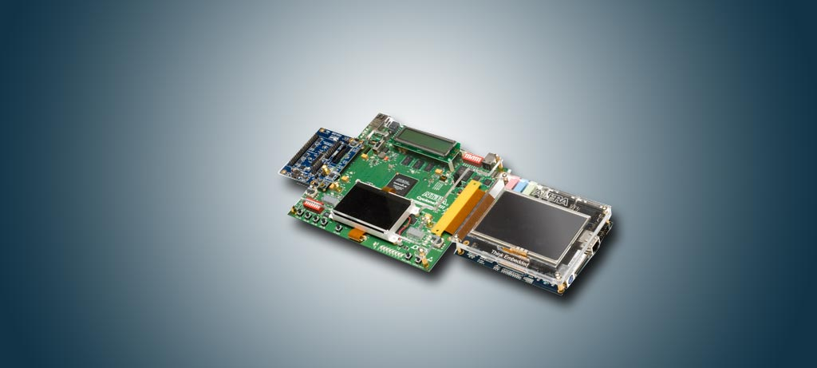
Product Engineering services
We have expertise in electronic product design (hardware + software development) and we provide one stop solution from prototype to production. We leverage reference designs of our own as well as from IC vendors to reduce your cost and time to market.
Our Expertise in Product Engineering
» System Architecture
» Hardware Design and Schematic Capture
» BOM Optimization
» Multi-Layer High Speed PCB Design
» Design Simulation/Analysis – SI, Thermal, MTBF
» Production and Support
» Embedded Software using Android, Linux, Windows, RTOS, BSP / Drivers
» Application Software including GUI development using Visual C++, Labview
» Bring up and Integration Testing
» Prototype Manufacturing using local partners
» Post Release, Production Support and Maintenance Support
info@bharatavionics.com

Slide 7
Our Technical Expertise
HDL, HVL, Methodology | VHDL, Verilog, System Verilog, System C, UVM
Operating System / Programming Languages | Linux, Android, RT Linux / C, C++, Assembly, VC++, Java, DotNet, PHP
Processor /Controllers | ARM cortex M3, ARM9, PIC Microcontrollers, 8051 , Microblaze, PowerPC
FPGA | Kintex 7, Spartan 6, Spartan 3, Cyclone 4, Stratix 4, ProASIC
Development Tools | Keil, Labview, Visual Studio, Eclipse
EDA Tools | Xilinx ISE, Quartus, Modelsim, Synplify Pro, Libero IDE, Orcad, CADSTAR
Memory, Protocols & Interfaces | DDRAM3, SDRAM, Serial EEPROM, Parallel EEPROM, SRAM PCI Express, PCI, Ethernet, VME, CPCI PCM, AMBA- AHB,APB , I2C, SPI, UART, USB Digibus, Mil Std 1553B, Graphics LCD,
Standards and Certifications | Experienced in ISO 9001, AS9100 REV C, CEMILAC processes and standards
info@bharatavionics.com

Slide 8
Products
Loud Speaking Telephone System for Military
Portable Fuel Tank Monitor System for Tejas - ADA
Data Acquisition Modules for ADA
Communication Modules
Power Supply Modules BEL
Test Jigs & Rigs
Airborne Systems
Ground Support Systems
RF controller board for BEL, Ghaziabad
Stabilizer system for BEL
info@bharatavionics.com

Slide 9
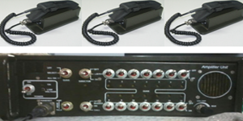
Loud Speaking Telephone System
LSTS is designed and developed to cater for wired voice communication between the Commandant and his battalion with multiple gun posts. The commander will be able to communicate with either one specific post or multiple posts or with all the posts at any point of time. The commander will be able to communicate to 14 such locations and one director gun post for monitoring over a distance of 1000 meters i.e 1Km.
Specification
Operating Voltage 20VDC to 28VDC
Operating current 0.5 to 4.5A
Calling Range Upto 1km
Frequency Response +/- 2dB variation
Sensitivity : 30mV&plusmn;10mV at s supply voltage of 24V DC
Harmonic Distortion =7%
Audio input voltage range 5m V rms to 50 m Vrms
info@bharatavionics.com

Slide 10
Software
PCM Decommutation Software in LabView
VxWorks Application for Airborne Application
Digibus Data Analysis software for PCM
Graphics LCD Application for Fuel tank monitor
PCM Decommutation Software in VC++
Windows & Linux Device Driver for PCI – PCM Encoder
VC++ Application for Electro Mechanical System for Indian Airforce Radar
info@bharatavionics.com

Slide 11
Current Activities
GPS Tracking system for Vehicle Tracking Application
Android based Building Security System
RAISEC Reengineering for RBI
Mil Std 1553B PCI Card Development for ADE
Optical Encoder for Object Detection in Military Tanks
info@bharatavionics.com

Slide 12

Thank You
Bharat Avionics Private Limited
Registered Office :
#601A, 11th cross, 5th Main Road,
Agrahara Layout, Yelahanka,
Bengaluru - 560 064.
Ph: 080 6565 7900,
Fax : 080 2846 2772
Email : info@bharatavionics.com
bharatavionics@gmail.com
info@bharatavionics.com

