Slide 1



Slide 2

ABOUT YANTRA
Yantra Engineering Service,
We are Flexible & Scalable Manufacturing service providing small batch production / large volume production.
We Manufacture with the help of a growing network of suppliers & bring speed in the manufacturing process.
We also Provide full site of manufacture service to the customers to reduce the cost, improve quality, manage inventory & time.
MISSION
To provide exceptional parts manufacturing and commitment with best services tailored to the unique needs of our clients, delivering superior quality products, fostering long-lasting partnerships, and contributing to the advancement of industries and a greener future.
VISION
To be a globally recognized and preferred manufacturing partner, driving innovation and sustainable solutions, empowering industries to thrive and create a positive impact on the world.

Slide 3
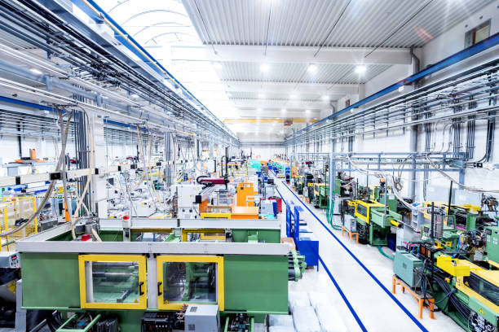
OUR CAPABILITIES
REVERSE ENGINEERING
INJECTION MOULDING
TOOL & DIE MANUFACTURING
SHEET METAL FABRICATION
DESIGN & DEVELOPMENT
CUSTOM PACKAGING SOLUTION
ALUMINIUM DIE CASTING
PRECISION PARTS

Slide 4
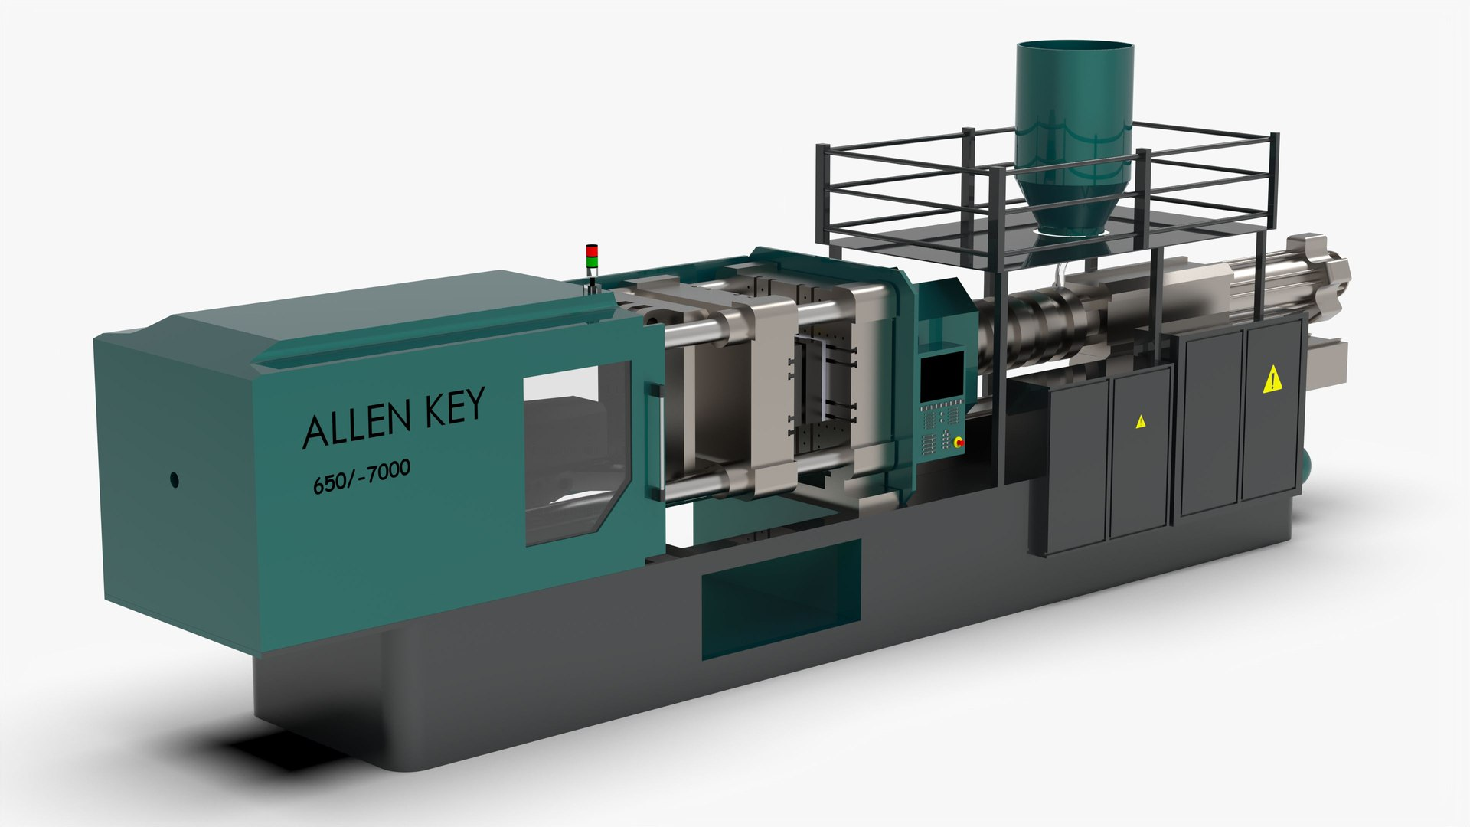
OUR INDUSTRY SERVICE
Consumer Electronics
Automotive Industry
Electronics Industry
Solar Industry
Injection Molded Phone Cases: Stylish and protective cases for smart phones and tablets.
Consumer Electronics Housings: Customized enclosures for various consumer electronic devices.
Injection Molded Automotive Interior Parts: Customized interior components like dashboard panels and console covers.
Automotive Lighting Housings: Durable housings for automotive headlights and taillights.
Electronic Enclosures: Protective casings for electronic devices and equipment.
Injection Molded Connectors: Reliable connectors for seamless electronic connectivity.
Solar Panel Mounts: Sturdy mounts for securing solar panels in solar energy systems.
Solar Panel Frame Components: Precision molded parts for solar panel assembly.

Slide 5
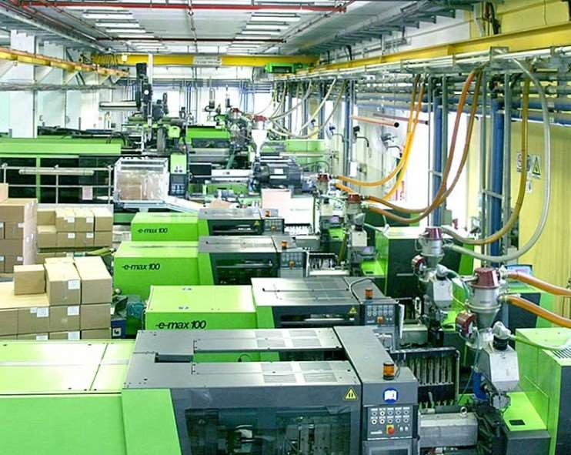
MANUFACTURING FACILITIES
Sl. No | Machine Make | Tonnage
1 | YIZUMI | 90T
2 | HAITIAN | 90T
3 | MILACRON | 100T
4 | MILACRON | 120T
5 | YEUN CHENN | 140T
6 | MILACRON | 150T
7 | YIZUMI | 160T
8 | MILACRON | 180T
9 | HAITIAN | 200T
10 | MILACRON | 250T
11 | YIZUMI | 260T
12 | YEUN CHENN | 400T

Slide 6
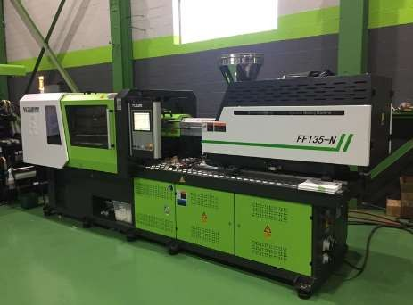
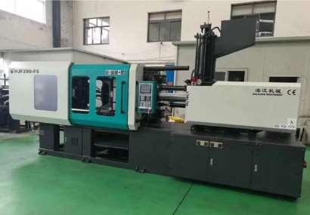
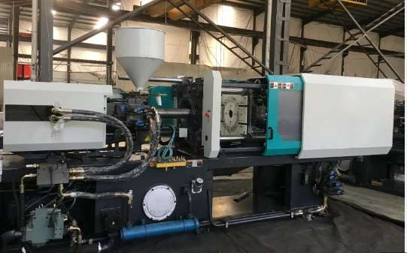
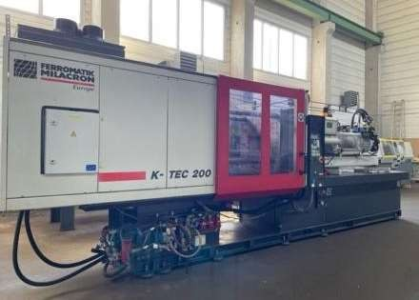
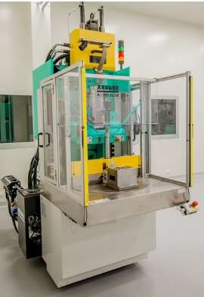
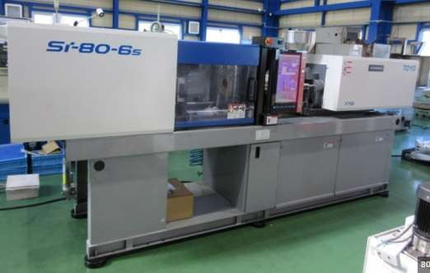
MANUFACTURING FACILITIES

Slide 7
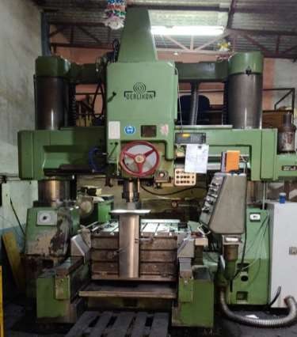
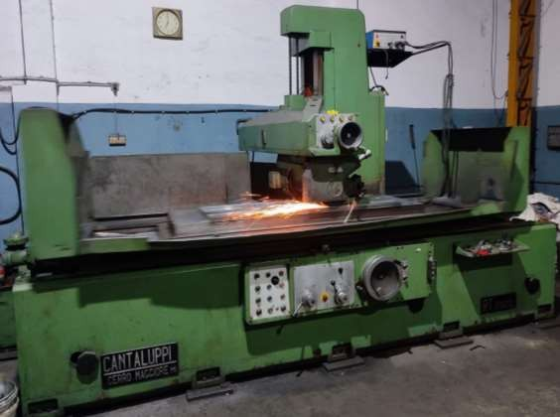
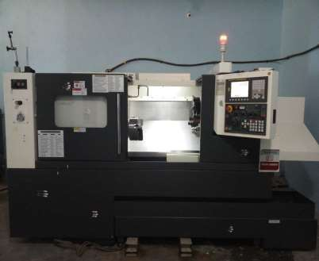
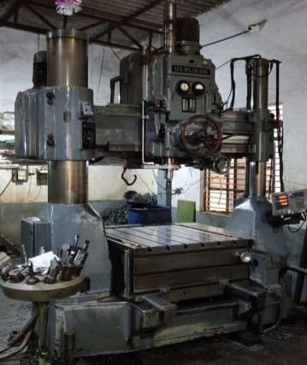
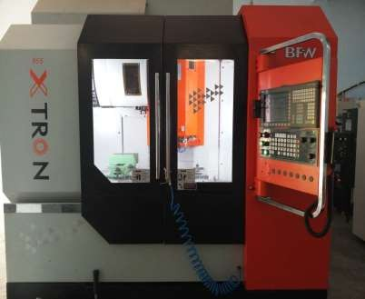
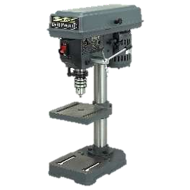
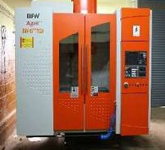
TOOLING FACILITIES
Conventional Milling
Surface Grinding
CNC
Conventional Milling
VMC
Drilling Machine
VMC

Slide 8
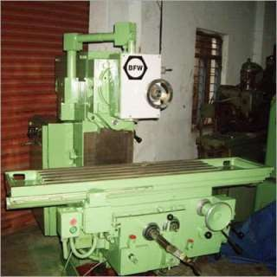
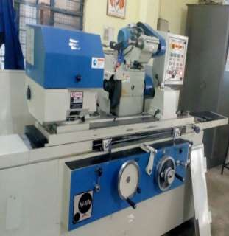
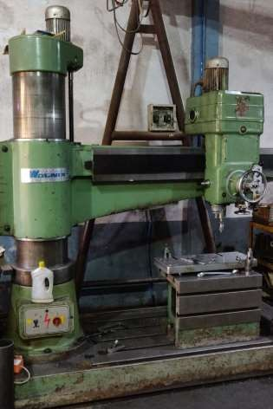
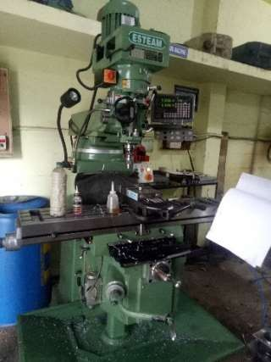
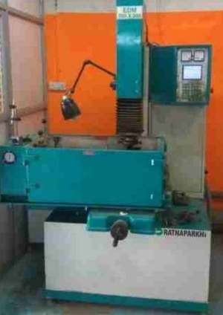
TOOLING FACILITIES
Surface Grinding Machine
Cylindrical Grinding
Drilling Machine
Milling Machine
Sparking Machine

Slide 9

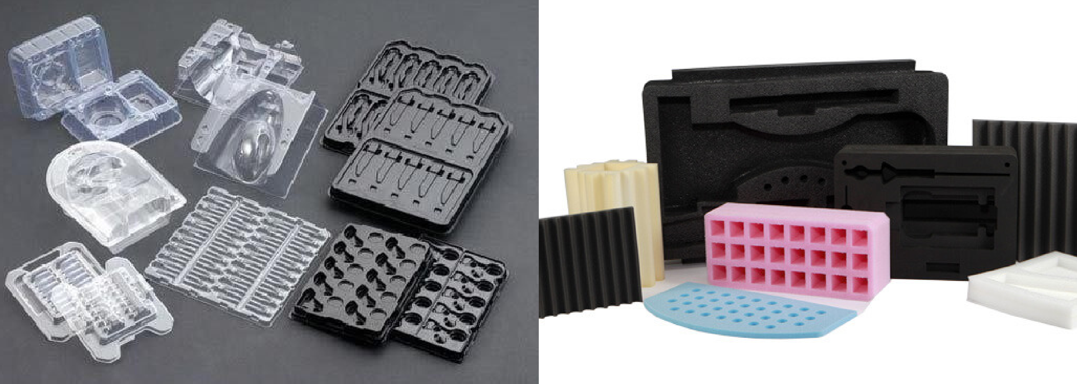
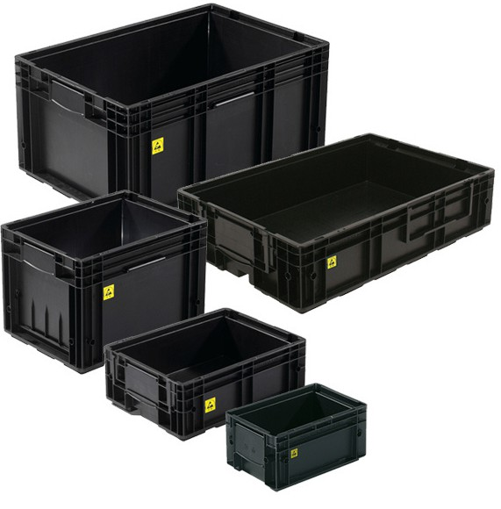

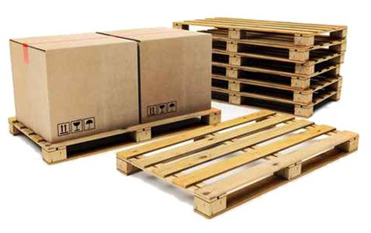

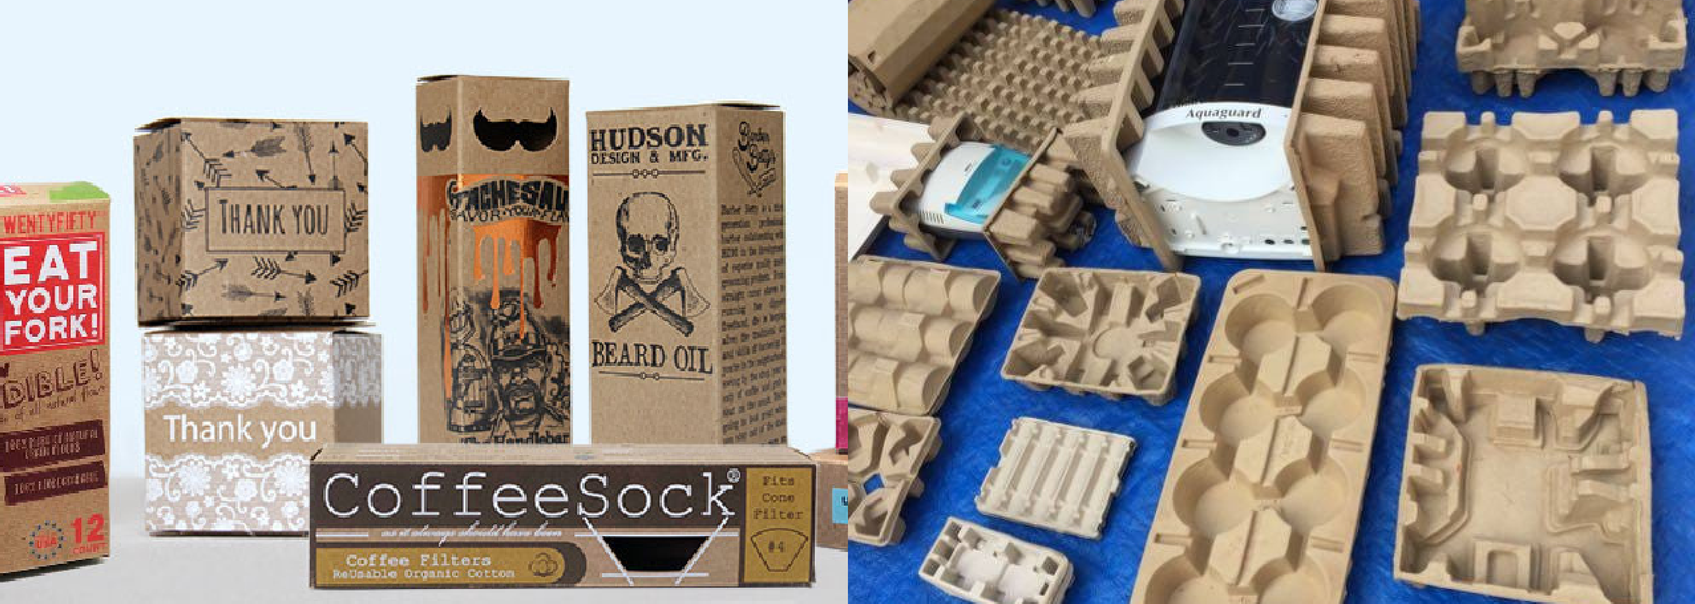
PACKAGING SOLUTION
Corrugated Box Packaging
Blister Packaging
Foam Packaging
ESD Packing and Bins
Brand Packaging
Pallets, Labels, Bubble Pouches, and More
Pulp Packing

Slide 10
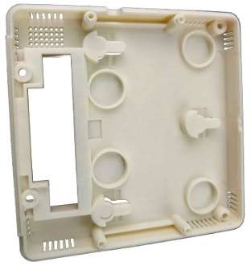
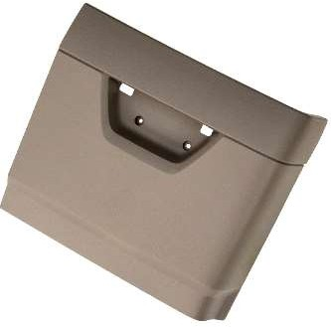
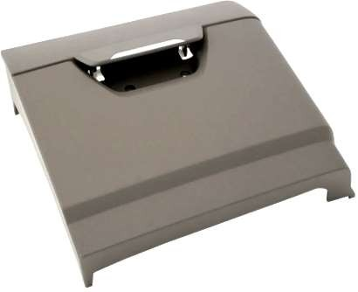
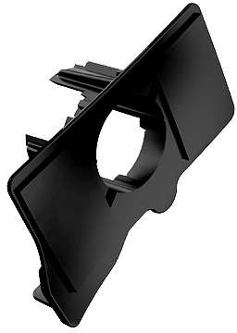
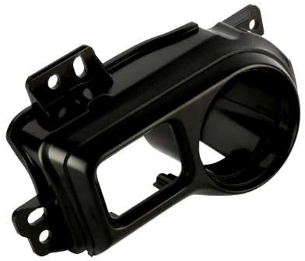
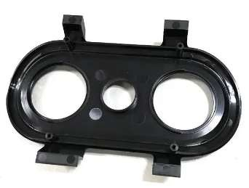
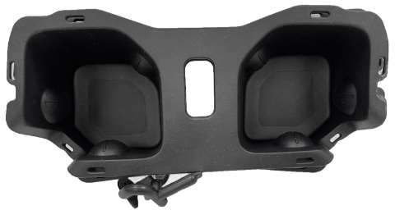
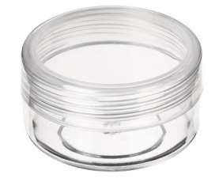
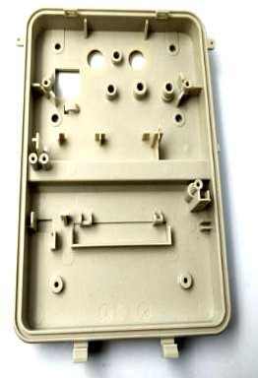
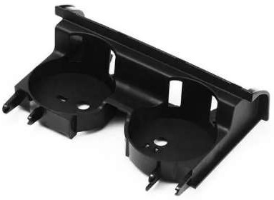
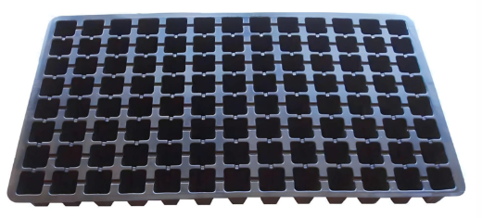
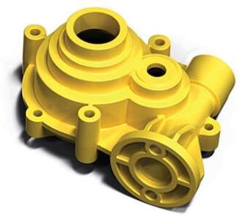

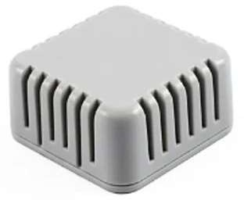
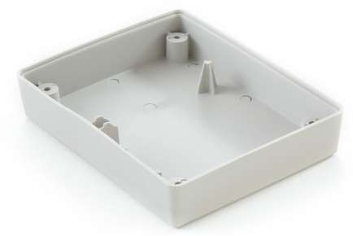
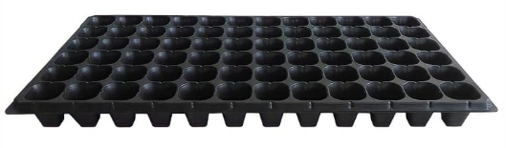
PRODUCT - PLASTIC

Slide 11
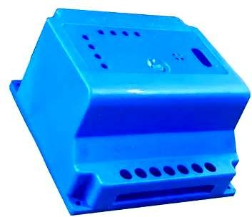
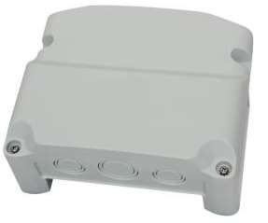
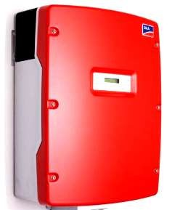
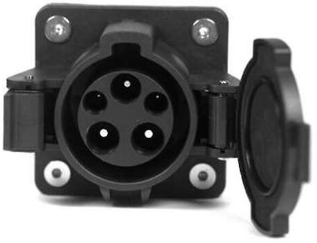
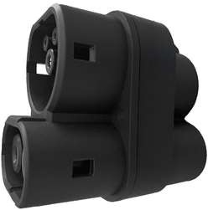
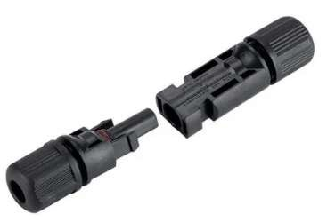
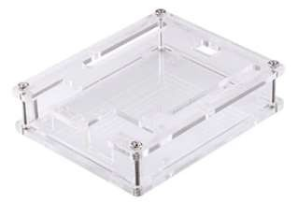
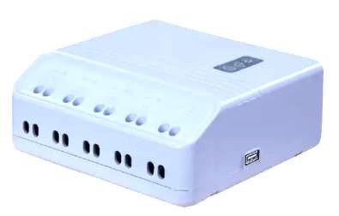
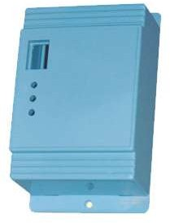
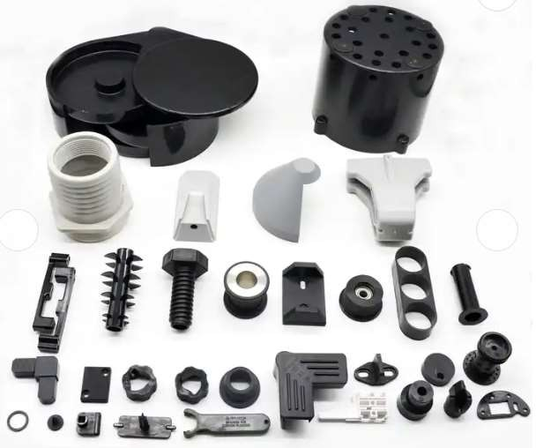





PRODUCT - PLASTIC

Slide 12















PRODUCT - PLASTIC

Slide 13















PRODUCT – SHEET METAL & BUS BAR

Slide 14




OUR CLIENTS

Slide 15

CONTACT DETAILS
CALL US :
+91 8550864945, 8073244458
EMAIL : info.yantraes@gmail.com
OFFICE ADDRESS :
No 51 Ajjavara, Nandi Village
Chikkaballapur Karnataka 562101
COMMUNICATION ADDRESS :
Near SLV Sapphire Flats
HT Line Road, Kereguddadahalli, Abbigere Bengaluru, Karnataka 560090
Thank YOU

