Slide 1




Slide 2
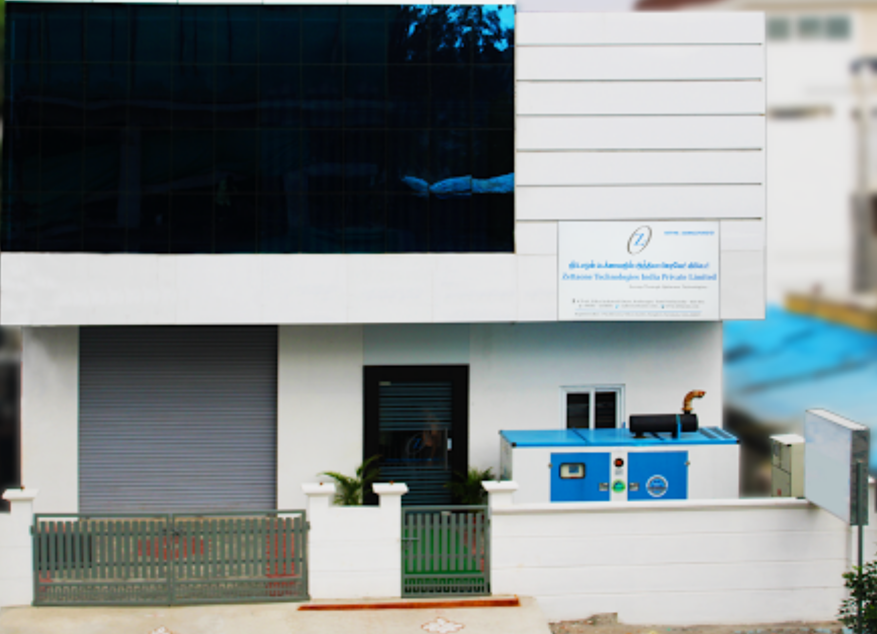
Company Overview
Design, Build and Test Under One Roof
Since 2007
An end-to-end system engineering company providing design and manufacturing services
A true SINGLE stop for your ED&M needs
Zettaone is adept at developing customized product solutions for versatile industry needs. Portfolio ranges from complex system level solutions to module-based solutions for Industrial, Automotive, Telecom and Consumer applications.
Zettaone is proficient and experienced to transform your ideas to design and build with prototypes, validation, testing and mass production.
The ZettaOne Difference
15+ Years in the Industry
250+ Professionals
Agile Practices, Competent, Competitive, Flexible and Open
200+ Trusted clients around the globe
Global Footprint
Copyright © 2022 Zettaone Technologies

Slide 3






Why Zettaone ?
One Stop Shop for
Design, Dev, Source, Build, Delivery
Quick Turn Around
Design to Manufacturing
R&D Company
Supporting End-End Product Delivery
Single vendor for your Design, Dev Sourcing, Rapid Proto and Manufacturing requirements
State of the art machine , Skilled & certified resources, integrated supply chain, ERP system, licensed tools
Our team of R&D Team supports right from initial concept to production-ready solutions
Lower Program risk
Cost efficiency
Time to market
Turn around time – 3 Weeks
No MOQ
Transparent BOM
Alternate sourcing
Accelerated design realisation
Design for Manufacturing and Testing (DFx) and scaling for M.P
Six Sigma yield
Requirement
Design
Develop
Source
Build
Ship
Copyright © 2022 Zettaone Technologies
3
Notes:
Data flow control

Slide 4






Our Portfolio
Tier 3 :
Complete Product Development & Manufacturing
End to End Solution & Support
Tier 2:
Product Engineering Services
Product Engineering – Technical Architecture, Project mgt.
Manufacturing Support
Tier 1:
Point to Point Services
Hardware System & PCB Design with SI-PI/DFx Analysis)
Firmware, Software & Web Application
Mechanical Design & Thermal Analysis Reliability
Testing & Certification
Electronic
Manufacturing
Service
Product Testing & Packaging
Industries Served
IOT
Industrial
Automotive
Telecom
Semiconductor
Aero & Defense

Slide 5
Hardware Expertise
Hardware Design Expertise- Complex board designs
Microcontrollers & Processors
  STM32, ESP32, TI MSP430, TI OMAP, TI DRA77X , NXP LPC , NxP Cold fire, Microchip PIC 8/16/32, AT-SAM, Tensilica
  NxP iMx6,8 , ExOR-SOM
  MIPS, ARM, Power PC & Multicore SOCs
Peripheral’s components & interface
  NAND Flash, NOR Flash, DDRx, RS232/RS422, Multiple Sensors (Temp, Pressure, Gas, Light, Sound etc.)
Power Products
  AC/DC/USB Powered, Battery operated low power circuits, upto 500W
Communication Protocols
  UART,QSPI,SPI, IxC,I2S, CAN, MODBUS, PCIe, USB, PCI/PCIe, SRIO, USB, LPC, SMBUS, SPI, VME , PECI
Network protocols - Modbus TCP/RTU, UDP, TCP/IP, DHCP
Wireless protocol - Wi-Fi, Bluetooth, BLE, ZigBee
Industry Protocols
  Ethernet, GSM (2G/3G/4G), GPS, Wired/Wireless HART, Thread, ZWave, Zigbee & OCF
Wired and Wireless protocol
Zettaone Technologies is an
ISO certified system design to manufacturing services company helping Original Equipment Manufacturers (OEM), Original Device Manufactures (ODM) and Innovators to bring their ideas to certified products rapidly to market.
We offer Design services starting with a Proof of Concept to the production ready design with compliance approvals
Hardware Design Process
Architecture Design
Circuit Design , Board Design , Schematic capture, Schematic Modelling
Design FMEA
Custom Library Parts creation , PCB Layout Design, Gerber Generation
Modelling and Simulation -Signal Integrity Analysis (Pre and Post Layout), Power Integrity (Pre and Post Layout) Analysis, Thermal Analysis
Fabrication Release , Board bring ups with Diags and OS
Precompliance, Compliance – EMI/c, Safety tests , Shock and Vib Lab's qualification
Proto EVT/DVT , Pilots, Mass Production , Field Trials
Copyright © 2022 Zettaone Technologies

Slide 6
FPGA Expertise
FPGA Design Expertise
Serial Protocols UART, SPI and I2C.
High speed Serial Protocols like PCIe and Ethernet Protocol Controller IP
DO-254 Safety Standard in develop and testing the safety critical systems
VHDL Assertion based test bench with safety critical standards
Functional verification in compliance to standards.
FPGA custom HW Board Bring-up.
On-Chip High speed bus protocols - AHB, APB, AXI
Architectural Designing for signal processing applications using MATLAB (Simulink, System generator)
RTL Design & Coding and verifying at module level for RTL Sign Off.
Design Synthesis and STA Using GENUS and Tempus tools
- FPGA Used: Xilinx, Altera, Lattice, and Actel,
Device Famlies: Xilinx Spartan3, Spartan 3A DSP, Virtex4, Virtex6 and ZYNQ 7000 Series, Altera Max5, Max10, ARRIA10, Agilex FPGAs, Lattice FPGA, Cyclone 10 GX, Artix - 7
- EDA Tools: Xilinx (ISE, VIVADO), Altera Quartus Prime PRO, Lattice Diamond, Model SIM, SPY Glass (Linting, CDC), GENUS(Synthesis), Tempus (STA), Active HDL, Questa SIM, Xcelium (Cadence), SIM Vision
Hardware Descriptive Languages: VHDL, Verilog HDL, System Verilog
Interfaces & IPs
Interface | IP
Soft processor | Microblaze
Clock Input | Clocking wizard
DAC | AXI SPI
Sensors | AXI IIC
Transceivers | AXI UART
USB | AXI USB2.0
Digital I/O | AXI GPIO
LVDS / Differential Signals | Buffering
Memory | DDR3, LPDDR4 and DDR5
Booting Mechanisms | QSPI
Interfaces | Ethernet, SPI, I2C, UART, Backplane
Copyright © 2022 Zettaone Technologies

Slide 7
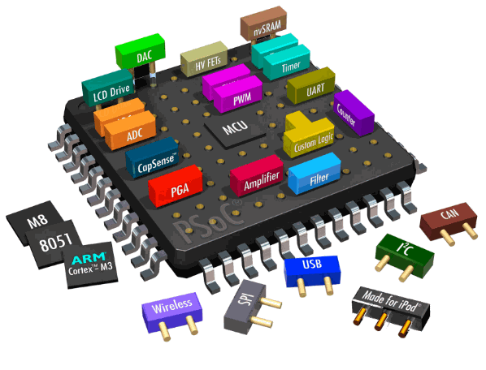













Firmware System Expertise
Firmware Development Experience ( Device driver/Boot loaders)
We program, update, and integrate embedded systems software including micro-controllers and processors, Our expertise includes
Microcontrollers, FPGA, System-on-Chip (SoC), Digital Signal Processing, Digital Light Processing, Micro-Electro-Mechanic Systems (MEMS), peripherals, ARM Cortex-M series, TI OMAP, Apple S1
Compact algorithms for programming Flash memories such as NAND & NOR
Boot loaders (like U-boot & UEFI)
Middleware Development Experience (Networking/IOT)
Wireless Mac development 802.11a/b/g/n, WLAN Linux and Windows drivers, Hostapd, Enterprise wireless solution & Access point solutions.
L2/L3 Roaming protocols such as ARP, UDP/TCP/IP/RTSF/OSPF
LTE/3GPP, Modem Stack, Connectivity Stack & Wireless customized solutions.
IoT specific protocols such as MQTT, LPWAN, CoAP & XMPP
Software Development Experience
OS - Embedded OS- Android, Linux, Free RTOS, MQX RTOS, VxWorks, pSOS, Quadros/RTXC
OS Porting - (Any OS l- Android or Linux or any other RTOS on ARM and MIPS architectures), device drivers, firmware & Linux Kernel modifications & optimizations
Cloud - Rest API, MQTT, Amazon AWS, Microsoft Azure cloud
Programming - C, C++, Python
Copyright © 2022 Zettaone Technologies

Slide 8














SW Applications Expertise
Technologies
Windows PC Application - Capability
Expertise in NodeJs, Angular, AngularJs, ReactJs, Express, Javascript, JQuery, ASP.Net, C#.Net, MySQL, MS SQL, MongoDB, NoSQL, SQLite, Python, Payment Gateways, .Net Framework, Java, Java Springboot, Microservices, Machine Learning, Predictive Maintenance, Scalable Solutions, Artificial Intelligence
Mobile Application - Capability
Expertise in Native application development using iOS and Android Platform, Flutter, IONIC Platforms, In-App Purchase, Payment Gateways, Wireless communications - Bluetooth, Wifi, NFC
Cloud Solution - Capability
Expertise in AWS – EC2, SQS, SES, IOTCore,Kinesis Data Stream,
Kinesis Firehose, IoT Events, SNS, Lambda, Aurora, Grafana, Redshift,
Quicksight, Glue, S3 bucket, S3 Landing, Lambda, IAM.
Expertise in Microsoft Azure - IoT Hub, IoT Edge, Time Series Insights, Application Insights, AD B2C, Power BI, Embedded Power BI, VM, SQL
Copyright © 2022 Zettaone Technologies

Slide 9
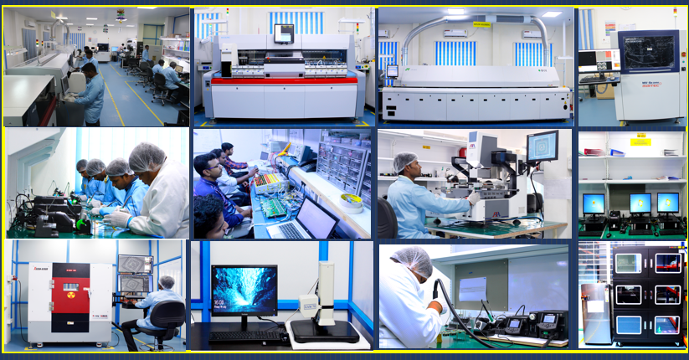
EMS – Capability Overview
Facilities
10000 Sqft ESD dust free workspace
Automatic Screen Printer- Dek
3D-Solder paste Inspection system
Pick & Place data- MYDATA MY300LX-11 with 16000CPH
M/c Capability of handling
  01005, 0201
  QFP, QFN BGA CSP's (Upto 0.2mm pitch)
  BGA 0.35mm Pitch
Reflow- JT 10 Zone +with Nitrogen ready – Pb Oven
3D AOI – MIRTEC MV-6e -OMNI
X-Ray –XAVIS XSCAN 100A 2.5D
7CH-Reflow profiler- KIC
JBC- Temperature controlled soldering stations.
BGA Rework - Seamark ZM
Rework Stations
Dry Cabinet- Storage for Humidity & temperature storage
Baking Oven
All images are from our EMS Facility @ Krishnagiri
Copyright © 2022 Zettaone Technologies
9

Slide 10

Thank You
Success through agile technologies…
HEADQUARTER
CHENNAI
ASSEMBLY PLANT
USA
ZettaOne Technologies India Pvt Ltd
#43, 5th Cross, Wilson Garden,
Bangalore 560027. INDIA.
Office: +91 97424 89111
Email: suresh@zettaone.com
ZettaOne Technologies India Pvt Ltd # 94, 1st Floor, 3rd Cross street,
Thirumalai Nagar Annexe, Perungudi,
Chennai, 600096, Tamilnadu Email: sales@zettaone.com
ZettaOne Technologies India Pvt Ltd No: P-4A, Sidco Industrial
Estate, Krishnagiri-635001.
Tamilnadu, INDIA.
Email: sales@zettaone.com
ZettaOne Technologies Inc
2355 Carpenter Ct
Fremont, CA 94539, USA
Office : +1 714 927 3480
Email: us-sales@zettaone.com
10

