Slide 1










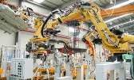

CORPORATE PRESENTATION
Pioneers in engineering & technology
Samniya Techsys
Confidential and Proprietary
1
Copyright © Samniya Techsys Pvt. Ltd.
TEMP:SAT/JAN-2018/01

Slide 2
VISION AND MISSION
VISION:
To be the Engineering and Technology Partner of choice for leading National and Global OEM’s in the domains of Aerospace & Defense, Automobile and Automation Industries and to build robust, technologically advanced products for use in Air, Land, Sea and Space applications, by integrating state of the art homegrown technology with foreign technology via win-win relationships, including JV’s, Partnerships and License Manufacturing.
MISSION:
To continuously create cutting edge home grown technology in niche areas, harnessing the capabilities of our human capital, focusing on quality in every aspect of our operations.
Build robust, advanced and eco-friendly systems and services meeting all the requirements of customer.
Practicing Transparency and ethics with customers and employees.

Slide 3


INTRODUCTION
Target Clients
Tier 1, Tier II, OEMs, System Integrators
Focus on long term partnerships and repeat business
Headquartered in _{Company} Bangalore, India ISO 9001:2015 certified
Strong Senior Technical _{Leadership} Leadership Team Proven Management Team
Aerospace _{Domains} •Automotive Automation IT Services and Hi-tech
Engineering Team
Human capital with multiple decades of experience in the related industries
Prior experience with product and service companies
Quality Excellence
Growth Plans
Talent Management
Core teams on Machine learning, Artificial intelligence and IoT
Technology partnerships

Slide 4












DOMAINS AND INDUSTRIES
Aerospace
Automotive
Automation
Ship Building
IT Services
Energy

Slide 5
OUR OFFERINGS ACROSS INDUSTRIES
Technical Publication/ Technical Illustrations
Wire Harness/Aut omated Test Equipments ( ATE)
Mechanical
/Structural parts Design and 3D Modelling
Turn-Key System Development
Custom Embedded Systems
Talent Management/
Staffing
Support and Maintenance Services
Software Engineering

Slide 6













Key Clients

Slide 7
PRODUCT ENGINEERING SERVICES

Slide 8
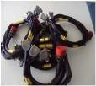
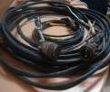
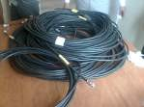
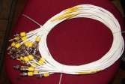
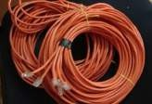
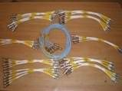
WIRE HARNESS ENGINEERING & MANUFACTURING
Samniya is the one stop solution for all your wire harness fabrication and cable fabrication requirements, we provide the complete End to End support in wire harness Engineering & Manufacturing, we practice a stringent quality stage gate inspection at every stage of the fabrication to meet the global slandered.
Wire Harness Activities Includes:
Design and Routing of wire harness & Components detailing .
Wiring Board design
Wiring chart, BOM preparation
Wire harness fabrication / cable assembly
Braiding, Shielding, Marking & Finishing
Wire Potting
Testing
Integration & Installation.

Slide 9
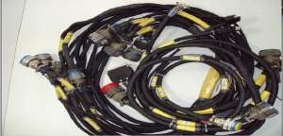
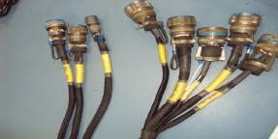
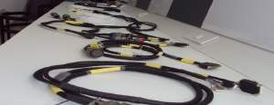
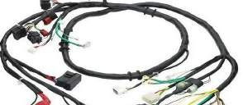
Wire Harness
Military Ground Equipment Wiring
D38999 Series Connectors Wiring
Aircraft Wiring
Automobile Wiring

Slide 10
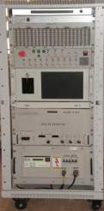
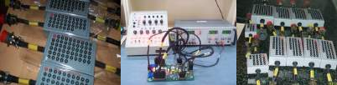

TEST SYSTEM ENGINEERING & MANUFACTURING
We provide customized / standard test solutions for all your applications/ products/ LRUs and systems, with the experienced team of System engineers we can understand the functionality of the systems better and can propose customized, reliable and effective test solutions in a cost effective approach.
Design and Develop Test Systems
Custom built Automated Test Equipment (ATE)
Test Equipments to the Build to Print Requirements
Test Equipments to the Build to Specification Requirements
Test Jigs & Rigs fabrication

Slide 11
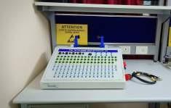
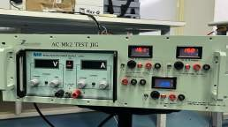
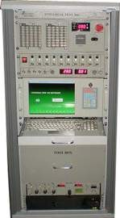
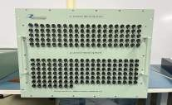
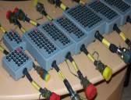
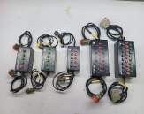
Test Jigs

Slide 12

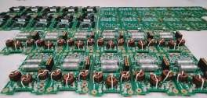

Case Study on Digital & Analog Servo Controller for an UAV Actuator Case study
Over View: Servo Controller Cards for Rotary Actuator are the Shop replaceable boards used in the Nose Wheel Steering Actuator and Control Surface Actuator.
This is a build to specification requirement, Where customer provided only Baseline Schematics, Bill of material.
Samniya Responsibility:
Requirements capture
Schematic Analysis
PCB Layout Design
Board Analysis including Signal Integrity(SI) Analysis, Thermal Analysis,
Component Derating Analysis and MTBF of the boards
BOM Scrubbing and Procurement of components
PCB Layout design and Fabrication as per the required standards.
Population of PCB
Assembly and FTP
SRU level ESS tests
Kit of parts and Final Assembly complying with RDAQA
Testing and Qualification

Slide 13
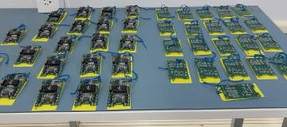
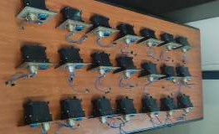
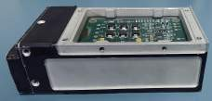

Fully Airworthy Qualified System.

Slide 14



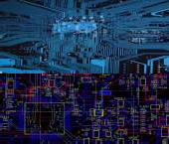
CUSTOM EMBEDDED ENGINEERING
At Samniya we support/ provide customised embedded system design, development and manufacturing meeting specific customer requirements.
Hardware Design Embedded Software:
Customized Analog, Digital and Mixed signal boards design
Embedded board bring up
FPGA design and implementation
Synchro to Digital /Digital to Synchro conversion
PCI Cards (Analog, Digital, Discrete I/O)
Isolated Digital & Analog I/O cards.
RS232/RS422/RS485 Communication IO cards.
Wireless (BT, Wi-Fi, 802.15.4, ISM), RFID)
Firmware Development
Board Support Packages (BSP)
Device Drivers Development(Windows,
Linux, RTOS)
PCB Design
Design of Multi layer & High Density Boards.
High-speed digital design & analysis
Schematic and layout translation
Advanced PCB including HDI rigid, flex
Solutions:
Servo controllers for actuators,
Custom Power supply design.
Product Design Service
Custom Computing Solutions
Design verification and testing
Production Management
IoT Solutions
Samniya Techsys
and low loss board design.
Simulation & Verification Services
CAM verification / Gerber edits and checks
Digital simulation for integrity
Thermal simulation
Confidential and Proprietary
14

Slide 15
Hands on Experience in
Customized data acquisition / IO Card Design on Standard form factors
Analog Designs,
DAC - 1.2 GHz Rated DAC (LVDS Interface)
DAC - 500 MHz for arbitrary waveform generation (LVDS Interface)
ADC – 400 MHz with 73 dB SFDR
ADC – 210 MHz with 76 dB SFDR
DDS – 3 GHz for Arbitrary waveform generation
VME based data Acquisition
PCIe Based Data Acquisition
PMC Based Data Acquisition
PMC Based IO Design
cPCIBased Data Acquisition
cPCI Based IO Design
PCI Based Data Acquisition
PCI Based IO Design
HSMC Based IO Design
FMC Based IO Design
Processor Based Design,
Intel E3930 based design
ARM based design
iMX 7D based Design
Protocol,
1553B Interface
ARINC 429 and 717
RS422,485
Ethernet
USB
UART
C012
FPGA Based Design
Experience with SPARTAN 3A and SPARTAN 3AN, Virtex 4 SX, FX, LX, Virtex5 SX, FX, LX, Virtex6 FX, Virtex7, Kintex 7, Artix 7, Zynq 7, Altera Cyclone IV,V

Slide 16
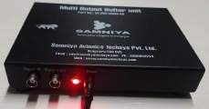

Multi Output Buffer Unit (MOBU) Case study
Multi Output Buffer Unit (MOBU) is used to drive the single signal Input to Multiple Outputs, This unit drives signal input to two different 16 Set of Outputs through two 50 Pin Standard D-Type Connector. This unit works with input 230V 50-60Hz and Output 15v Power supply adaptor.
Application:
Simulation of Sensor out put up to 5Mhz with 2+ to 10V VPP, to use at Test environments.
Specifications:
Size : 180mm x 150mm x 30mm (LxWxH- Portable & Table top)
Power Input : 15V.
Frequency Range : up to 5 MHz, +/- 10v
Driving Capabilities : Up to 5 Mtrs.
Signal Output : 32 Outputs through two 50 pin D- type connectors
Operating Temperature : 0° C - 50° C
Storage Temperature : -40°C - +80°C
Operating Voltage : 230 V AC using 15V 5A Output power adaptor.

Slide 17
Digital Telemetry De-Multiplexer – Model #:ST/TM/DDM-01
Digital De- Multiplexer consists of two Input channels having 34 output channels (1- PCM, 1- Audio & 32-Analog signals).
Specifications:
Number of Input Channels | 2
Number of Output Channels per Input Channel | 34(1-PCM, 1- Audio, 32- Analog)
Mode of Operation for Individual channels | Filter Only: Filter the Input Signal and bypass the demodulator. Output available from the filter. Filter and Demodulator: Filter the Input Signal and demodulate . Output available
Display | To be provided to configure the filter and demodulator parameters using key panel.
Parameters to be configured through key panel per channel | Filter: Function, type, Cutoff frequency, gain, Maximum Output Voltage. Demodulator : Subcarrier Frequency, demodulation Parameters, Video filter, bandwidth, Output Voltage.
Configuration utility | Provision to be provided for configuring the unit through configuration utility over Ethernet and /or RS232 link.
Parameters to be configured through Ethernet | All the Parameters
Performance | Minimum Output SNR of 10dB at all the Subcarrier outputs when input signal is 100 mVpp with input SNR of 15dB

Slide 18





Digital Telemetry De-Multiplexer – Model #:ST/TM/DDM-01
Size |  | 1U, 19” Rack Mountable
Power Supply |  | 230V/50 Hz
Interface Connectors |  | BNC (F) Connector for Input and Output (for Output Via octopus connector due to limited dimension)
Temperature range | Operating | 0°C to 50°C
 | Storage | -30°C to 65°C
Relative Humidity |  | Up to 95%
 |  |  |  |  |  |  | Digital Telemetry De- Multiplexer Unit
Digital Telemetry De- Multiplexer Unit

Slide 19

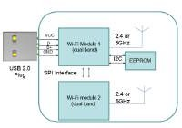
Linux Firmware & Driver Development for Duel Band Wifi Module
Overview:
Development of Firmware on Linux RTOS Platform for Duel band WIFI Module, this includes design and development of Board Support Packages(BSP), Kernel Porting, Device drivers development and Board Bring up activities.
Our Responsibility:
Linux Board Support Package and Board Bring-up Activities on Duel Band Wifi module.
Porting U-Boot on Main Module.
Porting Linux-Kernel 4.4 or Latest Version
Linux driver, Stack or, Application support for the following H/W interfaces.
Interfaces:
USB 2.0 x2
Micro SD Card
eMMC
BLE-5.0
LEDs x2
Reset Button
RTC
Power Management IC

Slide 20











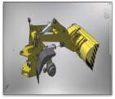
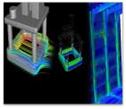
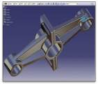




MECHANICAL ENGINEERING SERVICES
Product Design and Modelling
Manufacturing
Engineering Analysis
Engineering
Concept Design
3D Modelling
Detail Engineering
Re Engineering
Reverse Engineering
System Installation Design
Conceptual to Detail Design
2D to 3D Conversion
Digital Mock –Up
Fatigue and Damage Tolerance (F&DT)
Static Shock & Vibration Analysis
Crash and Drop test Analysis
CFD- Thermal & Hydraulic flow analysis
CFD Lift & Drag Analysis
Optimization of Design for weight and strength
Tool Design and Detailing
Jigs & Fixtures Design & Detailing
Design-for-Manufacturing
NC Programming
DFM DFA & DFMA
Redrafting/ Re Designing of legacy Tools.

Slide 21
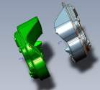

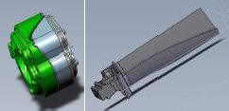
Shot Peen Masking one of the Mechanical Modeling Case Study
Scope of Work:
Design of masking for the blade leading edge side:
Extend the masking features covering till blade root platform.
Maintain the maskant contour and clearances near blade platform side as per to other masking areas.
Design of masking for the blade trailing edge side:
Extend the masking features covering blade root platform.
Maintain the maskant contour and clearances near blade platform side as per to other masking areas.
Design of complete parametric Model of the Maskant and Blade.
Tools Used: SolidWorks 2019-20

Slide 22
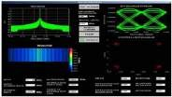
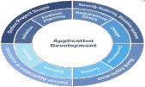

SOFTWARE ENGINEERING SERVICES
We know the importance of software engineering activities in the process of critical system development. To meet this requirement of software Engineering we bring together the right technical expertise with strong business process knowledge using the state of the art technologies to deliver flexible and scalable software solutions to our client in the areas like
Design and Development of Software,
Application Software Development - Desktop, Embedded, Mobile
Data Acquisition Software
Firmware Development
Software Verification and Validation
Software Test Case Development
Software Maintenance & Support

Slide 23
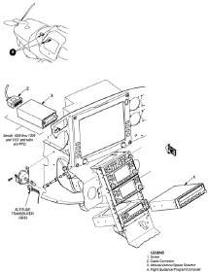
Technical Documentation
We at Samniya provide end-to-end solutions in the area of Technical Documentation including Authoring, Illustration, Computer Based Training and Content Management.
Our team have hands-on experience in wide range of Technical Manuals for the Aerospace Industries, including Operation and Maintenance Manuals for Airframes, Engines, Mechanical/Electrical/Electronic Systems, Ground Support Equipments, Standard Practices Manuals, Illustrated Parts Catalogues and Service Bulletins.
Our Offerings:
Interactive Electronic Technical Manuals (IETM)
Computer Based Training Packages (CBT)
Illustrated Parts Catalogues (IPC)
Content Management
Technical Illustration
Animation
eLearning Solutions
Technical Translation and Localization
Application development
Legacy data conversion
Tools Expertise:
Arbor text
Oxygen
MS Office
Adobe FrameMaker
AutoCAD
Active CGM Author
ISODraw
Adobe Illustrator
Solid Works
Standards:
ATA iSpec
S1000D
CMS

Slide 24
Industry / Domain Expertise.

Slide 25




AEROSPACE & DEFENSE OFFERINGS
Systems, Sub systems design and development – Airborne and Ground based
ATEs & Test Jigs/Rigs development
Firmware and Platform engineering Application software development Independent Verification and Validation
Value Engineering – Obsolescence management, Re-Engineering Technical Documentation
Testing and Certification services Maintenance, Overhauls and Repair services

Slide 26








AUTOMOTIVE OFFERINGS
FOCUS AREAS
OUR OFFERINGS
BCM (Body control Modules)
ECU Software development
Powertrain
In-Vehicle Network management and Diagnostics
OBD II, UDS, ODX, KWP2000
Model based development & testing
In-Car Infotainment
Instrument Cluster
Autosar and Functional Safety
Telematics,
Connected Car, ADAS
EV & HV Systems
Verification & Validation
Testing as a Service – Unit, Integration, System

Slide 27
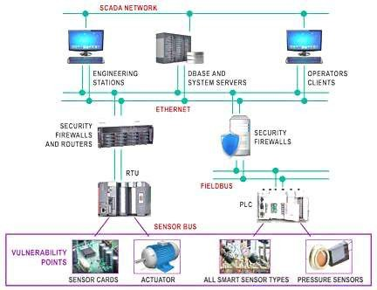
INDUSTRIAL AUTOMATION
PC/Cloud based applications
HMI for SCADA systems HMI/Application development for control panels
PLCs, DCS Implementation Communication protocols – Modbus, ProfiBus,
EtherCAT,RS-485, Wireless HART etc.,
Data Acquisition Systems
Sensor/Actuator control

Slide 28













CONTACT US
PIONEERS IN ENGINEERING & TECHNOLOGY
Samniya Avionics Techsys Pvt. Ltd.
#12, 1st Floor, 3rd Cross, PNR Layout, 6th Block, Koramangala, Bengaluru,560095
+91 9900932214
info@samniyatechsys.com www.samniyatechsys.com
Samniya Techsys Pvt. Ltd.
#65, 1st Main, Kaverappa layout, Kadubeesanahalli, Bangalore -560103
+91-80 43712313
info@samniyatechsys.com www.samniyatechsys.com
Samniya Techsys
© 2017 Samniya Techsys. All Rights Reserved.
Confidential an
d Proprietary 28

