Slide 1
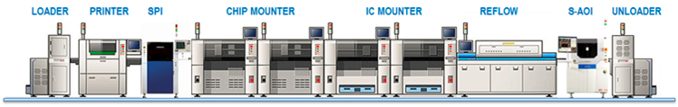
MBK Equipments & Machineries
  MBK is India's leading provider of Equipments , Machines & Tools for Electronics / SMT / PCB Assembly Dispensing and Potting Equipments Wire Harness: Cutting & Stripping Machines. We Supply Equipments for EMS / LED Light Manufacturing, Wire Harness
  We Buy & Sell New / old equipments & machineries. For all your used/idled equipment selling/buying needs, we're just an email away.
  We buy functional and non-functional used equipment .
  We Prepay 100% prior to shipment and handle logistics.
  We are one stop solution for Asset Recovery and your non moving Inventory.
  Contact us Mr. Kadam 9980046872 Email: mbkequipments@gmail.com
“The single window of Asset Recovery for the Hi-Tech Industry in the Market”

Slide 2


Slide 3
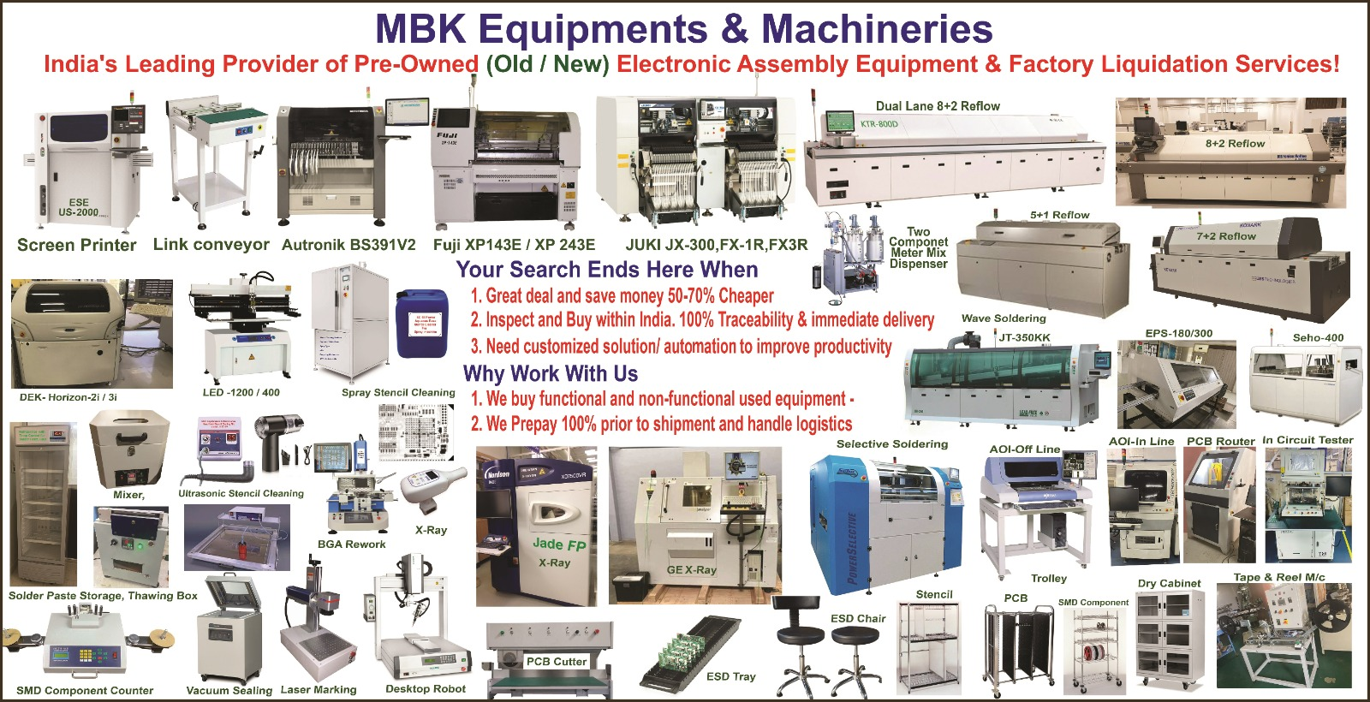

Slide 4
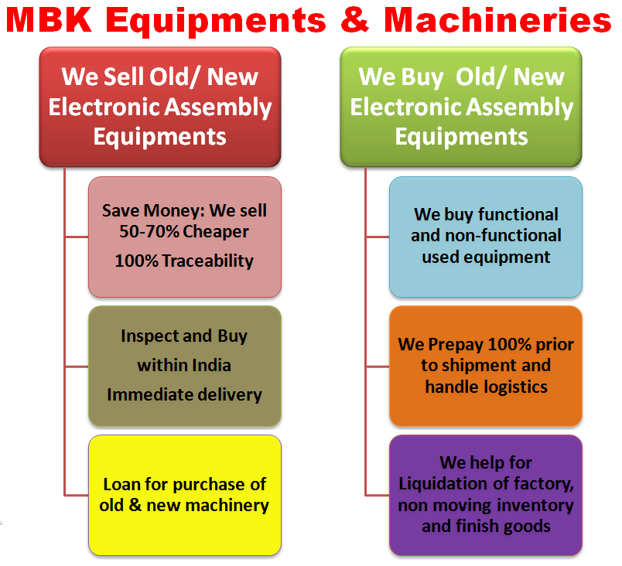

Slide 5


































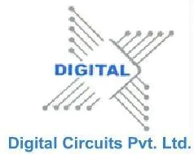



We are in business since 2010
In 12+ years successful Journey we worked with 500+ Manufacturers including

