Slide 1



Centre of Excellence
“Food & Agri.-Parma-Environment-Material”
FOOD SAFETY AND QUALITY TESTING IN VSIX ANALYTICAL LABS PVT. LTD(VSIX).

Slide 2

FOOD SAFETY AND QUALITY TESTING IN VSIX ANALYTICAL LABS PVT. LTD(VSIX).
Vsix Analytical Labs Pvt. Ltd.is an Analytical testing laboratory, established in 2013,provides Analytical solutions for customers and industries involved in Food, Agriculture, Environment (Air, Soil and Water) and Microbiology.
We've got knowledgeable and quality scientific and technical workforce within the food testing laboratory with best analytical equipment’s and high-quality workforce, our food testing laboratory is one among its kind and distinctive in serving the food industries, analysis institutes and different stakeholders in areas of the food processor.

Slide 3

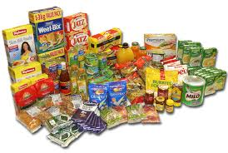
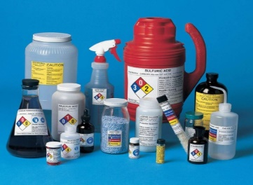
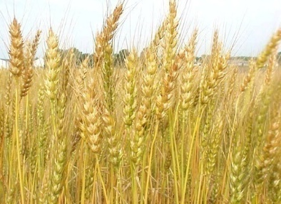

Specialized Analytical Service
Agricultural commodities
Processed Foods & Ingredients
Animal Feed & Supplements
Pharmaceuticals & Nutraceuticals
Personal Care & Home Care products
Pesticide Formulations
Chemicals and Fertilizers
Industrial Microbiology
Environmental Testing
Materials Testing

Slide 4
Centre of Excellence- Food Safety & Materials
VSix Analytical Lab.
Food & Food Packaging
Drugs & Cosmetics
Material (Food Packaging)
RoHS-REACH
Environment

Slide 5
Bouquet of Services
Food Testing
Food Safety as per FSSAI * Fruits & Veg. * Feed * Milk & Milk Products
Environment
Air
Stack * Effluent * Drinking Water * Noise * Soil * Waste Oil
Pharma & Cosmetics
Pharmacopeia-USP,IP,BP,EP
Water
Drinking Water
Process Water
Package Drinking water as per IS: 14543
Testing Materials
Ecological Safety : RoHS, REACH, Composition, Substances of Concern
Training & Consultancy
Audit ( Hygiene – Vendor – Personal - Food - GMP
Food Nutrition * Pesticides *Mycotoxins * Heavy Metals * Antibiotics * Microbiology
Method Validation * Method Development
Microbiology * Instrumentation * Water

Slide 6
Food
Safety
Pesticides, Antibiotics, Toxins, PAHs
Heavy Metals, Dioxins & Furans, PCBs
Nutrition
Labeling Requirements, Minerals,
Profiles: Fat, Vitamins, Amino Acids, Sugar
Microbiological
Food Pathogens
Shelf Life Studies, Indoor Air Quality, Spoilage Study
Packaging
Hygiene
Global & Specific Migration with different simulants
Printing Dyes Safety
Safety of food served in Restaurants & Industrial Canteens
Menu Designing, Nutritional requirements

Slide 7




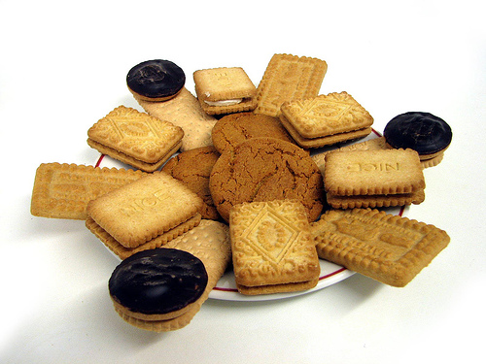
Food & Beverages

Slide 8
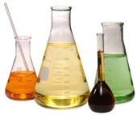
Analytical Services - Food
Quality Parameters
Conformance to FSSAI stds
Physical & Chemical tests
Nutritional Labeling
Proximate analysis
Vitamins
Minerals
Fatty Acid Profile
Cholesterol
transFat
Amino Acid Profile
Sugar Profile
Flavour Profile
Microbiological analysis
Shelf Life & Stability studies
Safety Parameters
Pesticide Residues
Antibiotic Residues
Toxic Metals
Mycotoxins
Naturally Occurring Toxins
PCBs and PAH
Screening of Dioxins
Banned Dyes
Pathogen testing
Melamine
Other Chemical Contaminants
Packaging material testing

Slide 9
FOOD, ANIMAL FEED, AGRICULTURAL PRODUCTS, FERTILISERS & CHEMICALS TESTING:
Product Group :
* Flavour & Fragrance
* Tea & Coffee
* Snacks and Instant mixes
* Vegetables & Vegetable products
* Herbs/Spices
* Fruits & Vegetables
* Cereals & Pulses
* Dried Fruits & Nuts
* Dietary supplements
* Confectionery
* Fine Foods
* Chemicals
* Canned & Processed foods
* Edible Oils
* Milk & Milk products
* Additives & Preservatives
* Bakery products
* Meat & Meat Products
* Dairy Products
Quality Parameters
Conformance to FSSAI stds.
Physical & Chemical tests
Nutritional Labeling
Proximate analysis
Vitamins
Minerals
Fatty Acid Profile
Cholesterol
Transat
Amino Acid Profile
Sugar Profile
Flavour Profile
Microbiological analysis
Shelf Life & Stability studies
Safety Parameters
Pesticide Residues
Antibiotic Residues
Toxic Metals
Mycotoxins
Naturally Occurring Toxins
PCBs and PAH
Screening of Dioxins
Banned Dyes
Pathogen testing
Melamine
Other Chemical Contaminants
Packaging material testing

Slide 10



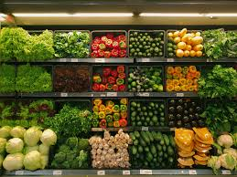

Agriculture

Slide 11
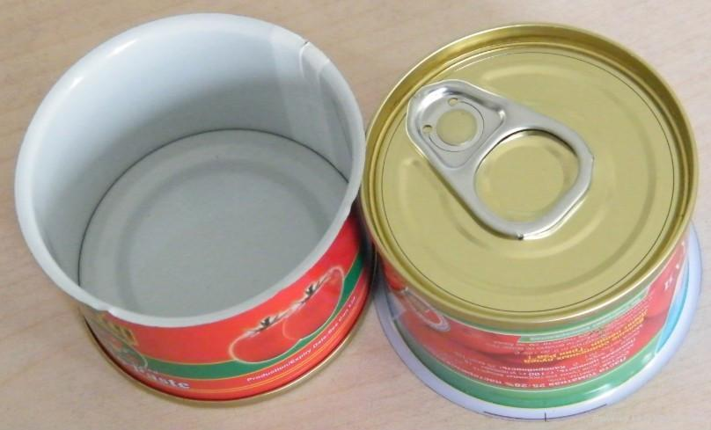
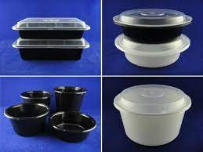
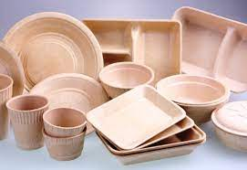
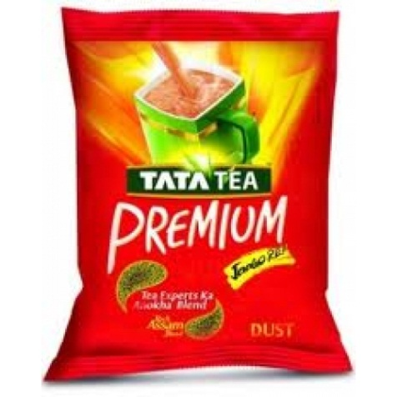

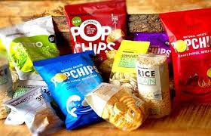
Packaging Material

Slide 12
Packaging
Global Migration & Specific Migration
EC 10:2011, BIS 9845
LfGB, AP 89,USFDA
Metals, Monomers, Phthalates, PFOS, PFOA,TPA,ISA, ORGANO Tin
21 CFR- Polymers, Rubber
Gaskets, Paper Board
Pharma Packaging USP/ EP
Glass, Polyethylene, PET
IR, DSC, Color Extraction, Heavy Metals Buffering Capacity. EG ,Physicochemical Tests
Containers

Slide 13
Testing of Packaging Materials
Overall Migration testing
Specific Migration testing
  Monomers
  Leachable Metals
  Leachable Phthalates
  Iso Phthalic Acid (IPA) & Terephthalic Acid ( TPA)
  PFOS/ PFOA-perfluorooctane sulfonic acid (PFOS) and perfluorooctanoic acid (PFOA)
  Organo Tin Compounds ( TBT, DBT, MBT)
  Aromatic Amines
EU Directive 85/572/EEC (testing migration of constituents of plastic materials and articles
intended to come into contact with foodstuffs)

Slide 14
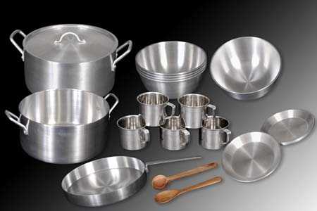




Hard Goods

Slide 15
Materials- Substances of Concern
REACH
RoHS
ELV
Polymers
Articles
Substances
Metals

Slide 16
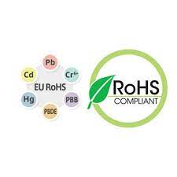
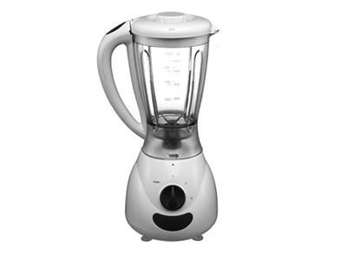


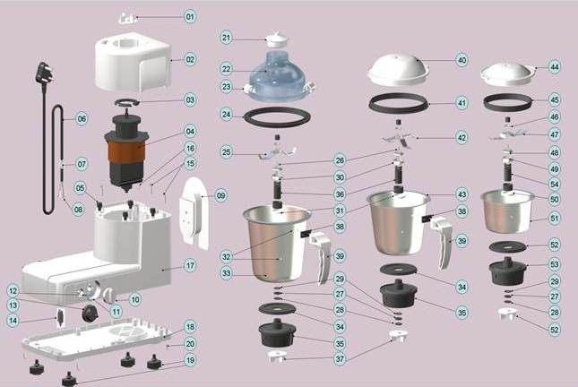
RoHS
Restriction of Hazardous Substances in electrical and electronic equipment : Directive 2002/95/EC
Cadmium
Lead
Mercury
Hexavalent Chromium
Poly Brominated Biphenyls
Poly Brominated Diphenyl Ethers

Slide 17

REACH
Registration, Evaluation, Authorisation and Restriction of Chemicals (REACH)
REACH (EC 1907/2006) aims to improve the protection of human health and the environment through the better and earlier identification of the intrinsic properties of chemical substances. This is done by the four processes of REACH, namely the registration, evaluation, authorisation and restriction of chemicals. REACH also aims to enhance innovation and competitiveness of the EU chemicals industry.
SVHC are Substances of Very High Concern, e.g., they cause cancer, or they have other hazardous properties and/or remain in the environment for a long time with their amounts in animals gradually building up.
REACH Candidate List
The Substances of Very High Concern (SVHC) candidate list, which is part of EU REACH regulation, currently contains 223 chemical substances.

Slide 18
Pharma & Cosmetics
Cosmetics
Allergens as per Annex III of EC
Chemical Composition and Physical Characteristics
Active Ingredient
Heavy Metals
Residual Solvents like 1,4 Dioxane, ETO
Microbiological Safety-freedom from Yeast & Mould, TPC and others
Microbial challenge test for Shampoos
Skin Irritation test on human subjects
Parabens- all five
NDELA (N-Nitroso Diethanolamine)
Surfactant Profile- Anionic, Cationic, Non Ionic
Pharma
APIs & Formulations
IP/BP/EP/USP
LAL Test
Sterility
Dissolution Profile
OVI
Pesticides
Pharma Packaging
Microbial Safety
Heavy Metals

Slide 19
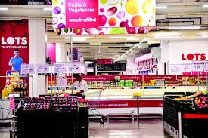


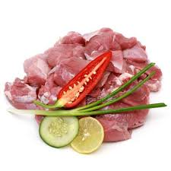
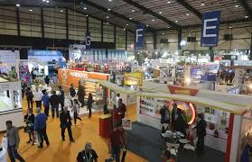
Hotels, Restaurants & Catering [HoReCa]

Slide 20

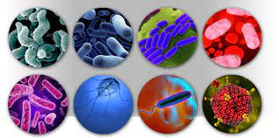
Microbiology
Pathogens
Food
Water
Industrial
Pharma

Slide 21
Testing of Cooked Foods
Microbiological testing of Cooked Foods
Microbiological testing of Pharma
Antifungal & Antibacterial activity of Textile
LIST OF TESTS BASED ON NUTRACEUTICAL AND COSMETIC GUIDELINES
ISO 11930:2012 – Evaluation of the antimicrobial protection of a cosmetic product
ISO 16212:2008 – Enumeration of yeast and mould
ISO 17516:2014 – Microbiological limits
ISO 18416:2015 – Detection of Candida albicans
ISO 21148:2005 – General instructions for microbiological examination
ISO 21149:2006 – Enumeration and detection of aerobic mesophilic bacteria
ISO 21150:2015 – Detection of Escherichia coli
ISO 22716:2007 – Guidelines on Good Manufacturing Practices
ISO 22717:2015 – Detection of Pseudomonas aeruginosa
ISO 22718:2015 – Detection of Staphylococcus aureus

Slide 22
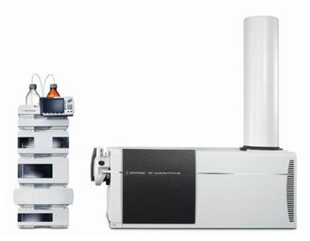
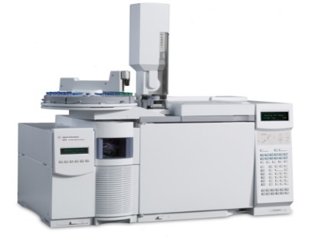
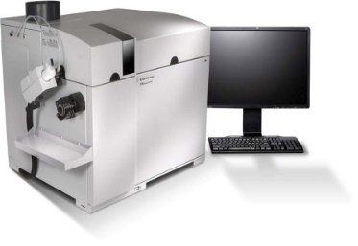
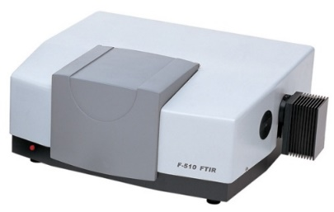
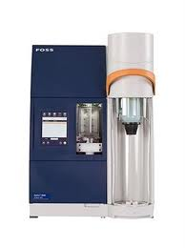
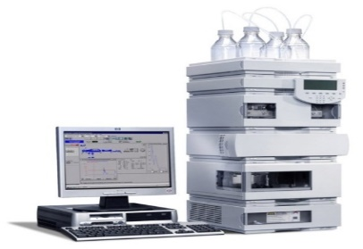
High-end Analytical Equipment
LC-MS/MS - triple quadrapole
GC-MS/Head Space/ECD/FID
ICP-MS
ICP-OES
GC-FID with Purge & Trap
HPLC with all detectors
FTIR
ELISA
UV-VIS Spectrophotometer
Automated Systems for Protein & Fat
Microwave Digestor
Stomacher Lab Blender

Slide 23

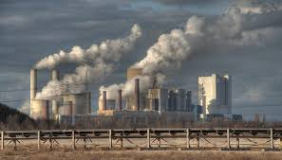
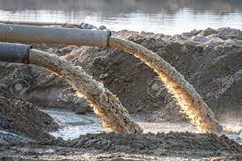
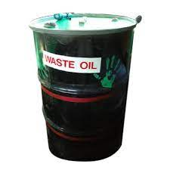
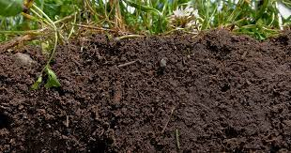
ENVIRONMENT (WATER, AIR & SOIL)

Slide 24
Environmental Testing
Environmental testing for water, soil, air, sludge, petroleum, chemicals, and other samples.
Ambient Air Testing:
We offer critical ambient air testing services. Our services include ambient air, stack emissions, noise, soil, sludge, effluent, generator and engine exhausts, volatile compounds, semi-volatiles, hazardous air pollutants, air toxins, metals and particulates. We also offer ambient air analysis and stack emission monitoring.
Stack Emission Testing:
We offer critical Stack Emission Testing Service which is appreciated for flexibility and offering the most effective outcome. Excessive production of paints, plastics, printing inks and adhesives give rise to excessive stack emission. We test for stack emission with our requisite tools & equipment.
Water Testing:
Our Water Testing Services are well appreciated in the market. Over the years we have become synonymous with quality service providers. We offer service for Drinking Water, Process Water as per IS, Treated and Un treated effluents.
Noise Level Testing:
Unwanted sound is called noise. Environmental noise is evaluated by comparing a measurement or prediction of the noise to one or more criteria. There are many different criteria and ways of measuring and specifying noise, depending on the purpose of the evaluation.
Soil Testing:
The introduction of substances, biological organisms, or solid wastes in the soil, results in a change in the soil quality, which is likely to affect the normal use of the soil and endangering public health and the environment, therefore it is necessary to consider it as a determinant to the environmental quality.

Slide 25
Agri. Inputs/ Environment
Water
Drinking , Process, Effluent, Package drinking water
VOCs, Metals, Organic Contaminants
Soil
NPK, Micronutrients
VOCs, Heavy Metals, PAHs, PCBs, Pesticides
Fertilizers
NPK,C/N Ratio, Micronutrients
Potency of Bio Fertilizers
Pesticides
Active Ingredient, Stability,

Slide 26
FOOD SAFETY AND QUALITY TESTING IN SCIENTIFIC FOOD TESTING SERVICES (SFTS).
Our food testing laboratory is provided to analyses the physico-chemical characteristics of food materials together with raw materials and finished product.
We've got a large variety of apparatus to research food composition, textural properties, viscosity, elemental analysis and poisonous substance analysis in water analysis, food grains and phytochemical analysis in fruits and vegetables.
Samples from completely different industries like food process industries, water research lab , edible oil industries, exporters and importers and company, and biotech industries for analysis.

Slide 27














PRESTIGIOUS ACCREDITATIONS, APPROVALS AND RECOGNITIONS
SHORTLY GETTING THE ACCREDITATIONS AND RECOGNITIONS from
National Accreditation Board for Testing and Calibration Laboratories
Food Safety and Standards Authority of India (Domestic & Imported)
Agricultural and Processed Food
Products Export Development Authority
Agmark
Bureau of Indian Standards
Export Inspection Council
Tea Board of India
Government of Indonesia
Saudi Food and Drug Authority
MOEF
ISO 9001-2015
7
FDA

Slide 28
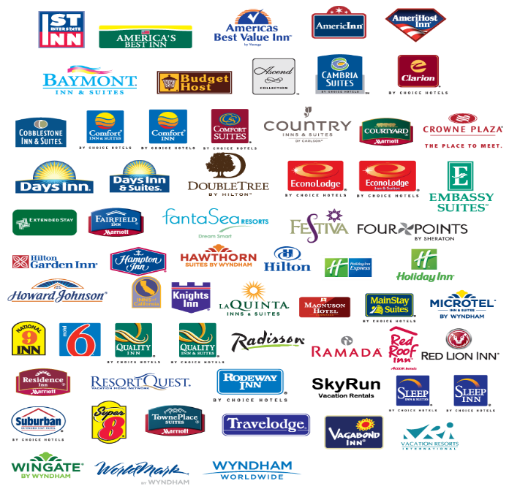


Clients We Serve in the area of
Food Testing *Pharma
Environmental Monitoring * Hygiene Monitoring

Slide 29

C.R. Chandra Shekar
Vice President- Marketing Strategy
crcshekar@vsixlabs.in
M- +919448078664

