Slide 1

Company Profile

Slide 2
About Us & our Values
Aeolus is an Engineering Solutions Company offering Products & Services catering to requirements in Automotive, Electronics , General Engineering & Aerospace Industry
Aeolus Core Values
Integrity
Do the Right Thing
Urgency
Respond Now
Team Work
Together, We All Win
Innovate
Get Better Every Day
Care
Respect & Be Courteous

Slide 3
Services & Solutions
Sourcing & Procurement Services
Industrial Distribution
Procurement Support
Tool Management
Machining Tooling Solutions
Cost Reduction
ESD & Product Identification
ESD Consulting
RFID Product Solutions
Fixture Design
Fixture Design
Drawing Reengineering
Inspection & Audits
Third Party Inspection
Chartered Engineer Certification
Localization Support
ESD Products& workstations
Electronic Parts, Cables

Slide 4
Industries Supported
Automotive / Aerospace Industry
Process Industry
Electronics Manufacturing
Logistics Industry
General Engineering
Electronics Service Industry

Slide 5
Sales Channels
Offline
B2B Customer Visits
Retail Outlets
Online
Aeolus.co.in
TheToolDepot.in
Indiamart
JustDial

Slide 6






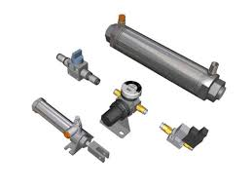

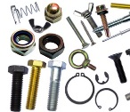




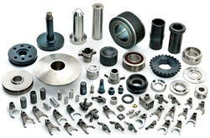



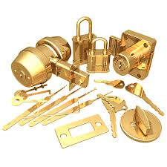


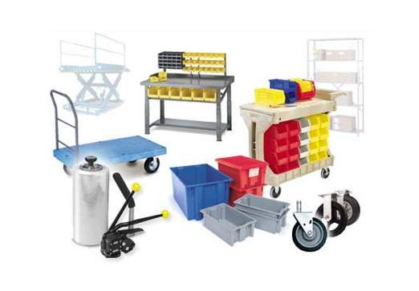
Product Categories Supported
Abrasives | Hand Tools | Power Tools | Safety | Electrical | Lights | Pneumatics
Storage | Fastener | Cutting Tools | Lubricants | Cleaning | Welding | Machine Spares
Packaging` | Measuring | Hardware | ESD | RFID | Tapes & Adhesives | Material Handling

Slide 7
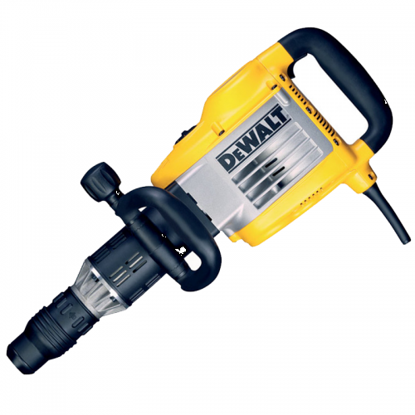
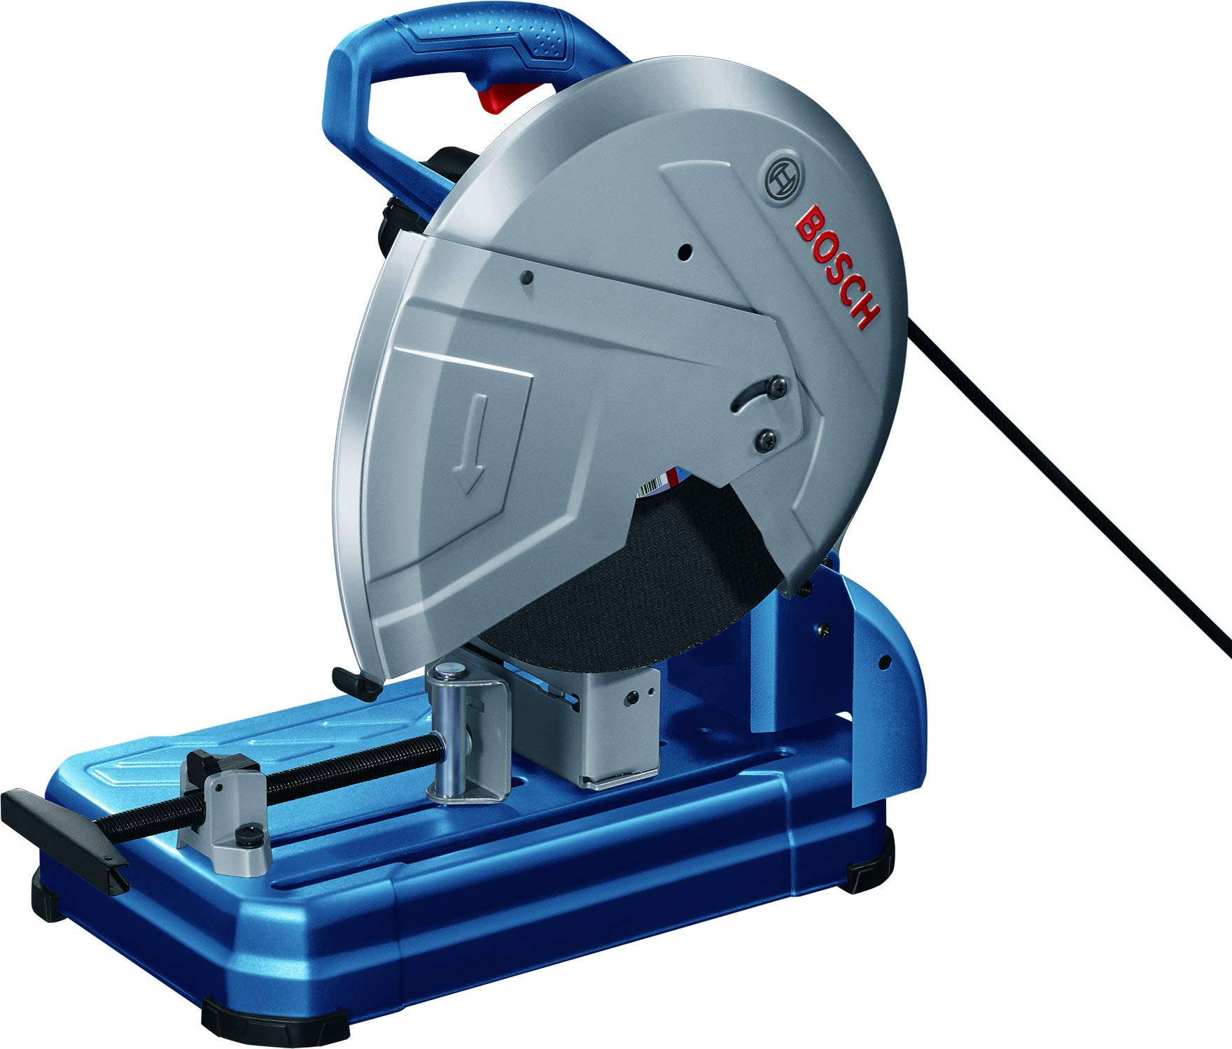
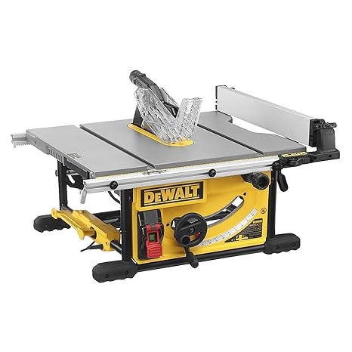
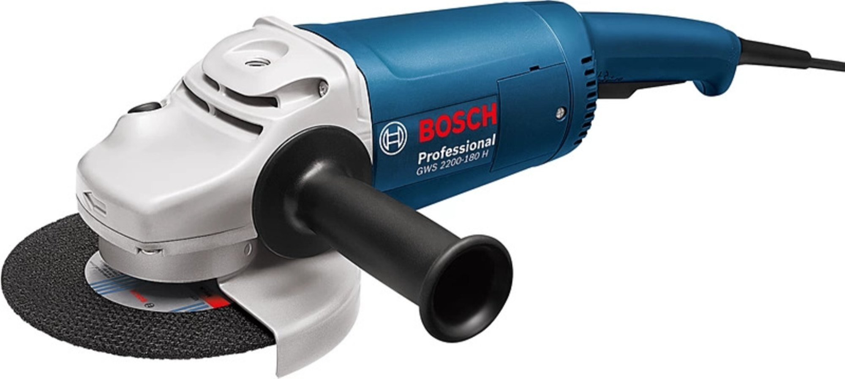
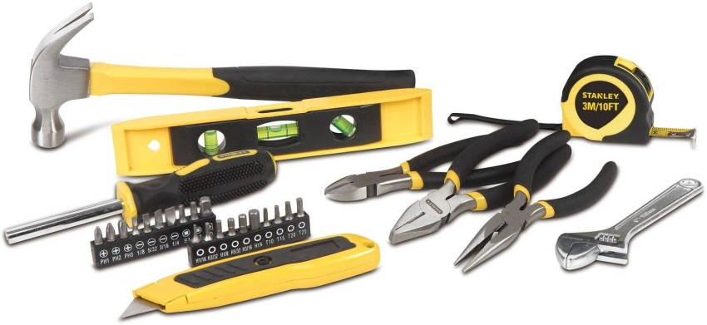
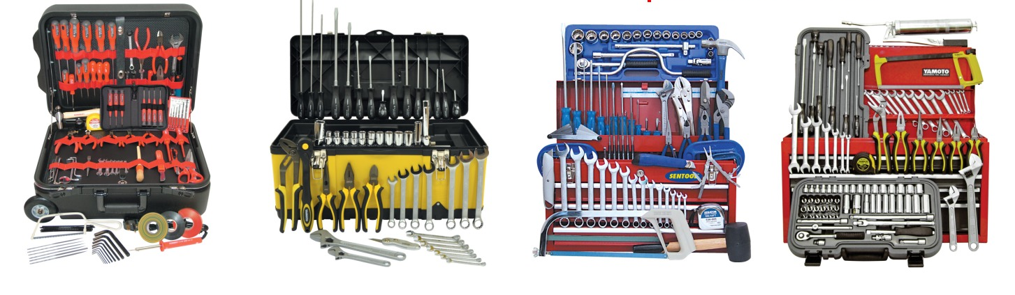





Authorized Dealer for Sales/Service

Slide 8

Contact
Lets Collaborate together…
Iyyappan 9994318676
Vignesh 9677084531
Aeolus Engineering Solutions
Plot 114, Mount Poonamallee High Road
Porur, Chennai, TamilNadu 600116
Sales1.aeolus@gmail.com
sourcing@aeolus.co.in
www.aeolus.co.in

