Slide 1






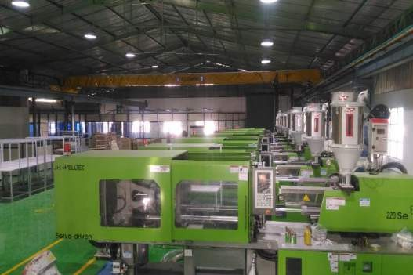
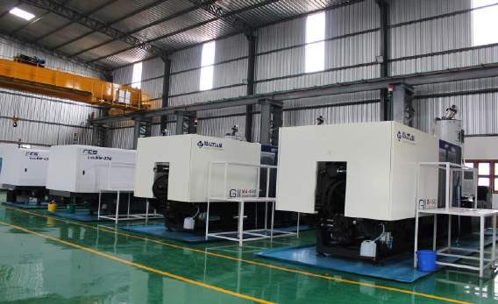
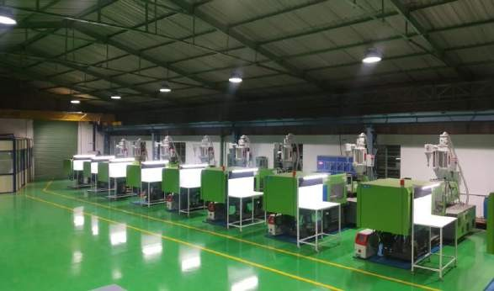






ABOUT US
SOLUTIONS & SERVICES
CUSTOMERS
PRODUCTS
MACHINERY
FACILITIES
CERTIFICATES
CONTACT US

Slide 2


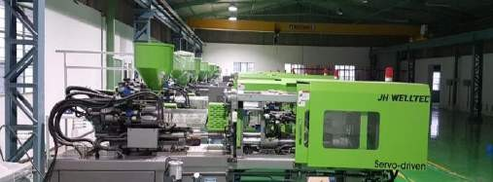
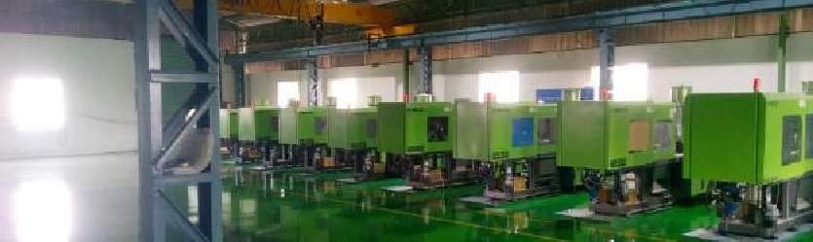
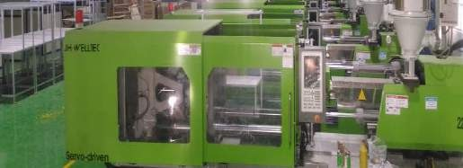
GPP Overview
BACK TO COVER PAGE
ABOUT US | SOLUTIONS & SERVICES | CUSTOMERS PRODUCTS | MACHINERY | FACILITIES | CERTIFICATES | CONTACT US
Guru Poly Products is a Partnership company established in 2018.
GPP is Located in a built-up Area of 20,600 sqft with a total area of 33,000 sqft facility in Hosur, Tamil Nadu, India. GPP has a significant Corporate MNC companies on its client list Like LS Automotive, Sundaram Auto Components Ltd, Emminitia, SSF & Winnercom Sandhar
GPP’s operational excellence is predicated by our ability to out-perform, out-class and out-deliver our competitors on levels of workmanship quality, streamlined manufacturing processes and un-surpassed levels of customer care and retention. Our performance within our industry sector is in the upper quartile for our client’s total cost of business.
The primary objective and core business driver for the GPP is to develop a distinctive capability. By definition a “Distinctive
Capability” is a set of core attributes in business that competitors find difficult to replicate.

Slide 3

BACK TO COVER PAGE
ABOUT US | SOLUTIONS & SERVICES | CUSTOMERS PRODUCTS | MACHINERY | FACILITIES | CERTIFICATES | CONTACT US
GPP Manufacturing Plant. was established in 2018 with primary objective of catering Automotive & Non Automotive customers on their various requirements involving Plastic Injection Molding.
Plant Address
Industry License No.
SF.NO: 549/1, Kothagondapalli Village, Hosur Taluk, Krishnagiri District, Tamil Nadu-635109.
KNG12077
MSME Registration No.
We are located in a facility of approximately 33,000Sqft area,
Founded
SMALL UDYAM-TN-11-0006781 where 20,600sqft are primarily used for production operation,
April-2018
while the remaining of it are used for warehousing, and is
reserved for future expansion.
GST No..
Contact Person
33AASFG1969L1ZS
Mr. AK Hussain Managing Partner Business Development.
Over the years, our company have expanded our customer base from Non Automotive to Automotive customer as a Tier-2 Supplier.

Slide 4


BACK TO COVER PAGE
ABOUT US | SOLUTIONS & SERVICES | CUSTOMERS PRODUCTS | MACHINERY | FACILITIES | CERTIFICATES | CONTACT US
VISION
QUALITY POLICY
To provide quality services with great self contented that exceeds the expectations of our esteemed customers requirement.
We at Guru Poly Products are committed to ensure high quality of products and services through continual improvement of our processes & Systems by the way of innovation, technology and knowledge management, which will be achieved through
MISSION
To build long term relationships with our customers and provide exceptional services by pursuing business through innovation and advanced technology.
Creating a culture of quality, teamwork & 5S through total employee involvement.
Healthy internal customer- External Provider relationship
Proactive continual improvement through education & training
Meet applicable statutory and regulatory requirements

Slide 5








BACK TO COVER PAGE
ABOUT US | SOLUTIONS & SERVICES |  | CUSTOMERS PRODUCTS | MACHINERY | FACILITIES | CERTIFICATES | CONTACT US
Design and Development
Manufacturing Process
Value added Services
Proven ability of design of new mould from concept through to prototyping, verification and into production.
Our manufacturing processes are
We integrate design, engineering, project management and value added activity into engineering solutions.
streamlined to deliver a 360
degree solution for customers.
Quality Assurance
Engineering Support
>> Just in time facility as specified by our customers
The IATF16949-2016 processes and procedures at GPP ensure that we deliver products to the highest quality specification.
Our in house capabilities ensure a zero down time rate and that all production equipment is operating to maximum efficiency.
>> Project management by dedicated project managers for each customer ensures timely and efficient delivery of customer requirements.
Logistics
Our logistics network allows customers to deploy JIT manufacturing processes.

Slide 6





BACK TO COVER PAGE
ABOUT US
SOLUTIONS & SERVICES
CUSTOMERS PRODUCTS
MACHINERY
FACILITIES
CERTIFICATES
CONTACT US
OUR EXPERTISE
Project Management and Execution
Tooling Design and Manufacturing
Our Top Management are technically Graduated persons & experienced in various corporate sectors with Plastic industrial background & we are having team of industrial design experts to deliver solutions based on innovation and engineering excellence.
Concept design and tooling expertise that
goes hand-in-hand with
World Class Manufacturing Process
State-of-the-art technology and best in class industrial engineering know-how, un-surpassed levels of customer care and retention
Product Design
Delivering solutions based on innovation and engineering excellence.

Slide 7





BACK TO COVER PAGE
ABOUT US | SOLUTIONS & SERVICES | CUSTOMERS | PRODUCTS | MACHINERY | FACILITIES | CERTIFICATES | CONTACT US
Our competitive advantage is that we are supplier to reputed Automotive customer as a Tier-2 Supplier.

Slide 8

BACK TO COVER PAGE
 | ABOUT US ^{SOLUTIONS} CUSTOMERS & SERVICES |  | PRODUCTS | MACHINERY FACILITIES CERTIFICATES CONTACT US
WHAT WE DO
We are your one-stop solution for plastic Injection molding from tool design up to proving the part as per the customer requirements.
Tool Design as per the customer requirement.
Effective process establishment.
Raw Material procurement as per customer requirement.
Multiple type of Raw Material handling as per customer requirement.(ABS XR 409H, PC-ABS NS5000C, POM F20-03, PA66
GF30% , ABS HU650, PBT GF30, PP GF20%, Nylon66 GF40%)
Multiple type of Injection Moulding tool handling.
If Your Requirement is not on this List, We can Design and Develop it for you Send us an Email now Click here

Slide 9
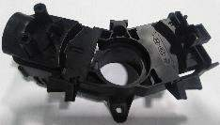
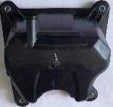
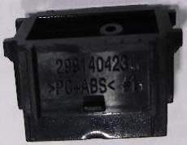
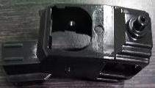
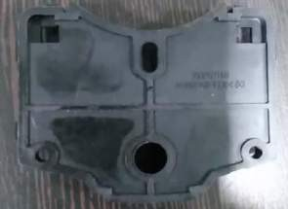
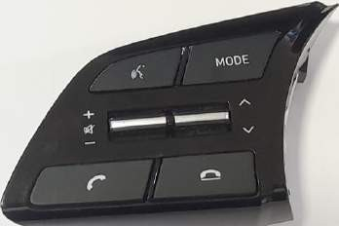
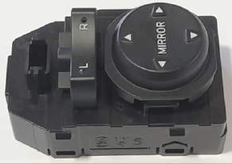
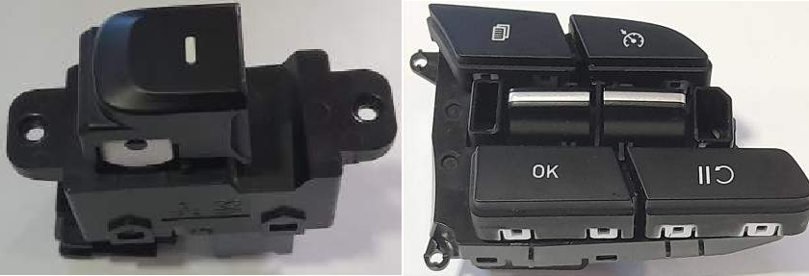
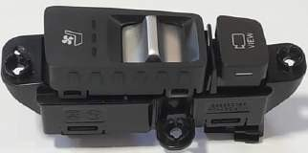
BACK TO COVER PAGE
ABOUT US ^{SOLUTIONS} CUSTOMERS & SERVICES |  | PRODUCTS | MACHINERY FACILITIES CERTIFICATES CONTACT US
Injection Molded Parts
PA66G30%
Nylon66 GF40%
PC ABS NS5000c
POM F20-03
PA66 GF30%
GPP Moulded Parts used in Final
Assembly at Customer end.

Slide 10
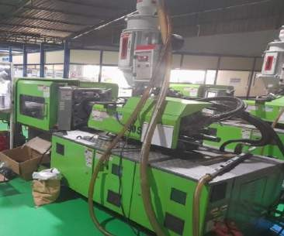
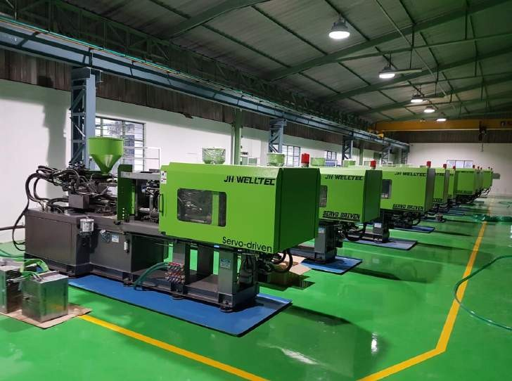
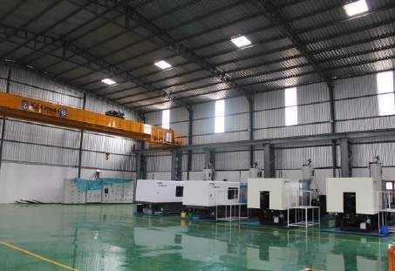
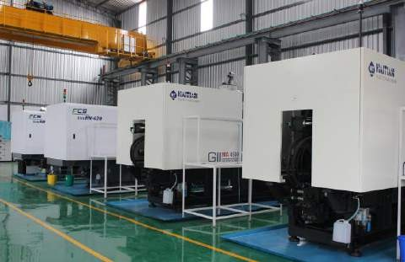
BACK TO COVER PAGE
ABOUT US | SOLUTIONS & SERVICES | CUSTOMERS PRODUCTS | MACHINERY | FACILITIES | CERTIFICATES | CONTACT US
Injection Molding Machine and Line
We are well equipped with 14 injection moulding machines ranging from a capacity of 90 tons to 470 tons to handle shot weights from 1 gm to 1200 gm. The current machineries includes JH-WELLTECH, FCS and HAITIAN with all the supporting equipment like Hopper, Auto loaders, Chillers, MTC’s, Crane, Annealing oven and Genset of 125KVA.

Slide 11
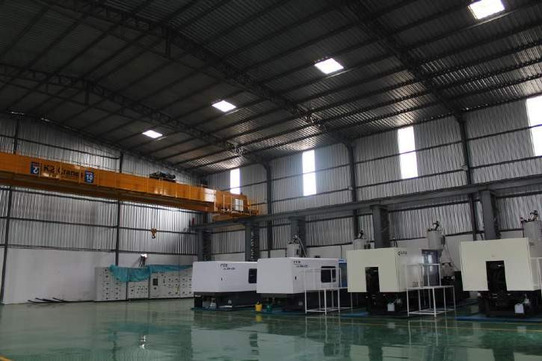
BACK TO COVER PAGE
ABOUT US | SOLUTIONS & SERVICES | CUSTOMERS PRODUCTS | MACHINERY |  | FACILITIES | CERTIFICATES | CONTACT US
Expansion of Guru Poly Products
Under our expansion plan, 9000Sqft built up area in the same premises have been added with 4 more higher tonnage machines 450T (2 no’s) and 470T (2 no’s) of HAITIAN & FCS and all other supporting accessories Like Hopper, Autoloaders, MTC, 10T Crane etc.

Slide 12

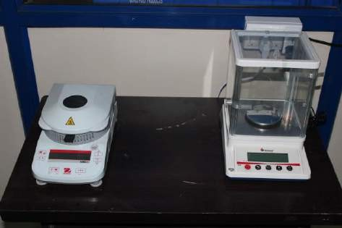
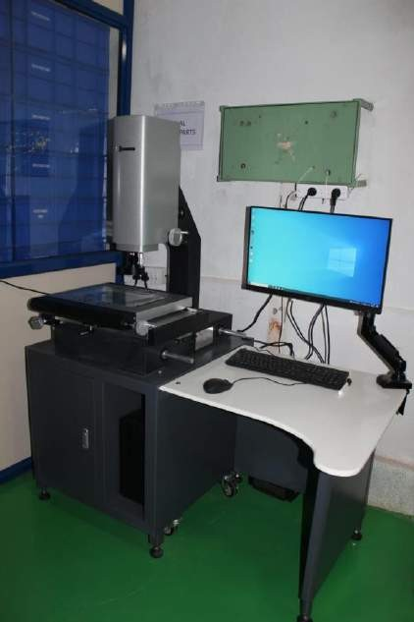
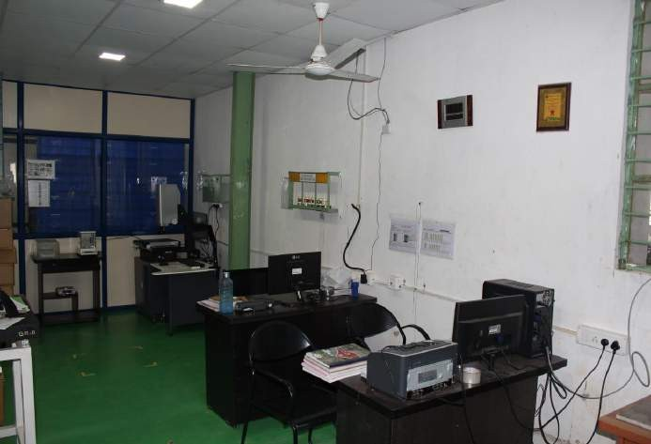
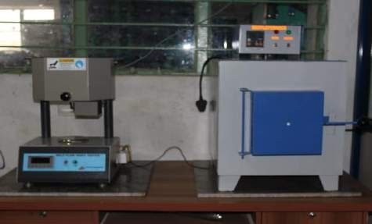
BACK TO COVER PAGE
ABOUT US
SOLUTIONS
& SERVICES
CUSTOMERS PRODUCTS
MACHINERY
FACILITIES
CERTIFICATES
CONTACT US
Metrology Lab
Moisture Analyser
MFI
Muffle furnace
VMM

Slide 13
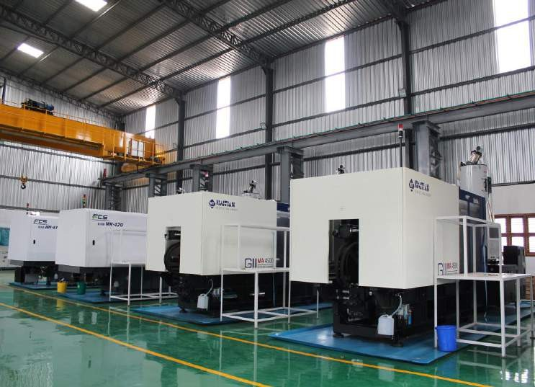
BACK TO COVER PAGE
SOLUTIONS
& SERVICES
FACILITIES
CERTIFICATES
ABOUT US
CUSTOMERS PRODUCTS MACHINERY
CONTACT US
Moulding

Slide 14
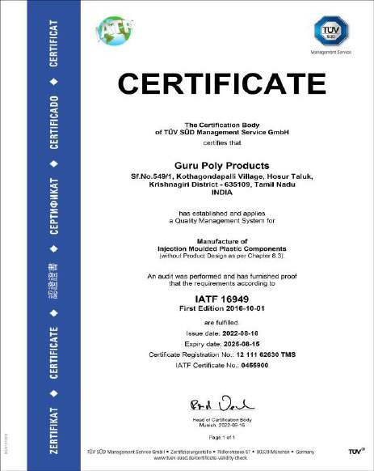
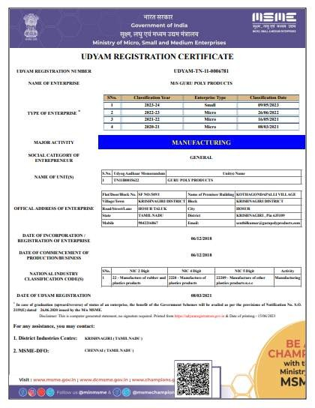
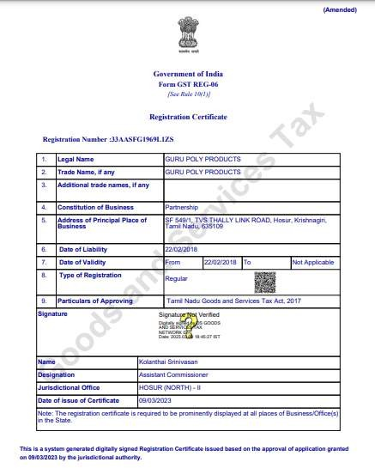
BACK TO COVER PAGE
ABOUT US
SOLUTIONS
& SERVICES
CUSTOMERS
PRODUCTS
MACHINERY
FACILITIES
CERTIFICATES
CONTACT US
IATF16949 -2016
MSME Certificate
GSTIN Certificate

Slide 15

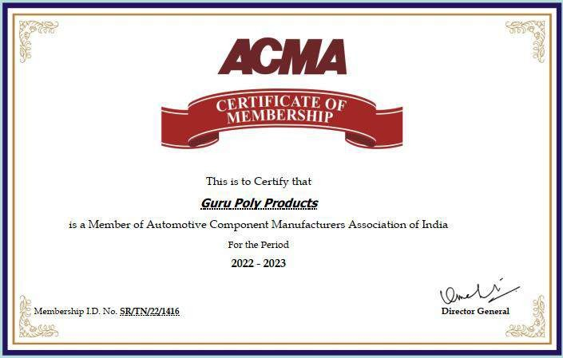
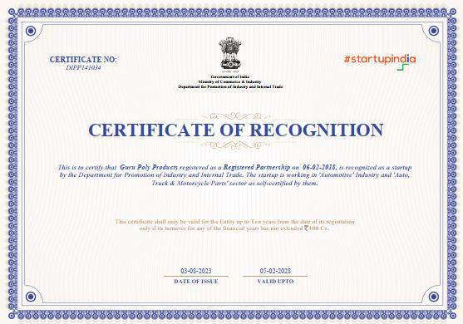
BACK TO COVER PAGE
ABOUT US | SOLUTIONS & SERVICES | CUSTOMERS PRODUCTS | MACHINERY | FACILITIES | CERTIFICATES | CONTACT US
Startup Recognition Certificate
ZED Gold Certificate
ACMA Member ship Certificate

Slide 16
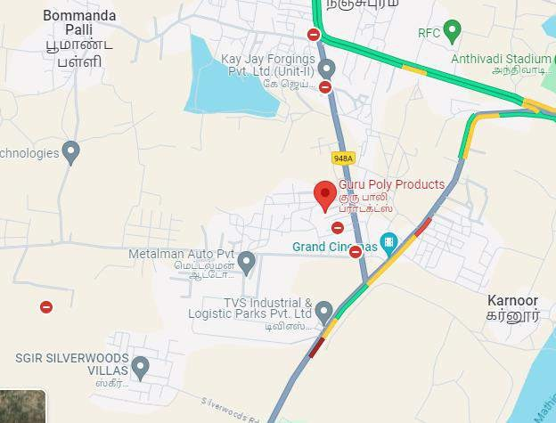
BACK TO COVER PAGE
ABOUT US
SOLUTIONS
& SERVICES
CUSTOMERS
PRODUCTS
MACHINERY
FACILITIES
CERTIFICATES
CONTACT US
Plant Address
SF. No: 549/1, Kothagondapalli Village, Hosur Taluk, Krishnagiri district-635109, Tamil Nadu
Contact Person
AK Hussain
Managing Partner- Business Development
Contact Details
Mobile / WhatsApp: +91 9941820220
Web site :www.gurupolyproducts.com
Email: akhussain@gurupolyproducts.com

Slide 17


We Assure our exceptional services at all TIME..
Starting together is a beginning..
Working together is Progress…
Remaining together is Success…
Thanking You ….for your valuable time and patience...
Awaiting your PROPOSALS ...
With Kind Regards… GPP Team…

