Slide 1


Slide 2
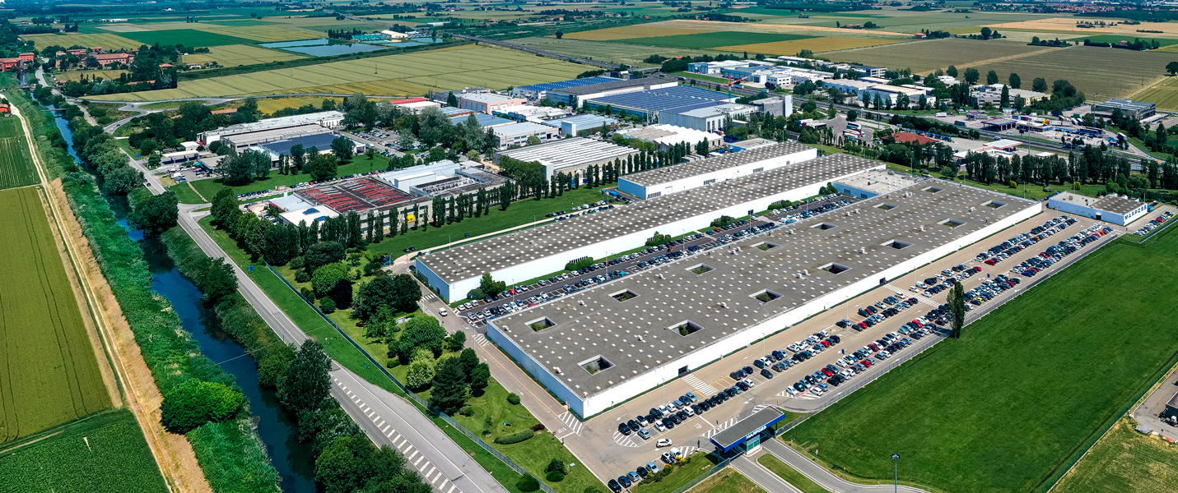
MARPOSS
Marposs can supply a widest range of equipment for quality and manufacturing process control in production environment.
Marposs has become a world leader in measurement technology by offering to its customers a combination of advanced products, market knowledge and commitment to long term global partnerships.
Marposs is directly present with its own
sales and service organization in 25 countries and has a network of agents and distributors in another dozen countries.

Slide 3

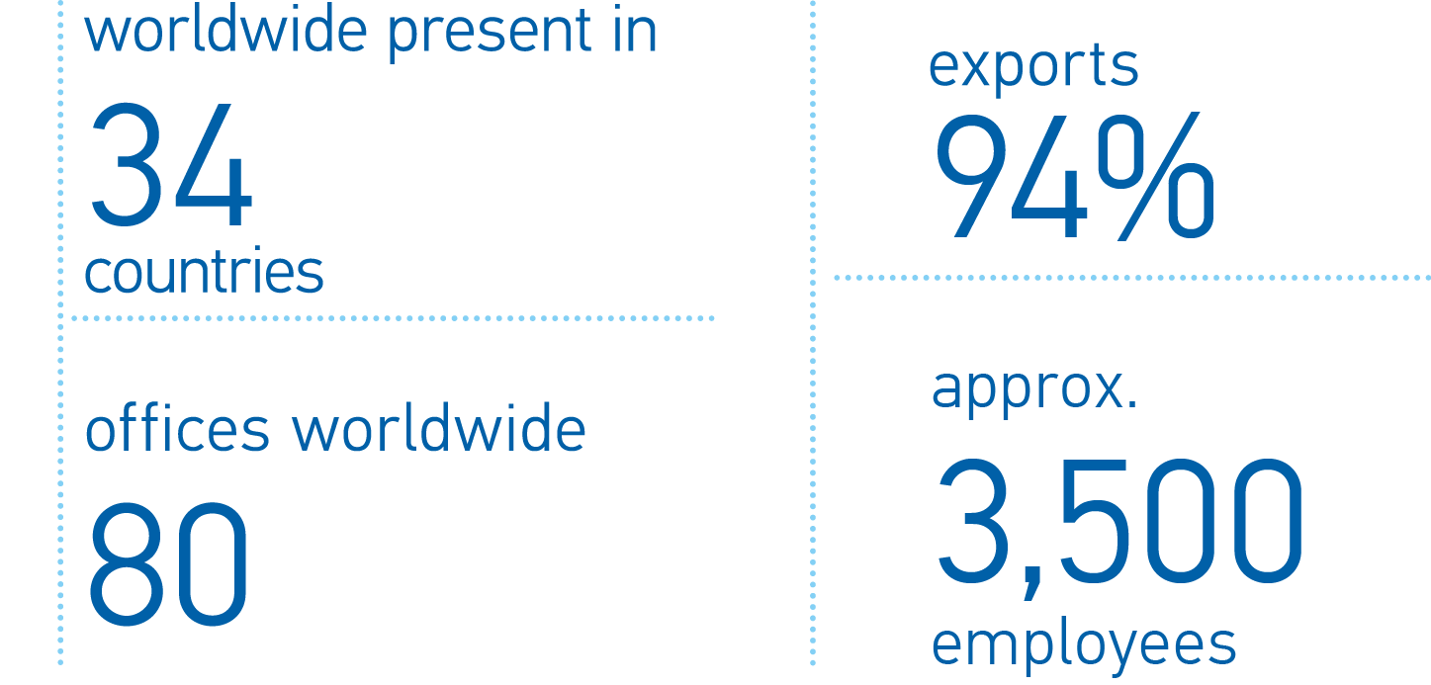
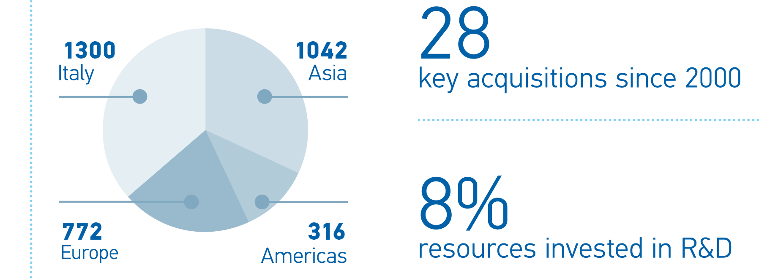
THE GROUP IN FIGURES
The Group in figure

Slide 4
WORLDWIDE PRESENCE
The Group in figure
Main Sales and Service
Centers in:
Germany, China, USA, Japan, Italy
Main Manufacturing
Plants in:
Italy, China, Germany, USA,
France

Slide 5









MARKET
  END USERS
Automotive
  SYSTEM INTEGRATORS
Aerospace
Machine tool makers
Biomedical
Gauge & fixture makers
Glass
Energy
3C
Bearing, electric motors, compressors

Slide 6
MARPOSS PRODUCT RANGE
Applications for machine tools
(grinding, cutting, forming and stamping machines)
Tool Control
Machine and Process Monitoring
Part Measurement
In-process gauges and touch probes;
post-process gauges and plugs for interoperational or final inspection
Grinding wheel balancers; sensors to control force, power, vibration, noise, displacement; part, die and tool deformation and MES (Manufacturing Execution Systems) software
Contact and non-contact (laser) systems
for tool measurement monitoring and compensation

Slide 7
MARPOSS PRODUCT RANGE
Gauging, inspection, testing and assembly solutions
Inline gauging
Inspection
Testing
Offline gauging
Assembly
Gauging machines and automatically loaded stations for 100% dimensional and geometric inspection
Manually loaded benches and hand-held gauges (variable and attribute types)
Machine Vision-based inspection solutions
Leak test, NDT and functional testing solutions
Automatic assembly solutions integrated also with inspection and testing

Slide 8
MARPOSS PRODUCT RANGE
Gauging components
for end users, system integrators and gauge makers
Standard Gauging Components
Display units, Industrial computers
Software
Pencil type probes, gauging components for fixtures, interface units for data acquisition
SPC and quality control software, data collection
Indicators, column and microcolumn displays, embedded gauge computers

Slide 9
TECHNOLOGY RANGE
Contact gauging
Non-contact gauging
Vision systems
Leak testing
Process monitoring
sensors and software
Functional testing
Electronic, Air-to-electronic, Hard gauging
Shadow casting, Reflectometer, Interferometer, Choromatic confocal
Infrared and High resolution cameras
Position, Force, Vibration an MES software
Pressure decay, Mass flow, Mass spectometer (vacum chamber, sniffer)
Laboratory and end-of-line testing of
e-motors and fuel cells

Slide 10
MARPOSS PRODUCT RANGE
MARPOSS products
Applications for machine tools
Gauging and testing systems
Gauging components for end users, system integrators and gauge makers

Slide 11
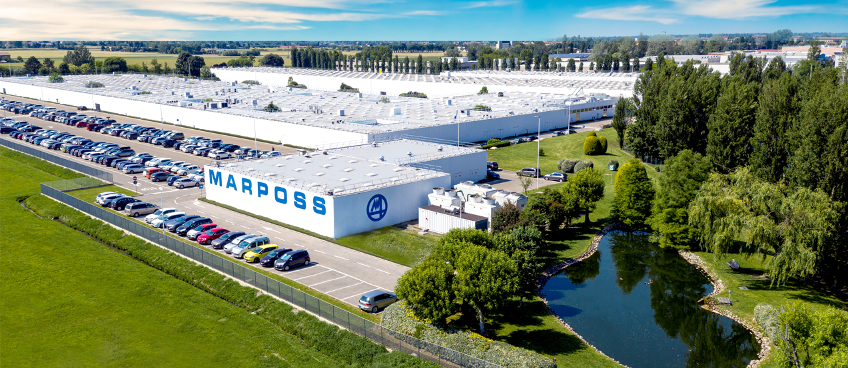
THE HEADQUARTERS
Marposs SpA (Italy)
Bentivoglio (Bologna)
Plant 39,600 sqm
Employees in HQ 699

Slide 12
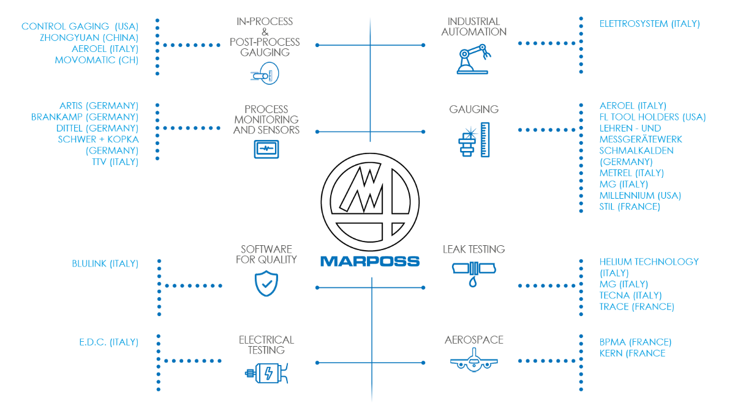
THE GROUP

Slide 13


The contents of this document are the exclusive property of Marposs S.p.A., Bentivoglio (BO), Italy.
Without prior written consent, they cannot be used, totally or partially, for purposes different from those expressly allowed. Offenders will be prosecuted.
MARPOSS, , and other Marposs name/signs shown herein are registered trademarks or trademarks of Marposs in the U.S.A. and other Countries.
© COPYRIGHT 2022 MARPOSS S.p.A. - ITALY. All rights reserved.

