Slide 1






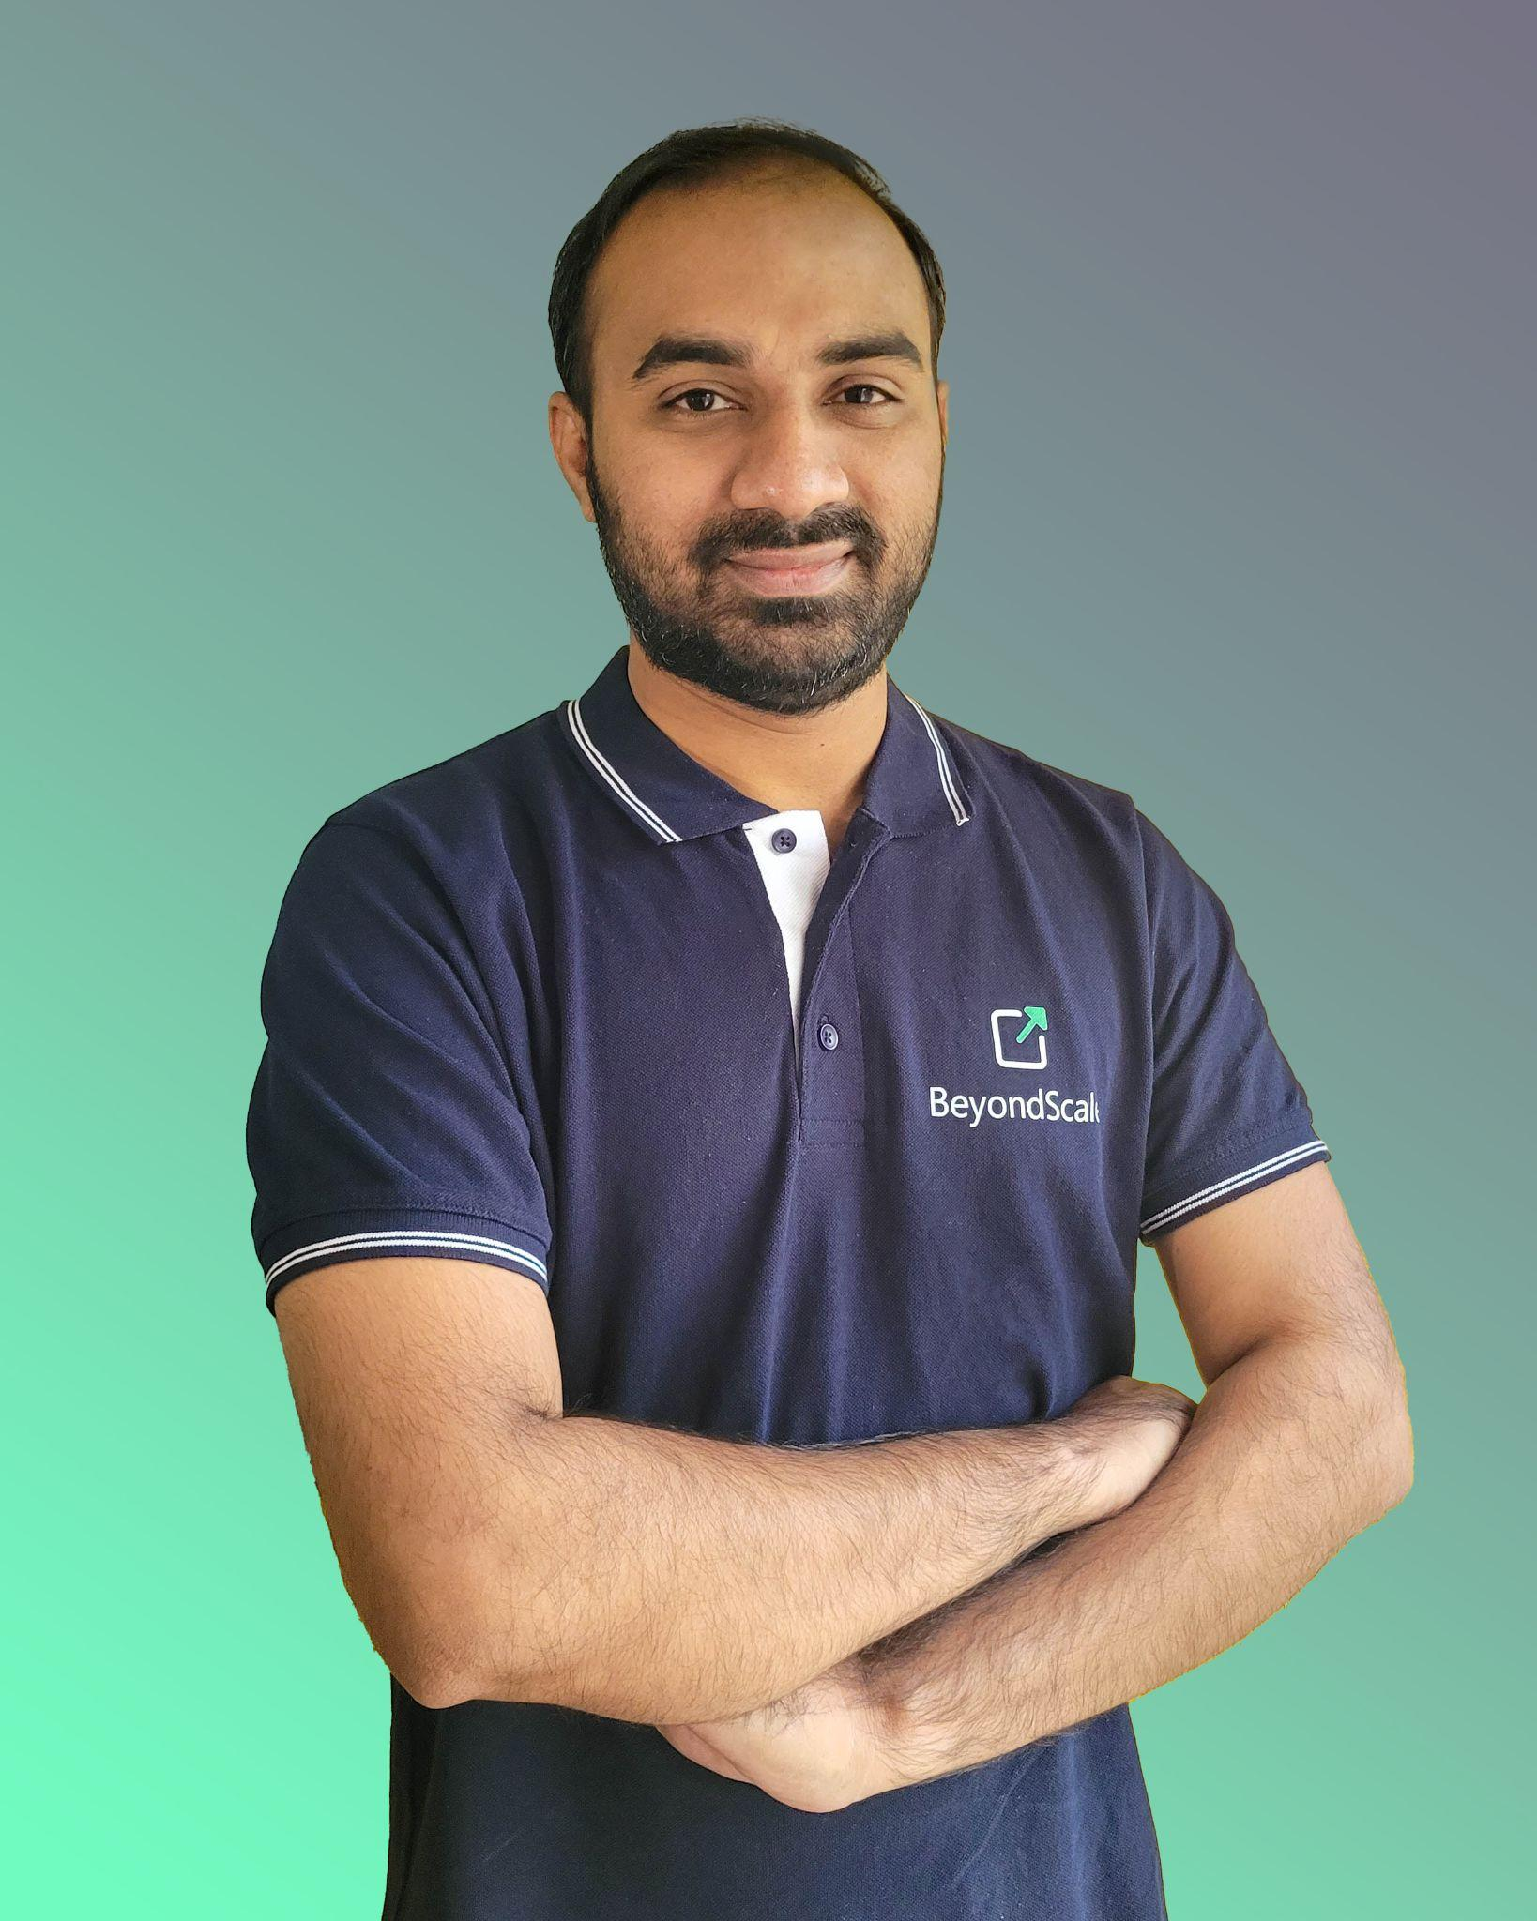
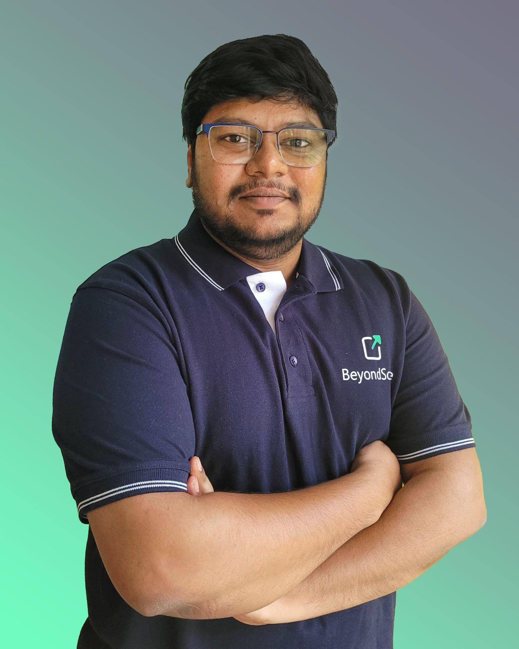
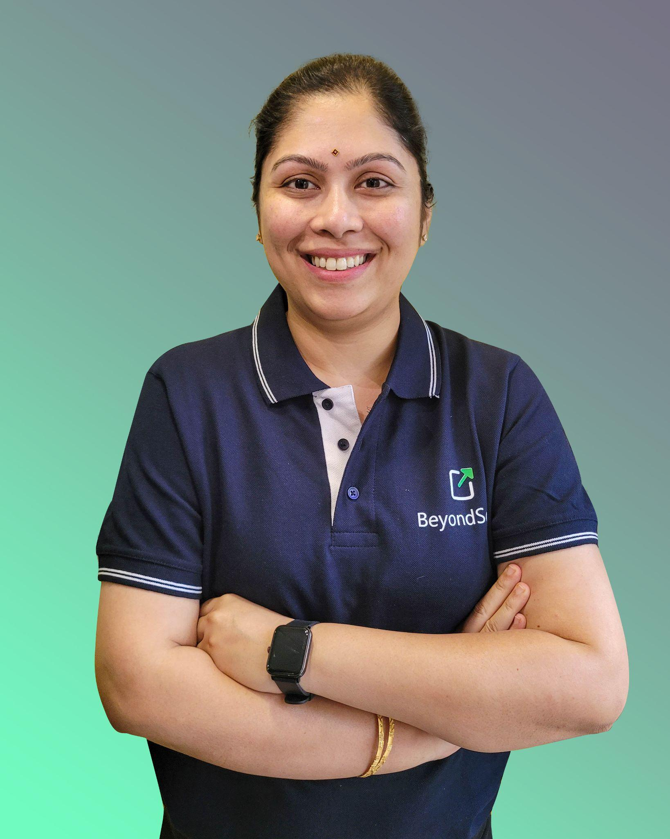
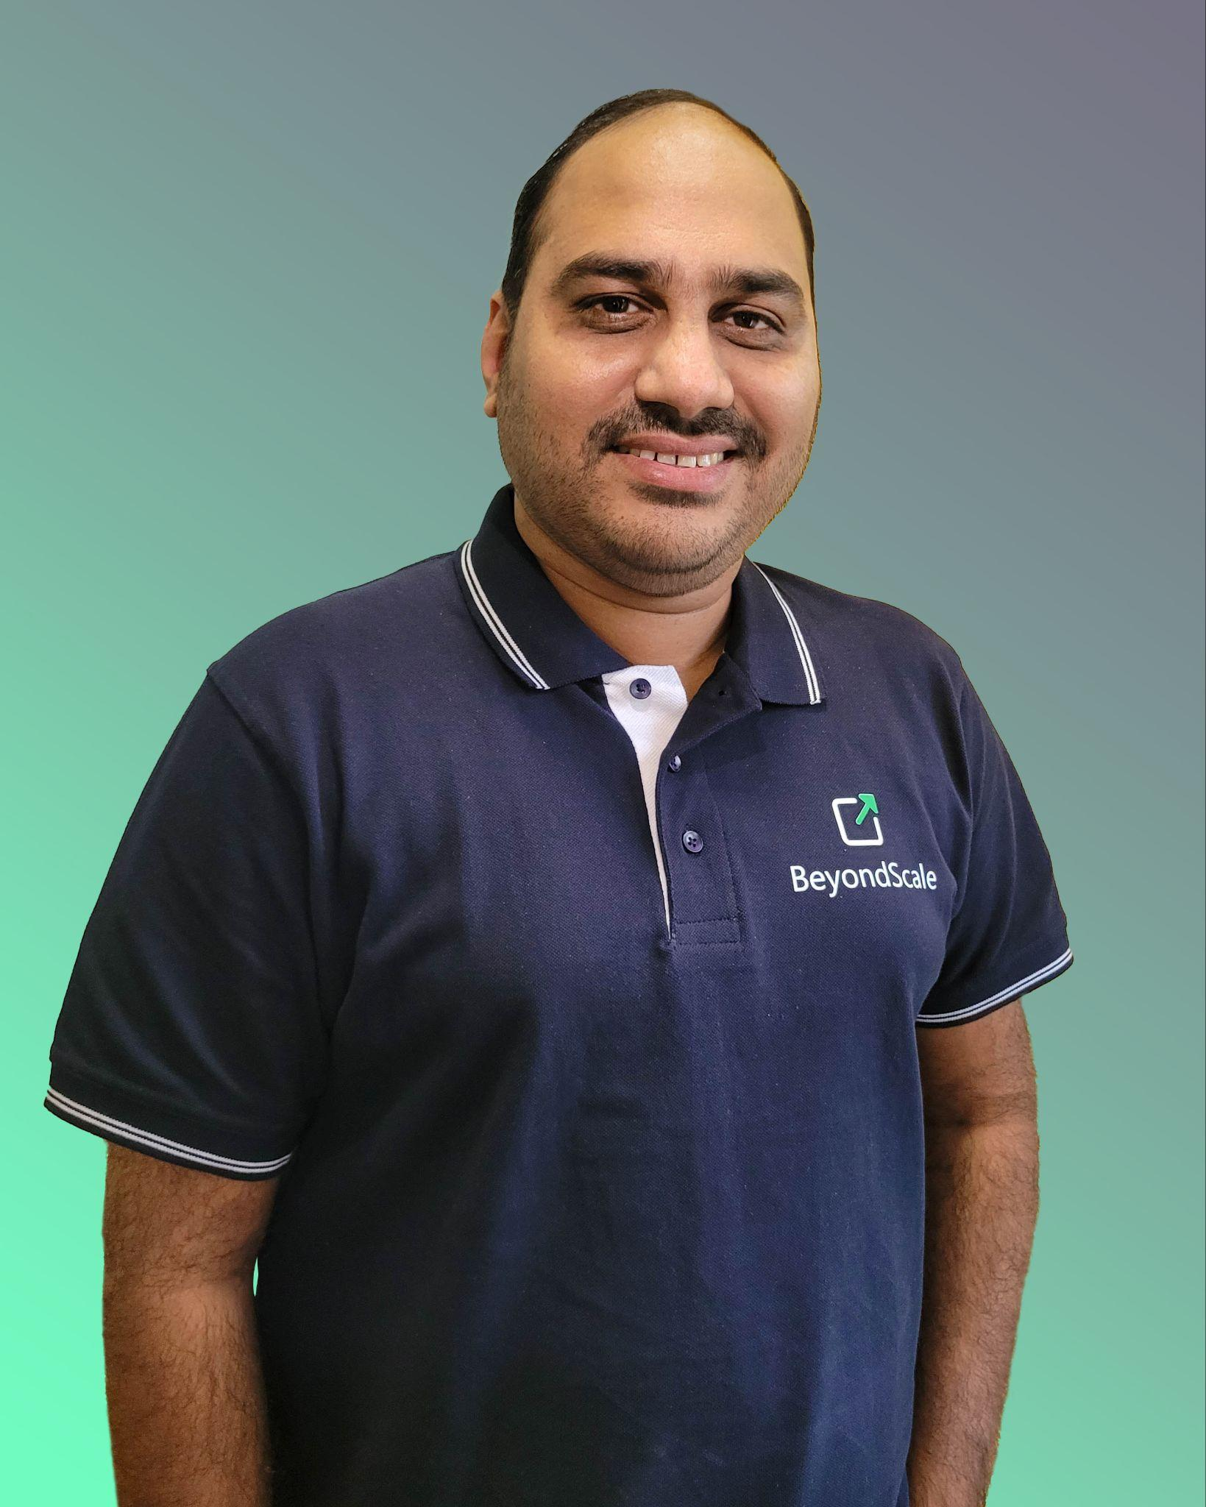









BeyondScale Technologies - Corporate Overview
At the forefront of digital innovation, crafting solutions for business excellence
Solutions Offered
8+
Years of Execution Excellence
18
Businesses Served
Data governance, ingestion, integration, processing & analysis
Real time critical assets monitoring with Industrial IoT
Tailored AI/ML solutions customising Foundational Models
Security Orchestration, Automation and Modernisation (Containerisation & Microservices)
Full Stack development. Custom dashboards and mobile applications
27
Projects Delivered
12k+
Development Hours
Data Governance, Ingestion, Integration, Processing & Analysis
Our Team
Key Customers
Have a project in mind?
Let’s connect
swetha@beyondscale.tech
+91 7386140798
Shashank Punuru, CEO
BITS Pilani ,Technology Leadership
Jeevan Sashank, CTO
IIT Chennai, AI/ML, Web 3.0
Nikhila Sattala, Lead
Ericsson, Nokia Siemens, Infrastructure
Sai Kurada, Lead
WIPRO, Fujitsu, Cloud/Citrix
Confidential: BeyondScale Technologies Pvt Ltd

