Slide 1


股份代码：HK.02166
SMC Product Portfolio
SMC-DTDS
2023.03.23

Slide 2
MediaTek
Simple Connect TV
(SCTV)

Slide 3

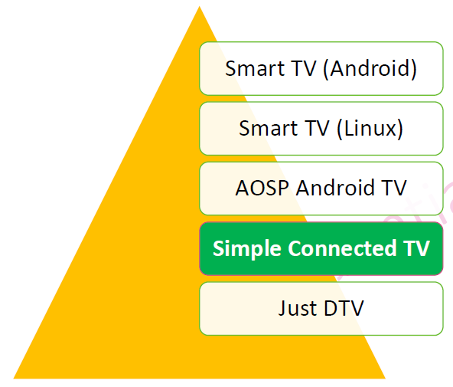

MediaTek Simple Connect TV
Why Choose Simple Connected TV
High entry barrier in quantity and cost to get Google certificate.
Middle-ware technical input caused time waste and cost increase .
AOSP non-certified device been blocked to watch YouTube in 2020.
Hi-performance SoC , low density DRAM and Flash to save cost. (DRAM Embedded 512MB , External 256MB , Nand 4GB)
Supported Miracast .
Dolby Audio hightly Improves the sound quality
Use web Browser engine to connect local CSP
Value added through embedded Advertising service.

Slide 4
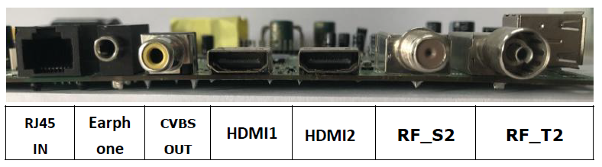

H/W Specification
SoC: MediaTek MT5686
  CPU: ARM CA53x4
  GPU: Mali470MP3
OS: Linux
DRAM: 768MB
eMMC: 4GB
Wi-Fi: 802.11 b/g/n
Ethernet LAN
FHD 2K TV
USB1
USB2
CVBS in
L
R

Slide 5
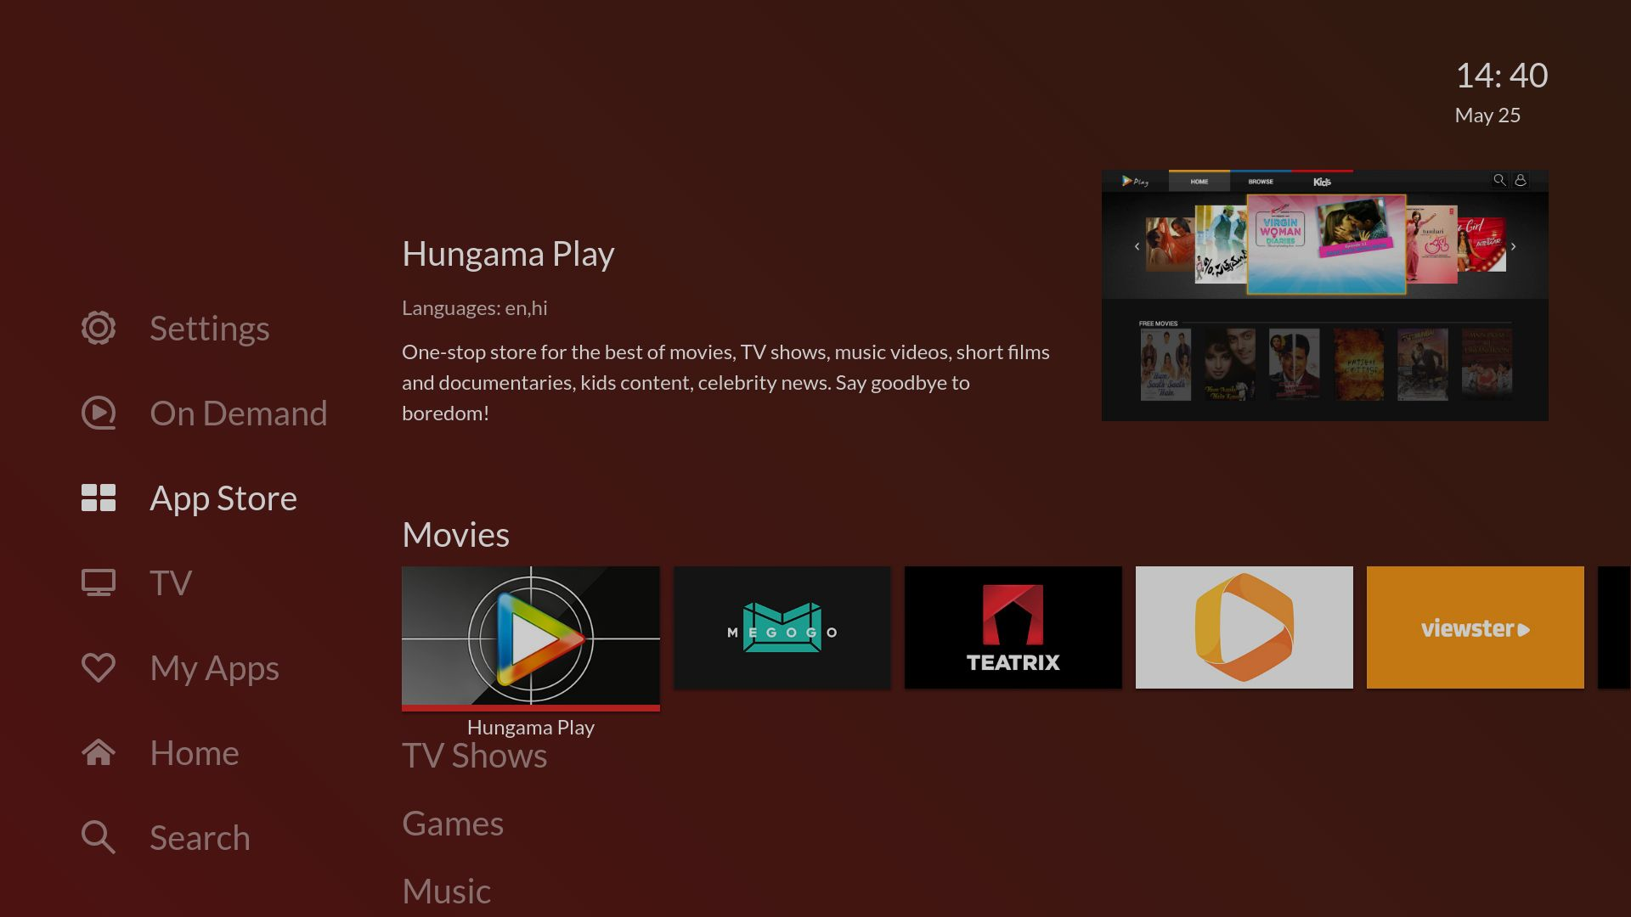
Launcher with HTML5 Formate

Slide 6


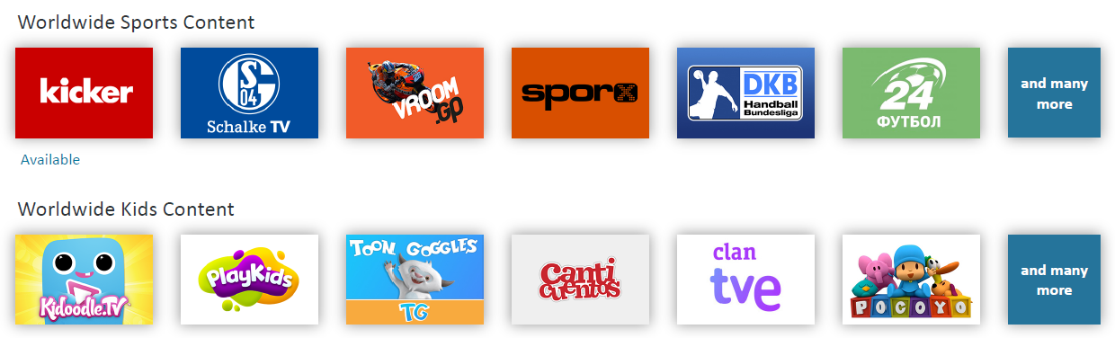
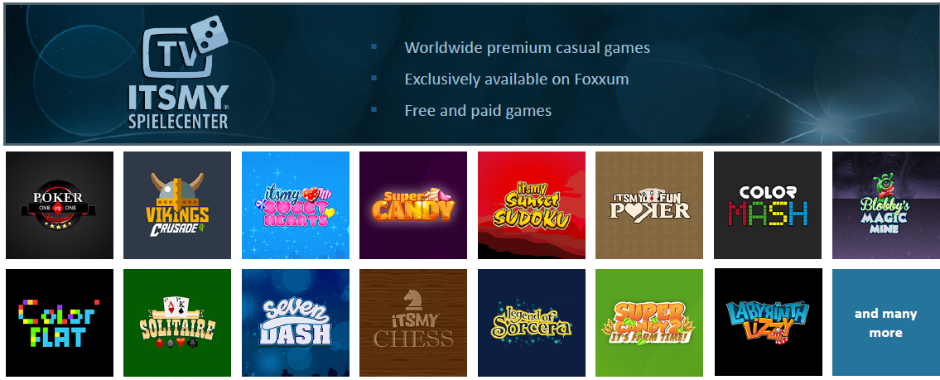
OTT Content
  YouTube & YouTube Kids Certified
Extend OTT Content via Foxxum:
  Worldwide Sports Content
  Worldwide Kids Content
  Game
  Education
  local popular OTT:
    Sony Liv
    VIU
    Yupp TV
    Eros Now
    Chaupal
    Plex
    ClouDDy
    Kral TV
    VINTERA.TV
    … etc

Slide 7

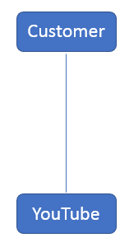
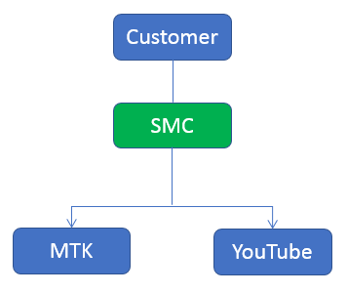
YouTube Certification
Difficulty:
Difficult to get Google agreement
Slow response from YouTube for the application process
Non-certified device will be blocked from 2020
Solution:
Coordinated with MTK and YouTube, SMC could provide One-stop service to complete YouTube certification

Slide 8
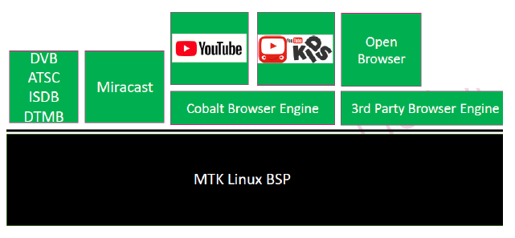
SCTV SW Architecture

Slide 9
Certified YouTube Hybrid Box

Slide 10

Certified YouTube Hybrid Box
Certified YouTube
Hybrid Box
SoC: MediaTek MT5686
OTT features:
  YouTube & YouTube Kids Certified
  Local Popular OTT Apps
  Casual Games from prominent brands
Interface:
  HDMI In x 3
  DVB-T2 x1 (w/o CA)
  DVB-S2 x1 (w/o CA)
  Ethernet 100M x1
  Wi-Fi + BT x1
  USB 2.0 x2
  HDMI Out x 1
HDMI In x3
DVB-T2 x1
DVB-S2 x1
Ethernet x1
HDMI Out x 1
Wi-Fi+BT x1
USB 2.0 x2
RC can be integrated with RC of current box as one.

Slide 11
YouTube Certification
Difficulty:
Difficult to get Google agreement
Slow response from YouTube for the application process
Non-certified device will be blocked from 2020
Solution:
Coordinated with MTK and YouTube, SMC could provide One-stop service to complete YouTube certification

Slide 12
OTT Content
  YouTube & YouTube Kids Certified
Extend OTT Content via Foxxum:
  Worldwide Sports Content
  Worldwide Kids Content
  Game
  Education
  local popular OTT:
    Sony Liv
    VIU
    Yupp TV
    Eros Now
    Chaupal
    Plex
    ClouDDy
    Kral TV
    VINTERA.TV
    … etc

Slide 13
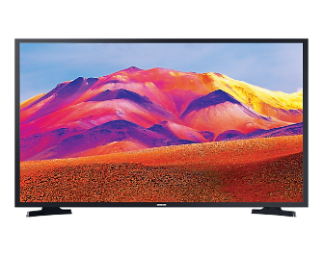
Upgrade TV in market
Current TV:
  DVB-C
  No Internet
  No YouTube
Current TV:
  DVB-C
  No Internet
  No YouTube
HDMI
Upgrade TV
  DVB-T2
  DVB-S2
  Ethernet
  Wi-Fi
  YouTube
  OTTs
Certified YouTube
Hybrid Box

Slide 14
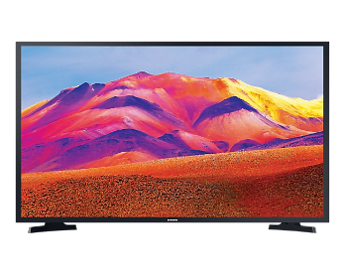


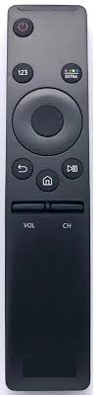
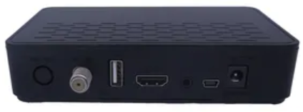
Upgrade STB in market
HDMI
Upgrade
STB+CA
  DVB-T2
  DVB-S2
  Ethernet
  Wi-Fi
  YouTube
  OTTs
Certified YouTube
Hybrid Box
HDMI
Current STB:
  DVB-C
  CA
  No YouTube
HDMI
STB + CA
(Linux)
Current STB:
  DVB-C
  CA
  No YouTube
STB + CA
(Linux)

Slide 15
SCTV SW Architecture

Slide 16
IP Camera
(IPC)

Slide 17
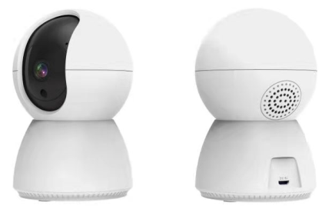
Indoor AI IPC - SigmaStar SSC335
80mm
APP
Resolution
Corelink App
3MP (HD)
Sensor
WIFI Protocal
1/2.8”low-light
2.4G 802.11b/g/n
120mm
Intercom
Pan-Tilt Angel
Buit-in Mic & Speaker
Vertical 65°，Horizontal 355°
Night Vision Distance
AI Features
10m
Human detection & tracking
Face detection
Car detection
Dog/cat detection
Supported
Android/IOS
Working Power
5V/2A
CoreLink Confidential

Slide 18
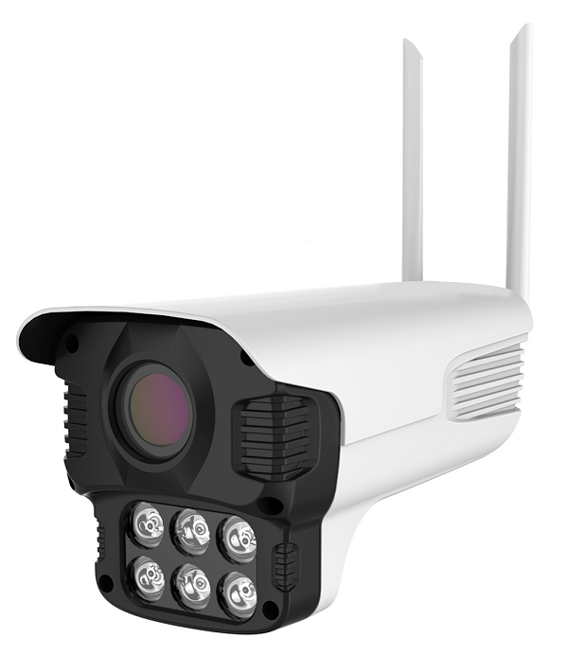
Outdoor AI IPC - SigmaStar SSC335
APP
Resolution
Corelink App
3MP
Sensor
WIFI Protocal
1/2.8”low-light
2.4G 802.11b/g/n
Intercom
Pan-Tilt Angel
Buit-in Mic & Speaker
Night Vision Distance
AI Features
10m
Human detection & tracking
Face detection
Car detection
Dog/cat detection
Supported
Android/IOS
Working Power
5V/2A
CoreLink Confidential

Slide 19
IPC Software Architecture
Cloud API
Ali Fyeiyan
(Ready)
AWS
(To be delivered)
Other cloud
(To be delivered)
IPC Device Basic Function
User Space
Video/Audio
PTZ/Preset
Led/Button
Reset factory
Human dectection
Motion dectection
OTA Update
Privacy mode
Night vision
Manuf. tool
Device Info
Abnomal sound
ONVIF
RTSP (RTMP) Server/push
TFCard recording
Cloud API Library
Kernel
Wifi Drive
Sensor Drive
Device Control
SMC Source Codes
Uboot
Sigmastar SDK
SigmaStar SSC335 SoC

Slide 20
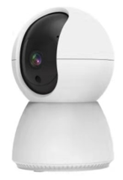
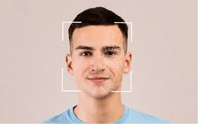

Next Generation of AI IPC
SigmaStar SSC377
CPU:
  Cortex-35 1.0GHz
  0.5Tops NIT8 AI
Resolution:
  5M
AI feature in indoor & outdoor IPC
  Face Recognition

Slide 21
AIoT

Slide 22
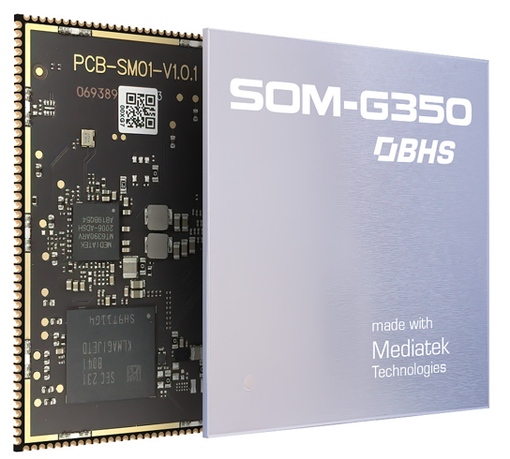
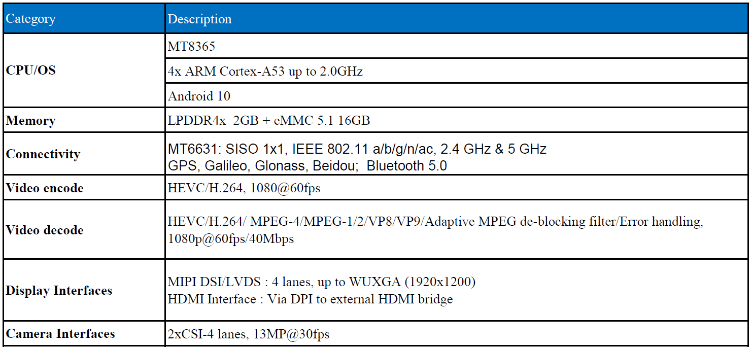
System-on-Module: SOM 350
Size: 52.5 x 52.5 mm

Slide 23
Application of SOM 350
Smart cash registers
Smart POS equipment
Vehicle screen device
Smart home
Industrial smart hand-carried devices
Cargo storage cabinet
Connectivity:
  Wi-Fi 5
  BT 5.0
  GPS
Display:
  MIPI
  LVDS
  HDMI
Camera:
  2xCSI-4 lanes

