Slide 1


Manufacturers of Cutting edge SMT Stencils, Carrier Pallets, Wave Solder Pallets and High Precision Laser Cut components.

Slide 2


Introduction
• We are Apertronics Private Limited.
• Located near Bangalore, India
We introduce ourselves as next generation SMT Stencil and Tooling manufacturers.

Slide 3

Our Vision
•“To be a world-class manufacturer of next generation high precision laser- cut products and SMT tooling.”

Slide 4
Mission Statement
•We will strive for continuous improvement in our technical capabilities in providing high quality products that meet and exceed our customer’s requirements and ensure complete satisfaction.

Slide 5
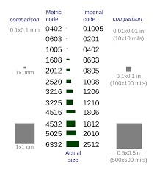
Current Industry Trends
•PCB’s are getting denser and more complex, IC’s are getting smaller with every generation, BGA’s are becoming common.
•The requirements of SMT Stencil are becoming more and more demanding day by day

Slide 6
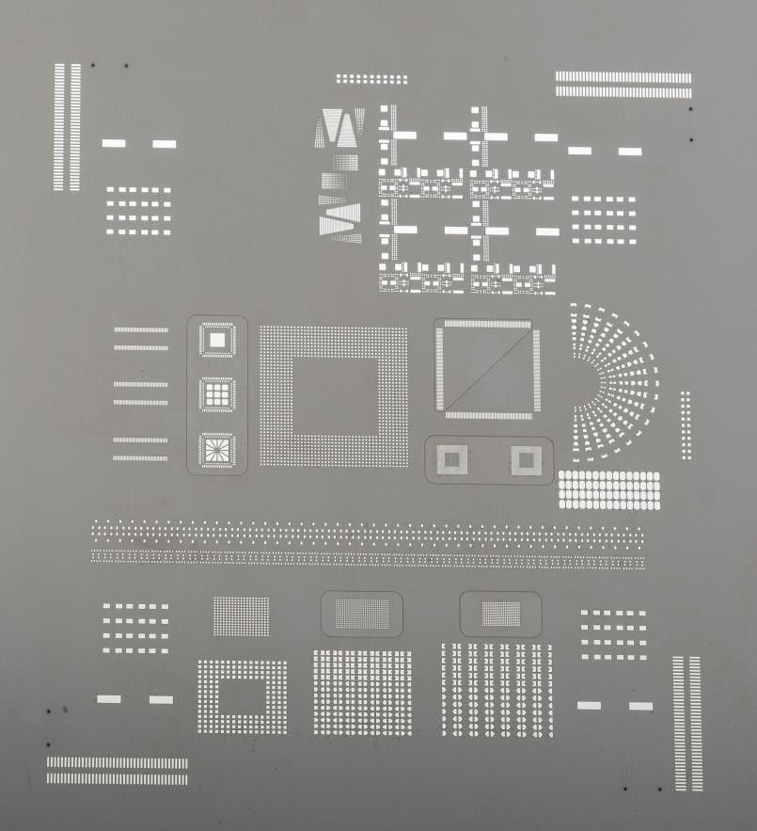
Type of SMT Stencils
• Basic stencil with multiple frame sizes.
• Step up/down & Multi-step stencils
(No theoretical limit on number of Steps)
• Nickel stencils
• Micro-Shield(nano coating) stencil
• Nano slic gold stencil
• Frameless stencil(Tetra-Bond)
• Mini stencil for rework.

Slide 7
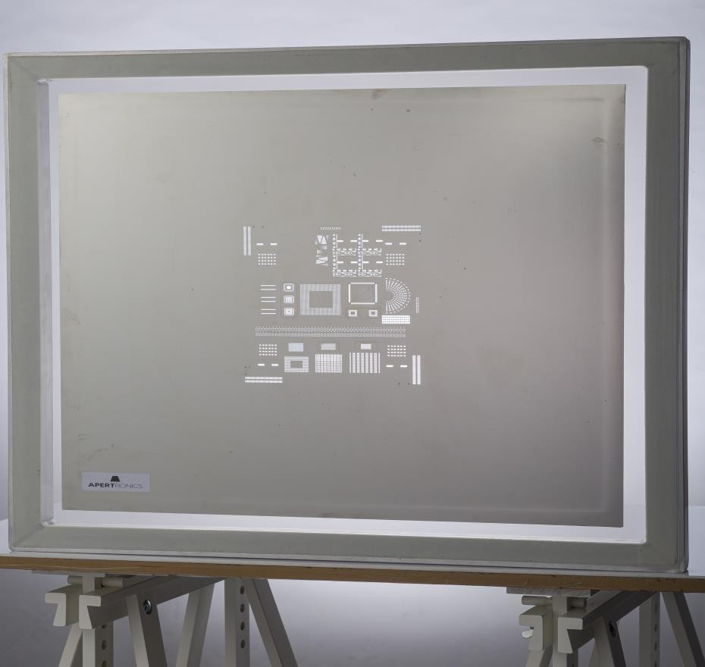
Basic Stencil- with Multiple Frame Sizes
● 29” by 29”
● 23” by 23”
● 650 mm by 550 mm
● 680mm by 650 mm
● 22” by 22”
● 20” by 20”
● 1350 mm by 500mm
● Customised sizes

Slide 8
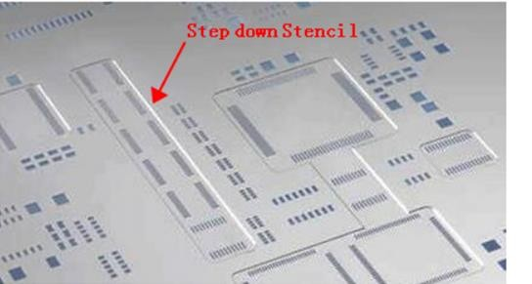
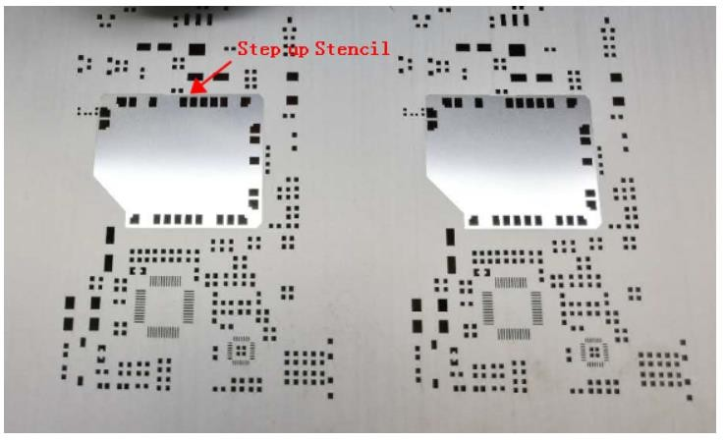
Step up/down & Multi-Step stencils
Maximum Step Difference upto 10 Mils and no changes in surface texture

Slide 9
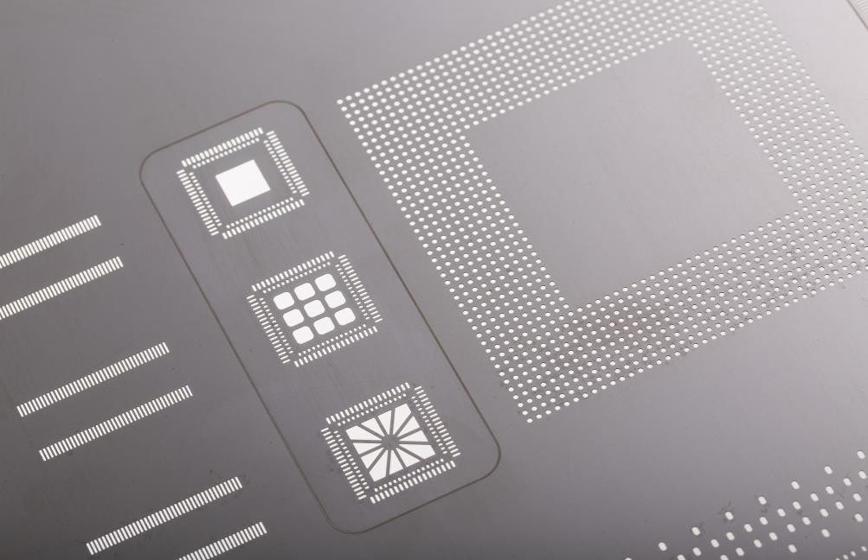
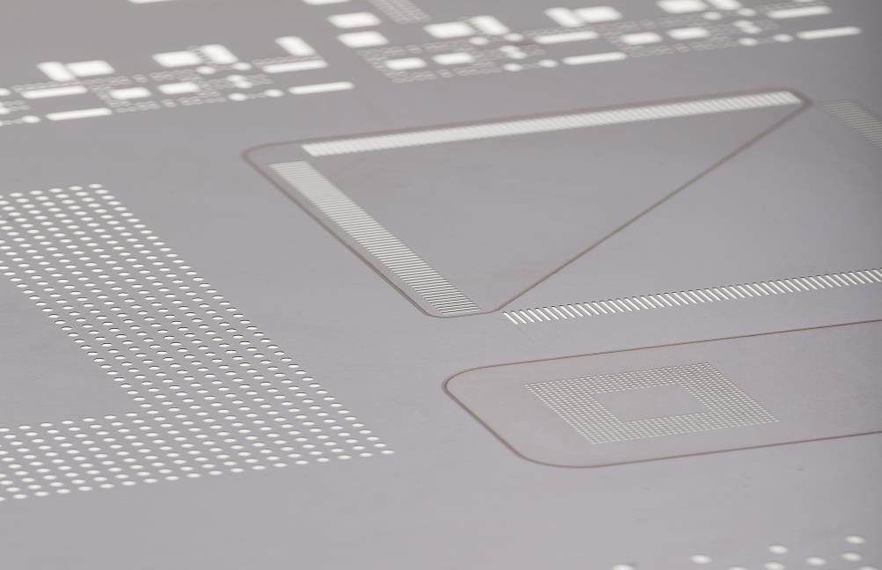
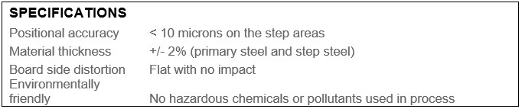
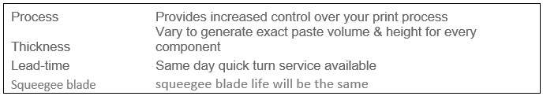
Next Gen technology for step up/down stencils
Step down
Step up

Slide 10

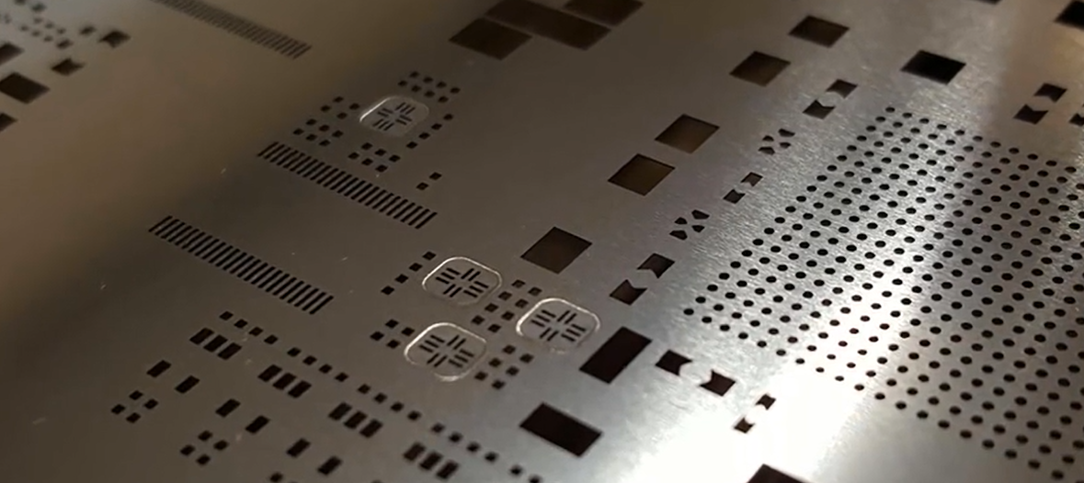
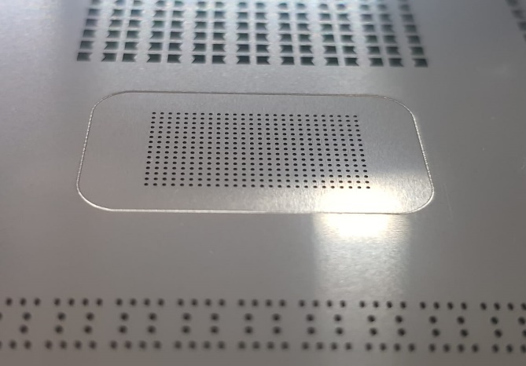
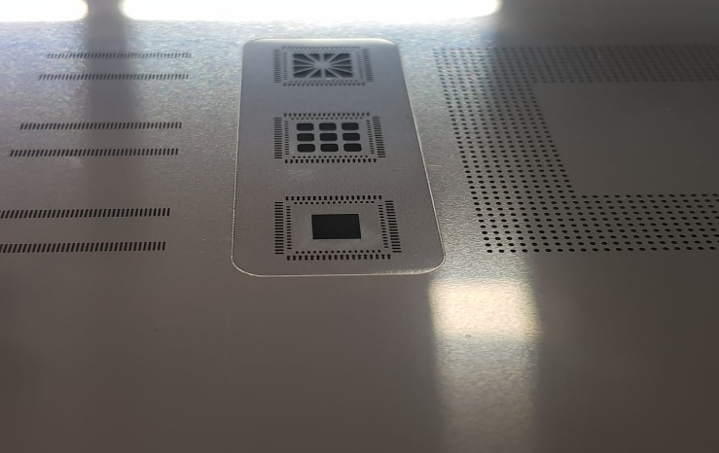
Next Gen technology for step up/down stencils
Manufacturing time 3-4 hours maximum
Step tolerance 2-3 microns
Squeegee damage significantly reduced
No change in the texture of the Stainless Steel
Solder paste release is excellent

Slide 11
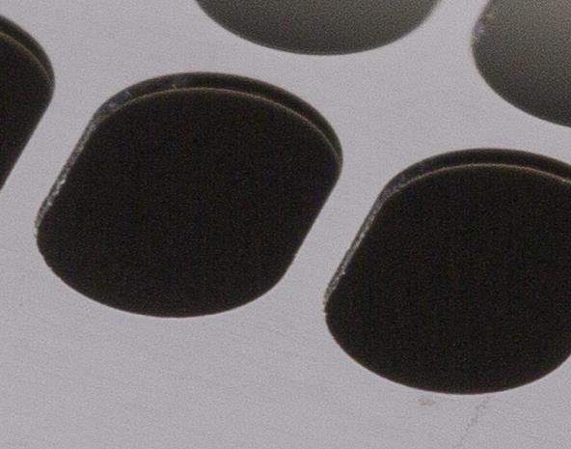
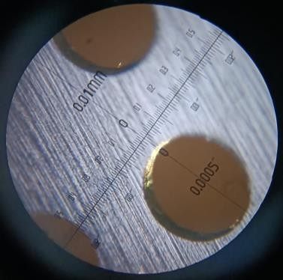
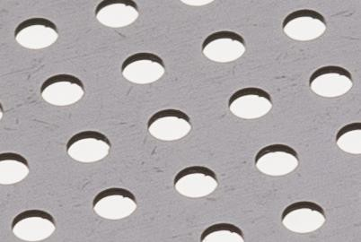
Aperture cutting in side wall
No bur in side the wall

Slide 12
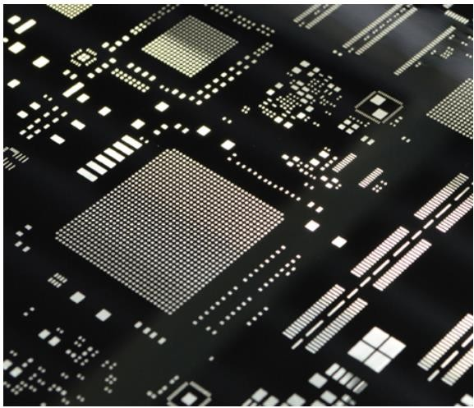
Nickel stencil
Our Nickel Stencils offer:
• High accuracy and repeatability
• Enhanced ultra fine pitch capability(5 Mil Gap)
• Reduced under-stencil cleaning requirements, due
to positive underside gasketing
• Transfer efficiency is optimised in cases of critical Surface Area(SA) ratio
• Stepped area(s) have optimized paste volume
deposit
• Long stencil life – up to twice that of stainless steel stencils
• Nickel stencils can also be shipped the same day, depending on approval and stock availability

Slide 13
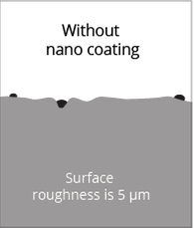
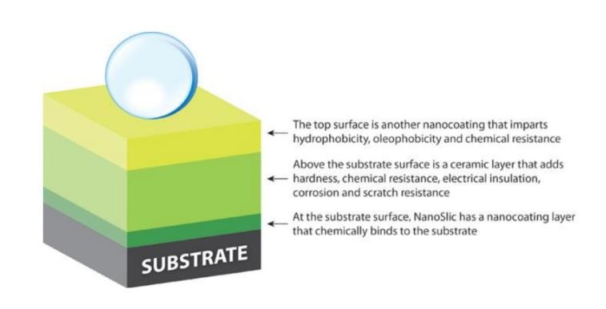
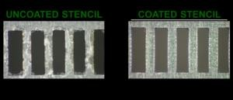
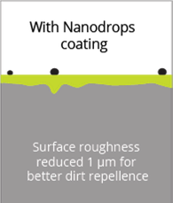
Micro Shield(Nano Coated) Stencil

Slide 14
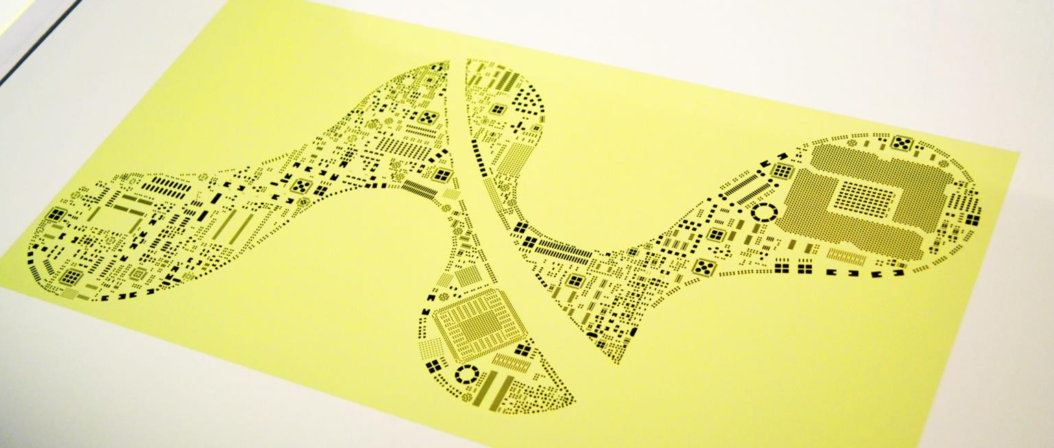
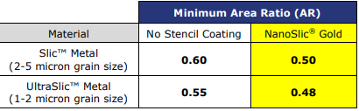
Nano slic gold Stencil
World's Most Advanced Stencil Coating NanoSlic offers the world's most advanced coating for solder paste stencils. The NanoSlic Stencil Coating System is a turn-key system that integrates surface preparation, coating and curing to provide unparalleled printing improvements, transfer efficiency and ease-of-cleaning.

Slide 15
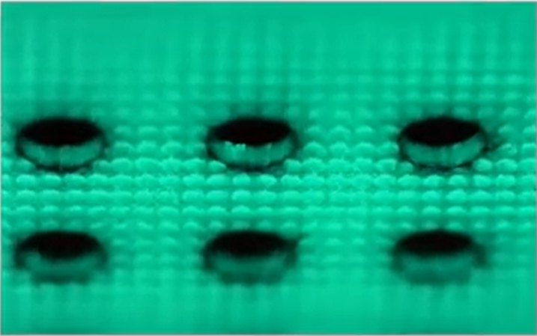
Aperture wall

Slide 16
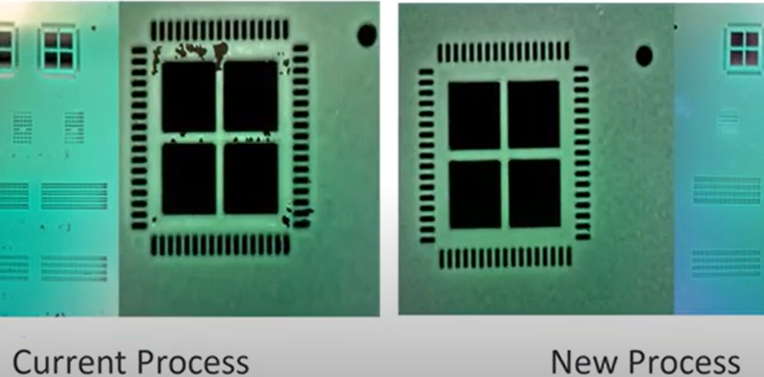
After 25000 print

Slide 17
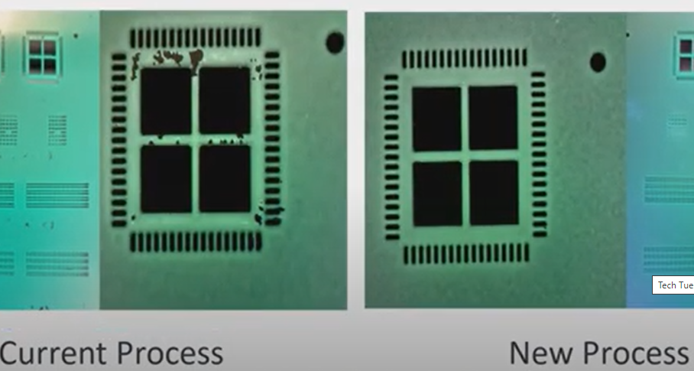
After 50000 print

Slide 18
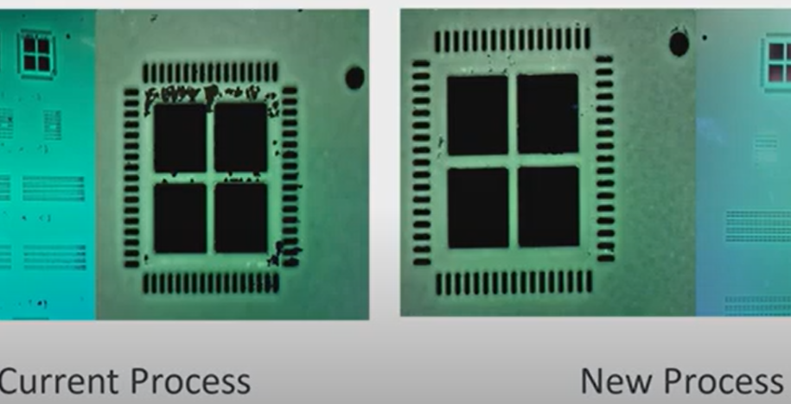
After 75000 prints

Slide 19
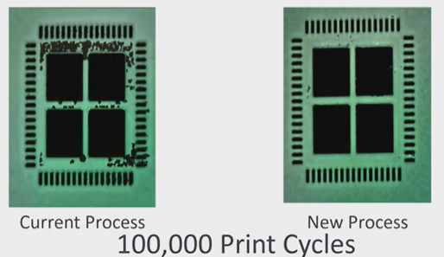
After 100000 prints

Slide 20
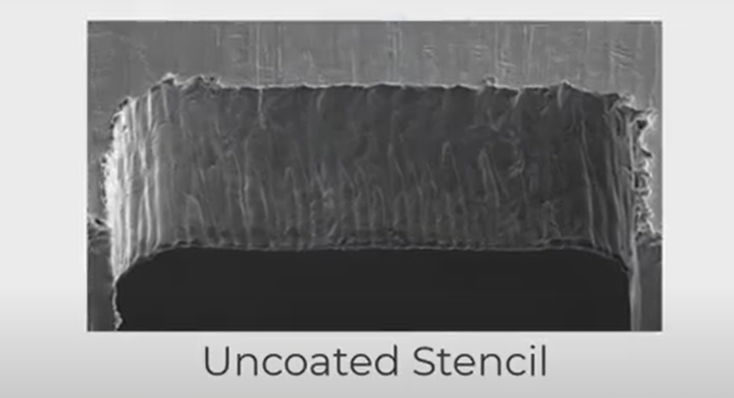
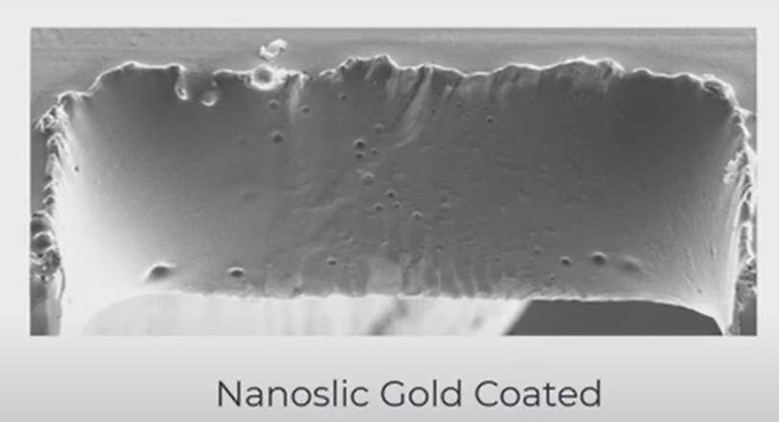
Nano slic coating in aperture wall

Slide 21
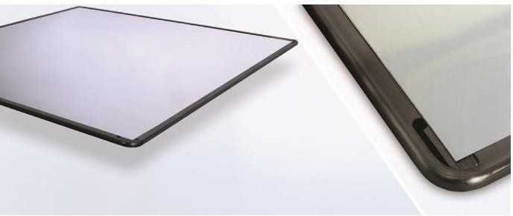
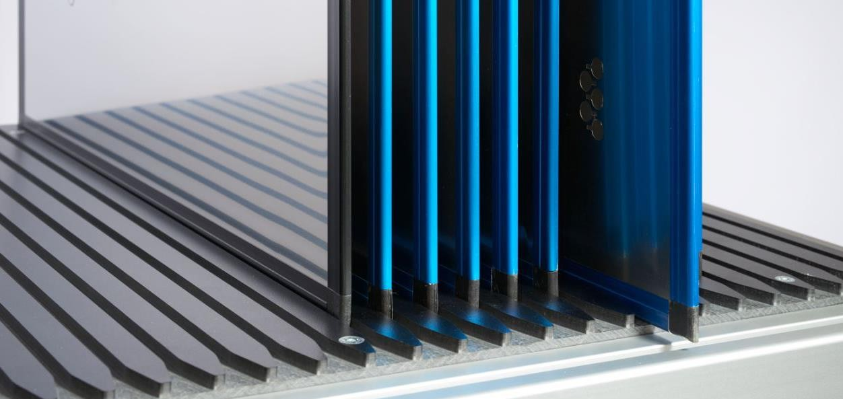
Frameless stencil- TetraBond
Advantages:
● Space saving(⅓ rd space needed)
● Latest generation design
● Moulded Pre-Hard Anodised frame

Slide 22
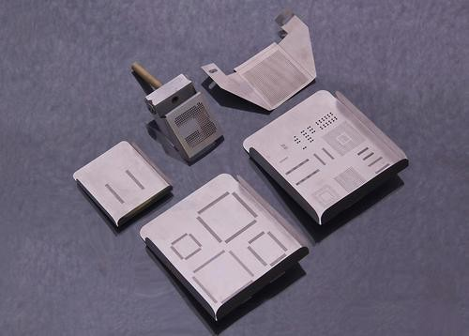
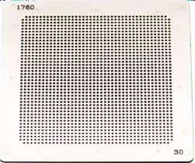
Mini stencils for Rework

Slide 23
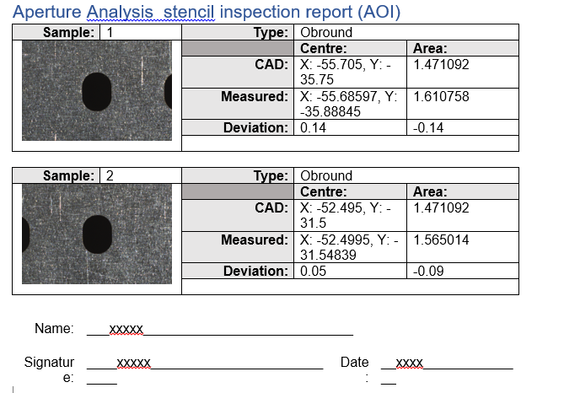
Stencil inspection report(AOI)
Detects clogged apertures or debris that can impact printing integrity, as well as checking aperture dimension, presence, position and area. Area ratio is also calculated.

Slide 24
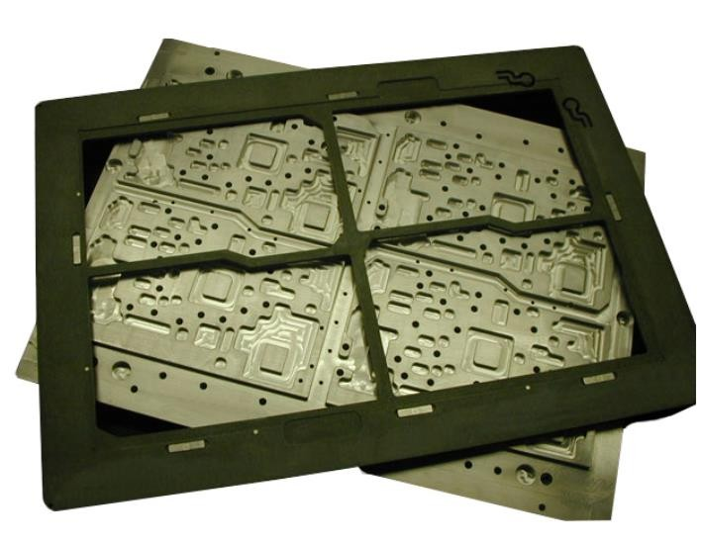
Carrier Pallets
Benefits:
• Reduces setup time
• Eliminates unnecessary PCB handling by operators
• Minimizes PCB warpage
• Eliminates expensive hand masking and related labor costs
• Standardizes process repetition
• Machine parameters can be fixed
• Minimizes soldering defects

Slide 25
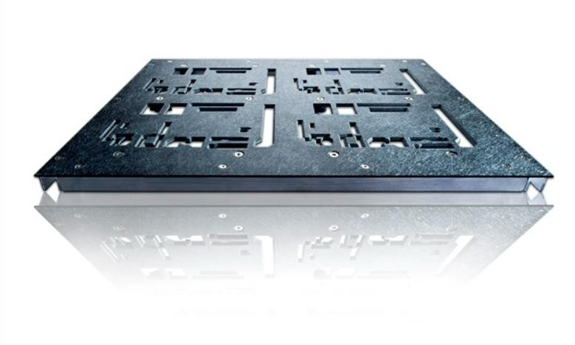
Wave Solder Pallets
Benefits:
• Reduces setup time
• Used to solder complex, double-sided
PCBA’s
• Eliminates expensive and labor-intensive masking
• Shields heat-sensitive components
• Processes multiple boards at the same time
• Reduces bridging and skipping
• Increases rate of production and supports automated assembly operations.

Slide 26
Thank you
Contact us:
Email: sales@apertronics.com Phone: + 91 6384027001
www.apertronics.com

