Slide 1
DATAFIELD India Private Limited
Product Overview

Slide 2
About us
Founded in 1992 specifically to make coil cords and line cords in joint venture with DATAFIELD, Singapore
Current product portfolio:
  Charger/adapter cables, USB cables
  BIS approved (IS694:2010 and IS1293:2019) power cords
  Automotive ABS/EBS cables
  Wiring harnesses, coil cords, line cords, special application products
Two units
  Export Oriented Unit – to support export cost objectives
  Domestic Unit – support local market requirements

Slide 3
Customer Profile
Telecom
Salcomp
Flextronics
Nokia*
Beetel
Gigaset
Motorola*
Samsung*
Gemini
Siemens
LG
Johnson Controls
Medical
Skanray Technologies
Cyient DLM
Automotive
Flextronics
Omnimatrix
Chargers Cords
Axiom
Accord
Power Cords
Elgi Ultra
VLA
SRV Home Appliances
Others
LECS
LRT
* Indirect/Tier II customers

Slide 4
Approvals
UL approvals
  UL Appliance Wiring Material Component
  UL Appliance Wiring Material Certified For Canada
  UL Communications Cable Certified For Canada
  UL Communications Cable
  UL Communications, Audio video, Data and other signaling accessories
  UL Appliance Wiring Material
IS 694:2010 – electrical wires up to 1100V
IS1293:2019 for India Standard Power Plugs – 2 pin and 3 pin
TUV Certified manufacturing process for automotive ADR cables
ISO Certificate 9001:2015
ISO Certificate 14001:2015

Slide 5
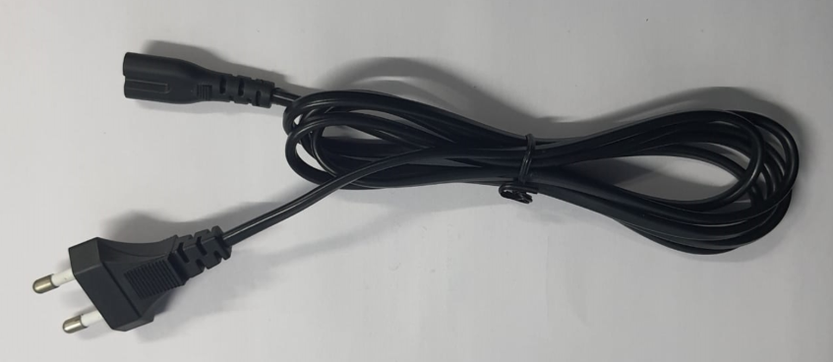
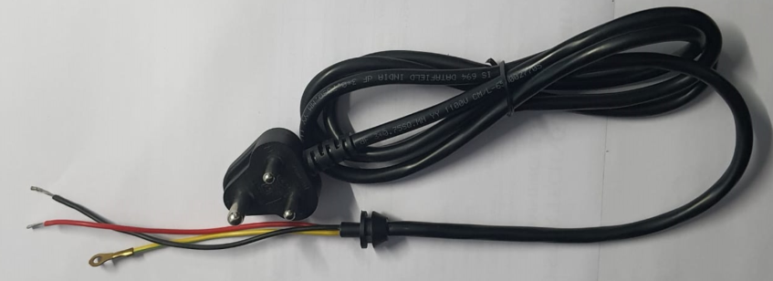
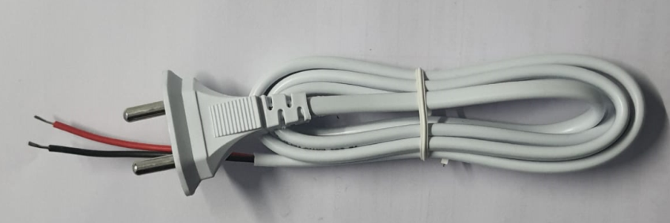
Power Cords
IS694 and IS1293 approved power cords
Approvals
  2.5 Amps – 2pin
  6 Amps – 2pin and 3 pin
  16 Amps – 3 pin
Hollow or Solid Pins
Over-moulded Strain relief
Back end tinned/crimped connectors
Applications
  Wet Grinders
  Mixer Grinders
  Tower fan
  Hand blender
  Vacuum cleaner

Slide 6
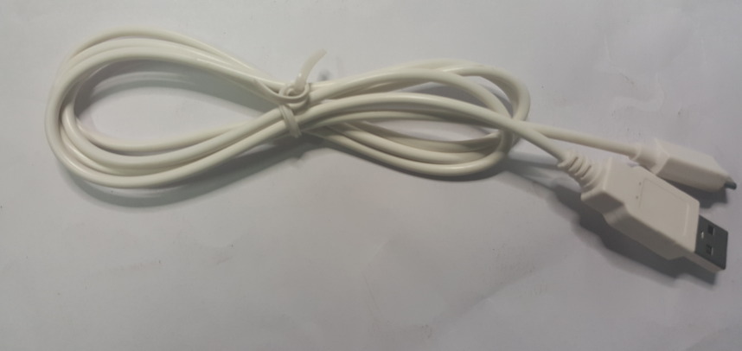
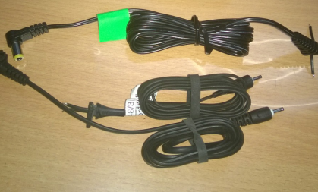
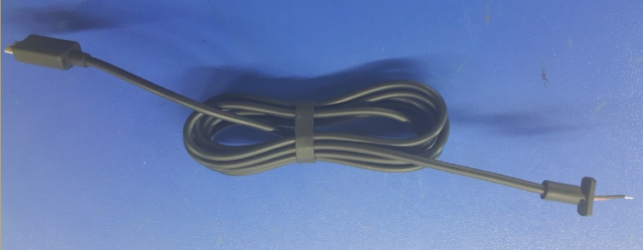
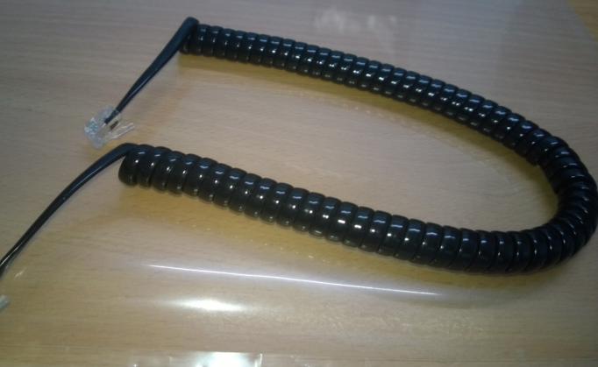
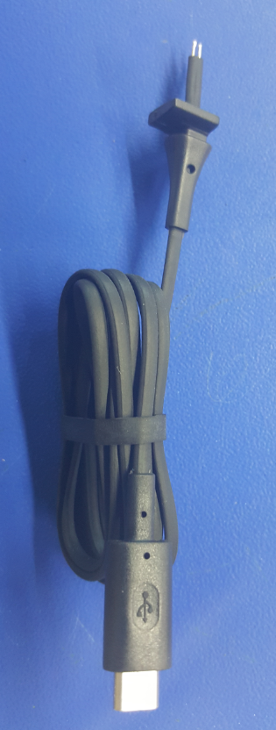
Charger Wires - Mobile Phone/Handset
Telecom Products
USB Cables
Gigaset
Nokia
Telephone Coil Cords
Motorola
Nokia

Slide 7
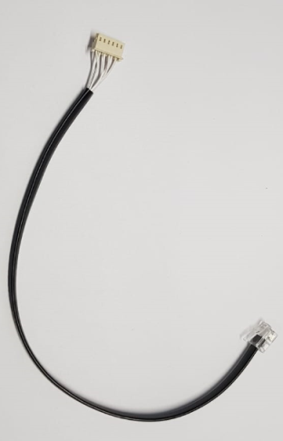
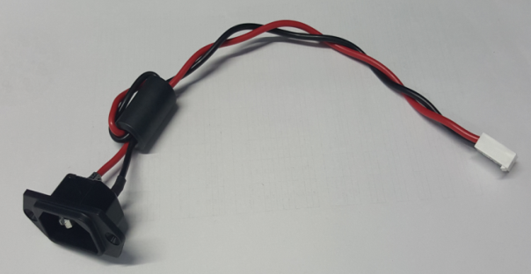
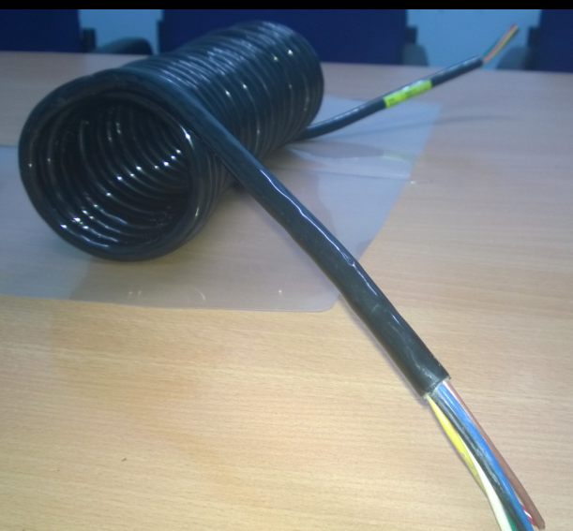
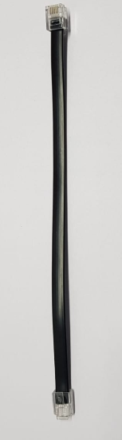
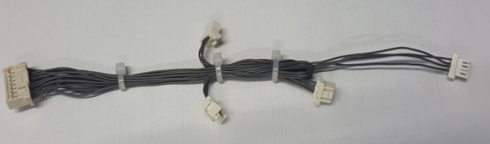
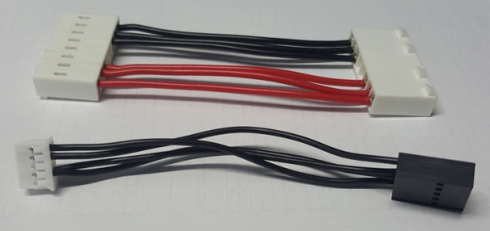
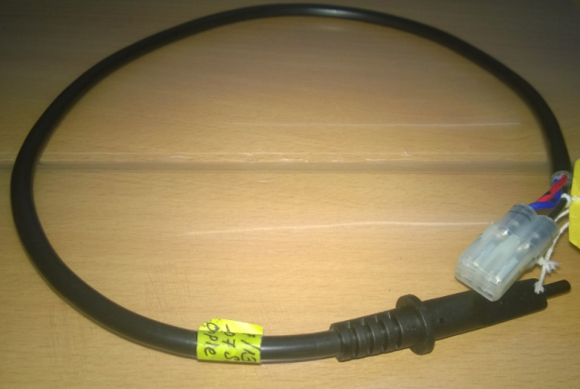
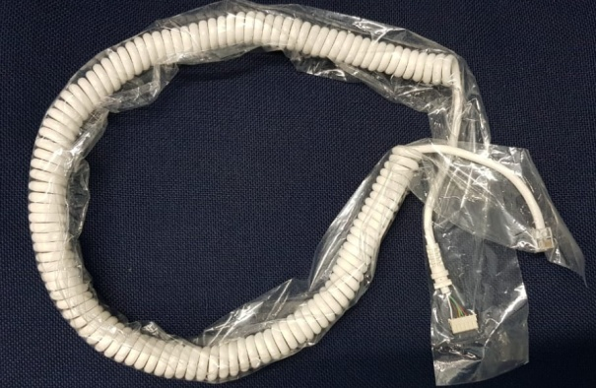
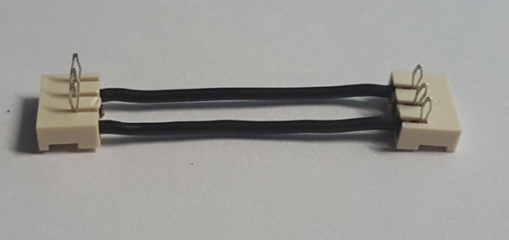
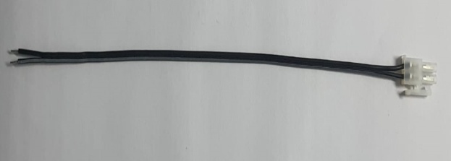
Automotive/General
Wire Harnesses
Medical

Slide 8
Contact us
Website: www.datafieldindia.com
Factory Location
DATAFIELD India Private Limited
119/2B, Mudalipalayam Road
Arasur. P.O
Coimbatore - 641 407
Tamil Nadu State, India
Sales Executive
Radhamani S
Mob: +91 9894082612
sales@datafieldindia.com

