Slide 1




Single Window Solutions

Slide 2
Company Profile
Glonix Electronics Private Limited, domicile at Salem & Branch office at Velachery, Chennai, Tamil Nadu.
We are specialized in providing worldwide clients with high-quality services at an affordable price and we promise to provide timely service to our esteemed clients.
“Focus, Consider, Commitments, Excellent.”, “Customer-centric and Market-oriented”

Slide 3

VISION
To be the eminent PCB and PCBA service provider & strategic partner of worldwide electronic industry & corporate company.
MISSION
To provide high-quality PCB and assembly, prompt satisfactory service for all our prospective clients & worldwide electronic industry.

Slide 4
Meet Our Team
Agalya K
Managing Director
Anish N
Director
Mukilan
R&D Head
Sanjana
EMS Head
Mohan Kumar
Design Head
10 Persons
10 Persons
5 Persons

Slide 5
Services
Product Development
Printed Circuit Board Designing
PCB Fabrication
Electronic Components Procurement
Stencils Manufacturing
Electronic Enclosures
PCB Training & Workshop for Students

Slide 6

Why Glonix?
NO STRESS for PCB Designing
NO WORRY for PCB Fabrication
NO ROAMING for Component Procurement
NO RUNNING for PCB Assembly
NO HESITATION for New Product Development

Slide 7
Domain Expertise - Product Development
Signal Conditioning Sensors
NDT (MFL)
IOT for Industries
Embedded
Industrial Robotics
Power Electronics

Slide 8
Domain Expertise - PCB Layout
High quality design information for signal integrity, power integrity, EMC/EMI
USB, PCIE, DDR & RF designs
Embedded boards, Power supply boards, High speed design & LTE design.
GSM, GPS, TRACKING SOLUTIONS, ITS, Wireless charging technology & Fire alarm systems.
Reverse Engineering

Slide 9
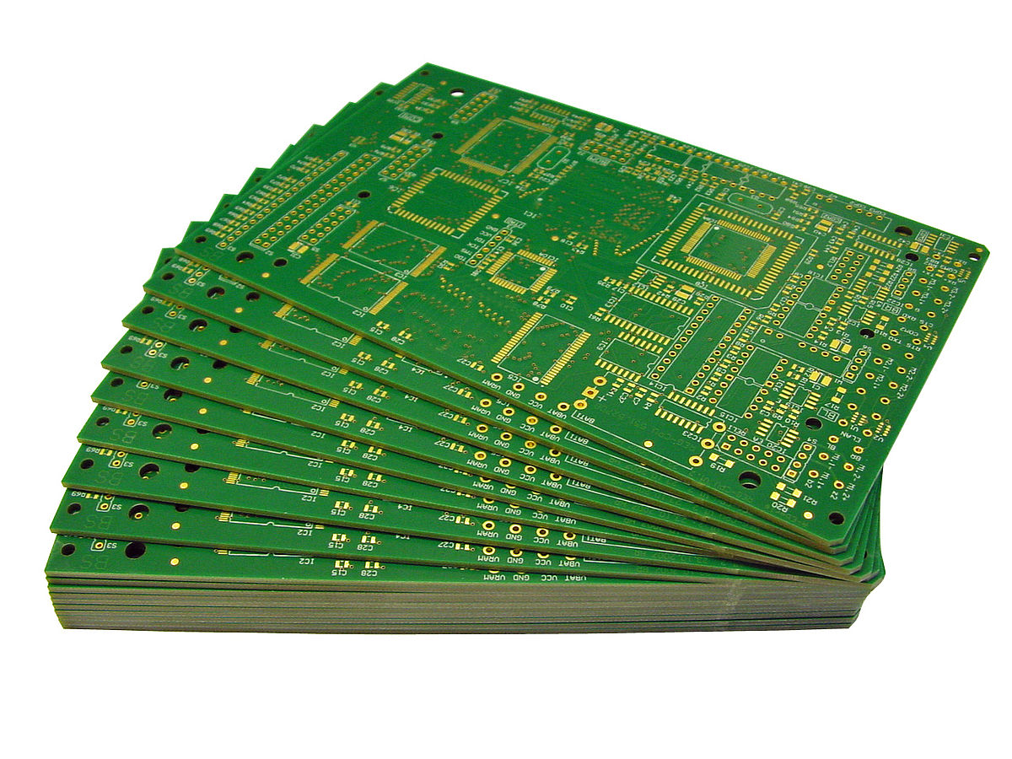
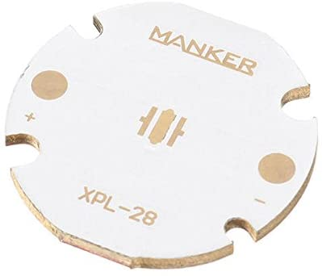
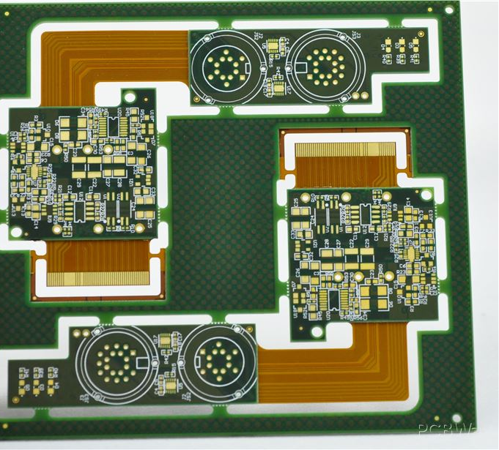
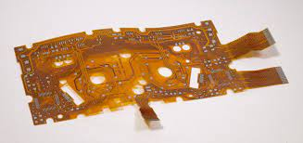
PCB Categories
RIGID
MCPCB
FLEX
RIGID FLEX

Slide 10

Manufacturing Location
India
China
Germany
Singapore

Slide 11
Component Procurement
Glonix Electronics is able to provide a comprehensive components procurement service for all required electronics components ensuring that products go from product to finished item.
We use our global procurement system made up of purchasing teams in India, China, Singapore, Europe& Germany to ensure we attain the best prices on the global market.

Slide 12
Assembling
Hand Soldering
Reflow Soldering
Pick and Place machine soldering
Wire Harness Job works

Slide 13
Glimpse of Our R&D Project
  Measurement of Engine value temperature
  Engine oil analysis
  Automotive Advertisement sound Card
  Custom made Electronic Tablet
  Electro Mechanical Component for control value
  RFID Card Product for Hospitals
  IOT Projects
  Loop Current (SMPS) etc..

Slide 14
Target Market
Telecommunication
Railways
Automobiles
Medical
Robotics
Aerospace
Electronics Companies and etc

Slide 15






















Our Customers

Slide 16
REACH US :
Glonix Electronics Private Limited,
Plot No.54, Second Floor, SF1, Raj Elegance, Anna Nagar 2nd Street, Tansi Nagar,Velachery, Chennai – 600042
91 9944237235, info@glonix.in, www.glonix.in

Slide 17

Domain Expertise - Product Development
Thank You

