Slide 1
Qmax Group
Corporate Profile Presentation and Overview

Slide 2
Qmax Buisness Verticals
Qmax Test Equipments Pvt Ltd QTEPL | Qmax Test Technologies Pvt Ltd QTTPL | Qmax Defense Systems Pvt Ltd QDSPL | Qmax Ion Pvt Ltd QIPL
Design and Development of Automated Test Systems Hardware Software for all products. Manufacturers Build to Design Build to Specifications STEs and Custom ATEs | On-site Installation Technical Support Application Engineering Authorized Distributors for Global T& M Leaders Electronics Test and Repair Services | Third Party Volume manufacturing of Strategic Electronic Systems Indigenization of Defence Systems / LRUs and modules Special purpose reverse engineering applications for Defence | Li Ion Polymer Battery Packs Battery Management System Energy Storage Systems using Li –Ion Batteries Battery Testers Super Capacitor based charging solutions

Slide 3
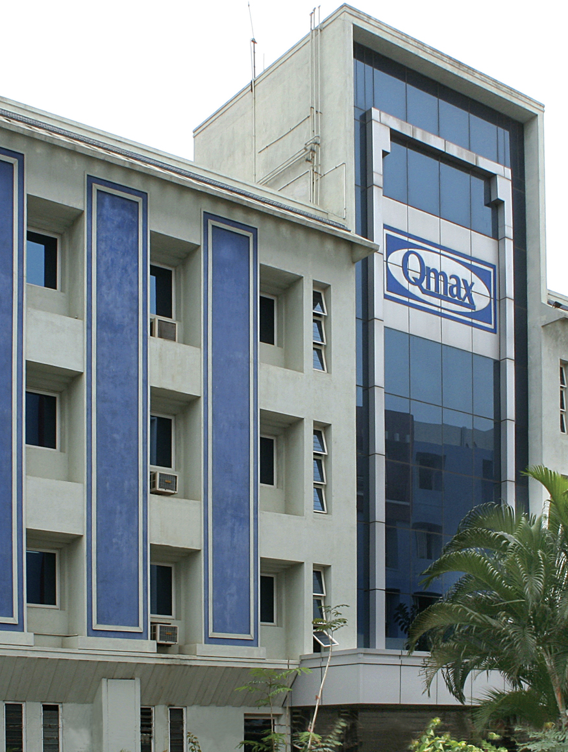
Qmax Test Equipments - Beyond Qmax ; Beyond Test
Qmax – A truly MAKE IN INDIA company from the inception
Leader in Technology Development and Innovative Automated Solutions
30+ Years of service to the Nation’s and International Defence , R&D, Aerospace, Industrial Automation , Energy , Automotive Segments
INDIAN ARMY, NAVY and AIRFORCE Depots, DRDO Organizations, Defence PSUs in our prestigious clients list
Certified for ISO 9001:2015 and AS9100D standards
Dun and Bradstreet Certified- DUNS number : 91- 443 -5621

Slide 4

Qmax – Corporate background
Chennai – HQ for R&D, Application Engg. Manufacturing , Training and Technical Support with 36,000 sq feet integrated facility
Regional Operations in all Metro Cities of INDIA
100+ engineers working for the group
Overseas Subsidiaries in
SINGAPORE , MALAYSIA and USA
Member of CII , INDO GERMAN CHAMBER OF COMMERCE, AIDAT , INDO AMERICAN CHAMBER , ESC and other associations
Customers in 50+ Countries , Distributors and Reps 25+ Countries

Slide 5
Qmax - Developer of Innovative Technologies
First Company in India to offer main frame ATE systems hitherto offered only by USA / UK and other developed nations
Qmax - First Company in INDIA to Indigenously build
Robotic Flying Probe Tester (Technology was denied by developed nations, Qmax converted challenge into opportunity by developing indigenously different versions of Flying Prober for test and repair applications)
Indigenously designed and developed Cable Harness Testers
Capability to deliver Build to Spec and Build to Design automated test solutions
Specialized / Customized electronics solutions for Chip level / Board level functional test , LRU level or System level automated test applications

Slide 6








Global Customers
Indian Defense
ISRO
BEL / HAL
MRO
FAA
US Army
Rosoboron Export
SSTC
KRET
Safran
iXBlue
Esterline
Korean Aviation
Korean Airlines
Korean Navy
Royal Thai Airforce
Royal Thai Navy
Thai Airways
German Army
German Airforce
Lufthansa
Singapore Airlines
Singtel
Changi Airport Authority
And Many more….

Slide 7
Awards and Accolades for Qmax team
ELCINA Award for Best R&D and Best exports, Best Innovation
ELCINA EFY Award for the QTouch Flying Prober and QT-Hi1 under innovation category
Definnovation award for the Panther 4HT Cable Harness Tester and Flying Probe Tester with customer reference Tester (used by DRDO Labs , HAL and BEL)
AIDAT & Indo American Chamber of Commerce Award for export performance by MSME
Paper presentation on ATEs at AUTOTESTCON , IEEE USA and Patent recognition for Qmax’s test technologies

Slide 8
Qmax team’s core capabilities
Successfully delivered , installed, and providing on-site support for several projects in India and abroad
Setting up of entire Repair facility for Automated Test , Calibration and Repair , Rework Labs
On-site and Off-site training services
On-line technical and application Engg. Support
Specialized Electronics Test & Repair Services

Slide 9
Qmax team Core competencies
Development of customized test solutions for today’s challenging electronics technologies
Turnkey projects
Build to design and build to spec solutions
Replacement of obsolete parts of Russian and Western Origin modules / testers and systems
Indigenization development for one-to-one replacement of existing systems without technical supports

Slide 10
Qmax Test Technologies Pvt Ltd
The One Stop Source
To Bring the Global T&M, Inspection and Rework Leaders to India
Test & Measurement (Pico/BK Precision/LCR)
Denon -Japan for 25+ Years SMD and BGA applications
Rework ( JCB Tools / METCAL / Monarch )
Inspection (Nuline)
Programming ( XELTEK / SMH Technologies)

Slide 11
Qmax Defence Systems Pvt Ltd.Defence Systems- Make in India
Electronics Manufacturing Services (EMS) for Strategic Electronics
Electronics Testing and Reverse Engg. Services
Offset collaborations

Slide 12
Qmax Ion- Energizing the future !
Lithium - Ion Battery technologies for Defence , Energy Storage , E-Mobility applications
Battery Management Systems
Battery Capacity Testers
Super Capacitor based charging solutions.

Slide 13
Thank you for your valuable time

