Slide 1
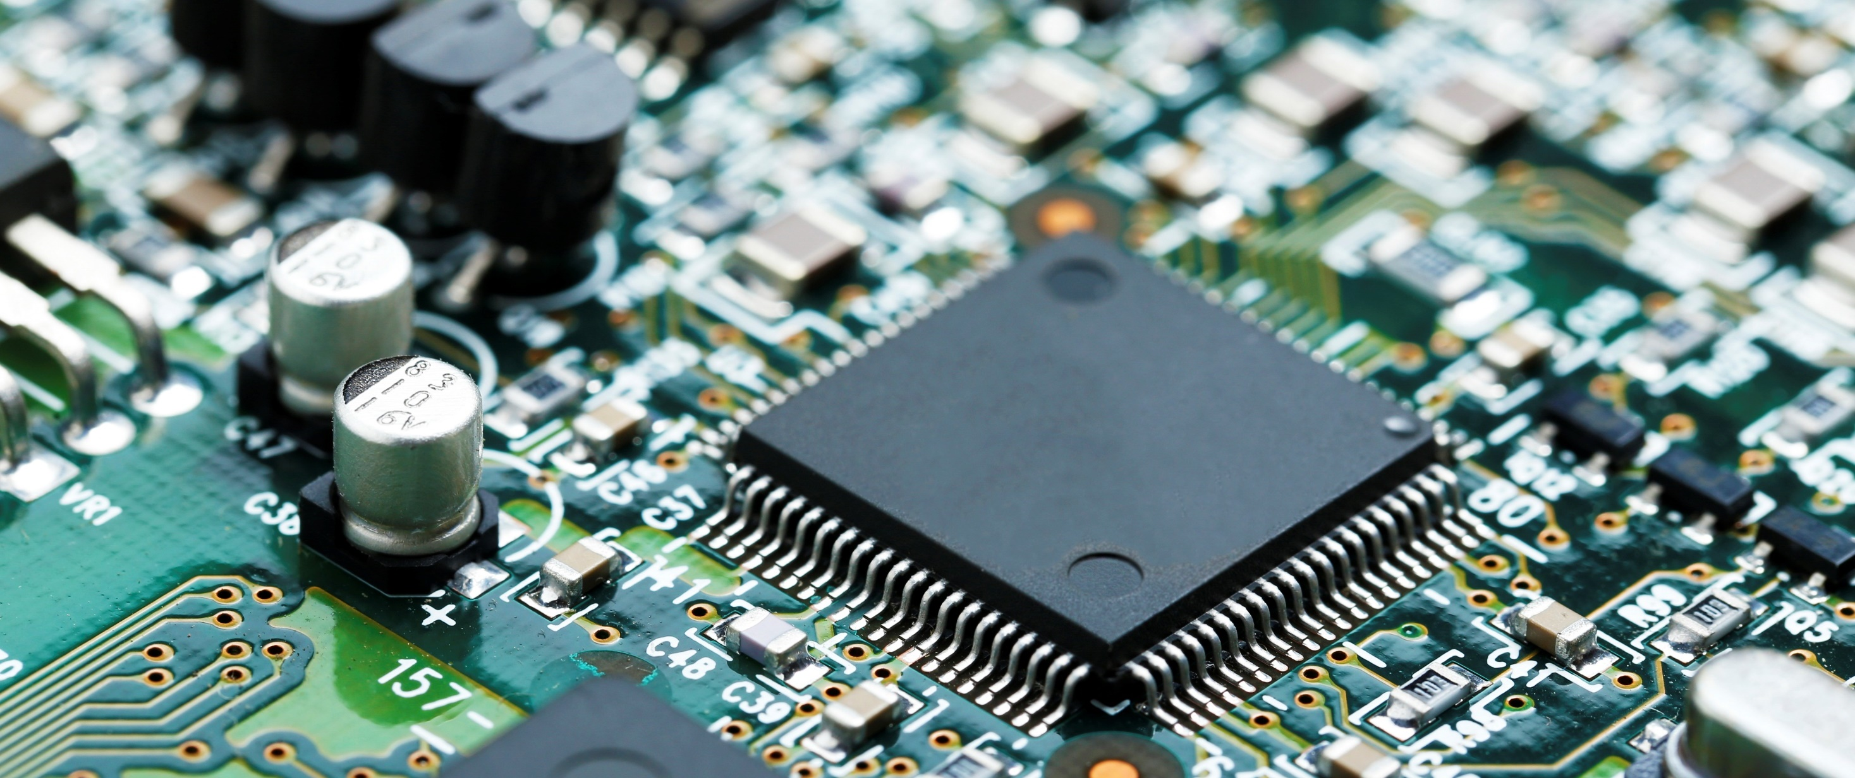
Blue Star - Electronics Assembly & Testing Solutions

Slide 2
Company Overview
    Blue Star Engineering & Electronics Limited (Blue Star E&E) is a wholly owned subsidiary of Blue Star Limited, a $ 1 billion Indian conglomerate
    The company has evolved as a high-end system integrator and value-added reseller over the last six decades
    With a rich history of association with renowned global firms, Blue Star E&E has been recognised as a gateway for advanced technologies in India
    Offerings across diverse industry segments:
      Advanced Technology Products
      Turnkey Engineering Solutions
      Customized Testing Products
      Value-Added Services
#2

Slide 3
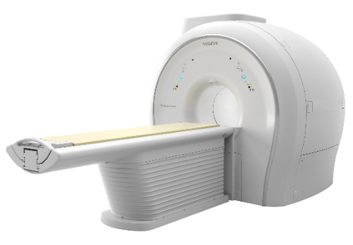
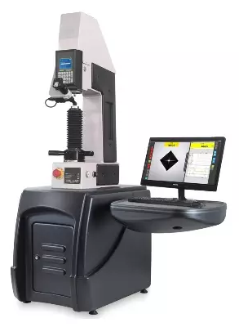
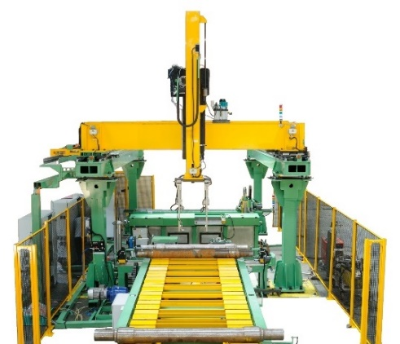
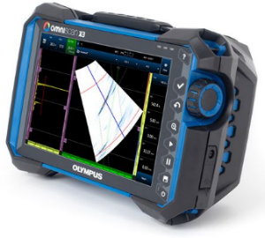
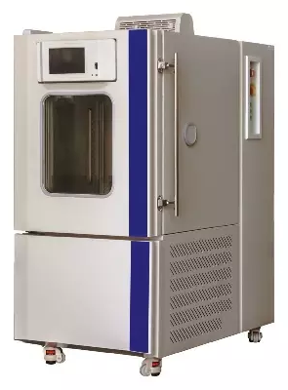
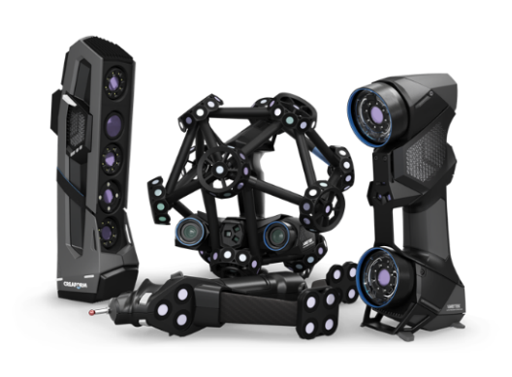
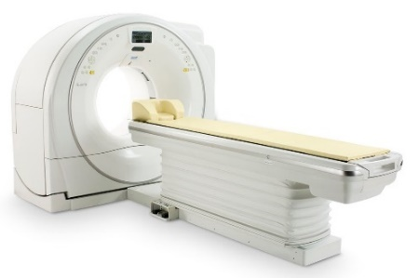
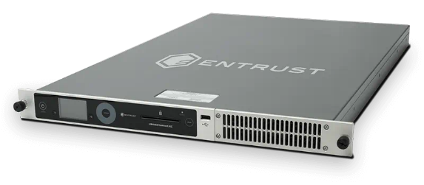
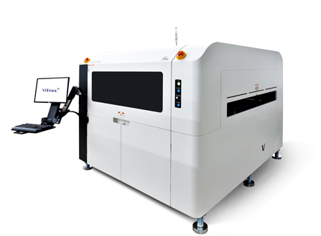
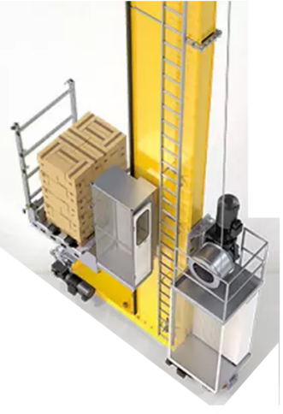
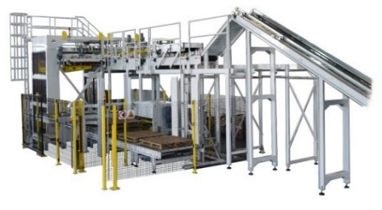
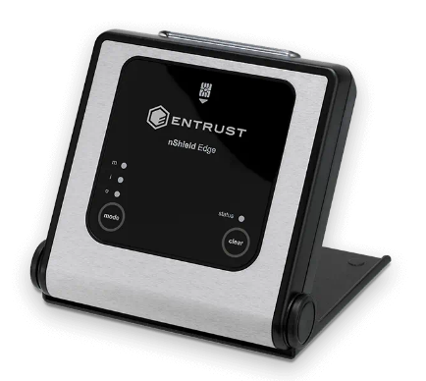
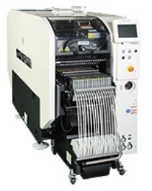
Business Units
MedTech Solutions
Industrial Solutions
Material Testing Systems
NDT Solutions
Metrology Solutions
Data Security Solutions
Warehouse Automation
Electronics Solutions
#3

Slide 4
Value Selling Process
    Bringing world-class technology-led solutions to customers across a wide range of industries
    Moving up the value chain, from its origin as a distributor of leading global manufacturers to that of a system integrator & value-added reseller
    We solve the business challenges of our esteemed customers by understanding their unique needs
    Precise Need Identification
    Solution Configuration
    Design & Engineering
    Pre-installation Support
    Installation & Commissioning
    After-sales Service
#4

Slide 5
Core Competencies
1
6
2
Years of association with renowned global OEMs
Part of Blue Star Group, which has a 75 year track record
Thorough knowledge of markets, technologies, solutions & applications
Engineering
Customer-Right
Solutions
Proven track record of operational excellence
Strong national presence for sales & service
5
Marquee customer list from all major industry segments
3
4
#5

Slide 6
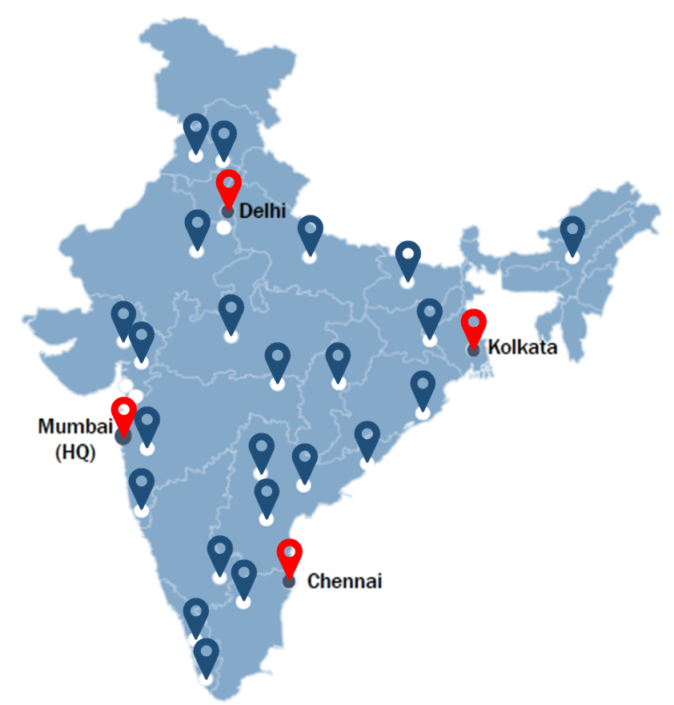
Strong national presence for sales & service
    Headquarter in Mumbai
    4 Region Offices
      Mumbai
      Delhi
      Chennai
      Kolkata
    31 Sales & Service offices with a strong network in T2, T3 and T4 cities
#6

Slide 7




































































Marquee Customer List
Healthcare
BFSI
Automotive
Metal
& Engineering
Space
& Nuclear
Consumer
Oil & Gas
Aerospace
Research
Power
Chemical
#7

Slide 8
Part of Blue Star Group
Revenue of
$1 Bn
2700+ employees
80 years old conglomerate
31 offices across India
Exports to 19 countries in ME, SAARC & ASEAN
Market Capitalisation of $1.6 Bn
4000 Channel Partners
5 world -class manufacturing facilities
FMCD items present in 7500 stores
Joint Ventures in Qatar, Malaysia
#8

Slide 9
Electronics Assembly & Testing Solutions
#9

Slide 10
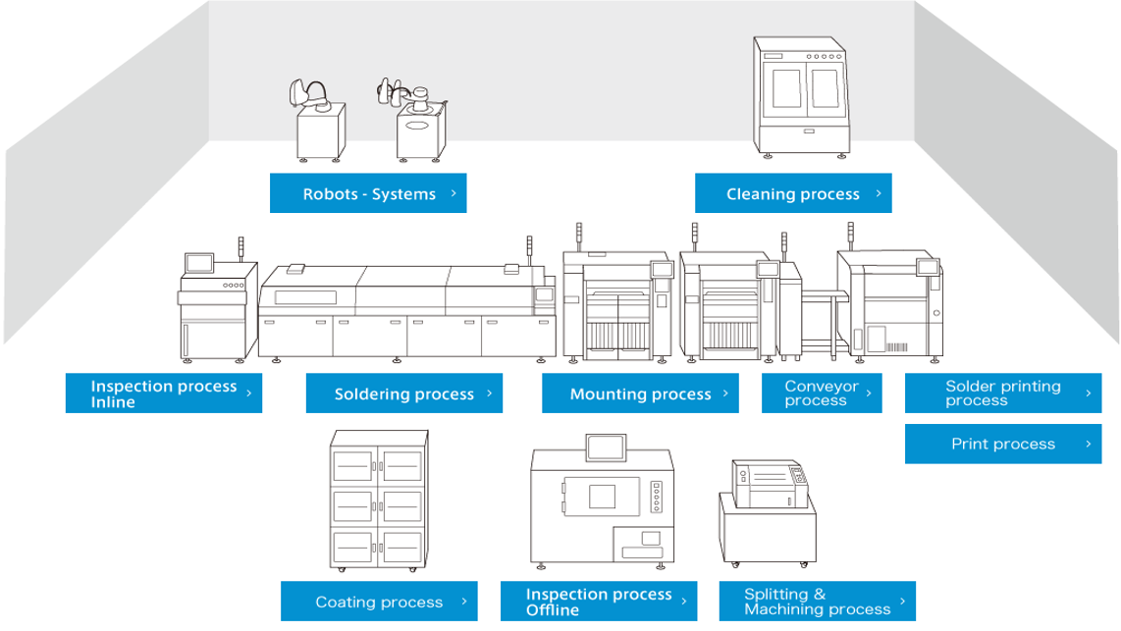


Turnkey Solutions for Electronics
    Blue Star offers end-to-end turnkey solutions for the assembly and testing of electronic components of SMT line
    We work closely with our customers to engineer the most suitable solution, with best-in-class products from a range of global OEMs
#10

Slide 11
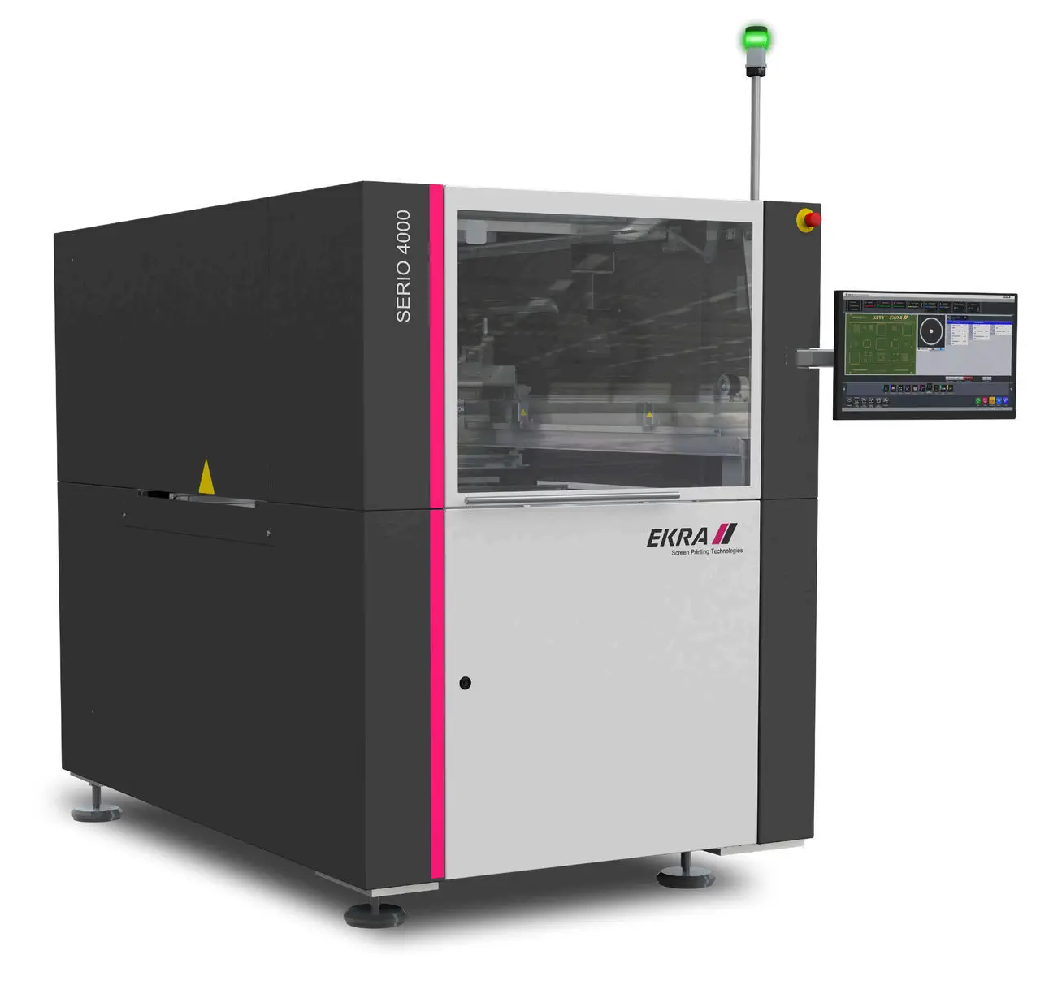
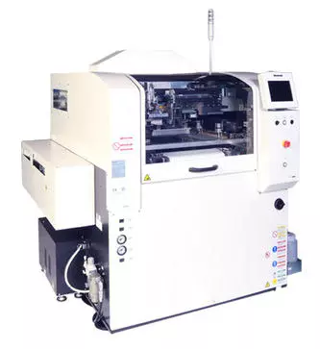
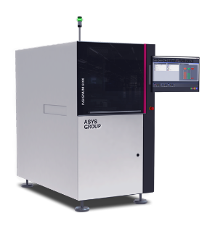
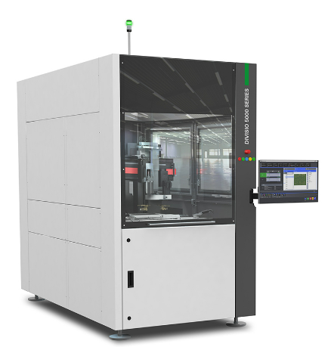
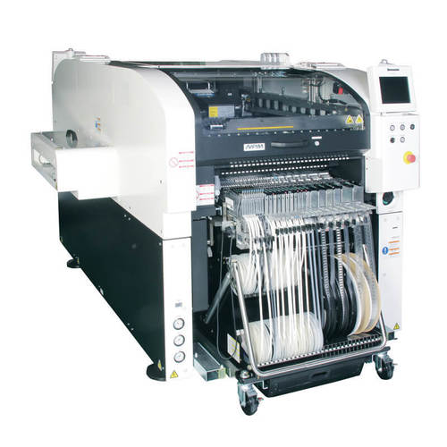
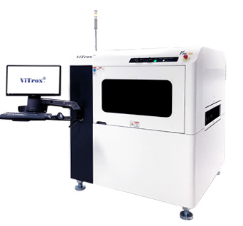
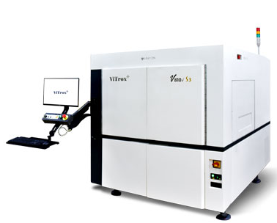
Products that goes into our Solutions
Solder Paste Printers
Laser Marking
Routing PCBA
Pick & Place
AOI
SPI
AXI
#11

Slide 12
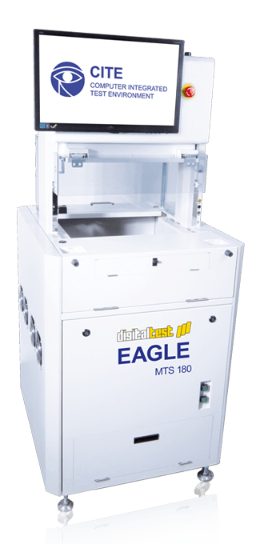
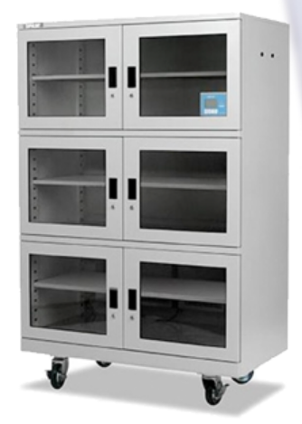
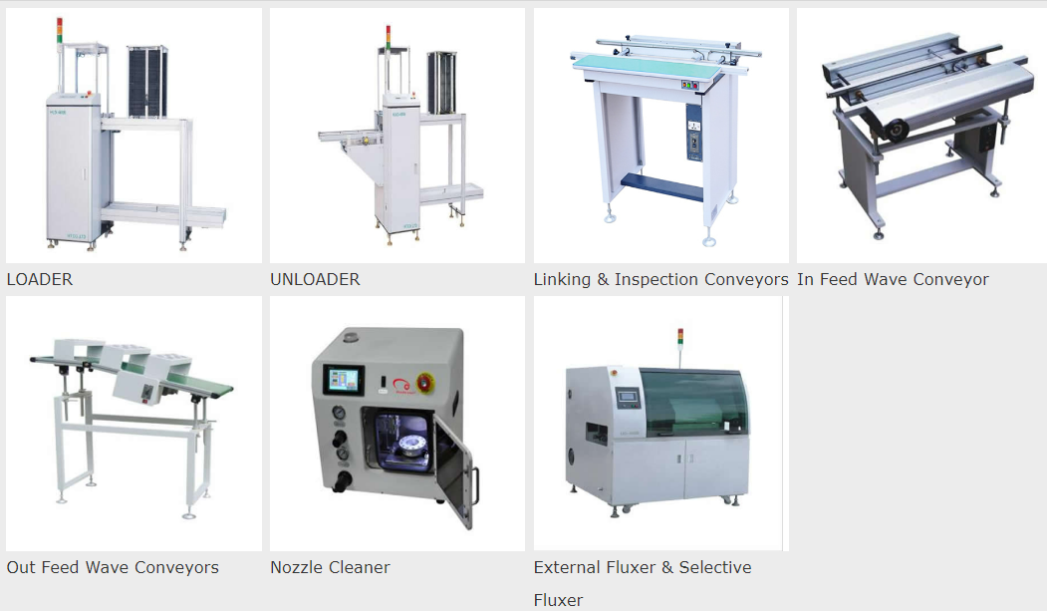
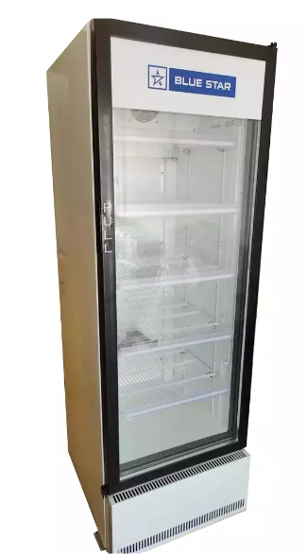
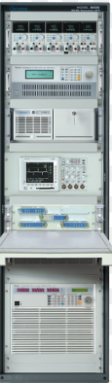
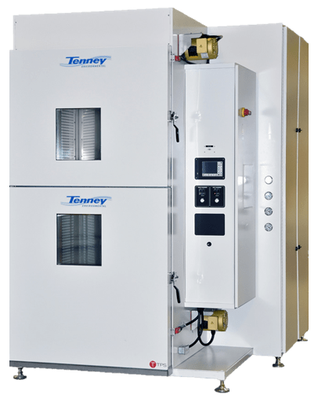
Products that goes into our Solutions
Unloader
ICT
Loaded
Storage Dry
Chamber
Refrigeration Storage
Fixture/ATE
#12

Slide 13
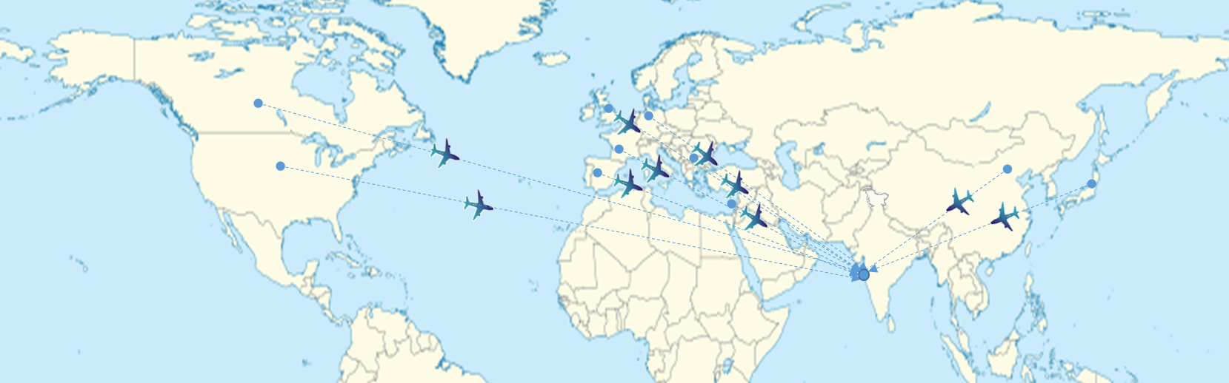






Global Technology Partners
#13

Slide 14

Thank You

