Slide 1
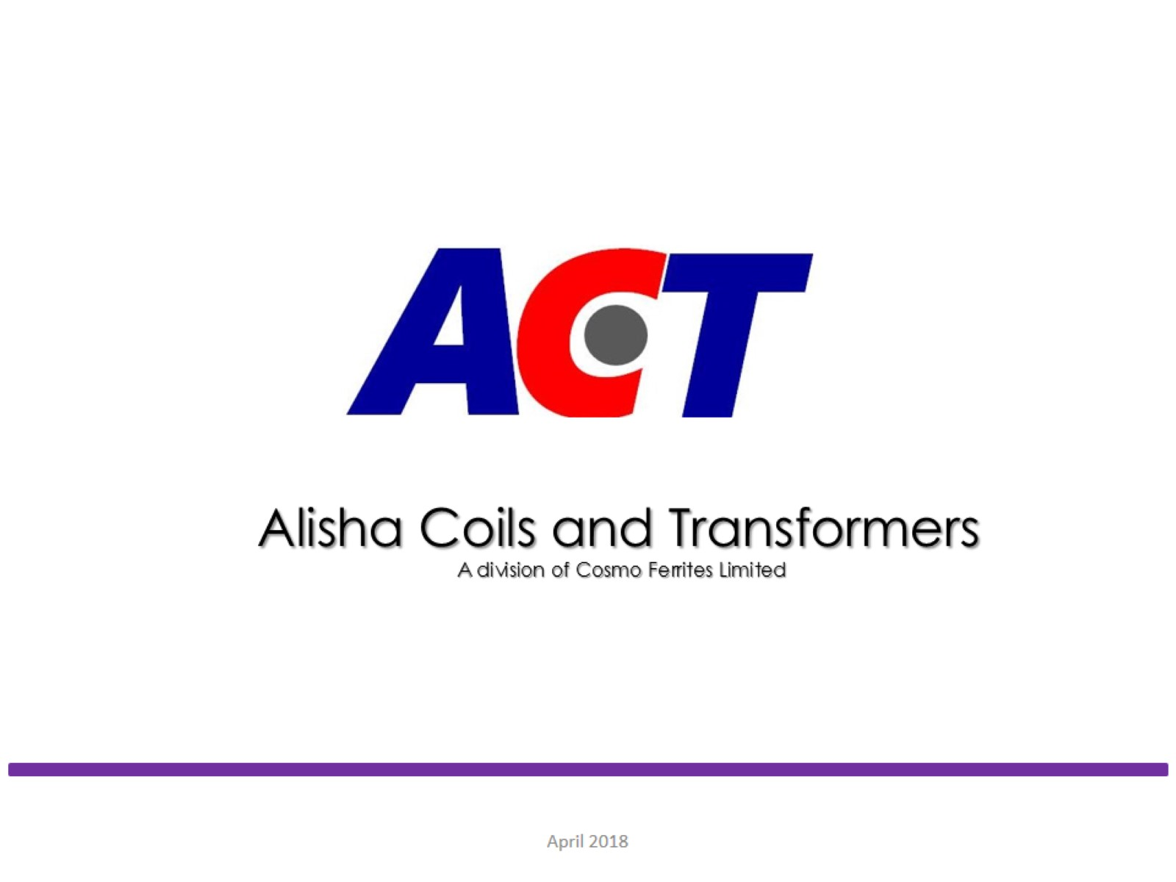

Slide 2


Group Companies
COSMO FIRST
COSMO FERRITES LIMITED
Backward Integration in chemicals, masterbatches
and adhesives.
A global leader in speciality films for packaging, labeling, lamination and synthetic paper applications.
Leading manufacturer and exporter of Mn-Zn Based Soft Ferrite Cores for Power Electronic Industries.
Manufacturer of Coils and Transformers
An all in one solution to
all pet products,
Accessories and services.

Slide 3
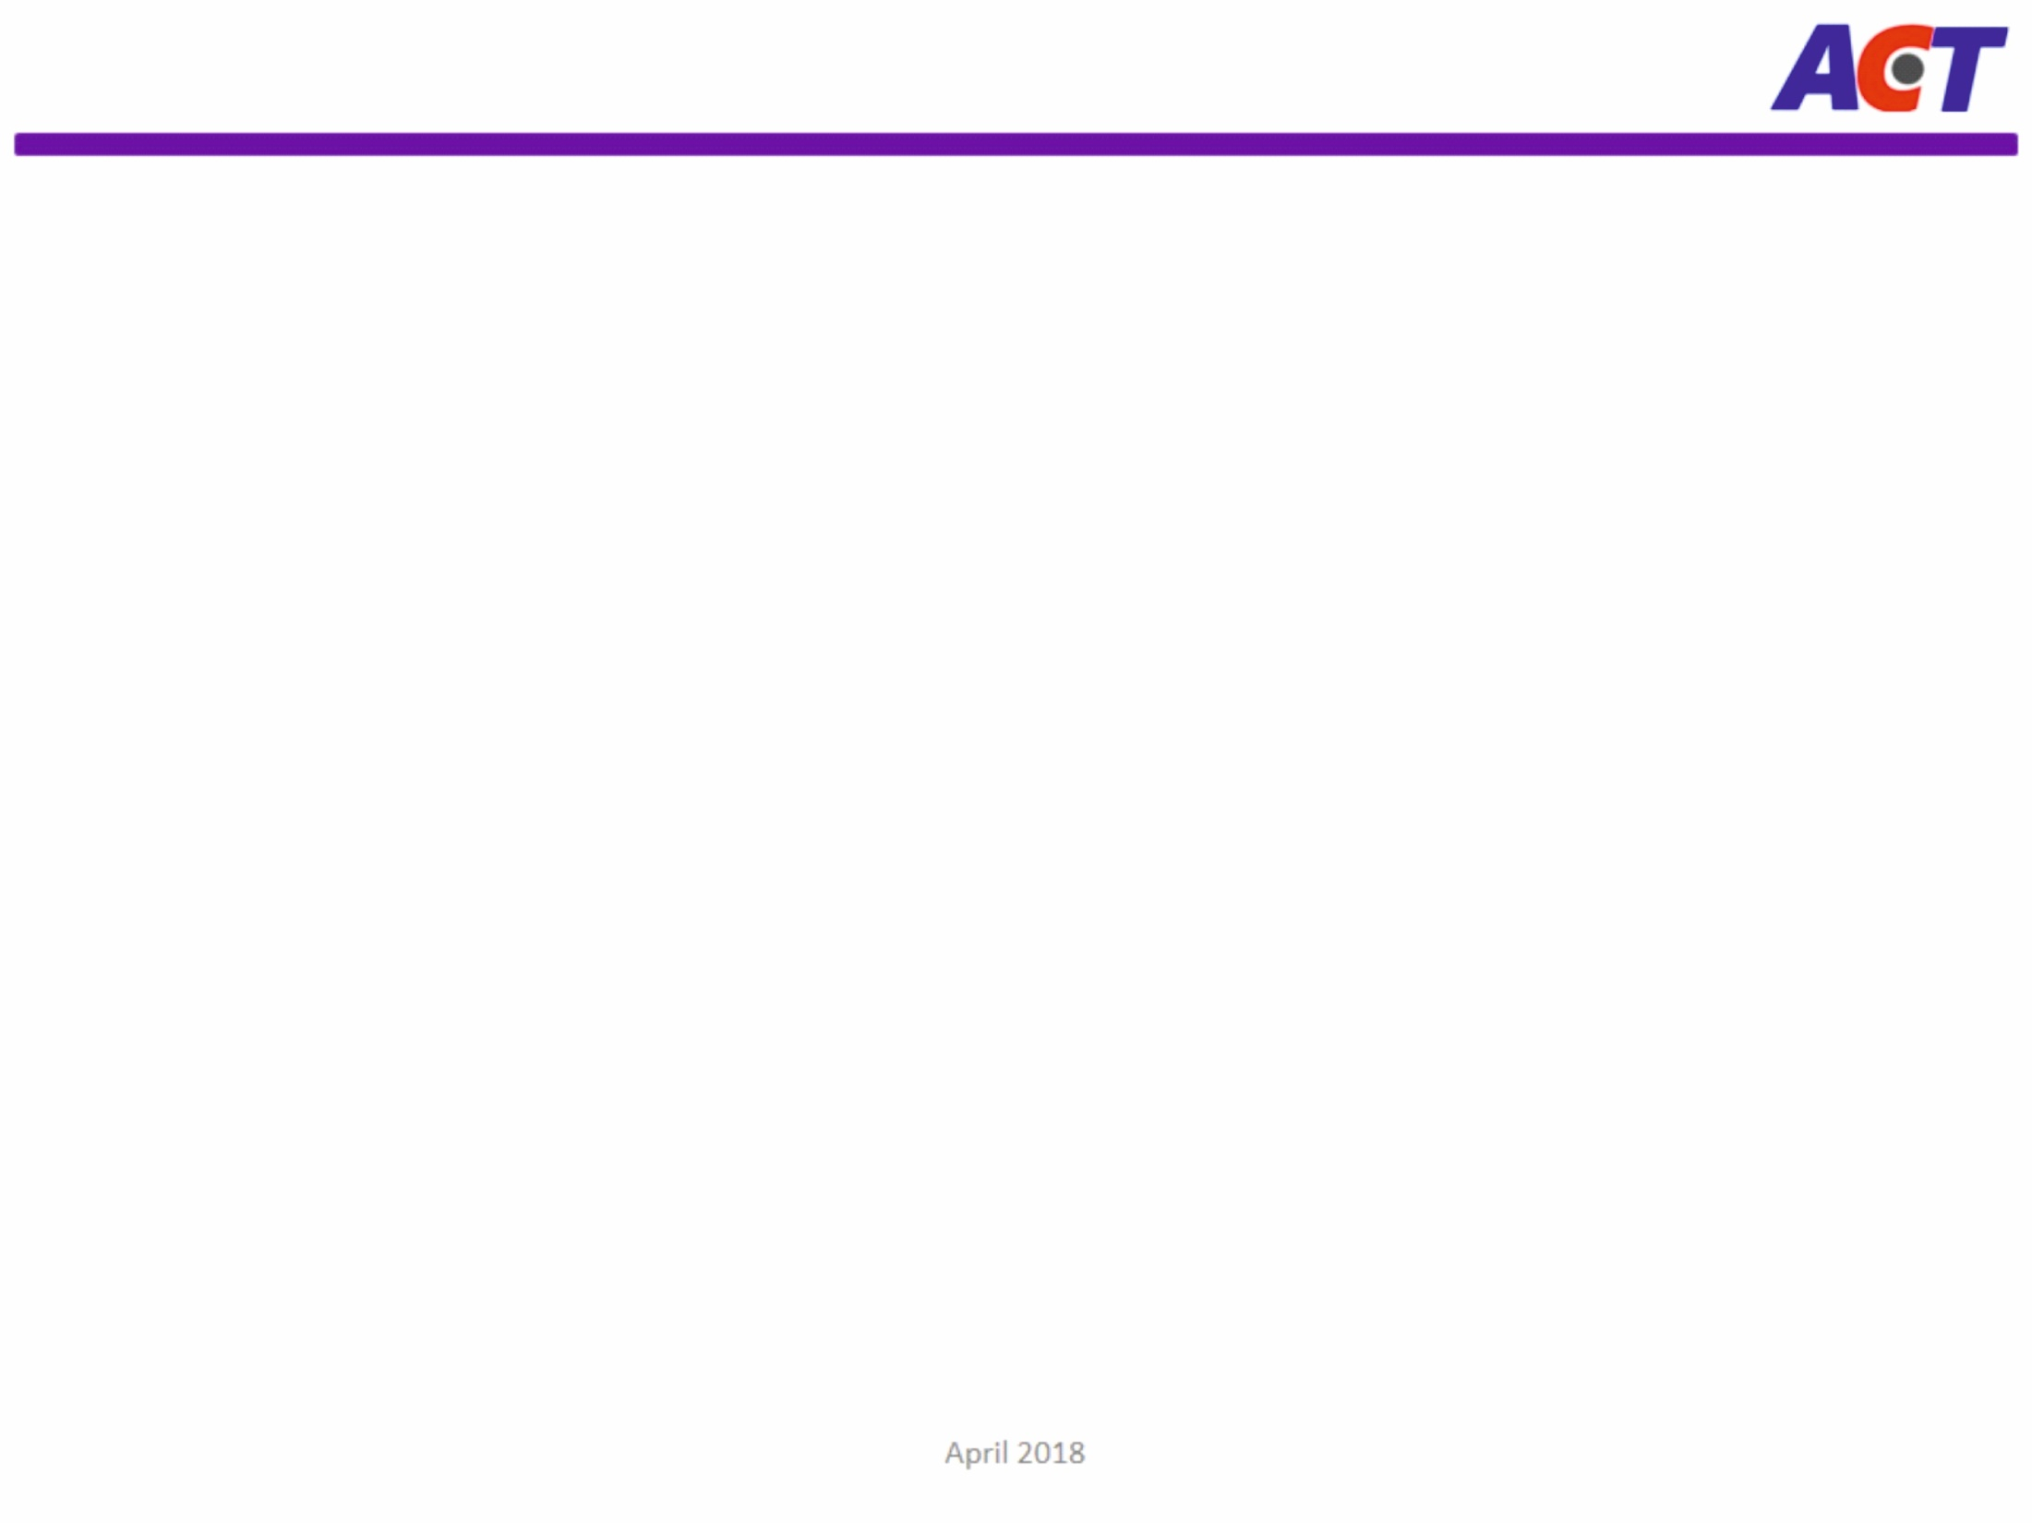








Cosmo Ferrites Overview
ESTABLISHMENT
PROMOTER
Established in 1986, Cosmo Ferrites Limited is one of the largest Soft Ferrite players in the world with a sales turnover of USD 8.54 Million in FY 2018-19
Promoted by Mr. Ashok Jaipuria, 1st Generation Entrepreneur, who introduced country to Soft Ferrite Cores
WORLD LEADER IN FERRITE CORES
PUBLIC LISTED
Cosmo Ferrites is one of the largest producers of MnZn Based Soft Ferrite Cores used in Power Electronics Industry
The company is listed on the Bombay Stock Exchange (BSE)
CERTIFICATIONS
AWARDS & RECOGNITION
ISO 9001:2015
ISO 14001:2015
ISO/TS:16949
RoHS Certified
REACH Compliant
UL Approved Insulation Coating
Winner of ELCINA-EFY Award for Outstanding Achievement in “Exports/Large Scale” Category
STRONG EXPORT FOOTPRINTS
BUSINESS PROCESS MANAGEMENT SOFTWARE
Leading Soft Ferrite Cores exporter from India with export to more than 50 countries .
Enterprise Resource Planning (ERP) system featured by ORACLE for advanced planning, scheduling and online testing
www.CosmoFerrites.com

Slide 4
Cosmo Ferrites Journey So Far
Portfolio increase to Bigger cores Major additions in Pressing ( Dorst & Hydraulic )
Component Capacity enahced to 40 Mn Pcs
In-house R&D setup with the help of DSIR (GoI)
5 new materials and 8 shapes introduced
New Kiln Added
Increased Component Capacity to 20 Mn Pcs
Component Capacity Increased to 50 Mn Pcs.
Accelerated Exports to Europe and US - 50 countries
Established in 1986 Cosmo Ferrites Ltd. commenced its production with an annual capacity of 10 Mn Pcs
Further expanded its component capacity to 35 Mn Pcs
Startred exports in other Asian Countries
Component capacity enhanced to 12 Mn
Powder Capacity to 1500 Mt
Forward Integration Alisha Coils & Transformers Launched to offer customized solutions
State of the Art New KILN Introduced
Production capacity increased 50% to 80 Mn Pcs
R&D
Productivity
Addition
Global Leader
Incorporated
Growth
Expand
New Vertical
Augmentation
1986
1987
1988
1994
1995 2000
2001
2005
2006
2010
2010
2014
2015
2016
2016
2021
2022 2023

Slide 5
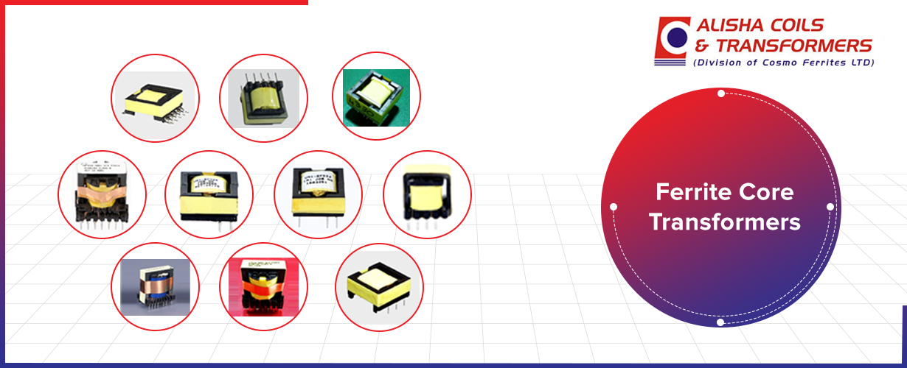
Ferrite Core Transformers: What Makes Them In Demand?
Transformers are passive devices used to transfer electrical energy from one circuit to another. Their primary aim is to increase or decrease the voltage levels between the circuits. Generally, transformers are used wherever there is AC to DC converter, DC to AC converter & DC to DC converter.

Slide 6
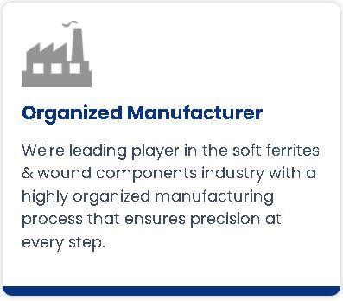
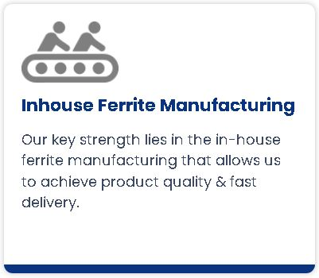
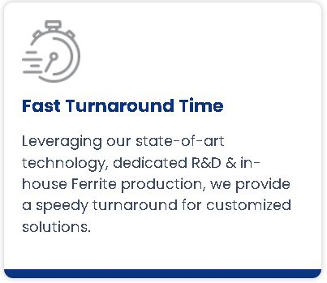
Why ACT ?
We as Alisha Coils & Transformers have established a state of art coils & transformer manufacturing facility nestled in the environmental friendly confines of Himachal Pradesh.
There are lots of reasons a customer could choose , but we found it often boiled down to three main options:

Slide 7



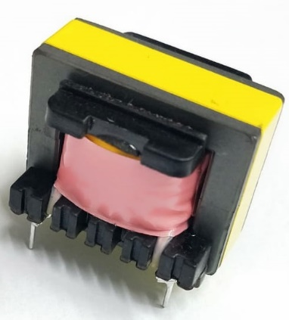
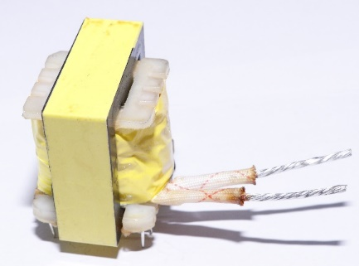
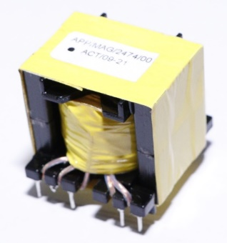
Areas of Operations
BLDC
LIGHTING
E-Vehicle
DC-DC Converter
AC-DC Converter
Motor Controller
Battery Charger
Fan Driver
Motor Controller
Electronic ballast for energy efficient lamps
Electronic chokes for Tubular Lamps

Slide 8



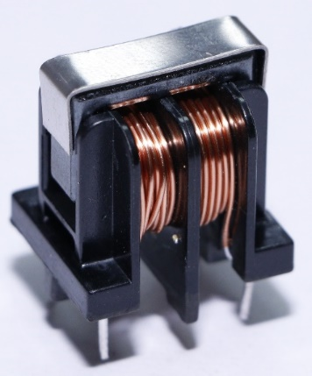
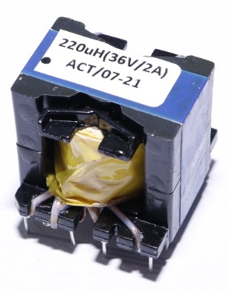
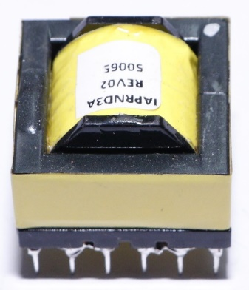
Areas of Operations
POWER CONDITIONING
EMI FILTERS
CHARGERS
E-Vehicle
BLDC
LIGHTING
Medical electronics
Telecom
SMPS
Induction
Battery Chargers
Solar invertors
Sensors
Mobile Charger
Setup Box Charger
RO Charger
Adopters

Slide 10
Who We Are
Manufacturing Plant Located in the foothills of Himalaya. Area 20600 sq m. | PUBLIC LISTED Listed on the Bombay Stock Exchange (BSE) | EMPLOYEES 720+ employees
VISION To become the Product and Quality leader of soft ferrite cores. | MISSION We endeavour to be an organization which delivers outstanding customer service, respects all individuals working with it and always encourages initiative & innovation | VALUES Conduct business with integrity and fairness. Focus on our customer’s need. Excellence in quality & customer service. Mutual respect and teamwork.

Slide 11
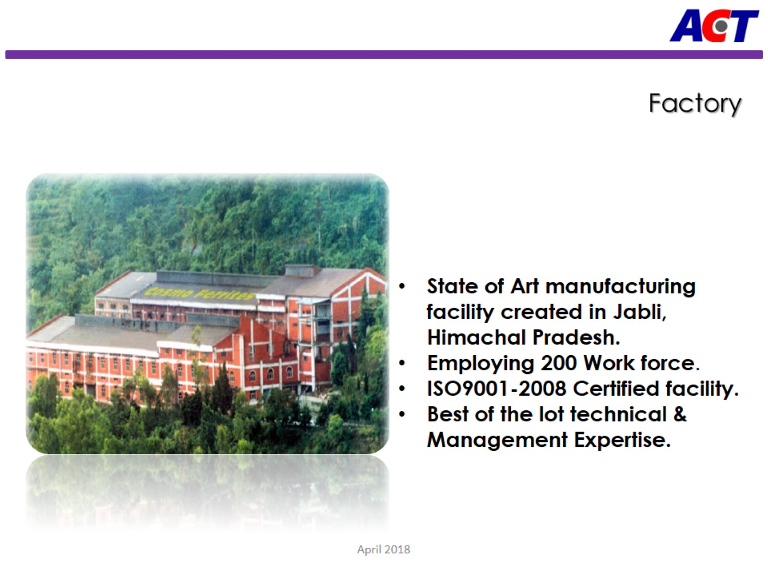

Slide 12
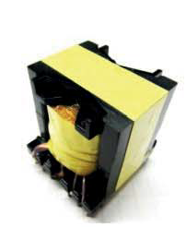
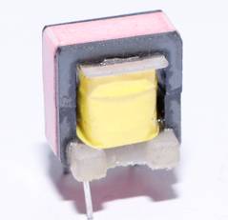
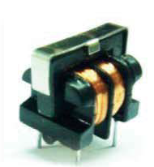
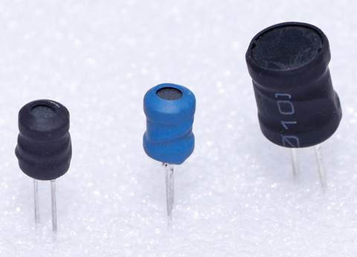
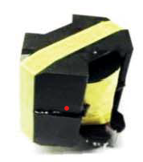
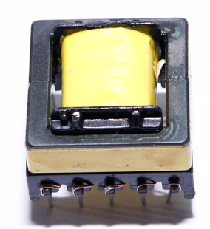
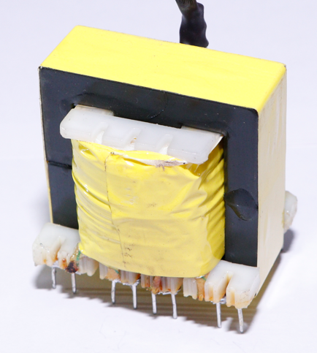
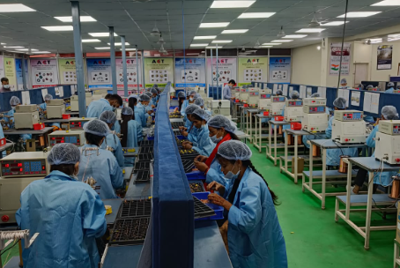
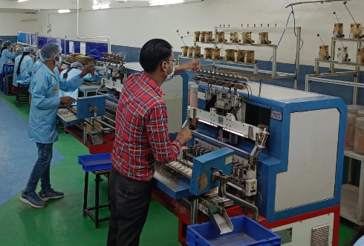
ACT Manufacturing Capacity
Single Spindle (SS)-11Mn Pcs/Y
Multi Spindle (MS)-70Mn Pcs/Y

Slide 13
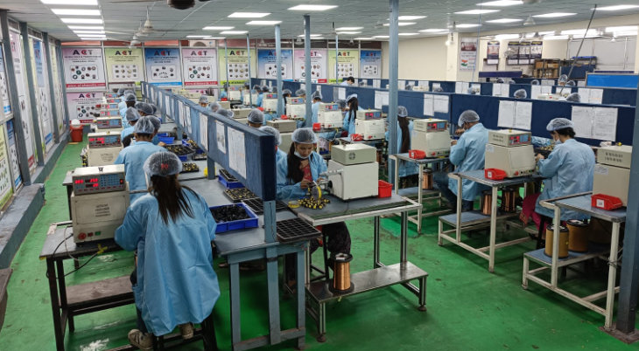
Single Spindle Winding Lines

Slide 14
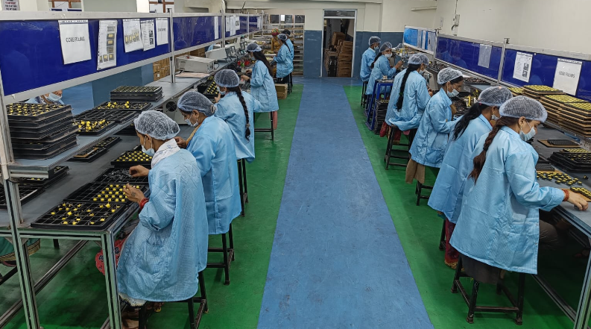
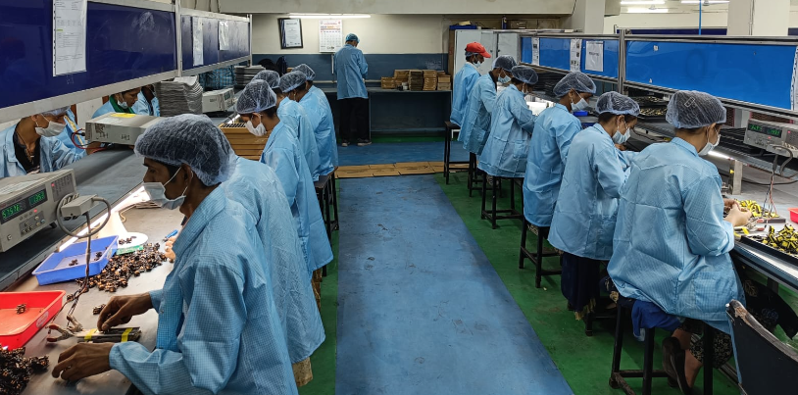
Assembly Lines

Slide 15
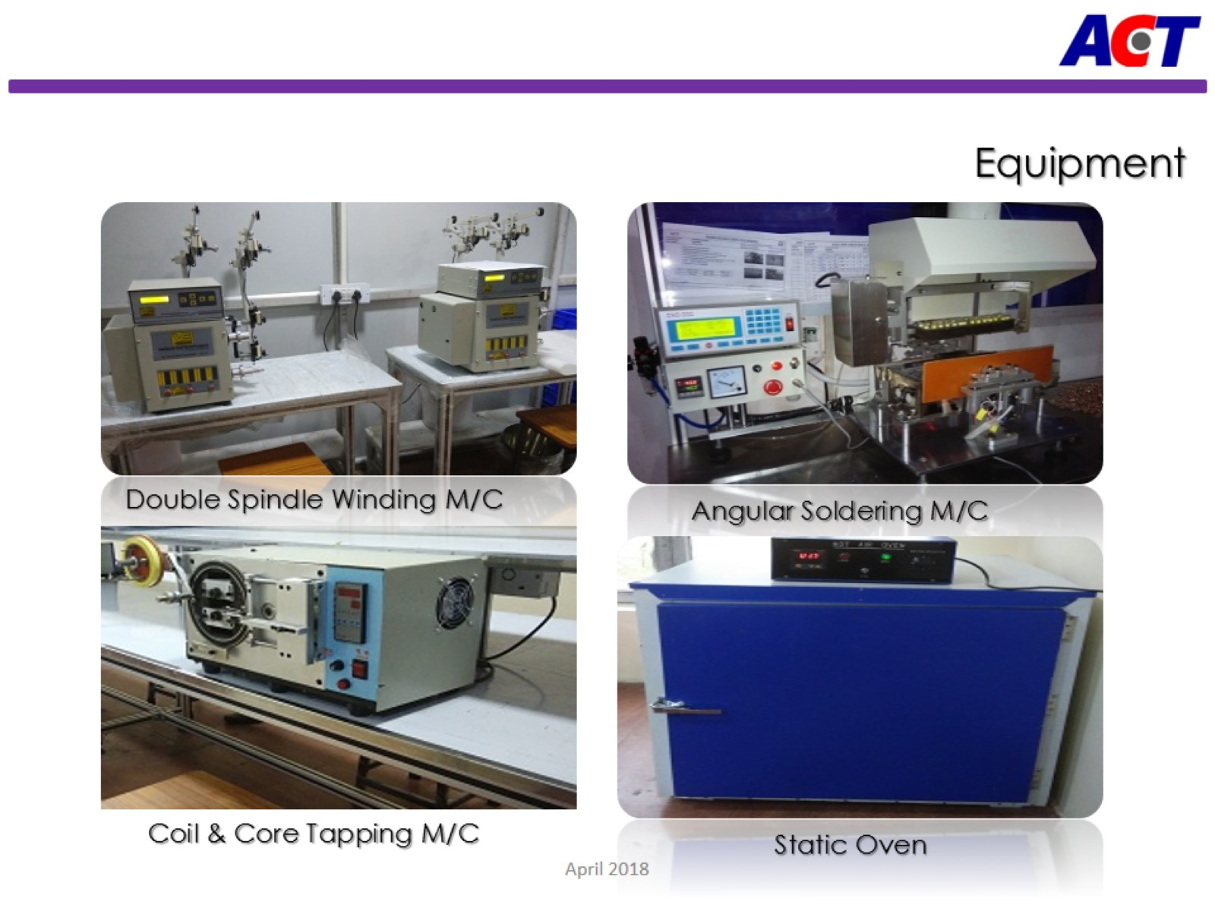

Slide 16
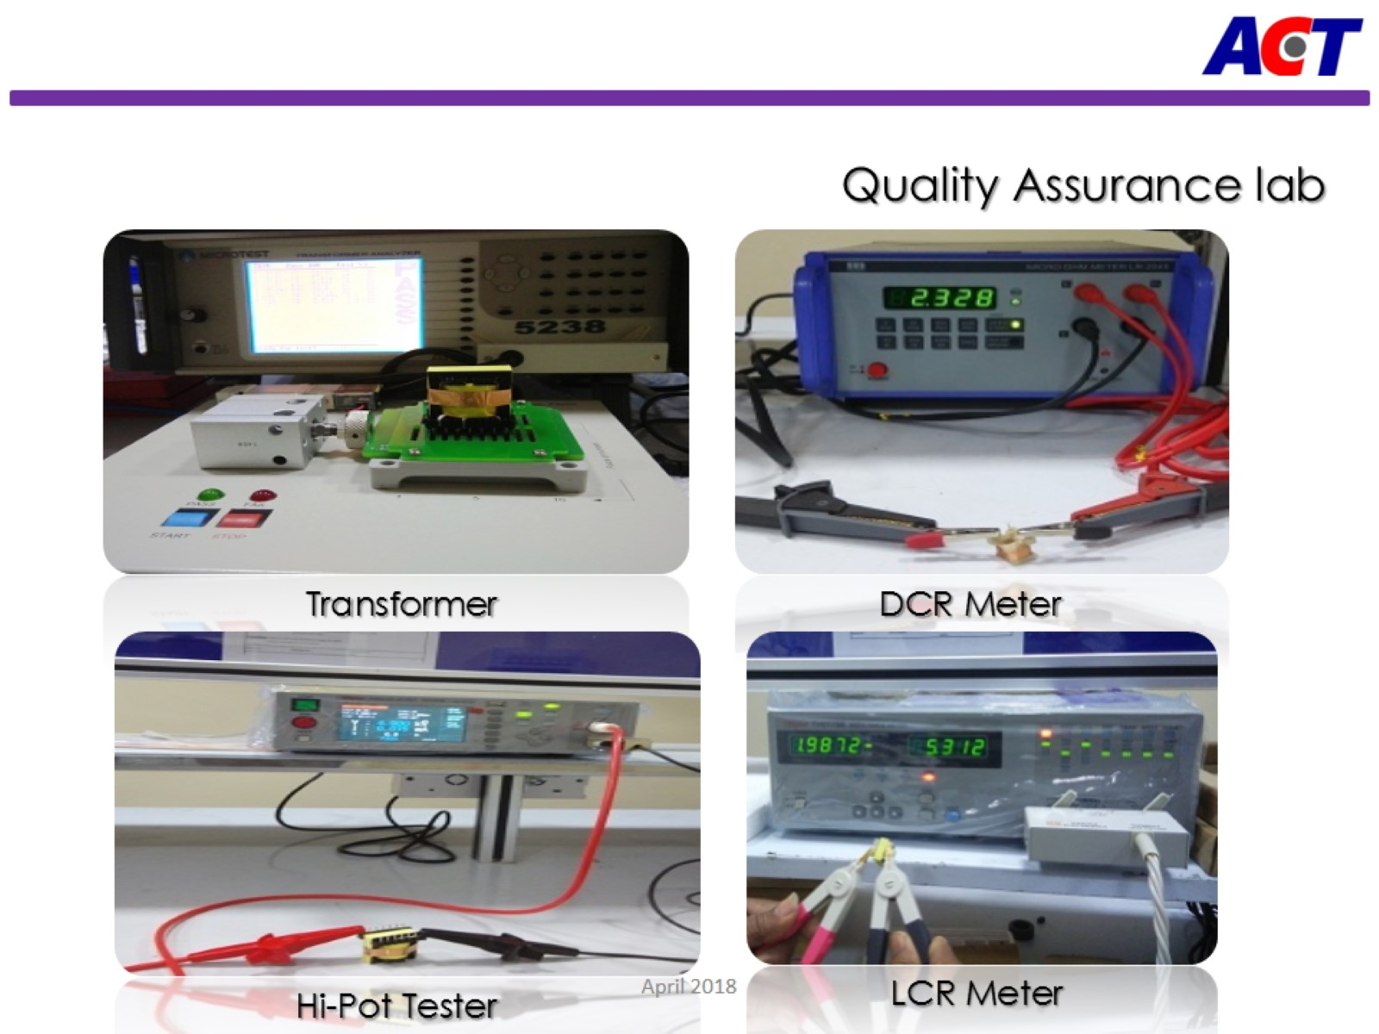

Slide 17
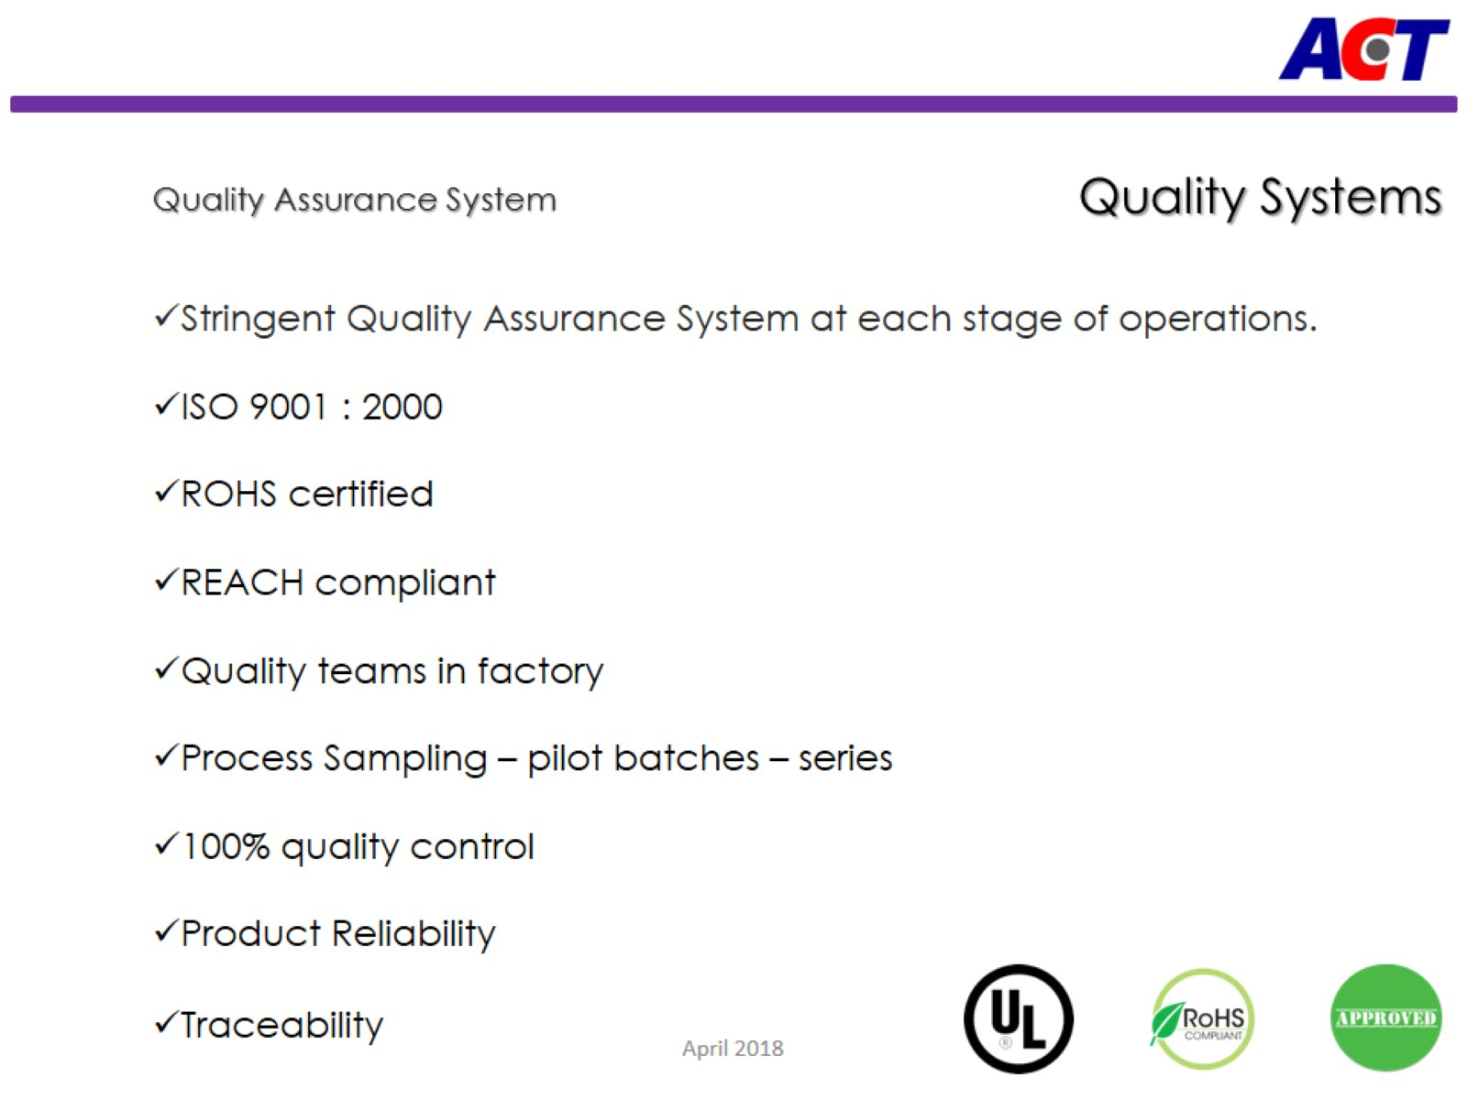

Slide 18
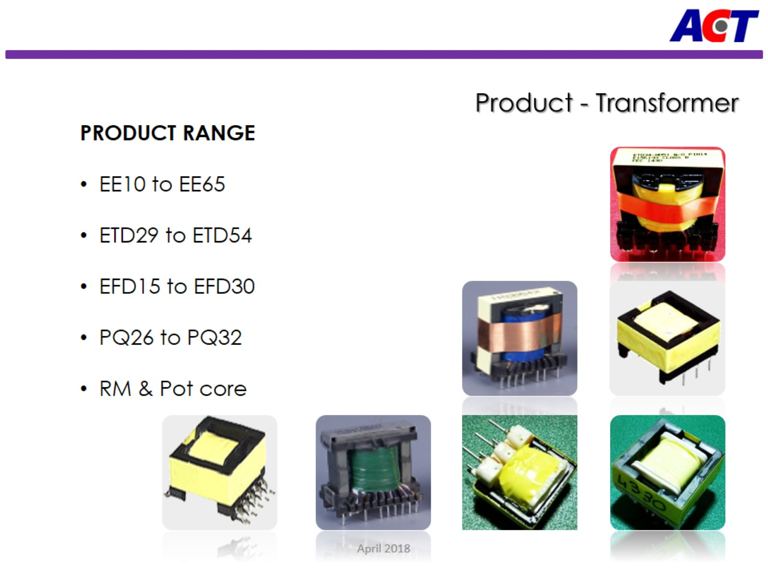

Slide 19
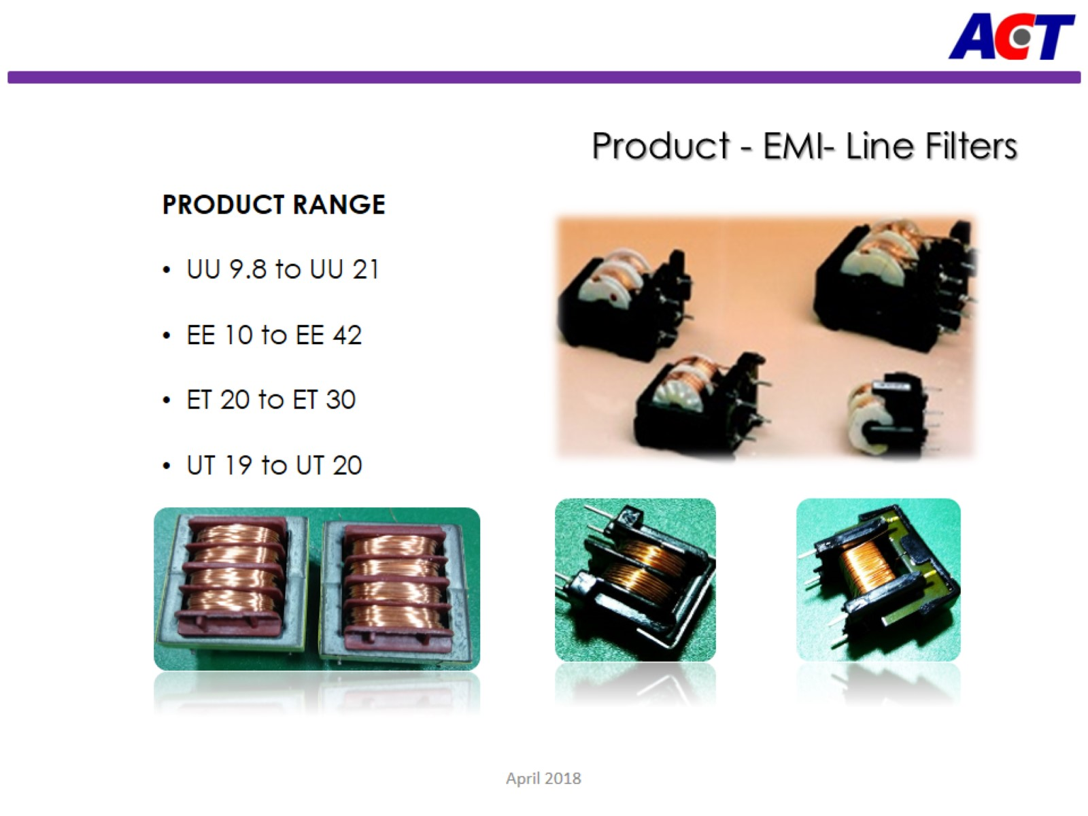

Slide 20
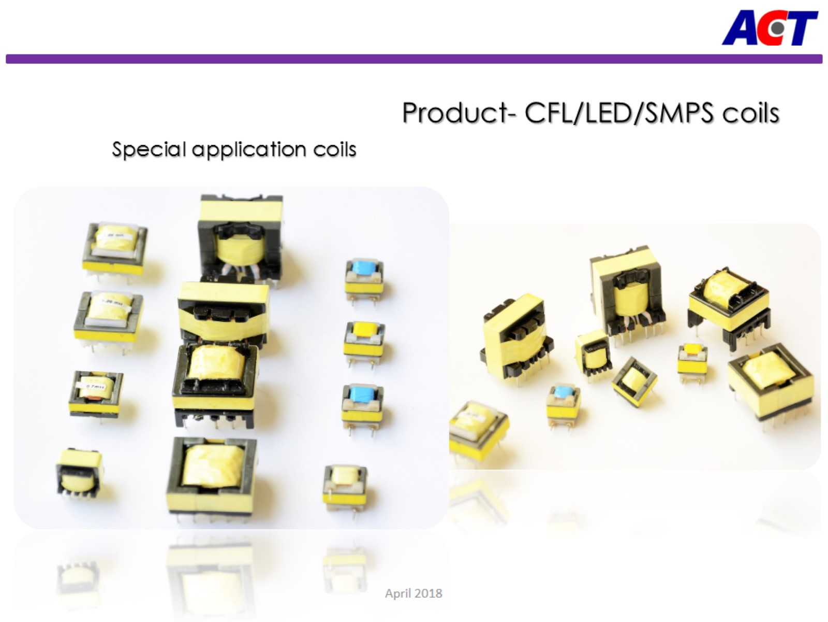

Slide 21



















Our Esteemed Customers

Slide 22
